Slide 1
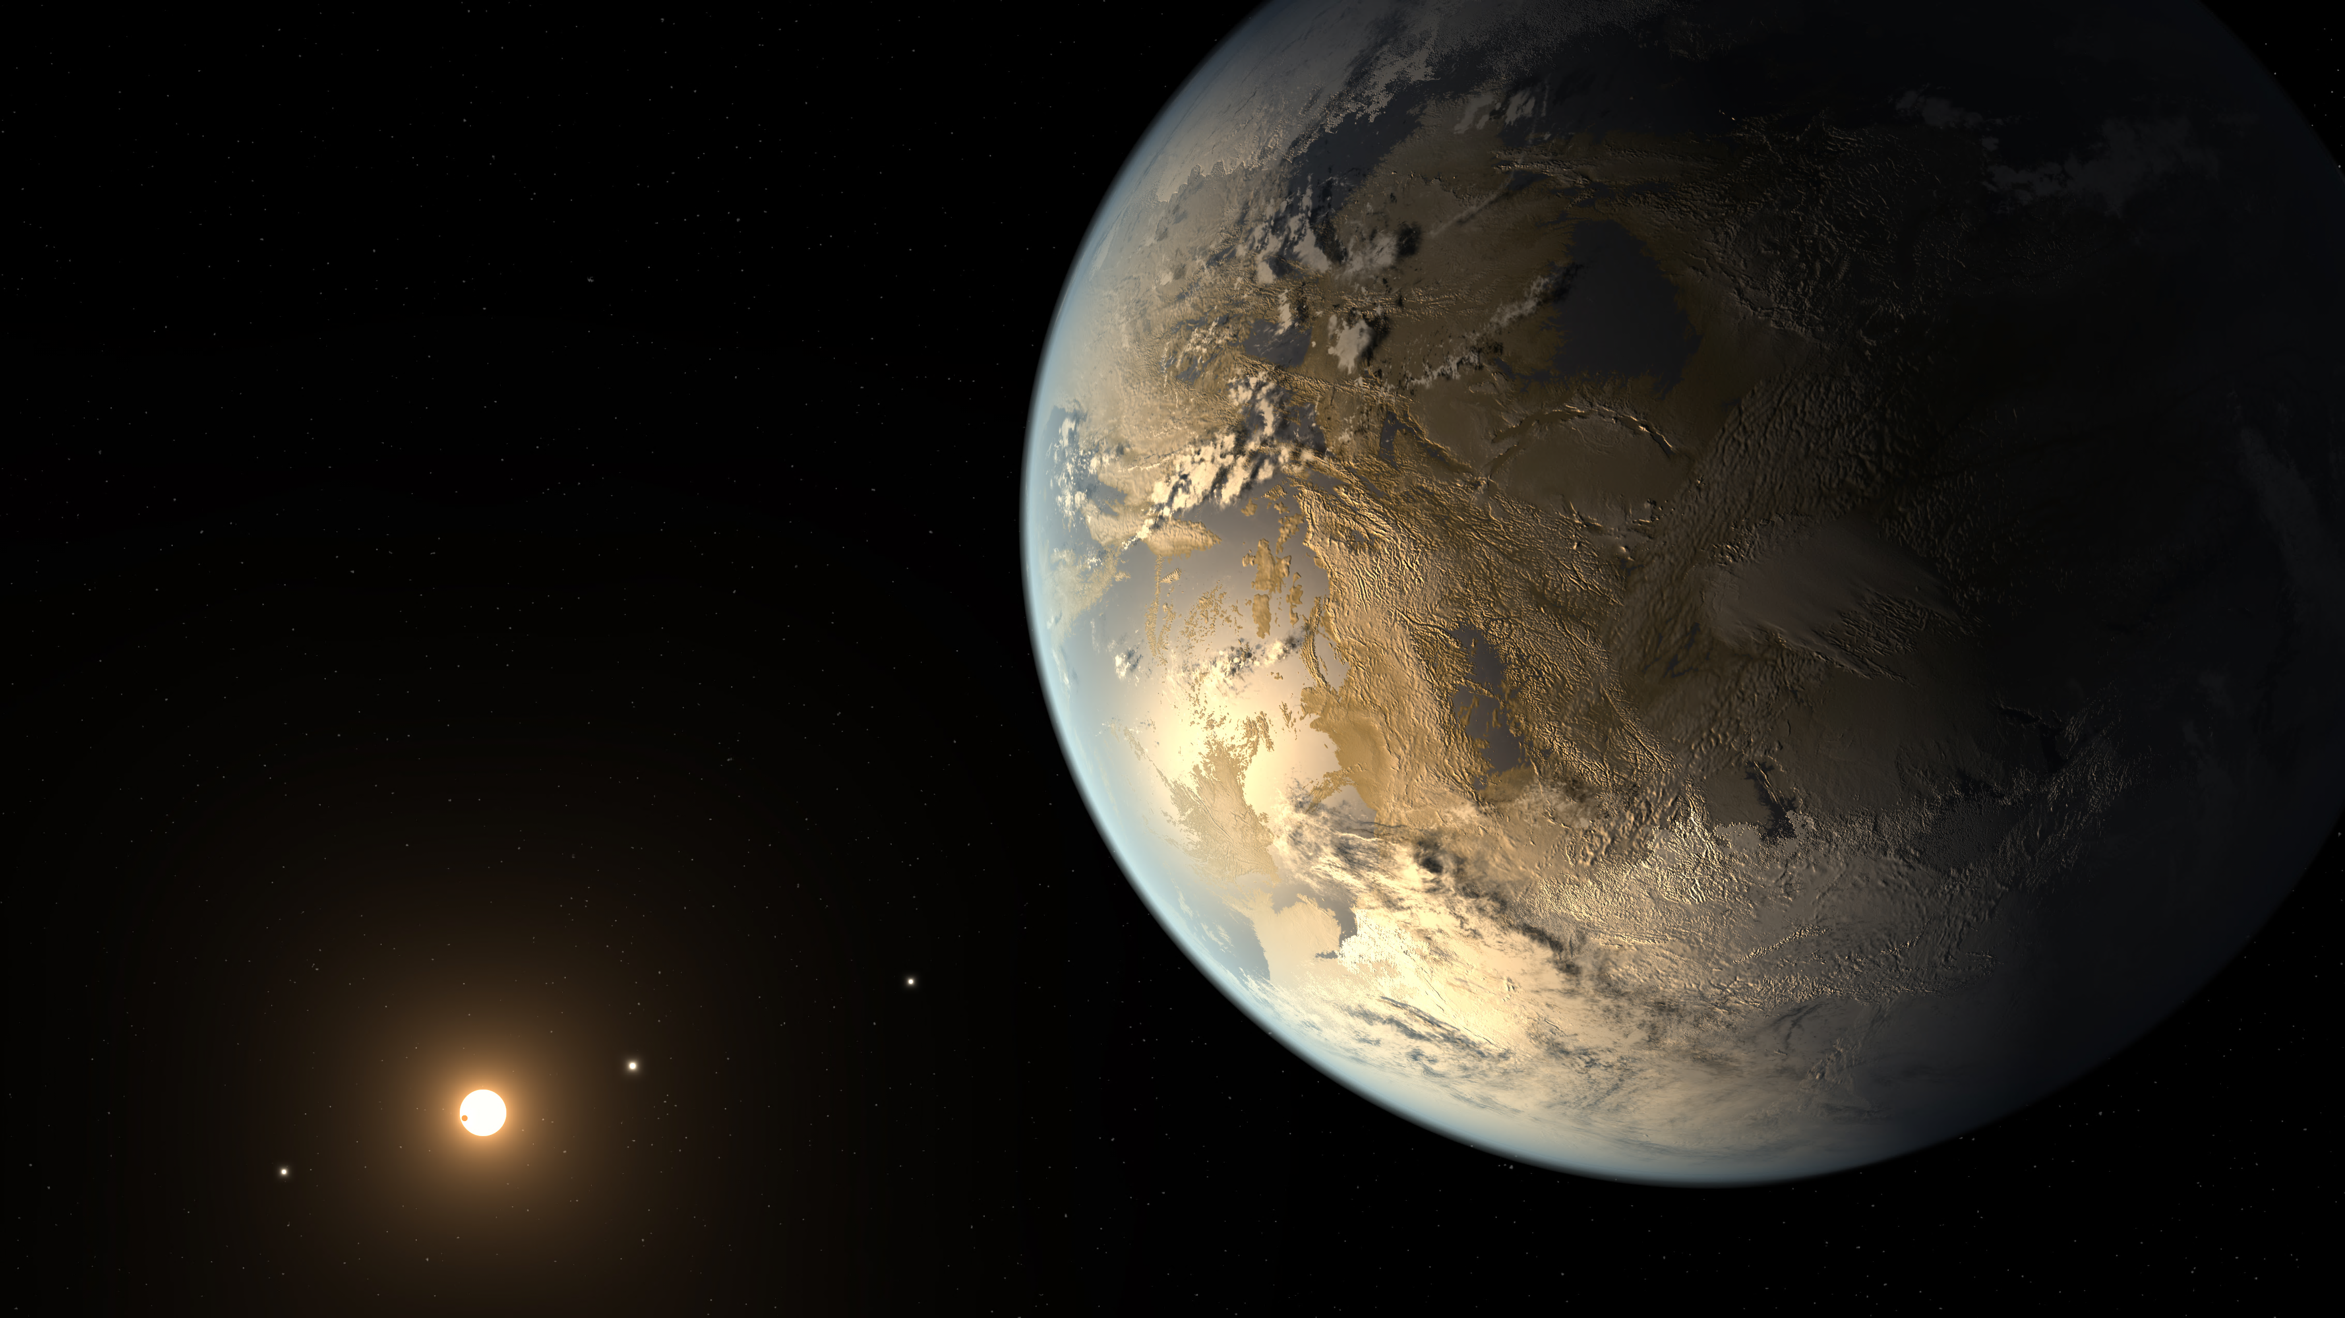

Exoplanet Yield Modeling and
Survey Optimization
Christopher Stark
NASA GSFC

Slide 2
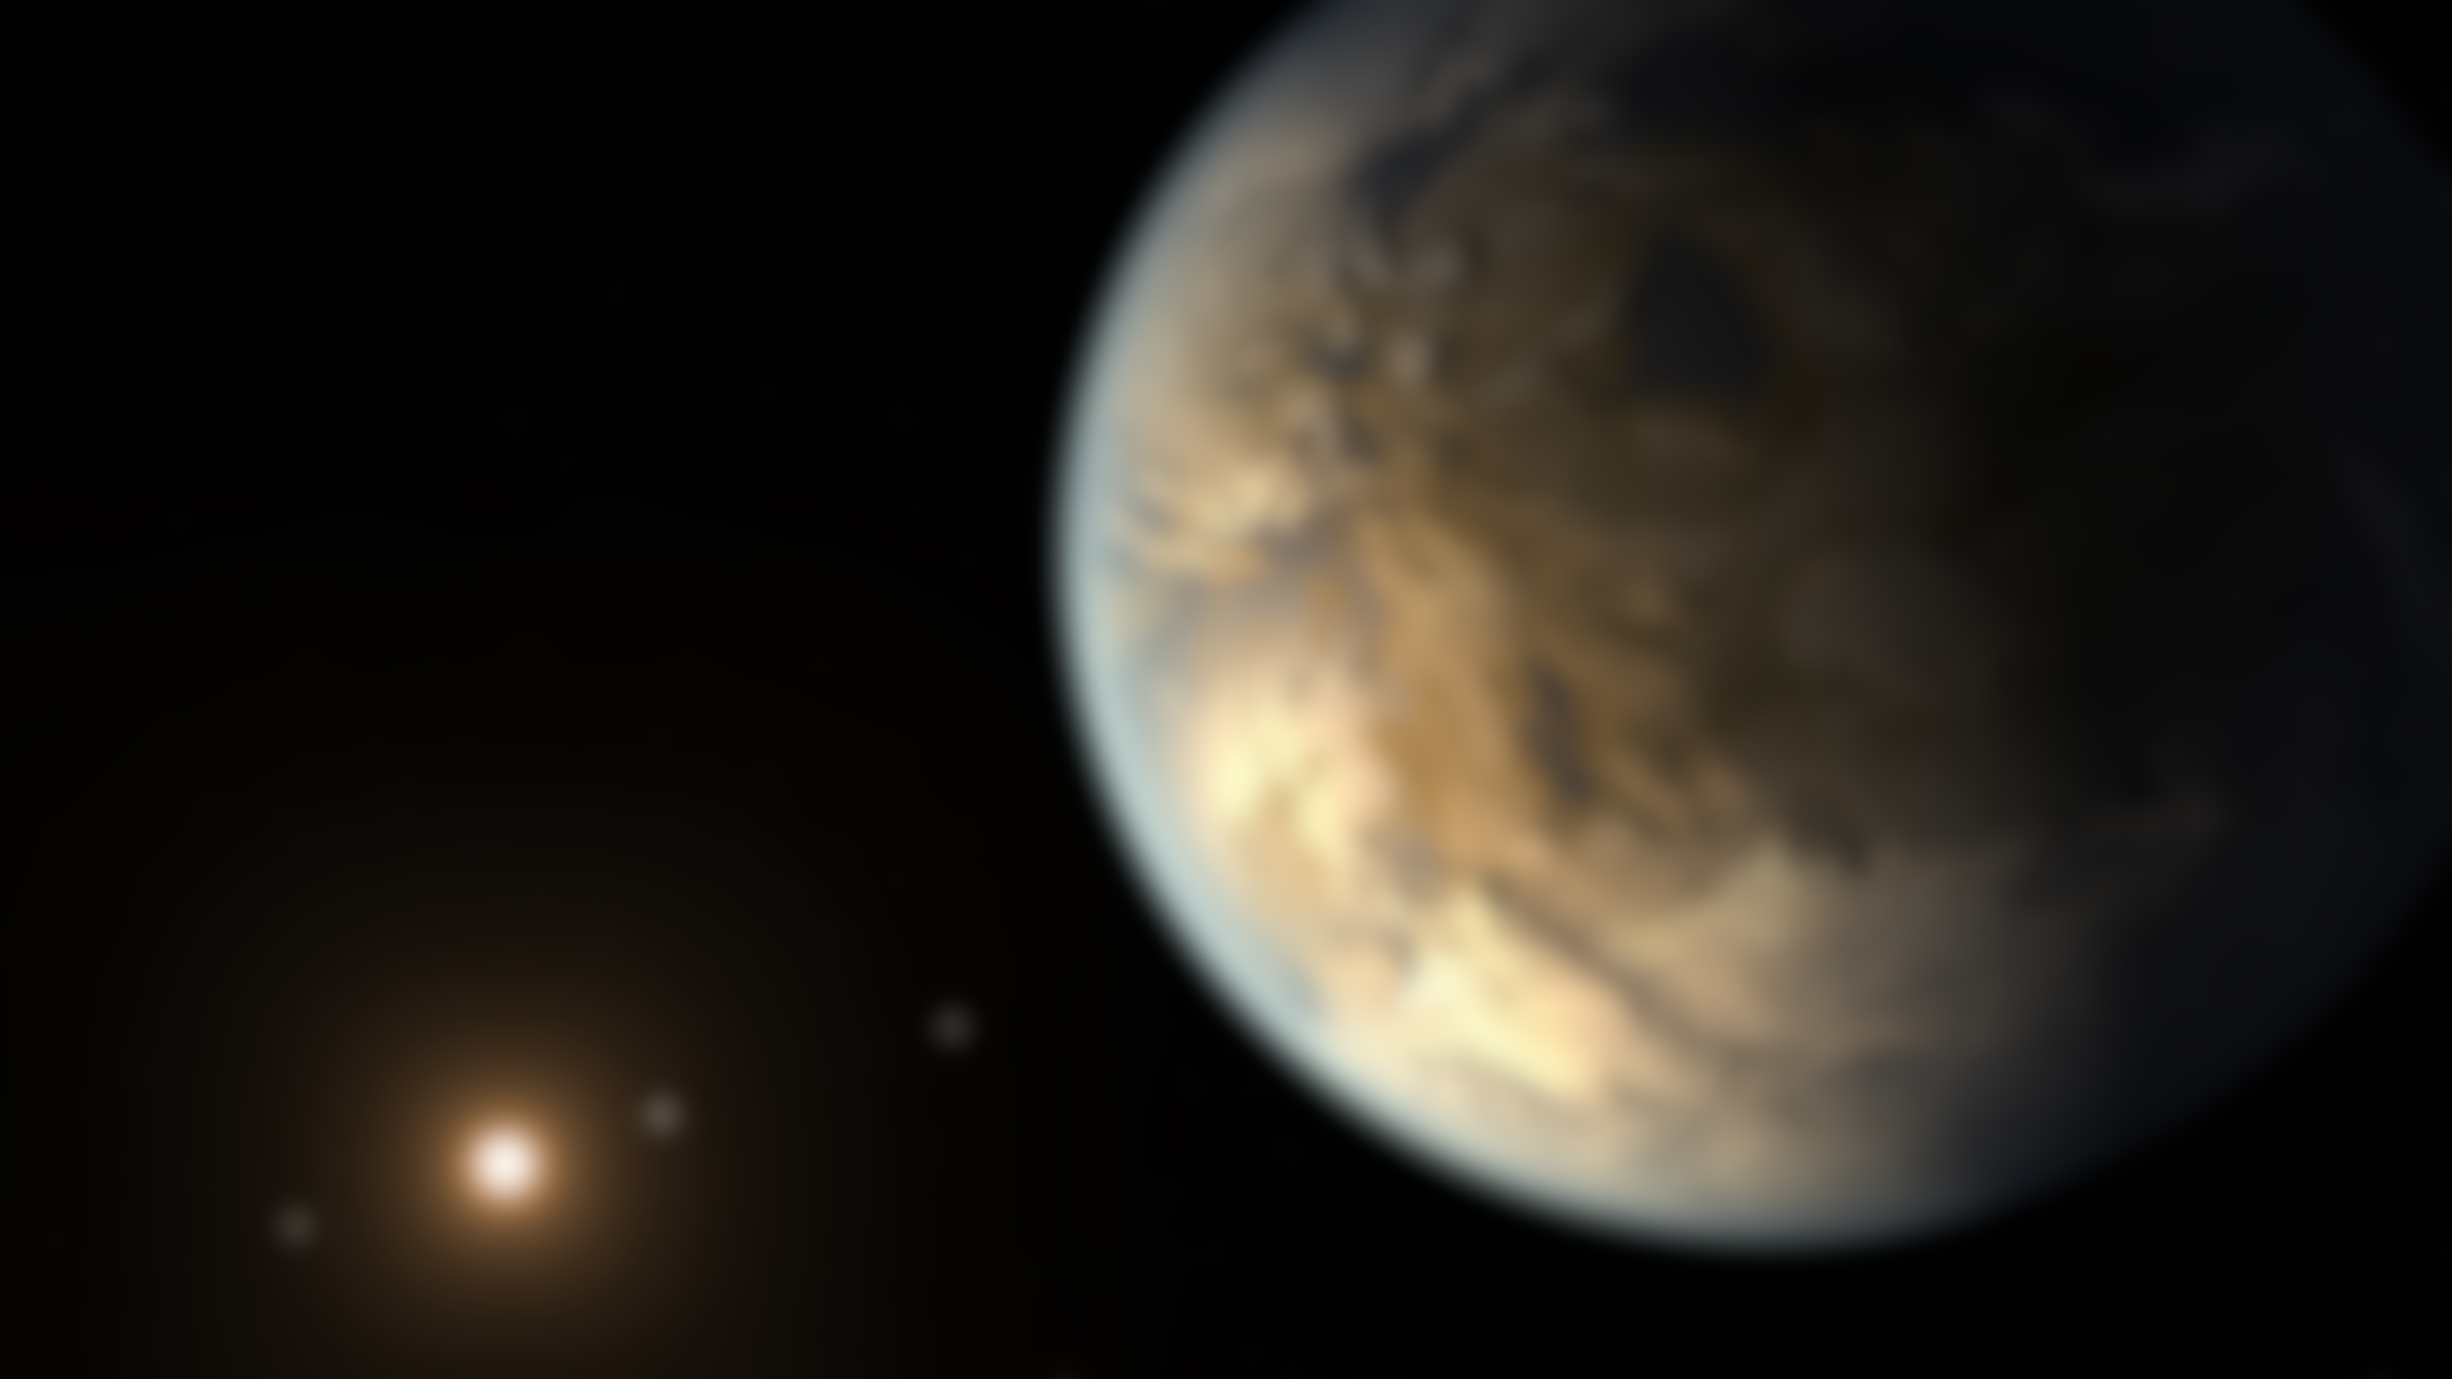
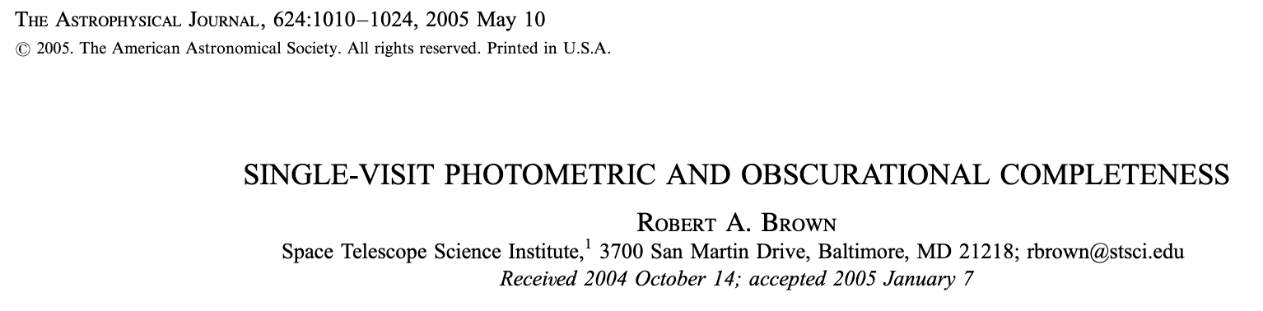
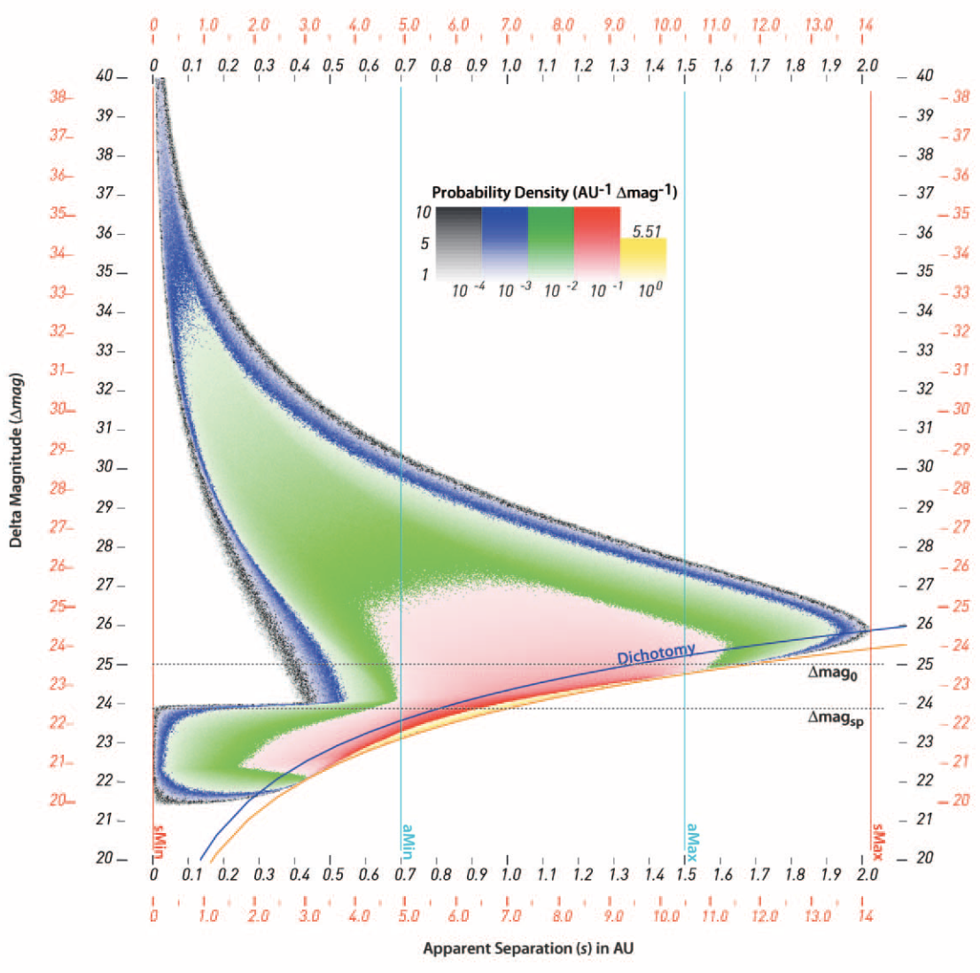
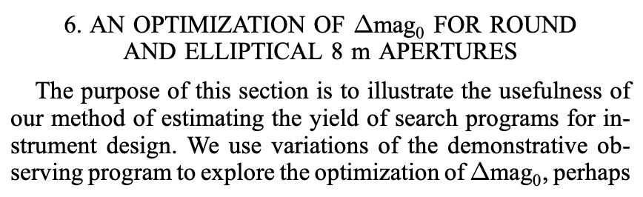
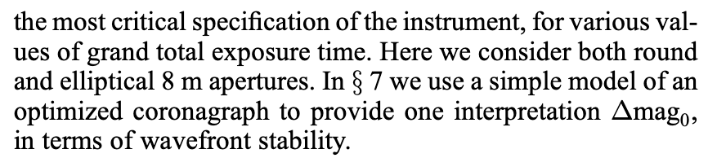
out of necessity.
Exoplanet “yields” started with TPF... .
Brown (2005)

Slide 3
Why do we calculate yield?
1. Our ability to learn about the universe is founded on sample size
2. Yield calculations help us make sense of a complicated, multi-variate trade space
3. Yield relates scientific productivity to mission design
4. Yield calculations can tell you how to operate your mission and conduct your survey

Slide 4
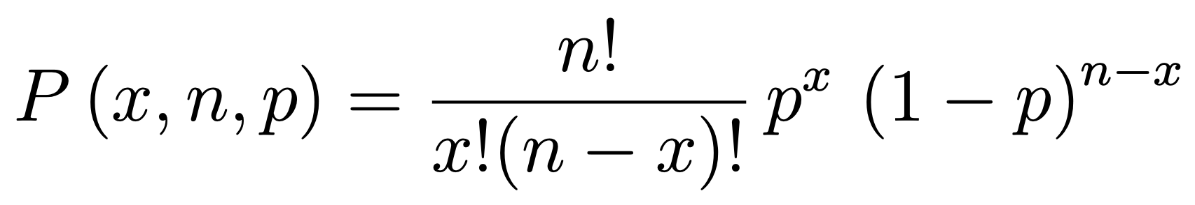
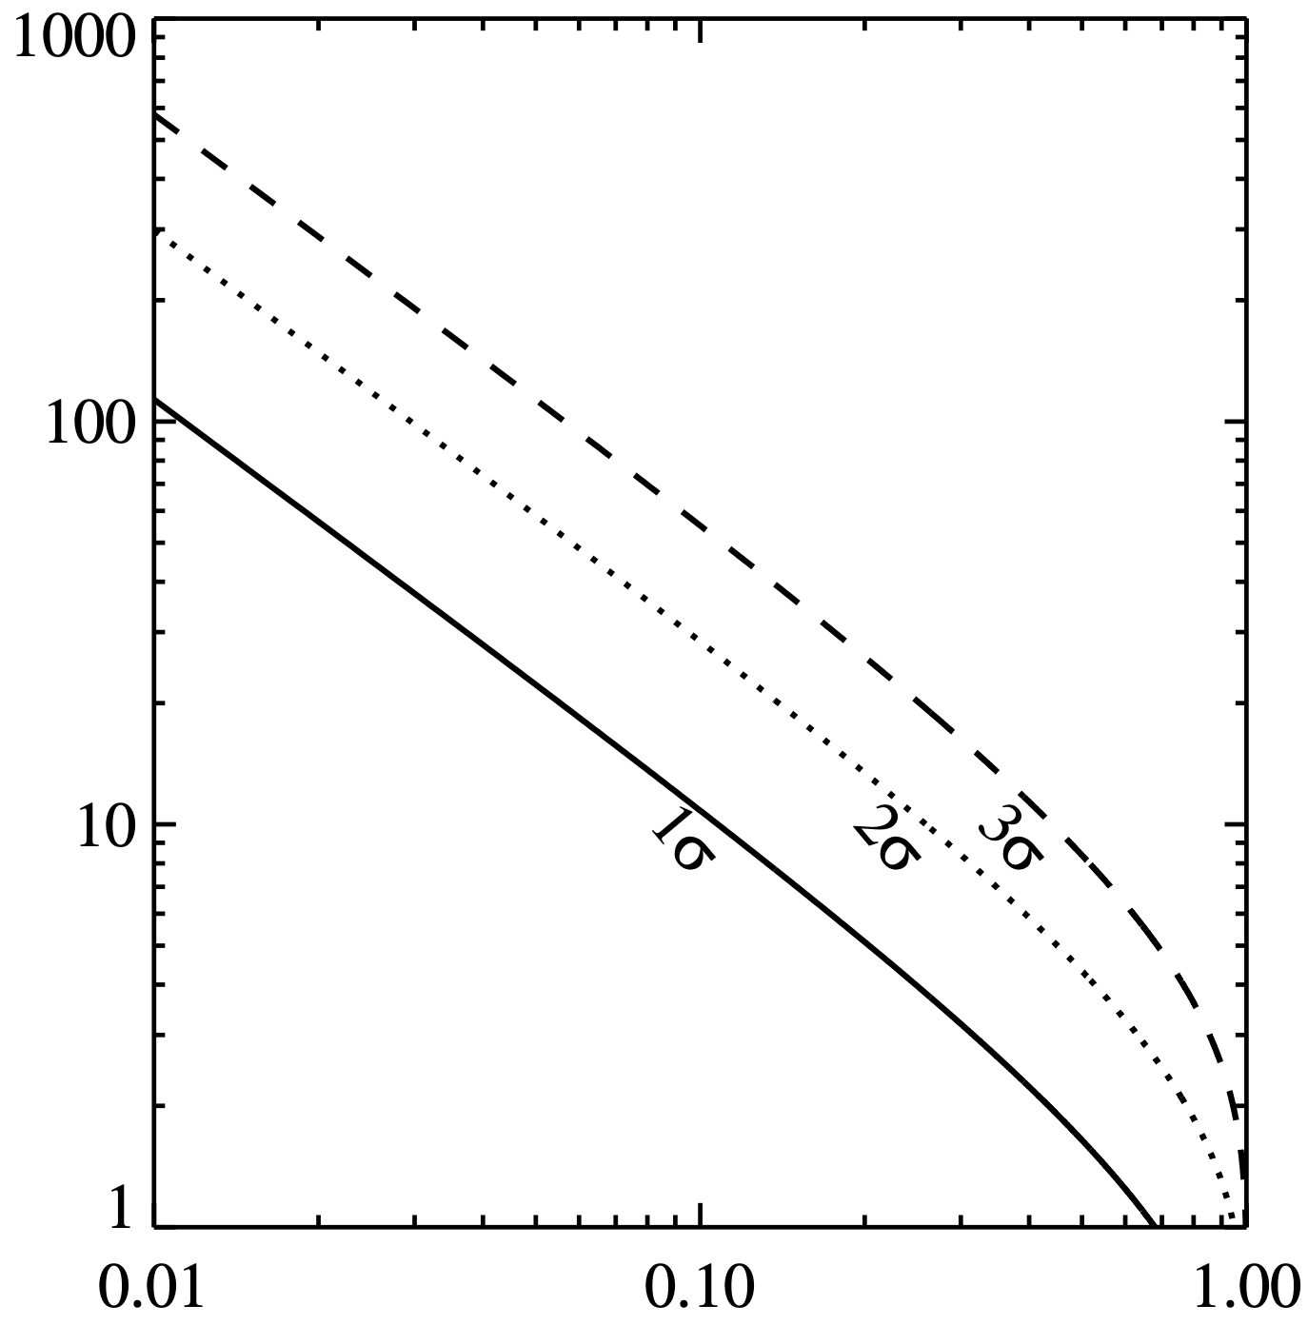
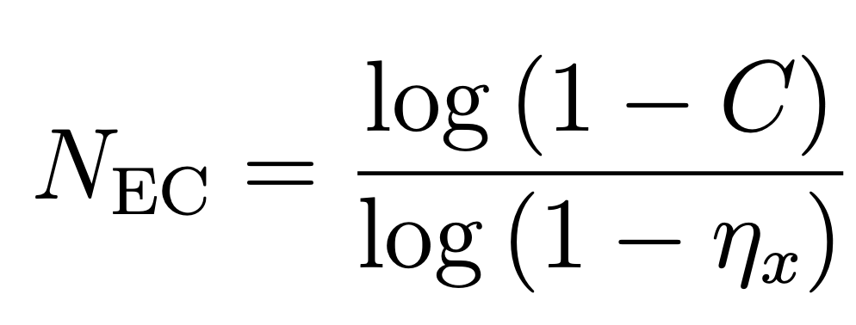
How Do We Pick A Yield Goal?
ExoEarth candidate yield required to guarantee at least 1 living world
Starting with the binomial function...
where
P = probability of x success out of n tries
p = probability of individual success
...and setting
n = N_{EC} (# of ExoEarth candidates)
p = f_{life} (prob. of remotely detectable life)
Confidence = 99.7%
Confidence = 95%
ExoEarth Candidate Yield (N_{EC})
Confidence = 68.2%
...and solving for
C = 1 - P(0, N_{EC}, f_{life}), we can show:
– f_{life}
f_{life}

Slide 5
How Do We Pick A Yield Goal?
ExoEarth candidate yield required to constrain f_{life} in the event of a null result
Confidence = 99.7%
Confidence = 95%
ExoEarth Candidate Yield (N_{EC})
Confidence = 68.2%
f_{life}

Slide 6
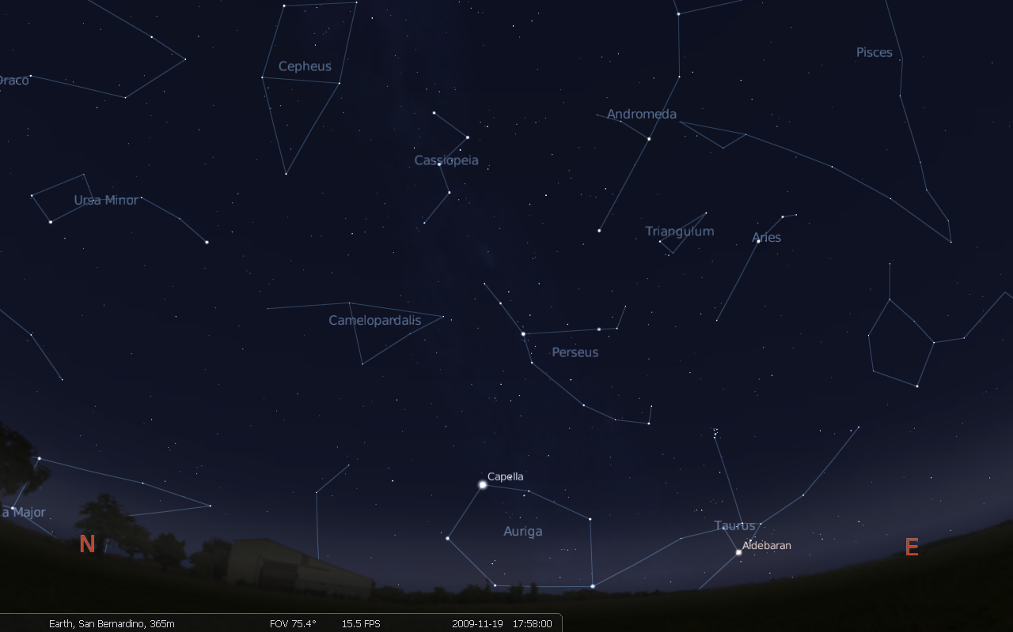
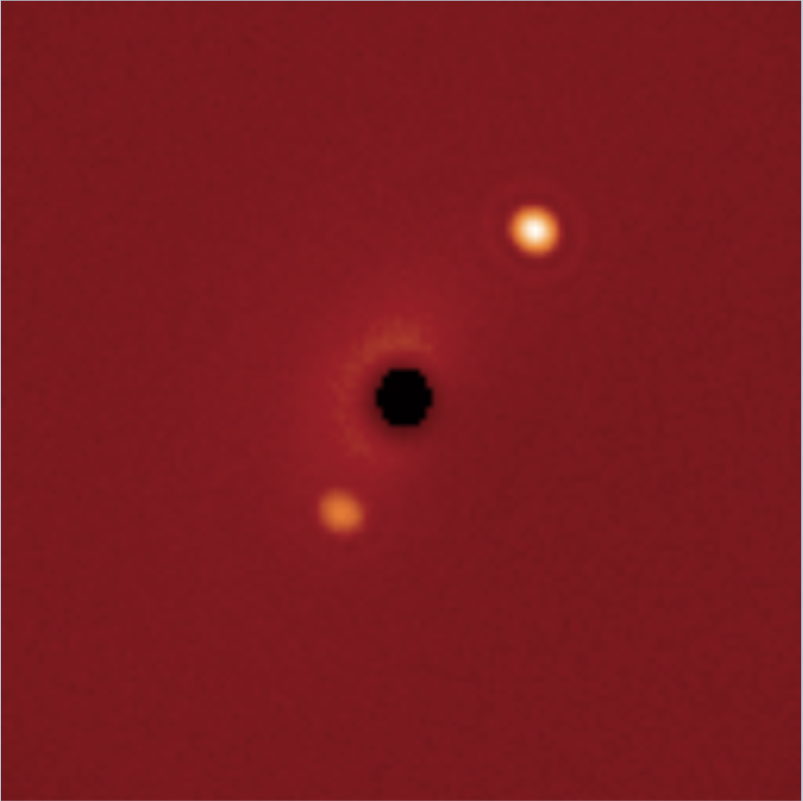
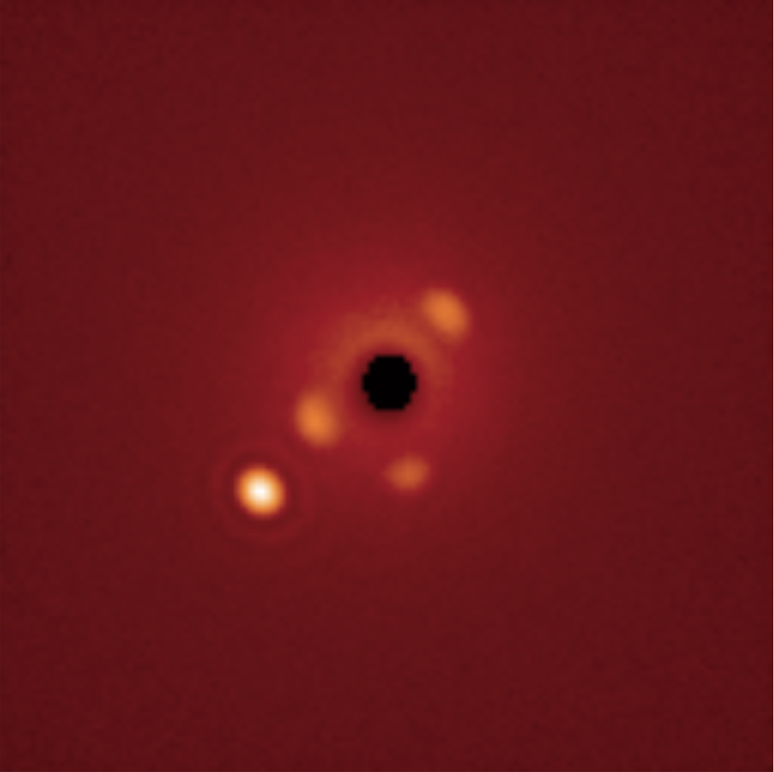
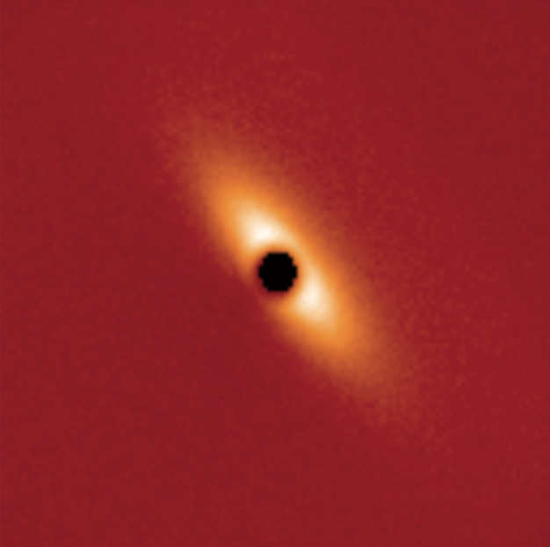
How Do We Calculate Yield?
Notes:
- We simulate Earth-like planets around known nearby stars
Then we simulate a space telescope observing those stars
Eta Cassiopia, Upsilon Andromedae, Iota Persei

Slide 7
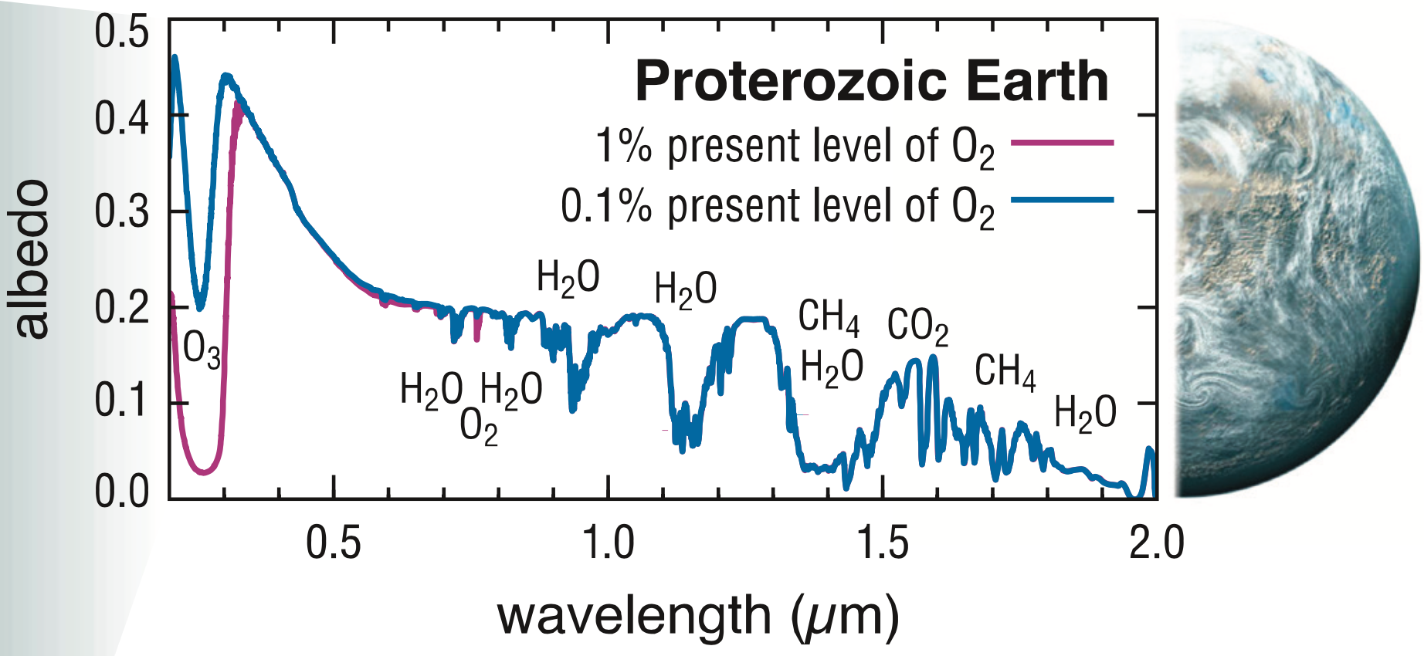
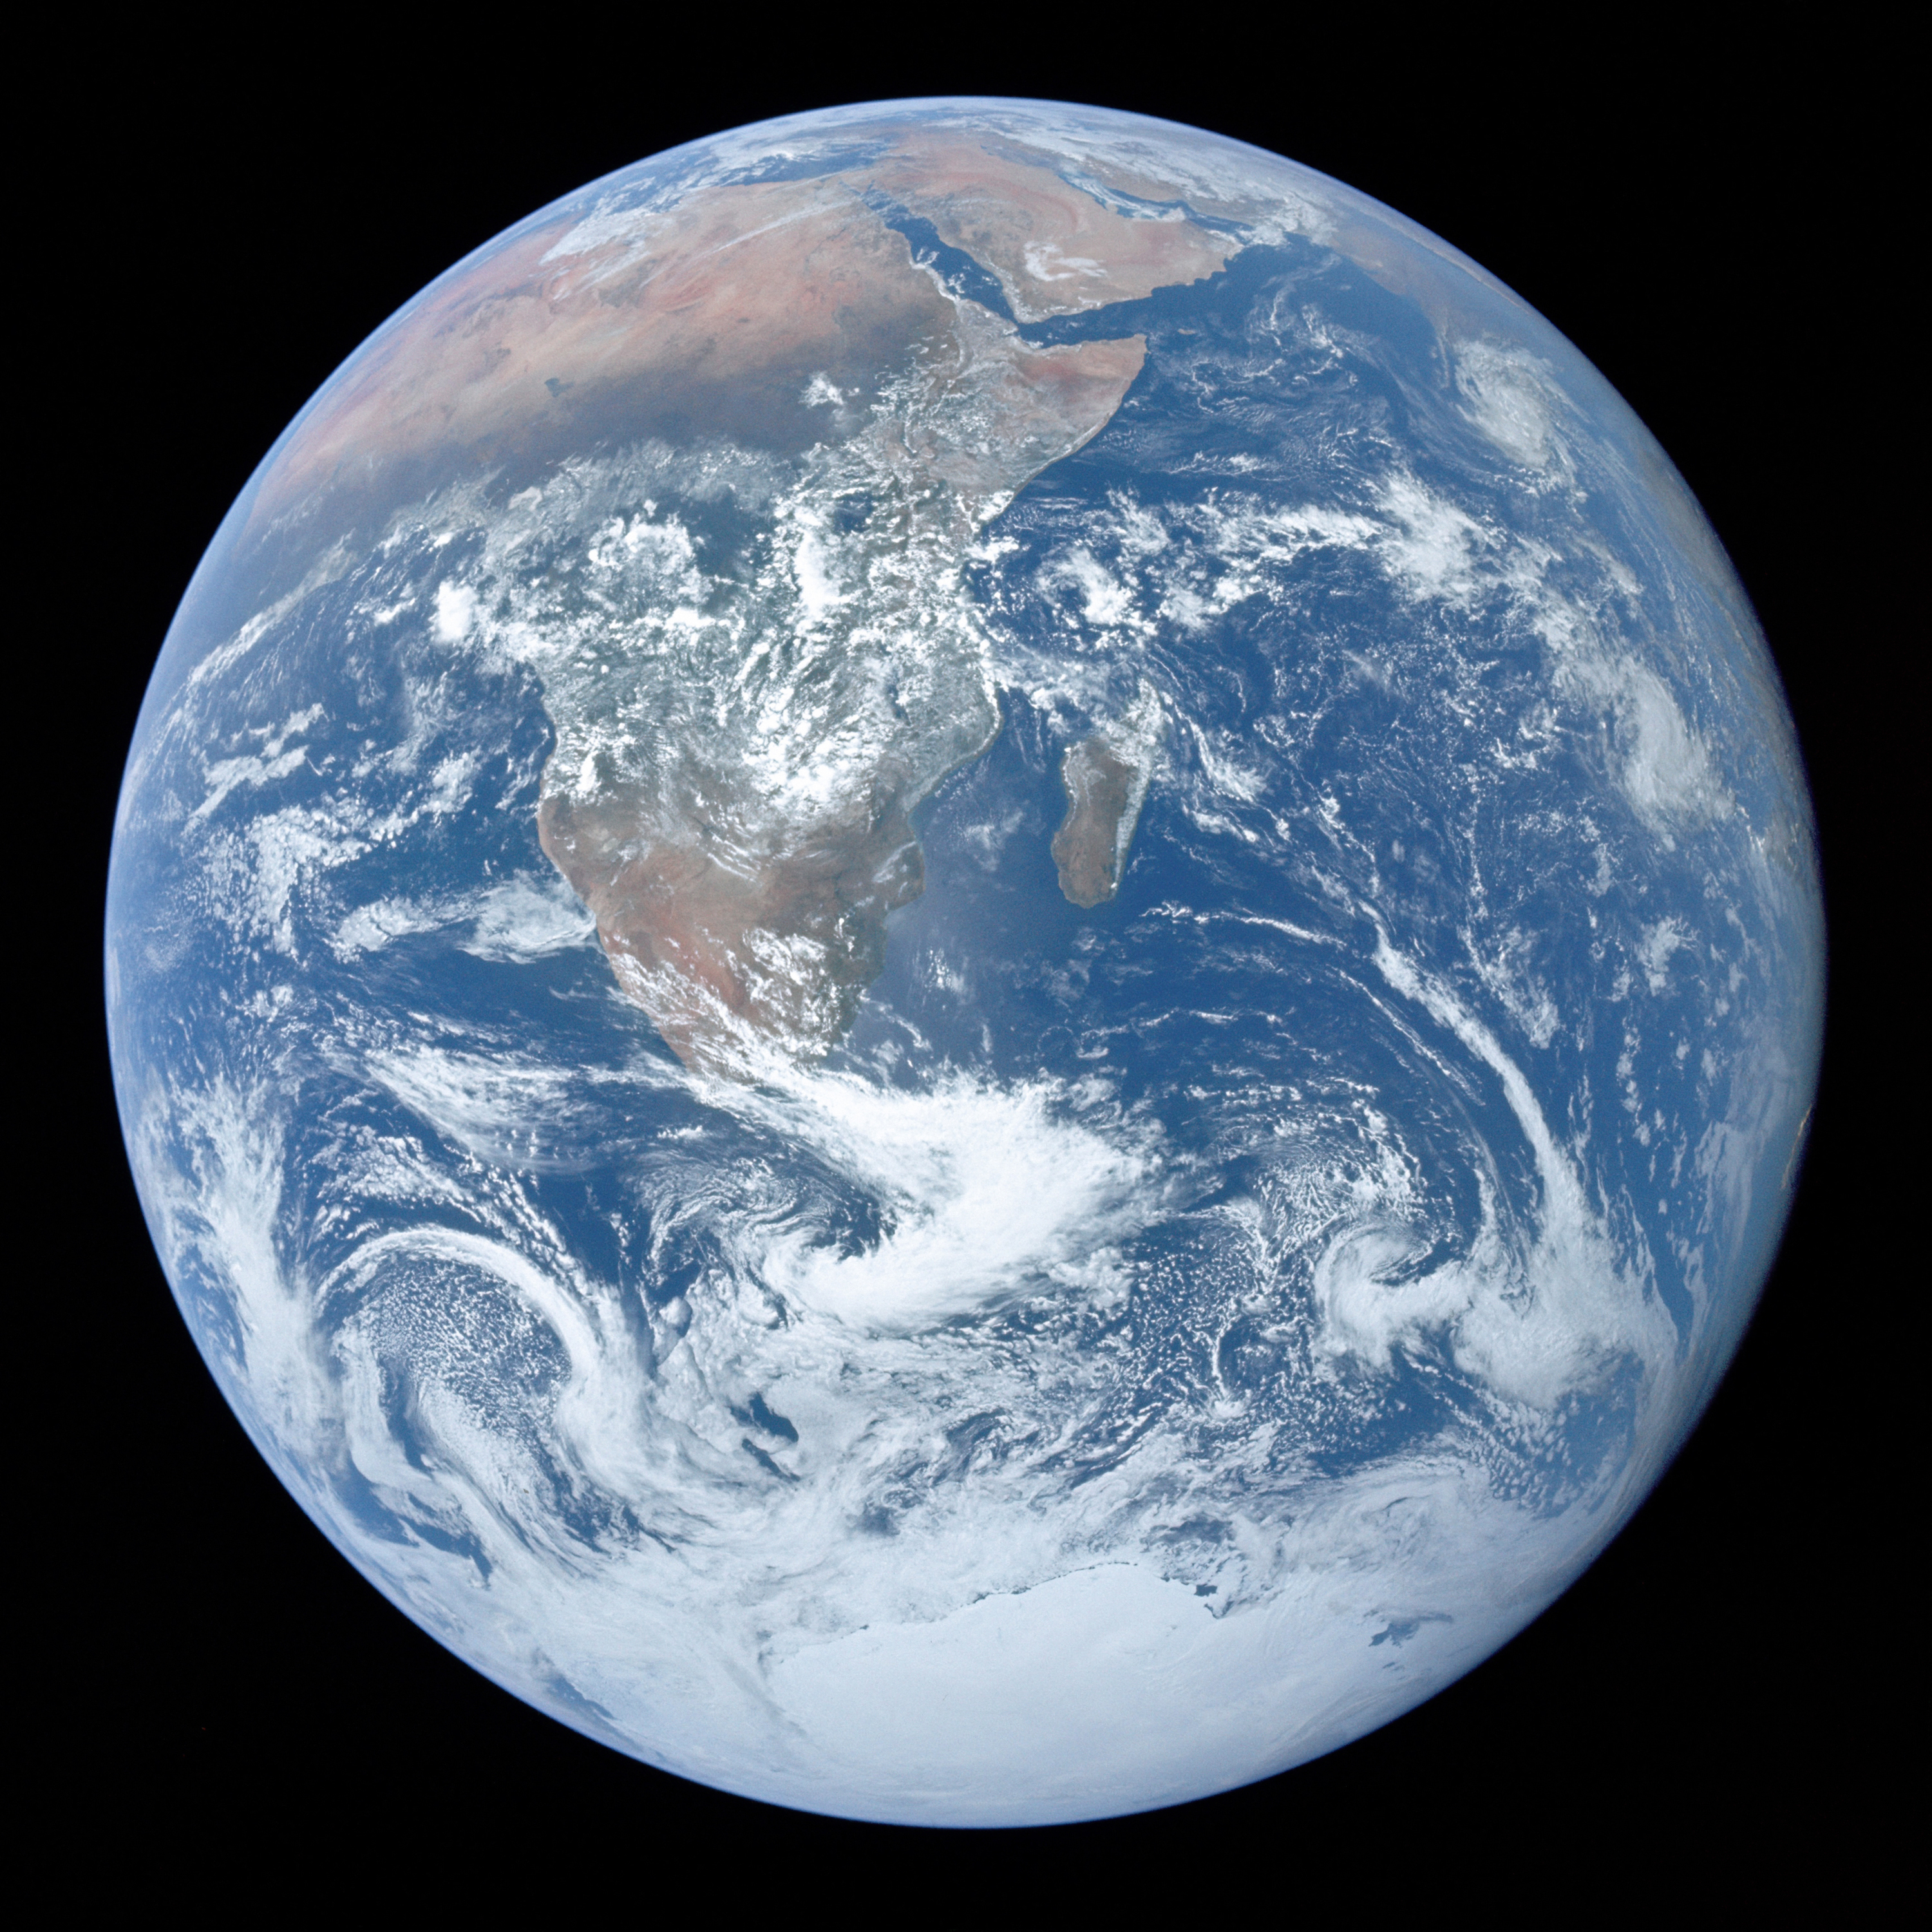
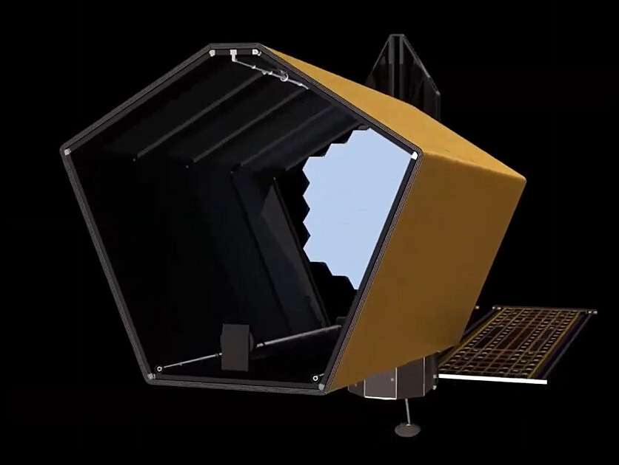
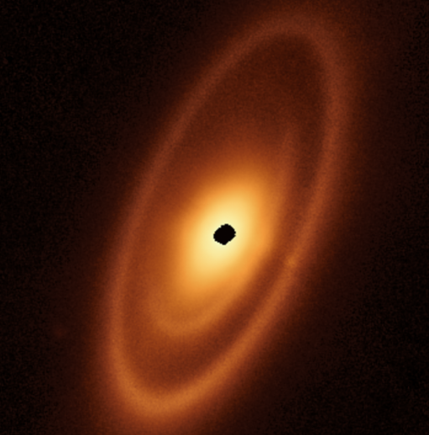
Inputs to Yield Calculators
Astrophysical Assumptions
Observational Requirements
Mission Description
Stellar catalog
Star models
Planet models
Exozodi model
Zodi model
Occurrence rates (η_{Earth})
Wavelength
Spectral resolution
SNR
Observing strategy
Telescope description
Optical reflectivities
Coronagraph model
Detector model
Overheads
Survey & mission lifetime
Yield
Calculator

Slide 8
Two major components of a yield calculator
Completeness calculator:
  “What is the benefit of making an observation?”
2. Exposure time calculator:
“What is the cost of making an observation?”

Slide 9
Completeness Calculation

Slide 10
Completeness
  Calculate projected separation and Δmag (i.e., contrast) for every synthetic planet
HZ
  Completeness, C = the chance of observing a given planet around a given star if that planet exists (Brown 2004)
  Calculated via a large number of synthetic planets
Notes:
Completeness calculated via Monte Carlo simulation
Distribute a “cloud” of synthetic exoplanets & calculate separation & magnitude
IWA & OWA block some planets
Others (crescent-phase) are so faint that their exposure times are too long
Completeness is a function of exposure time!

Slide 11
Completeness: The Bird Diagram
Projected “IWA”
Projected “OWA”
Completeness = fraction of PDF that is observable
Obs. Depth
“Single-Visit Photometric and Observational Completeness”
Brown (2005)

Slide 12
Completeness: The Bird Diagram
Treatment in (sep, Δmag) space:
Realistic coronagraph performance would have more complex Δmag(sep)
Assumes radial coronagraph performance
Requires translating exposure time into Δmag(sep)
Projected “IWA”
Projected “OWA”
Obs. Depth
“Single-Visit Photometric and Observational Completeness”
Brown (2005)

Slide 13
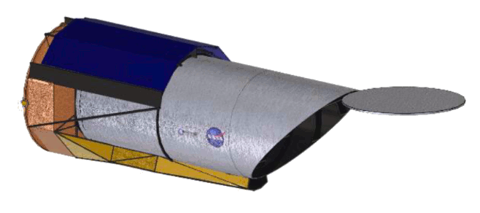
Alternative: (sep, Δmag) -> τ
τ
Too faint
HZ
“IWA”
  Completeness, C = the chance of observing a given planet around a given star if that planet exists (Brown 2004)
  Yield = η_{Earth} Σ C
  Calculated using a large number of synthetic planets
Notes:
Completeness calculated via Monte Carlo simulation
Distribute a “cloud” of synthetic exoplanets & calculate separation & magnitude
IWA & OWA block some planets
Others (crescent-phase) are so faint that their exposure times are too long
Completeness is a function of exposure time!

Slide 14
Revisit Completeness
τ
Too faint
HZ
“IWA”
  Revisiting same star multiple times can increase total completeness
Notes:
Completeness calculated via Monte Carlo simulation
Distribute a “cloud” of synthetic exoplanets & calculate separation & magnitude
IWA & OWA block some planets
Others (crescent-phase) are so faint that their exposure times are too long
Completeness is a function of exposure time!

Slide 15
Exposure Time Calculation

Slide 16
Exposure time
We will assume:
Aperture photometry
We are able to empirically subtract or model all noise sources
Poisson noise ~ sqrt(expected counts)
Signal = total planet counts within photometric aperture
Noise = sqrt(total counts in photometric aperture)

Slide 17
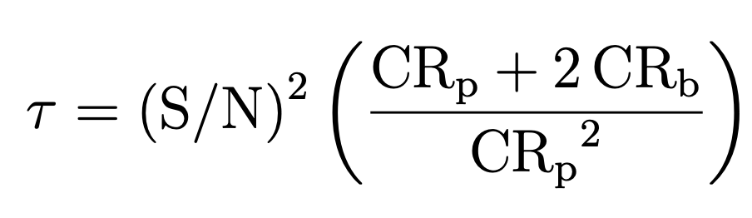
Exposure time
√
(
)
Adding a systematic noise floor, and a factor of 2 for empirical background subtraction...
nf

Slide 18
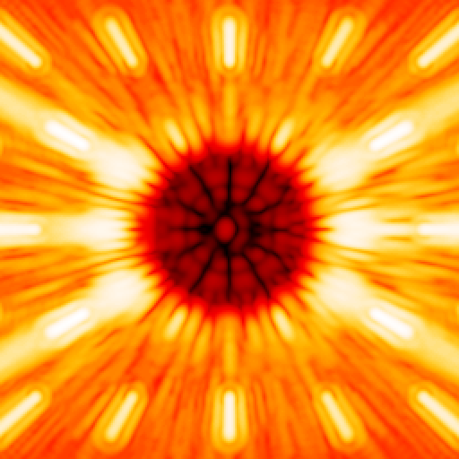
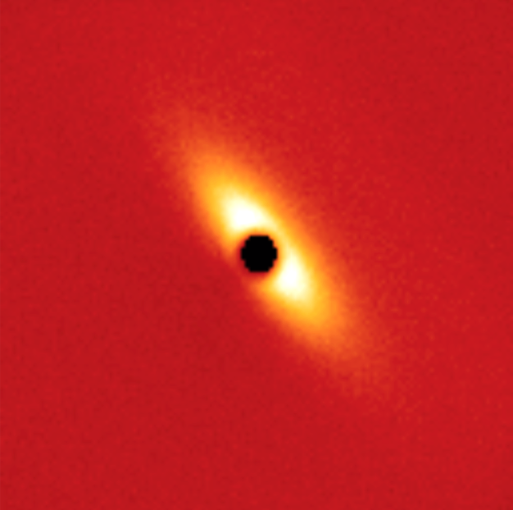


Exposure time: Background Sources
Unsupressed starlight
Exozodiacal light
Zodiacal light
Detector noise

Slide 19
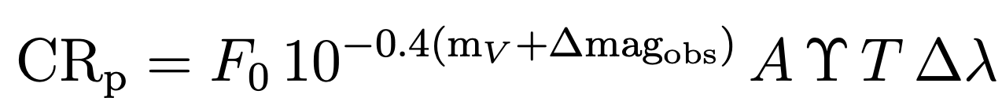
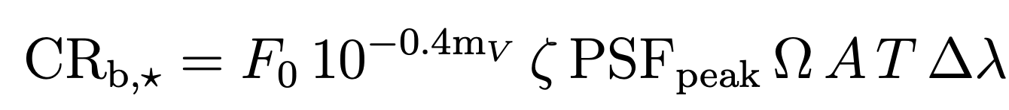
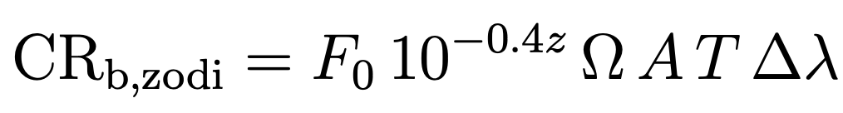
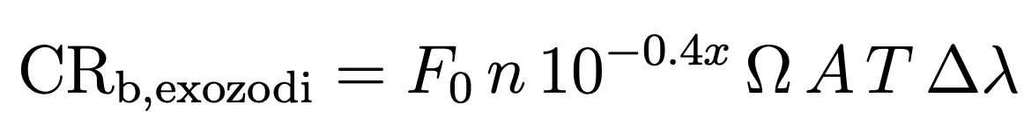
Exposure time
nf

Slide 20
Exposure time calculators
EXOSIMS
https://github.com/dsavransky/EXOSIMS
(Python)
EBS
https://github.com/chen-pin/ebs
(Python)
AYO ETC
www.starkspace.com
(IDL + C; Python + C coming soon)
All ETCs cross-model validated via Exoplanet Science Yield sub-Working Group, Coronagraph Design Survey, and Coronagraph Technology Roadmap

Slide 21
Combining Completeness and Exposure Time:
Observation Optimization

Slide 22
Exoplanet yield & completeness
τ
Too faint
HZ
IWA
  Completeness, C = the chance of observing a given planet around a given star if that planet exists (Brown 2004)
  Yield = η_{Earth} Σ C
  Calculated using a large number of synthetic planets
Notes:
Completeness calculated via Monte Carlo simulation
Distribute a “cloud” of synthetic exoplanets & calculate separation & magnitude
IWA & OWA block some planets
Others (crescent-phase) are so faint that their exposure times are too long
Completeness is a function of exposure time!

Slide 23
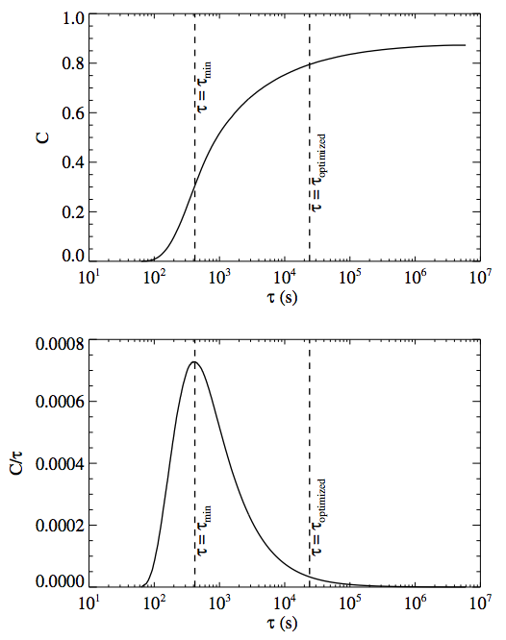
Maximizing yield by optimizing observations
  Optimally distributing exposure time can potentially double yield

Slide 24
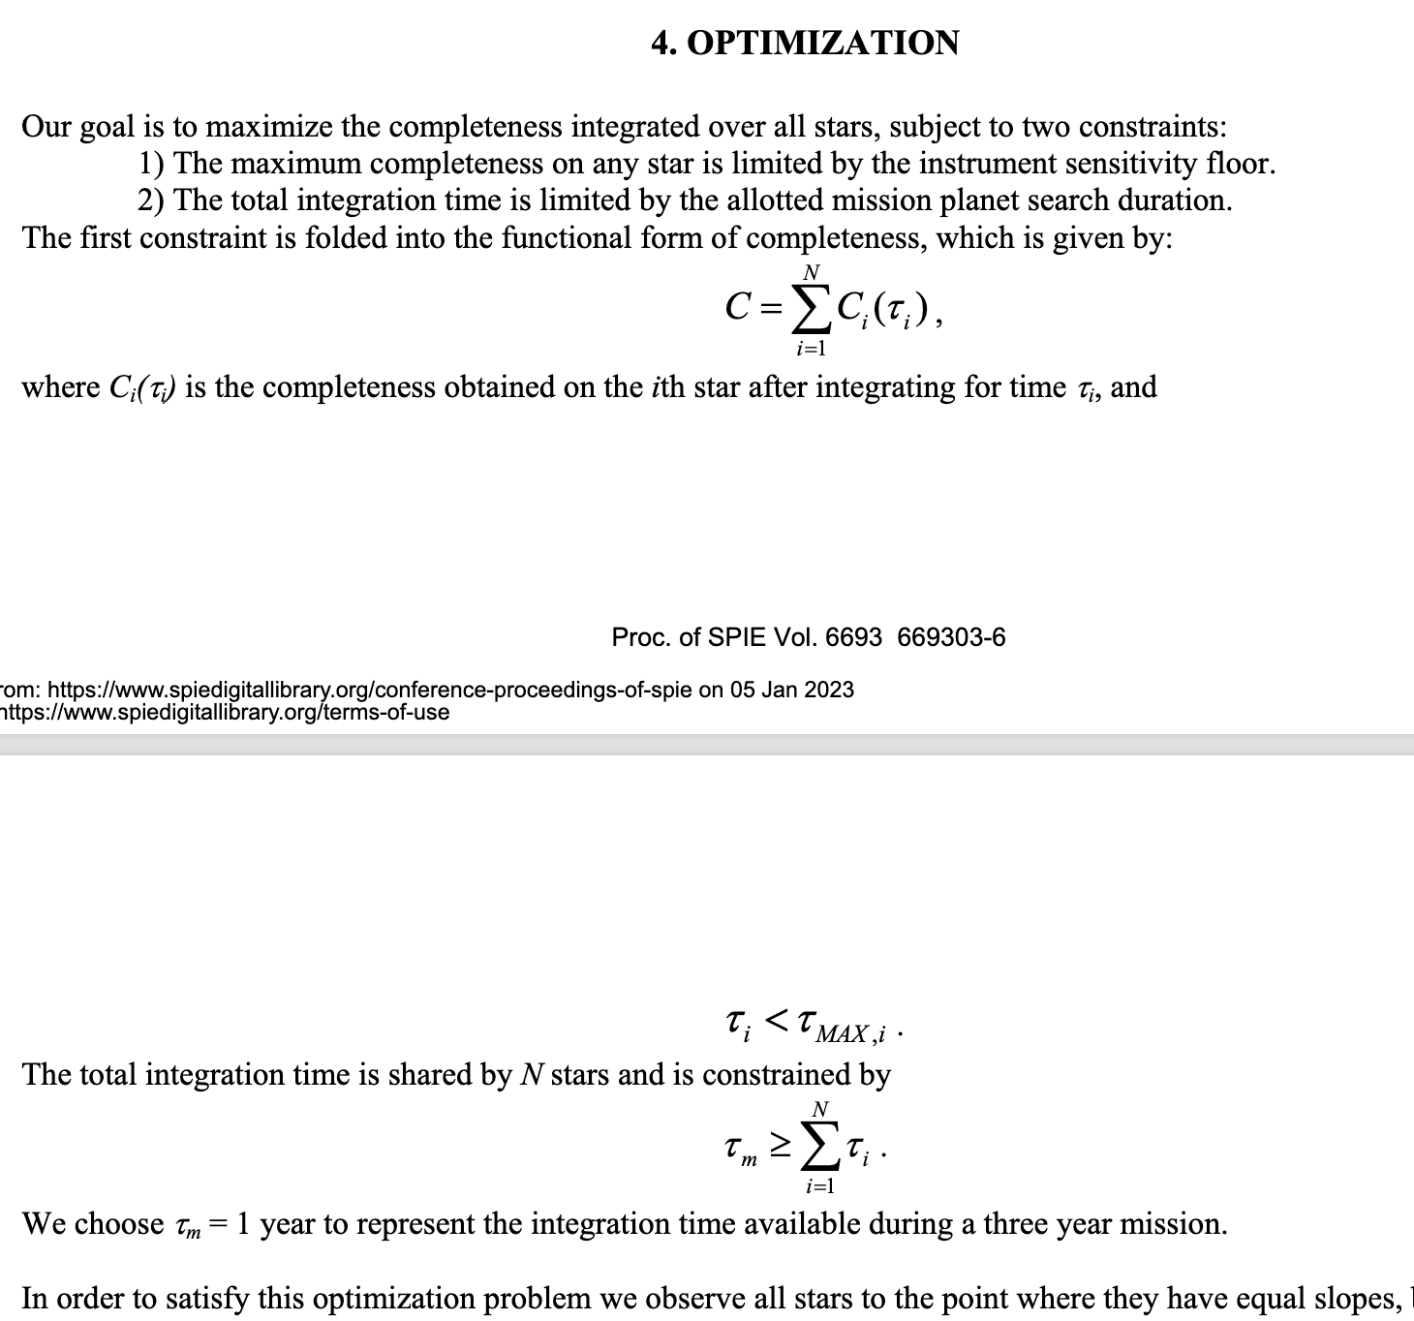
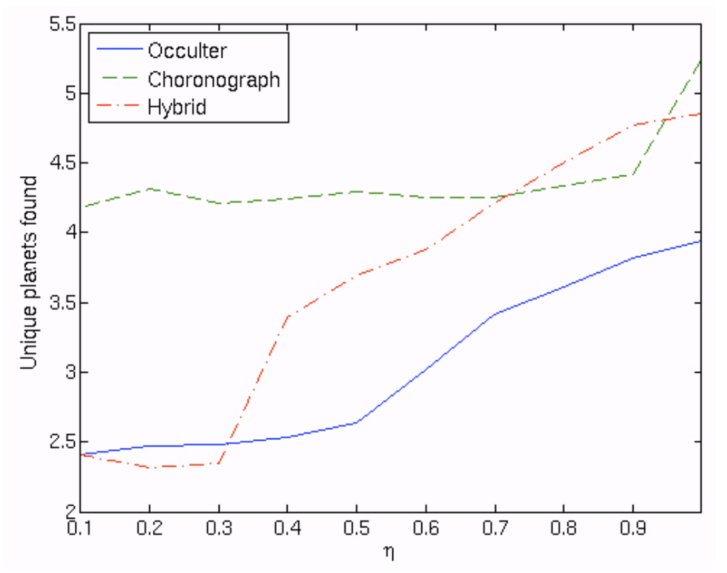
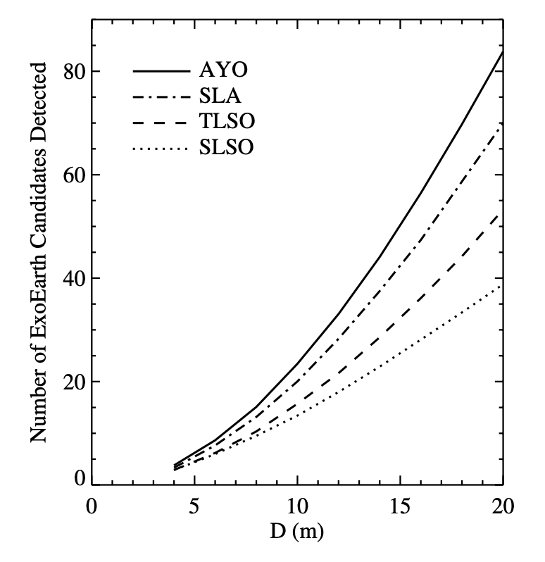
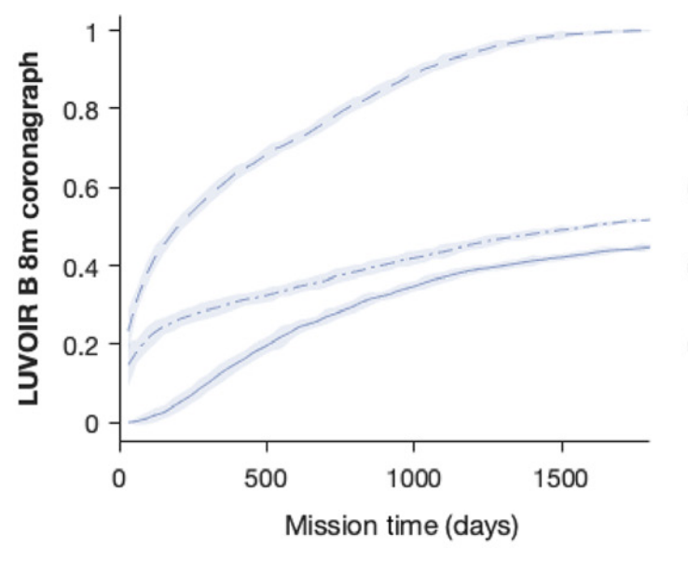
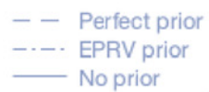
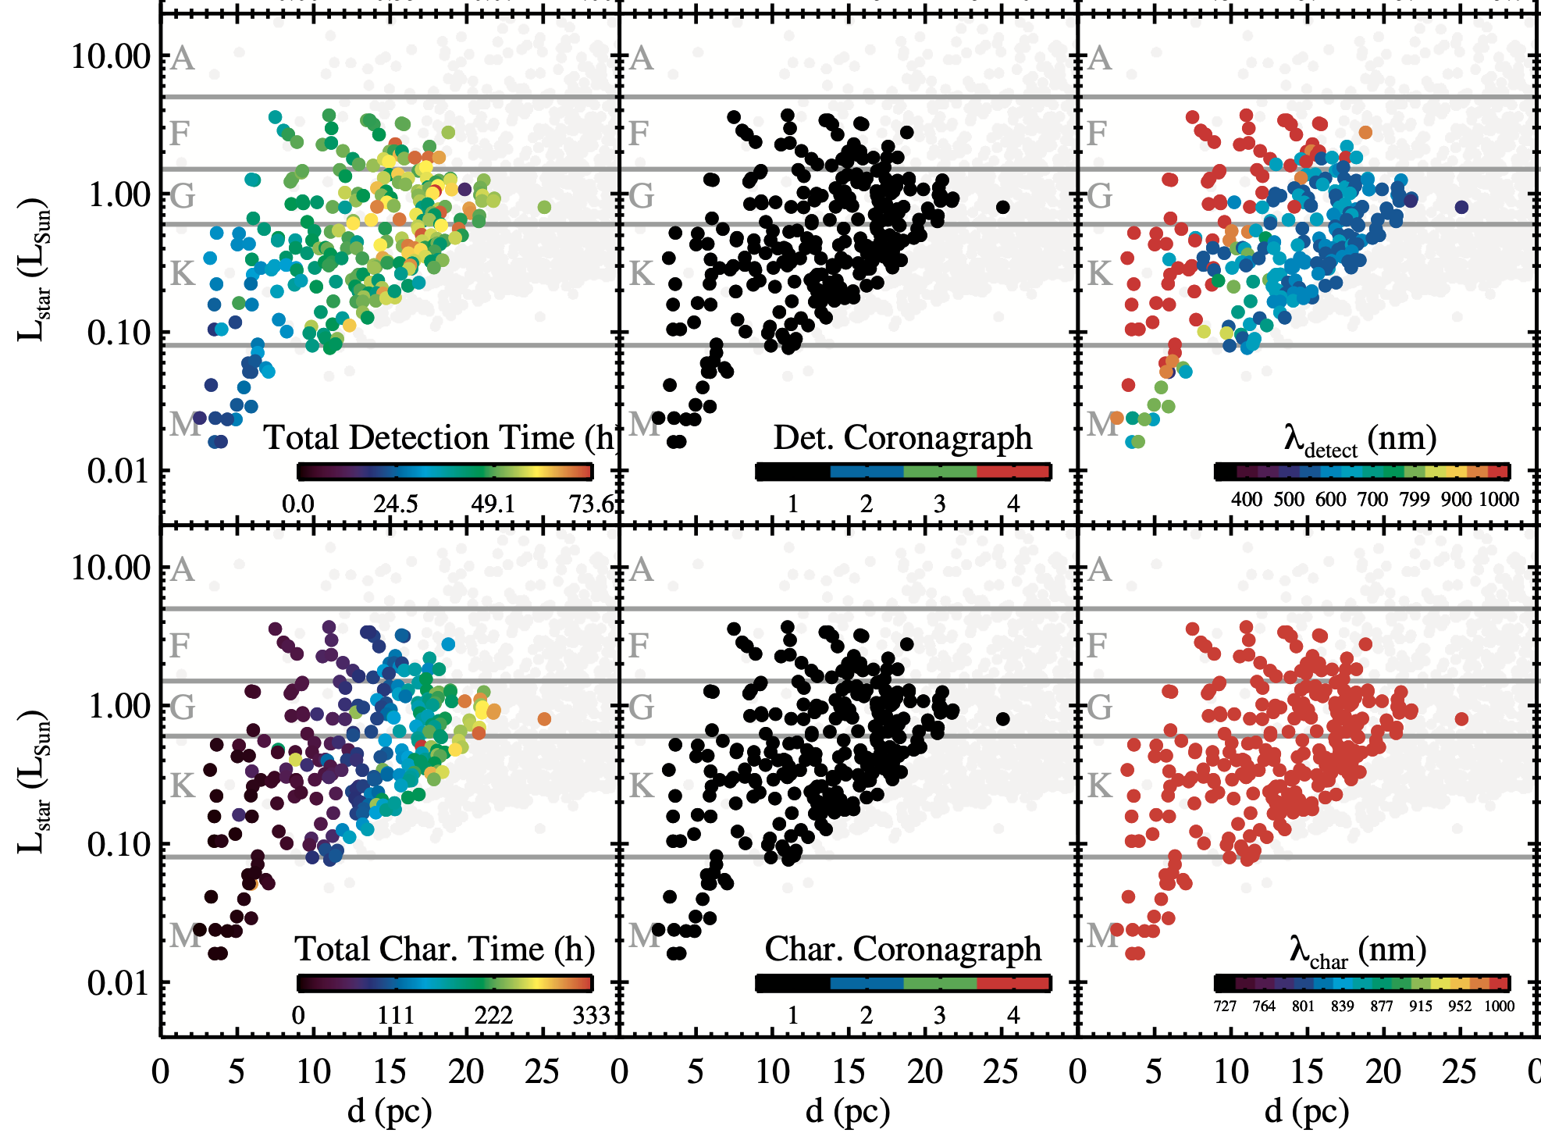
20 years of optimization progress
Brown (2005)
Hunyadi, Lo, & Shaklan (2007)
Savransky & Kasdin (2008)
Stark et al. (2014 & 2015)
Morgan et al. (2021)
Stark et al. (2024)

Slide 25
Two methods for calculating yield
Summed Completeness
Mission Monte Carlo
Pro:
Relatively straightforward to compute
Allows for easier optimization
Cons:
Ignores schedulability
Yield uncertainties harder to estimate
Pro:
Produces yield uncertainties easily
Includes scheduling complexities
Cons:
Computationally costly
Decision making strategy critical
Slide credit: D. Savransky

Slide 26
Lessons Learned

Slide 27
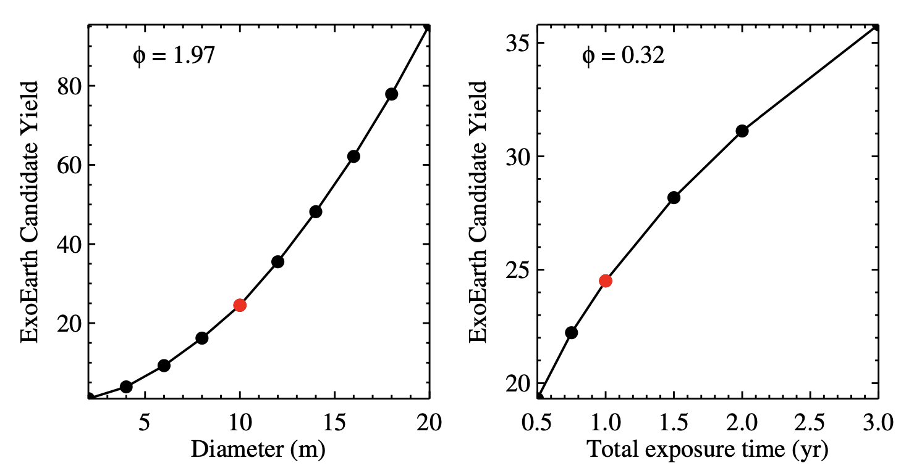
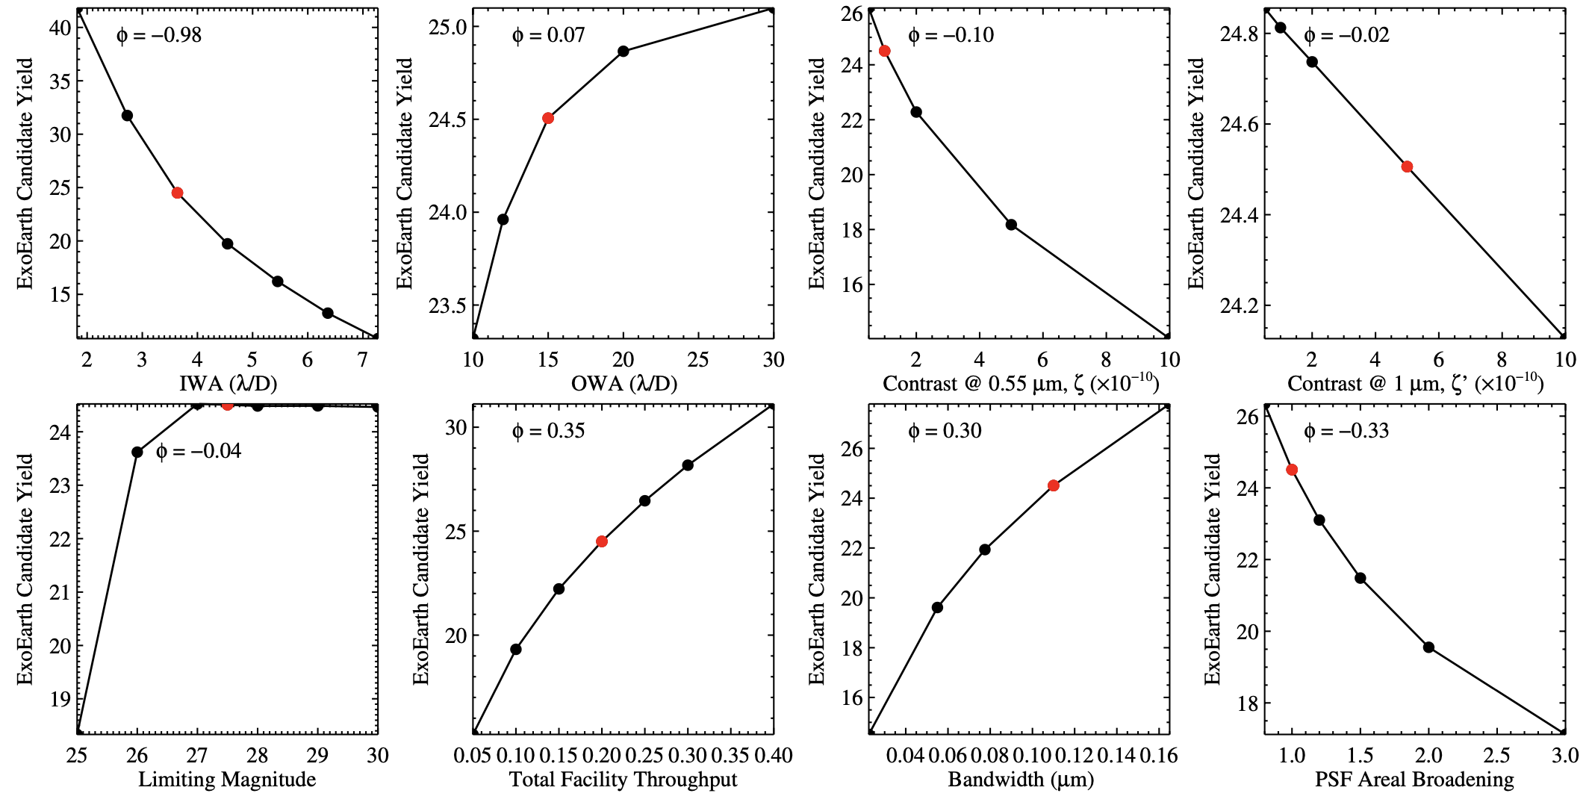
Lesson: Yield is Most Sensitive to D
Stark et al. (2015)

Slide 28
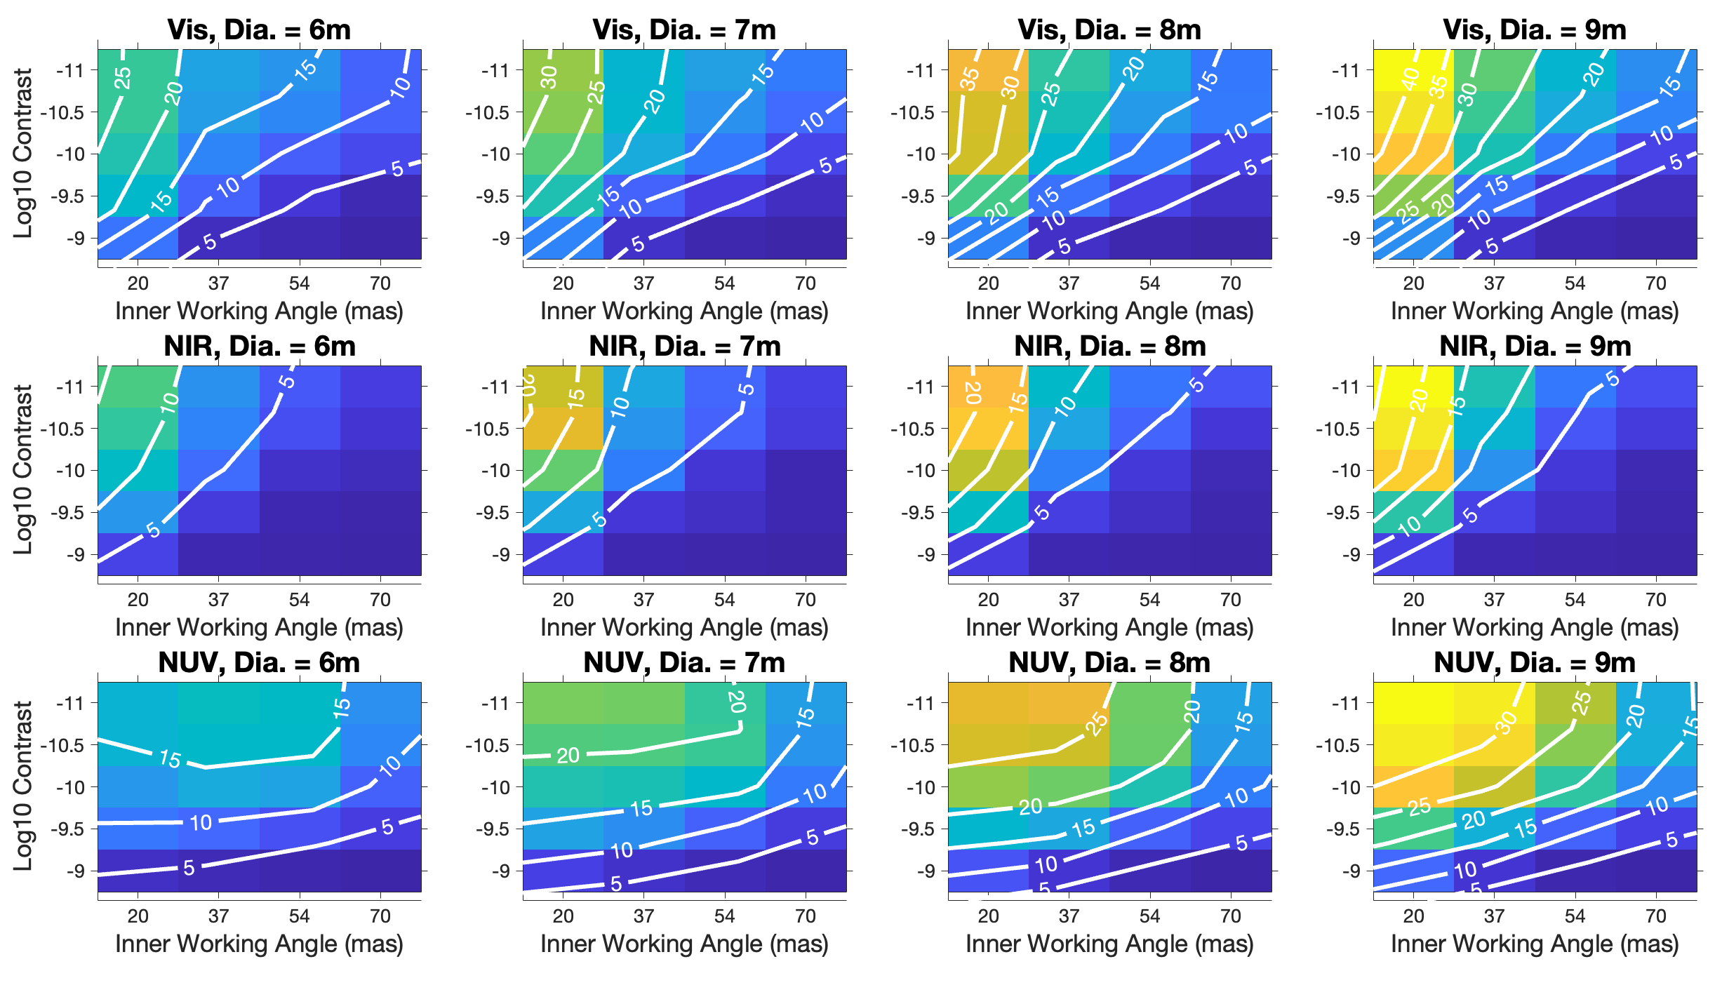
Lesson: Yield sensitivities are correlated
E.g., IWA & contrast joint-sensitivity depends on λ and D
Morgan (2024)

Slide 29

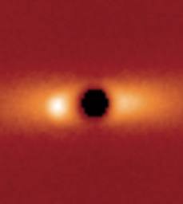
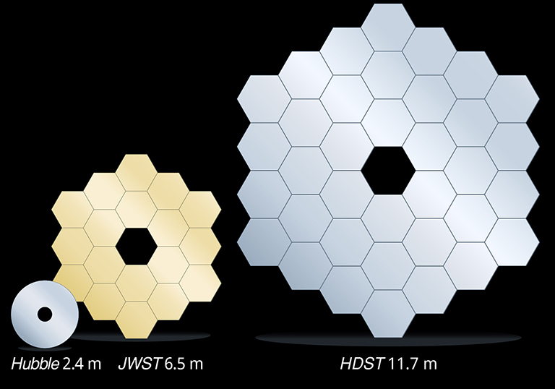
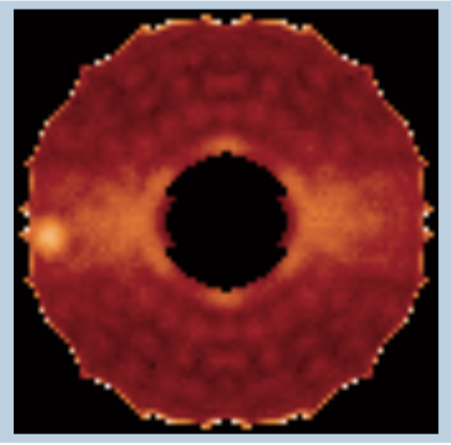
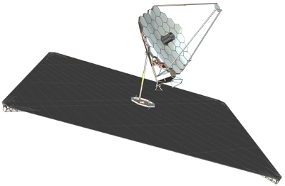
Why coronagraph yield is controlled by D
Larger photon bucket
Smaller IWA
~ λ/D
Sharper PSF
4 m
12 m
Exposure time scales as D⁻⁴

Slide 30
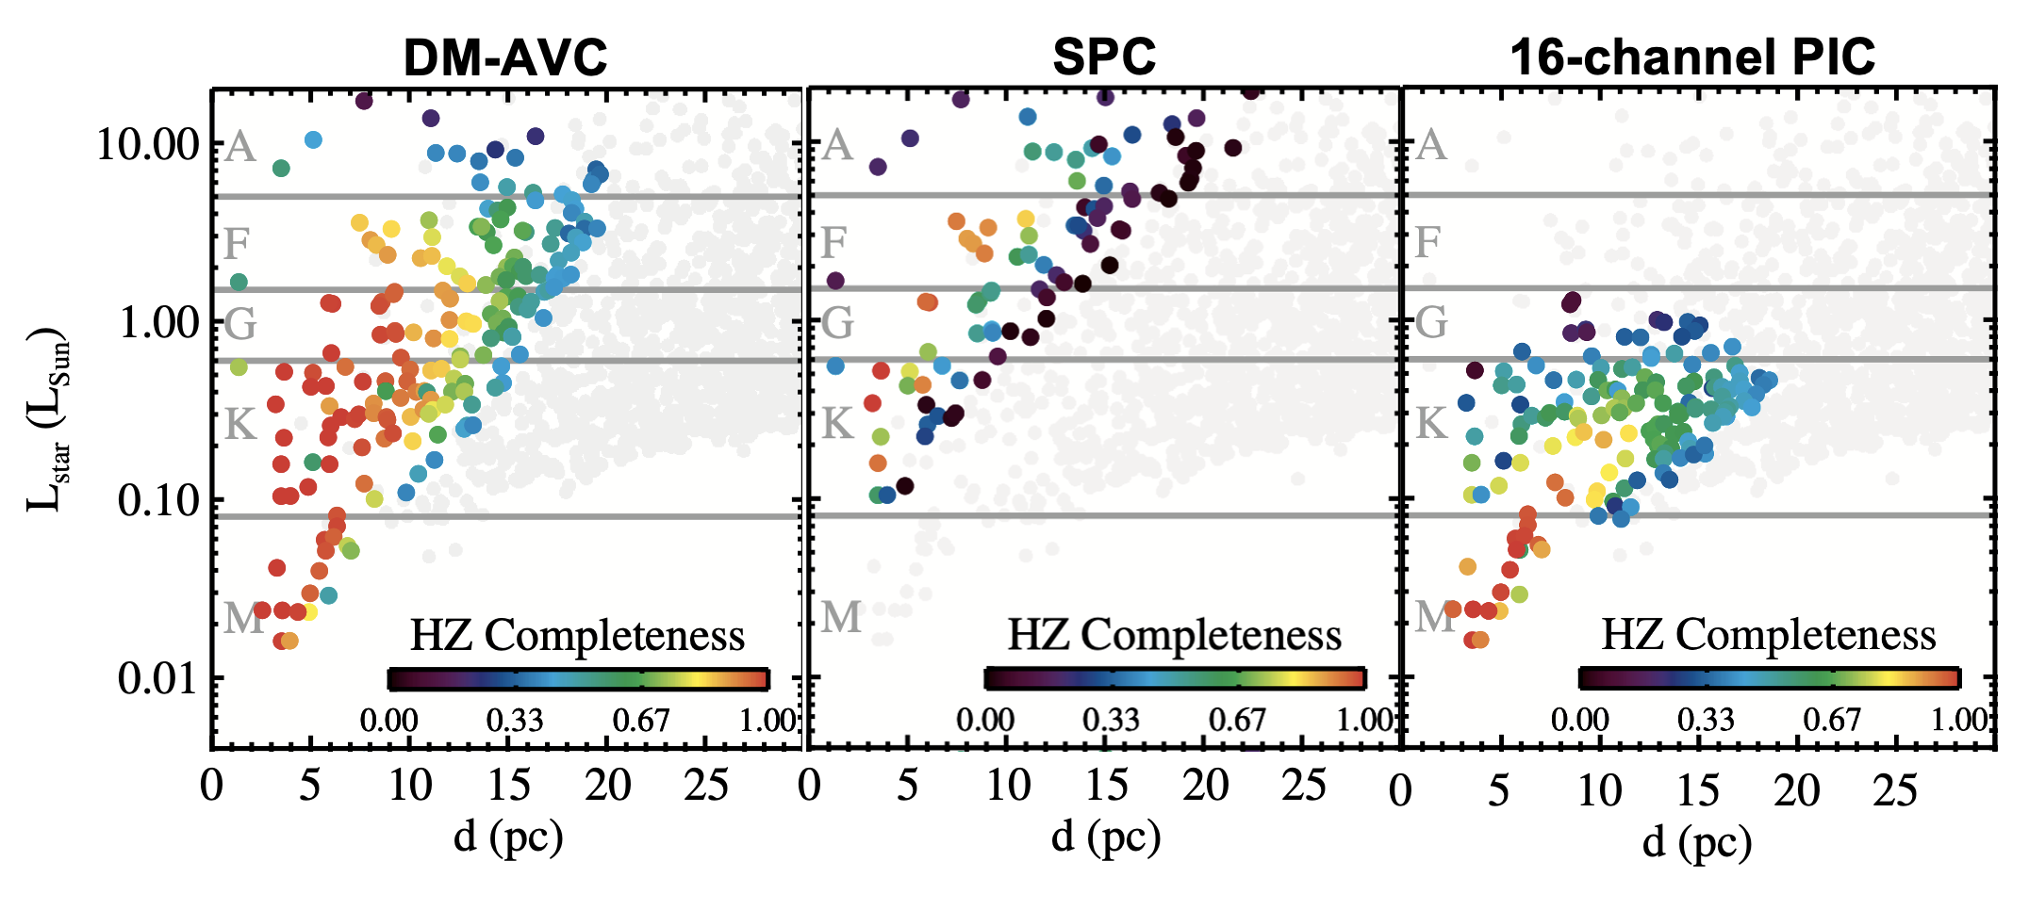
Lesson: We Can Use Astro. & Obs. DOF to Our Advantage
We can adapt target list to take advantage of mission’s strengths and mitigate the weaknesses
We can adapt observations to mission’s strengths
Stark et al. (2024)
Notes:
The less prescriptive you are, the more you can learn
Must play to the strengths of a given design

Slide 31
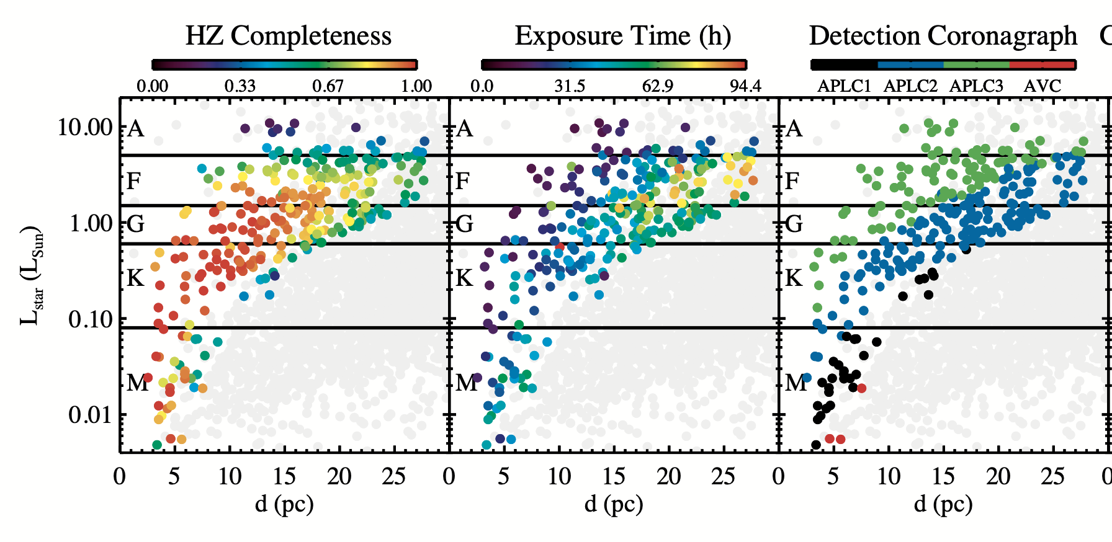
Lesson: Coronagraphs Can Play Well Together
One coronagraph doesn’t have to do everything
We can optimally assign coronagraphs on a star-by-star basis
Relaxes coronagraph design phase space
Leads to higher yields
LUVOIR Final Report (2019)

Slide 32
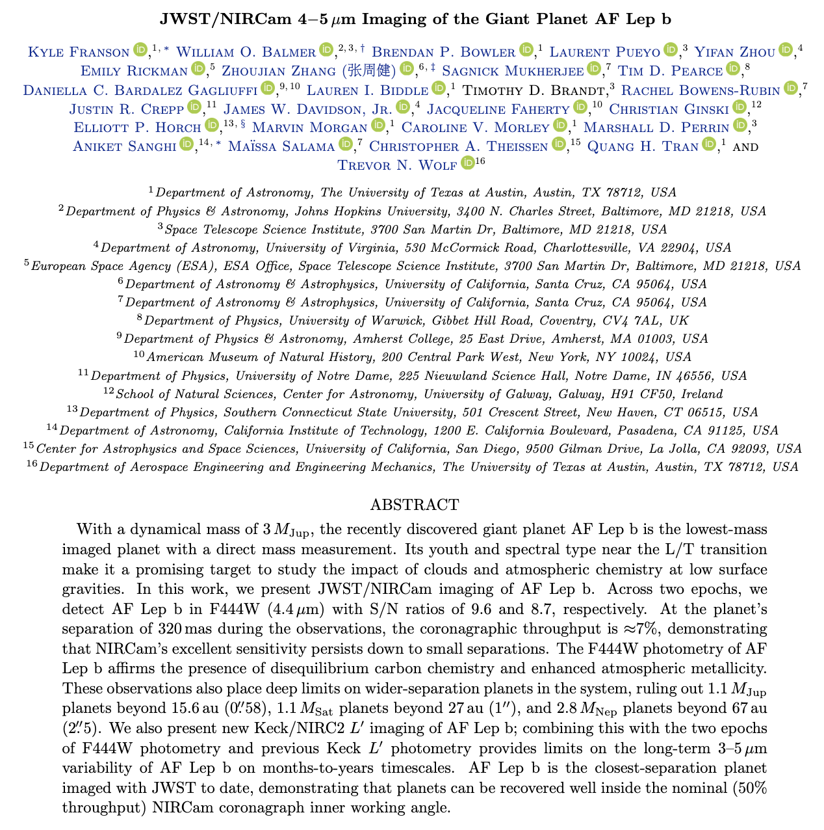
Lesson: Working Inside of the “IWA” is Potentially Productive
JWST has demonstrated exoplanet detection at 1.8 λ/D
DMVC6
Standards Team

Slide 33
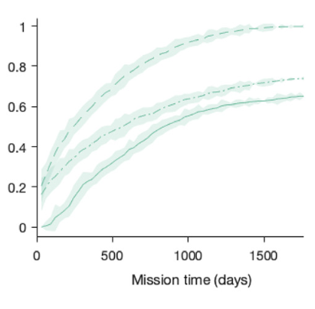
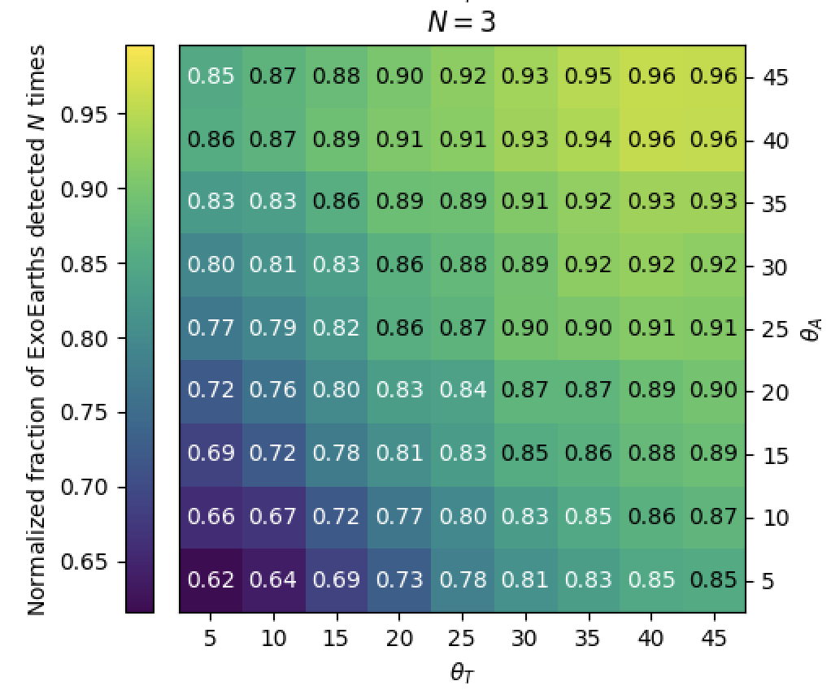
Lesson: Precursor Information Is Valuable
Precursor Knowledge Can Lead to Faster and Higher Yields
Instantaneous Field of Regard Needs to be Large To Use Precursor Info
Normalized Fraction of EPRV-Detected EECs Imaged 3 Times
Perfect Prior Knowledge
EPRV Priors
No Priors
Normalized EEC Yield
LUVOIR-B
Morgan et al. (2021)
Spohn et al. (2024)

Slide 34
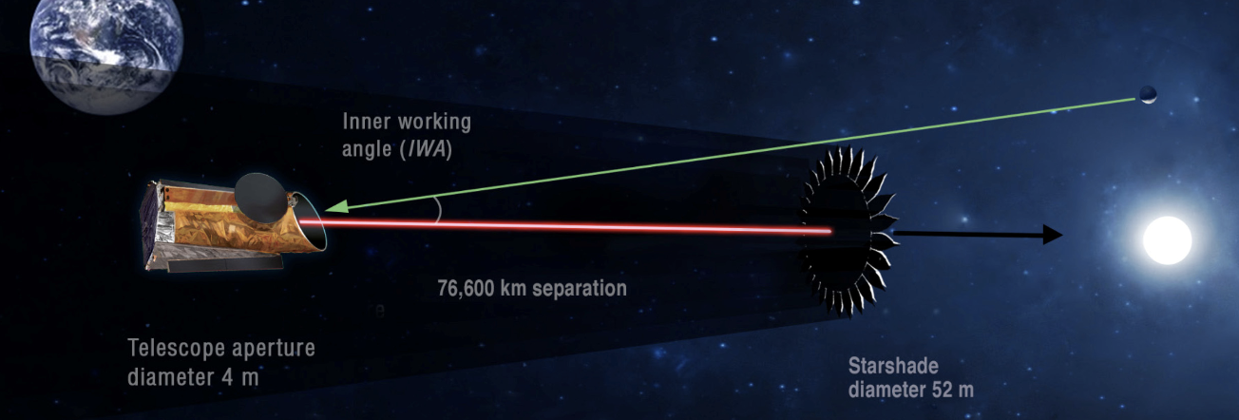
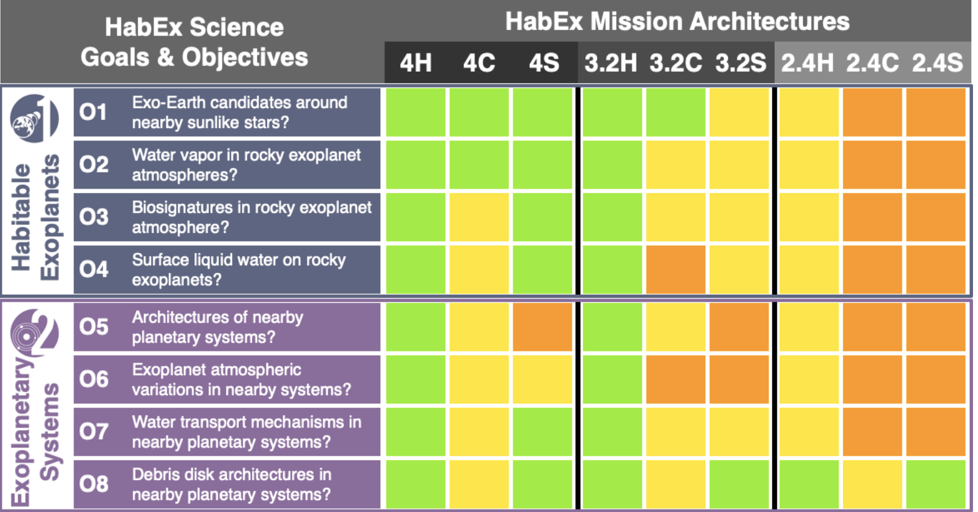
Lesson: Starshades and Coronagraphs Are Complimentary
Savransky & Kasdin (2008)
HabEx Final Report (2019)

Slide 35
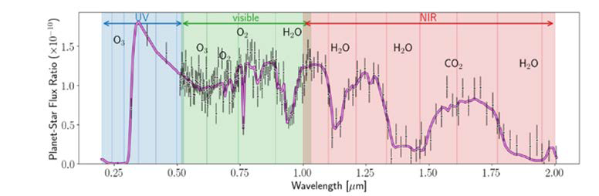
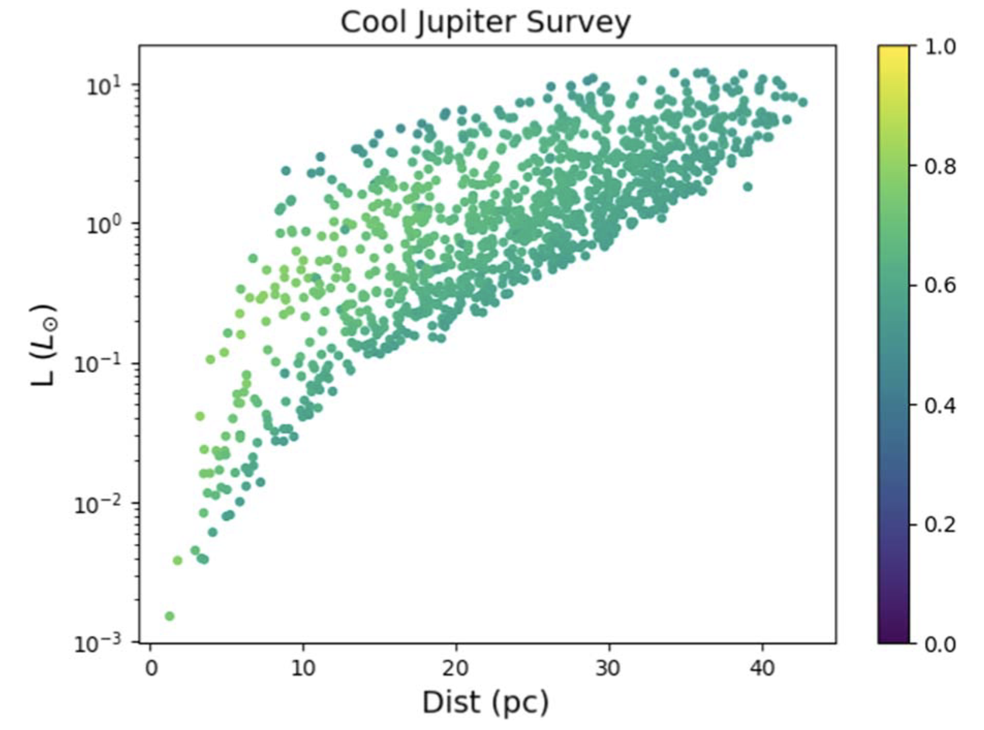

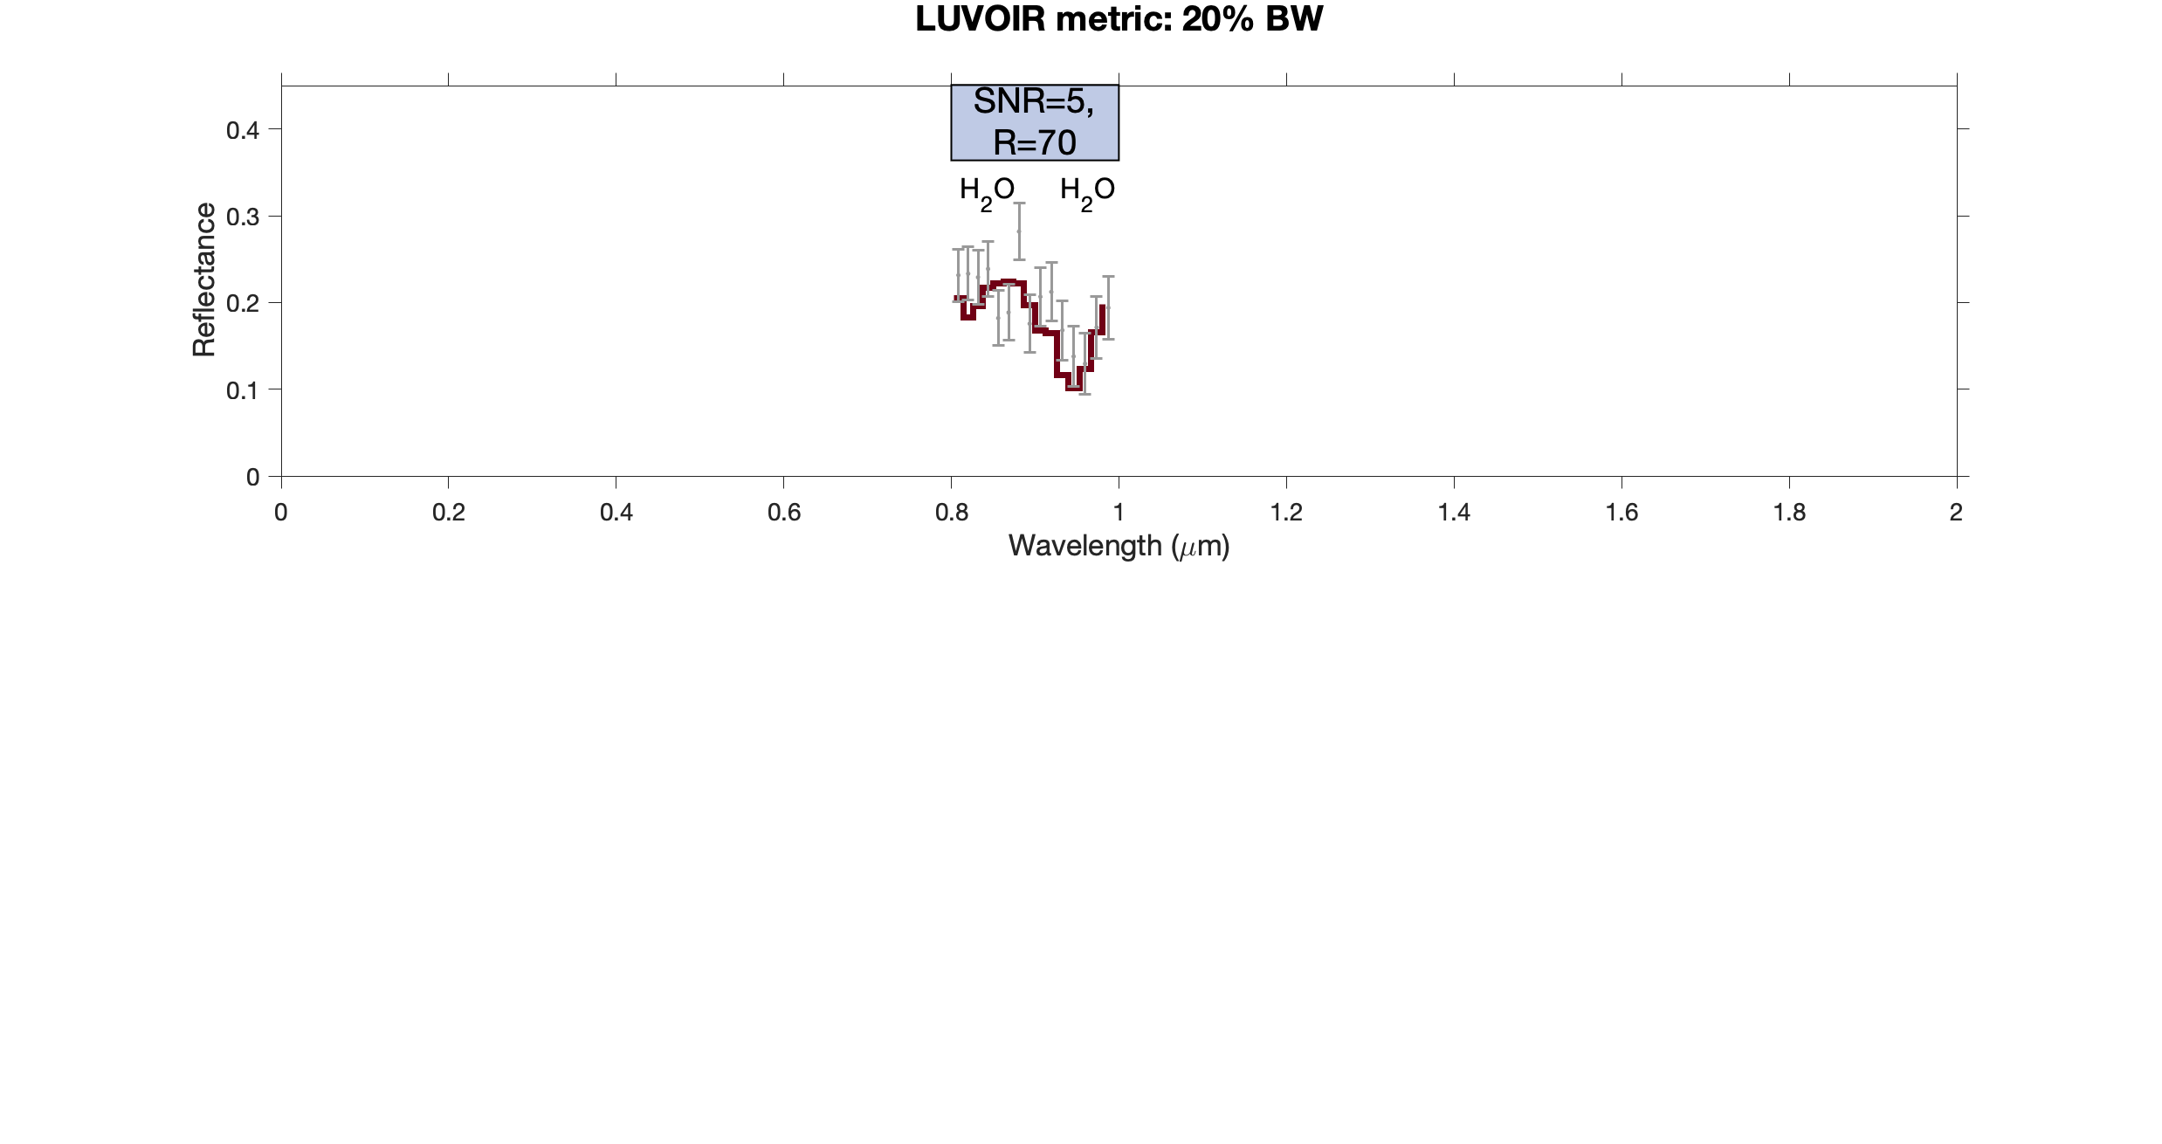

Lesson: The Yield Metric Matters
Surveying for cool Jupiters is a piece of cake.
Fig 7.5
(6 months of imaging)
~Boundaries of EEC survey
>1100 stars!
Standards Team
Standards Team
Tuchow et al. (2024)
Morgan (2022)

Slide 36
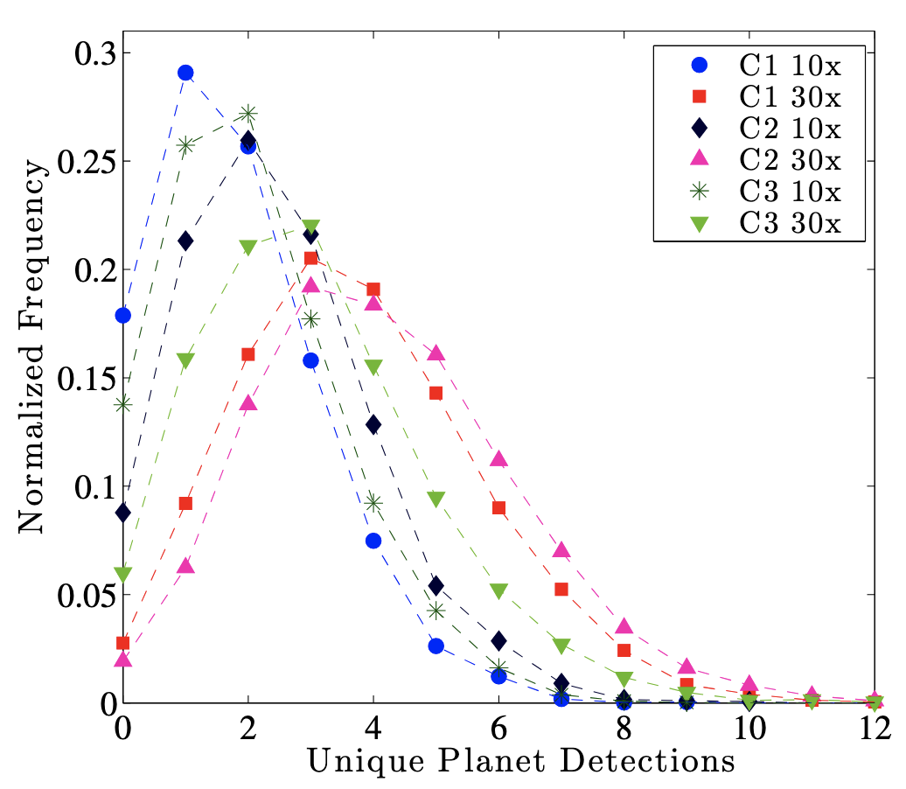

Lesson: Uncertainties Matter
Yields are inherently probabilistic
Astrophysical uncertainties are large for 6 m ID version of LUVOIR-B
Savransky et al. (2016)
Stark et al. (in review)

Slide 37

Lesson: Changes are Synergistic
Stark et al. (in review)
Many small changes can compile to produce big differences in yield.

Slide 38
Lesson: Beware of Yield Erosion
“Every bit of added fidelity in our simulations tends to decrease projected yield.”
- Dmitry Savransky

Slide 39
Lesson: Yield is Hard
Exposure time, completeness, and survey simulation are inherently complicated, require a large number of inputs, and have many opportunities for error. Cross-model validation and output visualizations are critical.

Slide 41
Backup

Slide 42


Optimizing revisits
Brown & Soummer et al. (2010)

Slide 43


Optimizing revisits
  Optimized revisits can increase yield by additional 35-75%

Slide 44
Method used by AYO
  Based on advancements to the Hunyadi method
Distribute ~10³ Planets/Orbits Around Every Star
Find t’ where dC/dt = (dC/dt)’
Mark planets with t_{p} < t’ as observed
Resolve each orbit into ~100 mean anomalies
Calculate C(t), dC/dt
Vary delay time and advance planets
Calculate each planet’s position and flux
Choose delay time with largest C(t’)/t’
Choose target slope with highest ΣC
Repeat for all revisits and all stars
Choose a target slope (dC/dt)’
Select obs. that fit within t_{mission} and have largest C/t; calculate ΣC
Calculate Exposure Time of Every Planet, t_{p}
Notes:
Completeness calculated via Monte Carlo simulation
Distribute a “cloud” of synthetic exoplanets & calculate separation & magnitude
IWA & OWA block some planets
Others (crescent-phase) are so faint that their exposure times are too long
Completeness is a function of exposure time!

Slide 45
AYO models realistic mission concepts
Key points:
The reflectivity of coatings matters a lot!
i.e., 0.95^12 = 0.5
We will likely have to trade bandwidth for throughput. UV coronagraphy reduces throughput at all wavelengths by up to ~0.5
Efficiently parallelizing coronagraphs may be essential for wavelength coverage
Stark et al. (2019)

