Slide 1
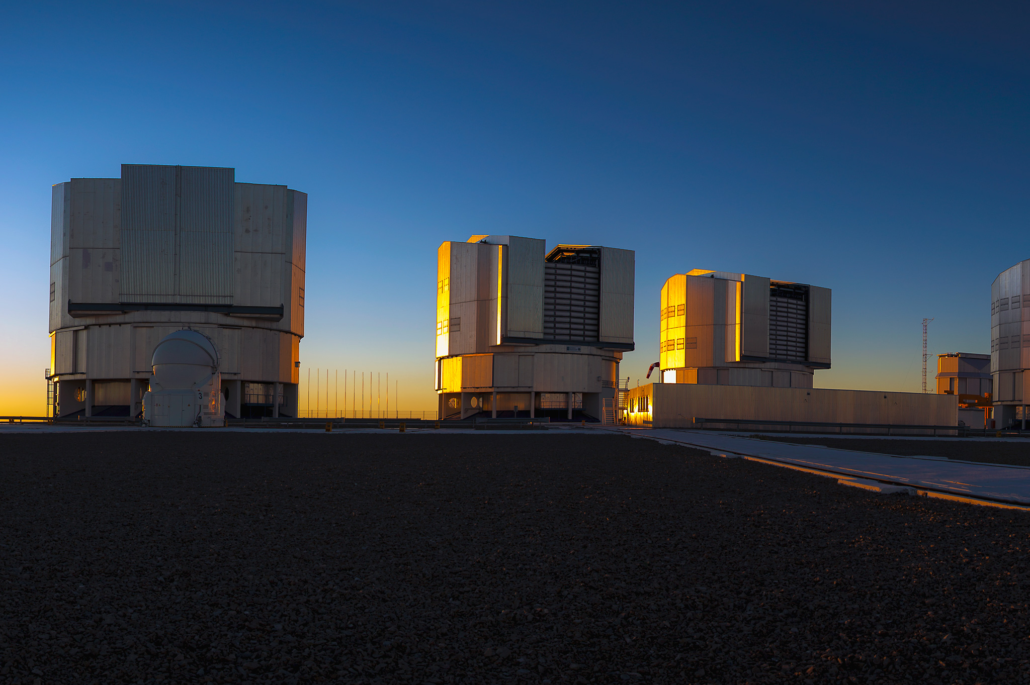
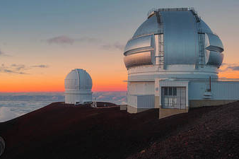
Lessons learnt in ground-based instruments
Julien Milli
Notes:
Biased towards VLT instruments bc spent many years @ VLT

Slide 2
Outline
What is currently limiting us ?
What have we learnt ?
Perspectives

Slide 3
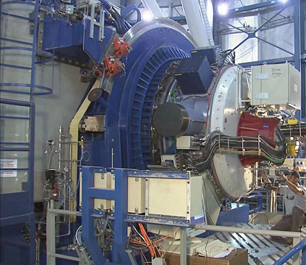
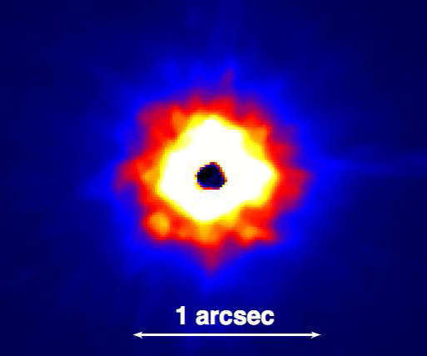
First generation AO systems
VLT/NaCo PSF at H band (1.6μm), saturated in the center
Asymmetric halo
Speckles with various timescales: dynamical and quasi-static poorly averaging with time
AO correction driving the design, not so much the temporal stability, critical to calibrate the stellar residuals (no pupil stabilisation initially, varying flexures of the instruments…)
Coronagraphy only starting
→ limited contrast
Notes:
Many of you have probably never worked with 1st gen AO systems

Slide 4
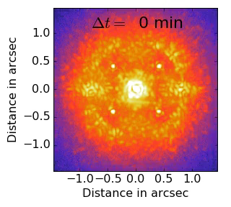
Second generation high-contrast instruments
VLT/SPHERE coronagraphic images at H band (1.6μm)
1st gen on steroids with a highlight on
Stability
Diffraction control and coronagraphy
Dedicated low-order WFS or NCPA calibration strategies
Dedicated observation strategies to allow differential imaging
Post-processing considered at instrument design
→ The contrast is the new metrics rather than the Strehl ratio
cf Tuesday talk by F. Cantalloube and B. Jansen-Clem
Notes:
A lot of promises: we’ll be able to forget about the atmosphere, turbulence will be perfectly corrected on bright stars

Slide 5
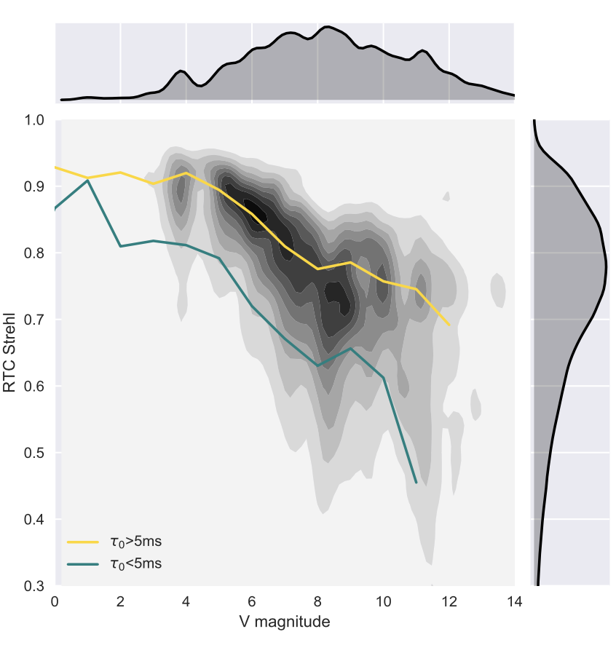
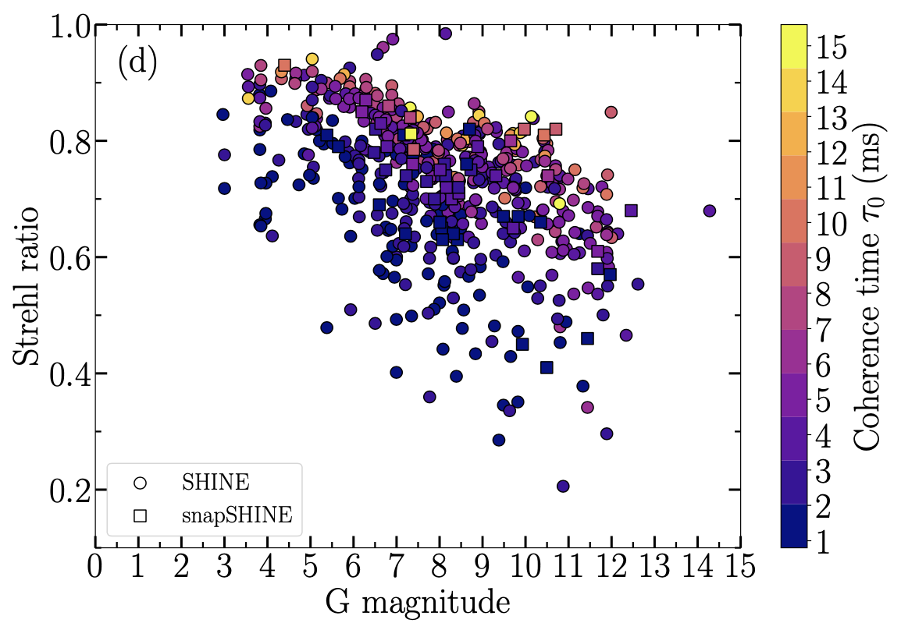
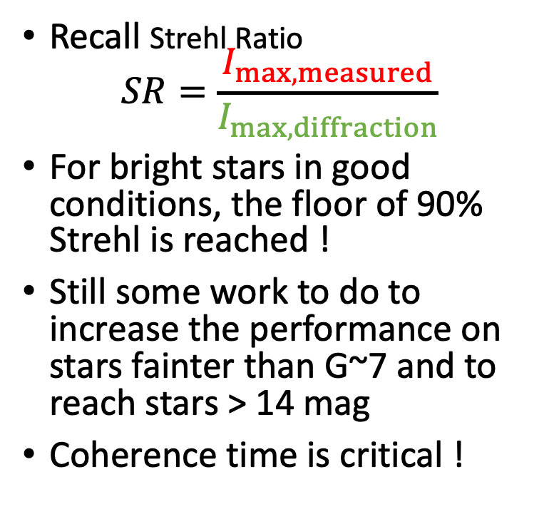
Strehl distribution
VLT/SPHERE (SHINE survey on 400 targets, visitor mode)
Recall Strehl Ratio
$SR=\frac{I_{max,measured}}{I_{max,diffraction}}$
For bright stars in good conditions, the floor of 90% Strehl is reached !
Still some work to do to increase the performance on stars fainter than G~7 and to reach stars > 14 mag
Coherence time is critical !
Strehl
Milli et al. 2017
Magnitude V
Chomez et al. submitted

Slide 6
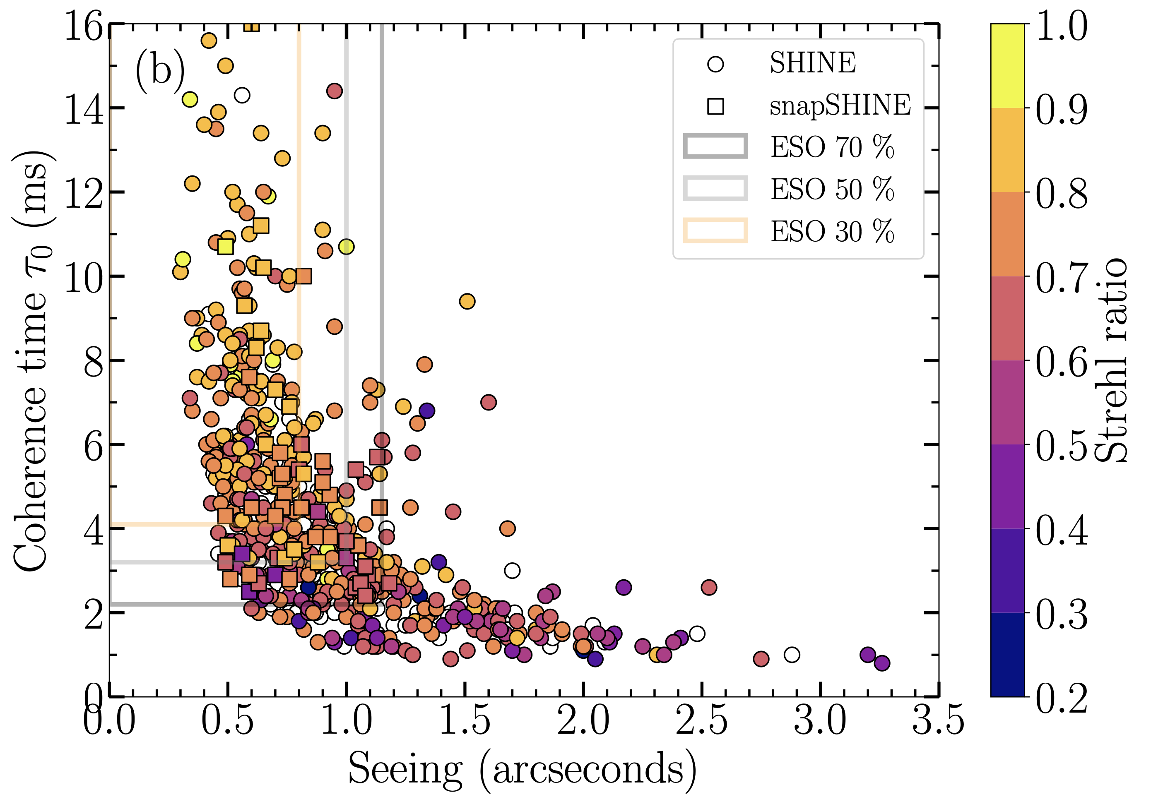
Conditions do matter
VLT/SPHERE (SHINE survey on 400 targets, visitor mode)
At the VLT, coherence time and seeing are jointly used as QC parameter (one of the 1st lessons from VLT/SPHERE operations)
Significant implications for detection / non-detection of a candidate
Drives the need for accurate turbulence predictions (e.g. Masciadri et al. 2023)
Turbulence conditions
top 70%
(H band)
top 50%
top 30%
Chomez et al. submitted

Slide 7
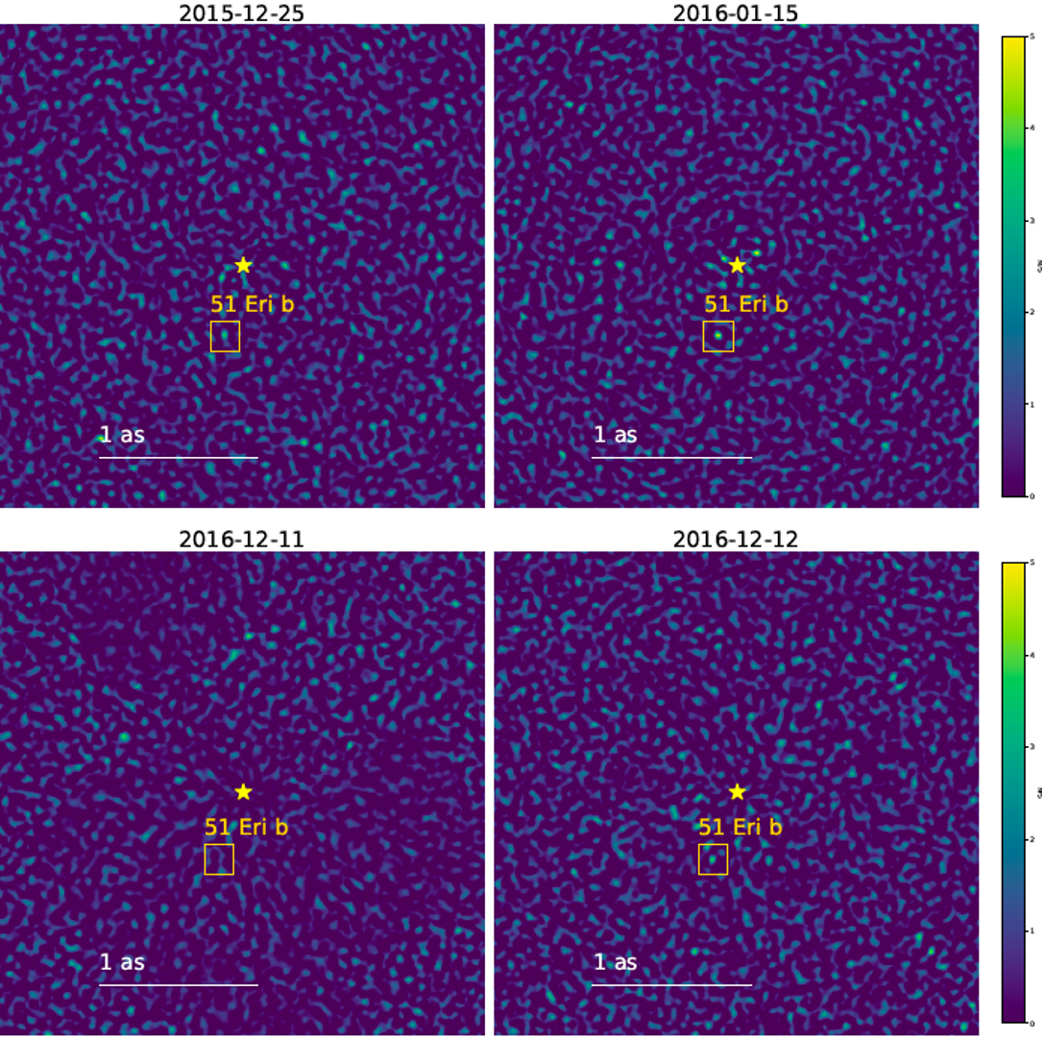
Conditions do matter
  Signal-to-noise maps of the 5 M_{Jup} planet 51 Eri b (Macintosh et al, 2015) observed on 4 epochs (Samland et al. 2017, Brown-Sevilla et al. 2023)
S/N
Various S/N despite similar Strehl 80-90%

Slide 8
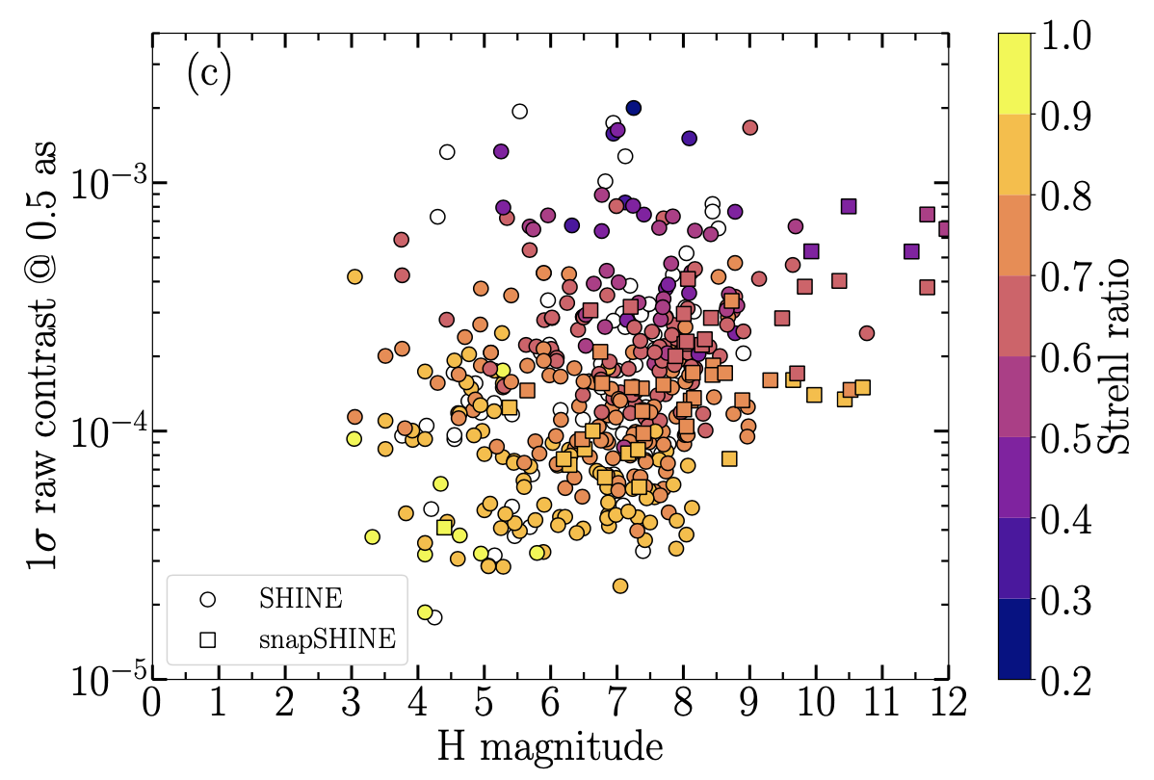
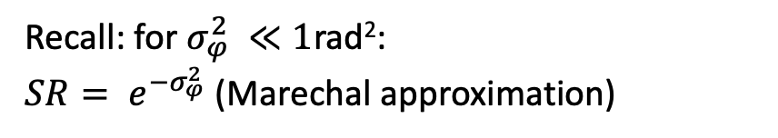
Contrast distribution
Raw contrast in the H band vs H mag (VLT/SPHERE SHINE survey)
Even at high Strehl, the contrast can vary by an order of magnitude
Strehl = integrated quantity that does not describe the PSD of the aberrations or the coronagraph centering
(H band)
Recall: for $σ_{φ}^{2} ≪1$rad²:
$SR= e^{−σ_{φ}^{2}}$ (Marechal approximation)
$σ_{φ}^{2}=σ_{fitting}^{2}+σ_{alias}^{2}$+ $σ_{servolag}^{2}$+ $σ_{noise}^{2}$+ $σ_{calib}^{2}$+ $σ_{NCPA}^{2}$
Chomez et al. submitted

Slide 9
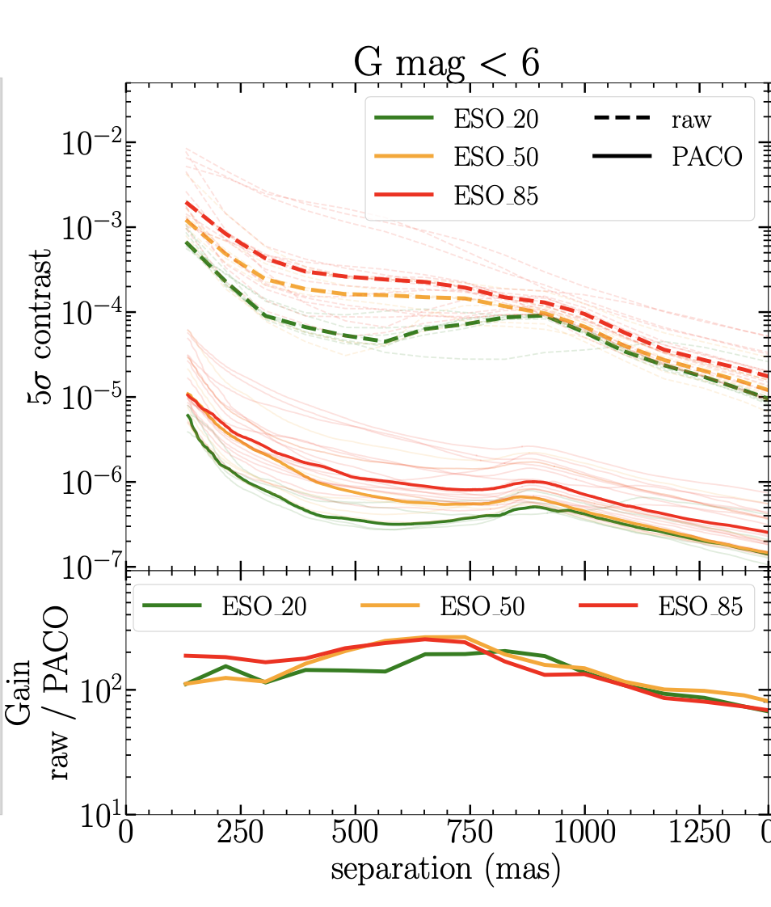
Contrast curves
VLT / SPHERE / IRDIS contrast from the SHINE survey
The contrast curve is the key to decipher what is limiting the performance
Top 30%
Top 50%
Top 85%
$σ_{φ}^{2}=σ_{fitting}^{2}+σ_{alias}^{2}$+ $σ_{servolag}^{2}$+ $σ_{noise}^{2}$+ $σ_{calib}^{2}$+ $σ_{NCPA}^{2}$
Chomez et al. submitted

Slide 10
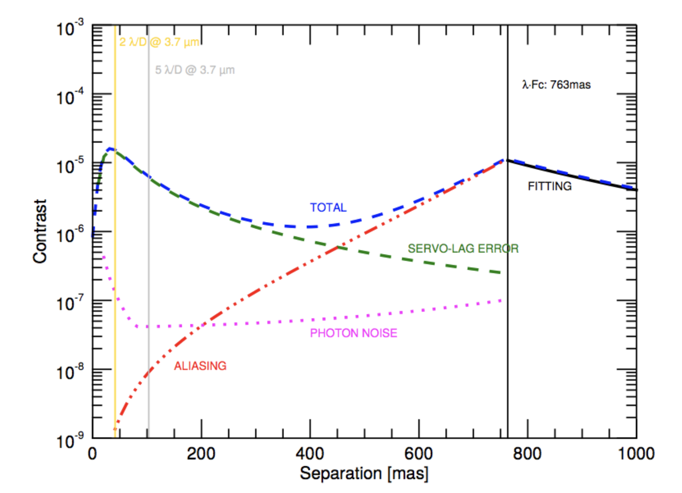
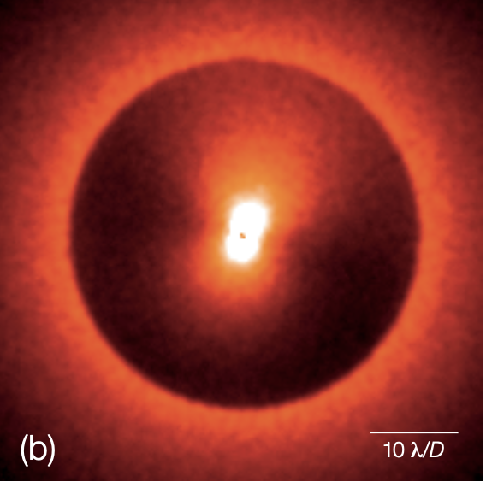
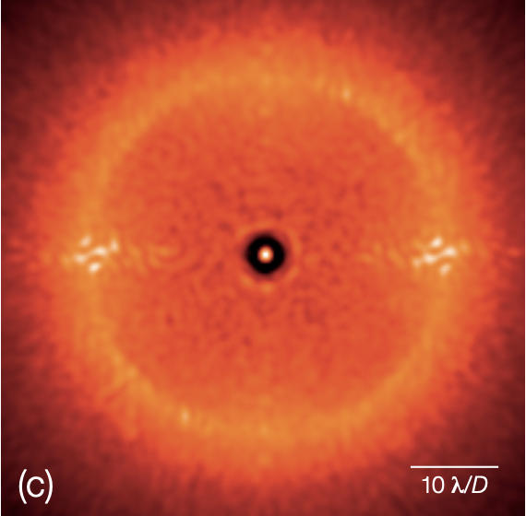
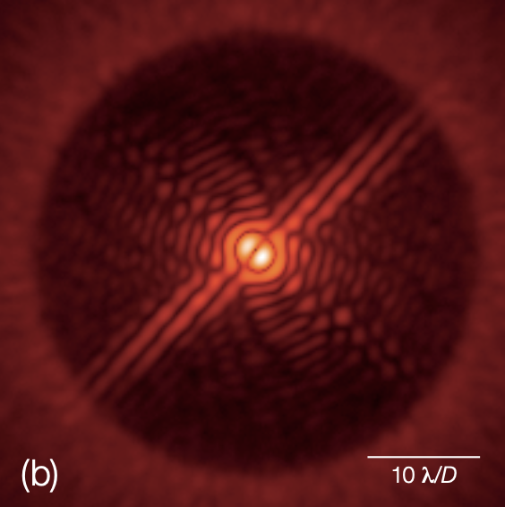
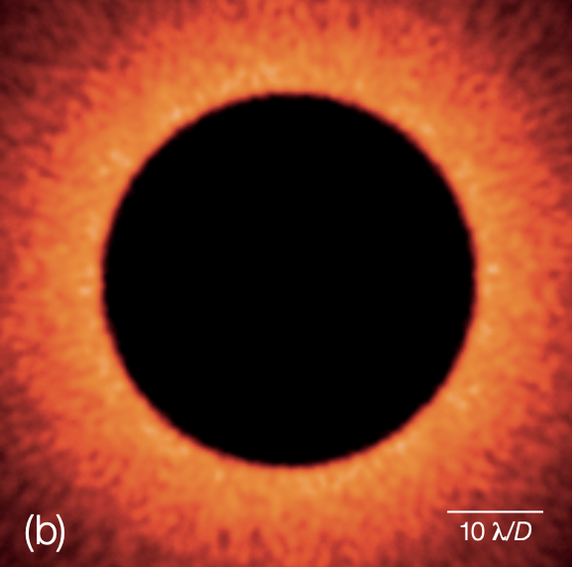
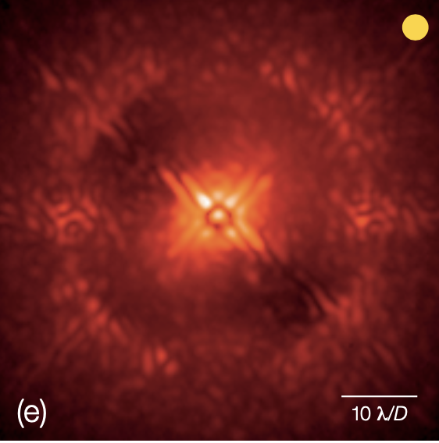
SERVOLAG
N/2 λ/D
ALIASING
LOW ORDERS
FITTING
cf Monday talk by I. Lagina
Curve adapted from Kasper et al. 2012, images from Cantalloube et al. 2019
Notes:
perfect coronagraph with pure servolag/low order/aliasing/fitting

Slide 11
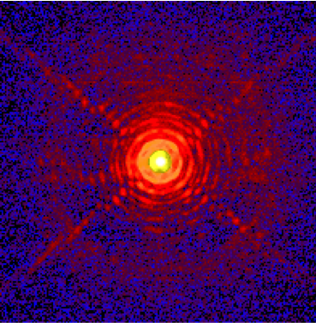
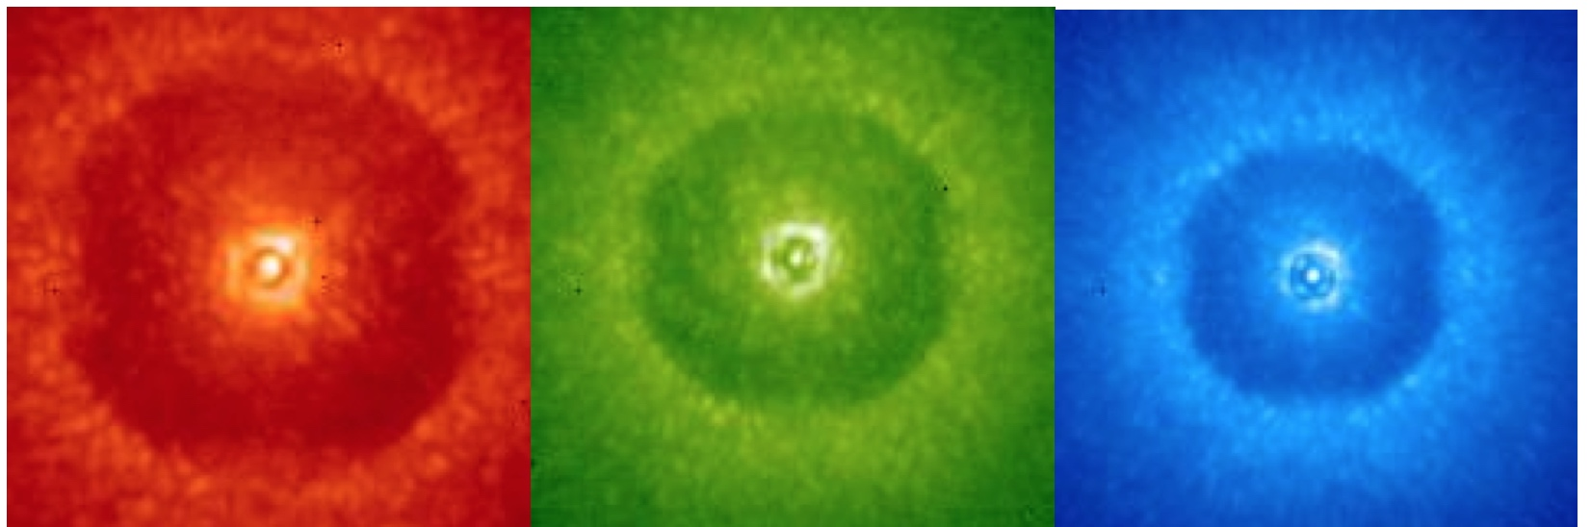
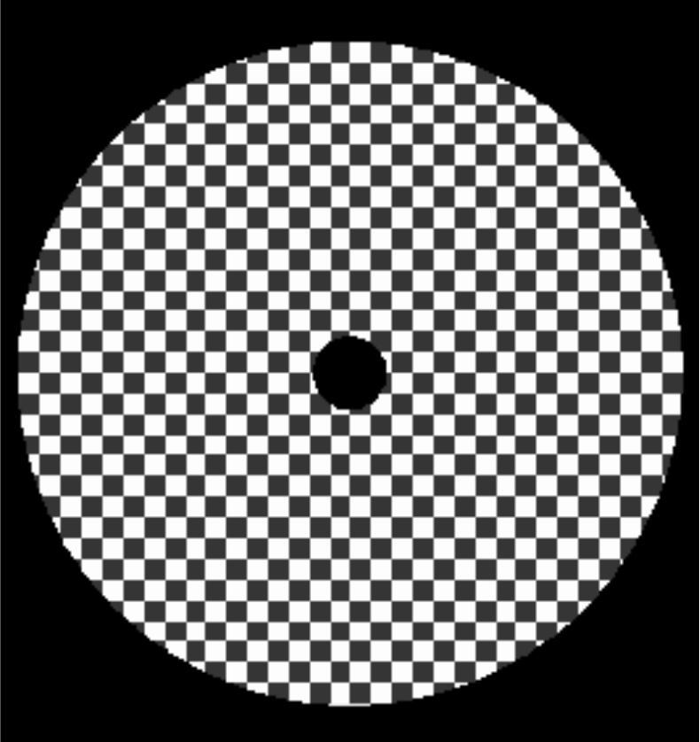
Fitting error
$σ^{2}=σ_{fitting}^{2}+σ_{alias}^{2}$+ $σ_{servolag}^{2}$+ $σ_{noise}^{2}$+ $σ_{calib}^{2}$+ $σ_{NCPA}^{2}$
$σ_{fitting}^{2}=a{\left(\frac{D}{r0}\right)}^{5/3}N^{−5/6}$ → maximize the number of actuators N (e.g. SPHERE with 41x41 actuators)
With N = N_{act} x N_{act} actuators one can correct N_{act}/2 cycles/pup:
J
H
K
Coronographic images
λ
Highest spatial frequency one can correct for
N_{act}/2 λ/D

Slide 12
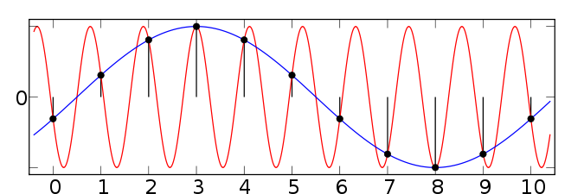
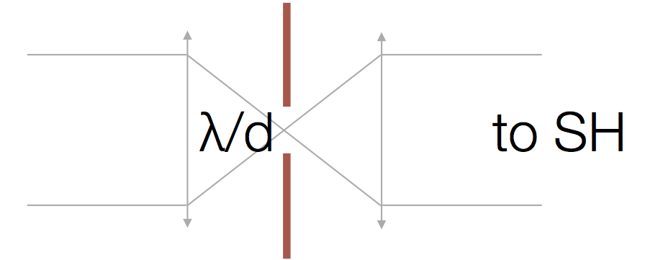
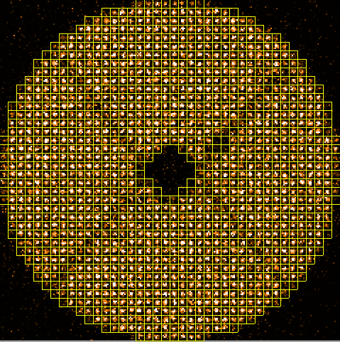
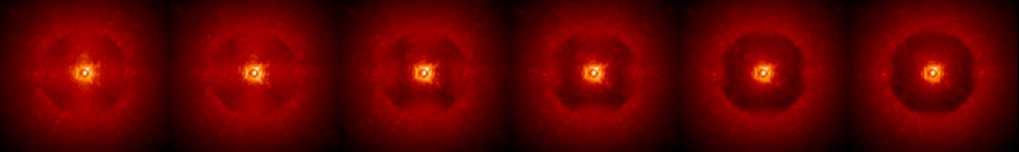

Aliasing error
$σ^{2}=σ_{fitting}^{2}+σ_{alias}^{2}$+ $σ_{servolag}^{2}$+ $σ_{noise}^{2}$+ $σ_{calib}^{2}$+ $σ_{NCPA}^{2}$
$$σ_{alias}^{2} ∝σ_{fitting}^{2}$$
Recall what is aliasing in signal processing
With a finite sampling frequency f_{s}, a signal of frequency f>f_{s}/2 is seen as a signal with a frequency f-f_{s}/2
Spatial filter
Possible solution: spatially-filter SH WFS
One filter spatial frequencies higher than f_{s}/2 upstream of the WFS
Fusco et al. 2014
Spatial filter progressively closed
Fusco et al. 2016

Slide 13
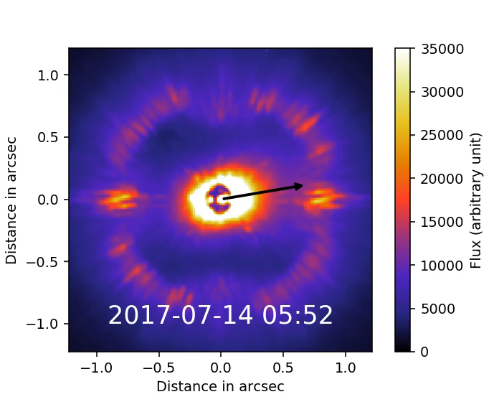

Servolag and wind-driven halo
$σ^{2}=σ_{fitting}^{2}+σ_{alias}^{2}$+ $σ_{servolag}^{2}$+ $σ_{noise}^{2}$+ $σ_{calib}^{2}$+ $σ_{NCPA}^{2}$
$$σ_{servo}^{2}={\left(\frac{τ}{τ_{0}}\right)}^{5/3}$$
Movie from VLT / SPHERE (Credit J. Milli)
Black arrow is the jet stream wind direction

Slide 14
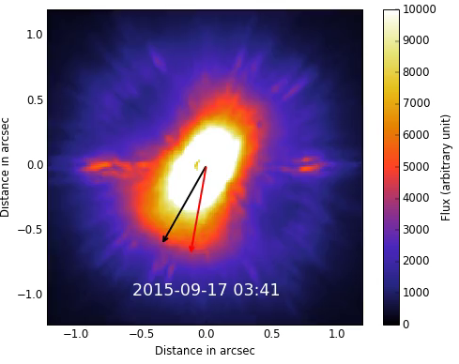
Servolag and wind-driven halo
$σ^{2}=σ_{fitting}^{2}+σ_{alias}^{2}$+ $σ_{servolag}^{2}$+ $σ_{noise}^{2}$+ $σ_{calib}^{2}$+ $σ_{NCPA}^{2}$
$$σ_{servo}^{2}={\left(\frac{τ}{τ_{0}}\right)}^{5/3}$$
Movie from VLT / SPHERE (Credit J. Milli)
Black arrow is the jet stream wind direction
Red arrow is the ground wind direction

Slide 15
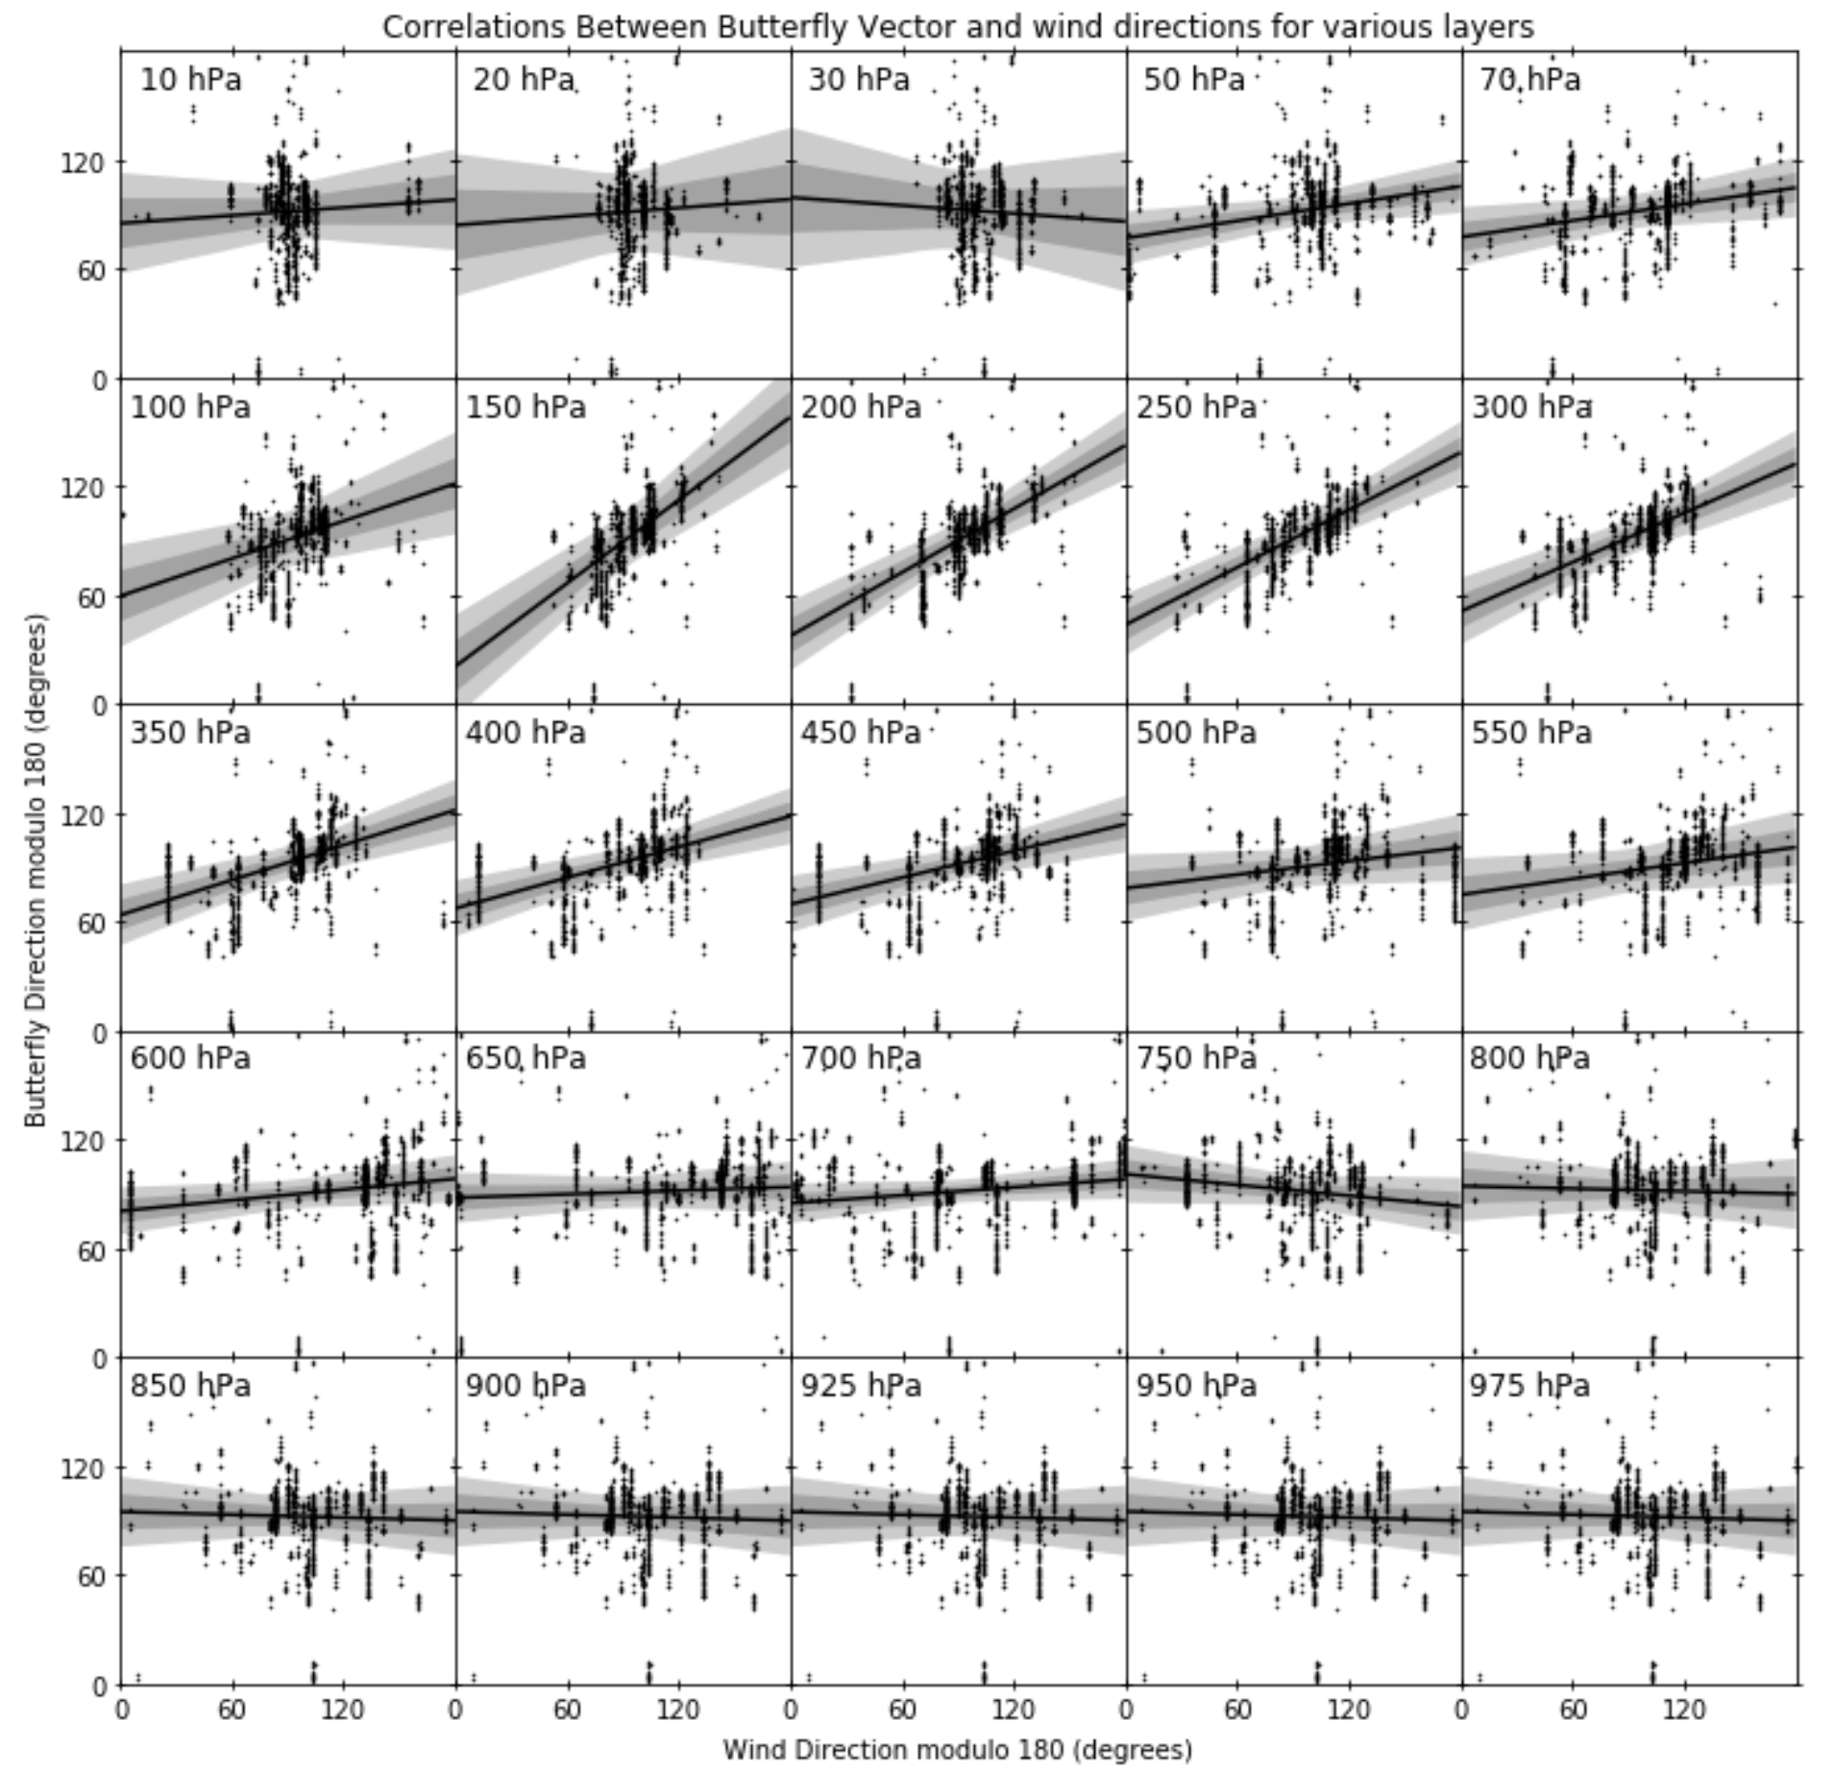
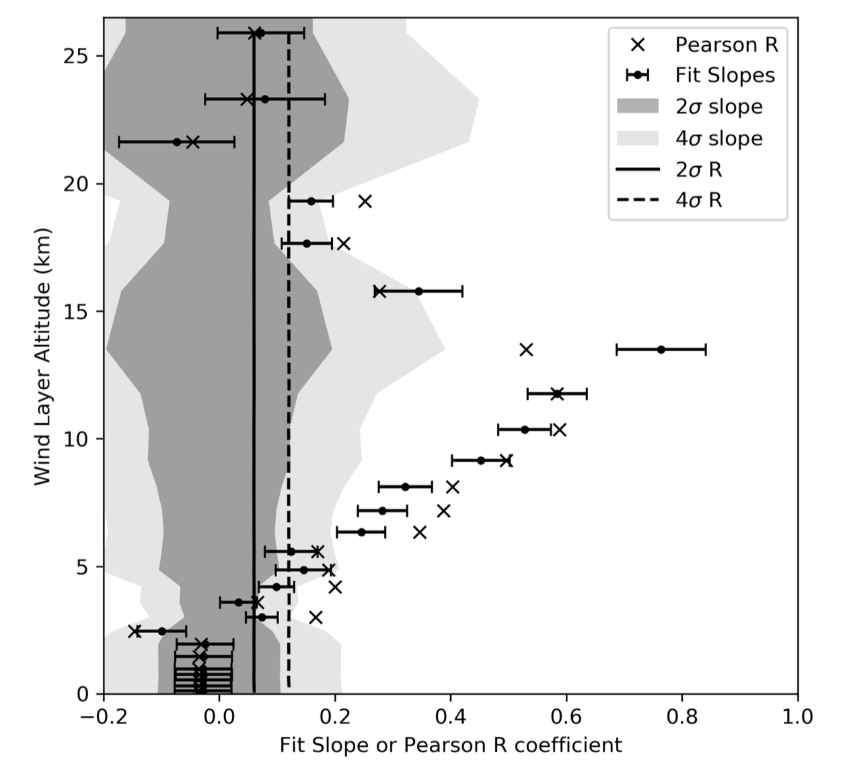
Servolag and wind-driven halo: pinning down the culprit
Madurowicz et al. 2018

Slide 16
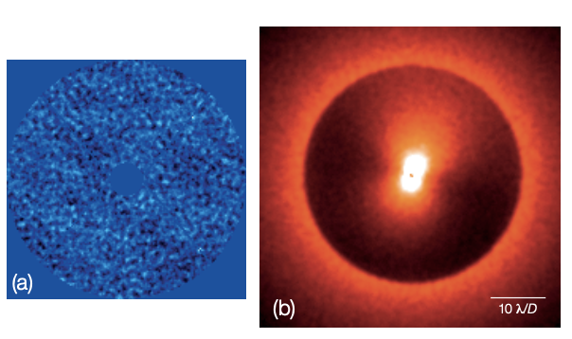
Servolag and wind-driven halo
$σ^{2}=σ_{fitting}^{2}+σ_{alias}^{2}$+ $σ_{servolag}^{2}$+ $σ_{noise}^{2}$+ $σ_{calib}^{2}$+ $σ_{NCPA}^{2}$
$$σ_{servo}^{2}={\left(\frac{τ}{τ_{0}}\right)}^{5/3}$$
Focal plane coronagraphic image
Other evidence from high-altitude winds: asymmetric butterfly pattern (Cantalloube et al. 2018)
Mitigation strategies:
  Higher loop frequency (e.g. Subaru @3.6kHz, future SAXO+ @3kHz)
  Predictive control algorithms
  Choose well your observing slot
Residual phase (pupil plane)

Slide 17
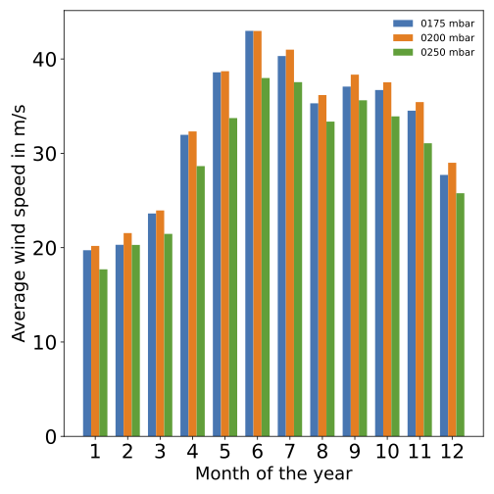
Servolag and wind-driven halo
$σ^{2}=σ_{fitting}^{2}+σ_{alias}^{2}$+ $σ_{servolag}^{2}$+ $σ_{noise}^{2}$+ $σ_{calib}^{2}$+ $σ_{NCPA}^{2}$
$$σ_{servo}^{2}={\left(\frac{τ}{τ_{0}}\right)}^{5/3}$$
Other evidence from high-altitude winds: asymmetric butterfly pattern (Cantalloube et al. 2018)
Mitigation strategies:
  Higher loop frequency (e.g. Subaru @3.6kHz, future SAXO+ @3kHz)
  Predictive control algorithms
  Choose well your observing slot
All months are not equal
Monthly averaged wind speeds @VLT
January-March are far better in Chile

Slide 18
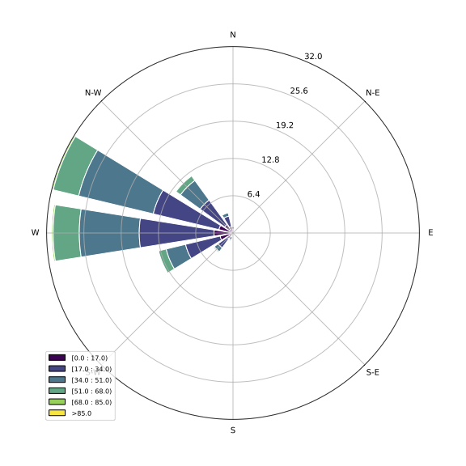
Servolag and wind-driven halo
$σ^{2}=σ_{fitting}^{2}+σ_{alias}^{2}$+ $σ_{servolag}^{2}$+ $σ_{noise}^{2}$+ $σ_{calib}^{2}$+ $σ_{NCPA}^{2}$
$$σ_{servo}^{2}={\left(\frac{τ}{τ_{0}}\right)}^{5/3}$$
Other evidence from high-altitude winds: asymmetric butterfly pattern (Cantalloube et al. 2018)
Mitigation strategies:
  Higher loop frequency (e.g. SCeXAO @3.6kHz, MagAO-X @2-4kHz, future SPHERE+ @3kHz)
  Predictive control algorithms
  Choose well your observing slot
All months are not equal
All directions are not equal
200mbar wind rose @ VLT (color=speed, radius=occurence in %)
Caution with E-W edge-on disks !

Slide 19
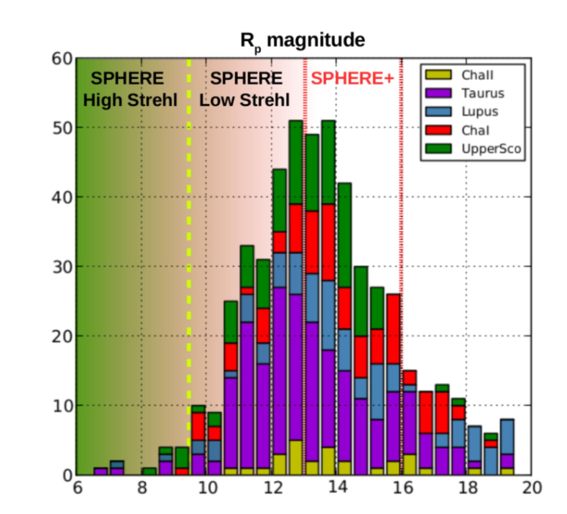
WFS photon noise
$σ^{2}=σ_{fitting}^{2}+σ_{alias}^{2}$+ $σ_{servolag}^{2}$+ $σ_{noise}^{2}$+ $σ_{calib}^{2}$+ $σ_{NCPA}^{2}$
For faint stars, becomes the dominant term → Sensitive cameras are favoured (EMCCD on most instruments including GPI2.0)
Noise propagation is not the same for all WFS (Guyon et al. 2005)
→ Pyramid WFS are favoured, with a higher sensitivity to low-order aberrations:
SCeXAO, MagAO, KPIC
Baseline for GPI2.0, SPHERE+ 2nd stage AO
To reach redder and fainter stars, sensing in the NIR is favoured
# known protoplanetary disks
cf Tuesday talk by B. Jansen-Clem
R magnitude
SPHERE+ white paper, Boccaletti et al. 2021
Notes:
As shown previously, perf degrades for fainter star

Slide 20
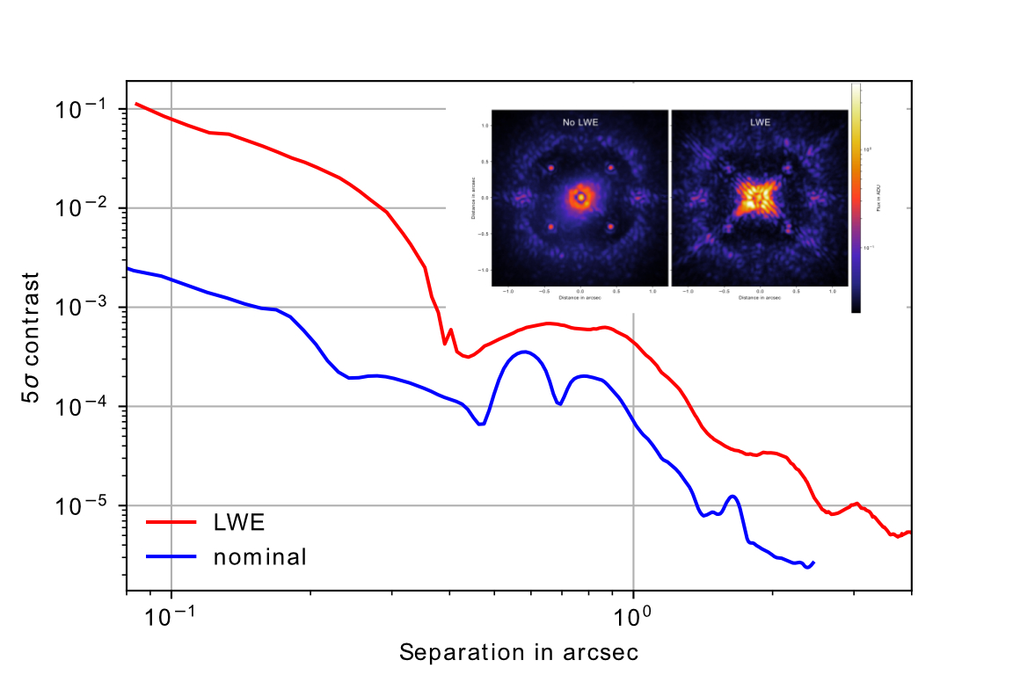
Specific calibration problems: low wind effect
$σ^{2}=σ_{fitting}^{2}+σ_{alias}^{2}$+ $σ_{servolag}^{2}$+ $σ_{noise}^{2}$+ $σ_{calib}^{2}$+ $σ_{NCPA}^{2}$
Factor 50
Contrast degradation up to a factor 50, affecting the best nights !

Slide 21
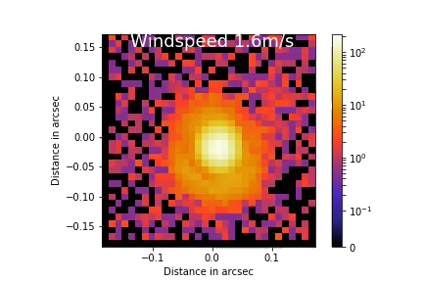
Specific calibration problems: low wind effect
$σ^{2}=σ_{fitting}^{2}+σ_{alias}^{2}$+ $σ_{servolag}^{2}$+ $σ_{noise}^{2}$+ $σ_{calib}^{2}$+ $σ_{NCPA}^{2}$

Slide 22
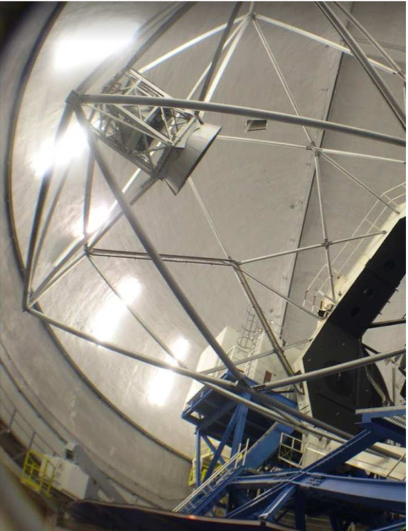
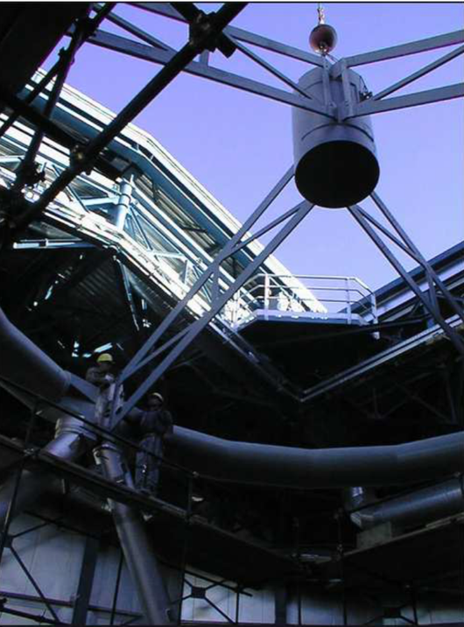
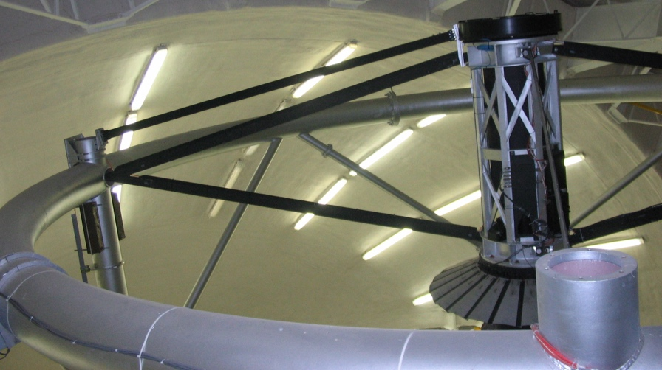
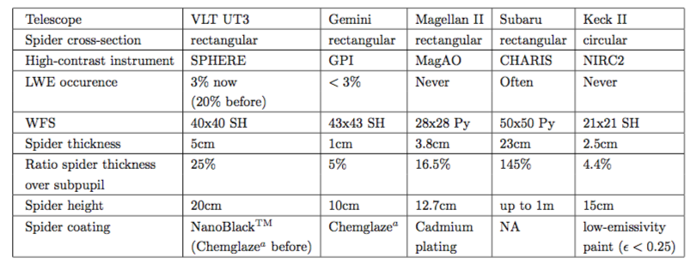
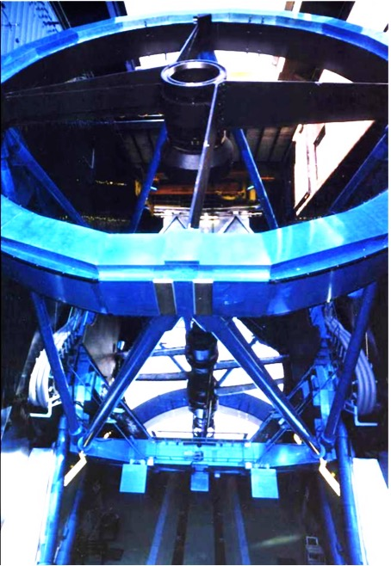
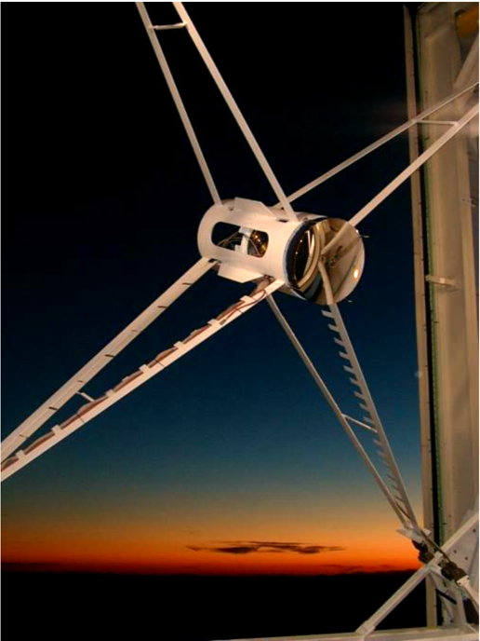
All telescopes are not equal
Gemini South
Keck II
VLT UT3
Subaru
Magellan (Clay)
Spider design makes a clear difference

Slide 23
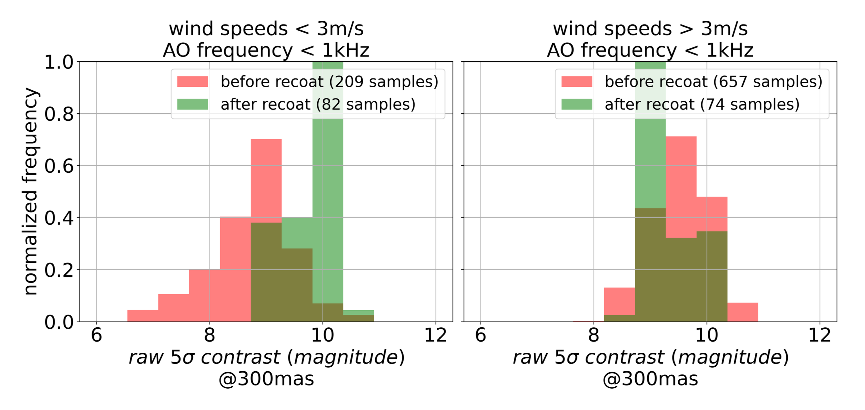
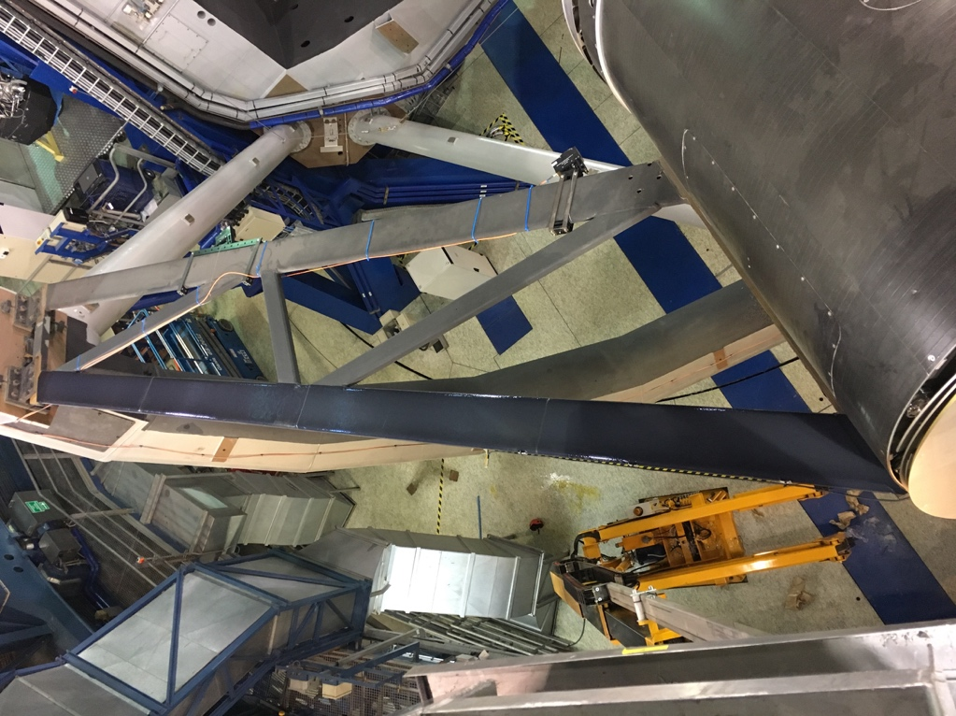
Mitigation strategies
Low-emissivity coating applied between August and November 2017
M2 tower
Uncoated spider
Coated spider
Picture: P. Bourget
Courtney-Barrer et al. 2023
Milli et al. 2018
Software solutions: use of a dedicated modal basis for AO control, pupil piston/tip/tilt (Pourré et al. 2023)
Focal plane WFS (e.g. N’diaye et al. 2018, Vievard et al. 2019, Bos et al. 2020)

Slide 24
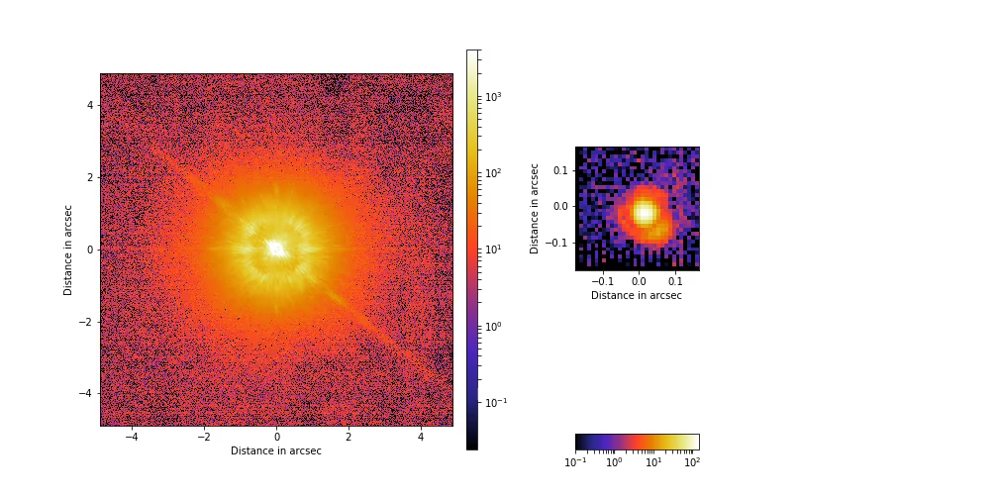
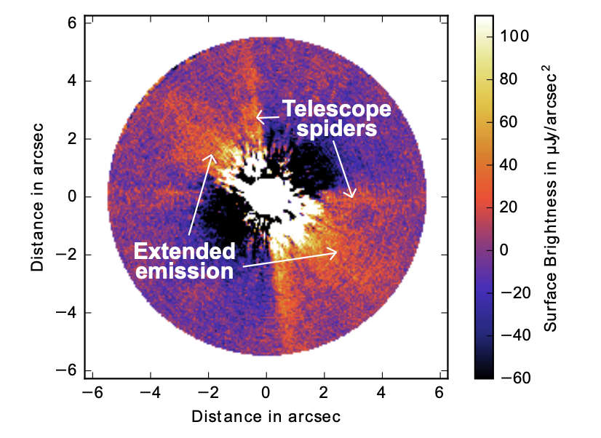
Specific calibration problems: low wind effects
$σ^{2}=σ_{fitting}^{2}+σ_{alias}^{2}$+ $σ_{servolag}^{2}$+ $σ_{noise}^{2}$+ $σ_{calib}^{2}$+ $σ_{NCPA}^{2}$
Illusive disk of HD206893 (Milli et al. 2017)
Beware of misinterpretation

Slide 25
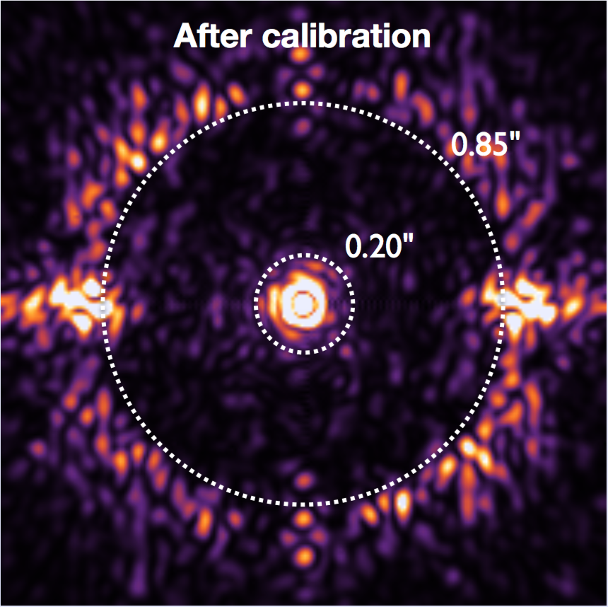
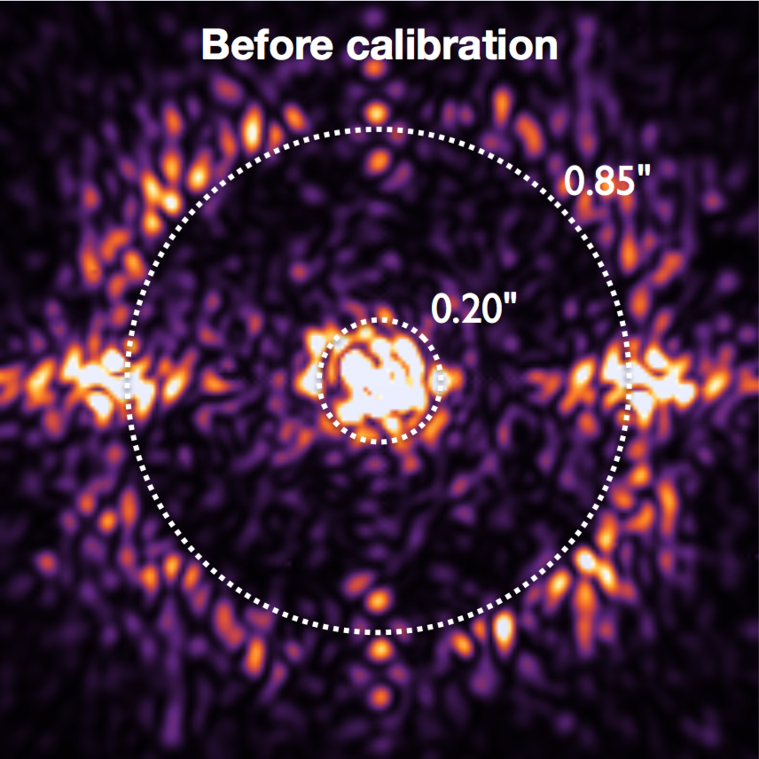
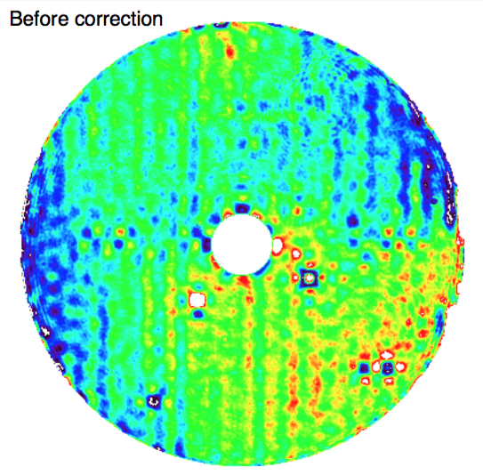

NCPA
$σ^{2}=σ_{fitting}^{2}+σ_{alias}^{2}$+ $σ_{servolag}^{2}$+ $σ_{noise}^{2}$+ $σ_{calib}^{2}$+ $σ_{NCPA}^{2}$
Residual wavefront
Example of a NCPA calibration strategy with the Zernike WFS
~45nm RMS
~35nm RMS
N’Diaye et al. 2016
Internal source
Vigan et al. 2019,2022
cf Tuesday talk by B. Jensen-Clem

Slide 26

Focal plane techniques to make a dark hole
Dark hole techniques do work on-sky in good conditions (when quasi-static speckles limit the contrast rather than the turbulence)
Mazoyer et al. 2024, Potier et al. 2020,2022
cf Tuesday talk by B. Jensen-Clem

Slide 27
Lessons learnt in observing strategy and postprocessing
Notes:
You’ve done your best in hardware, what else can you do?

Slide 28

Use of telemetry data
Deconvolved images of Vesta
Dawn model
AO telemetry data carry information about residuals statistics, hence the PSF:
  PSF reconstruction (from Véran+ 1997 to now, e.g. Fetick et al. 2019)
  Or support to deconvolution : relevant priors are beneficial (e.g. Lau et al. 2023)
Use in high contrast scenes ?
  Active field of research
  Relation between AO internal data and ultimate contrast performance not trivial
Fetick et al. 2019

Slide 29




Revisited strategies:
Reference differential imaging
A) (Carefully selected)
Single reference
  similar visual magnitude for AO performance
  close on sky and in time
  similar turbulence conditions
B) Large library of references
  Needs a large set of images available
  No additional observing time required
  Needs to identify the subset of adequate targets
Xie et al. 2023

Slide 30


Single reference differential imaging: star hopping
Example with SPHERE IRDIS on a binary system with 9” separation and similar R magnitude
Combined offset done at the telescope → fast transition between A and B less than 20s (best case)
Duty cycle of 2min20
Telescope pointing A
Telescope pointing B

Slide 31


Single reference differential imaging: results
β Pic b shortest separation IFS detection (ADI, 2.5h)
Contrast 1.5.10⁻⁴
Separation 125mas
Lagrange et al. 2018
Fake planet
Star hoping (1.5h)
Simulated planet
of 2.10⁻⁵ contrast at 150mas
SPHERE Manual
Wahhaj et al. 2021

Slide 32

The contrast floor in polarimetry
Typical contrast curve in PDI with VLT/SPHERE (45min on-source)
Contrast typically limited by photon noise from 0.5 arcsec (depending on conditions) up to the RON / background limit
PDI is very efficient because of the differential imaging is simultaneous
IRDAP, Van Holstein et al. 2020

Slide 33

The contrast floor in optical polarimetry
Best contrasts on a Cen B with SPHERE / Zimpol (2h observations)
  0.2''-0.4'': ~3.10⁻⁷
  0.6''-0.8'': ~3.10⁻⁸
  > 1.0'': ~1.10⁻⁸
Separation in arcsec
Hunziker et al. 2020
Schmid et al. 2018

Slide 34


Post-processing is key
Obs night summary as seen from SPHERE telemetry
cf Tuesday talk by F. Cantalloube
A dedicated processing center (e.g. High Contrast Data Center) is very beneficial.
It combines in the same place all information relevent for signal extraction and interpretation
  environmental data from the observatory or beyond (GCM)
  Telemetry and engineering data
  Science and calibration data
It allows efficient building of reference library for RDI
Notes:
Data center: does not replace instrument expertise and pipelines or ESO archive, but build on them and with benefit to them

Slide 35


Take home messages
Many contrast killers in current XAO instruments but those 2 are probably the most limiting
Dedicated observing strategies or postprocessing can mitigate many of those current limitations
Upgrades are on-going to tackle remaining limitations and act as demonstrators for future XAO on ELTs.
Wind-driven halo
Low-order aberrations
Cantalloube et al. 2019

Slide 36





Upgrades coming or already on-sky
XAO systems are sensitive to very fine effects poorly known/studied before
  in the atmosphere (evolution of high-altitude wind, outer scale pattern…)
  in the dome (enhanced dome seeing due to global warming, low-wind effects, vibrations)
Servolag is a main contributor to error at small separations → upgrades with higher loop frequency and predictive control
Focal plane techniques will be key to further dig the contrast and remove remaining instrumental speckles at short separation
New parameter space also for fainter and redder targets

Slide 37

2030 horizon
Challenge : diffraction and wavefront control strategy over large, segmented, heavily obscured apertures
First-light instruments will have one HC mode (among others)

Slide 38
Backup slides

Slide 39

Star magnitude distribution
G magnitude

