Slide 1

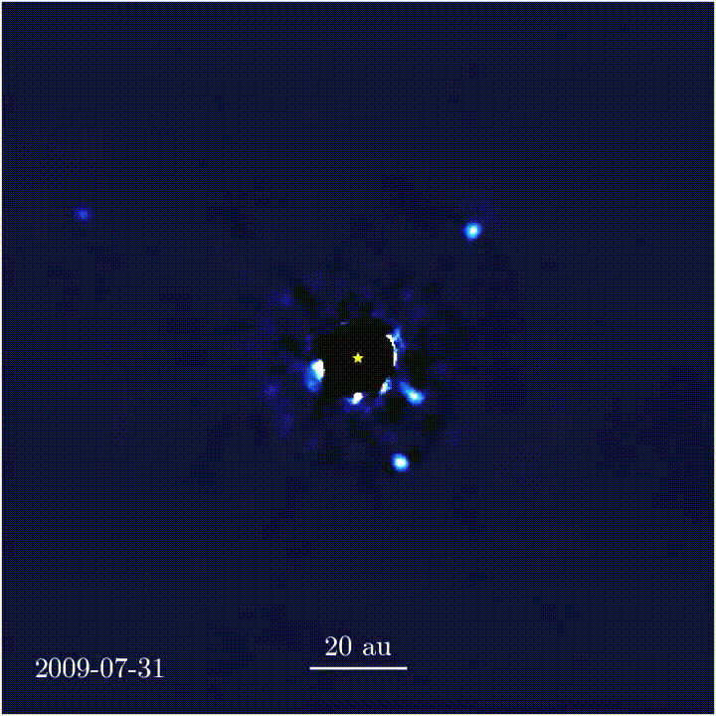

HR 8799
Jason Wang (Caltech)
Christian Marois (NRC Herzberg)

Slide 2
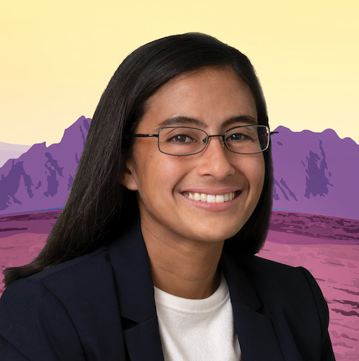

HR 8799
Jason Wang (Caltech)
Christian Marois (NRC Herzberg)
Anjali Tripathi
Science Ambassador,
NASA Exoplanet Exploration Program,
NASA/JPL-Caltech
Government sponsorship acknowledged.

Slide 3
HR 8799
Jason Wang (Caltech)
Christian Marois (NRC Herzberg)
WHO
HOW
HWO

Slide 4
WHO
HOW
HWO
Careers Panel
Working with NASA,
The Decadal Survey,
Mission Formulation
The Road to the Habitable Worlds Observatory

Slide 5
WHO
HOW
HWO
Careers Panel
Working with NASA,
The Decadal Survey,
Mission Formulation
The Road to the Habitable Worlds Observatory
Talks -> Speaker chats
Hybrid, 12-2:45 In-person, 2:45-3:45

Slide 6
Careers Panel
Working with NASA,
The Decadal Survey,
Mission Formulation
The Road to the Habitable Worlds Observatory
Anjali Tripathi
Science Ambassador, NASA Exoplanet Exploration Program, NASA / JPL
Legislative Affairs Specialist, NASA/JPL
Principal Systems Engineer, RTX
Act. Executive Director, National Science & Technology Council
White House Fellow, Office of Science and Technology Policy + US Department of Agriculture
- - - - - - - - - - - - - - - - - - - - - - - - - - - -
PhD & AM, Astronomy and Astrophysics, Harvard
MPhil, Astronomy, University of Cambridge
SB, Physics, MIT
-> Speaker chats
^{In-person, 2:45-3:45}

Slide 7
WHO
HOW
HWO
CAREERS PANEL
Steps to become an astronomer:
Assistant professor
My Path
Based on research, science communication, mentoring,
non-astronomy experience (earthquakes, engineering, disasters, waste)
Grad school (PhD)
Post-doctoral fellowship (0-3 times)
Grad school (PhD)
White House Fellowship
(USDA + OSTP)
Technical staff
Raytheon
JPL
Smithsonian (Associate)

Slide 8
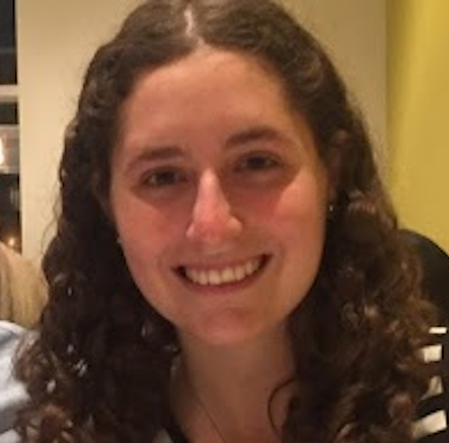
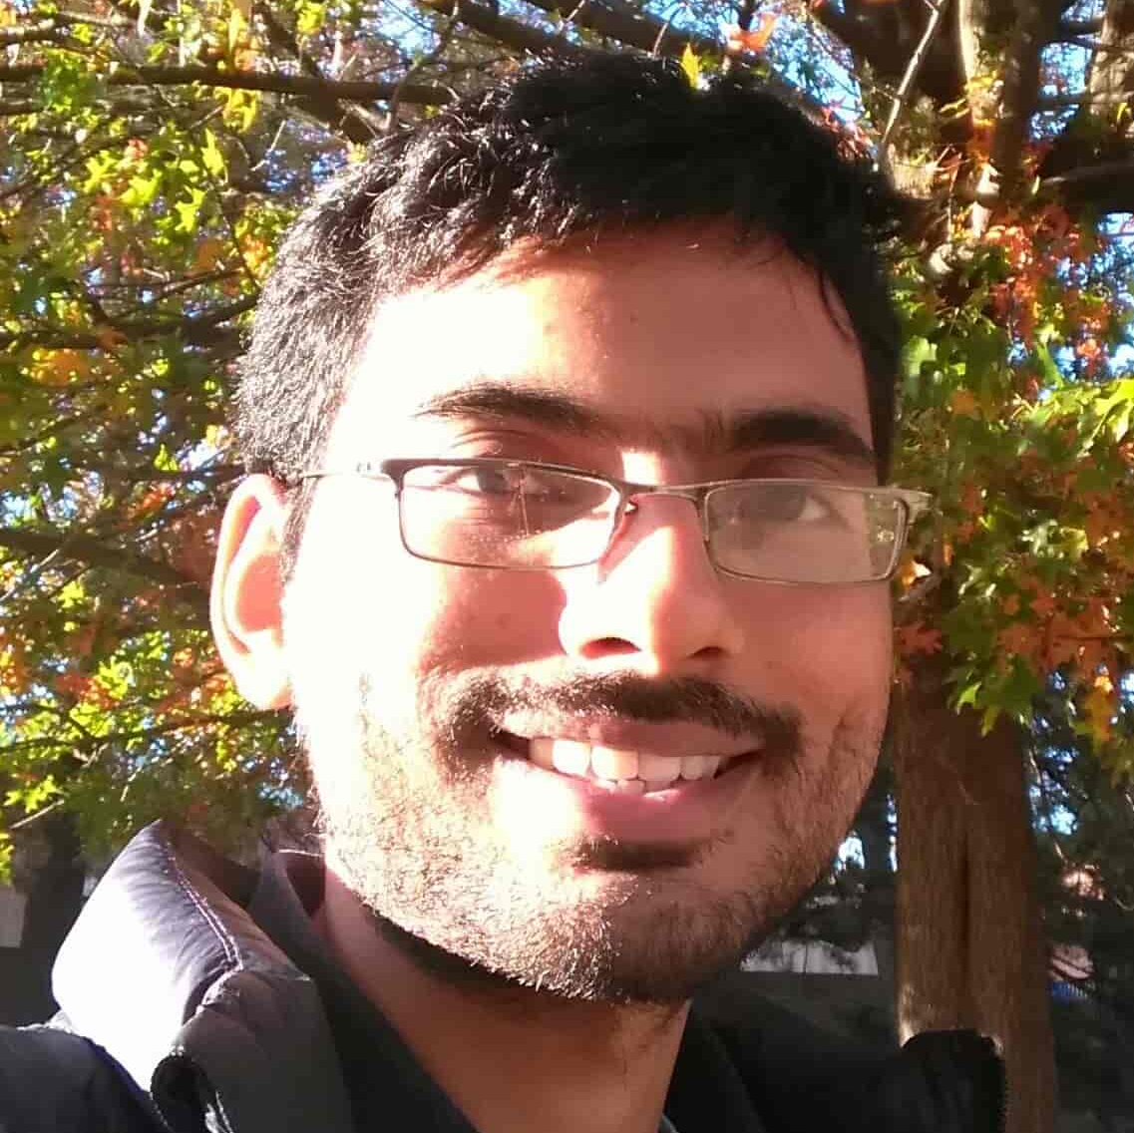

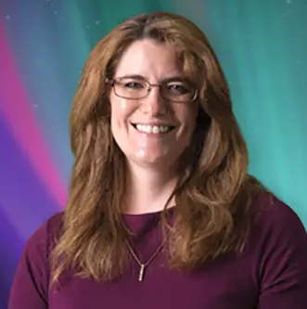
Sarah Blunt
NSF Astronomy & Astrophysics Postdoctoral Fellow (Incoming),
UC Santa Cruz
CIERA Postdoctoral Fellow, Northwestern University
- - - - - - - - - - - - - - - - - - - - - - - - - - - -
PhD & MS, Astrophysics, Caltech
Cert. of Practice in University Teaching
BS, Mathematical Physics,
Brown University
Pradip Gatkine
Assistant Professor,
Physics & Astronomy, UCLA
Hubble Fellow, Caltech
Lee Prize Postdoctoral Fellow, Caltech
- - - - - - - - - - - - - - - - - - - - - - - - - - - -
PhD & MS, Astronomy,
University of Maryland
B.Tech., Mechanical Engineering,
IIT Bombay
Beth Biller
Professor, Institute for Astronomy, University of Edinburgh
Chancellor’s Fellow, Institute for Astronomy, University of Edinburgh
Star and Planet Formation Fellow,
Max Planck Institute for Astronomy, Heidelberg, Germany
Hubble Fellow, University of Hawaii
- - - - - - - - - - - - - - - - - - - - - - - - - - - -
PhD & MS, Astronomy,
University of Arizona
BA, Astrophysics, Swarthmore College
Dawn Gelino
Manager, NASA Exoplanet Exploration Program, NASA / JPL
Deputy Director, NASA Exoplanet Science Institute, Caltech/IPAC
Science Affairs Lead, NASA Exoplanet Science Institute, Caltech/IPAC
CASS Postdoctoral Fellow, UC San Diego
- - - - - - - - - - - - - - - - - - - - - - - - - - - -
PhD & MS, Astronomy and Astrophysics, New Mexico State University
BS, Physics and Astronomy,
Rensselaer Polytechnic Institute
CAREER PANELISTS

Slide 9

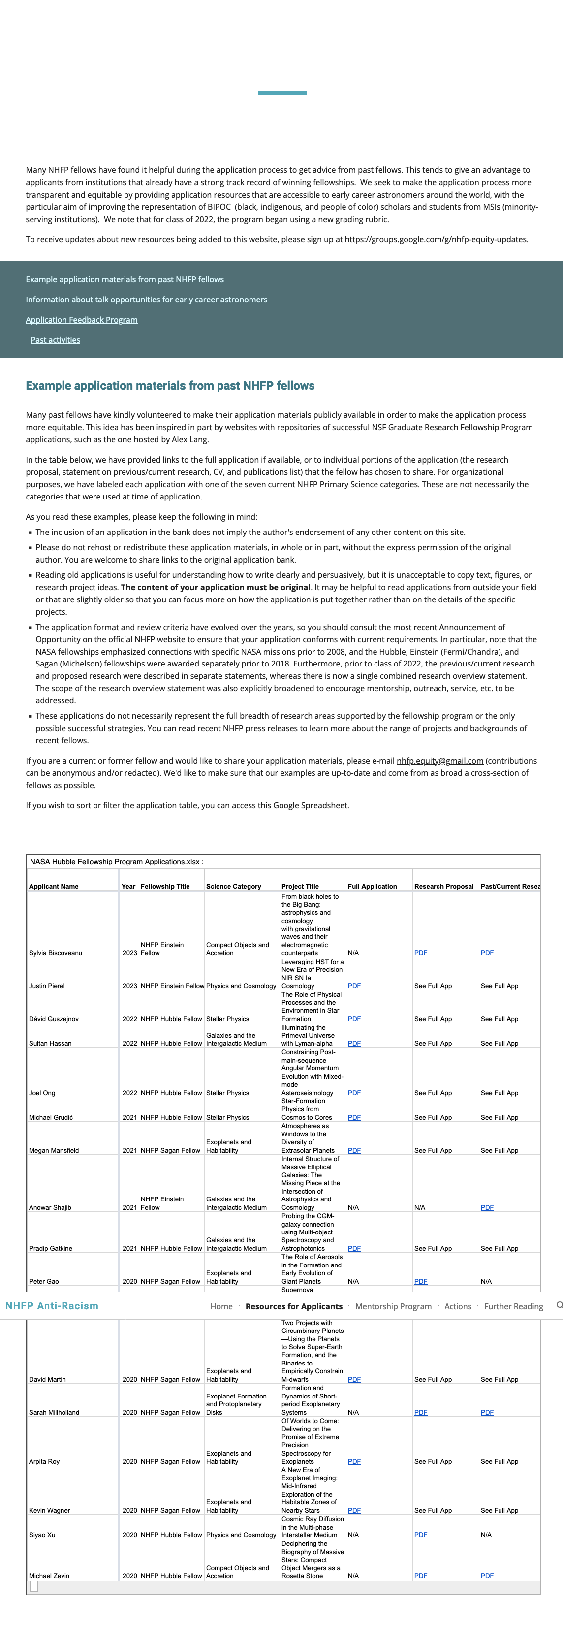
POSTDOC NUTS & BOLTS
Types:
*National Fellowships
(e.g. NHFP (Hubble), NSF AAPF, 51 Peg b, NPP)
*Institutional Fellowships
*PI/Grant-Based
www.nhfp-equity.org
Support
* 1-5 years
* ~$60-90k
(salary + research fund)
Application Components:
*Research Statement
*CV & Publications
*~3 Reference letters
*[Cover letter/Other statements]
*[Interviews]
Timeline
Application Deadlines:
Oct ~ Jan
Decision Response:
Feb 15
Resources:
*Listings: AAS Job Register, EAS Job Directory (Europe)
*Advice: NHFP Anti-Racism Initiative, Astrobetter, Astrobites
& many more online
Notes:
https://sites.psu.edu/pmeszaros/nrc-2010-ranking-of-the-penn-state/

Slide 10
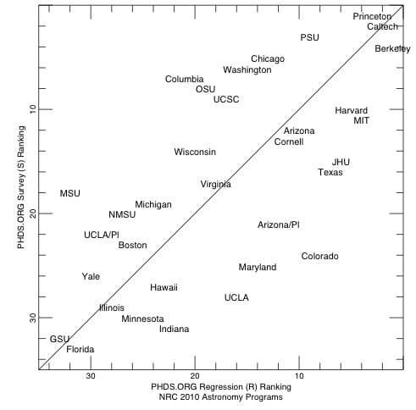
FACULTY & STAFF JOB CONTEXT
US Faculty Job Application Components:
*Research Statement
*Teaching Statement
*[DEI Statement]
*CV & Publications
*Cover letter
*~3 Reference letters
*Visits
US Universities with Highly Ranked Astronomy Programs
University Faculty Tenure-track, Adjunct, Research
Sagan Workshop participants’ institutions:
Staff Scientist Institutions
Observatories, Science Centers, Research Institutes
Federal Labs
Industry
e.g. NOIRLab, IPAC-NExScI (Caltech),
Space Telescope Science Institute, Flatiron Institute,
APL (Johns Hopkins), NASA Goddard, NASA JPL
Northrup Grumman Space Systems
(From P. Meszaros, based on National Research Council 2010 rankings of graduate departments )

Slide 11
WHO
HOW
HWO
UP NEXT:
NASA & MISSION OVERVIEW

Slide 12
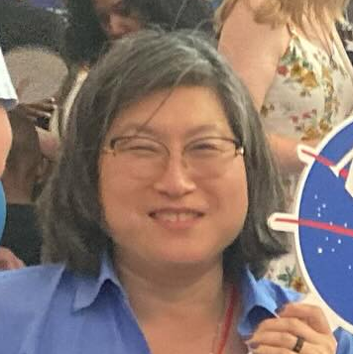
WHO
HOW
HWO
Hannah Jang-Condell
Program Scientist, NASA Exoplanet Exploration Program, NASA HQ
Associate Professor, University of Wyoming
Postdoctoral Researcher, Space Telescope
Science Institute
Michelson Fellow, University of Maryland +
NASA Goddard Space Flight Center
Carnegie Postdoctoral Fellow, Carnegie Institution of Washington, Department of Terrestrial Magnetism
- - - - - - - - - - - - - - - - - - - - - - - - - - - -
PhD & AM, Astronomy and Astrophysics, Harvard
SB, Physics, MIT
WORKING WITH NASA

Slide 13
WHO
HOW
HWO
UP NEXT:
THE DECADAL SURVEY

Slide 14
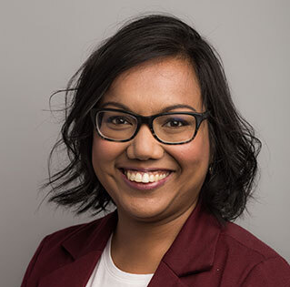
WHO
HOW
HWO
THE DECADAL SURVEY
Tiffany Kataria
Research Scientist, NASA JPL
Postdoctoral Research Fellow, University of Exeter
- - - - - - - - - - - - - - - - - - - - - - - - - - - -
PhD & MS, Planetary Sciences, University of Arizona
BS, Astronomy/Planetary Science, SUNY Stony Brook
BS, Physics, SUNY Stony Brook

Slide 15
WHO
HOW
HWO
MISSION FORMULATION

Slide 16
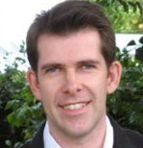
WHO
HOW
HWO
Keith Grogan
Program Manager, Astrophysics & Heliophysics Competed Missions and Technology,
NASA JPL
Manager, Innovation Foundry Proposal Office, NASA/JPL
Group Supervisor, Formulation Systems Engineering Group, NASA/JPL
Research Scientist, NASA/JPL
Postdoctoral Research Fellow, NASA Goddard Space Flight Center
Postdoctoral Researcher, University of Florida
- - - - - - - - - - - - - - - - - - - - - - - - - - - -
PhD, Astronomy, University of Florida
BSc, Astronomy and Astrophysics, University of St. Andrews
MISSION FORMULATION

Slide 17
WHO
HOW
HWO
THE ROAD TO HWO

Slide 18
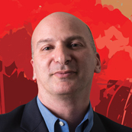
WHO
HOW
HWO
David Ciardi
Deputy Director, NASA Exoplanet Science Institute, Caltech/IPAC
Chief Scientist, NASA Exoplanet Science Institute
Previously: Assoc. Research Scientist, Asst. Research Scientist, Asst. Staff
Assistant Scientist, University of Florida
Postdoctoral Research Scientist, University of Florida
Postdoctoral Research Scientist, University of Wyoming
- - - - - - - - - - - - - - - - - - - - - - - - - - - -
PhD, Physics, University of Wyoming
BA, Astronomy and Physics, Boston University
THE ROAD TO HWO

Slide 19
WHO
HOW
HWO

Slide 20
WHO
HOW
HWO
Talks -> Speaker chats
^{Hybrid, 12-2:45 In-person}

