Slide 1
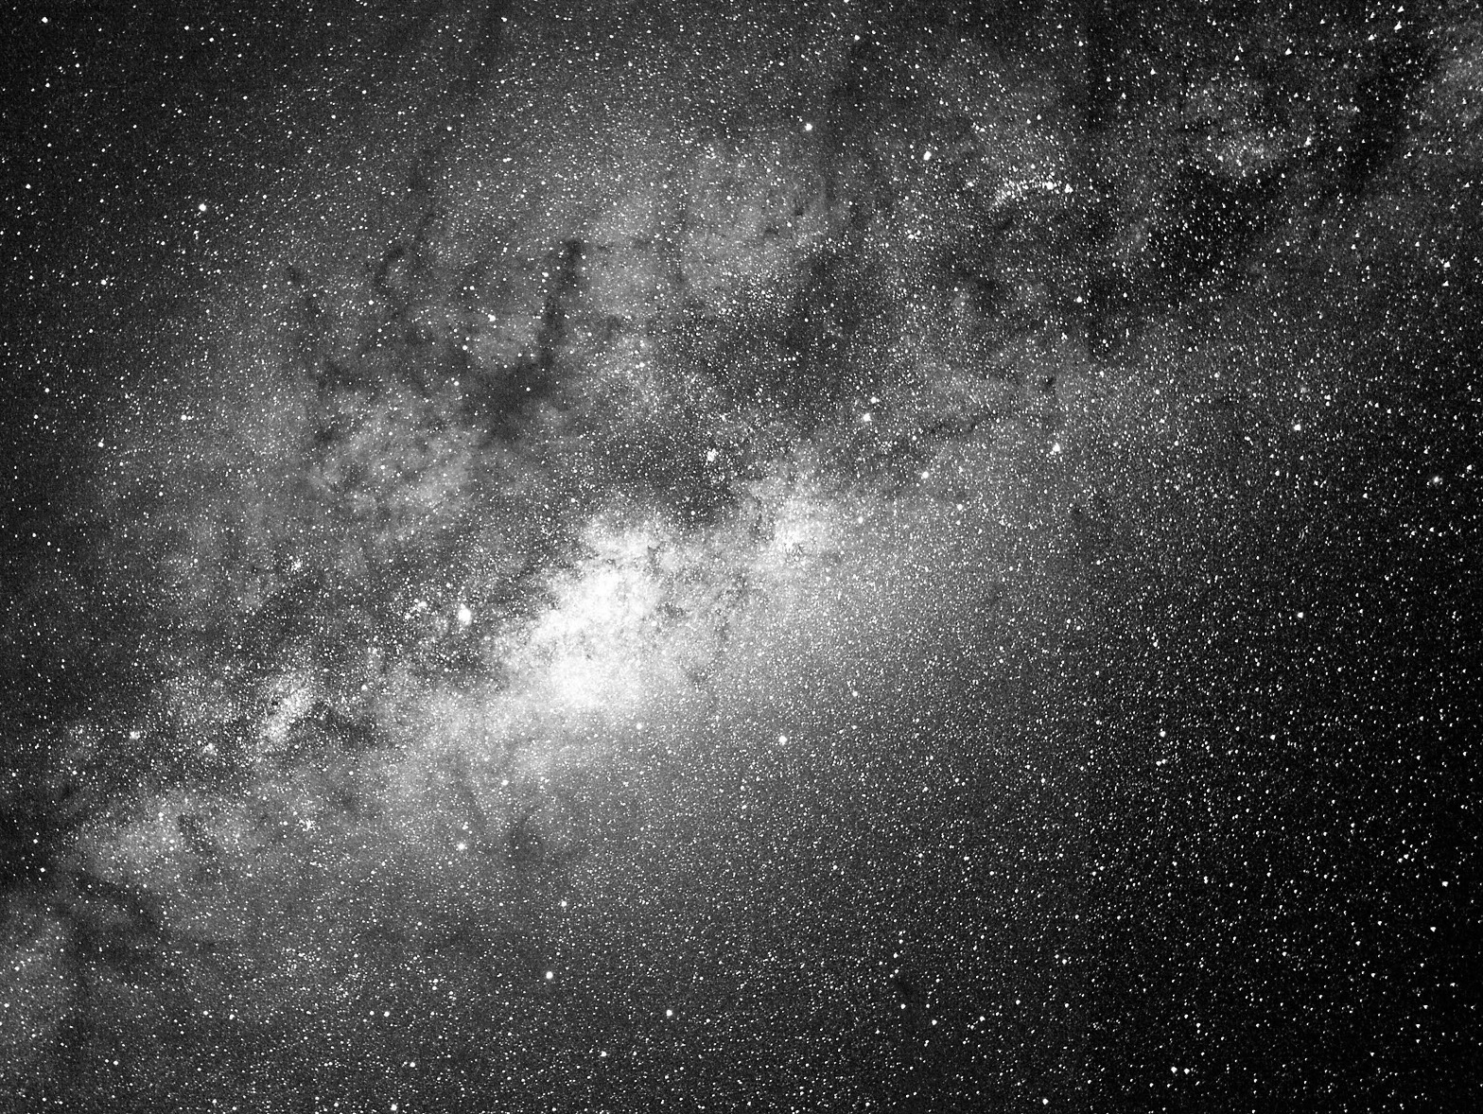
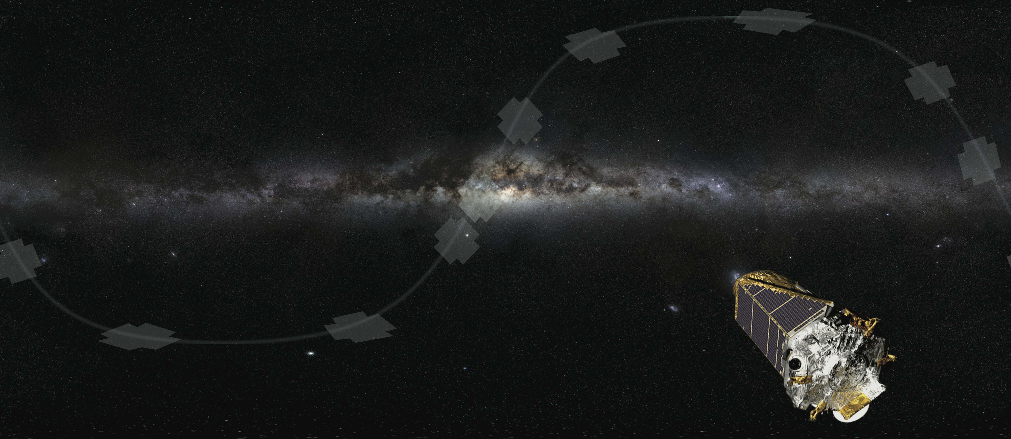

K2’s Campaign 9 (K2C9):
A Joint Ground+Space Microlensing Survey
Calen B. Henderson
Caltech/IPAC-NExScI
Sagan Workshop 2017
M, 7/Aug/2017

Slide 2
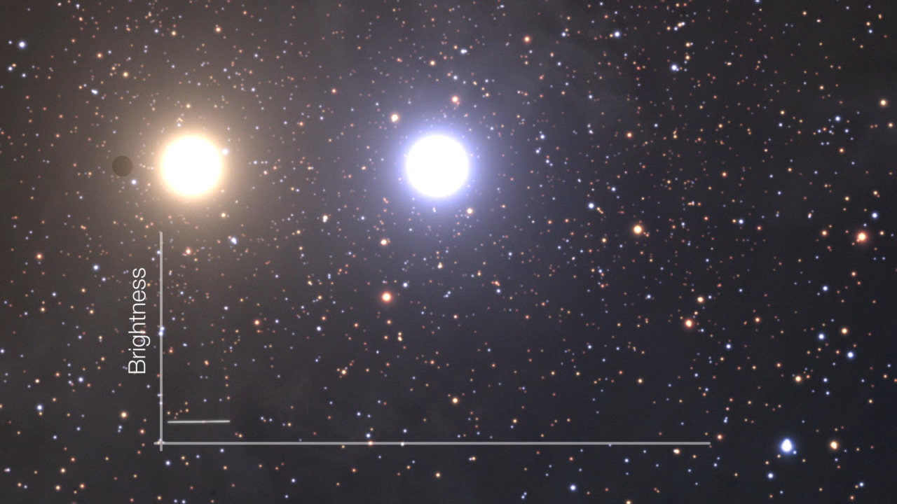
Observational Microlensing
Calen B. Henderson
SSW 2017

Slide 3
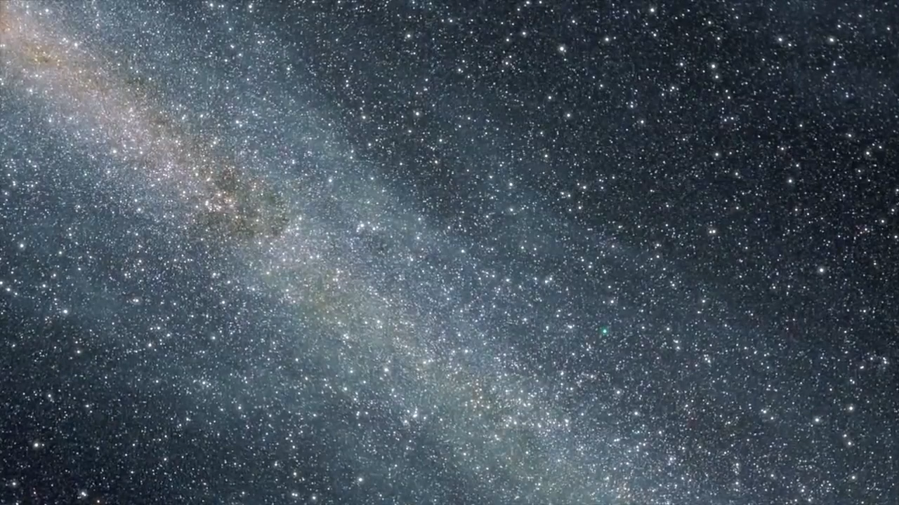
Observational Microlensing
Calen B. Henderson
SSW 2017

Slide 4
Science Goals: Quality versus Quantity
Addressing (relatively) Unexplored Demographic Questions
1
Cold and bound exoplanets
2
Free-floating planets
3
Galactic distribution
Calen B. Henderson
SSW 2017

Slide 5
Science Goals: Quality versus Quantity
Addressing (relatively) Unexplored Demographic Questions
1
Cold and bound exoplanets
See talks by Yossi Shvartzvald, Daisuke Suzuki, & Christian
Clanton Tuesday morning!!!
2
Free-floating planets
3
Galactic distribution
Calen B. Henderson
SSW 2017

Slide 6
Free-floating Planets (FFPs)
Overarching Timescale Distribution
Sumi+ (2011) Nature, 473, 349
Mroz+ (2017) arXiv:1707.07634
Calen B. Henderson
SSW 2017

Slide 7
Free-floating Planets (FFPs)
Overarching Timescale Distribution
See talk by Takahiro Sumi Tuesday morning!!!
Sumi+ (2011) Nature, 473, 349
Mroz+ (2017) arXiv:1707.07634
Calen B. Henderson
SSW 2017

Slide 8
Galactic Distribution of Exoplanets
Using data from the NASA Exoplanet Archive
Henderson+ (2016), PASP, 128, 124401
Calen B. Henderson
SSW 2017
Notes:
34 ulens detections are: ∼4% of the 844 planets
but ∼40% (32 out of 78) of those with Dp > 1000 pc and ∼70% (26 out of 36) of those with Dp > 2000 pc.
Only half of the microlensing-discovered exoplanets have mass constraints either via πE or NIR flux measurements, while the rest rely on characterization through Bayesian analysis. There are thus only 17 microlensing planets (in 15 systems) with directly measured distances. (As D_l increases, theta_E decreases)

Slide 9
Why conduct microlensing from space?
Standard Observables
Single Object Lens
Two-body Lens
Einstein Timescale: t_{E}
(Finite Source Size: ρ)
Mass Ratio: q
Projected Separation: s
?
Parameters
Lens Mass: M_{l}
Lens System Distance: D_{l}
Calen B. Henderson
SSW 2017
Notes:
For a lensing system comprised of a single mass, the most salient observable is the timescale, in which is encoded the mass of the lens, the distance to both the lens and the source, and their relative proper motion.
For a two-body lens system, such as a planet orbiting a star, you can also measure their mass ratio, and their instantaneous, projected, normalized, angular separation.
What we’re interested in are the fundamental physical properties, namely the mass and distance of the lens.

Slide 10
Why conduct microlensing from space?
Standard Observables
Single Object Lens
Two-body Lens
M_{l} = θ_{E} / (κπ_{E})
Einstein Timescale: t_{E}
(Finite Source Size: ρ)
Mass Ratio: q
Projected Separation: s
?
Parameters
Lens Mass: M_{l}
Lens System Distance: D_{l}
Calen B. Henderson
SSW 2017
Notes:
One way to measure the mass is by measuring the satellite parallax, which is given by pi_E here. Theta_E is the angular size of the Einstein radius, which is routinely measured, and kappa is a constant, so measuring the parallax will yield the lens mass.
Refer to Jenn’s talk!

Slide 11
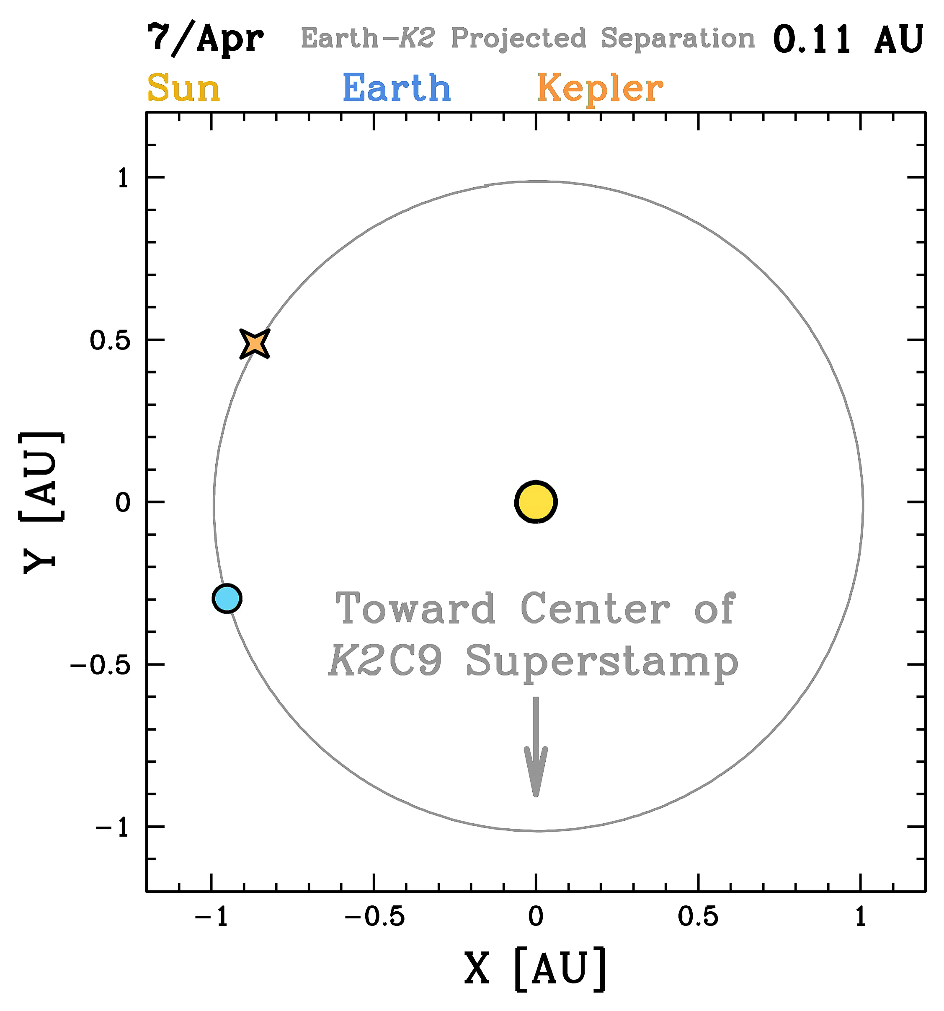
But what does satellite parallax mean?
Henderson+ (2016), PASP, 128, 124401
Found at:
http://www.astronomy.ohio-state.edu/~henderson/k2c9_parallax_animations/
Calen B. Henderson
SSW 2017
Notes:
For the upper left, the bulge, wherein the vast majority of microlensing source stars reside, is located at X=0, and, roughly, Y=-1.69 billion

Slide 12
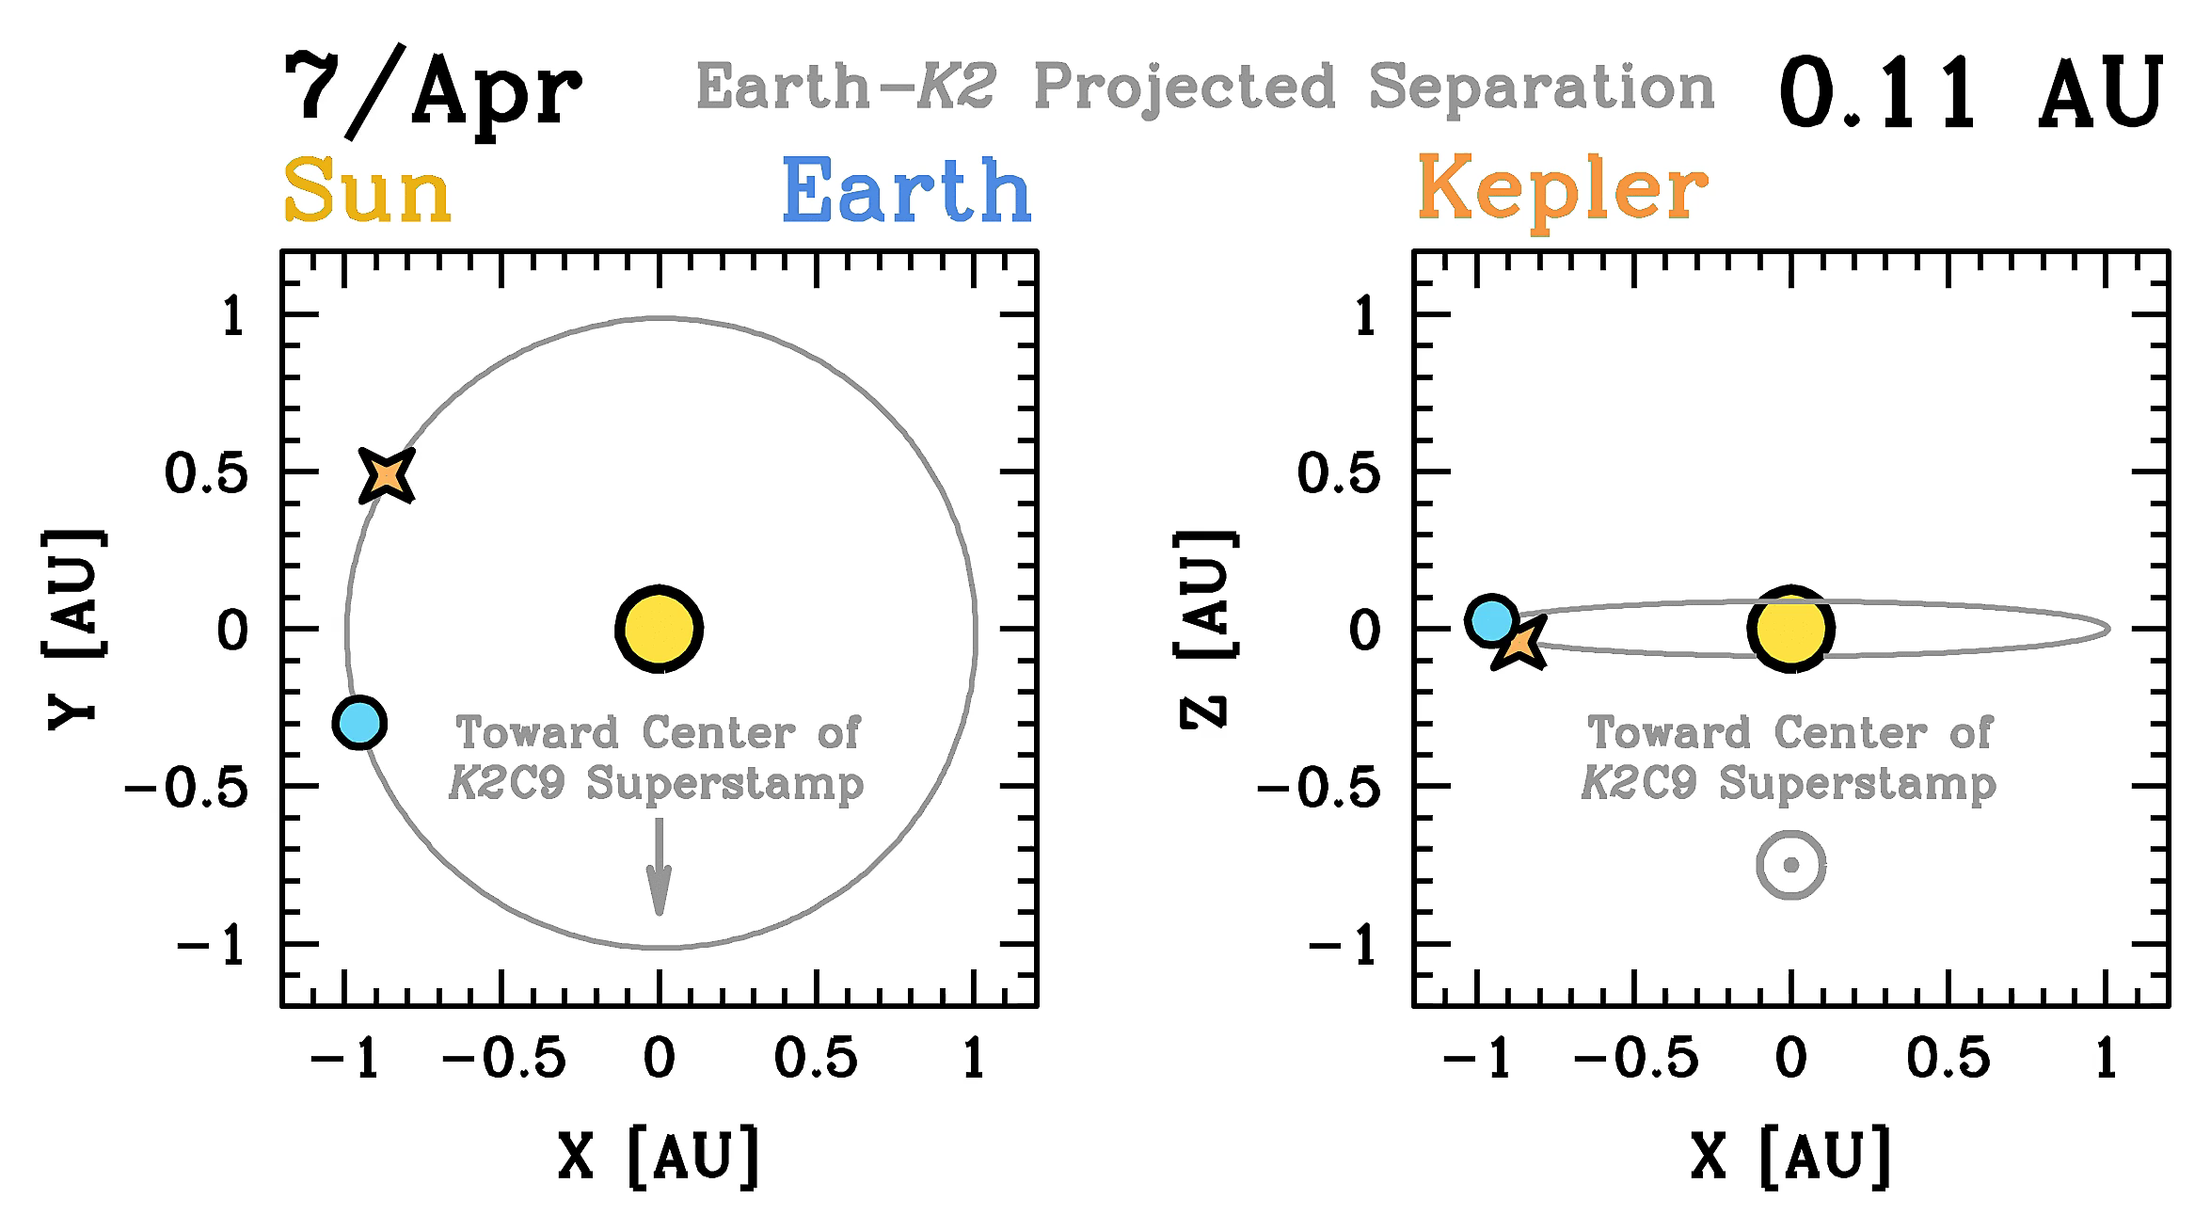
But what does satellite parallax mean?
Henderson+ (2016), PASP, 128, 124401
Found at:
http://www.astronomy.ohio-state.edu/~henderson/k2c9_parallax_animations/
Calen B. Henderson
SSW 2017
Notes:
For the upper right, there is a tilt since the center of the K2C9 superstamp is ~5 degrees south of the ecliptic.

Slide 13
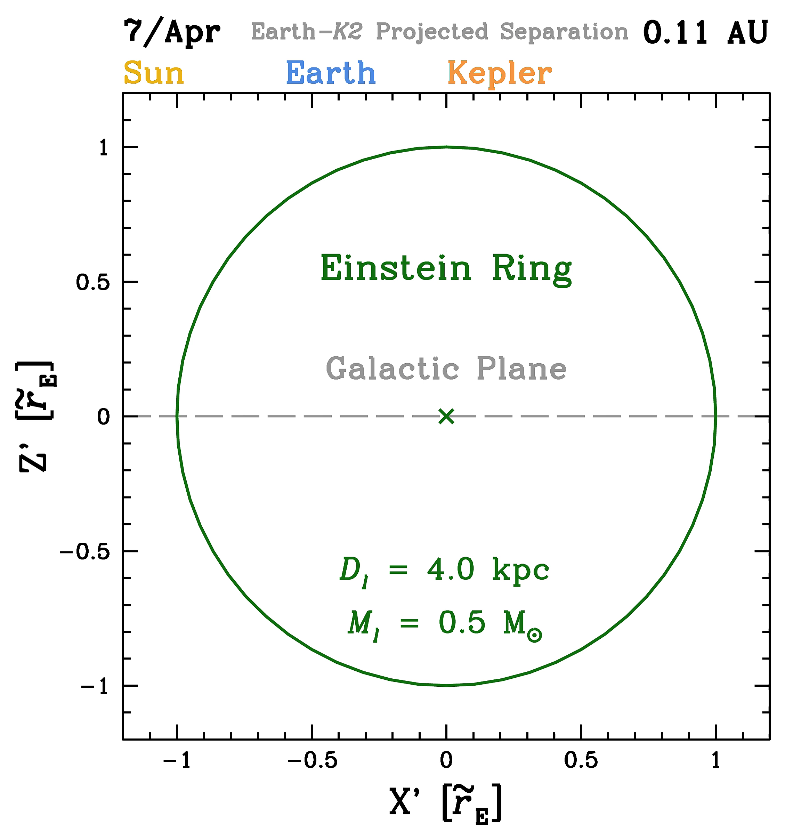
But what does satellite parallax mean?
Henderson+ (2016), PASP, 128, 124401
Found at:
http://www.astronomy.ohio-state.edu/~henderson/k2c9_parallax_animations/
Calen B. Henderson
SSW 2017

Slide 14
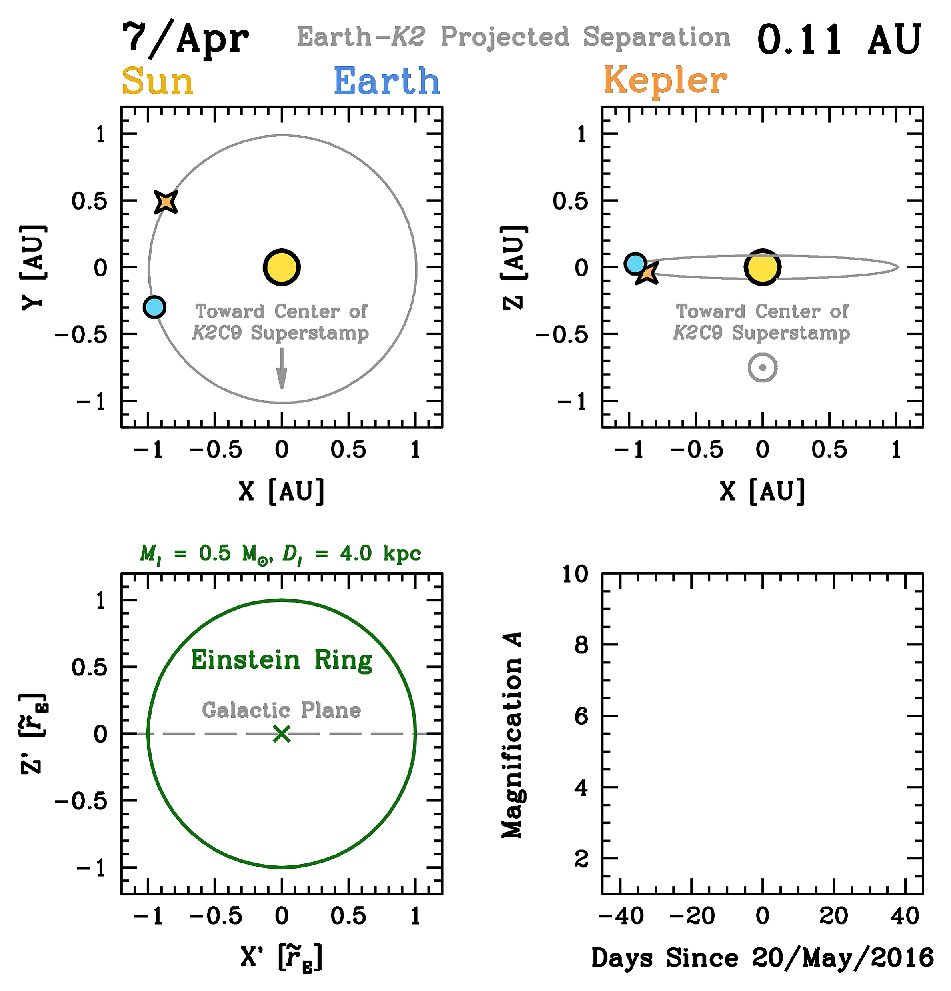
But what does satellite parallax mean?
Henderson+ (2016), PASP, 128, 124401
Found at:
http://www.astronomy.ohio-state.edu/~henderson/k2c9_parallax_animations/
Calen B. Henderson
SSW 2017

Slide 15
K2C9 Sensitivity to Free-floating
Planet π_{E} Measurements
Henderson & Shvartzvald (2016), AJ, 152, 96
Calen B. Henderson
SSW 2017

Slide 16
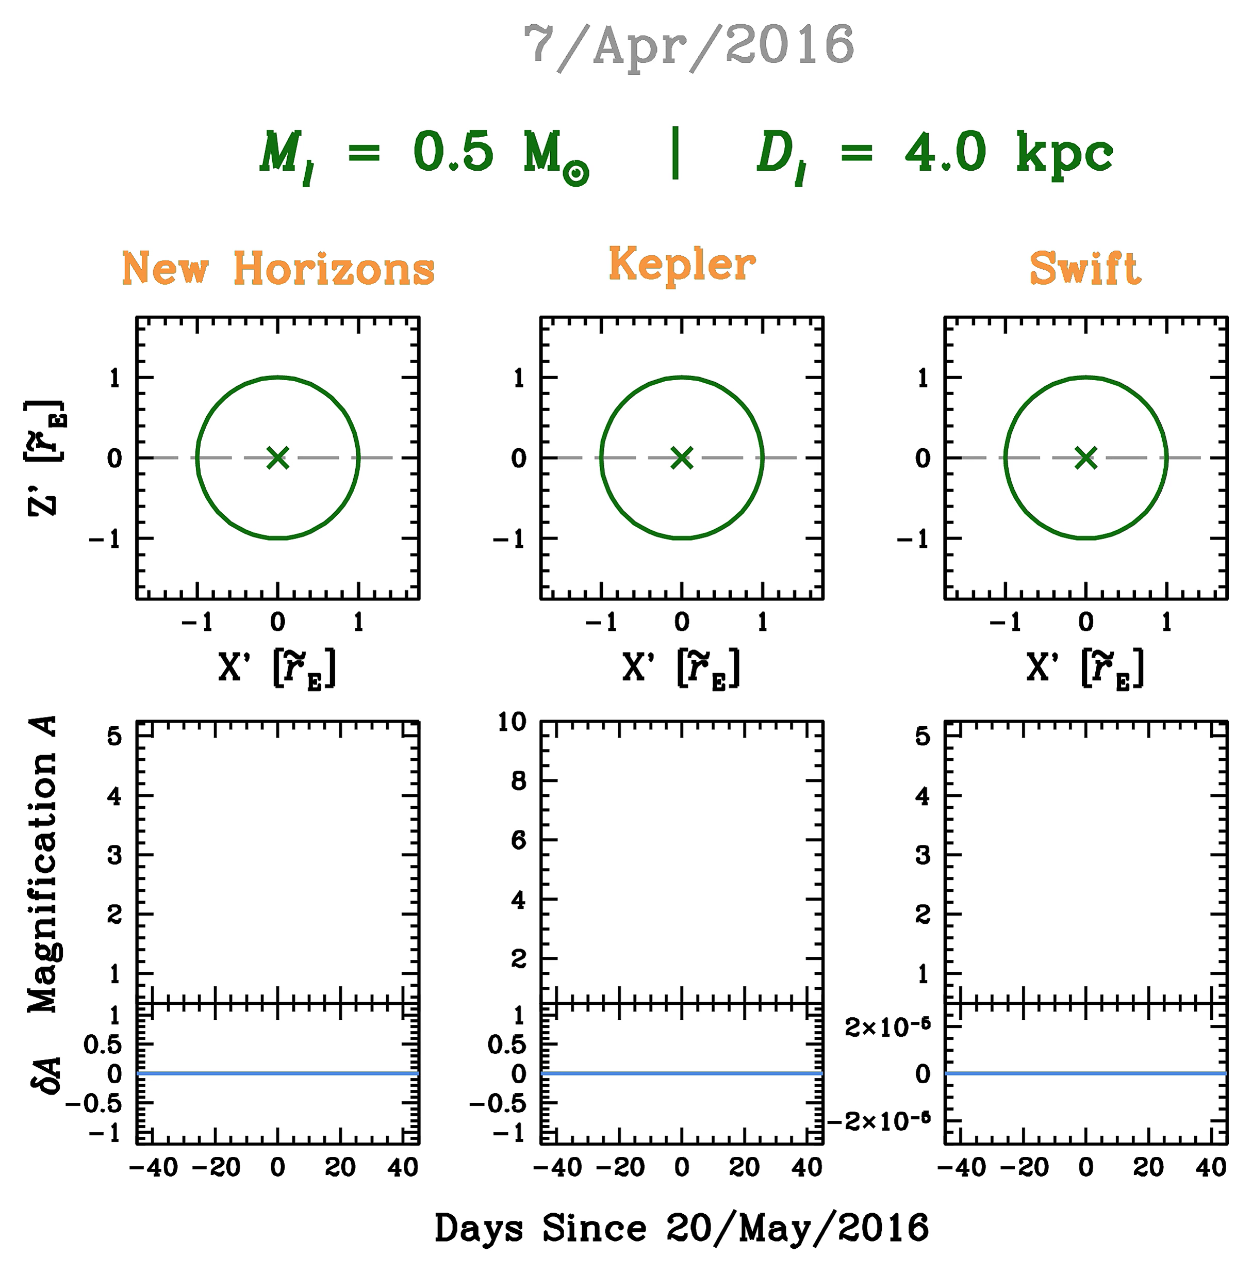
Balance between D⏊ and r_{E}
~
Calen B. Henderson
SSW 2017

Slide 17
K2 Orbit: In Goldilocks Zone!!! ***
*** when considering the physical projection of the Einstein radius onto the observer plane for a roughly typical lens discovered via a microlensing survey toward the center of the Milky Way with a source in the Galactic bulge
Calen B. Henderson
SSW 2017

Slide 18
K2C9: Forward pointing, forward thinking!
Area
Cadence
Events
Start
End
Duration
3.74 deg²
30 min
~7/Apr
~1/Jul
~85 d
Found in Henderson+ (2016), PASP, 128, 124401
Uses methodology of Poleski (2016) MNRAS, 455, 3656
Calen B. Henderson
SSW 2017

Slide 19
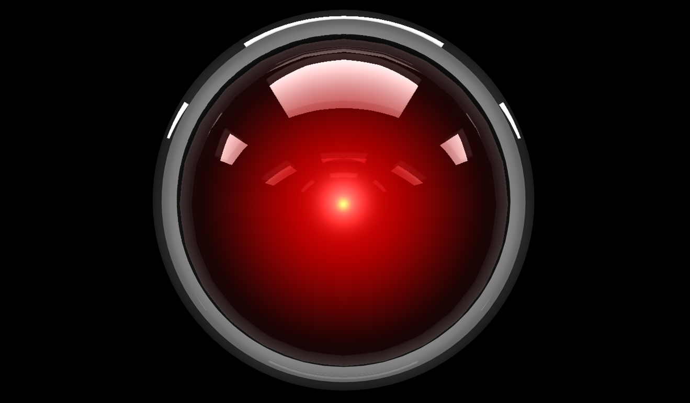
I’m sorry K2 Science Team
I can’t let you do that

Slide 20
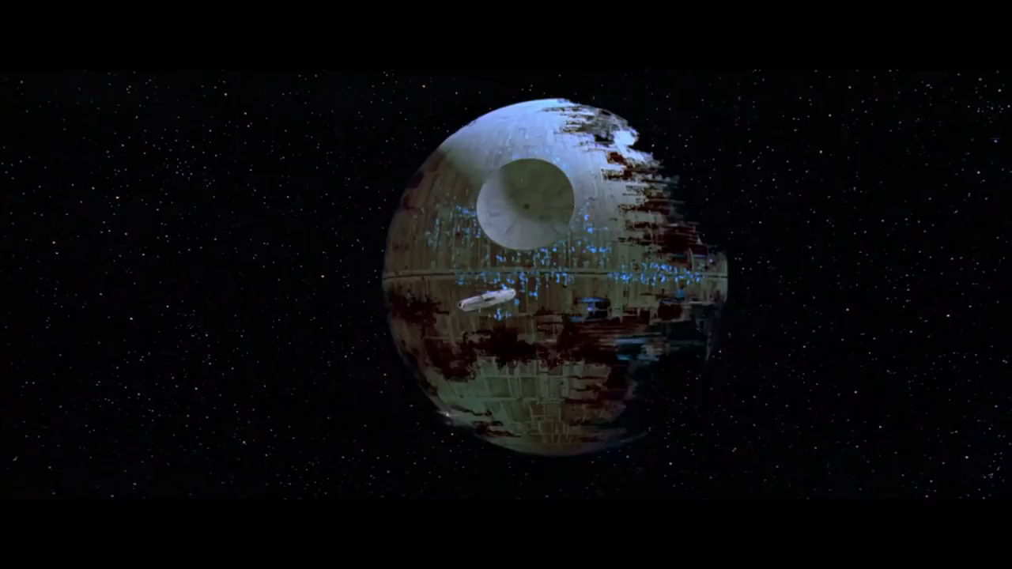

Slide 21
K2C9: Forward pointing, forward thinking!
Area*
Cadence
Events*
Start
End
Duration
3.74 deg²
30 min
109
22/Apr, 14:04 UT
2/Jul, 22:34 UT
71.4 days
Found in Henderson+ (2016), PASP, 128, 124401
Uses methodology of Poleski (2016) MNRAS, 455, 3656
* Postage stamps added later to C9a (34) & C9b (61) target lists for ongoing events (70 unique)
Calen B. Henderson
SSW 2017

Slide 22
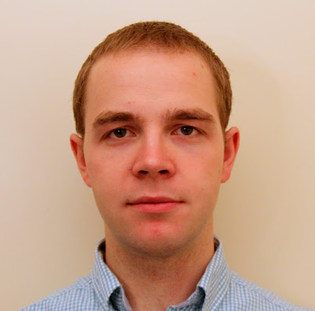
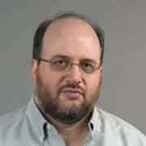
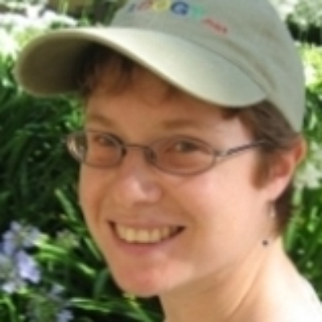
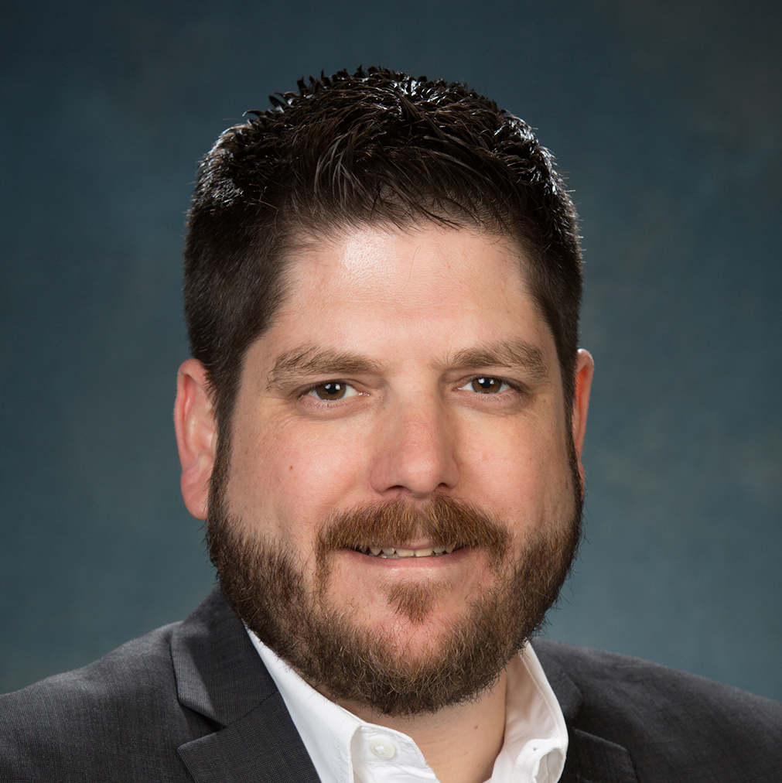
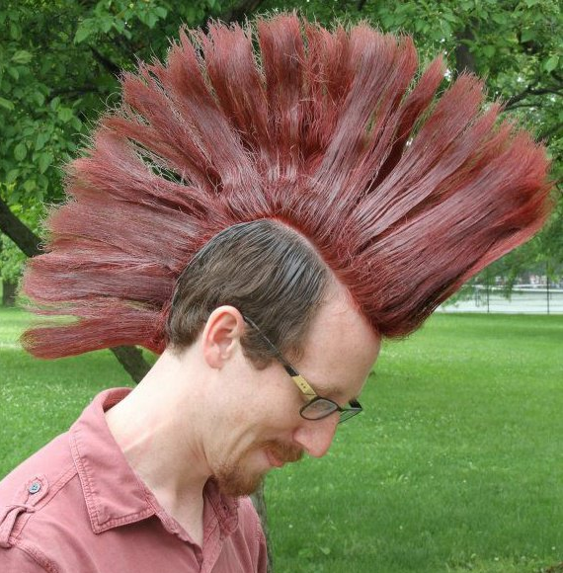

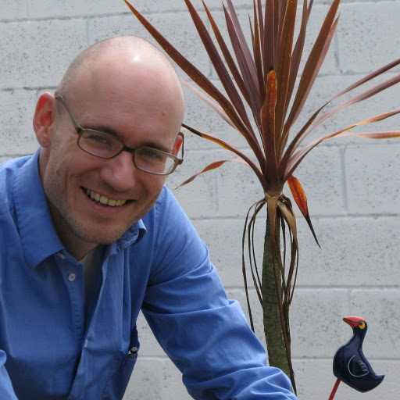
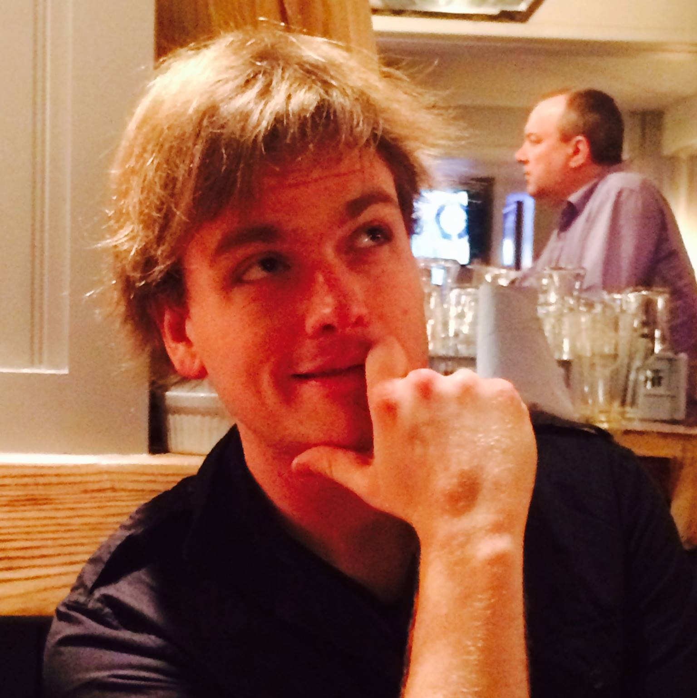
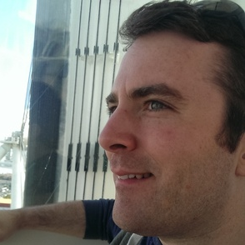
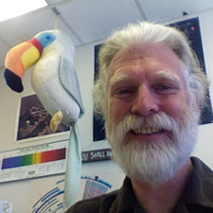
Key Contributors to K2C9
Microlensing Science Team
Radek Poleski
Research Associate
The Ohio State University
David Bennett
Senior Research Scientist
NASA Goddard
Rachel Street
Project Scientist
Las Cumbres Observatory
Scott Gaudi
Professor of Astronomy, Thomas Jefferson Chair
The Ohio State University, JPL
K2 Project Office
Calen B. Henderson
Staff Scientist
Caltech/IPAC
Tom Barclay
Deputy Director TESS Science Support Center
NASA Ames
David W. Hogg
Professor of Physics and Data Science
New York University
Geert Barentsen
K2 GO Office Director
NASA Ames
Matthew Penny
Sagan Fellow
The Ohio State University
Steve Howell
Ames Science Division Chief
NASA Ames
Calen B. Henderson
SSW 2017

Slide 23
Key Contributors to K2C9
Microlensing Science Team
Radek Poleski
Research Associate
The Ohio State University
David Bennett
Senior Research Scientist
NASA Goddard
Rachel Street
Project Scientist
Las Cumbres Observatory
Scott Gaudi
Professor of Astronomy, Thomas Jefferson Chair
The Ohio State University, JPL
K2 Project Office
Calen B. Henderson
Staff Scientist
Caltech/IPAC-NExScI
Tom Barclay
Deputy Director TESS Science Support Center
NASA Ames
David W. Hogg
Professor of Physics and Data Science
New York University
Geert Barentsen
K2 GO Office Director
NASA Ames
Matthew Penny
Sagan Fellow
The Ohio State University
Steve Howell
Ames Science Division Chief
NASA Ames
Calen B. Henderson
SSW 2017

Slide 24
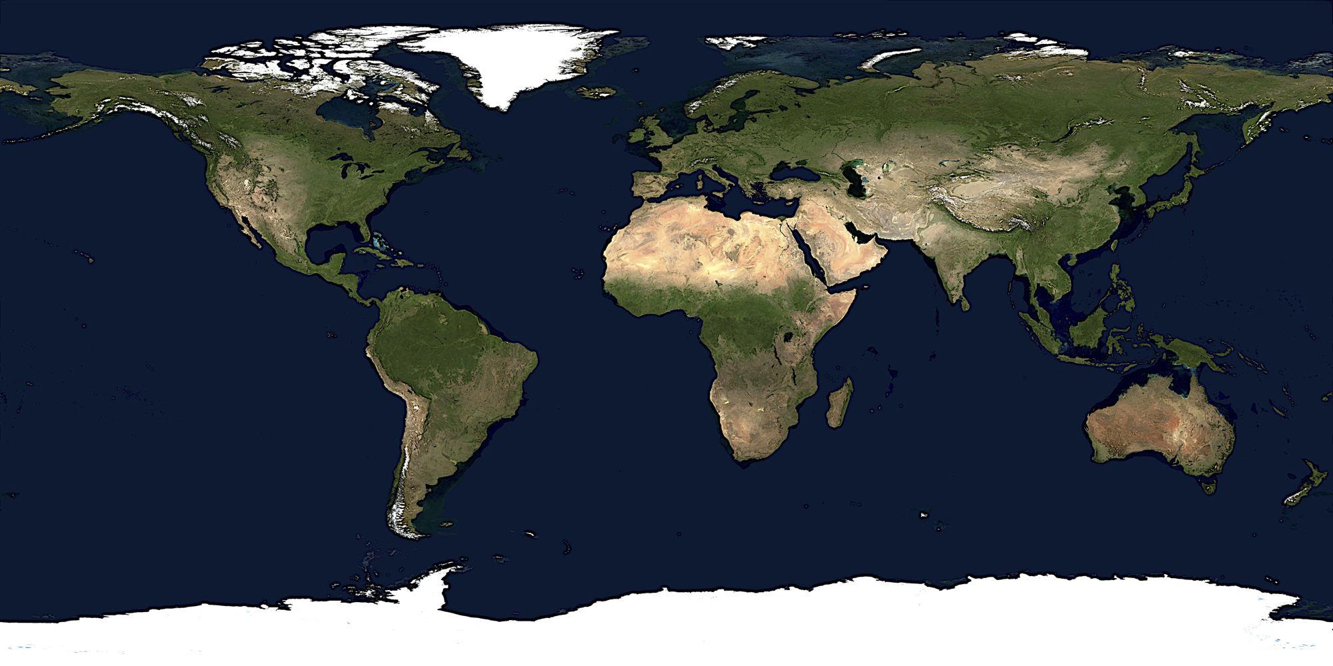
Simultaneous Ground-based Resources
Wise
OGLE
LCOGT
KMTNet
LCOGT
KMTNet
LCOGT
KMTNet
MOA
Automated Survey
Henderson+ (2016), PASP, 128, 124401
Calen B. Henderson
SSW 2017
Notes:
Event detection from ground, enable parallax measurement for all events.

Slide 25
Simultaneous Ground-based Resources
MiNDSTEp
Wise
MiNDSTEp
OGLE
LCOGT
KMTNet
LCOGT
MiNDSTEp
LCOGT
KMTNet
LCOGT
LCOGT
KMTNet
LCOGT
MiNDSTEp
PLANET
MOA
Automated Survey
High-cadence Follow-up
Henderson+ (2016), PASP, 128, 124401
Calen B. Henderson
SSW 2017
Notes:
Longitudinal redundancy, cover high-profile events (short timescales, caustic crossings, high magnification)

Slide 26
Simultaneous Ground-based Resources
MiNDSTEp
WIYN
Wise
MiNDSTEp
CFHT
OGLE
LCOGT
KMTNet
LCOGT
MiNDSTEp
DECam
VST
LCOGT
KMTNet
LCOGT
SkyMapper
LCOGT
KMTNet
LCOGT
MiNDSTEp
PLANET
MOA
Automated Survey
Multiband Monitoring
High-cadence Follow-up
Henderson+ (2016), PASP, 128, 124401
Calen B. Henderson
SSW 2017
Notes:
Important for measuring the angular Einstein radius, which is, crucially, the other ingredient, in addition to the satellite parallax, necessary for deriving the physical properties of the lens, such as its mass and distance

Slide 27
Simultaneous Ground-based Resources
MiNDSTEp
WIYN
Wise
MiNDSTEp
LT
CFHT
UKIRT
IRTF
Keck
Subaru
OGLE
LCOGT
KMTNet
LCOGT
MiNDSTEp
DECam
VST
SMARTS
LCOGT
KMTNet
LCOGT
SkyMapper
LCOGT
KMTNet
LCOGT
MiNDSTEp
IRSF
PLANET
MOA
Automated Survey
Multiband Monitoring
High-cadence Follow-up
Near-infrared Source Fluxes
Henderson+ (2016), PASP, 128, 124401
Calen B. Henderson
SSW 2017
Notes:
NIR source fluxes for lens flux characterization, to provide independent solution and vet parallax solutions.
Over two dozen telescopes in total!

Slide 28
Simultaneous Ground-based Resources
MiNDSTEp
WIYN
Wise
MiNDSTEp
LT
CFHT
UKIRT
IRTF
Keck
Subaru
See talk by Jean-Philippe Beaulieu Tuesday morning!!!
OGLE
LCOGT
KMTNet
LCOGT
MiNDSTEp
DECam
VST
SMARTS
LCOGT
KMTNet
LCOGT
SkyMapper
LCOGT
KMTNet
LCOGT
MiNDSTEp
IRSF
PLANET
MOA
Automated Survey
Multiband Monitoring
High-cadence Follow-up
Near-infrared Source Fluxes
Henderson+ (2016), PASP, 128, 124401
Calen B. Henderson
SSW 2017
Notes:
NIR source fluxes for lens flux characterization, to provide independent solution and vet parallax solutions.
Over two dozen telescopes in total!

Slide 29

Photometric Challenges
Downloaded from The MAST
Calen B. Henderson
Notes:
An 8 kilosecond (133 minutes) exposure using the F435W filter with HST toward the bulge, only a few degrees away from the center of the K2C9 superstamp
HST image
Filter: F435W
Detector: ACS/WFC
Aperture: WFC
NExposures: 16
ExpTime: 7872s
StartTime: 2005-08-19 09:43:32
Dataset: HST_MOS_6924_ACS_WFC_F435W
PropID: 10353
PI: Grindlay
Search parameters
http://archive.stsci.edu/k2/
→ Mission Search: Hubble Legacy Archive
→ RA: 17 56 54.0
→ Dec: -28 22 05.0
→ Radius: r=10.0d
→ Data Product: Mosaic (Level 3)

Slide 30
Photometric Challenges
Downloaded from The MAST
4”
Calen B. Henderson

Slide 31
Moving Forward – Photometry Challenges:
Blending in Kepler
Created by R. Poleski
Henderson+ (2016), PASP, 128, 124401
Calen B. Henderson
SSW 2017

Slide 32
Moving Forward – Photometry Challenges:
Blending in Kepler
K2C9 superstamp
~10 times more dense than K2C0 clusters!!!
Created by R. Poleski
Henderson+ (2016), PASP, 128, 124401
Calen B. Henderson
SSW 2017

Slide 33
Moving Forward – Photometry Challenges:
Blending in Kepler
K2C9 superstamp
~10 times more dense than K2C0 clusters!!!
See talk by Scott Gaudi Wednesday morning!!!
Created by R. Poleski
Henderson+ (2016), PASP, 128, 124401
Calen B. Henderson
SSW 2017

Slide 34
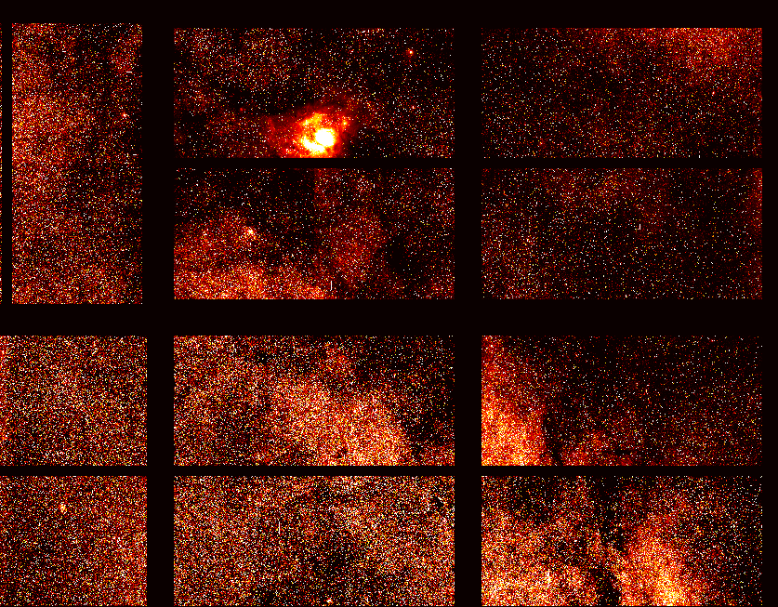
From K2 Project Office
Courtesy K. Colón

Slide 35
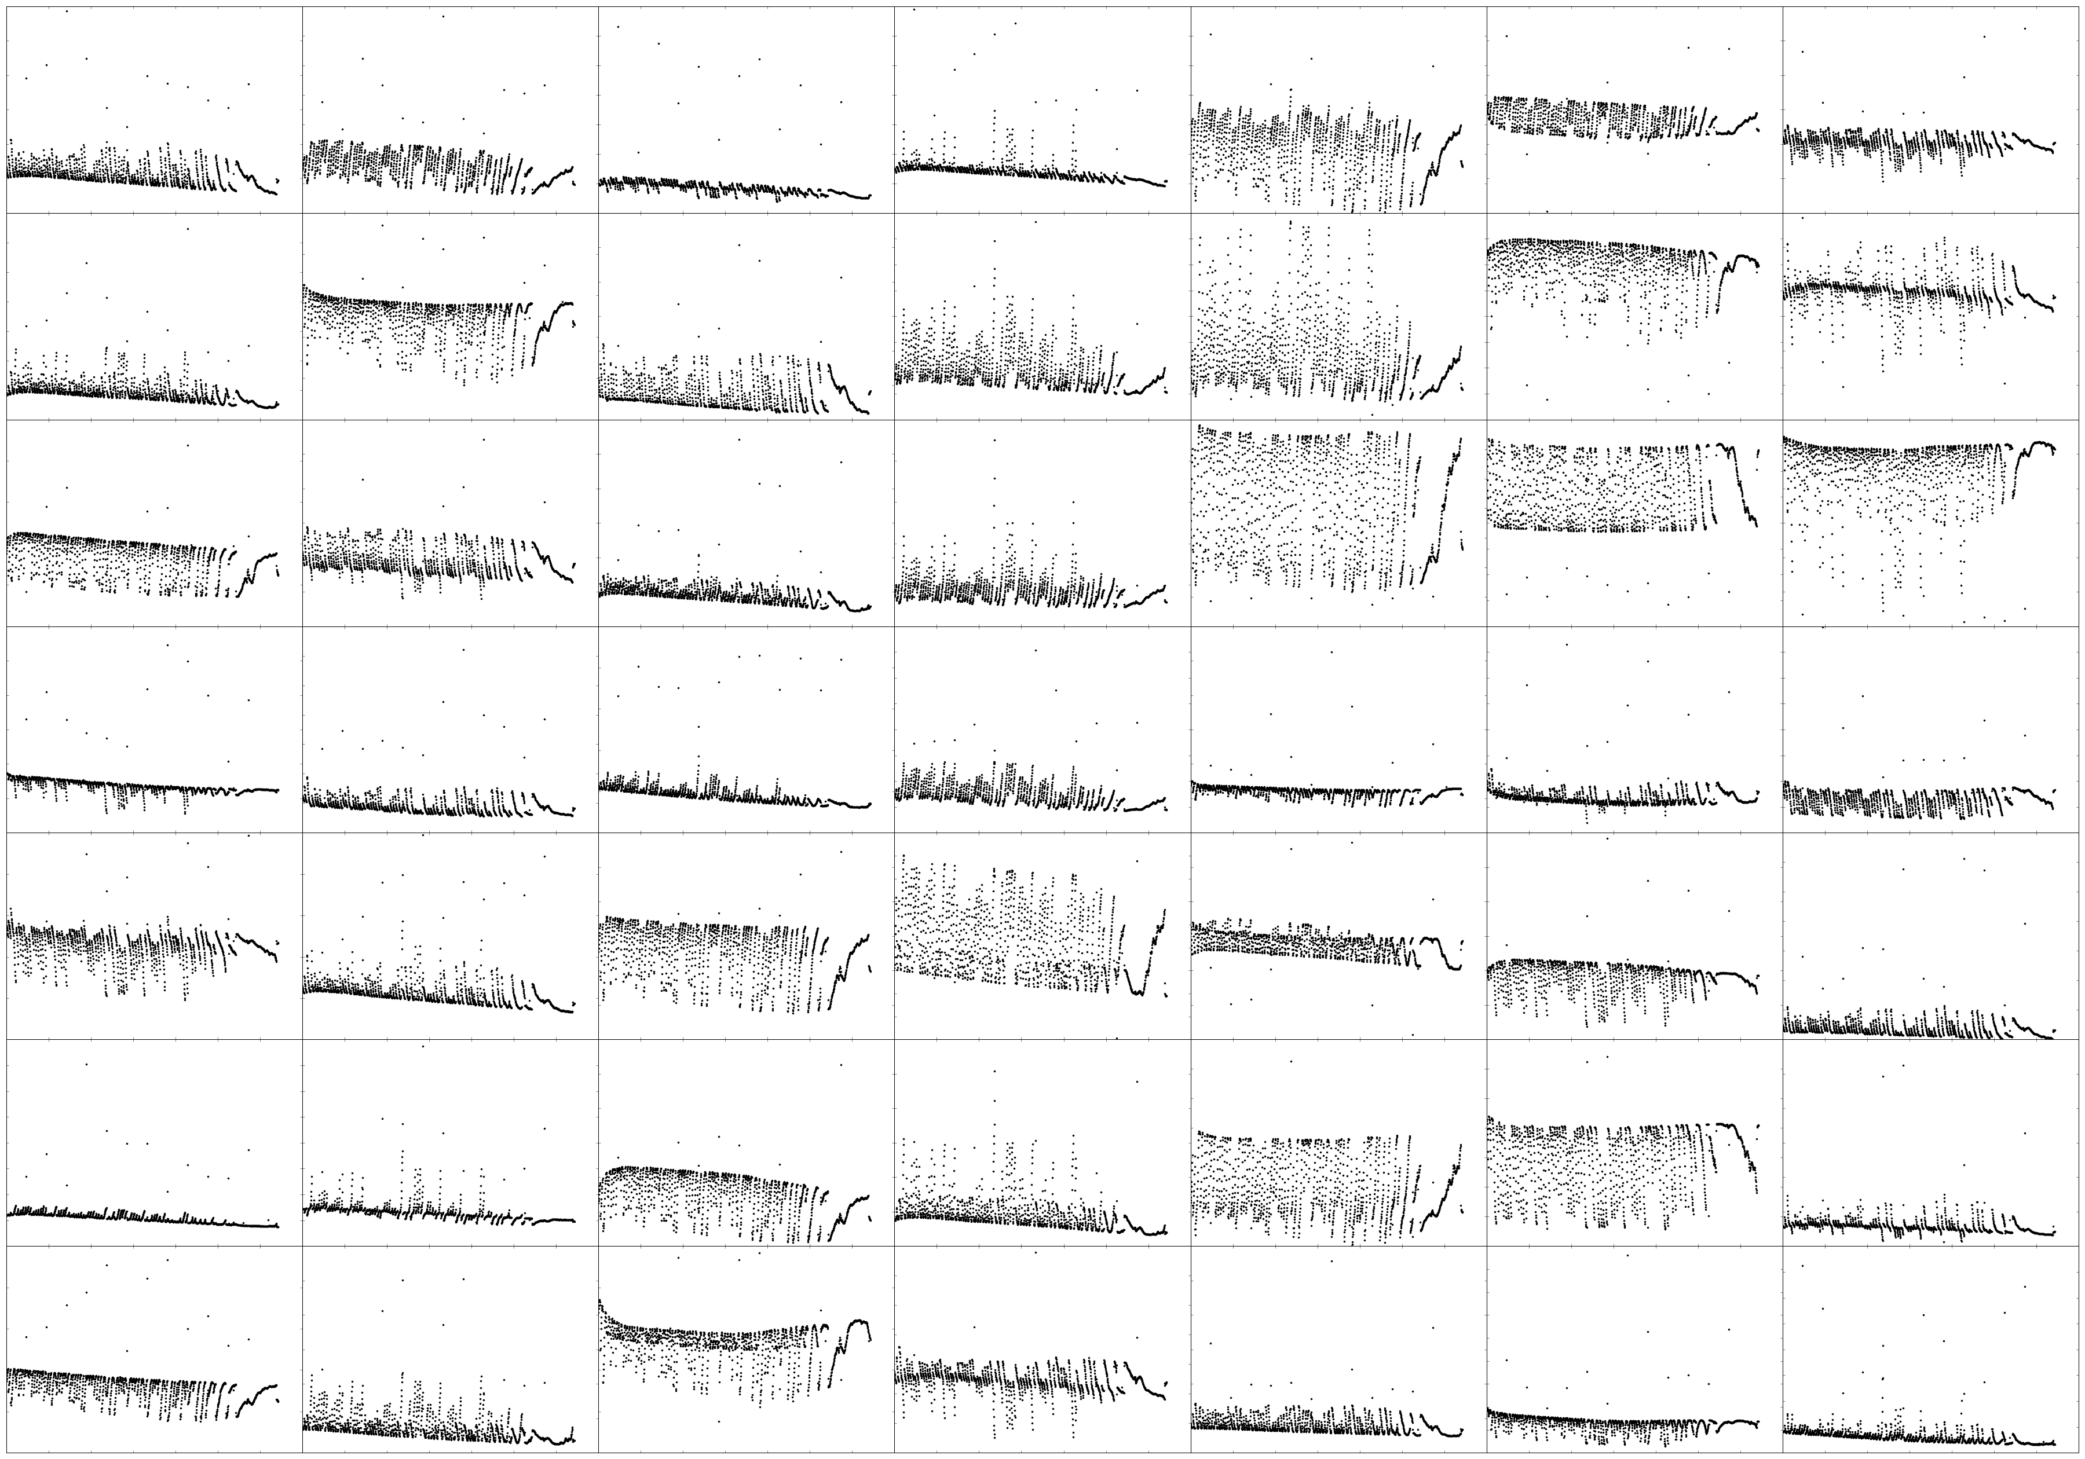
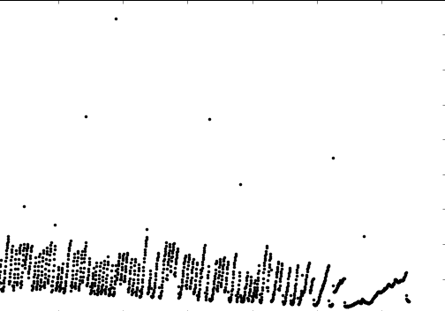
From K2 Project Office
Courtesy K. Colón

Slide 36
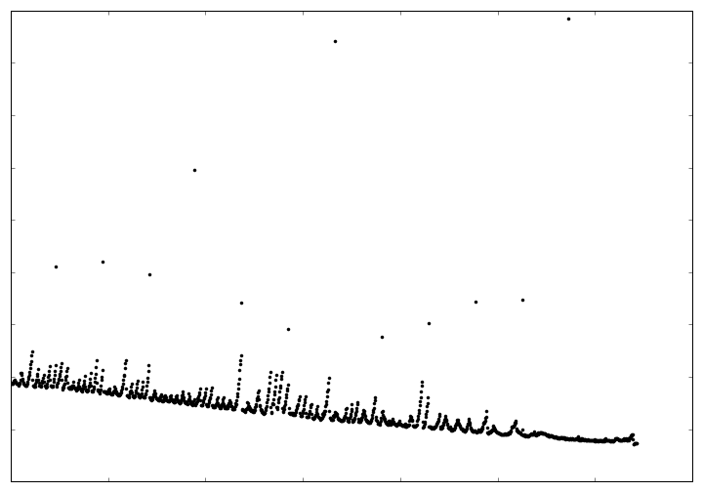
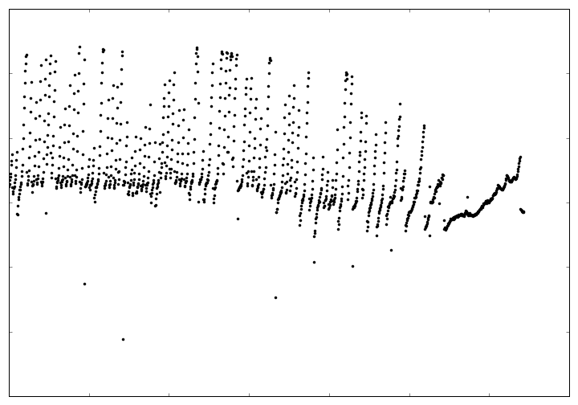
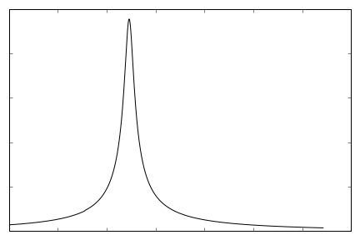
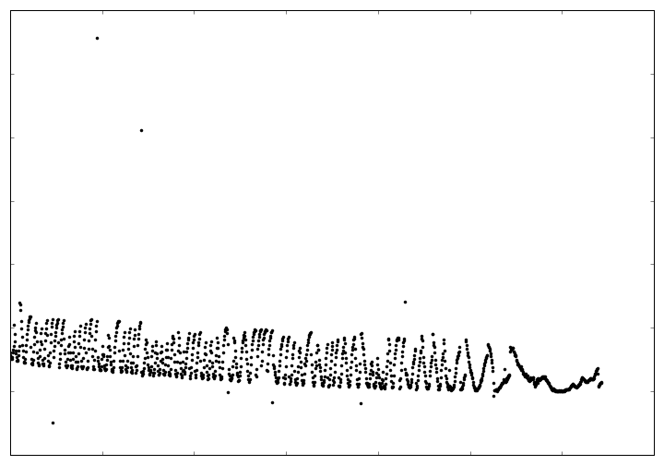
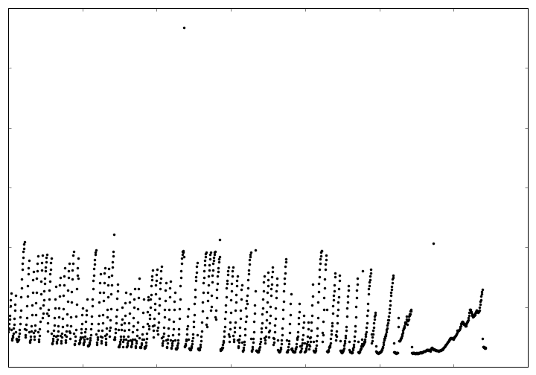
Moving Forward – Photometry Challenges:
Kepler Event Recovery
Input pixels
Causal Pixel Model
Microlensing Model
…
Calen B. Henderson
SSW 2017

Slide 37
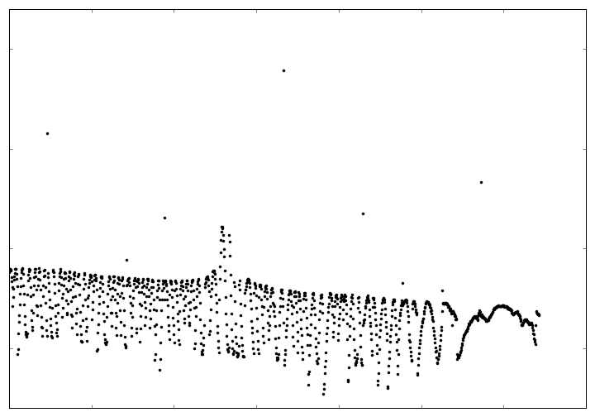
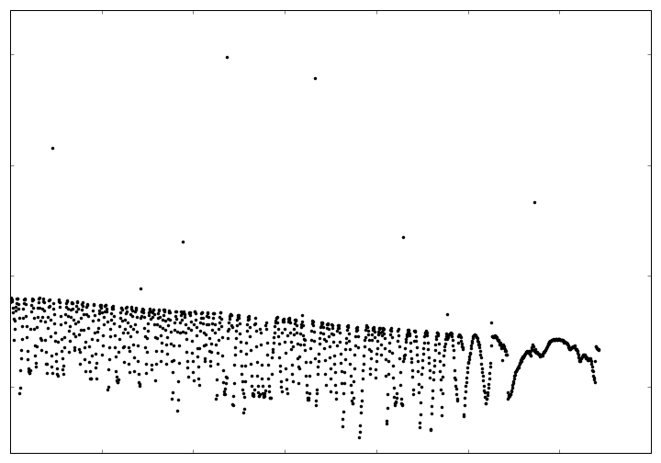
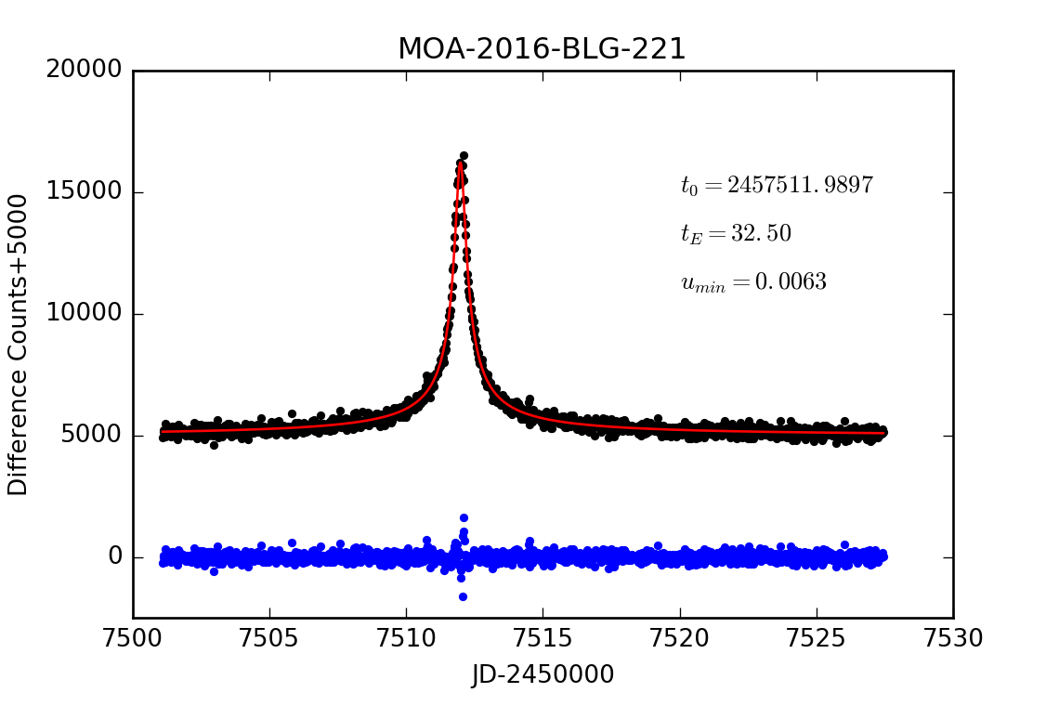
Moving Forward – Photometry Challenges:
Kepler Event Recovery
Raw Pixel Light Curve
(i.e., data!)
Causal Pixel Model
Output light curve!
Calen B. Henderson
SSW 2017

Slide 38
Moving Forward – Photometry Approaches:
(1) CPM + LCM
Effort led by:
Clément Ranc &
David Bennett
(NASA Goddard)
Calen B. Henderson
SSW 2017
Notes:
q ~ 0.5

Slide 39
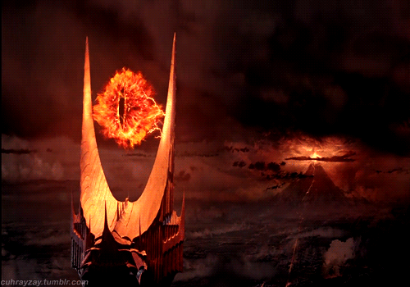
Moving Forward – Photometry Approaches:
(1) CPM + LCM
Effort led by:
Clément Ranc &
David Bennett
(NASA Goddard)
Calen B. Henderson
SSW 2017
Notes:
q ~ 0.5

Slide 40
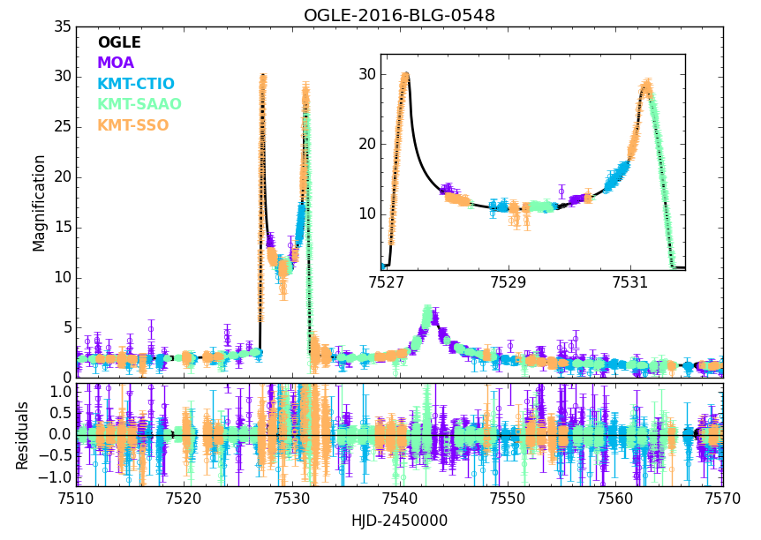
Moving Forward – Photometry Approaches:
(2) Astrometry + LCM + Color-Color
Calen B. Henderson
SSW 2017
Notes:
q ~ 0.7

Slide 41
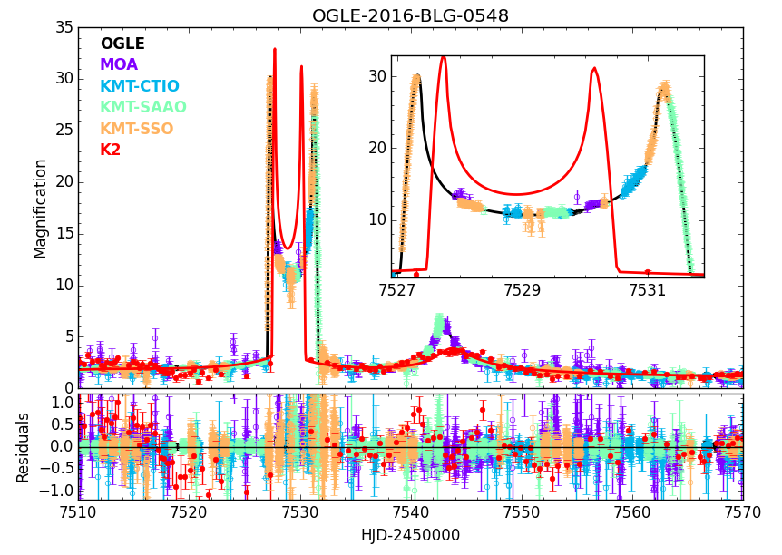
Moving Forward – Photometry Approaches:
(2) Astrometry + LCM + Color-Color
Effort led by:
Wei Zhu
(OSU → CITA)
Calen B. Henderson
SSW 2017
Notes:
0.69 and 0.35 M_Sun
q ~ 0.5
D_l ~ 7.8 kpc

Slide 42
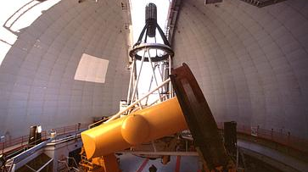
Moving Forward – Photometry Approaches:
(3) Empirical Kepler source mag
CFHT
Effort led by:
Matthew Penny
(OSU)
Calen B. Henderson
SSW 2017

Slide 43
Moving Forward:
K2C9 Synergies
1
Spitzer
Henderson+ (2016), PASP, 128, 124401
Calen B. Henderson
SSW 2017
Notes:
14 days
38 events (WZ: M, 19/Jun/2017), including 5 anomalous events and a planet known from the Spitzer campaign that is potentially also in the K2 data
Four-fold geometric degeneracy: sign and amplitude of u0

Slide 44
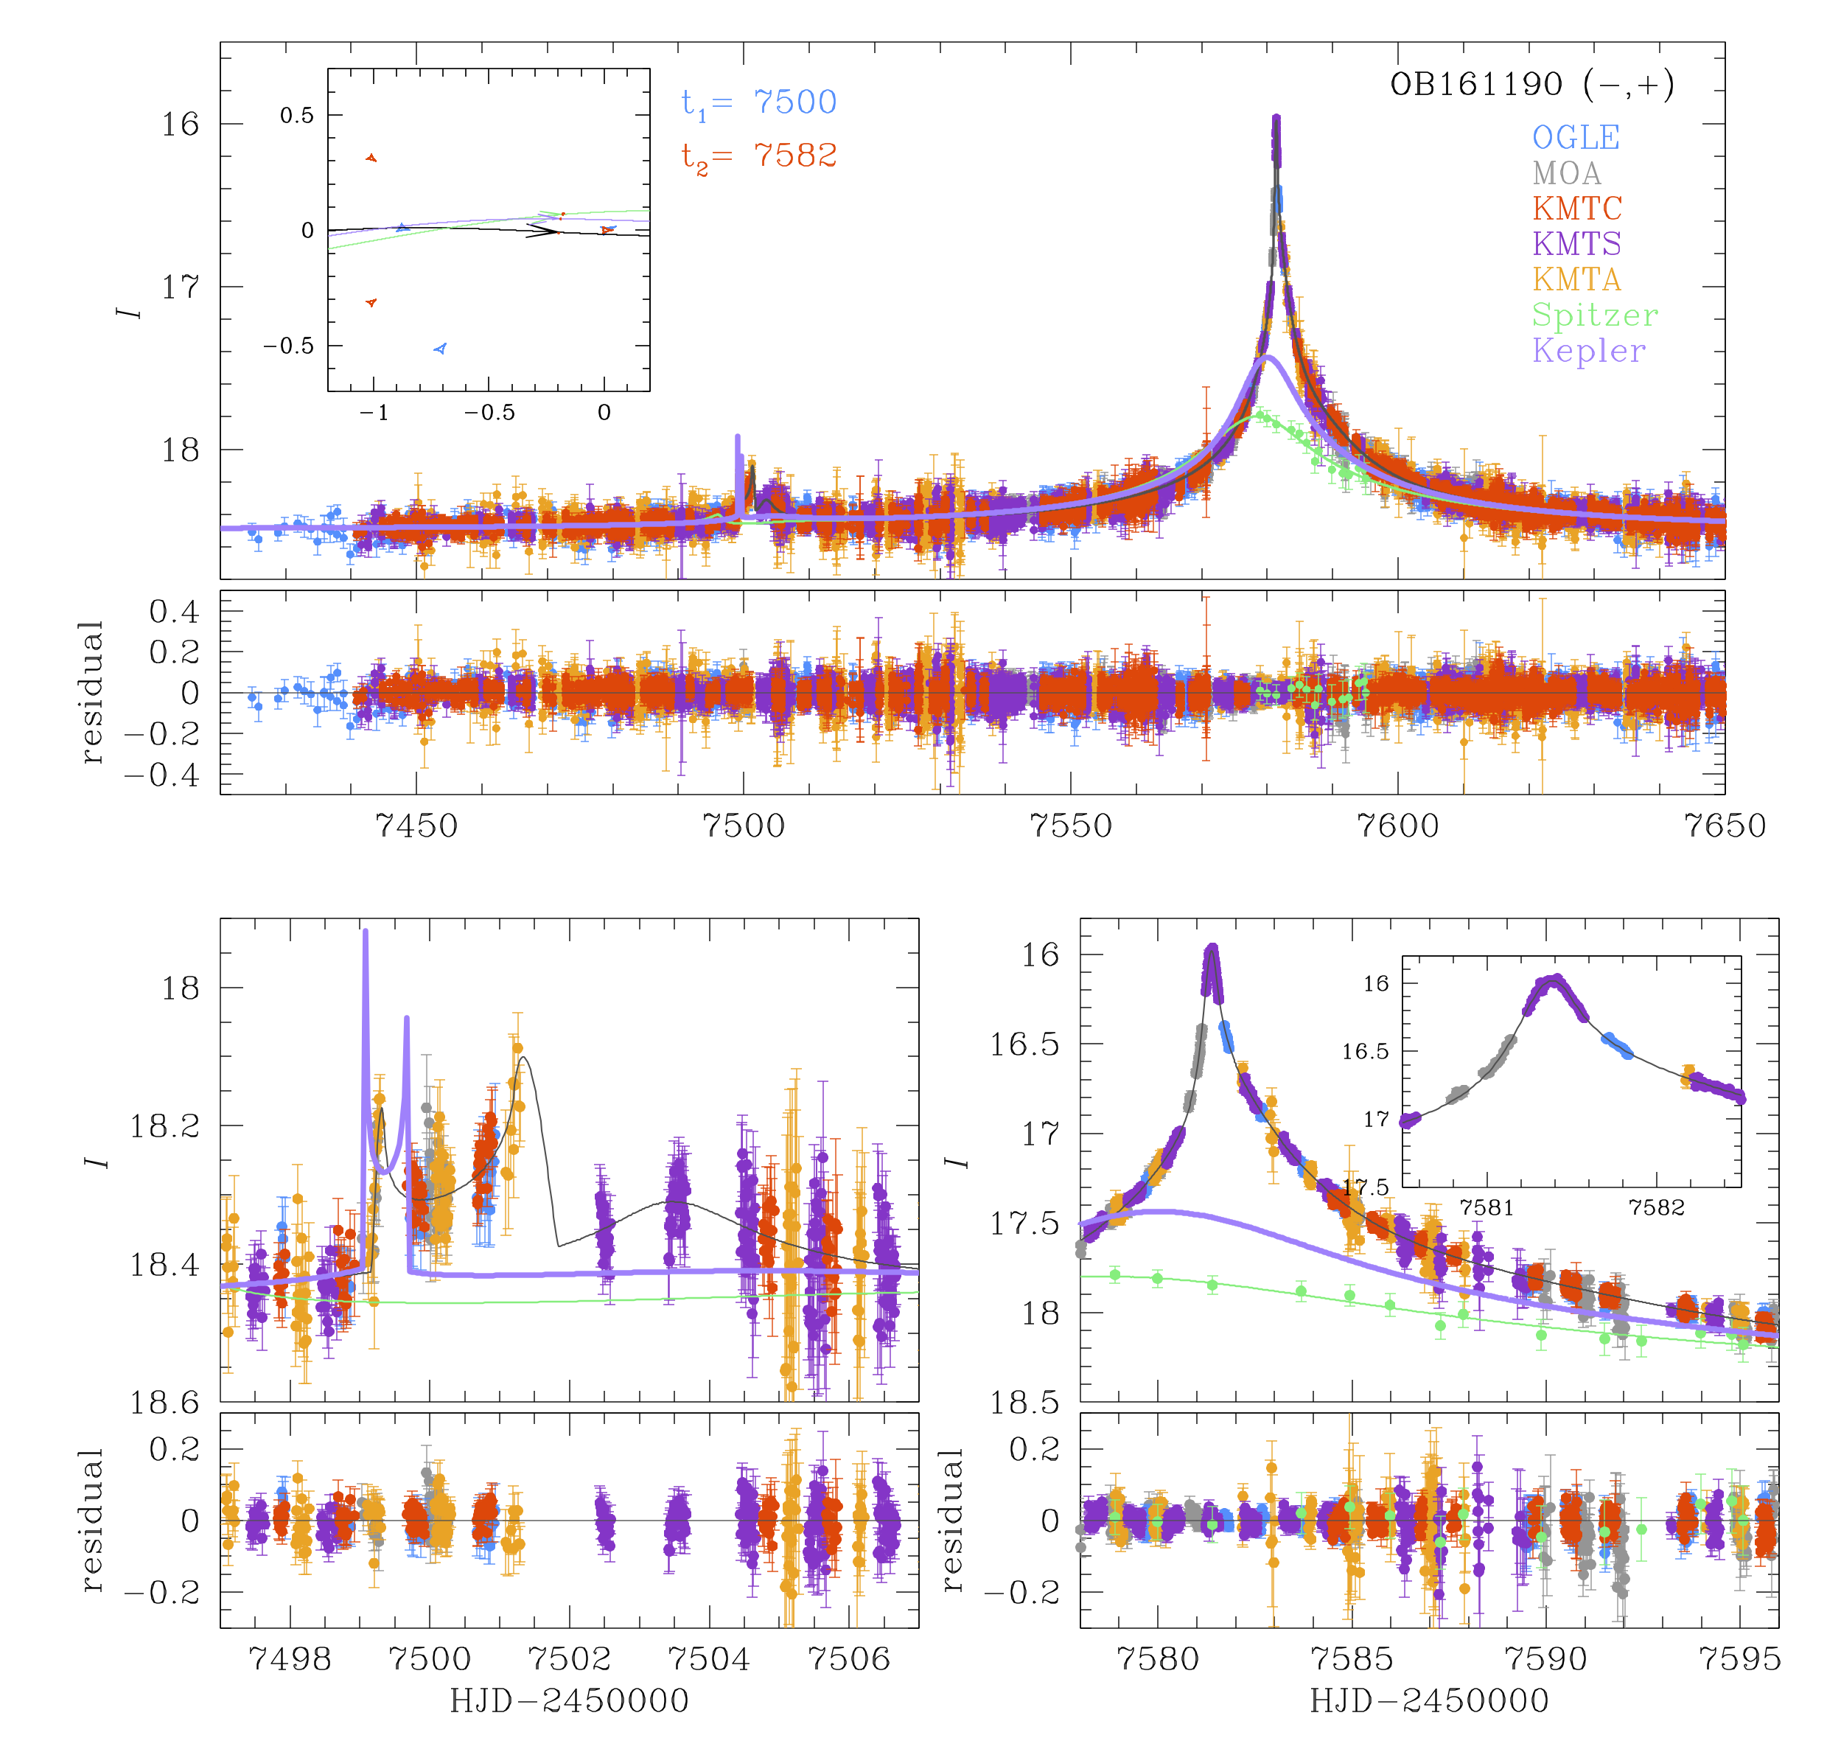
Moving Forward:
K2C9 Synergies
1
Spitzer
Ryu+ (2017) in prep.
Calen B. Henderson
SSW 2017
Notes:
14-day overlap
38 events (WZ: M, 19/Jun/2017), including 5 anomalous events and a planet known from the Spitzer campaign that is potentially also in the K2 data
Four-fold geometric degeneracy: sign and amplitude of u0; can lead to degeneracy in physical parameters (but usually not for lens systems with >1 mass)
q ~ 0.014 (~5 M_J around 0.5 M_Sun)

Slide 45
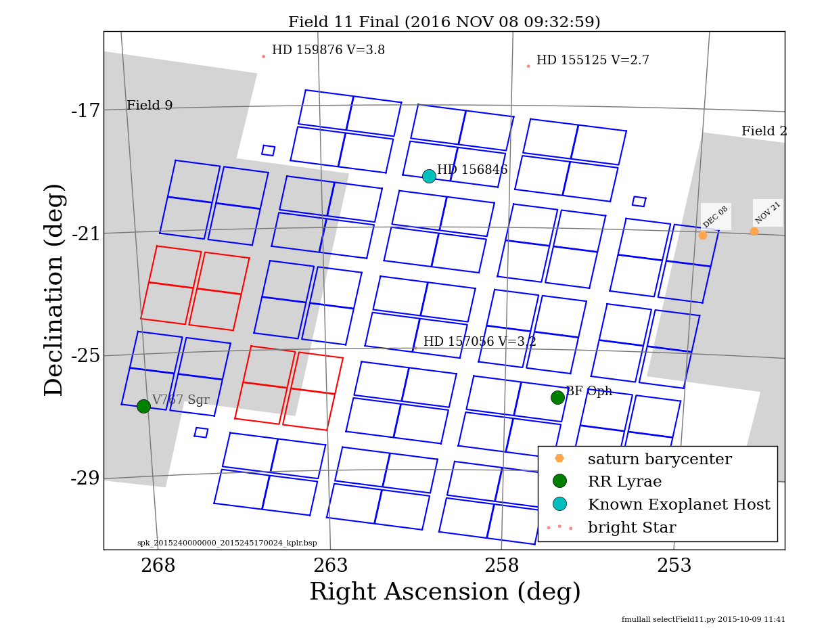
Moving Forward:
K2C9 Synergies
1
Spitzer
2
K2C11
Calen B. Henderson
SSW 2017
Notes:
24/Sep/2016—8/Dec/2016
33 events: 1 from K2C9(b) [ob160570] / 5 from Spitzer
All events peaked by the time K2 started taking data
No planets or binaries known (yet)

Slide 46
Moving Forward:
K2C9 Synergies
1
Spitzer
2
K2C11
3
Non-microlensing science!
Calen B. Henderson
SSW 2017

Slide 47
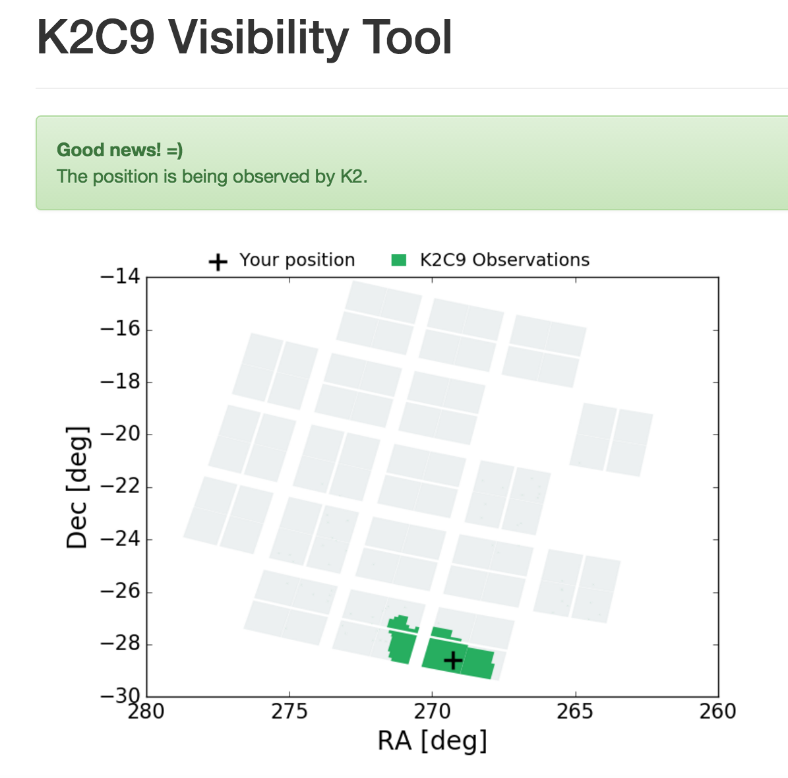
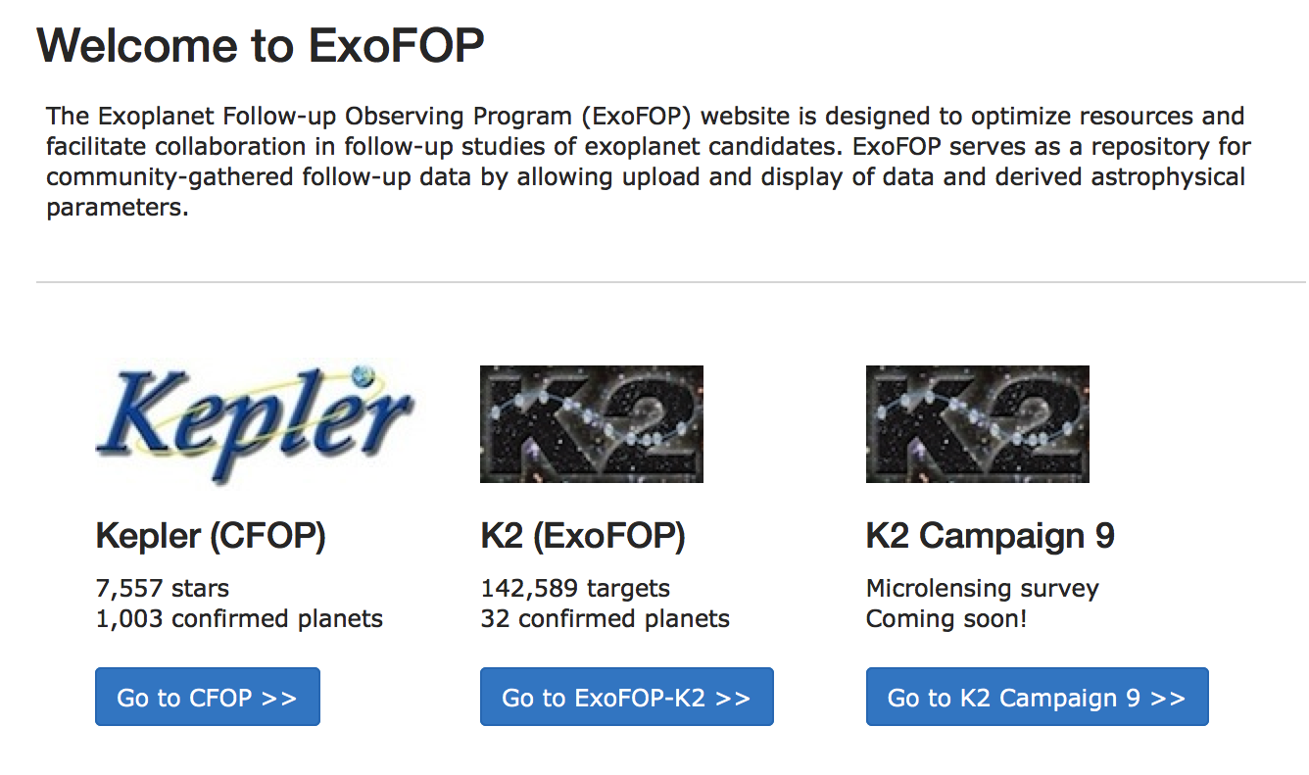
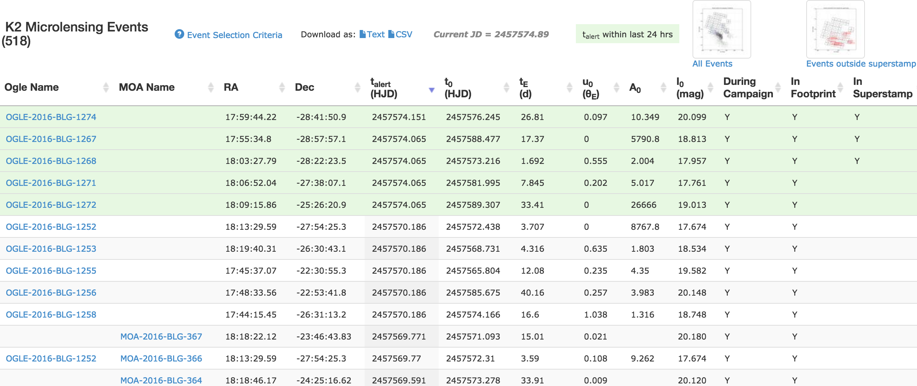
Community Interface
Your target here!!?!
Created by:
G. Barentsen, T. Barclay, R. Poleski
http://k2c9.herokuapp.com/
Created and curated by:
R. Akeson, R. Street
Calen B. Henderson
SSW 2017

Slide 48
Community Interface
See talk by Calen B. Henderson Tuesday afternoon!!!
Your target here!!?!
Created by:
G. Barentsen, T. Barclay, R. Poleski
http://k2c9.herokuapp.com/
Created and curated by:
R. Akeson, R. Street
Calen B. Henderson
SSW 2017

Slide 49
Calen B. Henderson
SSW 2017

Slide 50
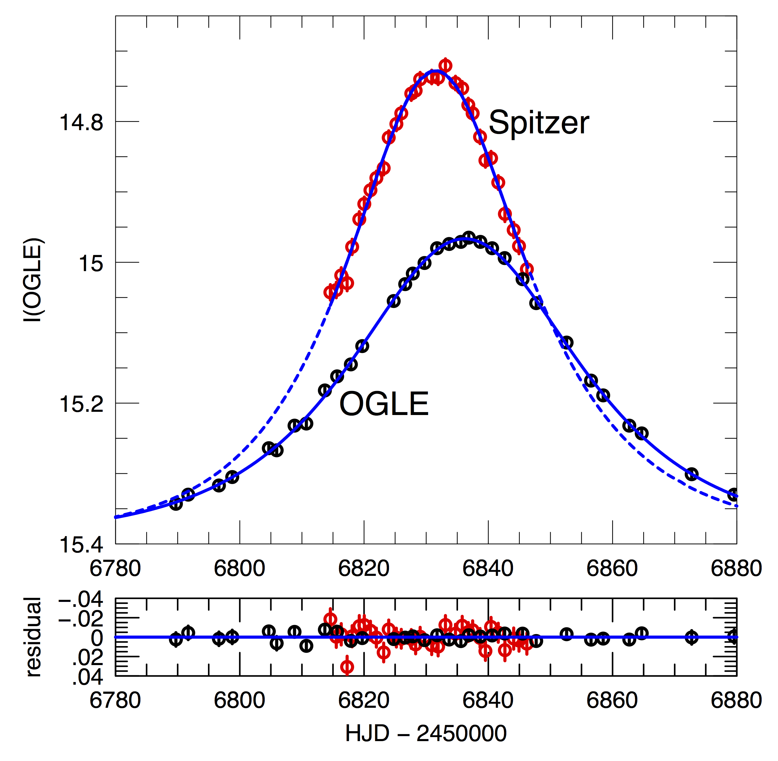
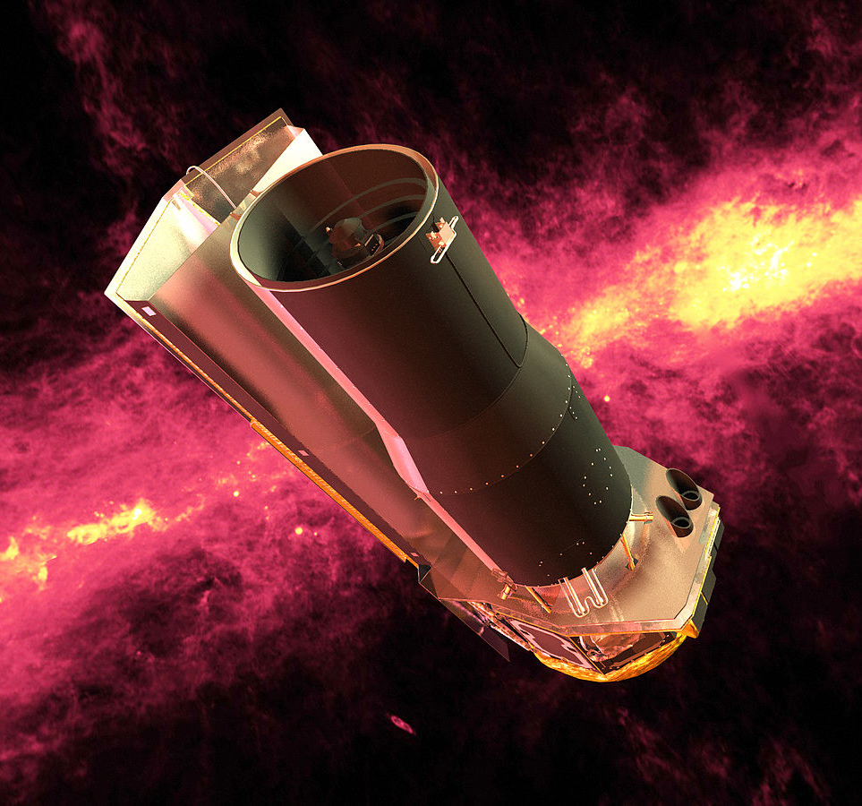
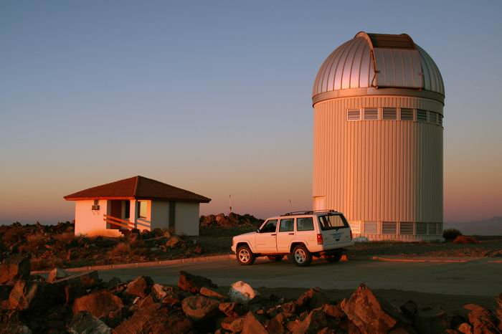
Microlens Parallax Satellite I. Spitzer
Credit: NASA/JPL-Caltech
Credit: Krzysztof Ulaczyk
Yee+ (2015) ApJ, 802, 76
Calen B. Henderson
SSW 2017

Slide 51
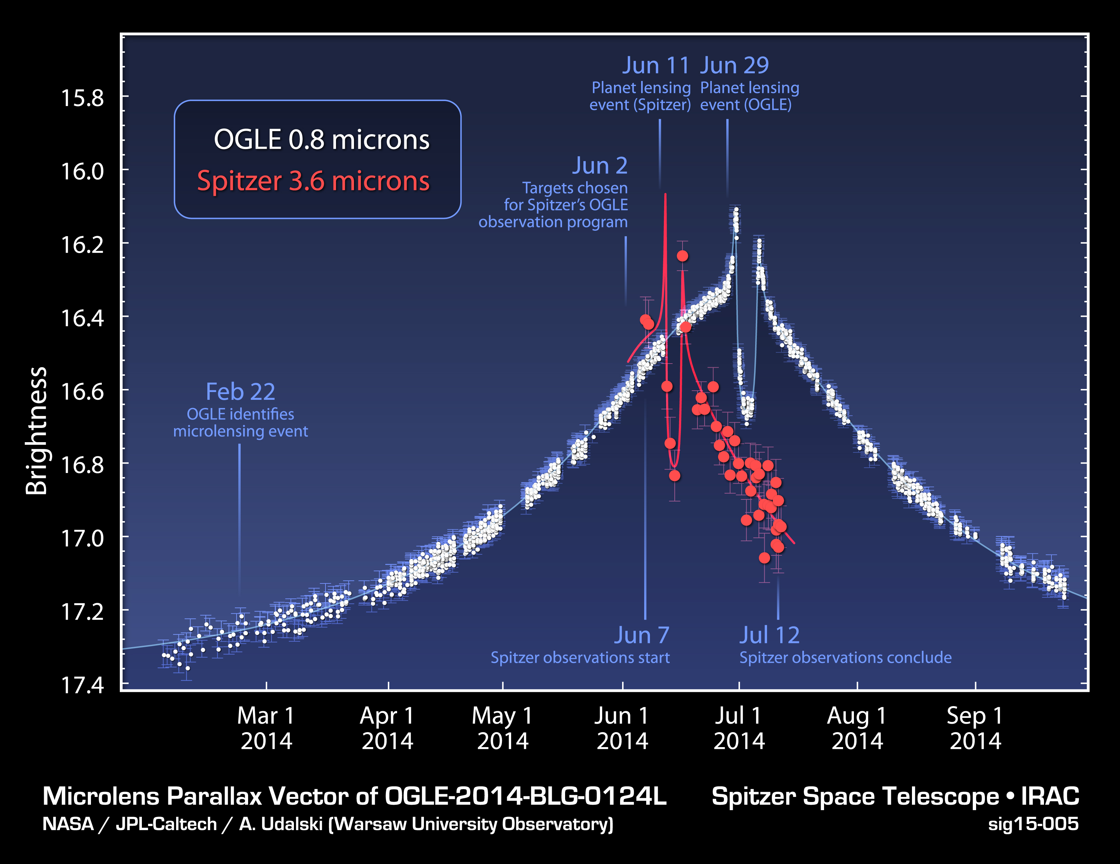
Microlens Parallax Satellite I. Spitzer
M_{p} = 0.5 M_{J}
M* = 0.7 M
D_{l} = 4.1 kpc
a_{inst,proj} = 3.1 AU
σ_{πE}
(OGLE) ≈ 22%
σ_{πE}
(Spitzer) ≈ 2.5%
Calen B. Henderson
SSW 2017

Slide 52
Limitations of Spitzer Campaigns
HJD’ = HJD - 2450000
Udalski+ (2015) ApJ, 799, 237
Calen B. Henderson
SSW 2017
Notes:
5 weeks of 2014 Spitzer campaign

Slide 53
Preliminary K2C9 Inventory
Total events
Bound Planets
FFP Candidates
Stellar Binaries
Long-timescale
109 (179)
1 (3)
9
8
13
Calen B. Henderson
SSW 2017
Notes:
Bound planets:
OB160241/MB16132
MB16181OB160722
OB160679/MB16189 (Dave found weak planetary signal)
OB161190 (Spitzer email from Jenn with KMTNet personnel modeling)
Binaries:
OB160676/MB16215 (Dave’s K2C9 photometry workshop talk)
MB16197/OB160818 (Dave’s K2C9 photometry workshop talk)
OB160548/MB16242 (Dave’s K2C9 photometry workshop talk)
OB160562 (Dave’s K2C9 photometry workshop talk, t0~7496.0…)
OB160613 (Dave’s K2C9 photometry workshop talk, t0~7494.7…)
OB161043 (Dave’s K2C9 photometry workshop talk)
MB16181/OB160722 (Valerio, t0~7495.9…)
OB160037 [C9b?] (Valerio)

