Slide 1
Overview of the Hands-On Sessions
Jennifer Yee
&
Etienne Bachelet

Slide 2
Big Picture
Using simulated WFIRST light curves, explore the kinds of microlensing planets WFIRST will find.

Slide 3
Goals
Identify planetary perturbations in light curves
Analytically calculate planetary microlensing parameters based on the light curves
Perform a numerical fit to determine the exact planetary parameters
Calculate the physical properties of the planet

Slide 4
Outline
Monday:
Part I: Classify planets from the literature
Part II: Classify planets from simulated WFIRST data
Tuesday: Calculate the parameters of a planet (Analytic)
Wednesday: Calculate the parameters of the planet (Numerical)
Thursday: Prepare presentations

Slide 5
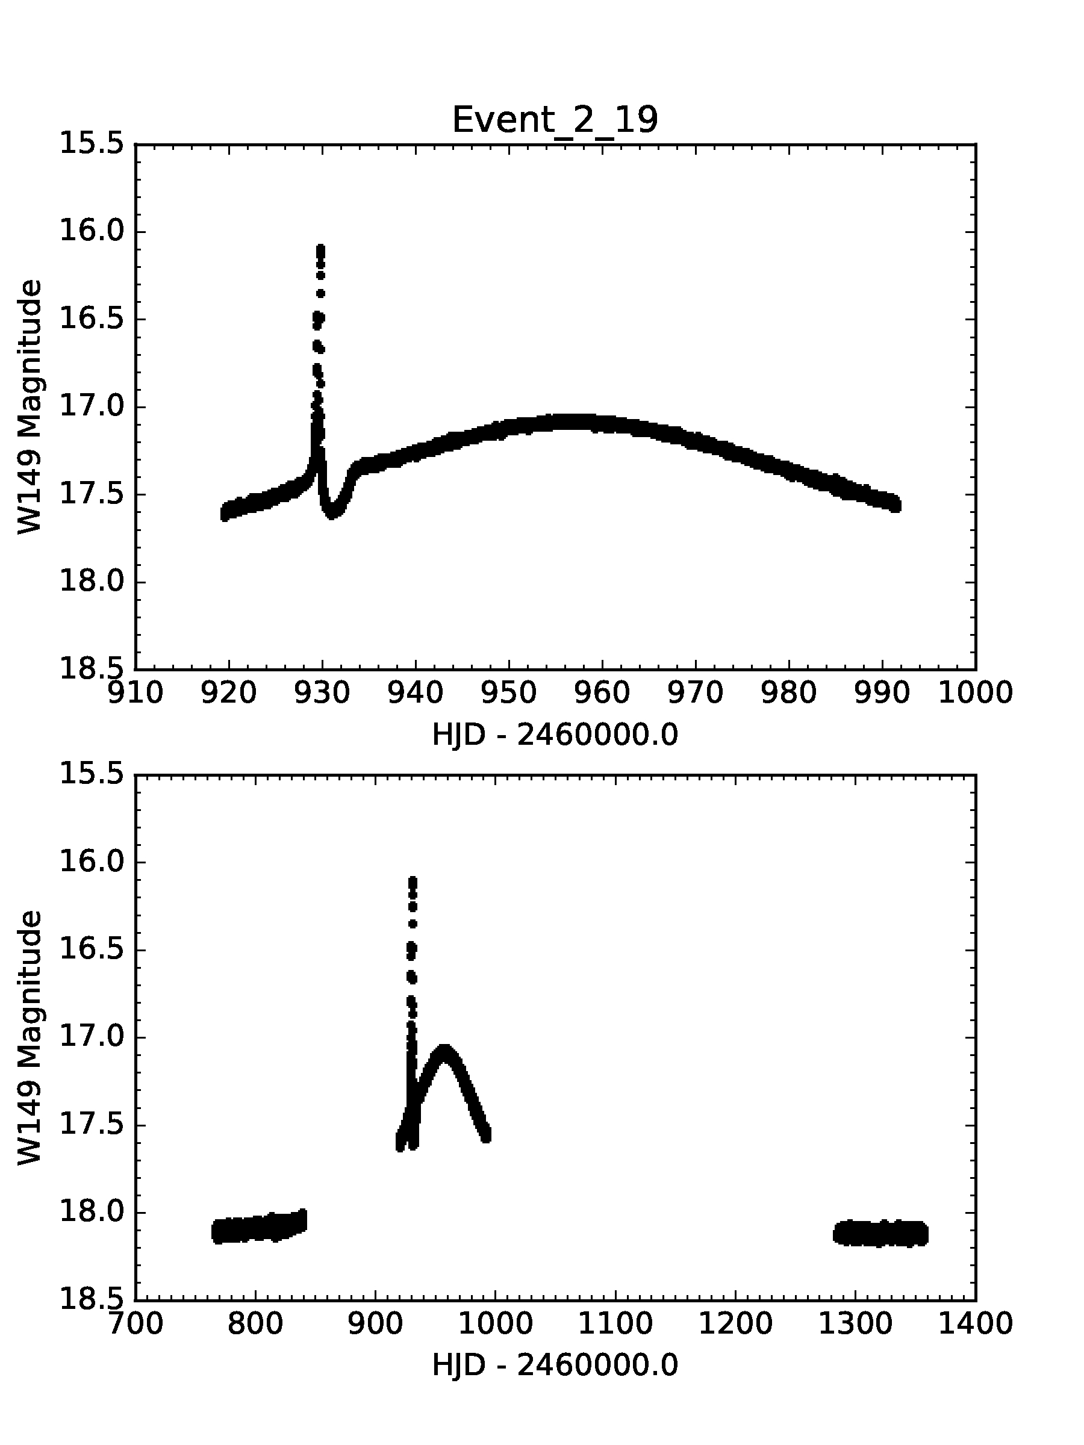
Monday:
Planet/No Planet?

Slide 6
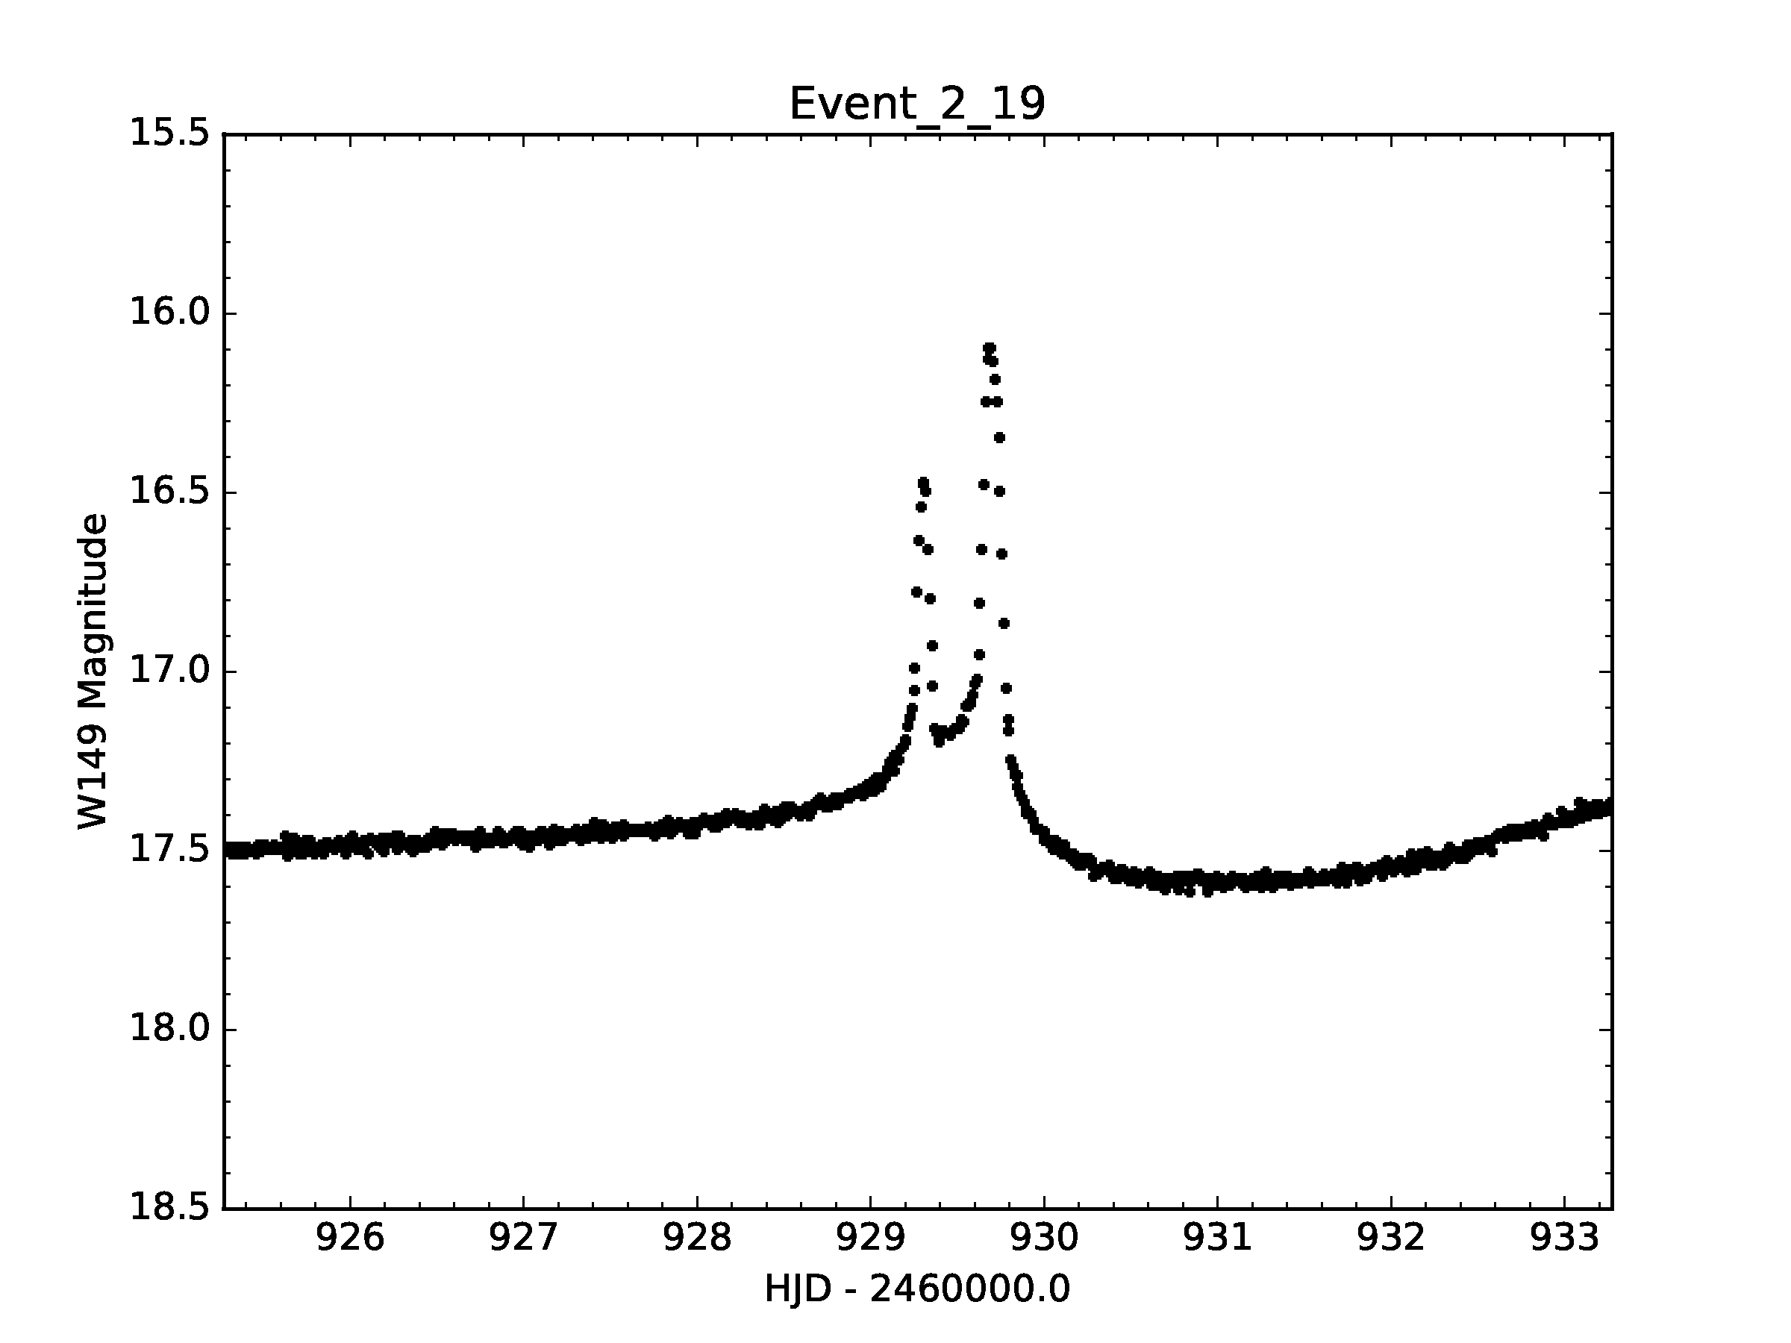
Tuesday:
microlensing parameters:
t₀, u₀, t_{E,} ρ, s, q, α

Slide 7
Wednesday:
Compare analytical estimation with the lightcurve
Fit a single lens model to the lightcurve
Fitting a planetary model using analytical guess as starting points

Slide 8
Thursday:
What are the 𝜇lensing properties of your planets?
Show some plots of your planetary perturbations.
What microlensing features do your planets have in common?
Are they major image or minor image perturbations?
How long do the perturbations last?
Make a plot showing the distribution of mass ratios and separations for the planets your group analyzed.
What is the typical mass ratio for your planets?
Are they inside or outside the Einstein ring?
Do your planets have a typical separation?

Slide 9
Thursday:
What are the physical properties of your planets?
Assuming the lens is a 1.0 MSun G dwarf at 6 kpc, what does that mean for the physical parameters of the planet (mass and semimajor axis)?
Repeat for a 0.3 MSun M dwarf at 6 kpc.
For both the G dwarf and M dwarf scenarios, make a plot showing planet mass vs. physical separation for your planets.
Show the snow line on these plots assuming
a_{snow} = 2.7AU (M* / M_{Sun})²
How do the physical parameters differ in the two cases?

