Slide 1
Group Projects:
Exploring Planet Formation
2015 Sagan Summer Workshop
“Exoplanetary System Demographics:
Theory and Observations”
Notes:
4

Slide 2
What is this group project about?
Explore planetary system formation by comparing models against observations
Hands-on sessions will introduce the tools needed for this research project
GlobalPFE: population synthesis model
archiveComparison: download & plot real data
Choose one of eight different science questions
You will sign up for a group on the sheets provided, and start working towards your 7-10 min presentation to be given on Friday afternoon.
Deadline to sign up is the mid-afternoon break tomorrow (3:30 Tuesday)

Slide 3
Which group should I choose?
Group 1: Metallicity
Question: How does the gas-to-dust ratio of the parent protoplanetary disk affect the results from a core accretion population synthesis?
Group 2: Initial Disk Mass
Question: What happens to the number of planets and planet masses if you change the initial mass of a protoplanetary disk?
Group 3: Initial Disk Distribution
Question: How is the distribution of planet orbits related to the original distribution of the parent disk? Does a steeper disk surface density slope result in more short-period planets? How small does the disk have to be for most gap-opening planets to move outward, rather than inward?
Group 4: Gas Accretion
Question: How does the assumed physics for runaway gas accretion (e.g. atmosphere opacity) affect the mass distribution for gas giant planets? Do changes in the gas accretion indirectly affect the frequency of gap formation and Type II orbital migration?

Slide 4
Which group should I choose?
Group 5: Embedded-Planet Migration
Question: How does the migration speed of embedded planets affect their orbital distribution? What is the ideal amount of migration to create short-period planets, but not have them all fall into their central star?
Group 6: Gap Formation
Question: How does gap formation affect the mass of gas giant planets? How does it affect their orbital distribution, by slowing their migration rate?
Group 7: Disk Lifetime
Question: How does the disk lifetime affect planet formation?
Is there a minimum lifetime required to form Jupiter-like planets?
Is there a maximum lifetime to avoid planets all migrating into the star?
Group 8: Disk Viscosity
Question: Does planet formation depend on the unknown disk viscosity? Can the orbital migration of gap-forming planets be slowed down by adopting a lower disk viscosity?

Slide 5
What Questions Should I Answer?
What question(s) are you trying to answer?
What are your hypotheses?
What methodology did you use to test your hypotheses?
What did you find?
What are the implications of your findings?
  Comparison with real data
  Most interesting/surprising result?
What conclusions can you draw?
What, if any, future work is needed?
DON’T BE AFRAID TO BE CREATIVE!!

Slide 6
Example
Template Group Project Slides

Slide 7
Understanding Planet Formation:
Disk Color
(names and affiliations)

Slide 8
Understanding Planet Formation:
Disk Color
Project Goal: Understand how planetary systems form and evolve
Objective: Use population synthesis models to determine what physics is needed to explain exoplanet observations
Science Questions: How does planet formation depend on the disk color?

Slide 9
Understanding Planet Formation:
Disk Color
Hypothesis (before numerical tests): A redder disk will produce redder planets. Small planets are redder, so these should be favored.
Methodology: Vary disk color above and below the nominal value (yellow); try red, orange, green, blue. While disk color is the primary variable of interest, we will also considered some related variables such as disk lightness and saturation, with the ultimate goal of finding the best match to observations.

Slide 10
Understanding Planet Formation:
Disk Color
Results: We find that the reddest disks do indeed produce the reddest planets. The increase in red planets, however, is not as large as expected.
Analysis: In order to compare the simulation against observations of planets detected by radial-velocity surveys, we filter the simulated population with a K=1 m/s filter. We also compared against the Kepler dataset after adding a transit-survey filter.

Slide 11
Understanding Planet Formation:
Disk Color
Statistical Comparison: As a simple attempt to quantify the success of each model, we performed a K-S comparing the model and observed distributions of semi-major axis and mass.
The table below shows log10 values from this test. Low values mean there is a low probability that the two distributions are the same.
Disk Color | semi-major axis | planet mass | notes
red | -90 | -55
orange | -80 | -49
yellow | -100 | -50 | (standard value)
green | -110 | -52
blue | -130 | -43

Slide 12
Understanding Planet Formation:
Disk Color
The simulated distributions never match the observed distribution very well. Still, we find that the simulations of orange disks produce the planet distribution most similar to the observed distribution, particular for the planet orbits (semi-major axis).

Slide 13
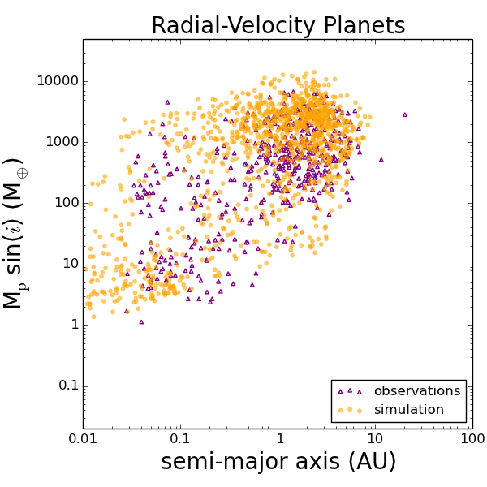
Understanding Planet Formation:
Disk Color
This agrees with our visual assessment of the simulation data (with RV selection effect added) plotted against RV-discovered planets.
Standard Model
Best Model

Slide 14
Understanding Planet Formation:
Disk Color
Conclusion: Inclusion of new physics into standard models of planet formation – disk color effects – allows for a better match to exoplanet observations. In particular, the semi-major axis distributions are now consistent with each other.
While this new model offers a solution for the formation of red and blue sub-Jupiters, there is still no good theoretical explanation for the distribution of brown super-Neptunes detected by microimaging.
Future work: Variation of disk shape (square, triangle) may help to explain some of the remaining discrepancies, such as the lack of purple short-period exoplanets within the models.

