Slide 1

Primordial C/H Predictions Inside the CO Snowline
Kamber Schwarz, NHFP Sagan Fellow
Edwin Bergin, Ilse Cleeves, Ke Zhang, Karin Öberg, Geoff Blake, Dana Anderson
Sagan/Michelson Fellows Symposium
November 8th, 2018

Slide 2
Volatile Abundances: Theory
Snowline:
Gas disk C/O controlled by snowlines
Determines initial C/O in gas giant atmospheres
Altered by dynamics & chemistry
Solar
10²
Adapted from Öberg+11
Notes:
This is assuming core accretion
Solar C/O = 0.54
How does this prediction match with what we see in protoplanetary disks?

Slide 3
ALMA Disk Surveys
Large surveys of CO disks in Taurus, Lupus, Chamaeleon
CO under-abundant relative to dust
Low total gas mass?
Low CO abundance?
Williams & Best 14
Ansdell+16
Long+17
Ansdell+16
Notes:
Grey: Williams & Best 14, red: Miotello+16
ALMA has been great for study the gas in protoplanetary disks, including allowing surveys of small disks which we were previously unable to detect in the gas. And one of the interesting results to come out of these surveys

Slide 4
Disk Mass from HD
TW Hya (9σ)
Flux (Jy)
Bergin+13
McClure+16
wavelength
 | TW Hya | DM Tau | GM Aur | ISM
M_{disk} | 0.06 M | 0.01-0.05 M | 0.03-0.2 M
CO/H₂ | (0.1-3) × 10⁻⁵ | ≤ 2 × 10⁻⁵ | 10⁻⁶-10⁻⁵ | ~10⁻⁴
  CO, not total gas, is missing
Notes:
McClure vD

Slide 5
Low CO Abundance in Disks
Williams & Best 14
Ansdell+16
Long+17
Assume gas-to-dust of 100
CO depletion is common
Notes:
can skip if need be

Slide 6
And it’s not just CO
Snowline:
CI under-abundant or not detected (Kama+16)
C₂H requires both C & O under-abundant (Bergin+16)
Observations

Slide 7
And it’s not just CO
Snowline:
CI under-abundant or not detected (Kama+16)
C₂H requires both C & O under-abundant (Bergin+16)
Observations
C/H / C/H_{stellar}
10²

Slide 8
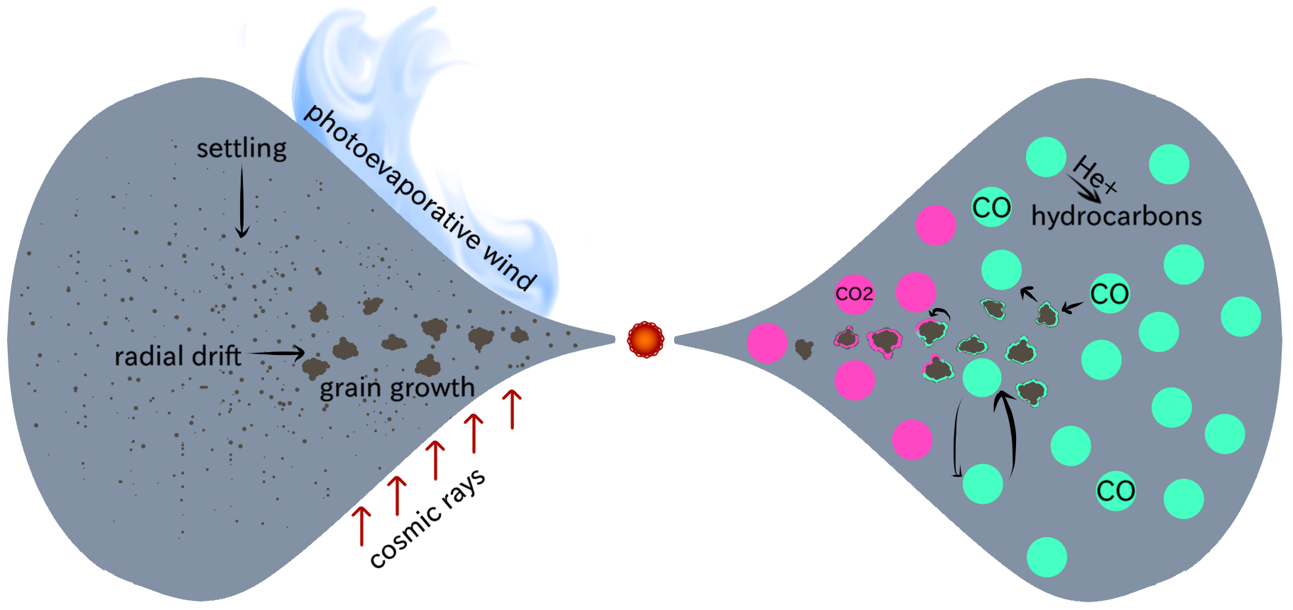
Chemical CO Depletion?
Hydrocarbons (Aikawa+97, Bergin+14)
CO₂ & CH₃OH (Reboussin+15, Eistrup+16)
Organics (Yu+17)
Models assume different physical properties
What physical conditions lead to chemical reprocessing of CO?
Cosmic Rays/ X-rays

Slide 9

Physical Modeling
R_{out} = 200 au
Disk temperature (Torus, Harries+00)
UV & X-ray radiative transport (Bethell & Bergin 11a,11b)
    Matched to observe field
200
133
66
66
133
200
Notes:
I did this for a grid of models with a wide range of physical properties

Slide 10
Physical Modeling
R_{out} = 200 au
Disk temperature (Torus, Harries+00)
UV & X-ray radiative transport (Bethell & Bergin 11a,11b)
  Matched to observe field
Cosmic ray attenuation (Cleeves+13)
200
133
66
66
133
200
Notes:
I did this for a grid of models with a wide range of physical properties
Observed uv field including ly a show spectrum

Slide 11
Chemical Modeling
Independent radii
  45 vertical zones
5984 chemical reactions
  Photo-chemistry
  Grain-surface chemistry
  Ion chemistry
  Self-shielding of H₂ and CO
CO/H₂ = 2×10⁻⁴ initially
Run for 6 Myr
200
133
66
66
133
200
Notes:
fix tabing on minor bullets

Slide 12
Model Grid: Dust
warm high CR
100% small grains
0.005 – 1 𝜇m
high X-ray
fiducial
high CR
warm
0% | ✓ | ✓ | ✓ | ✓ | ✓
10% | ✓ | ✓ | ✓ | ✓ | ✓
20% | ✓ | ✓ | ✓ | ✓ | ✓
30% | ✓ | ✓ | ✓ | ✓ | ✓
40% | ✓ | ✓ | ✓ | ✓ | ✓
50% | ✓ | ✓ | ✓ | ✓ | ✓
60% | ✓ | ✓ | ✓ | ✓ | ✓
70% | ✓ | ✓ | ✓ | ✓ | ✓
80% | ✓ | ✓ | ✓ | ✓ | ✓
90% | ✓ | ✓ | ✓ | ✓ | ✓
99% | ✓ | ✓ | ✓ | ✓ | ✓
Affects:
Temperature
Freeze out & photodesorption
Large grains
99% large grains
0.005 – 1000 𝜇m
Notes:
Effects temperature structure (Torus, Harries+), freezeout & photodesorption reactions

Slide 13
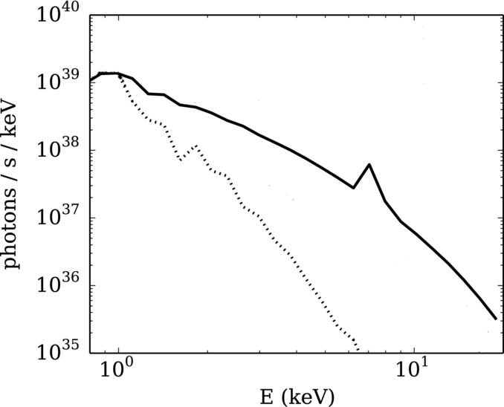
Model Grid: X-rays
high X-ray
warm high CR
fiducial
high CR
warm
0% | ✓ | ✓ | ✓ | ✓ | ✓
10% | ✓ | ✓ | ✓ | ✓ | ✓
20% | ✓ | ✓ | ✓ | ✓ | ✓
30% | ✓ | ✓ | ✓ | ✓ | ✓
40% | ✓ | ✓ | ✓ | ✓ | ✓
50% | ✓ | ✓ | ✓ | ✓ | ✓
60% | ✓ | ✓ | ✓ | ✓ | ✓
70% | ✓ | ✓ | ✓ | ✓ | ✓
80% | ✓ | ✓ | ✓ | ✓ | ✓
90% | ✓ | ✓ | ✓ | ✓ | ✓
99% | ✓ | ✓ | ✓ | ✓ | ✓
High X-rays:
L_{XR} = 10³¹ erg s⁻¹
Flaring
Large grains
Fiducial:
L_{XR} = 10³⁰ erg s⁻¹
Quiescent
Cleeves+15

Slide 14
Model Grid: Cosmic Rays
high X-ray
warm high CR
fiducial
high CR
warm
0% | ✓ | ✓ | ✓ | ✓ | ✓
10% | ✓ | ✓ | ✓ | ✓ | ✓
20% | ✓ | ✓ | ✓ | ✓ | ✓
30% | ✓ | ✓ | ✓ | ✓ | ✓
40% | ✓ | ✓ | ✓ | ✓ | ✓
50% | ✓ | ✓ | ✓ | ✓ | ✓
60% | ✓ | ✓ | ✓ | ✓ | ✓
70% | ✓ | ✓ | ✓ | ✓ | ✓
80% | ✓ | ✓ | ✓ | ✓ | ✓
90% | ✓ | ✓ | ✓ | ✓ | ✓
99% | ✓ | ✓ | ✓ | ✓ | ✓
Large grains
High CR:
𝛇_{CR} = 2×10⁻¹⁷ s⁻¹
ISM level
Fiducial:
𝛇_{CR} = 1.6×10⁻¹⁹ s⁻¹
Modulated by stellar wind
see Cleeves+13

Slide 15
Model Grid: Temperature
high X-ray
warm high CR
fiducial
high CR
warm
0% | ✓ | ✓ | ✓ | ✓ | ✓
10% | ✓ | ✓ | ✓ | ✓ | ✓
20% | ✓ | ✓ | ✓ | ✓ | ✓
30% | ✓ | ✓ | ✓ | ✓ | ✓
40% | ✓ | ✓ | ✓ | ✓ | ✓
50% | ✓ | ✓ | ✓ | ✓ | ✓
60% | ✓ | ✓ | ✓ | ✓ | ✓
70% | ✓ | ✓ | ✓ | ✓ | ✓
80% | ✓ | ✓ | ✓ | ✓ | ✓
90% | ✓ | ✓ | ✓ | ✓ | ✓
99% | ✓ | ✓ | ✓ | ✓ | ✓
Large grains
warm:
Increase T by 20 K
Younger disk
Heating by accretion/envelope (D’Alessio+97)

Slide 16
Model Grid: Temperature
high X-ray
warm high CR
fiducial
high CR
warm
0% | ✓ | ✓ | ✓ | ✓ | ✓
10% | ✓ | ✓ | ✓ | ✓ | ✓
20% | ✓ | ✓ | ✓ | ✓ | ✓
30% | ✓ | ✓ | ✓ | ✓ | ✓
40% | ✓ | ✓ | ✓ | ✓ | ✓
50% | ✓ | ✓ | ✓ | ✓ | ✓
60% | ✓ | ✓ | ✓ | ✓ | ✓
70% | ✓ | ✓ | ✓ | ✓ | ✓
80% | ✓ | ✓ | ✓ | ✓ | ✓
90% | ✓ | ✓ | ✓ | ✓ | ✓
99% | ✓ | ✓ | ✓ | ✓ | ✓
Large grains
warm high CR:
Increase T by 20 K
𝛇_{CR} = 2×10⁻¹⁷ s⁻¹

Slide 17

Model Grid: Disk Mass
0.003 M⨀
high X-ray
warm high CR
fiducial
high CR
warm
0% | ✓ | ✓ | ✓ | ✓ | ✓
10% | ✓ | ✓ | ✓ | ✓ | ✓
20% | ✓ | ✓ | ✓ | ✓ | ✓
30% | ✓ | ✓ | ✓ | ✓ | ✓
40% | ✓ | ✓ | ✓ | ✓ | ✓
50% | ✓ | ✓ | ✓ | ✓ | ✓
60% | ✓ | ✓ | ✓ | ✓ | ✓
70% | ✓ | ✓ | ✓ | ✓ | ✓
80% | ✓ | ✓ | ✓ | ✓ | ✓
90% | ✓ | ✓ | ✓ | ✓ | ✓
99% | ✓ | ✓ | ✓ | ✓ | ✓
Large grains
Notes:
3.14

Slide 18
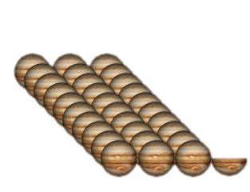
Model Grid: Disk Mass
0.003 M⨀
0.03 M⨀
warm high CR
high X-ray
warm high CR
high X-ray
fiducial
high CR
fiducial
high CR
warm
warm
0% | ✓ | ✓ | ✓ | ✓ | ✓
10% | ✓ | ✓ | ✓ | ✓ | ✓
20% | ✓ | ✓ | ✓ | ✓ | ✓
30% | ✓ | ✓ | ✓ | ✓ | ✓
40% | ✓ | ✓ | ✓ | ✓ | ✓
50% | ✓ | ✓ | ✓ | ✓ | ✓
60% | ✓ | ✓ | ✓ | ✓ | ✓
70% | ✓ | ✓ | ✓ | ✓ | ✓
80% | ✓ | ✓ | ✓ | ✓ | ✓
90% | ✓ | ✓ | ✓ | ✓ | ✓
99% | ✓ | ✓ | ✓ | ✓ | ✓
✓ | ✓ | ✓ | ✓ | ✓
✓ | ✓ | ✓ | ✓ | ✓
✓ | ✓ | ✓ | ✓ | ✓
✓ | ✓ | ✓ | ✓ | ✓
✓ | ✓ | ✓ | ✓ | ✓
✓ | ✓ | ✓ | ✓ | ✓
✓ | ✓ | ✓ | ✓ | ✓
✓ | ✓ | ✓ | ✓ | ✓
✓ | ✓ | ✓ | ✓ | ✓
✓ | ✓ | ✓ | ✓ | ✓
✓ | ✓ | ✓ | ✓ | ✓
Large grains
Notes:
31.4

Slide 19
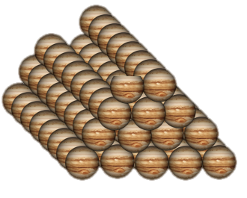
Model Grid: Disk Mass
0.003 M⨀
0.03 M⨀
0.1 M⨀
warm high CR
high X-ray
warm high CR
high X-ray
warm high CR
high X-ray
fiducial
high CR
fiducial
high CR
fiducial
high CR
warm
warm
warm
0% | ✓ | ✓ | ✓ | ✓ | ✓
10% | ✓ | ✓ | ✓ | ✓ | ✓
20% | ✓ | ✓ | ✓ | ✓ | ✓
30% | ✓ | ✓ | ✓ | ✓ | ✓
40% | ✓ | ✓ | ✓ | ✓ | ✓
50% | ✓ | ✓ | ✓ | ✓ | ✓
60% | ✓ | ✓ | ✓ | ✓ | ✓
70% | ✓ | ✓ | ✓ | ✓ | ✓
80% | ✓ | ✓ | ✓ | ✓ | ✓
90% | ✓ | ✓ | ✓ | ✓ | ✓
99% | ✓ | ✓ | ✓ | ✓ | ✓
✓ | ✓ | ✓ | ✓ | ✓
✓ | ✓ | ✓ | ✓ | ✓
✓ | ✓ | ✓ | ✓ | ✓
✓ | ✓ | ✓ | ✓ | ✓
✓ | ✓ | ✓ | ✓ | ✓
✓ | ✓ | ✓ | ✓ | ✓
✓ | ✓ | ✓ | ✓ | ✓
✓ | ✓ | ✓ | ✓ | ✓
✓ | ✓ | ✓ | ✓ | ✓
✓ | ✓ | ✓ | ✓ | ✓
✓ | ✓ | ✓ | ✓ | ✓
✓ | ✓ | ✓ | ✓ | ✓
✓ | ✓ | ✓ | ✓ | ✓
✓ | ✓ | ✓ | ✓ | ✓
✓ | ✓ | ✓ | ✓ | ✓
✓ | ✓ | ✓ | ✓ | ✓
✓ | ✓ | ✓ | ✓ | ✓
✓ | ✓ | ✓ | ✓ | ✓
✓ | ✓ | ✓ | ✓ | ✓
✓ | ✓ | ✓ | ✓ | ✓
✓ | ✓ | ✓ | ✓ | ✓
✓ | ✓ | ✓ | ✓ | ✓
Large grains
Notes:
103.8 Jupiters

Slide 20
Analysis
100 au
Warm molecular layer (Schwarz+18)
  Probed by ALMA
Midplane (Schwarz+ in prep)
  Planet formation
12 au
CO ice
Warm molecular layer
CO gas

Slide 21
Midplane CO After 1 Myr
Factor of 10 depletion for high CR
  C in CH₃OH & CO₂ ices
No model depleted by 100
not
depleted
depleted
extremely
depleted
Schwarz+in prep
Notes:
Total column or average density?

Slide 22
Midplane CO After 1 Myr
Factor of 100 depletion for high CR 0.03 M⨀ disks
Lower density
  Higher CR ionization rate
not
depleted
depleted
extremely
depleted
Schwarz+in prep
Notes:
Ionization rate in 1.7 times higher in 0.03 msun models

Slide 23
Midplane CO After 1 Myr
not
depleted
Lower density
UV & X-rays reach deeper
Higher temperature
depleted
extremely
depleted
Schwarz+in prep
Notes:
Total column or average density?

Slide 24
Midplane CO After 6 Myr
not
depleted
depleted
extremely
depleted
Schwarz+in prep
Notes:
Total column or average density?

Slide 25
Conditions for Chemical Depletion
High cosmic ray rate or low surface density
Depletion timescales longer than disk lifetime (3 Myr)
Need ionization structure to understand the importance of chemistry
Physical processes also needed (e.g., Krijt+18)
not
depleted
depleted
extremely
depleted
Notes:
Can combine with final slide if need be
change un-attenuated to high ionization rate

Slide 26
Links to Planets: Total Gas C/H
6 Myr
Chemistry decreases C/H
  Opposite of dynamics (Booth+17)
Low C/H for models with high ionization
High C/H for models with low ionization
C/H_{model} / C/H_{stellar}
Schwarz+in prep

Slide 27
Links to Planets: Total Gas C/H
6 Myr
Chemistry decreases C/H
  Opposite of dynamics (Booth+17)
Low C/H for models with high ionization
High C/H for models with low ionization
C/H_{model} / C/H_{stellar}
Schwarz+in prep

Slide 28
Links to Planets: Total Gas C/H
6 Myr
Chemistry decreases C/H
  Opposite of drift (Booth+17)
High ionization → low C/H
Low ionization → high C/H
C/H_{model} / C/H_{stellar}
Schwarz+in prep
Notes:
high ionization -> low C/H

Slide 29
Links to Planets: Total Gas C/O
6 Myr
C/O ~ 1 for most models
Initial C/O super-stellar for planets formed between CO & CO₂ snowlines
Solar
Schwarz+in prep

Slide 30
C/O & Hydrocarbons
Bergin+16
Elevated C/O in low CO models
Hydrocarbons in ionized models
log C/H_{model} / C/H_{stellar}
Schwarz+in prep
Notes:
cut last bullet point

Slide 31
Summary
High cosmic ray rate or low surface density needed to chemically process CO
  Timescales 1-6 Myr
  Other processes needed
When CO is extremely depleted:
  Low C/H
  High C/O
log C/H_{model} / C/H_{stellar}

Slide 32
CO in TW Hya
CO reduced by 100 in TW Hya from 5-70 au
Does not return inside snow line
C¹⁸O J=3-2
Schwarz+16
¹³C¹⁸O J=3-2
Zhang, KS+17
Notes:
Can cut if need be

Slide 33
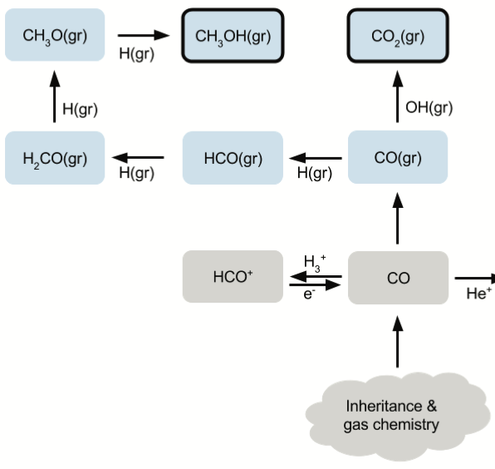
Cosmic Rays & CO Reprocessing
Cosmic rays increase H₃⁺
Destruction of HCO⁺ ➔ H
Increases H(gr)

Slide 34
Chemistry is only half the picture

Slide 35
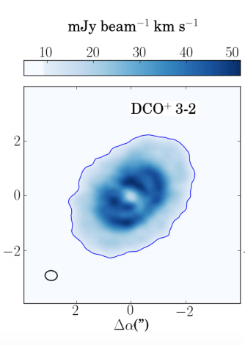
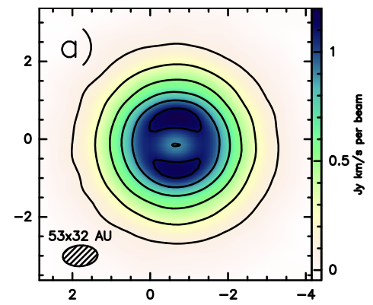
C¹⁸O J=3-2
C₂H N=4-3
Qi+ 2013
Schwarz+16
Loomis+17
Bergin+16
CS J = 5-4
CN N = 3-2
Teague+17
Hily-Blant+17
Öberg+17
Salinas+17
Notes:
Can cut if need be. These differences are because of evolving chemistry, we want to understand what this information tells us about the disks themselves and how we can relate the composition of disks to that of exoplanets

