Slide 1
A deep search for planets in the inner 15 au around Vega
Tiffany Meshkat
TM, Ricky Nilsson, Jonathan Aguilar, Gautam Vasisht, Rebecca Oppenheimer, Kate Y. L. Su, Eric Cady, Thomas Lockhart, Christopher Matthews, Richard Dekany, Jarron Leisenring, Marie Ygouf, Dimitri Mawet, Laurent Pueyo, Charles Beichman AJ in press.

Slide 2
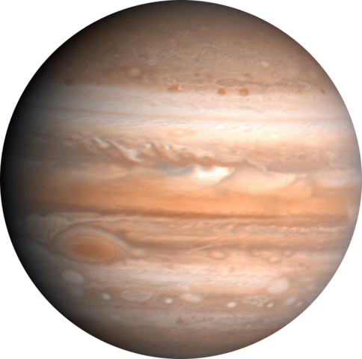
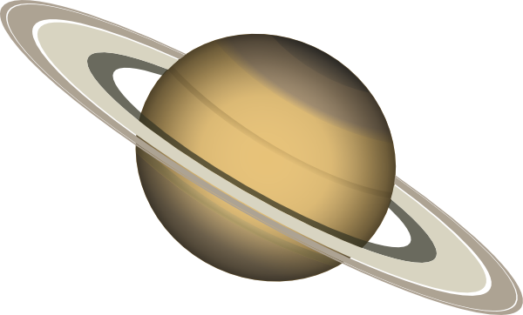
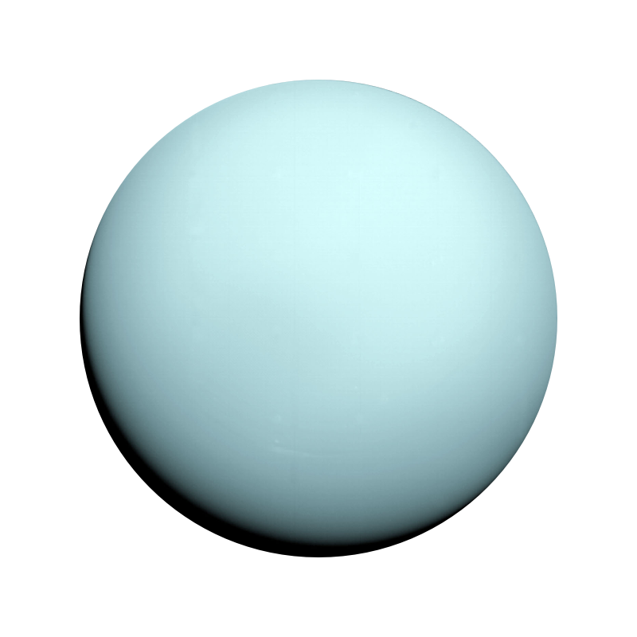
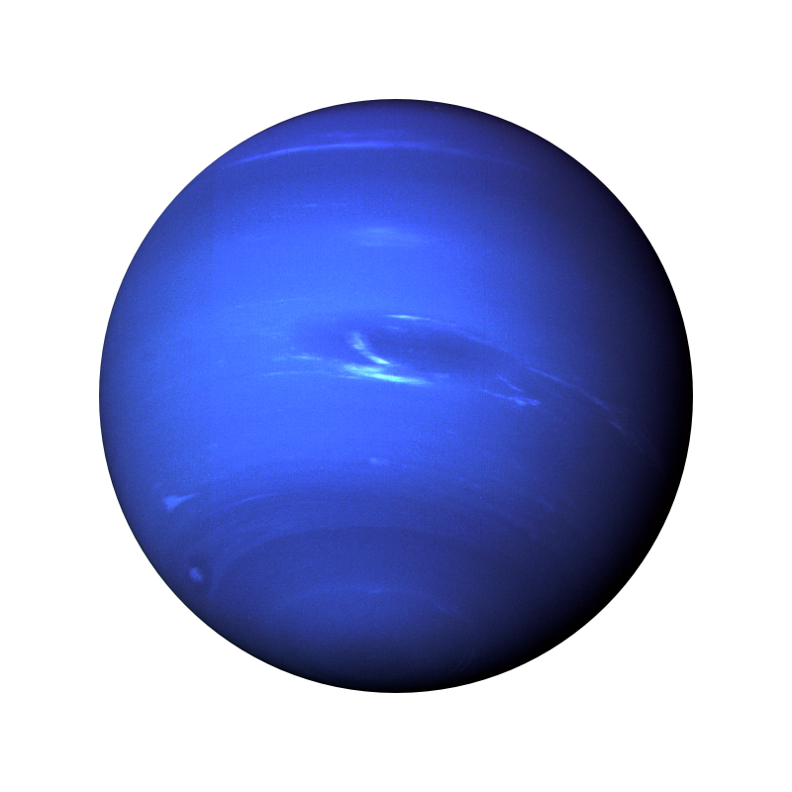

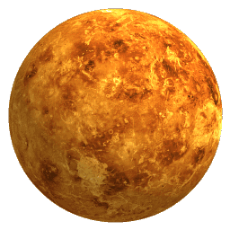
Data from NASA Exoplanet Archive

Slide 3
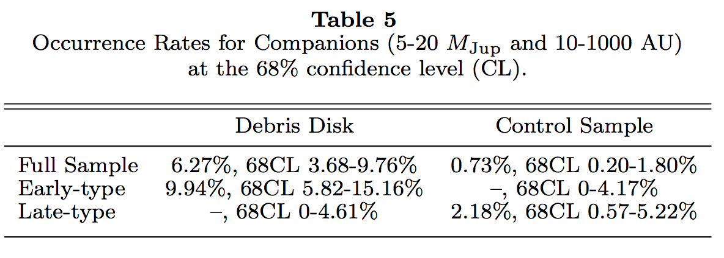
Giant planets be more common around stars with debris disks
Meshkat et al. 2017

Slide 4
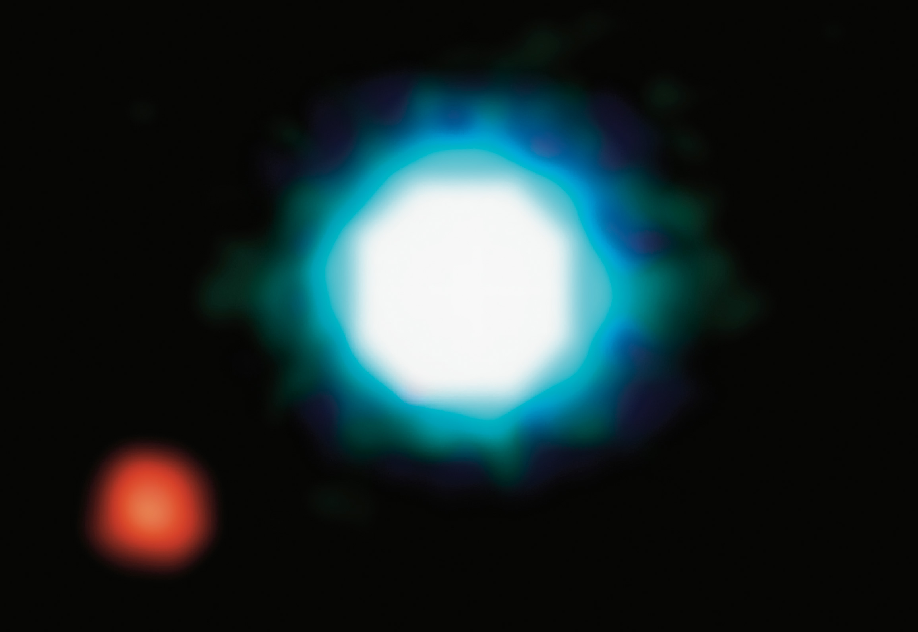
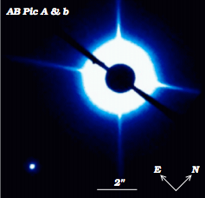
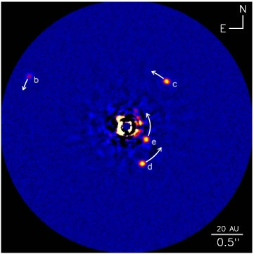
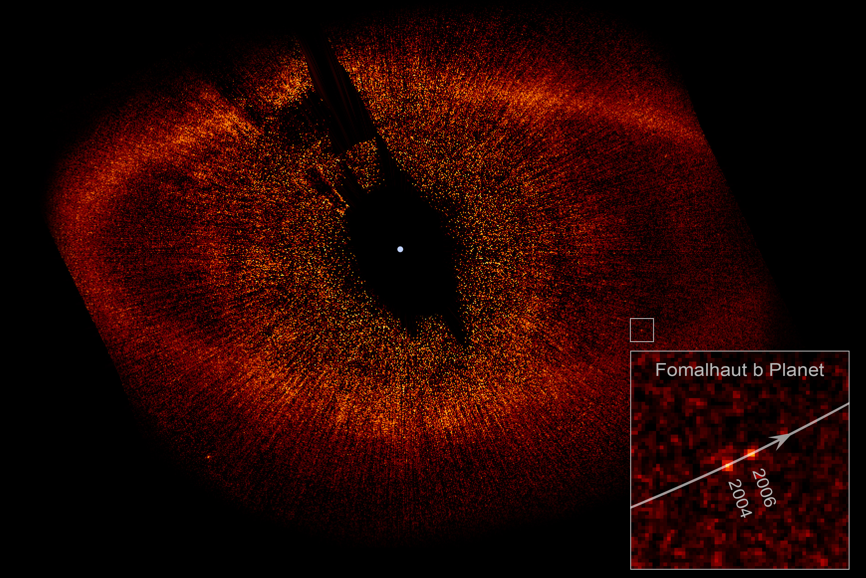
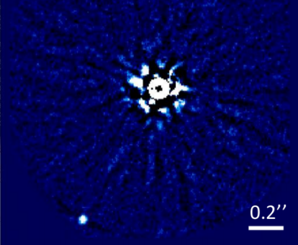
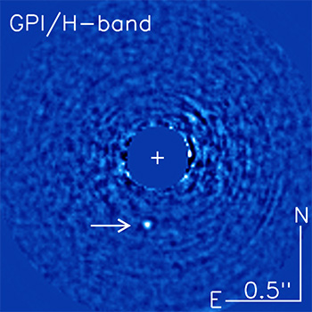
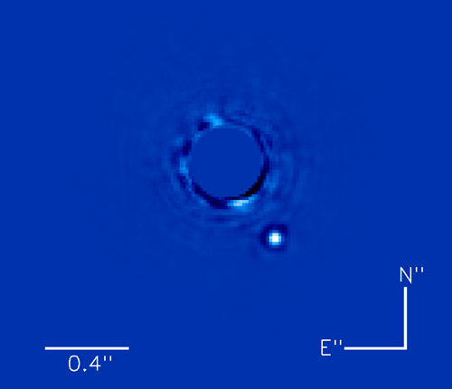
2M1207 b
HD 95086 b
HD 106906 b
HR 8799 bcde
Fomalhaut b
HIP 65426 b
51 Eri b
Beta Pic b

Slide 5
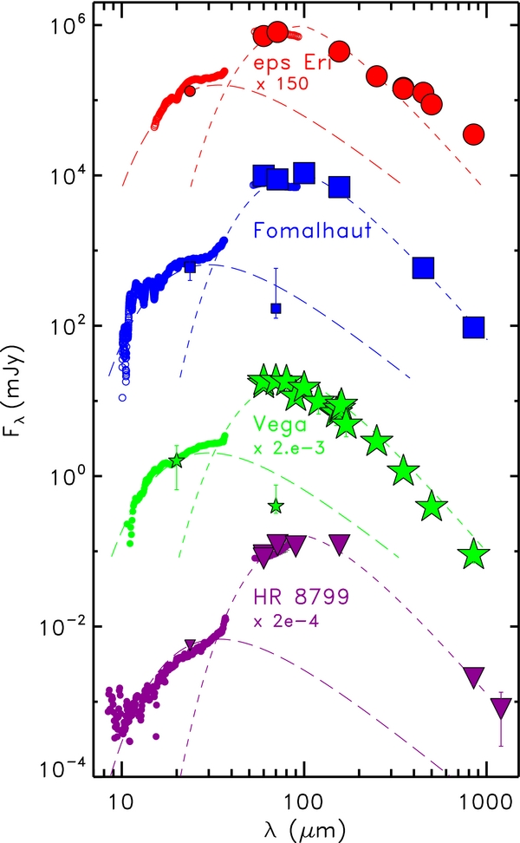
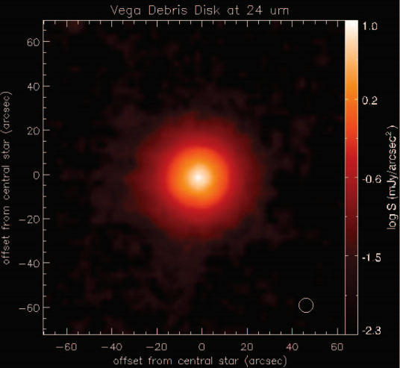

Vega has a gap in its debris disk!
445 +/- 13 Myr
A0V star
7.68 pc
Face-on debris disk with resolved cold belt and inferred warm belt
Su et al. 2005
Su et al. 2013

Slide 6
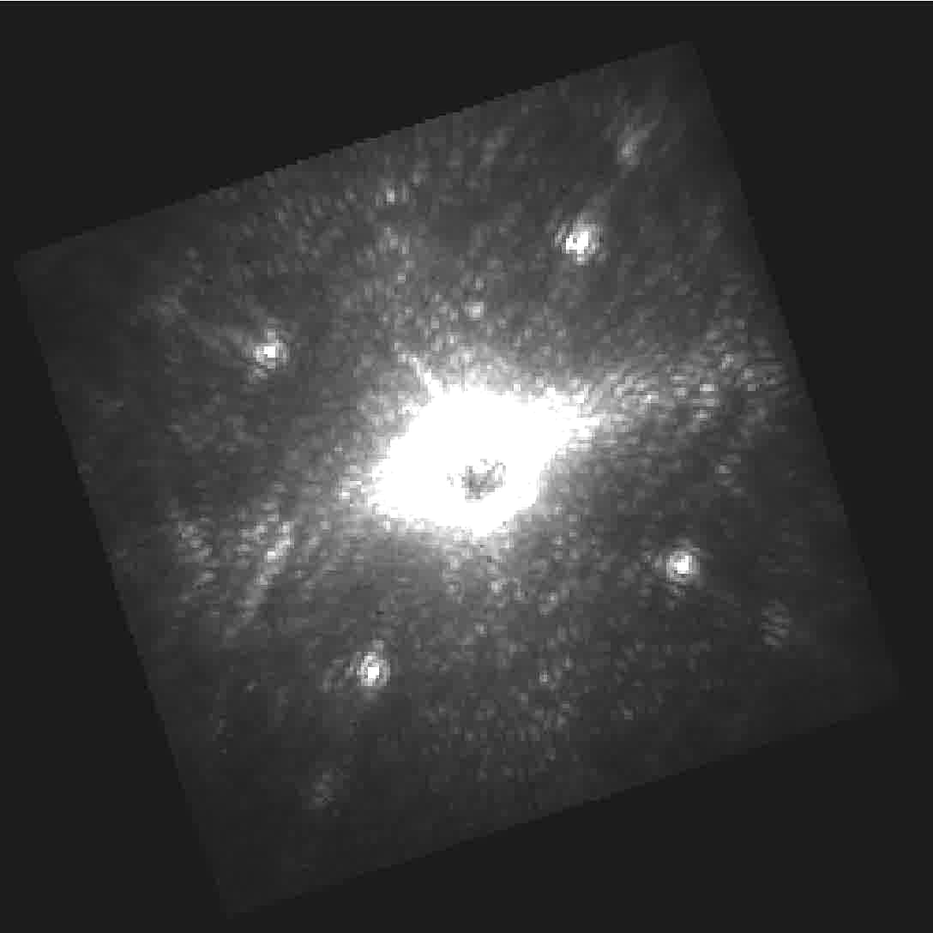
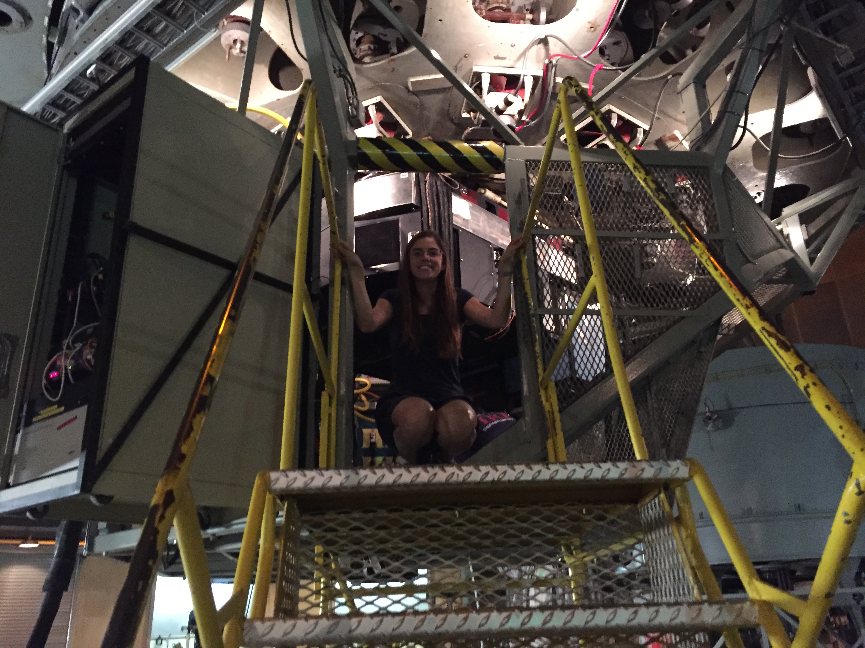
Palomar P1640 data
Integral field spectrograph
969-1797 nm (Y-H band) 32 channels
FOV 3.8”x3.8”
4 nights approved
  5.5 hrs in seeing >1.5”

Slide 7
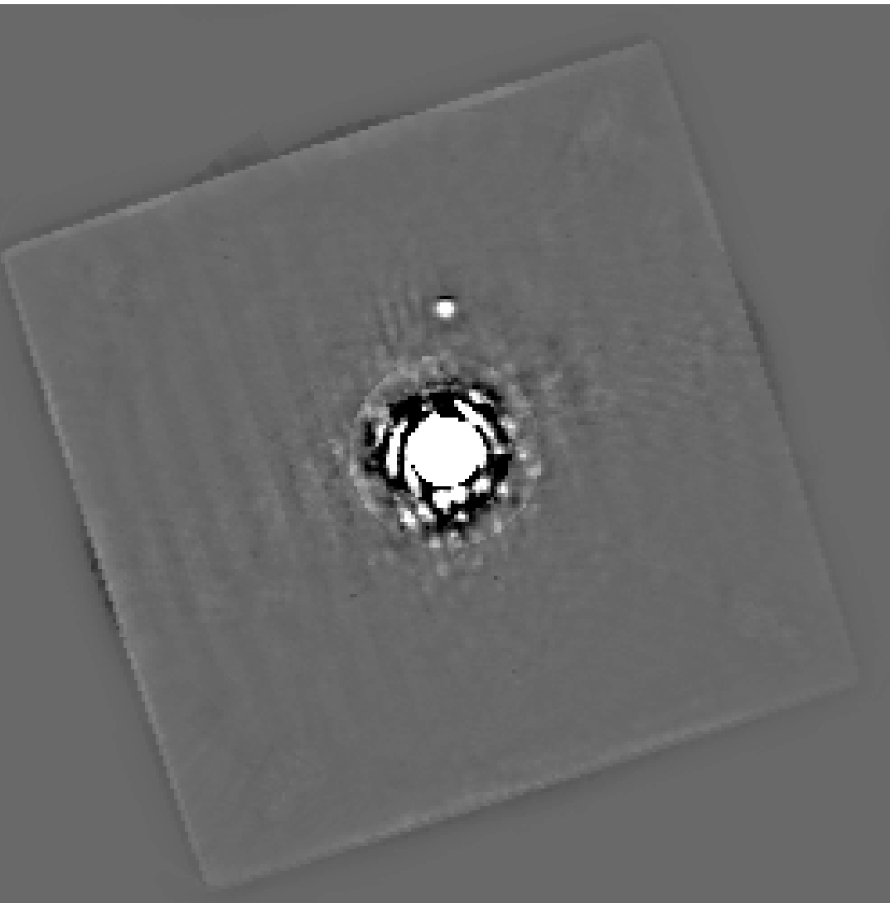
SDI: wavelength to separate the planet
Not real!

Slide 8
Sensitivity achieved inside warm belt
Meshkat et al. 2018 in press

Slide 9
How good are we doing?
Expect co-adding frames to provide n^{-1/2} improvement
Only saw improvement of n^{-1/5}
Meshkat et al. 2018 in press
Notes:
Expected almost 3 magnitudes of gain but only saw about 1 magnitude of gain

Slide 10
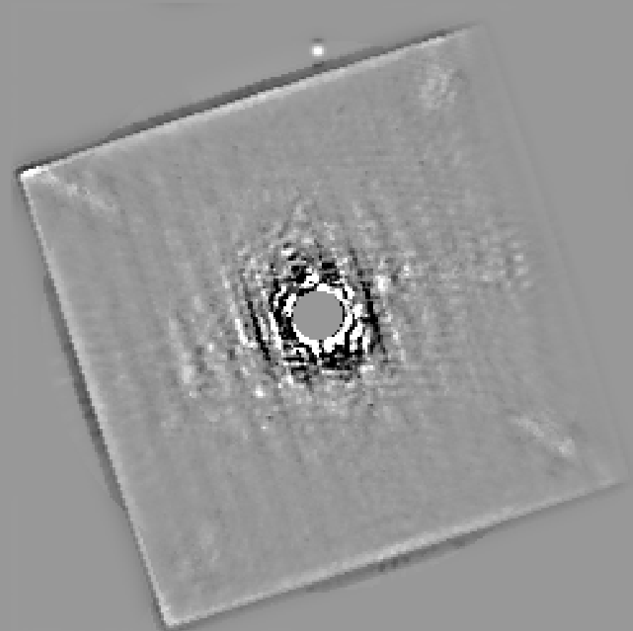
Residual structure after post-processing
Striping pattern due to the H2RG detector temporal gain variations between readout channels
Under-responsive actuators on the high order deformable mirror (due to aging of the DM)

Slide 11
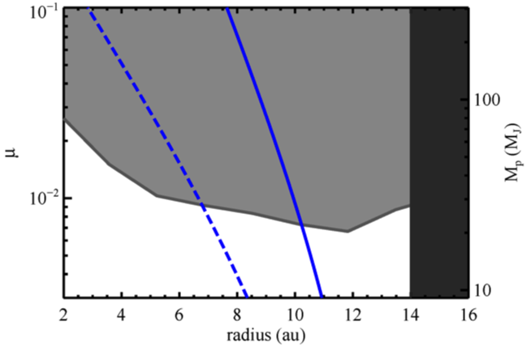
Limits on shepherding planets
Meshkat et al. 2018 in press
Notes:
Blue line is the mass and location of a possible circular, shepherding planet needed to maintain the inner edge

Slide 12
Where we are with Vega
Meshkat et al. 2018 in press

Slide 13
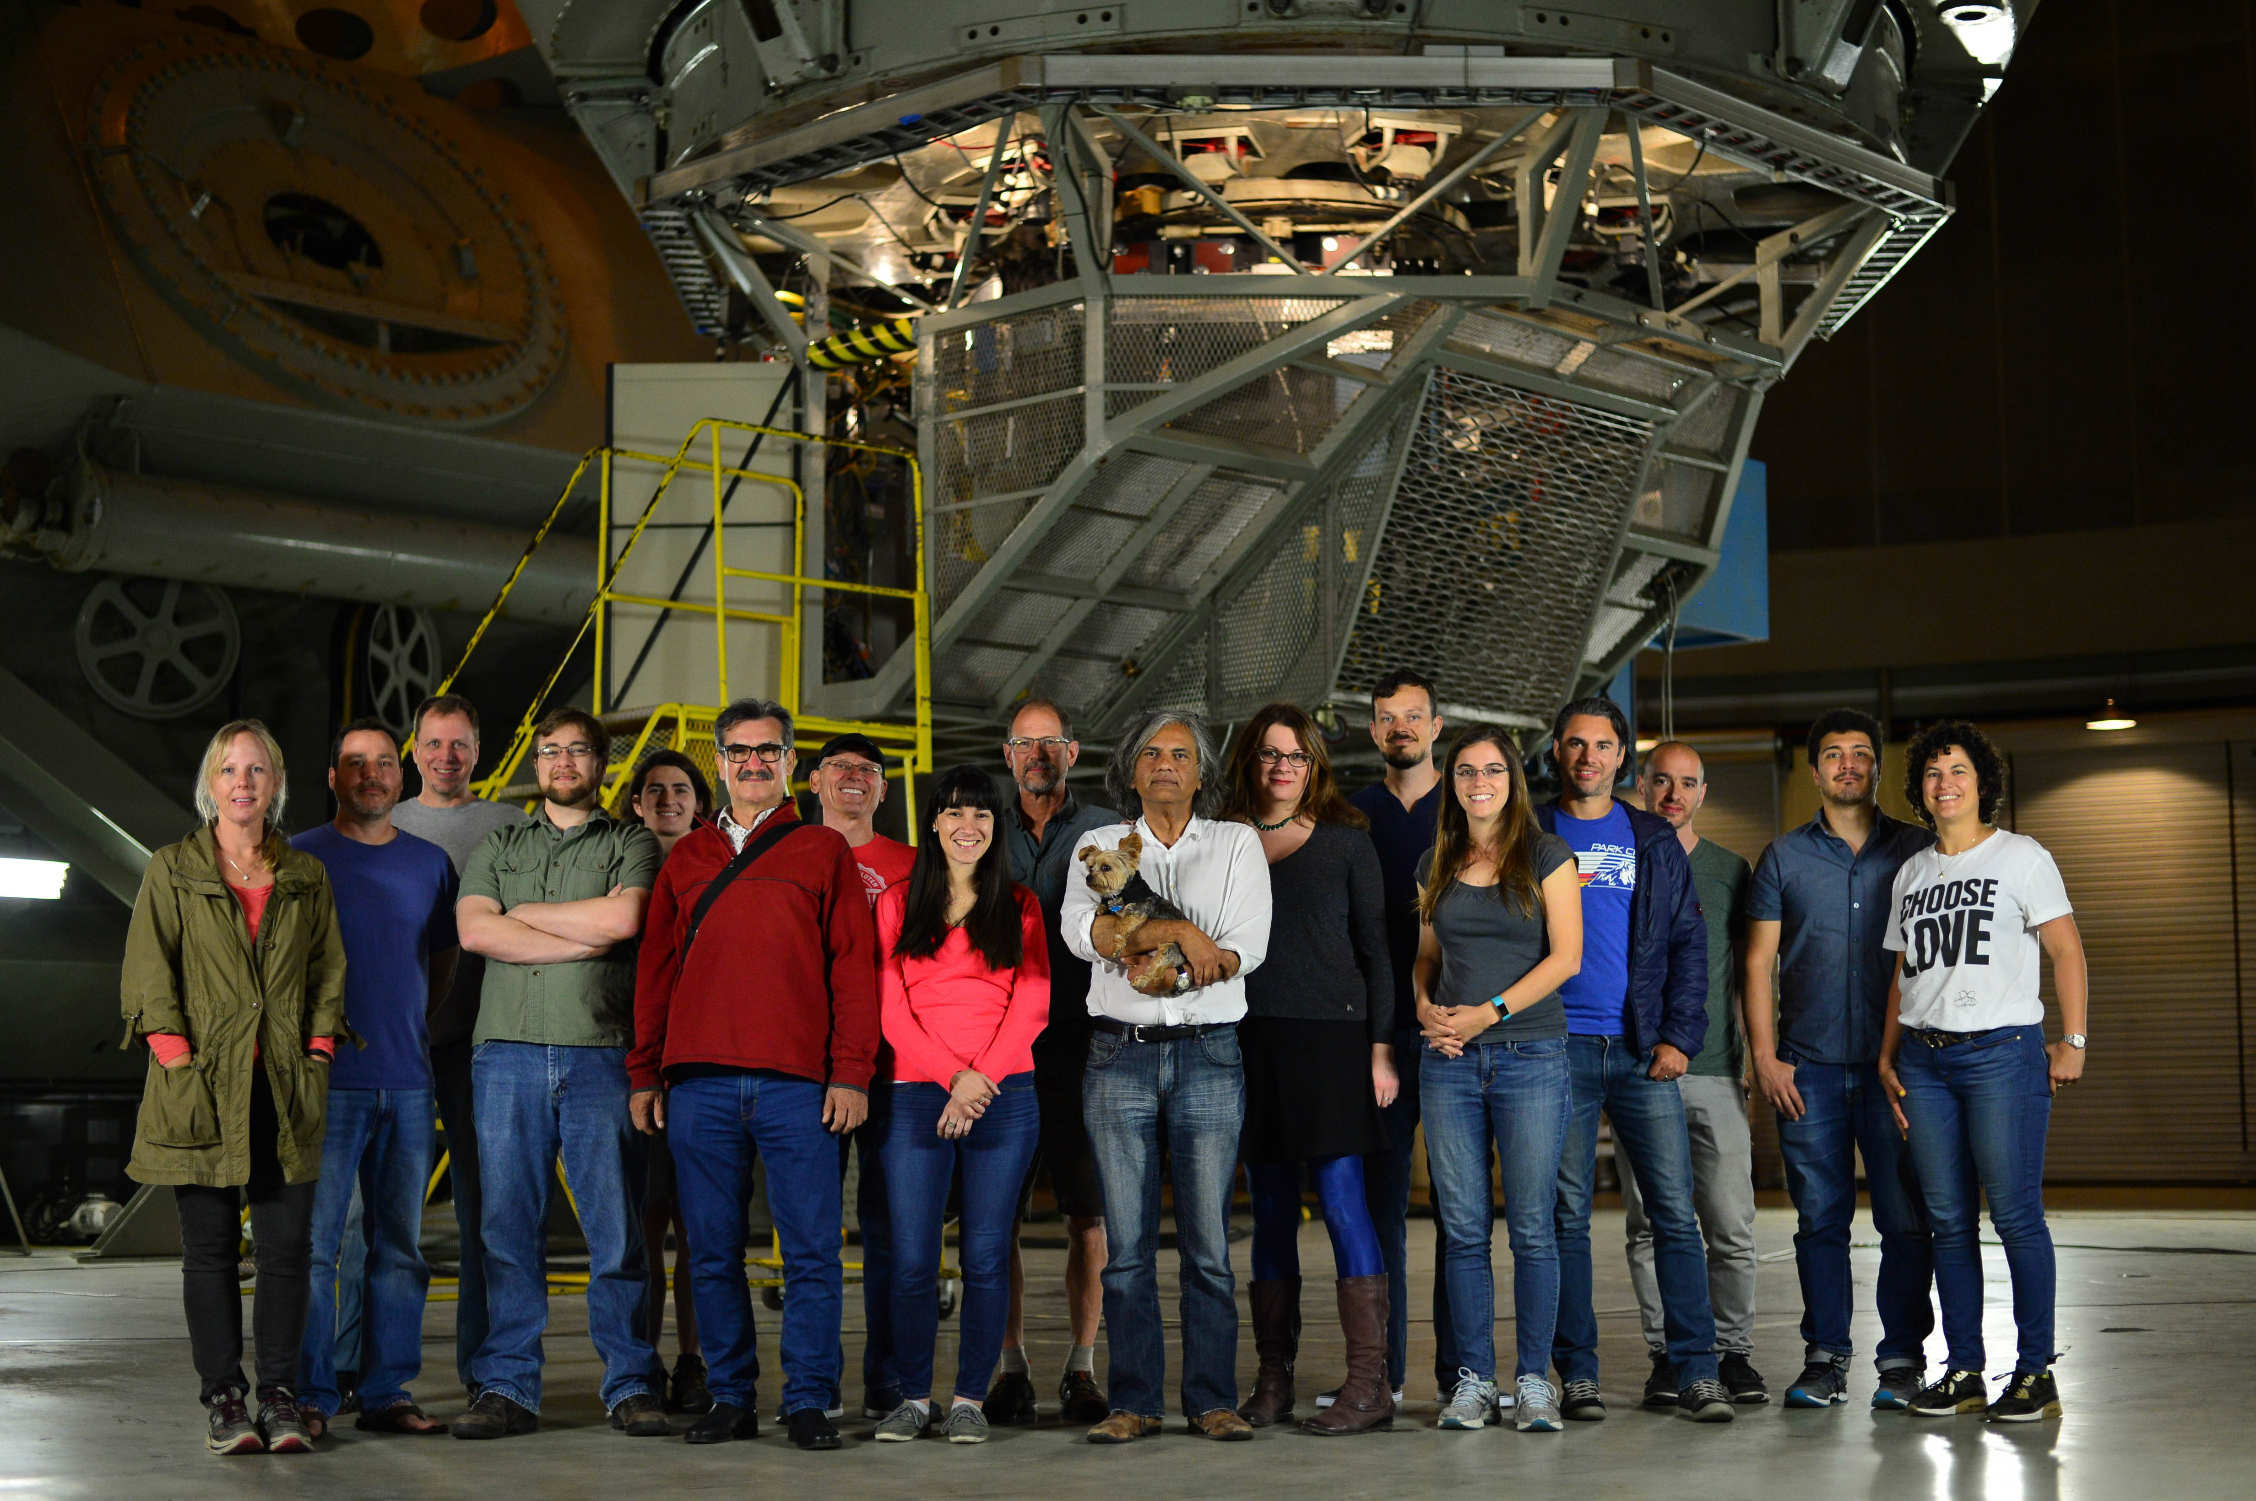
Conclusions
5.5 hours of Vega near-infrared data with Palomar P1640
  Deepest dataset with P1640 and Vega (from 2-15 au)
JWST will provide significant improvement beyond 11 au
Approved Keck Vortex M-band observations will complement JWST observations and set deep limits inside the inner warm belt!

Slide 14



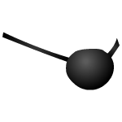




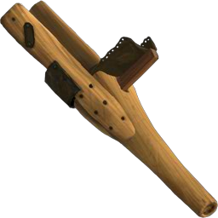
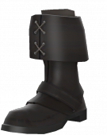
Conclusions
5.5 hours of Vega near-infrared data with Palomar P1640
  Deepest dataset with P1640 and Vega (from 2-15 au)
JWST will provide significant improvement beyond 11 au
Approved Keck Vortex M-band observations will complement JWST observations and set deep limits inside the inner warm belt!

Slide 16
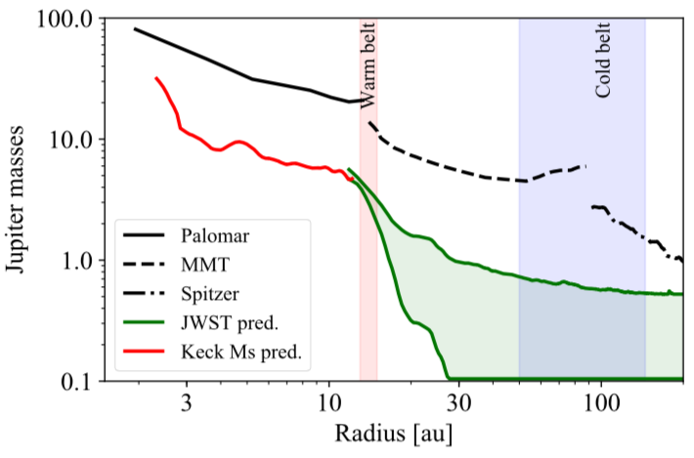
Future work with Keck in M-band
Keck 2018B approved

