Slide 1
A Preliminary Trade Study of Hybrid Lyot Coronagraphs for LUVOIR
Carl Coker, NASA Postdoctoral Program Fellow, NASA JPL
Collaborators: AJ Riggs, Gareth Ruane, Stuart Shaklan
September 17, 2018
© 2018. California Institute of Technology. Government sponsorship acknowledged.

Slide 2
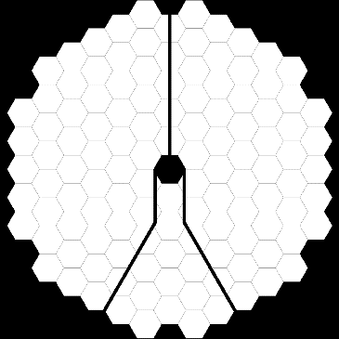
Large UV/Optical/Infrared Surveyor (LUVOIR)
LUVOIR A
15 meters, on-axis
LUVOIR B
8 meters, off-axis
General astrophysics observatory with dedicated exoplanet instrumentation
Telescope Pupil
DM1
DM2
Focal Plane Mask
Lyot Stop
Image Plane

Slide 3
Hybrid Lyot Coronagraphs
No pupil-plane apodization
Two-layer partially transmissive focal plane mask
Thin (<100 nm) uniform nickel layer
Variable-thickness dielectric (PMGI) layer
Controls focal plane phase
Allow inner working angles below 3λ/D on obstructed aperture telescopes

Slide 4
Inter-DM Fresnel Number

Slide 5
Number of DM Actuators

Slide 6
Performance Vs. Inner Working Angle

Slide 7
Optimal Starting PMGI Thickness

Slide 8
Optimal Lyot Stop Size

Slide 9
Future Work
Improving tip/tilt sensitivity
Reducing likelihood of controller missteps
Limited true multi-dimensional surveys
Many parameters likely to be interdependent

