Slide 1
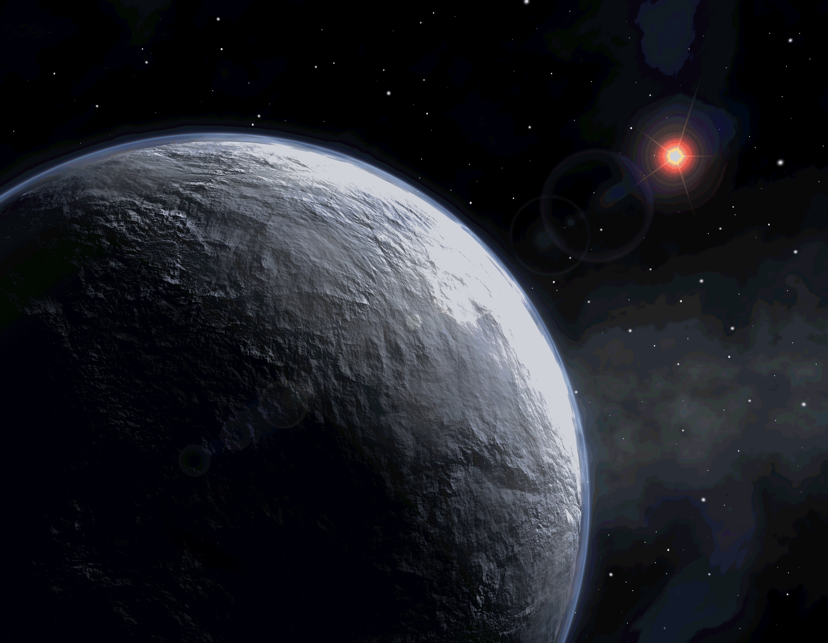



The Future of Exoplanetary Microlensing:
The Watershed
Microlensing 21
Microlensing Tutorial
January 31, 2016
Scott Gaudi
The Ohio State University

Slide 2
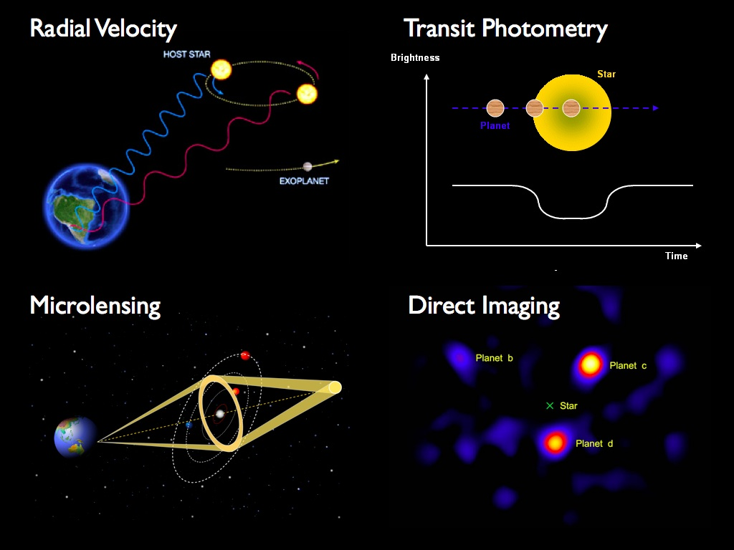
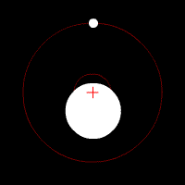
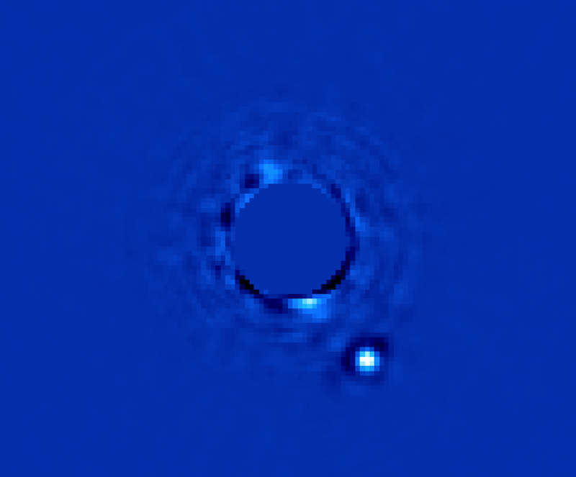
Four Methods of Finding Planets.
Astrometry
Direct Imaging
Macintosh et al. 2014

Slide 3
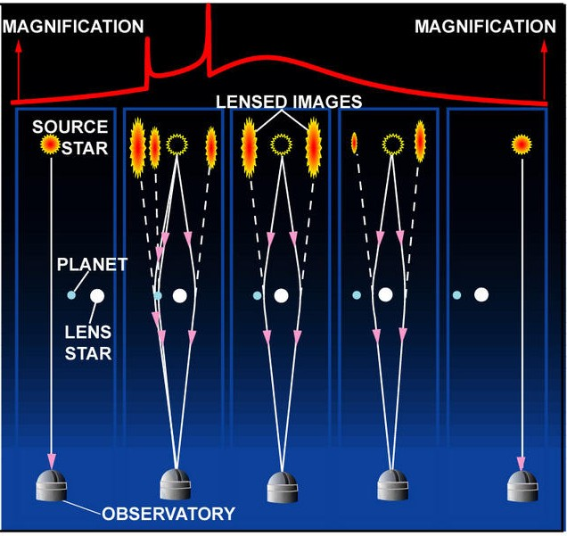
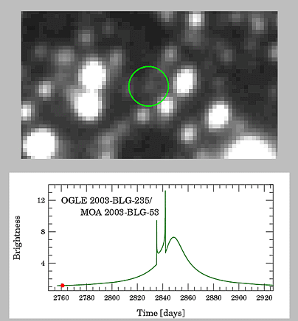
Oh, yeah, and microlensing…

Slide 4
“I don’t understand. You are looking for planets you can’t see around stars you can’t see.”
-Debra Fischer
(c. 2000)
“Microlensing is a cult.”
-Dave Koerner

Slide 5
cult n.
1. A religion or religious sect generally considered extremist or false, with its followers often living in an unconventional manner under the guidance of an authoritarian, charismatic leader.
2. A system or community of religious worship and ritual.
3. The formal means of expressing religious reverence; religious ceremony and ritual.
4. A usually non-scientific method or regimen claimed by its originator to have exclusive or exceptional power in curing a particular disease.
5. Obsessive, especially faddish, devotion to or veneration for a person, principle, or thing.
6. An exclusive group of persons sharing an esoteric, usually artistic or intellectual interest.

Slide 6
Drink the Kool-Aid…
Planets beyond the snow line.
  Most sensitive at ~few × a_{snow}
Very low-mass planets.
  >10% Mars.
Long-period and free-floating planets.
  0.5 AU - ∞
Wide range of host masses.
  BD, M<M_{Sun}, remnants
  Typically 0.5 M_{Sun}
Planets throughout the Galaxy.
  1-8 kpc

Slide 7
The Watershed.

Slide 8
watershed n.
1. An area or ridge of land that separates waters flowing to different rivers, basins, or seas.
2. An event or period marking a turning point in a course of action or state of affairs.

Slide 9
The Watershed:
The 2010 Decadal Survey.

Slide 10
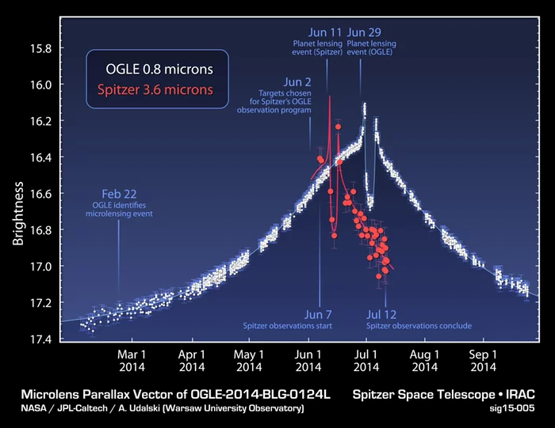
The Microlensing Watershed.
Spitzer & K2C9+K2C11.
  Masses and distances.
  Mass function and Galactic distribution of planets.
  Free-floating planets masses (K2C9).
KMTNet
  3 1.6m telescopes, 4 sq. degree FOV
  ~50 detections/year.
Euclid & WFIRST
  Detections en masse.
  Complete the census of exoplanets started by Kepler.
(Udalski et al. 2014; Yee et al. 2014, 2015; Calchi Novati et al. 2014, 2015; Zhu et al. 2015a,b,c; Shvartzvald et al. 2015; Street et al. 2015; Poleski et al. 2015; Henderson et al. 2015; Bozza et al. 2016)

Slide 11
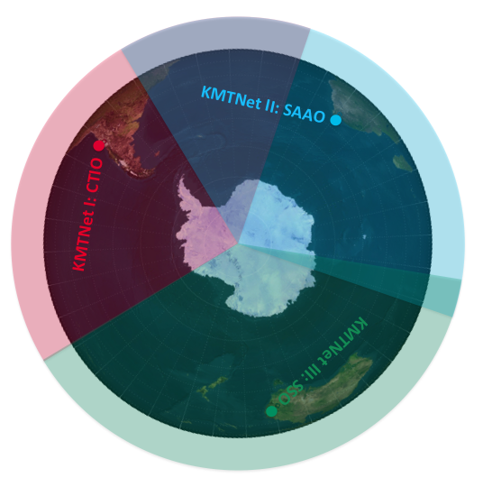
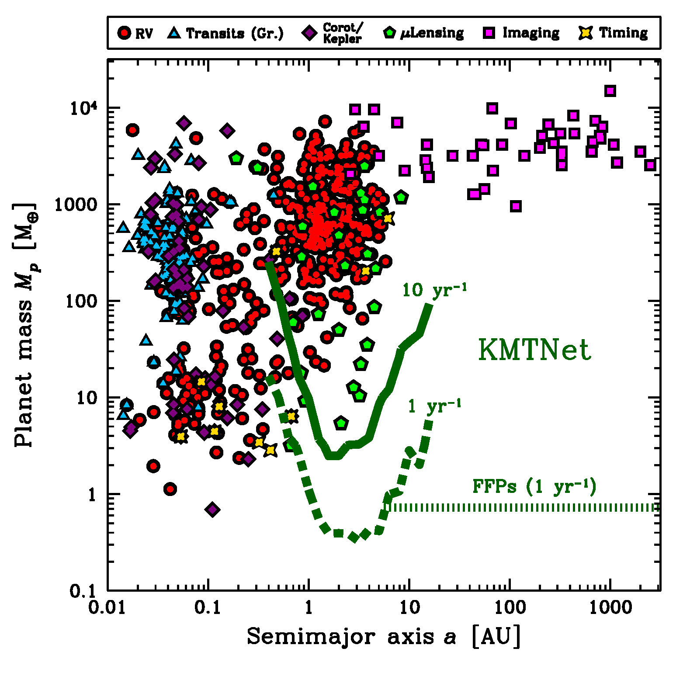
Korean Microlensing Telescope Network.
(Henderson et al. 2014)

Slide 12
Spitzer and K2

Slide 13
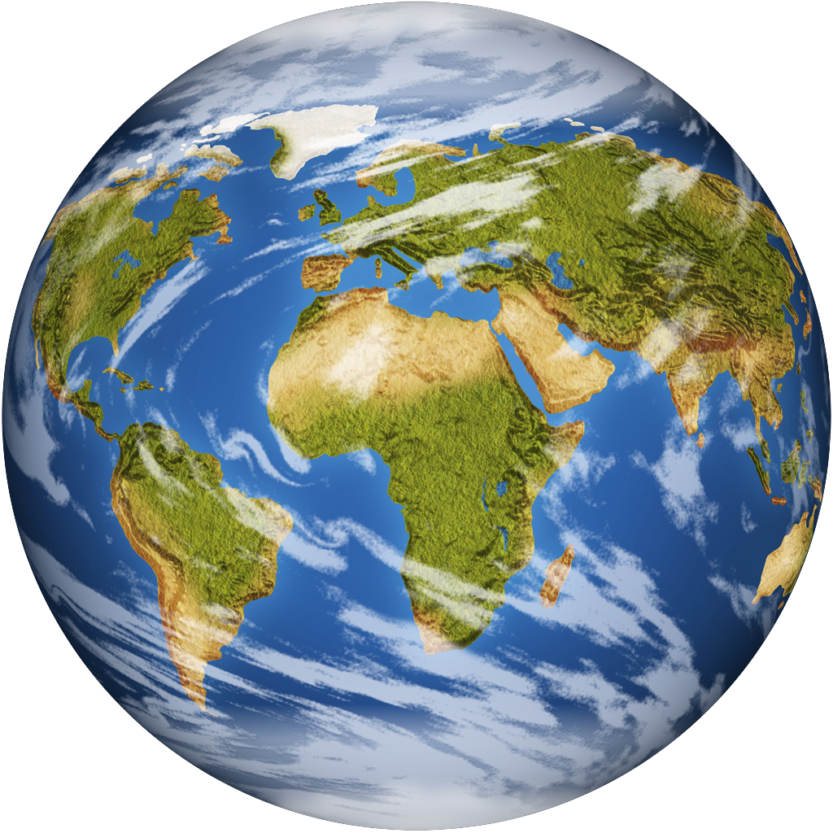
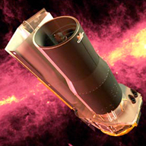
Spitzer
Kepler
Gould 1994 ApJL, 421, 75

Slide 14
Spitzer
Gould 1994 ApJL, 421, 75

Slide 15
May 22
Jun 11
Jul 1
Jul 21
Aug 10
Yee et al. 2015, ApJ 802, 76
Notes:
Fig. 1.— Lightcurve of OGLE-2014-BLG-0939 as seen by OGLE from Earth (black) and Spitzer (red) ∼ 1AU to the West. While both are well-represented by Paczyn ́ski (1986) curves (blue), they have substantially different maximum magnifications and times of max- imum, whose differences yield a measurement of the “microlens parallax” vector πE. The dashed portion of the Spitzer curve extends the model to what Spitzer could have observed if it were not prevented from doing so by its Sun-angle constraints. Light curves are aligned to the OGLE I-band scale (as is customary), even though Spitzer observations are at 3.6μm. Lower panel shows residuals.
We infer a projected velocity v ̃hel ∼ 250 km s−1, which strongly favors a lens in the Galactic Disk with mass M = 0.23 ± 0.07 M⊙ and distance DL = 3.1 ± 0.4 kpc.

Slide 16
May 22
Jun 11
Jul 1
Jul 21
Aug 10
Yee et al. 2015, ApJ 802, 76

Slide 17
May 22
Jun 11
Jul 1
Jul 21
Aug 10
Yee et al. 2015, ApJ 802, 76

Slide 18
M = 0.23 ± 0.07 M⊙
DL = 3.1 ± 0.4 kpc
May 22
Jun 11
Jul 1
Jul 21
Aug 10
Yee et al. 2015, ApJ 802, 76

Slide 19
Feb 11
Apr 2
May 22
Jul 11
Aug 30
Jun 21
Jul 11
Udalski, Yee et al. 2015, ApJ, 799, 237
Notes:
Fig. 2.— Lightcurve and residuals for planetary model of OGLE-2014-BLG-0124 as observed from Earth by OGLE in I band (black) and by Spitzer at 3.6 μm (red), which was located ∼ 1AU East of Earth in projection at the time of the observations. Simple inspection of the OGLE lightcurve features shows that this is Jovian planet, while the fact that Spitzer observed similar features 20 days earlier demonstrates that the lens is moving v ̃ ∼ 105 km s−1 due East projected on the plane of the sky (Section 3). Detailed model-fitting confirms and refines this by-eye analysis (Section 5). Note that in the left inset, the Spitzer light curve is aligned to the OGLE system (as is customary), but it is displaced by 0.2 mag in the main diagram, for clarity.
The planet and star have masses m ∼ 0.5 Mjup and M ∼ 0.7 M⊙ and are separated by a⊥ ∼ 3.1 AU in projection. The main source of uncertainty in all these numbers (approximately 30%, 30%, and 20%) is the relatively poor measurement of the Einstein radius θE, rather than uncertainty in πE, which is measured with 2.5% precision,
q=0.7*10^(-3)

Slide 20
Feb 11
Apr 2
May 22
Jul 11
Aug 30
mp ∼ 0.5 Mjup
ML ∼ 0.7 M⊙
a⊥ ∼ 3.1 AU
Udalski, Yee et al. 2015, ApJ, 799, 237
Notes:
Fig. 2.— Lightcurve and residuals for planetary model of OGLE-2014-BLG-0124 as observed from Earth by OGLE in I band (black) and by Spitzer at 3.6 μm (red), which was located ∼ 1AU East of Earth in projection at the time of the observations. Simple inspection of the OGLE lightcurve features shows that this is Jovian planet, while the fact that Spitzer observed similar features 20 days earlier demonstrates that the lens is moving v ̃ ∼ 105 km s−1 due East projected on the plane of the sky (Section 3). Detailed model-fitting confirms and refines this by-eye analysis (Section 5). Note that in the left inset, the Spitzer light curve is aligned to the OGLE system (as is customary), but it is displaced by 0.2 mag in the main diagram, for clarity.
The planet and star have masses m ∼ 0.5 Mjup and M ∼ 0.7 M⊙ and are separated by a⊥ ∼ 3.1 AU in projection. The main source of uncertainty in all these numbers (approximately 30%, 30%, and 20%) is the relatively poor measurement of the Einstein radius θE, rather than uncertainty in πE, which is measured with 2.5% precision,
q=0.7*10^(-3)

Slide 21


Slide 22
Angular Size of Einstein Ring
Microlens
Parallax
M_{star}= θ_{E}/(κπ_{E})
κ = constant
Notes:
M = 0.056 ± 0.004 M⊙ (OB07224)

Slide 23
Street et al. 2016, ApJ, 819, 93

Slide 24
Planet!
Street et al. 2016, ApJ, 819, 93

Slide 25
Planet!
Street et al. 2016, ApJ, 819, 93

Slide 26
θE
Street et al. 2016, ApJ, 819, 93

Slide 27
θE
Street et al. 2016, ApJ, 819, 93

Slide 28
πE
θE
Street et al. 2016, ApJ, 819, 93

Slide 29
πE
θE
mp = 21±2 ME
ML = 0.38 M⊙
a⊥ =2.7 AU
Street et al. 2016, ApJ, 819, 93

Slide 30
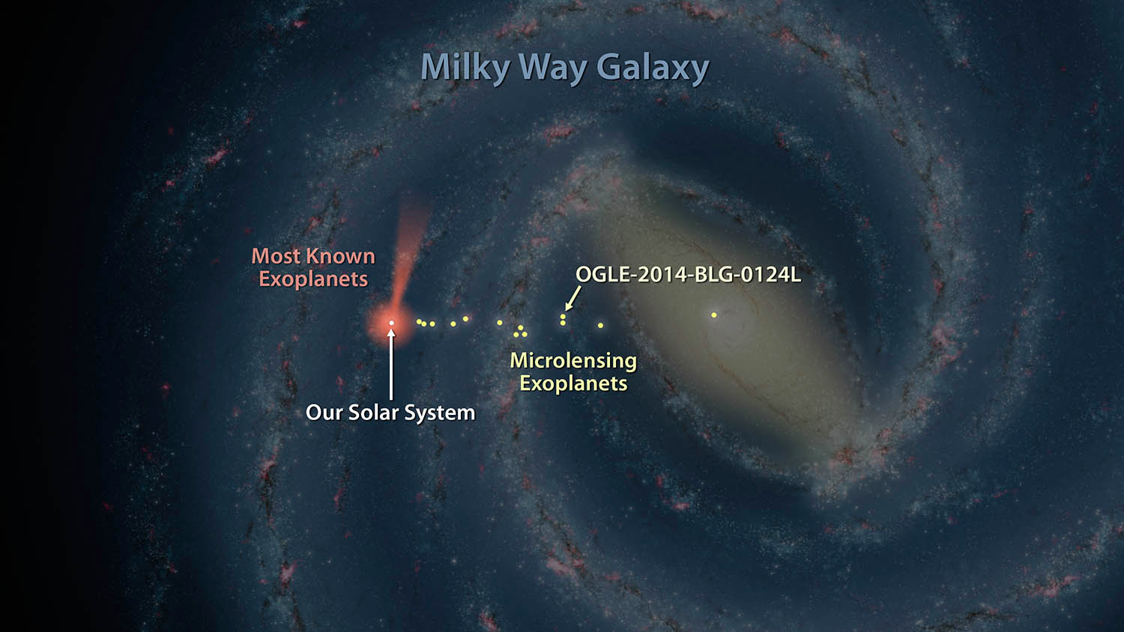
Udalski, Yee et al. 2015, ApJ, 799, 237

Slide 31
Udalski, Yee et al. 2015, ApJ, 799, 237

Slide 32
Udalski, Yee et al. 2015, ApJ, 799, 237

Slide 33
Udalski, Yee et al. 2015, ApJ, 799, 237

Slide 34
K2C9 Planet Masses.

Slide 35

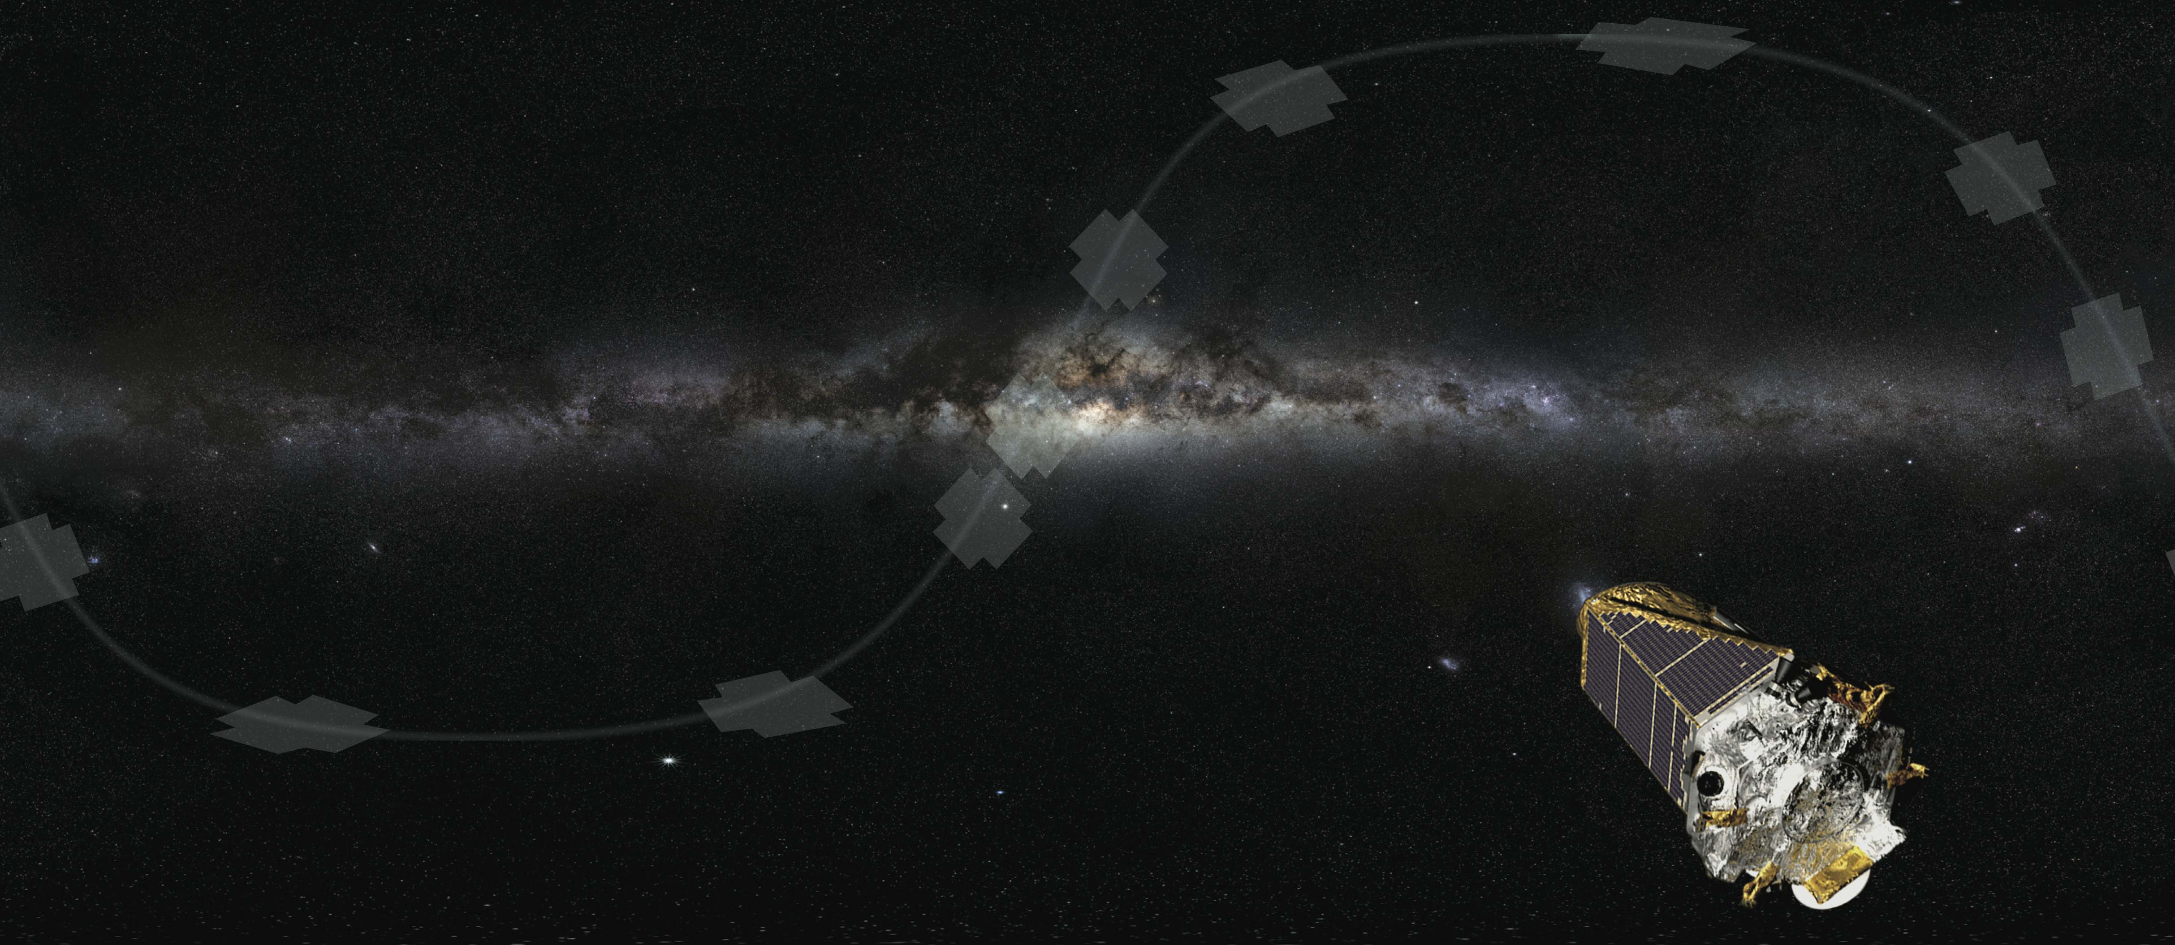
K2’s Campaign 9 (K2C9):
A Joint Ground+Space Microlensing Survey

Slide 36
What is K2C9?
Area*
Cadence
Events*
Start
End
Duration
3.74 deg²
30 min
106 (expected)
22/April, 14:04 UT
2/July, 22:34 UT
71.4 days
Found in Henderson+ (2015) arXiv:1512.09142
Uses methodology of Poleski (2016) MNRAS, 455, 3656

Slide 37
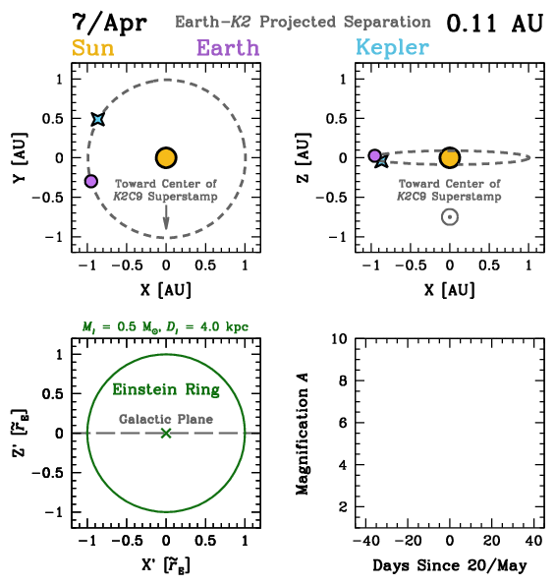

Satellite Parallax.
Henderson+ (2015) arXiv:1512.09142

Slide 38
Science Goals: Quality versus Quantity
Addressing (relatively) Unexplored Demographic Questions
1
Free-floating planets
2
Galactic distribution
3
Cold and bound exoplanets

Slide 39
Science Goals: Quality versus Quantity
Addressing (relatively) Unexplored Demographic Questions
1
Free-floating planets
2
Galactic distribution
3
Cold and bound exoplanets

Slide 40
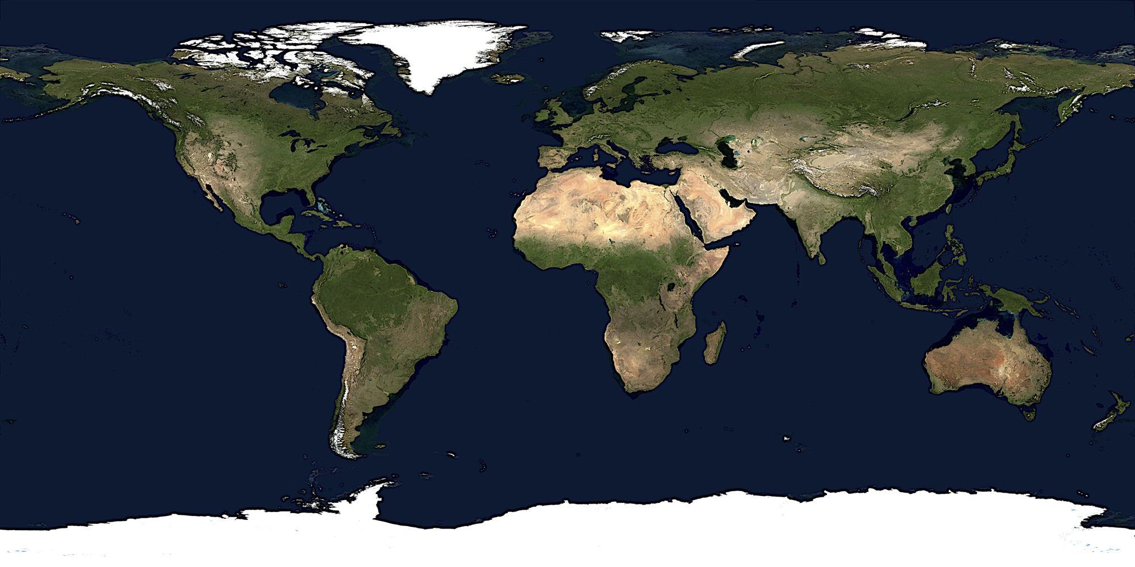
Simultaneous Ground-based Resources
MiNDSTEp
WIYN
Wise
MiNDSTEp
LT
CFHT
UKIRT
IRTF
Keck
Subaru
OGLE
LCOGT
KMTNet
LCOGT
MiNDSTEp
DECam
VST
SMARTS
LCOGT
KMTNet
LCOGT
SkyMapper
LCOGT
KMTNet
LCOGT
MiNDSTEp
IRSF
PLANET
MOA
Automated Survey
Multiband Monitoring
High-cadence Follow-up
Near-infrared Source Fluxes
Henderson+ (2015) arXiv:1512.09142

Slide 41
KMTNet
15m | Earth
1h | Nep
2.5h | Sat
5h | Jup
Declination
Right Ascension

Slide 42
KMTNet
15m | Earth
1h | Nep
2.5h | Sat
5h | Jup
Declination
Right Ascension

Slide 43
Preliminary K2C9 Parallax Inventory
Total events
Bound Planets
FFP Candidates
Stellar Binaries
Long-timescale
110 (180)
4
7 (13)
8
13
Values are, generally, lower limits!!

Slide 44
Toward a Complete Galactic
(Statistical) Census of Exoplanets.

Slide 45
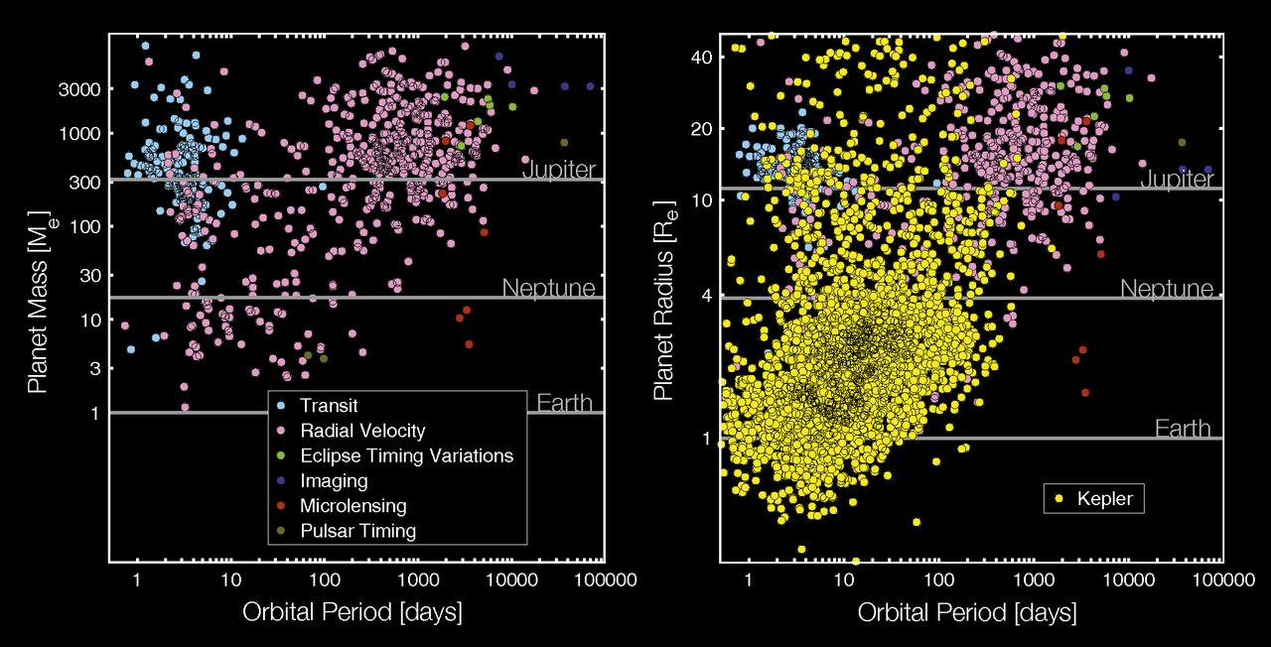
J
S
U
N
Natalie Batalha
V
E
~2950 Confirmed Planets
~2504 Planet Candidates

Slide 46
Kepler’s
Search Area
M
V
E
M
J
S
U
N
P

Slide 47
Why complete the census?
A complete census is likely needed to understand planet formation and evolution.
  Most giant planets likely formed beyond the snow line.
  Place our solar system in context.
  Water for habitable planets likely delivered from beyond the snow line.
  Understand the frequency of planet formation in different environments.

Slide 48
Why complete the census?
A complete census is likely needed to understand planet formation and evolution.
  Most giant planets likely formed beyond the snow line.
  Place our solar system in context.
  Water for habitable planets likely delivered from beyond the snow line.
  Understand the frequency of planet formation in different environments.
Blah, blah, blah.

Slide 49
So really, why complete the census?

Slide 50
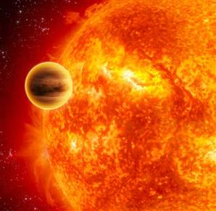


1995: A Planetary Companion to 51 Peg
(Mayor & Queloz 1995)

Slide 51
Mother Nature is More Imaginative Than We Are.

Slide 52
Earth Mass and Below?
Monitor hundreds of millions of bulge stars continuously on a time scale of ~10 minutes.
  Event rate ~10⁻⁵/year/star.
  Detection probability ~0.1-1%.
  Shortest features are ~30 minutes.
Relative photometry of a few %.
  Deviations are few – 10%.
Resolve main sequence source stars for smallest planets.
Masses: resolve background stars for primary mass determinations.

Slide 53
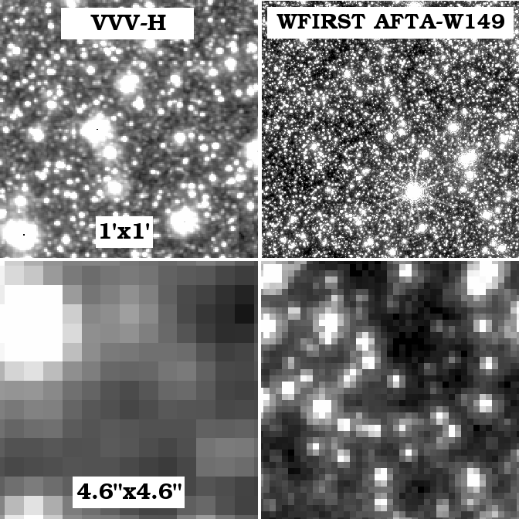
Ground vs. Space.
Infrared.
  More extincted fields.
  Smaller sources.
Resolution.
  Low-magnification events.
  Isolate light from the lens star.
Visibility.
  Complete coverage.
Smaller systematics.
  Better characterization.
  Robust quantification of sensitivities.
Science enabled from space: sub-Earth mass planets, habitable zone planets, free-floating Earth-mass planets, mass measurements.
(Bennett & Rhie 2002)

Slide 54
WFIRST.

Slide 55
What is the Wide Field InfraRed Survey Telescope?
#1 recommendation of the 2010 Decadal Survey for a large space mission.
Notional mission, based on several different inputs, including:
  JDEM-Omega (Gehrels et al.)
  MPF (Bennett et al.)
  NISS (Stern et al.)
Three equal science areas:
  Dark energy (SNe, Weak Lensing, BAO).
  Exoplanet microlensing survey.
  GO program including a Galactic plane survey.

Slide 56
Is WFIRST Real?
Yes!
FY16 appropriation provides $90M for WFIRST (+$76M more than OMB request) and directs NASA to start formulation.
New start (KDP-A) February 18, 2016.
WFIRST Science Investigation Team Proposals were due on October 15, 2015, selected proposals announced on December 18, 2015.

Slide 57
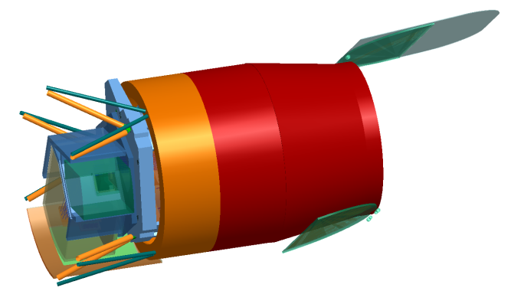
WFIRST-AFTA.
Wide-Field Instrument
Imaging & spectroscopy over 1000's sq deg.
Monitoring of SN and microlensing fields
0.7 – 2.0 micron bandpass
0.28 sq deg FoV (100X JWST FoV)
18 H4RG detectors (288 Mpixels)
4 filter imaging, grism + IFU spectroscopy
Coronagraph
Imaging of ice & gas giant exoplanets
Imaging of debris disks
400 – 1000 nm bandpass
10⁻⁹ contrast
200 milli-arcsec inner working angle
 | WFIRST-AFTA
Eff. Aperture | 2.28m
FOV | 0.281 deg²
Wavelengths | 0.7-2 μm
FWHM@1μm | 0.10”
Pixel Size | 0.11”
Lifetime | 5+1 years
Orbit | L2
Wide-Field Instrument
Imaging & spectroscopy over 1000's sq deg.
Monitoring of SN and microlensing fields
0.7 – 2.0 micron bandpass
0.28 sq deg FoV (100X JWST FoV)
18 H4RG detectors (288 Mpixels)
4 filter imaging, grism + IFU spectroscopy
Coronagraph
Imaging of ice & gas giant exoplanets
Imaging of debris disks
400 – 1000 nm bandpass
10⁻⁹ contrast
200 milli-arcsec inner working angle

Slide 58
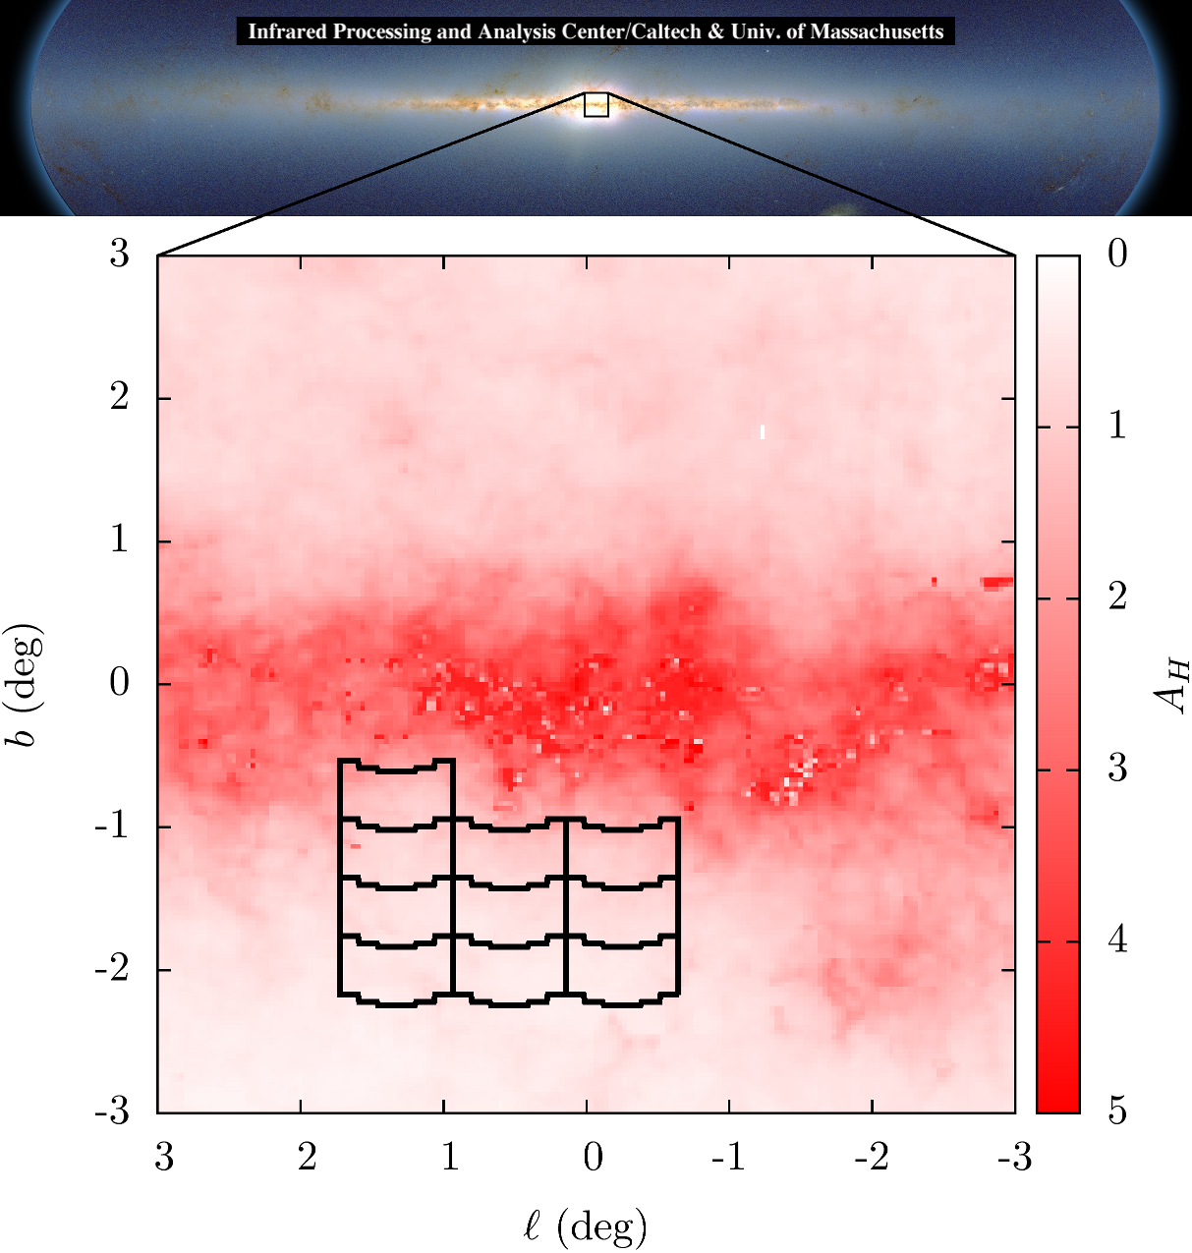
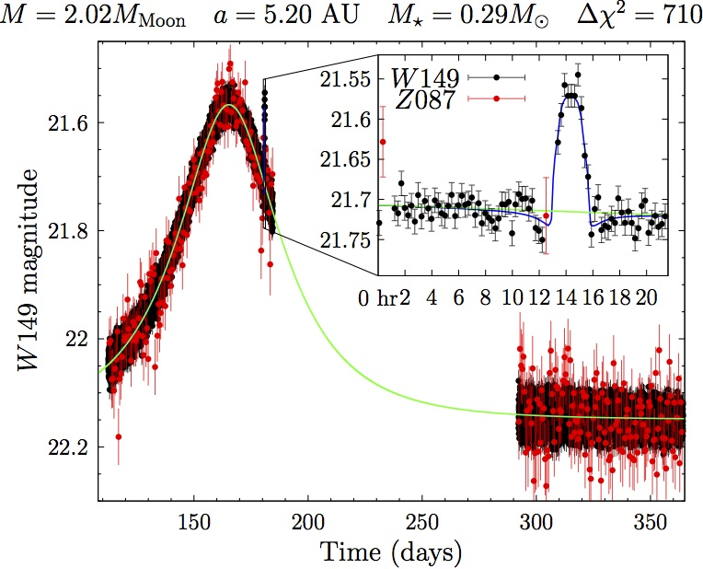
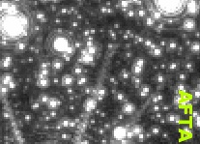
Microlensing Simulations.
(Matthew Penny)
(Penny et al. in prep)
Notes:
A microlensing event:
Occurs when one star passes close (<~milliarcsecond) to our line of sight to a more distant star. Events typically last a few days to a few months.
Rare (1 per star per 100,000 years toward the bulge) and unpredictable.
Must monitor 100s of million of stars on daily cadences to detect many microlensing events per year.
Surveys focus on the Galactic bulge, where the event rate is the highest. Results in very crowded fields.
Detecting planets
If the foreground star hosts a planet that is near one of the two images, it will create an additional perturbation.
Images are near the Einstein ring radius, which is a typically a few to 5 AU depending on host distances and mass, and a factor of ~2 beyond the snow line.
Thus microlensing is sensitive to cold planets.
Signal magnitude does not decrease with planet mass, thus very low mass planets are detectable (ultimately limited by source size).
Duration of signal declines as mass^{1/2}, thus need cadences of tens of minutes.
Microlensing survey
Given the areal density of stars in the bulge, must monitor several square degrees on timescales of 10s of minutes with photometric precisions of a few percent.

Slide 59
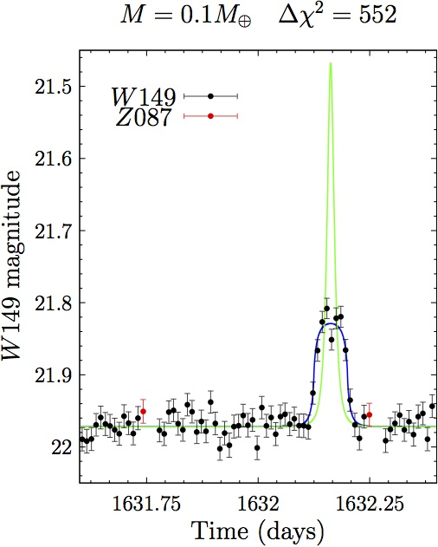
(Penny et al. in prep)
2 ✕ Mass of the Moon @ 5.2 AU
(~27 sigma)
Free floating Mars
(~23 sigma)

Slide 60
Kepler’s
Search Area
WFIRST’s
Search Area
M
V
E
M
J
S
U
N
P

Slide 61
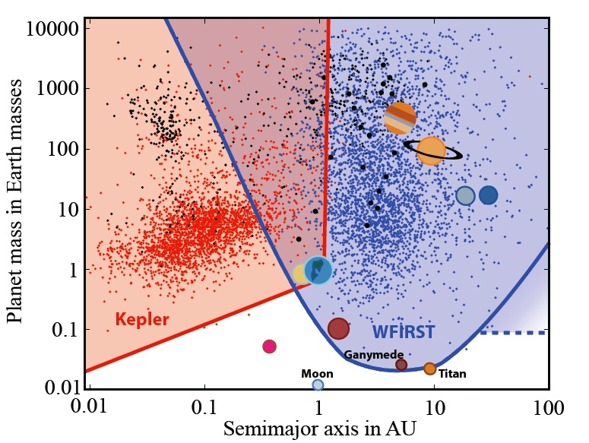
~1200 cold exoplanets
~150 Earth-mass planets
~20 Mars-mass or smaller planets
~20 free-floating Earth-mass planets
~100,000 transiting planets (Montet et al. 2017)
(Penny et al. in prep)

Slide 62
Summary.
Microlensing is no longer the “poor cousin” of exoplanet detection methods (although it might still be a cult).
Microlensing is currently experiencing a watershed (thanks NWNH!).
KMTNet will increase the detection rate by a factor of several.
Spitzer and K2 will inform us about the Galactic distribution of planets, and K2 will confirm (or refute) the existence of a large population of free floating planets.
WFIRST will complete the census begun by Kepler, and will revolutionize our understanding of cold planets.
WFIRST will enable qualitatively new, exciting science: sub-Earth-mass planets, free-floating planets, outer habitable zone planets, mass measurements.

Slide 63
