Slide 1
The IR Microlensing Survey Telescope in SAAO
(PRIME: Prime Focus Infrared Microlensing Experiment)
Daisuke Suzuki (NASA/GSFC)
Takahiro Sumi (PI, Osaka U), D.Bennett (NASA/GSFC), I.Bond (Massey U), N.Rattenbury (U Auckland), J-P.Beaulieu (IAP), J.Wambsganss (Heidelberg U), F.Abe, Y.Muraki (Nagoya U), A.Fukui (NAOJ), N.Koshimoto (Osaka U), M.Tamura (U Tokyo),
A. Kutyrev, E. Cheng, N, Matsunaga, R.Barry, E. Kerins, H. Shibai, T. Nagayama, M. Kurita, T. Matsuo, L. Mancini, N. Narita, Y. Hirao, M. Nagakane
on behalf of the PRIME team
21st International Microlensing Conference @Nasadena, Feb 3, 2017
Notes:
Last year in April, a new microlensing survey telescope was granted.
We decided the project name, PRIME: prime focus infrared microlensing experiment.
PI is Takahiro Sumi, and these are core members of PRIME team.
I will introduce this new project in my talk.

Slide 2
Why NIR, Ground-based µlens planet survey?
Less extinction
  Study Earth-mass planets outside snowline
  Planet frequency toward the Galactic Center
Notes:
So, why NIR, ground-based microlens planet survey?
NIR suffers less extinction compared to the optical, so we can observe more fainter stars, and
With NIR, we can survey the area which is much closer to the Galactic Center than the current optical microlensing survey area.
then we expect more microlensing events because there will be more lens stars and source stars toward this area.
The less extinction allows us to get better S/N light curves, and fainter stars will have smaller finite source effect, thus we will have better sensitivity to the planet signals, and we can study Earth-mass planets beyond the snowline.
Recently, MOA-II microlensing survey found the possible break in the mass ratio function.
NIR microlensing survey can put better constraints on the smaller planets, so we will study the planet frequency toward the Galactic Center down to the Earth-mass planets.
And most importantly, because this is the WFIRST session, NIR ground-based survey can optimize the WFIRST microlensing survey field by measuring the event rate, and also, it will allow us to measure the parallax by the concurrent observations with WFIRST.

Slide 3
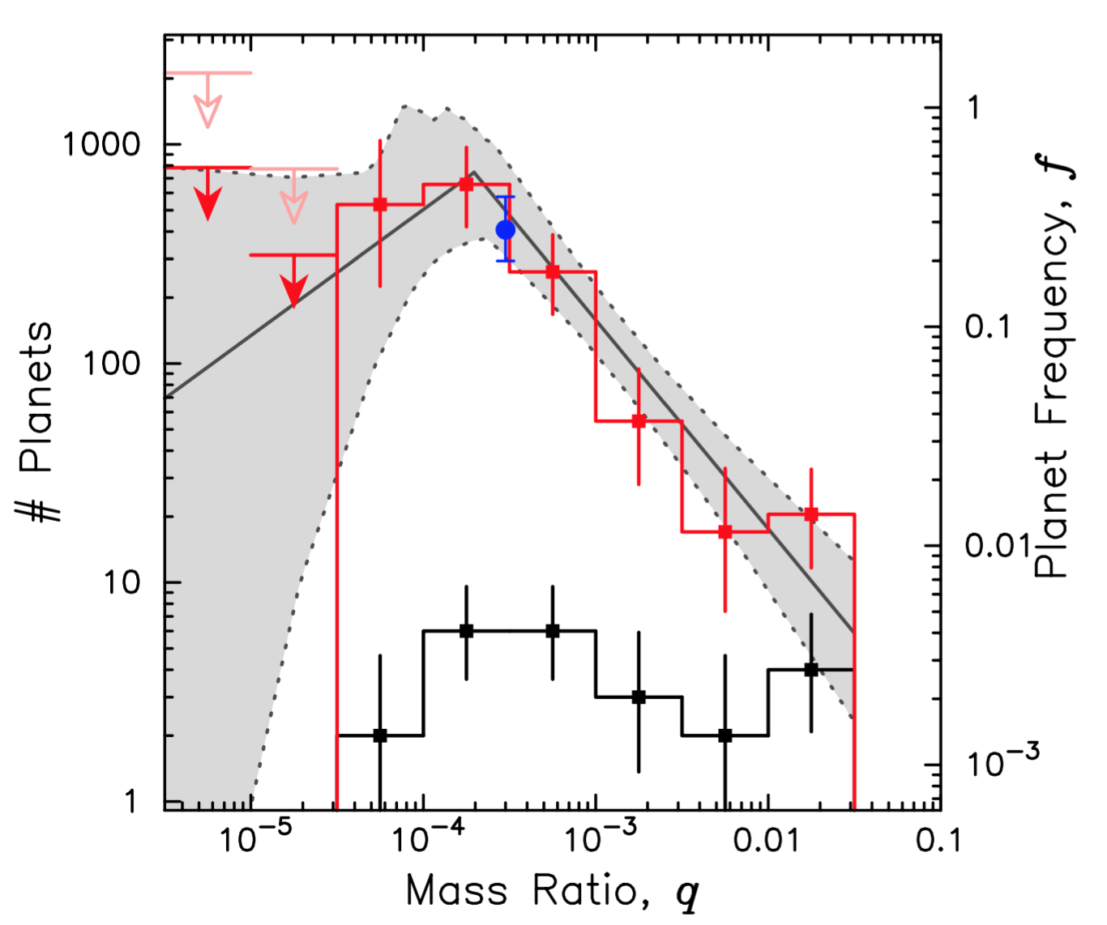
Why NIR, Ground-based µlens planet survey?
Less extinction
  Study Earth-mass planets outside snowline
  Planet frequency toward the Galactic Center
Suzuki+16

Slide 4
Why NIR, Ground-based µlens planet survey?
Less extinction
  Study Earth-mass planets outside snowline
  Planet frequency toward the Galactic Center
Optimize the WFIRST microlensing field
Concurrent observations with WFIRST

Slide 5
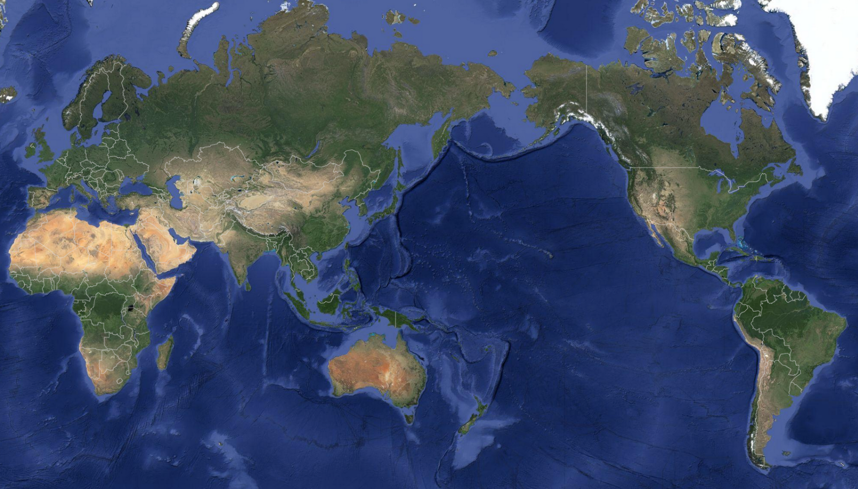
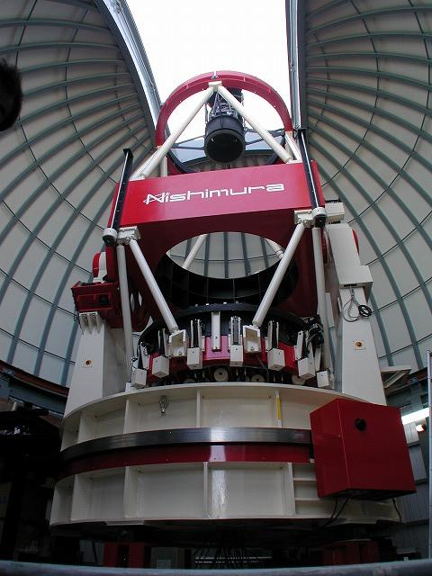
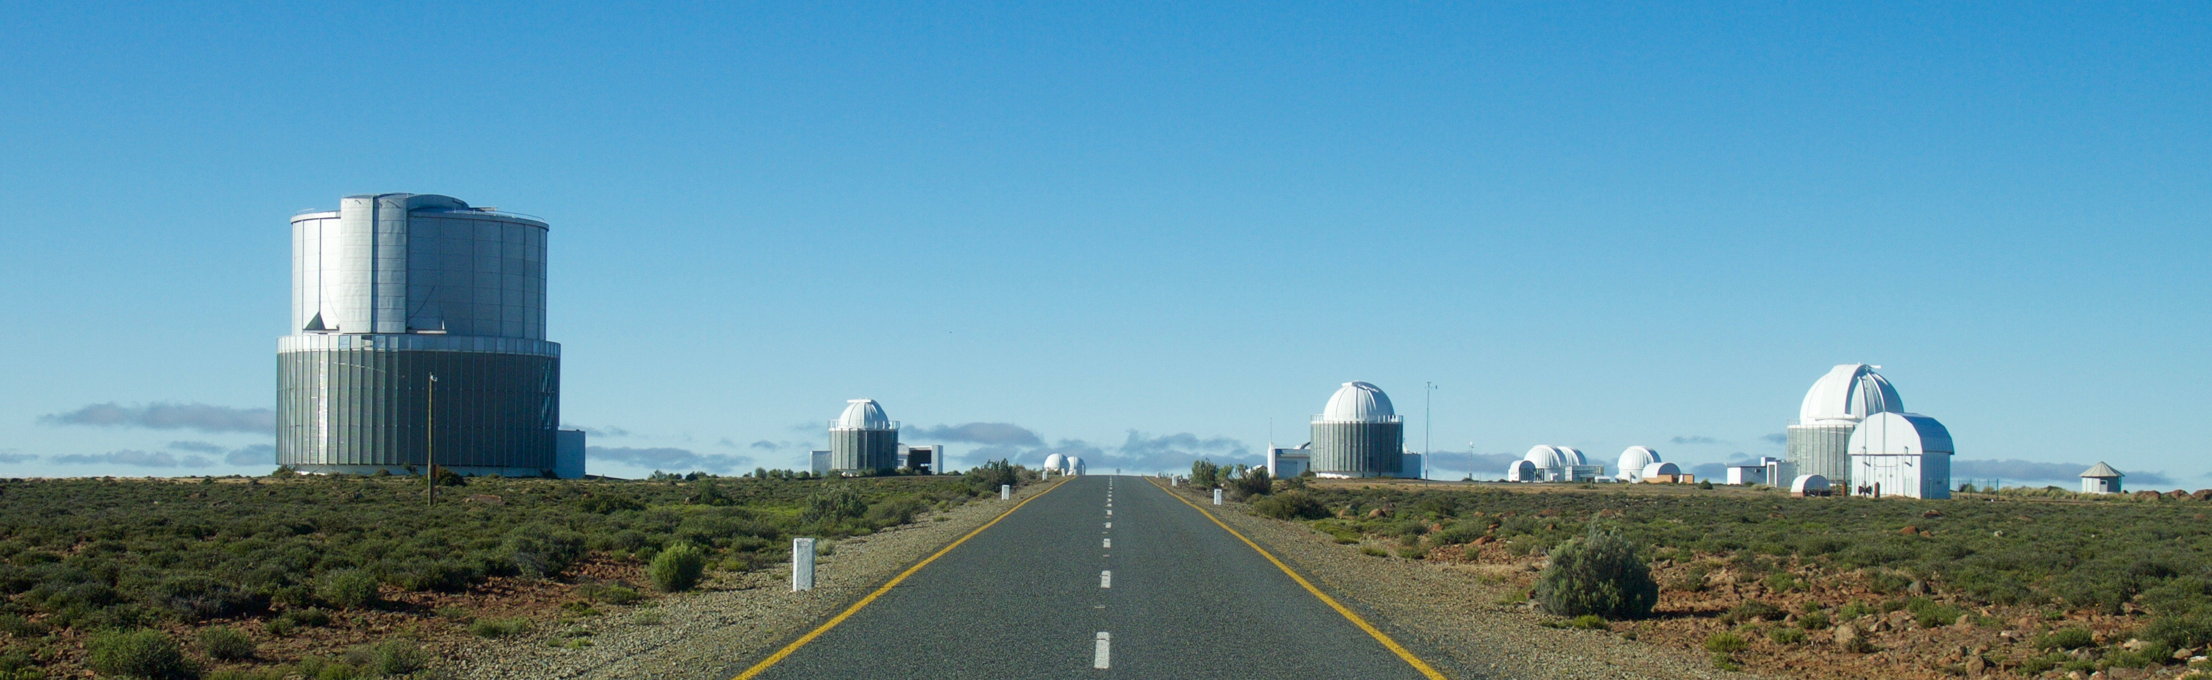
PRIME: NIR Wide FOV Telescope at SAAO
Diameter: 1.8m, (f/2.29)
FOV: 1.13 deg x 1.13 deg => 1.3 deg² (6 x full moon)
Pixel Scale: 0.5”/pix
H-band survey (Y, J-band TBD)
We are here
SAAO
South African Astronomical Observatory
Seeing:0.7”(best), 1.2”(50%), 1.4”(median)
Expected picture
Alt. 1761m
taken in 2012: KMTNet not built yet
Notes:
So, PRIME telescope is the NIR, dedicated microlensing survey telescope at South African Astronomical Observatory.
This is the view of the SAAO in Sutherland, and this is the expected image of the PRIME telescope, which will be similar to the MOA-II telescope.
These are showing the key numbers of the PRIME telescope and observatory.
The primary mirror is 1.8 m, which is same as MOA-II.
FOV is 1.3 deg^2, which is 6 times of the full moon, and 4.6 times of WFIRST FOV.
The pixel scale is 0.5”, and we will use H-band for the main survey, and will use bluer filters, but they are TBD.
The best seeing at this site is around 0.7”, and median seeing is 1.4”.
MOA-II : f/2.91

Slide 6

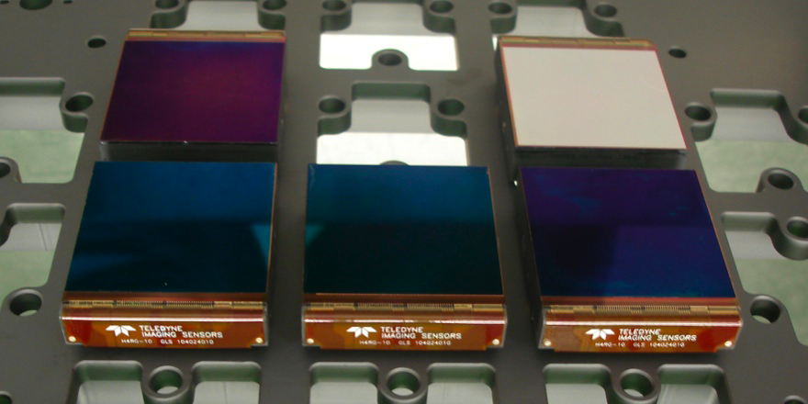
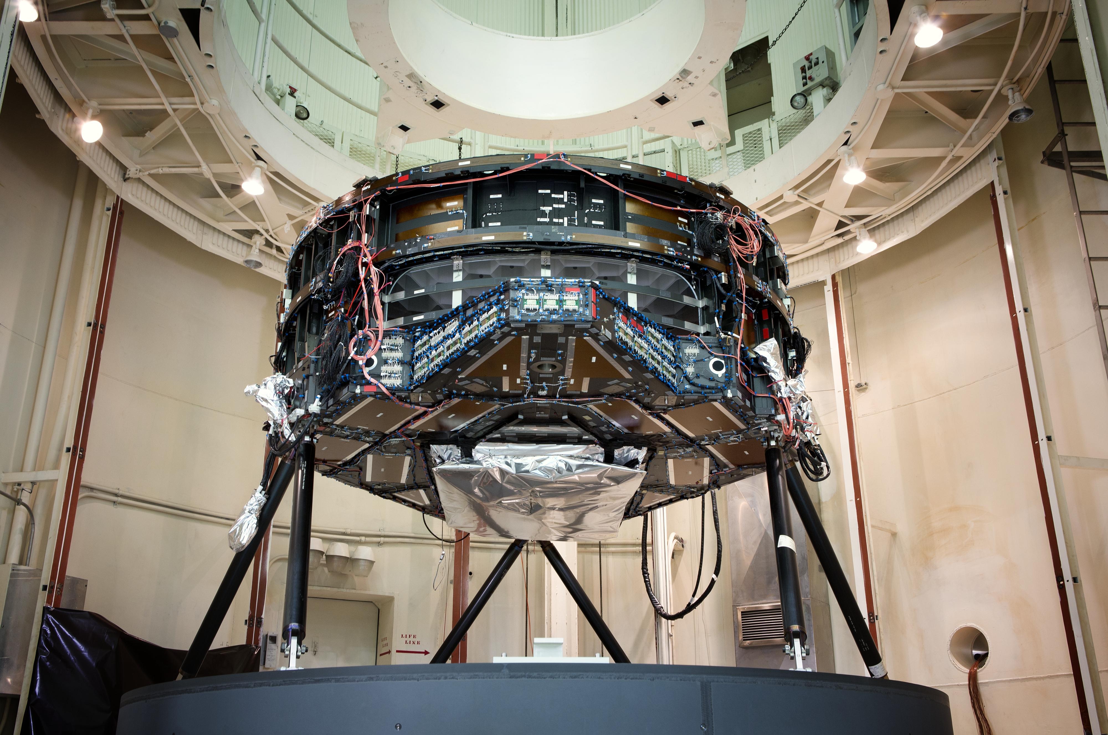
The World Widest FOV in NIR with World Largest class NIR Camera
Loan Four Teledyne HgCdTe 4kx4k 10μm pitch (H4RG-10) from the WFIRST team (NASA)
Four H4RG-10 which WFIRST
Team owns. (1 chip is dummy)
Notes:
The PRIME telescope has the widest FOV in NIR and its camera will be largest class NIR camera until WFIRST.
We will use 4 infrared detectors which will be provided by the WFIRST team.
Each of the detectors has 4k x 4k.
The camera design is ongoing, and the camera will be built by the Goddard team

Slide 7
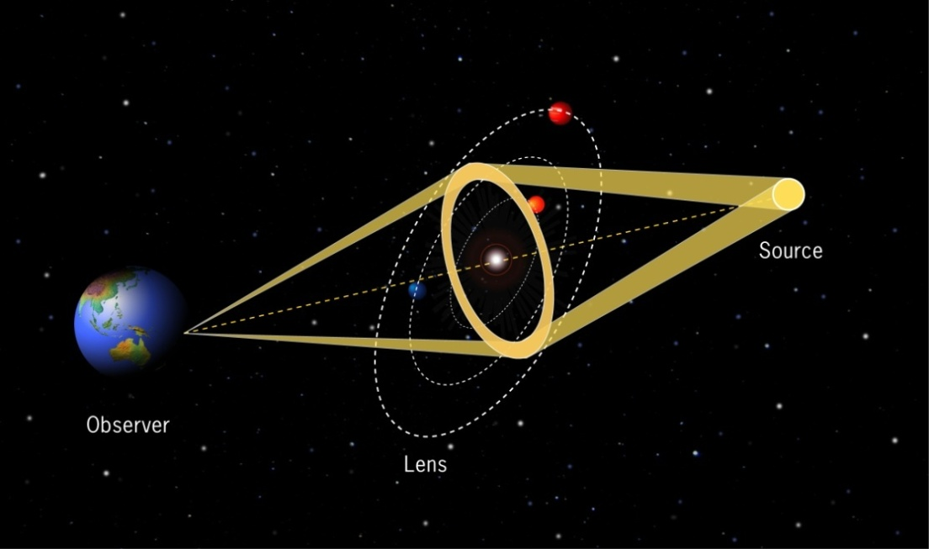
Planetary Microlensing
Time scale: t_{p}~M^{1/2} ~1day(M_{J})
~a few hours (M_{E})
Sensitive to Cold planets
outside of snowline (~3a_{snow})
Brightness
Time
Notes:
We don’t need the details of the basics because this is almost last talk in this conference, but
The point is that we need the high cadence, wide FOV survey to find the planet signal in the microlensing light curve,
because the planet signals last only a few hours for earth mass planet, and we don’t know when it happens, and microlensing itself is a rare event.

Slide 8
Planetary Microlensing
Time scale: t_{p}~M^{1/2} ~1day(M_{J})
~a few hours (M_{E})
Sensitive to Cold planets
outside of snowline (~3a_{snow})
Brightness
Time

Slide 9
Discovered Planets and µlensing Sensitivity
current
RV
Transit (Kepler)
Direct image
Microlensing
Mass measurements
Mass by Bayesian
Ground NIR survey
WFIRST
Notes:
Now this figure indicates the detected planets by the “big four” detection methods.
X-axis is semi-major axis and y-axis is planet mass in earth mass.
The microlensing planets are indicated in the red points.
So the current ground based survey network has sensitivity like this.
This will be pushed down by the Ground NIR survey, and the WFIRST microlens survey will complete this figure.

Slide 10
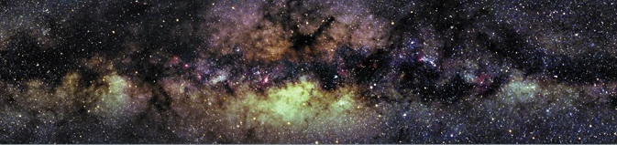
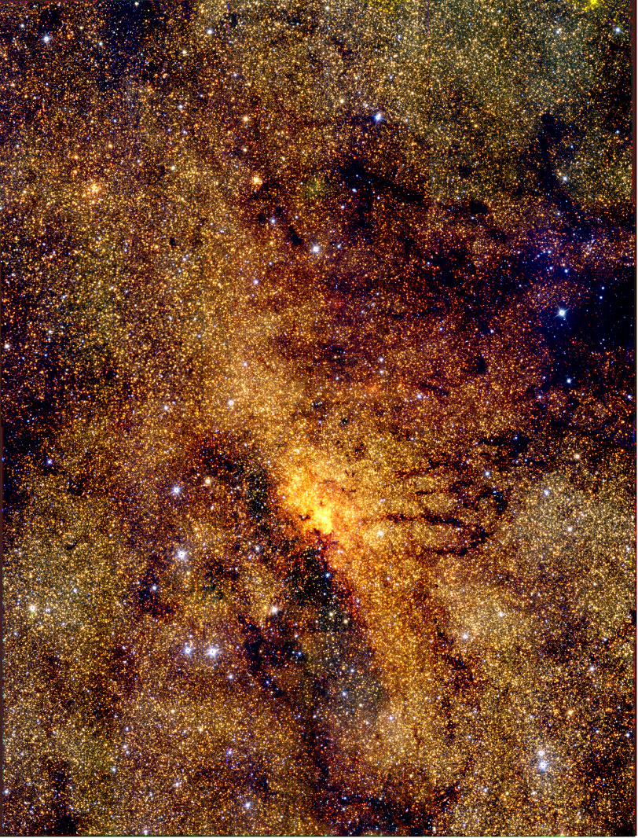
More Events & Planets in NIR at GC
Optical
G.C.
Galactic bulge is highly obscured
NIR
More stars & more events at GC.（~2400 events/yr,~12planets/yr）
Smaller radius source (redder) enable us to detect low (Earth)-mass planets. (small finite source effect)
Planet frequency at GC.
Select WFIRST fields.
Simultaneous observation with WFIRST to measure lens mass.
Mass Function at GC （planet-Black Hole）
Notes:
Galactic bulge is highly obscured in the optical, but this is how NIR image looks like.
So, we expect more stars and more microlens events toward the galactic center.
Smaller source size enable us to detect low-mass planets,
And also, the PRIME survey enable us to study optical depth, mass function and galactic structure toward the galactic center.

Slide 11
Study the Galactic structure & Optimize WFIRST microlensing survey fields by mapping the event rate in NIR
Galactic disk
G.C.
WFIRST
b（degree）
Event rate map in optical
l (degree)
(Sumi & Penny 2016)
Event rate vary by a factor of 2 （peak is at l = 1）
Notes:
This figure indicates the event rate map from the MOA-II survey.
WFIRST field will be placed around here, but we need to know the event rate closer to the galactic plane to maximize the expected number of WFIRST events.
So, of course, the PRIME survey field will be around here, but the exact survey field is not yet determined.
If we apply an uniform 1 hour cadence, we can survey 27 deg^2, but it is highly likely that we will apply a tier survey, such as 3 fields for 15 min cadence, and 9 fields for 1 hour cadence.
UKIRT survey will also measure the event rate in this area as Yossi talked yesterday, but UKIRT and PRIME surveys are complementary each other.
UKIRT is larger mirror, better seeing, and earlier results, on the other hand, PRIME is much higher cadence, and larger statistics.

Slide 12
Study the Galactic structure & Optimize WFIRST microlensing survey fields by mapping the event rate in NIR
PRIME Survey
(TBD)
Galactic disk
G.C.
WFIRST
b（degree）
l (degree)
(Sumi & Penny 2016)
Event rate vary by a factor of 2 （peak is at l = 1）
Notes:
0.5

Slide 13
Study the Galactic structure & Optimize WFIRST microlensing survey fields by mapping the event rate in NIR
PRIME Survey
(TBD)
Galactic disk
G.C.
WFIRST
b（degree）
21 fields (27 deg²) / hr
3 fields (3.9 deg²) / 15 min + 9 fields (11.6 deg²) / hr
l (degree)
(Sumi & Penny 2016)
Event rate vary by a factor of 2 （peak is at l = 1）
Notes:
0.5

Slide 14
Concurrent observations with WFIRST
Important for short and long events
  Short events: measure parallax to determine mass
  Long events: measure tE
Most events will be too faint for Ground telescopes
  More faint source stars
  More low-mag events
  High-extinction for optical observations
NIR, wide FOV: PRIME
Optical, but Large telescopes: Subaru/HSC, LSST
Notes:
Concurrent ground based observations with WFIRST is important to measure the parallax of short events.
Long events are also important as well to measure the tE, but this might be follow-up type observations.
The problem is that most events could be too faint for ground telescopes.
This is because most source stars are faint, low-mag events are more common, and high-extinction for optical telescopes.
So, NIR wide FOV telescope, such as PRIME, can do better concurrent observations compared to same size of optical telescopes.
Also, optical but large telescopes such as, Subaru/HSC and LSST are important for the concurrent observation.

Slide 15
Schedule for PRIME
2016: detail design and manufacture
2017: manufacture
2018: construction, install, first light
2019: observation start
2023: create event rate map in the bulge
2024-25: concurrent observation with WFIRST
Notes:
Here is the time schedule.
Now, designing is on going, manufacture will start in this year.
Construction, installation and first light will be in 2018, and the survey will start in 2019.
Event rate map will come in 2023, and concurrent observation with WFIRST will start in 2024 or 2025

Slide 16
Off-bulge Season Sciences
Transit search for M-dwarfs:
Search for habitable planets around M-dwarf which is bright in IR
Follow-up transit candidates by HAT-South, Mearth projects for select real planets and measure the atmosphere.
Systematics due to Sunspot and limb darkening is smaller in IR.
Wide FOV enable us to observe many reference stars for high precision photometry.
Follow-up TESS candidates. TESS is optical. Need IR for M-dwarfs. Collaborators:
  David Charbonneau（Harvard, Mearth PI, TESS CoI）
  Cullen Blake (Pennsylvania、TESS CoI)
  Narita（NAOJ, TESS CoI）, Fukui（Okayama）
Search for counterparts of high-z GRB, GW
etc. ….

Slide 17
Summary
The first NIR microlensing exoplanet survey
Detect 〜2400 events/yr & 〜12 planets/yr
Search for the first Earth-mass planet outside of the snowline
Optimize WFIRST fields by event rate measurement
Concurrent observation with WFIRST to measure lens mass
Mass Function at GC （planet-Black Hole mass）
Notes:
0.5

Slide 19
MOA-II Event Rate
# of Events for WFIRST
WFIRST
b（degree）
l (degree)
(Sumi & Penny 2016)
Figure by M. Penny based on MaBµlS (Awiphan, Kerins & Robin 2016)
Notes:
Figure by M. Penny based on MaBµlS (Awiphan, Kerins & Robin 2016)

Slide 20
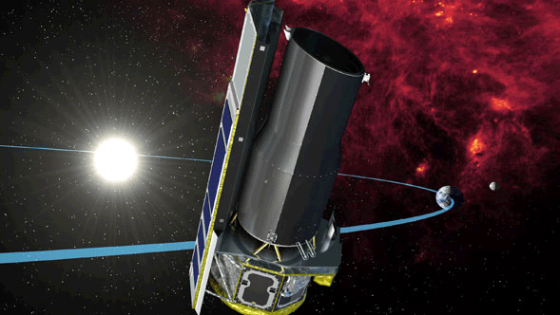
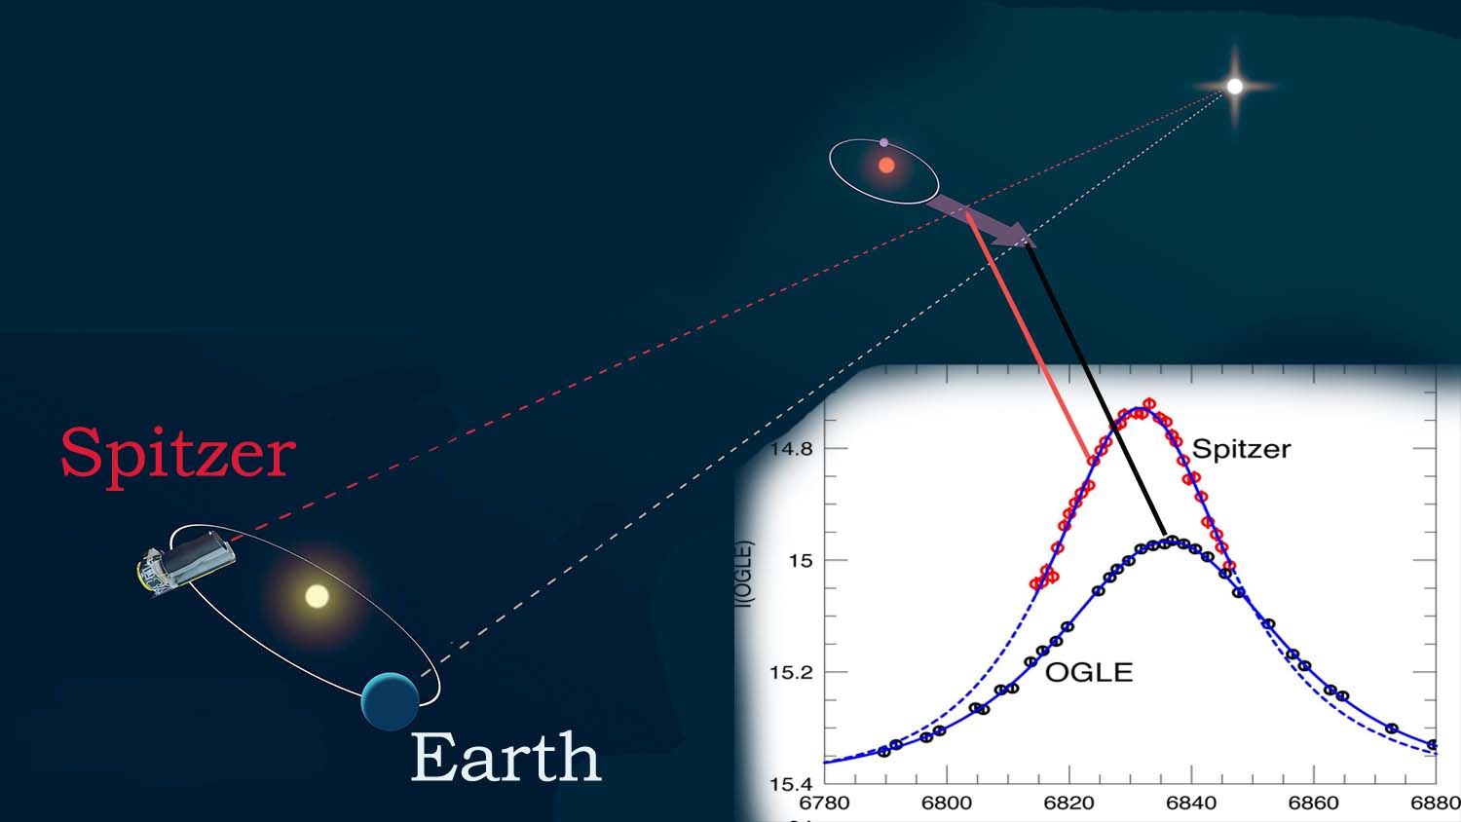
Simultaneous Ground-Space monitoring with Spitzer / WFIRST
We can do same
observations
with WFIRST
M = 0.23 ±0.07 Msun
D_{L} = 3.1 ±0.4 kpc.
Yee et al.205

Slide 21
OGLE-2015-BLG-0966/MOA-2015-BLG-281
（Street et al. 2015)
Spitzer
海王星質量系外惑星

