Slide 1








Practical Microlensing
Harvard-Smithsonian
Center for Astrophysics
Jennifer C. Yee
PLANET
Probing Lensing Anomalies NETwork
MicroFUN
Microlensing Follow-Up Network

Slide 2
Even in the most favorable cases … there is no great chance of observing this phenomenon.
– Albert Einstein 1936

Slide 3
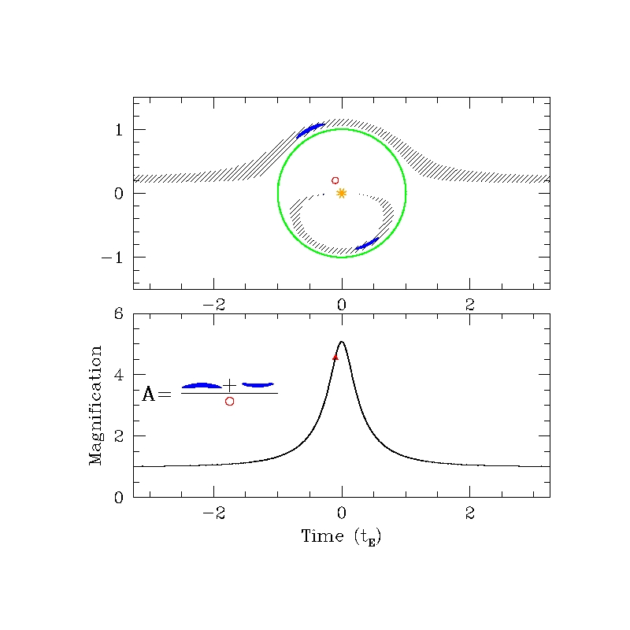
θ_{E}~ 1 mas
Image courtesy of B. Scott Gaudi
http://www.astronomy.ohio-state.edu/~gaudi/movies.html

Slide 4
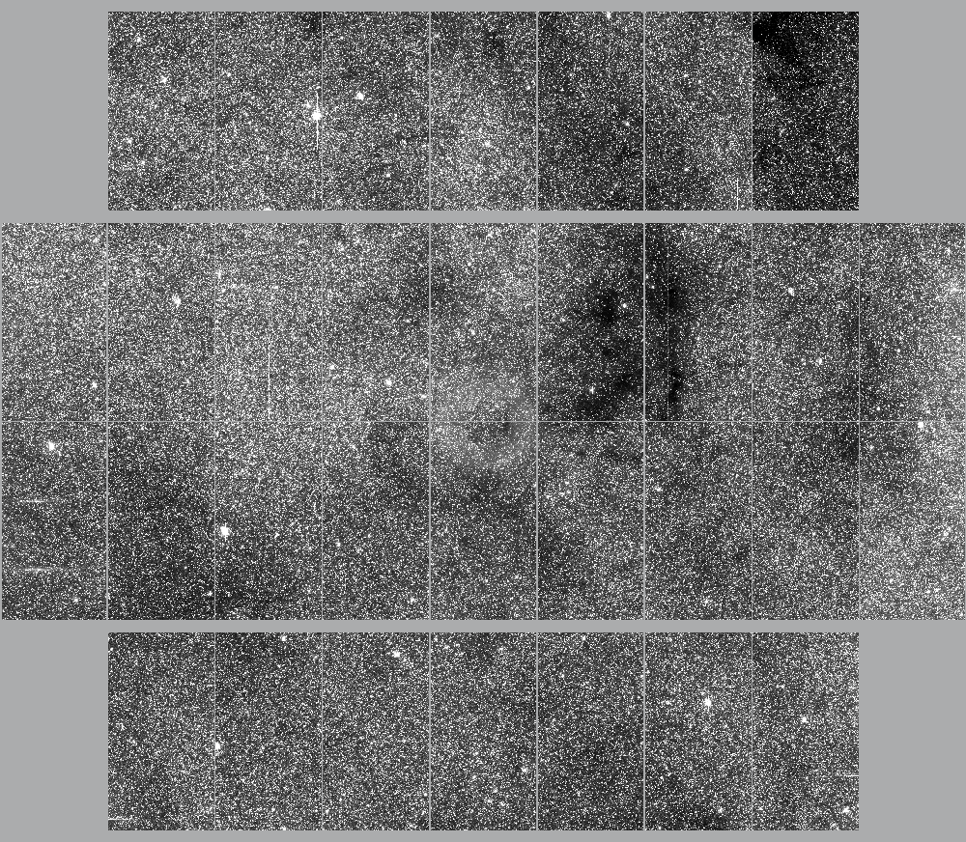
1 MILLION stars = ONE μlensing Event
OGLE 505

Slide 5
blue
1992: The First Microlensing Event from MACHO
red
Alcock et al. 1993 Nature 365, 621
Notes:
(Figure 2)
2*tE = 33.9 days

Slide 6
blue
1992: The First Microlensing Event from MACHO
red
Alcock et al. 1993 Nature 365, 621
Notes:
(Figure 2)
tE = 33.9 days

Slide 7
Planet Signals Last < ~1 day
Gould & Loeb 1992 ApJ 396, 104
Notes:
Figure 1: Jupiter mass planet (q ~ 10^(-3))

Slide 8
Planet Signals Last < ~1 day
Gould & Loeb 1992 ApJ 396, 104
Notes:
Figure 1: Jupiter mass planet (q ~ 10^(-3))

Slide 9
Planet Signals Last < ~1 day
Gould & Loeb 1992 ApJ 396, 104
Notes:
Figure 1: Jupiter mass planet (q ~ 10^(-3))

Slide 10
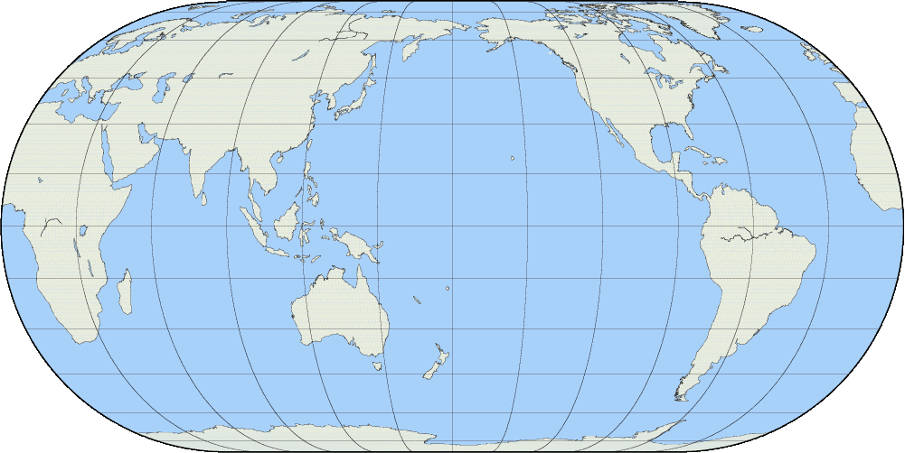
Survey Groups Discover Events
OGLE
MOA

Slide 11
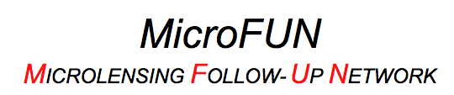

Slide 12
OSU
Weizmann
IAC80
FCO
AO
MAO
Kumeu
OPD
Possum
Turitea
KKO
CTIO
VLO
PEST
Craigie

Slide 13
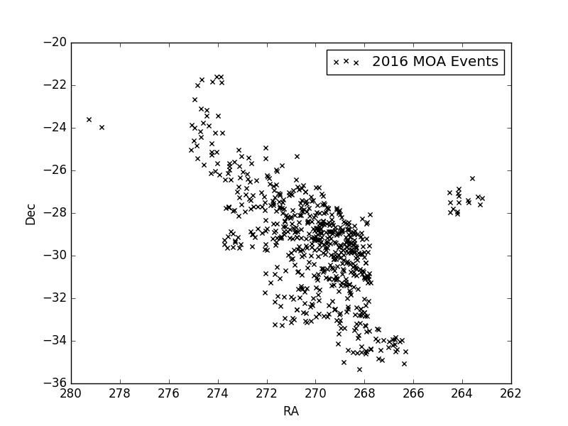
Which Events Should be Followed Up?

Slide 14
Magnification Map
Lens Star

Slide 15
Magnification Map
Notes:
What is impact parameter?

Slide 16
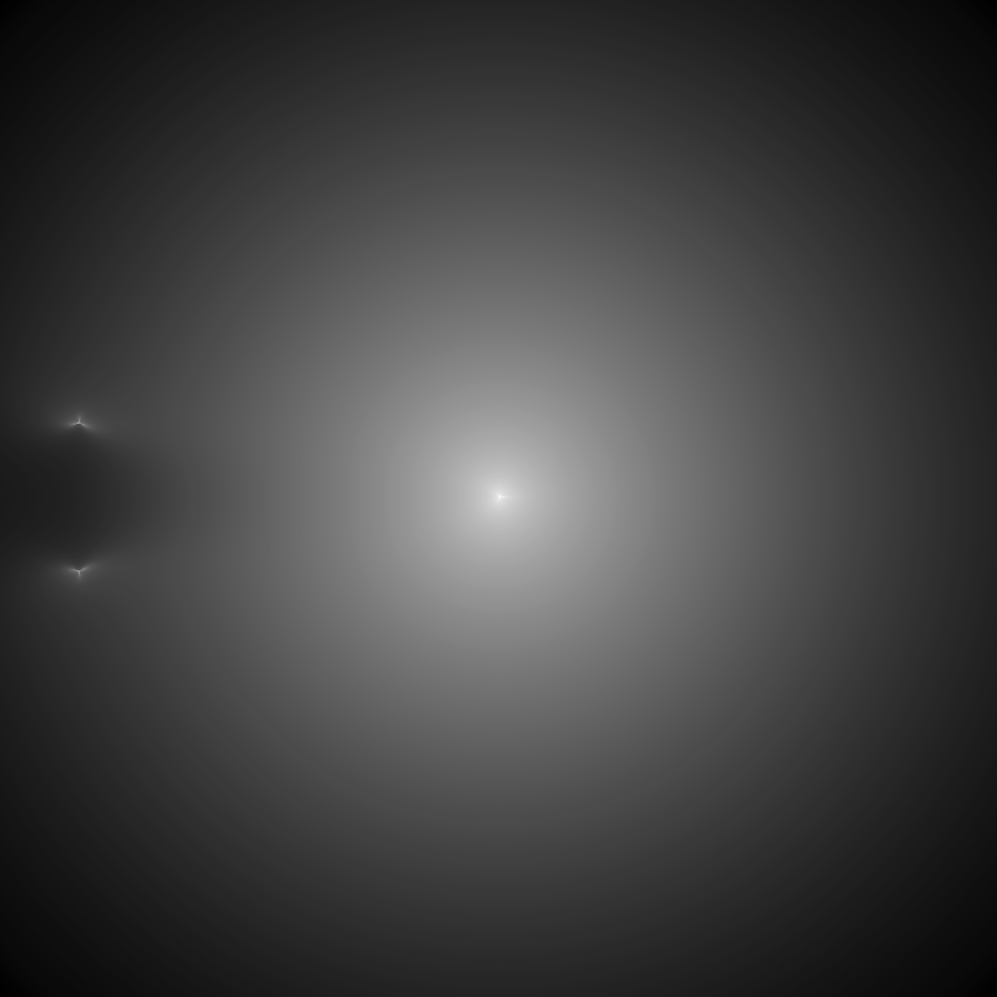
Lens Star
Planet

Slide 17
Lens Star
Planet

Slide 18
Lens Star
Planet

Slide 19
Lens Star
Planetary Caustics
Planet
Central Caustic

Slide 20
Lens Star
Planet

Slide 21
Lens Star
Planet

Slide 22
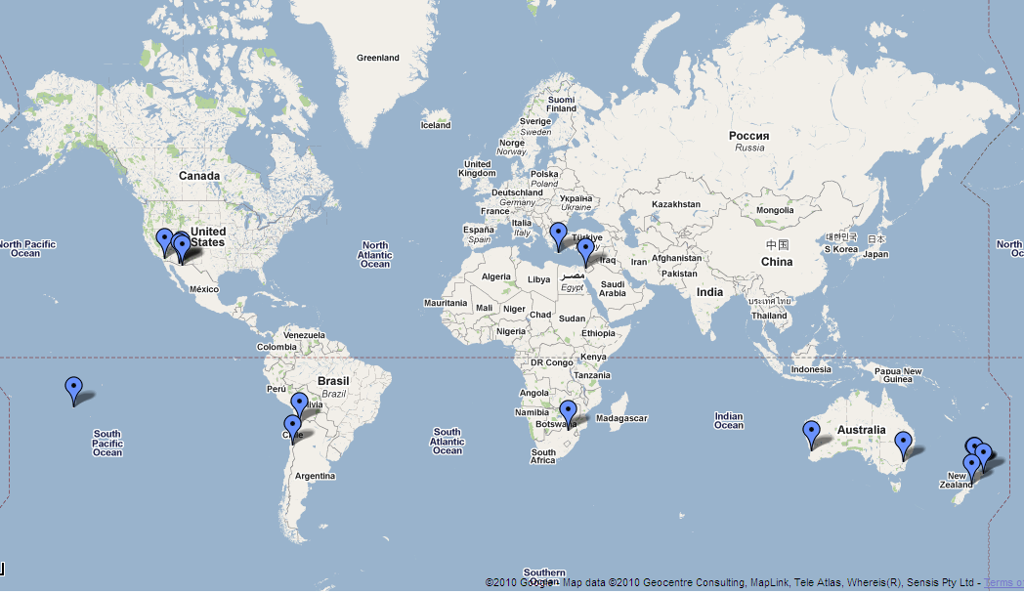
New Microlensing Event!
MOA-2011-BLG-293
MOA

Slide 23
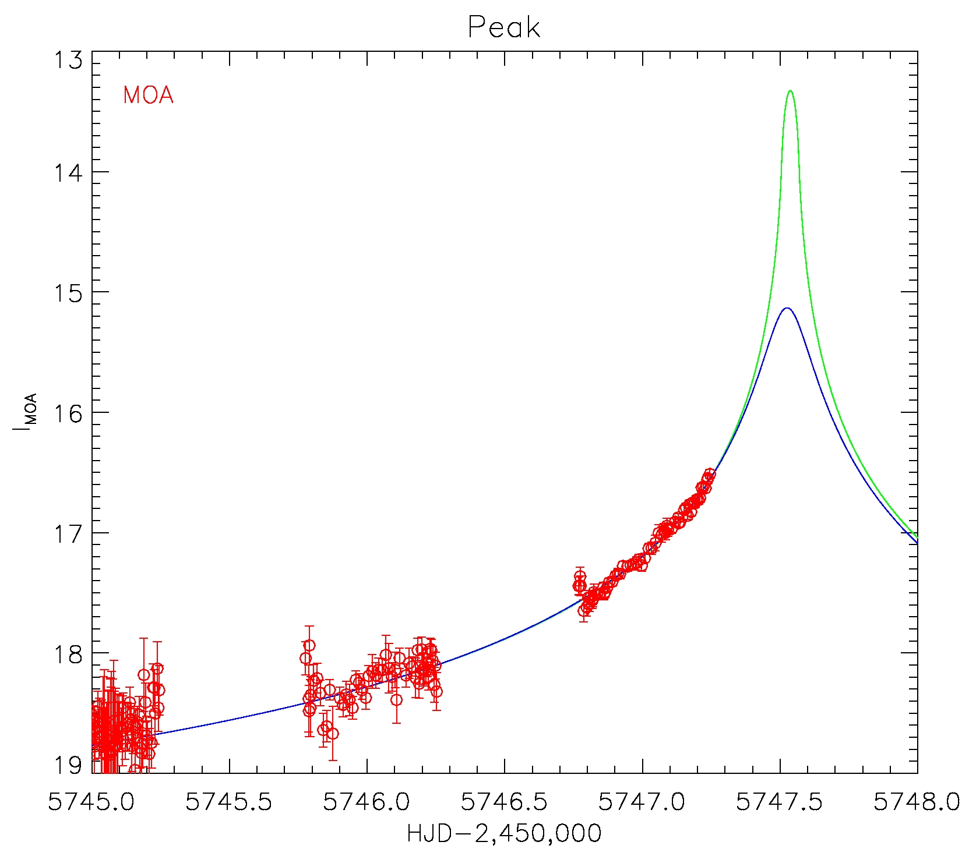
OSU
Wise
12hr
OGLE
MOA

Slide 24

Wise
OGLE
MOA

Slide 25
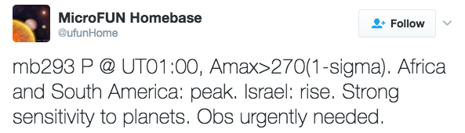

Wise
OGLE
MOA

Slide 26
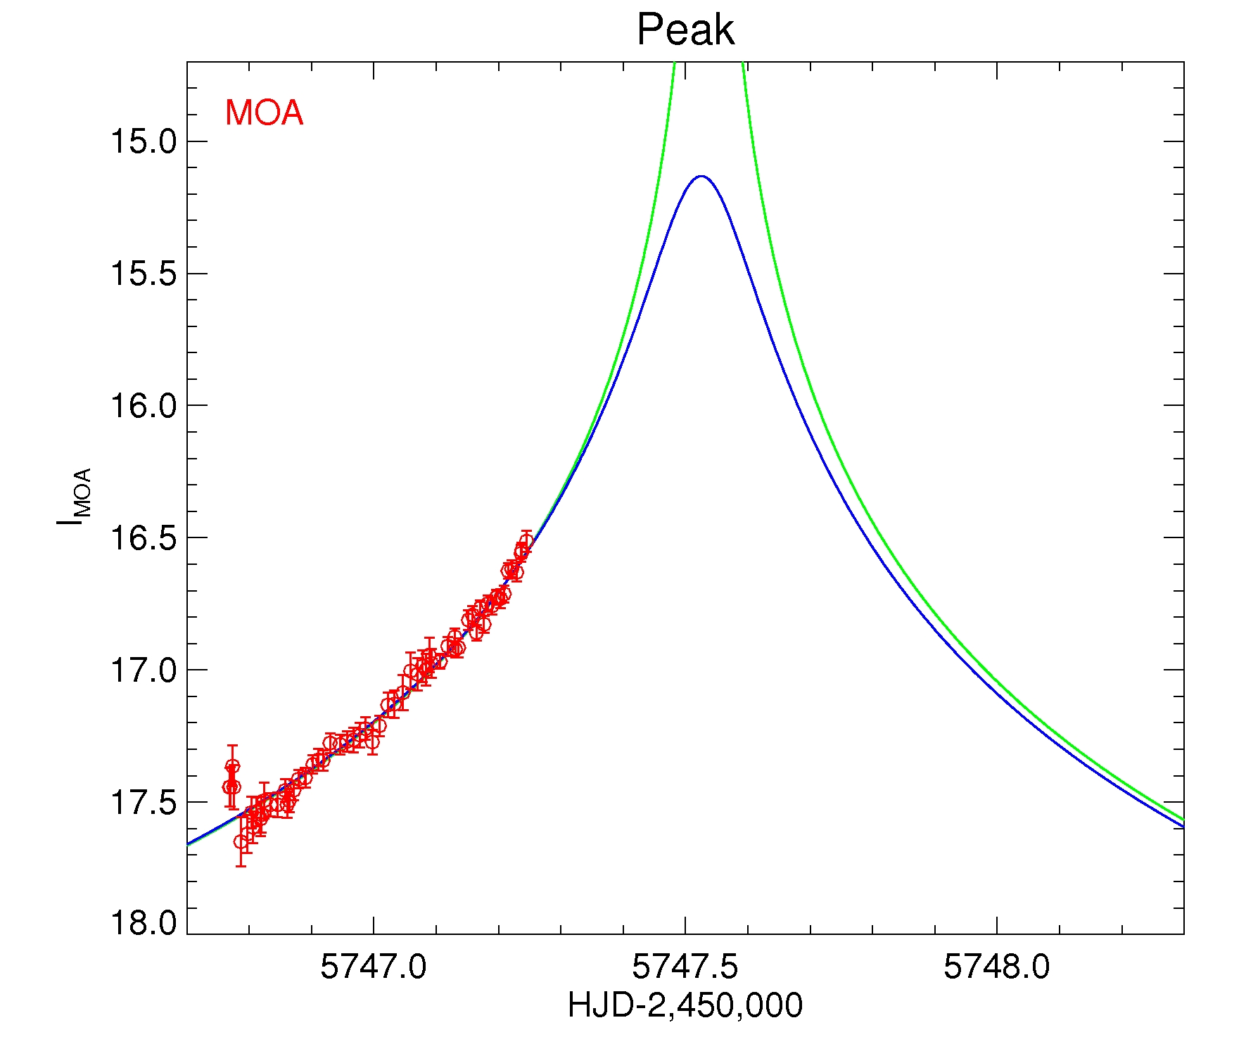
MOA-2011-BLG-293
10hr
Brightness
Chile
Time

Slide 27
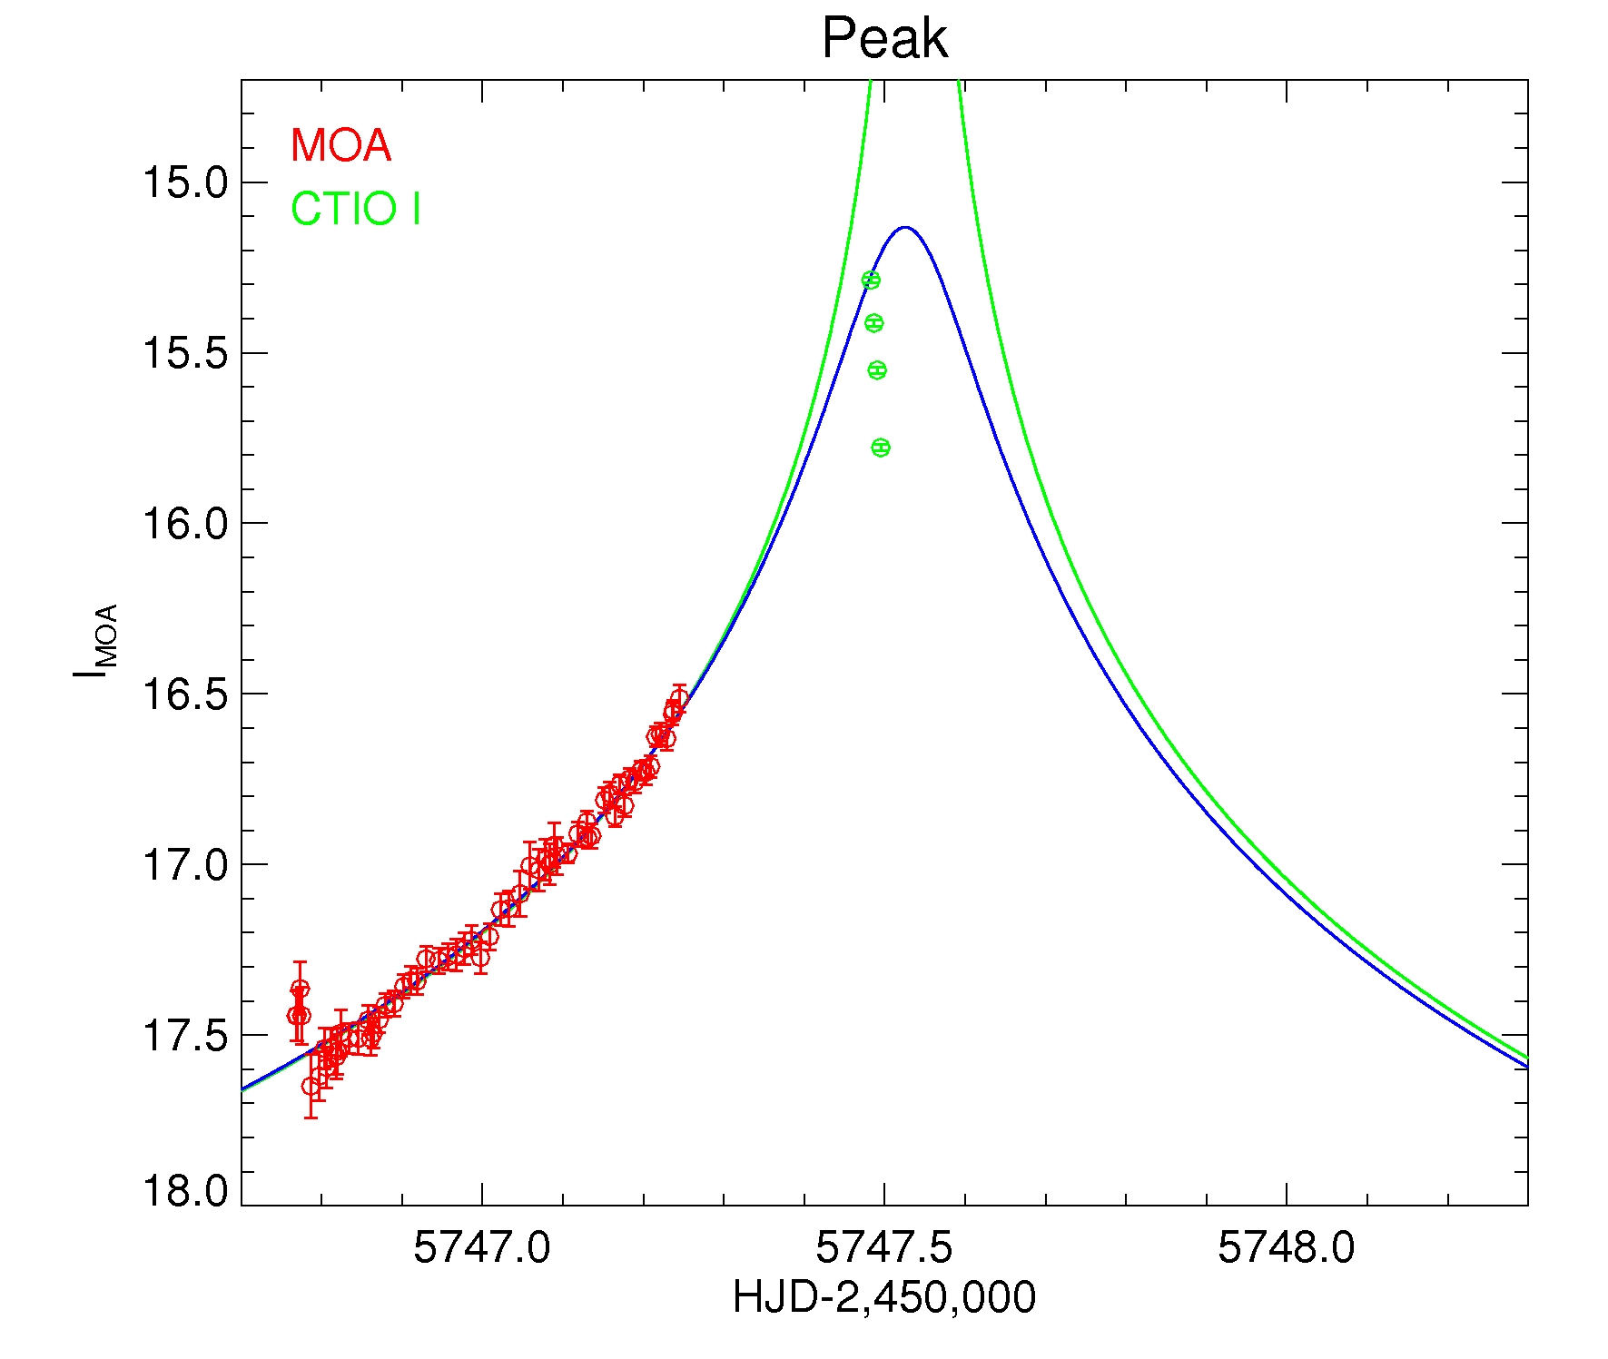
MOA-2011-BLG-293
Brightness
Time

Slide 28

OSU
OGLE
CTIO
MOA

Slide 29
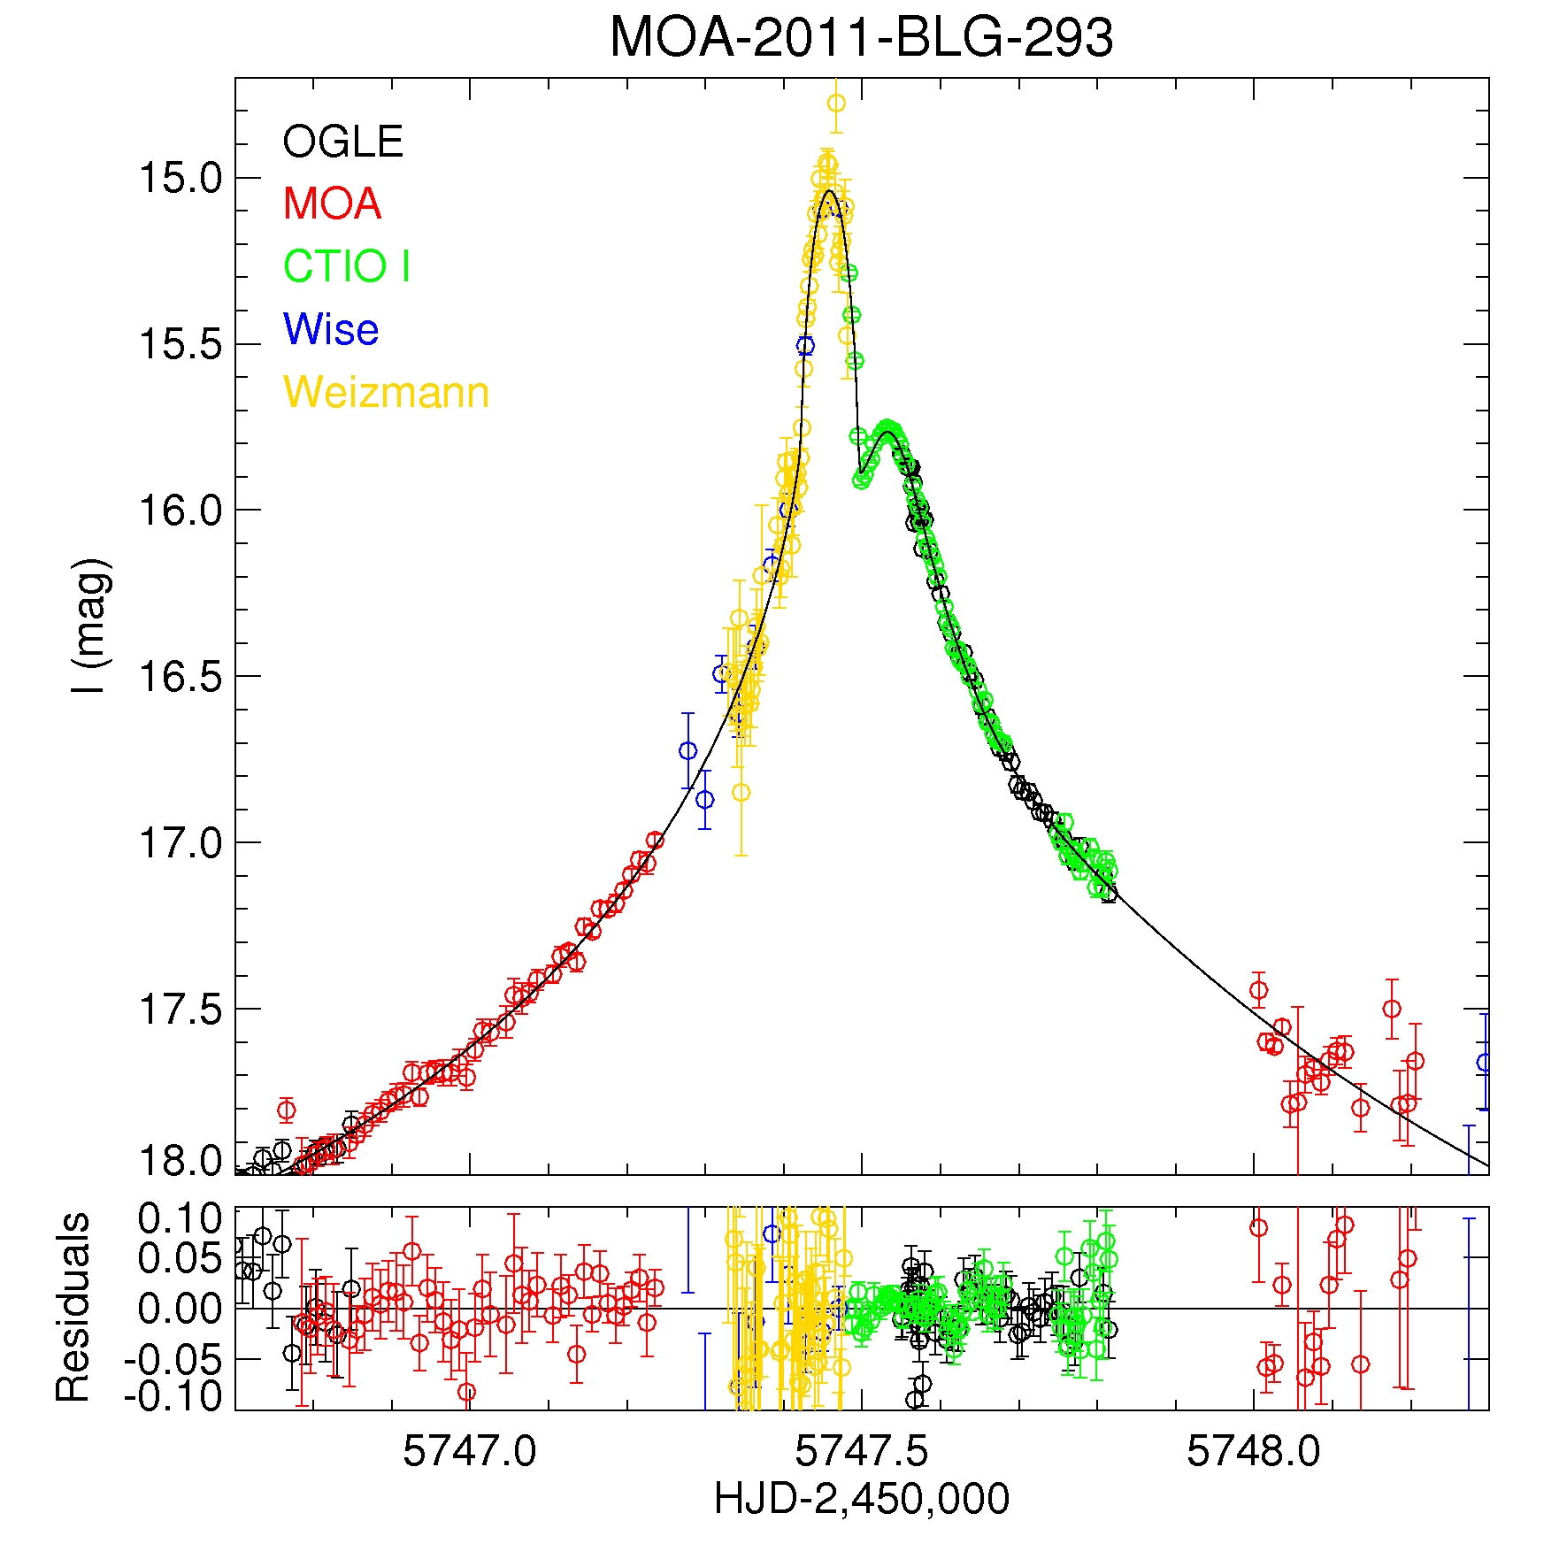
MOA-2011-BLG-293
q = m_{p}/M_{star}
q = 5x10⁻³
Brightness
Time
Yee et al., 2012, ApJ, 755, 102
Yee et al. 2012, ApJ, 755, 102

Slide 30
Planet Statistics
Uniform Sample
Detection Efficiencies

Slide 31
Magnification
∞
500
200
100
Gould et al. 2010, ApJ, 720, 1073

Slide 32
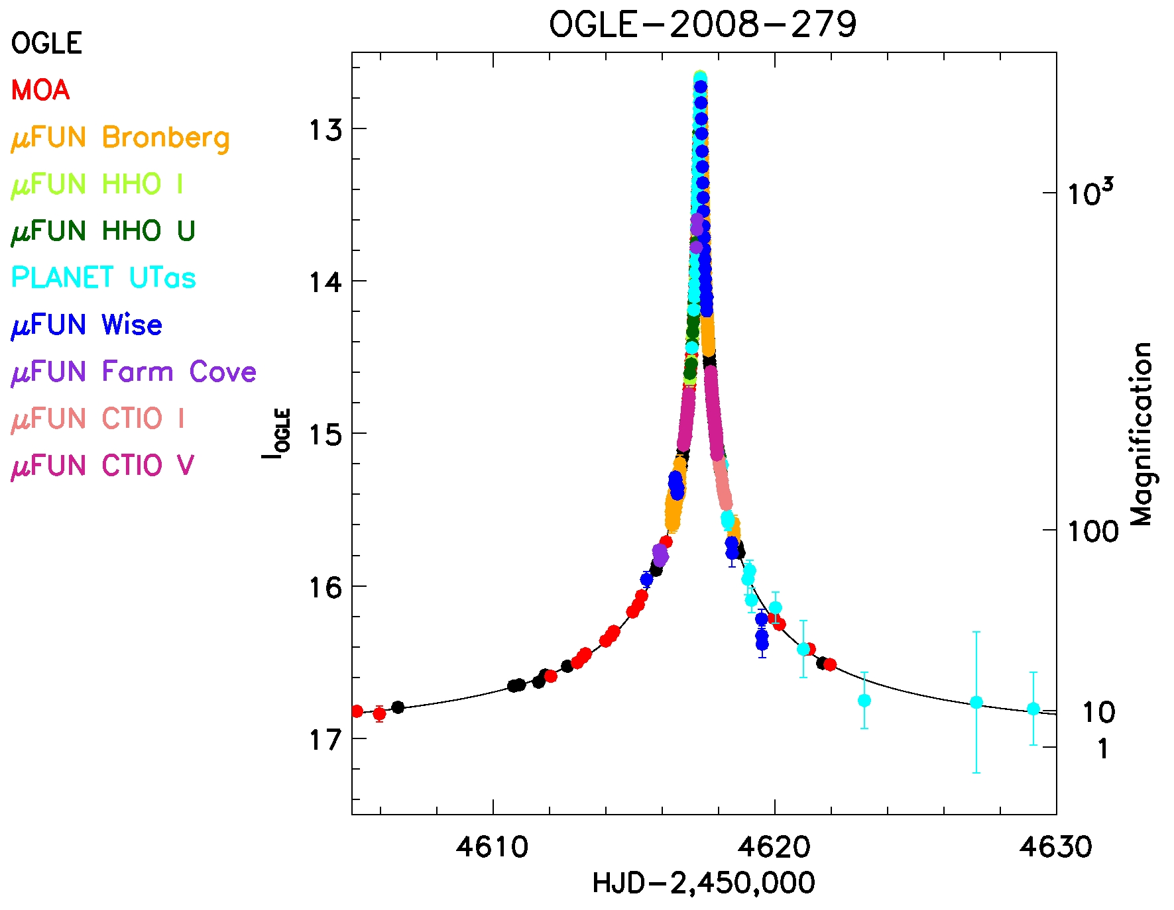
OGLE-2008-BLG-279
Yee et al. 2009 ApJ, 703, 2082
Notes:
theta_E= ~3 AU
rsnow=1.1 AU
Mstar=0.64 M_sun

Slide 33
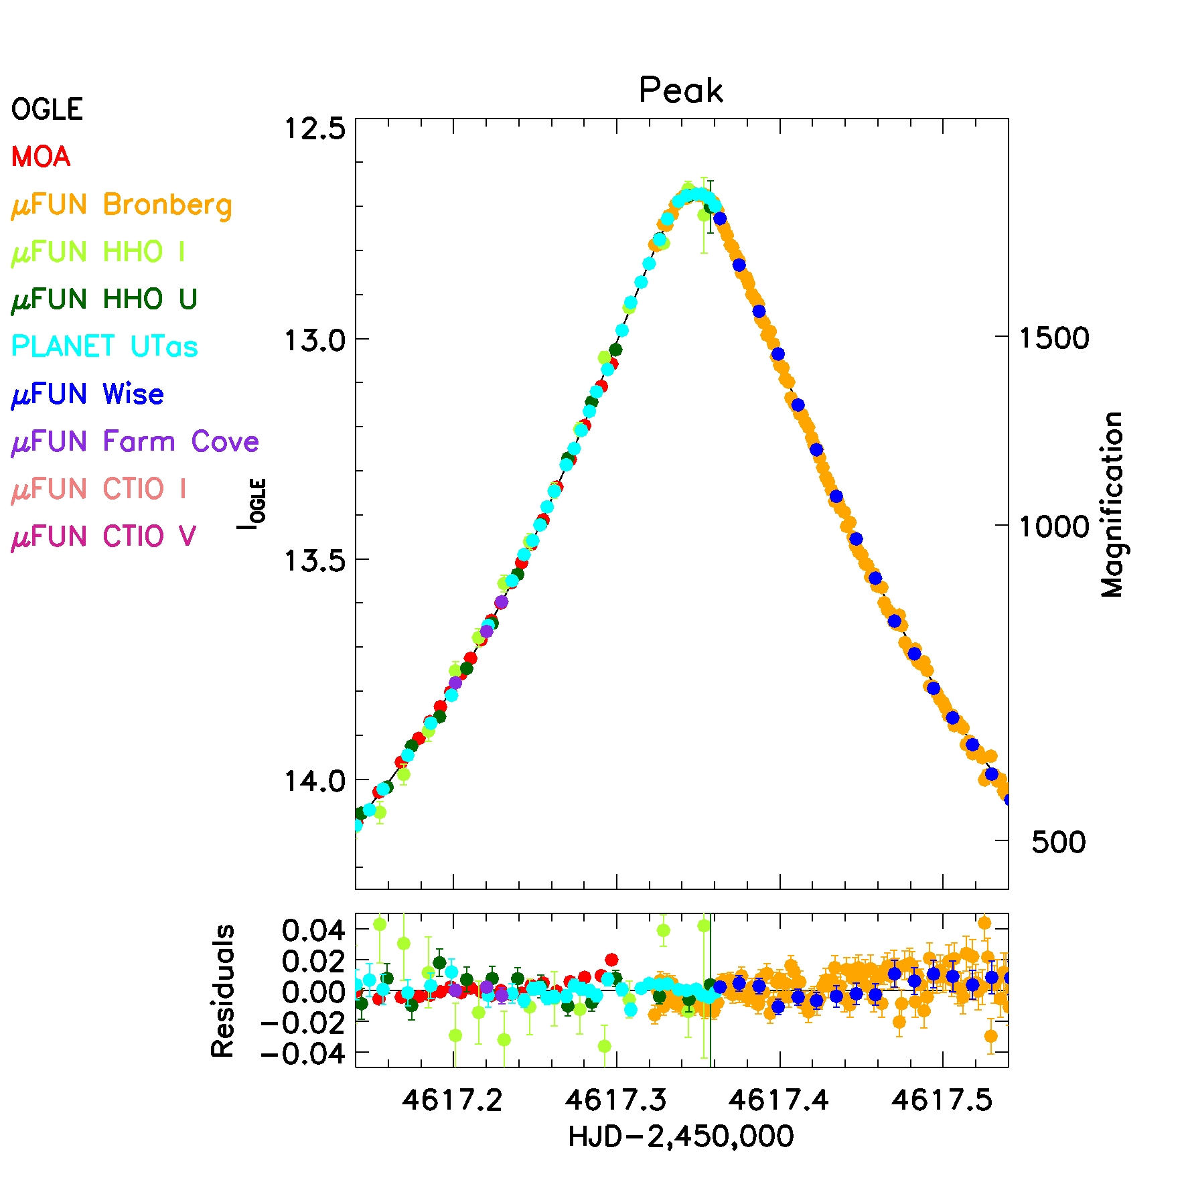
OGLE-2008-BLG-279
Yee et al. 2009 ApJ, 703, 2082

Slide 34
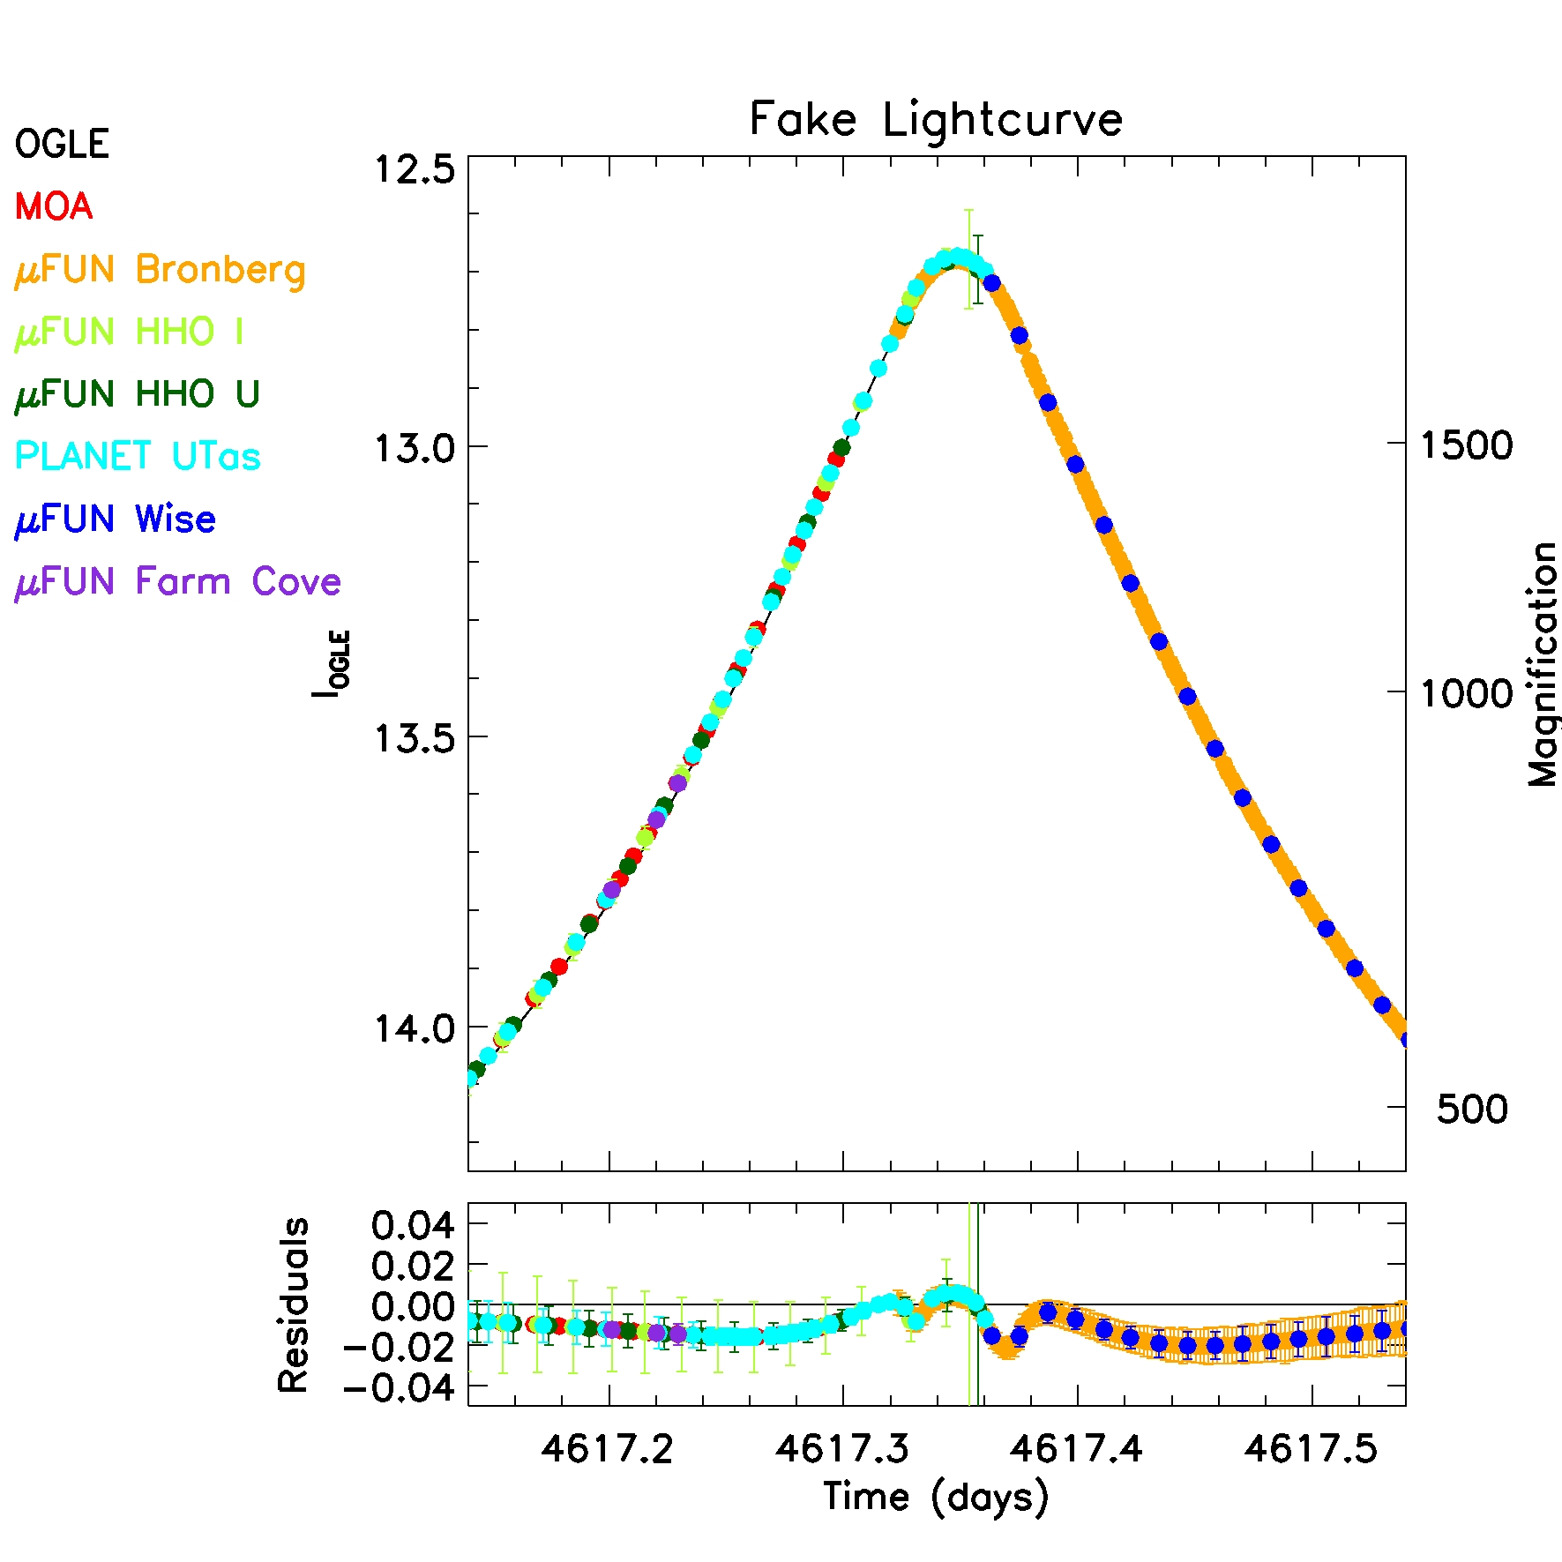
The Rhie Method: Fit Fake Planets
Yee et al. 2009 ApJ, 703, 2082
Notes:
bmap = 5.
q0 = 0.001
a0 = 0.52359878

Slide 35
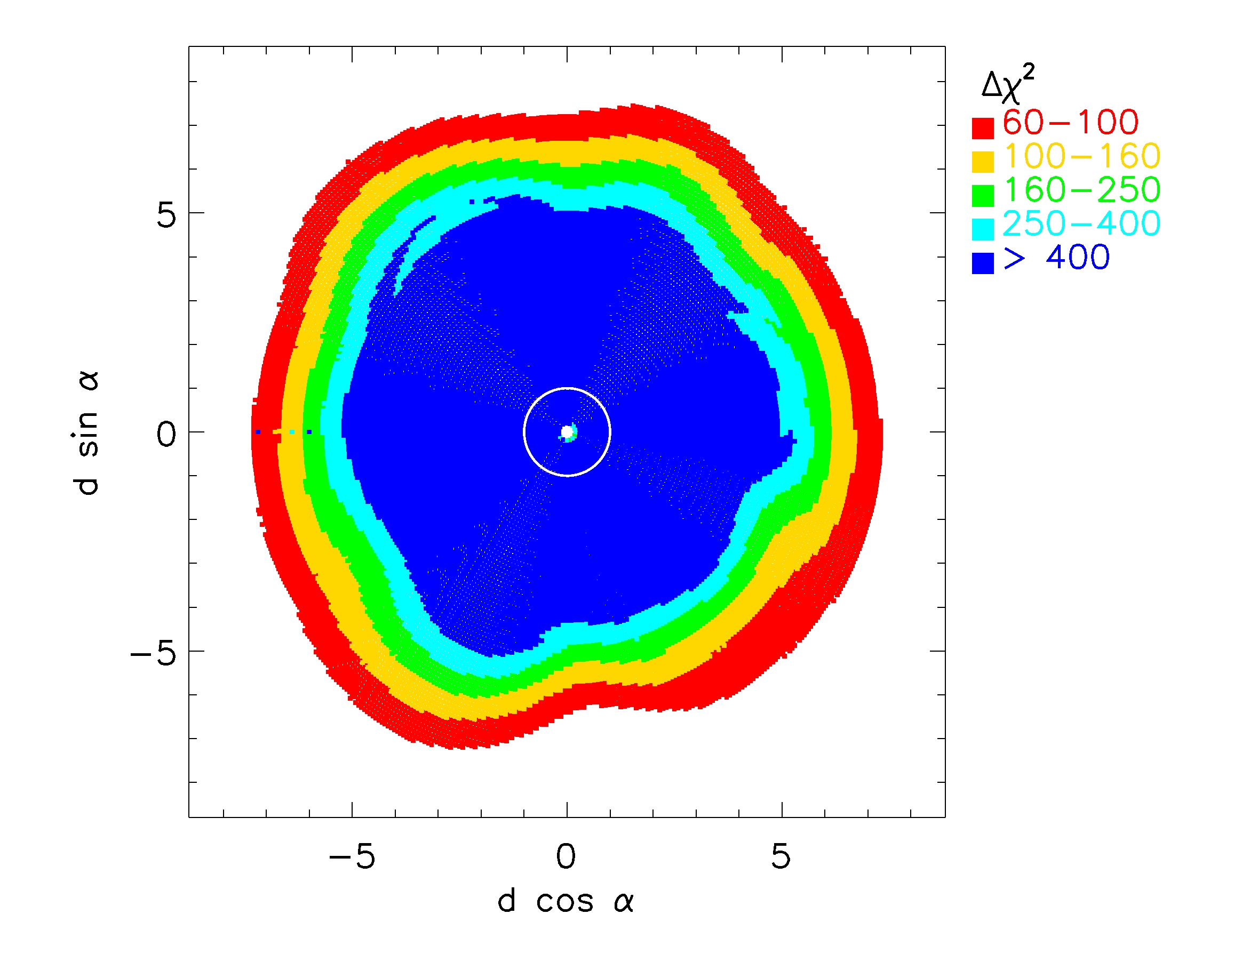
Yee et al. 2009 ApJ, 703, 2082

Slide 36
Yee et al. 2009 ApJ, 703, 2082

Slide 37
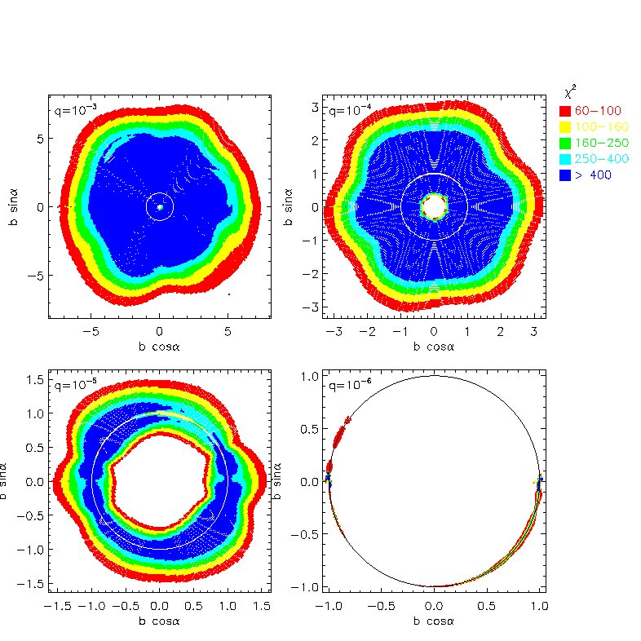
Yee et al. 2009 ApJ, 703, 2082

Slide 38
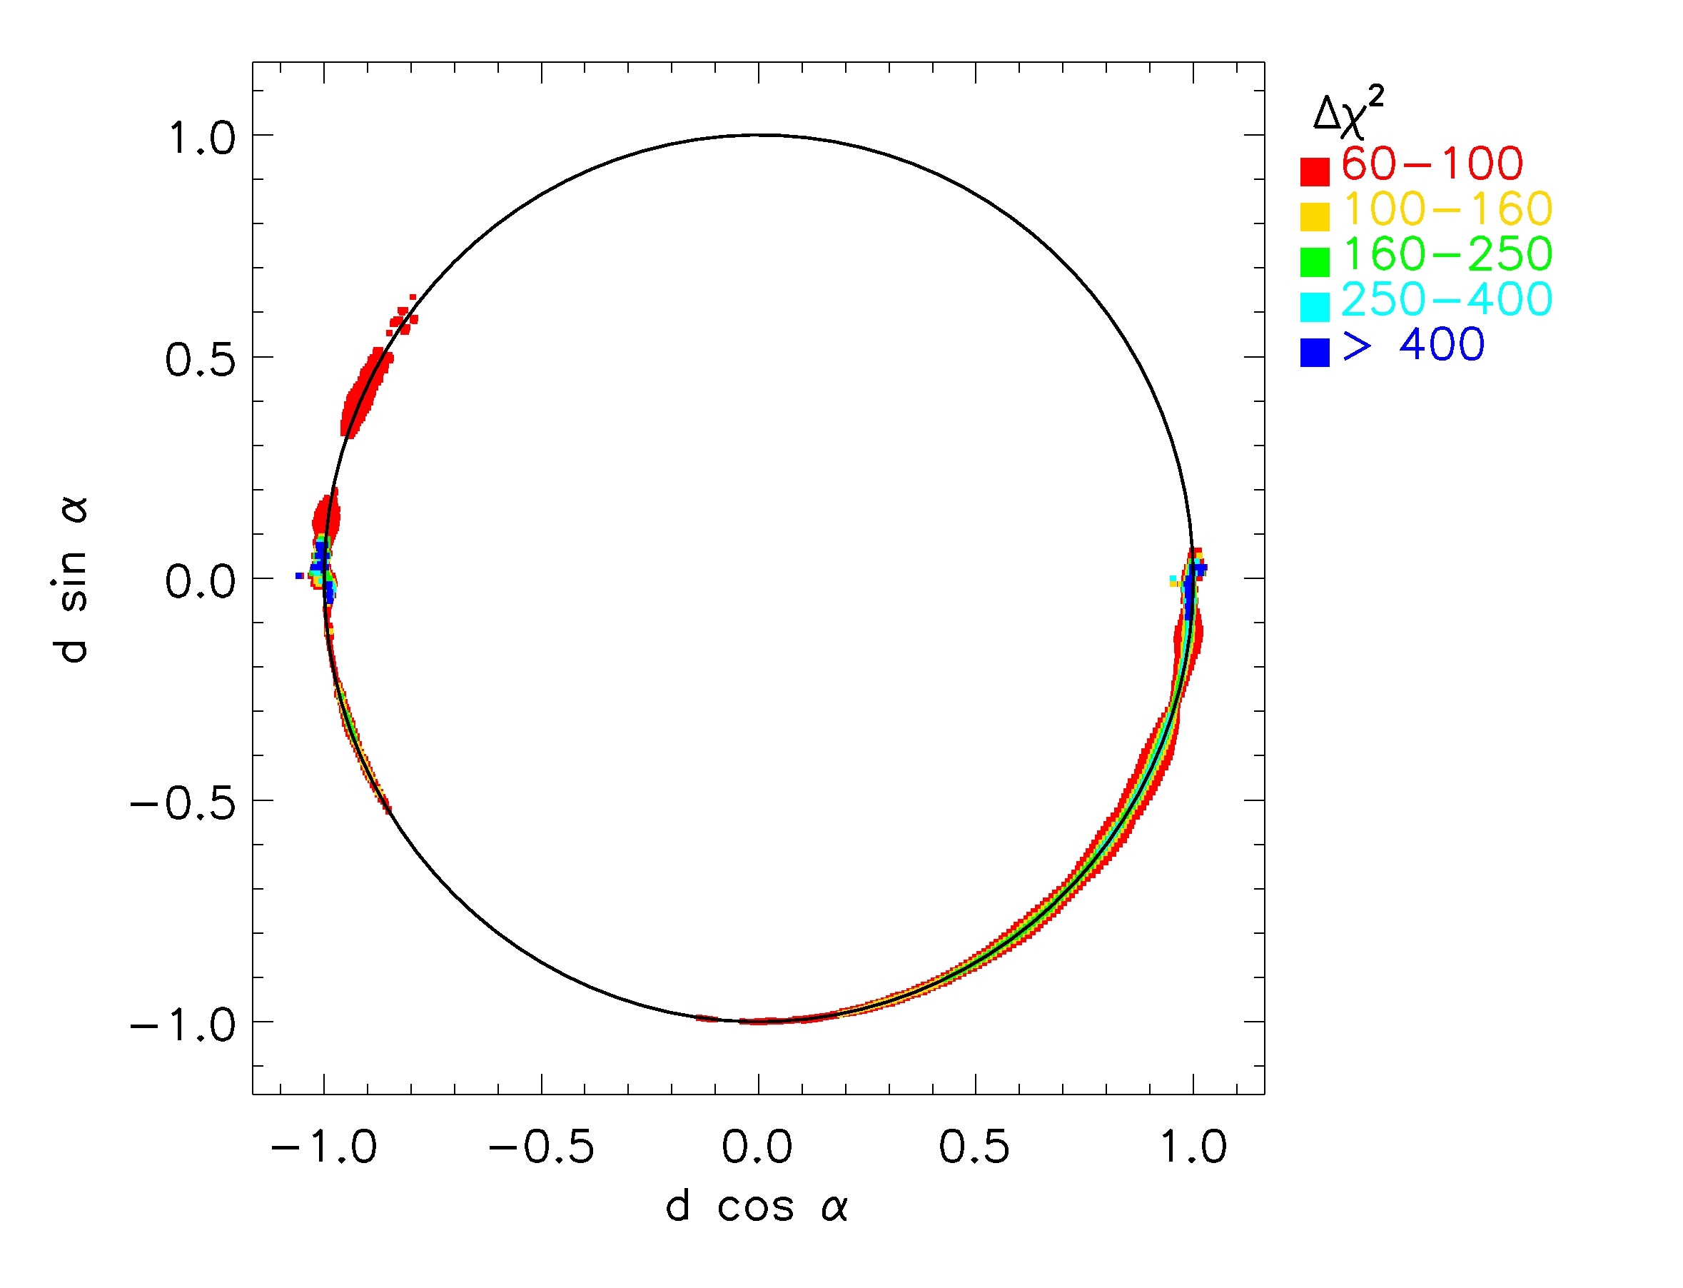
Yee et al. 2009 ApJ, 703, 2082

Slide 39
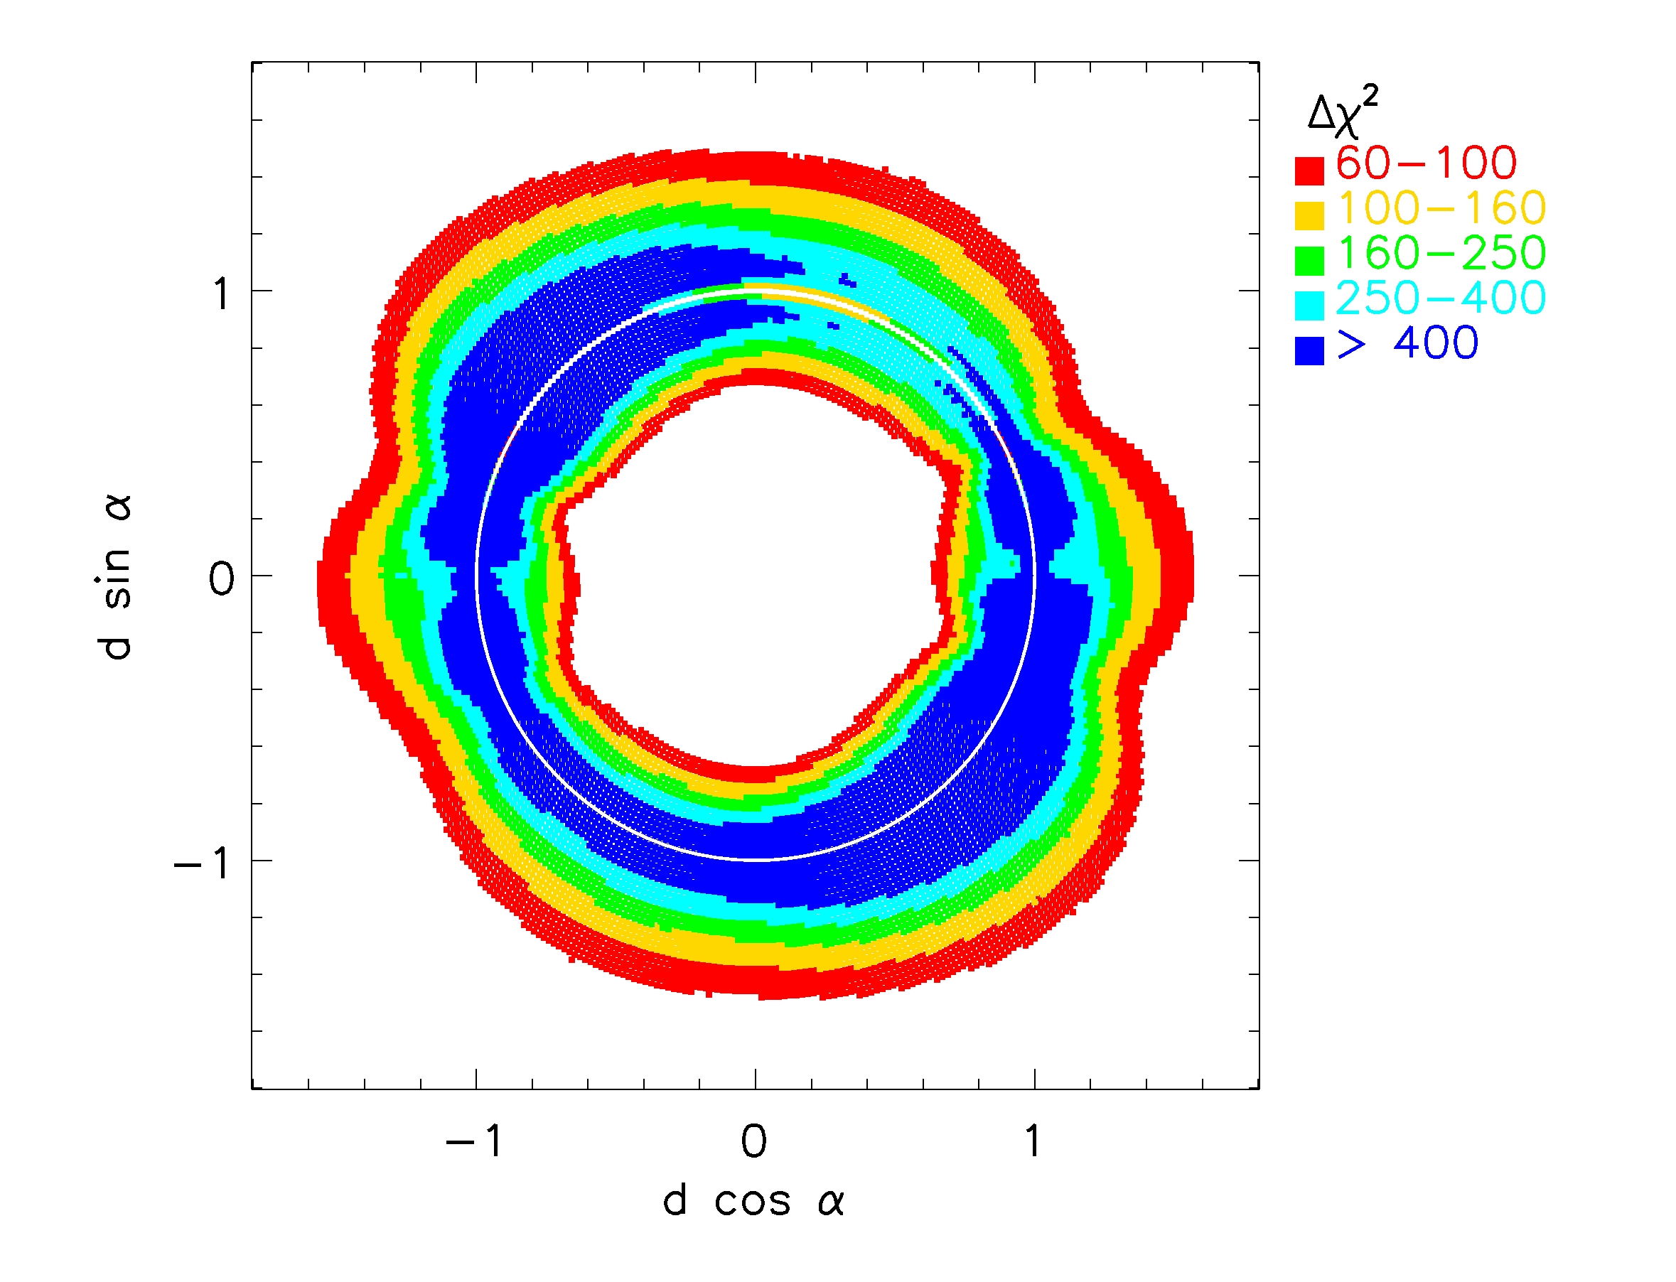
Yee et al. 2009 ApJ, 703, 2082

Slide 40
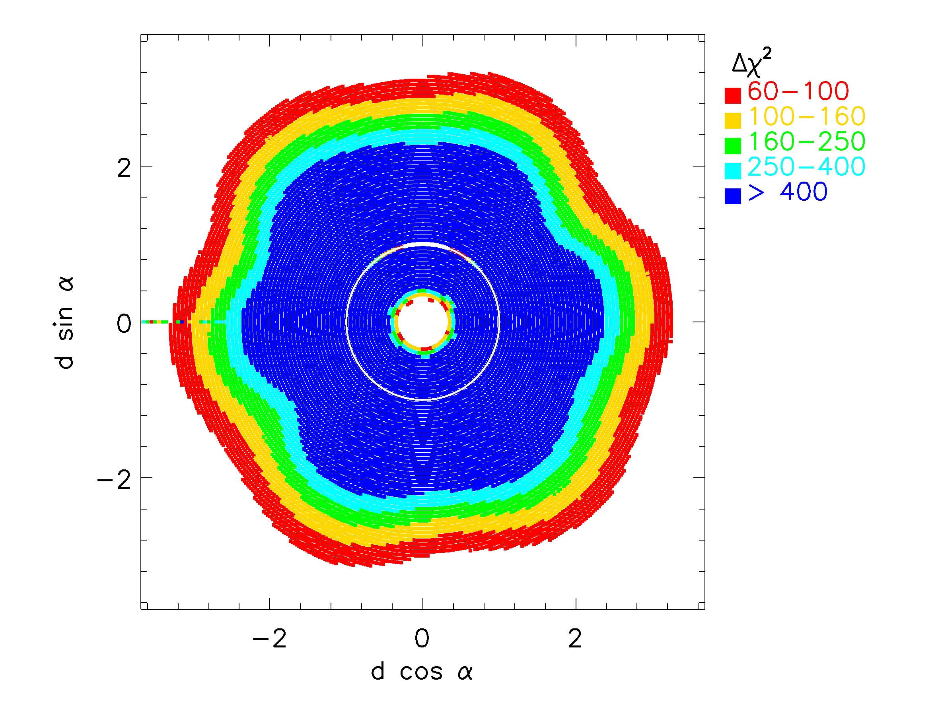
Yee et al. 2009 ApJ, 703, 2082

Slide 41
Yee et al. 2009 ApJ, 703, 2082

Slide 42
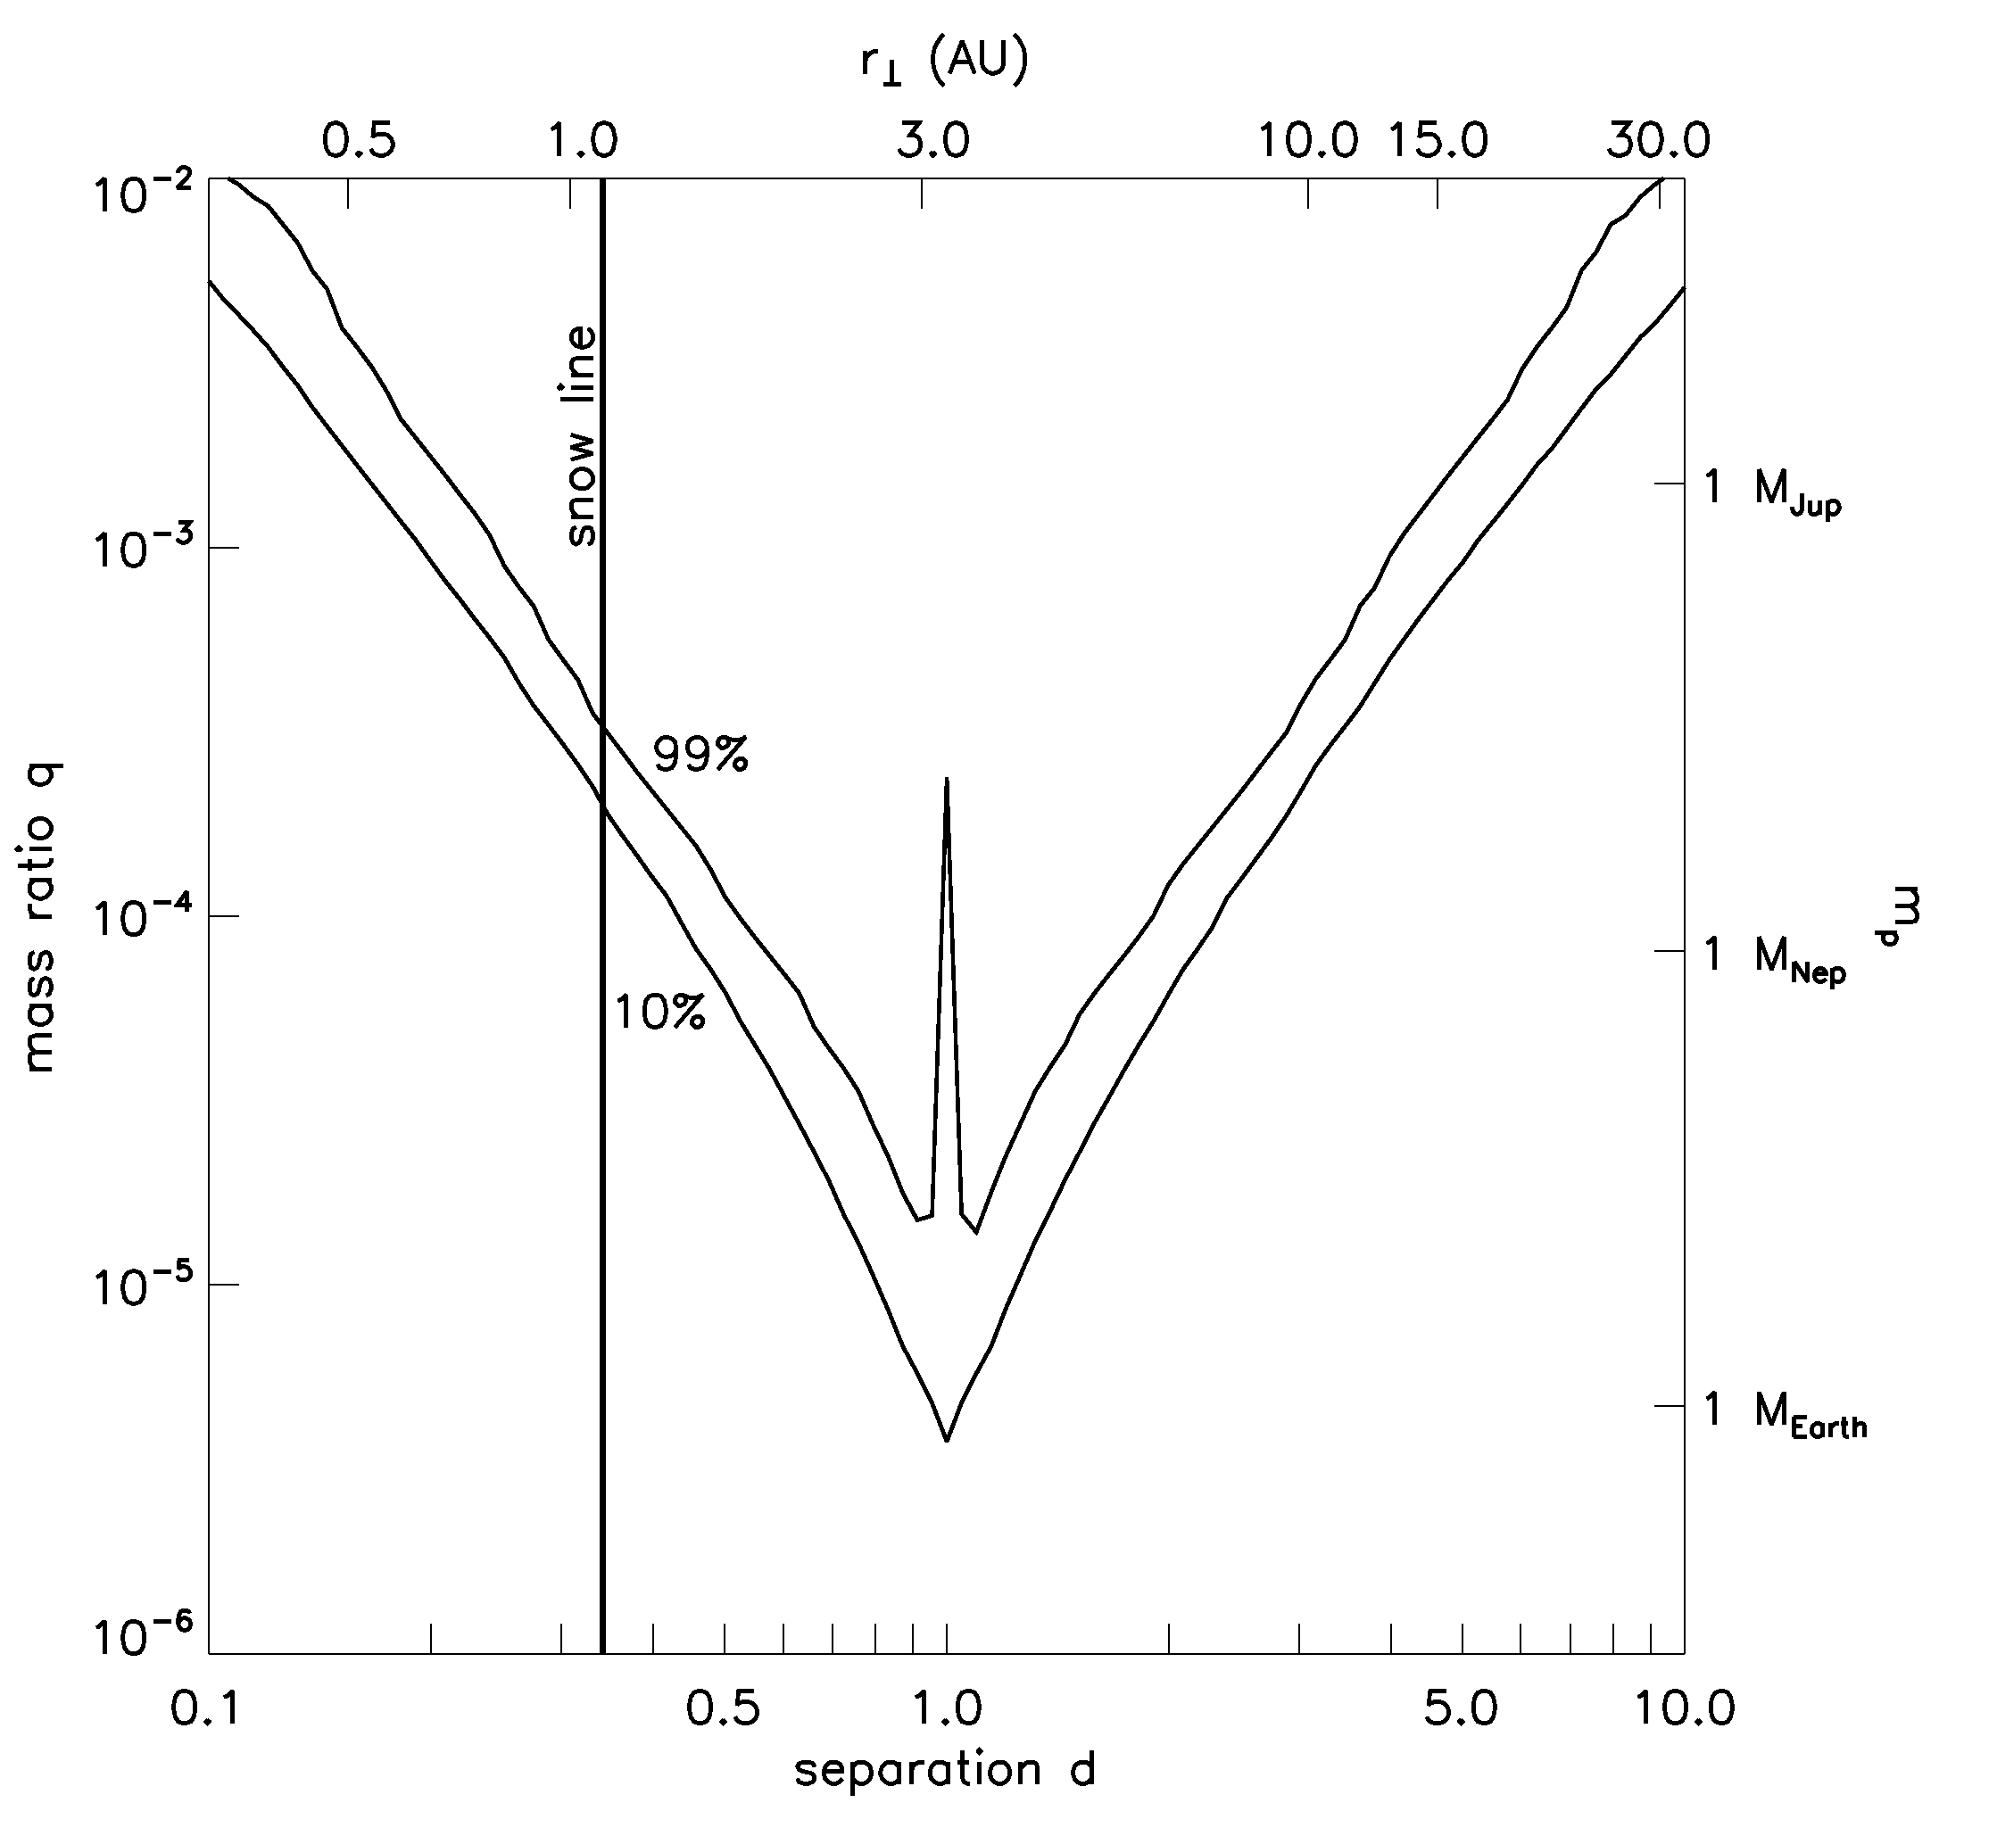
Yee et al. 2009 ApJ, 703, 2082

Slide 43
Einstein Ring
Yee et al. 2009 ApJ, 703, 2082

Slide 44
Einstein Ring
Yee et al. 2009 ApJ, 703, 2082

Slide 45
Einstein Ring
Yee et al. 2009 ApJ, 703, 2082

Slide 46
Gould et al. 2010, ApJ, 720, 1073

Slide 47
Planet
Gould et al. 2010, ApJ, 720, 1073

Slide 48
Planet
Gould et al. 2010, ApJ, 720, 1073

Slide 49
Planet
Gould et al. 2010, ApJ, 720, 1073

Slide 50
Planet
Gould et al. 2010, ApJ, 720, 1073

Slide 51
Planet
Gould et al. 2010, ApJ, 720, 1073

Slide 52
Planet
Gould et al. 2010, ApJ, 720, 1073

Slide 53
Planet
Gould et al. 2010, ApJ, 720, 1073

Slide 54
Planet
0.36 planets/star/dex²
Gould et al. 2010, ApJ, 720, 1073

Slide 55
Microlensing = Extrapolation of RV?
Gould et al. 2010, ApJ, 720, 1073

Slide 56
Microlensing = Extrapolation of RV?
Gould et al. 2010, ApJ, 720, 1073

Slide 57
Microlensing = Extrapolation of RV?
Gould et al. 2010, ApJ, 720, 1073

Slide 58
Gould et al. 2010, ApJ, 720, 1073

Slide 59
Christian Clanton: Thursday Morning
Gould et al. 2010, ApJ, 720, 1073

Slide 60
OGLE-2005-BLG-390
Beaulieu et al. 2006, Nature, 439, 437

Slide 61
Cassan et al. 2012 Nature 481, 167

Slide 62
Cassan et al. 2012 Nature 481, 167

Slide 63
# planets / star / dex²
Planet Mass
Cassan et al. 2012 Nature 481, 167

Slide 64
# planets / star / dex²
Planet Mass
Cassan et al. 2012 Nature 481, 167

Slide 65
# planets / star / dex²
Planet Mass
Cassan et al. 2012 Nature 481, 167

Slide 66
3 Problems w/ Survey+Followup:
It’s crazy.

Slide 67
3 Problems w/ Survey+Followup:
It’s crazy.
The statistics are brutal.

Slide 68
3 Problems w/ Survey+Followup:
It’s crazy.
The statistics are brutal.
We’re missing most of the planets.
Planetary Caustics
Central Caustic
Griest & Safizadeh 1998 ApJ 500, 37

Slide 69
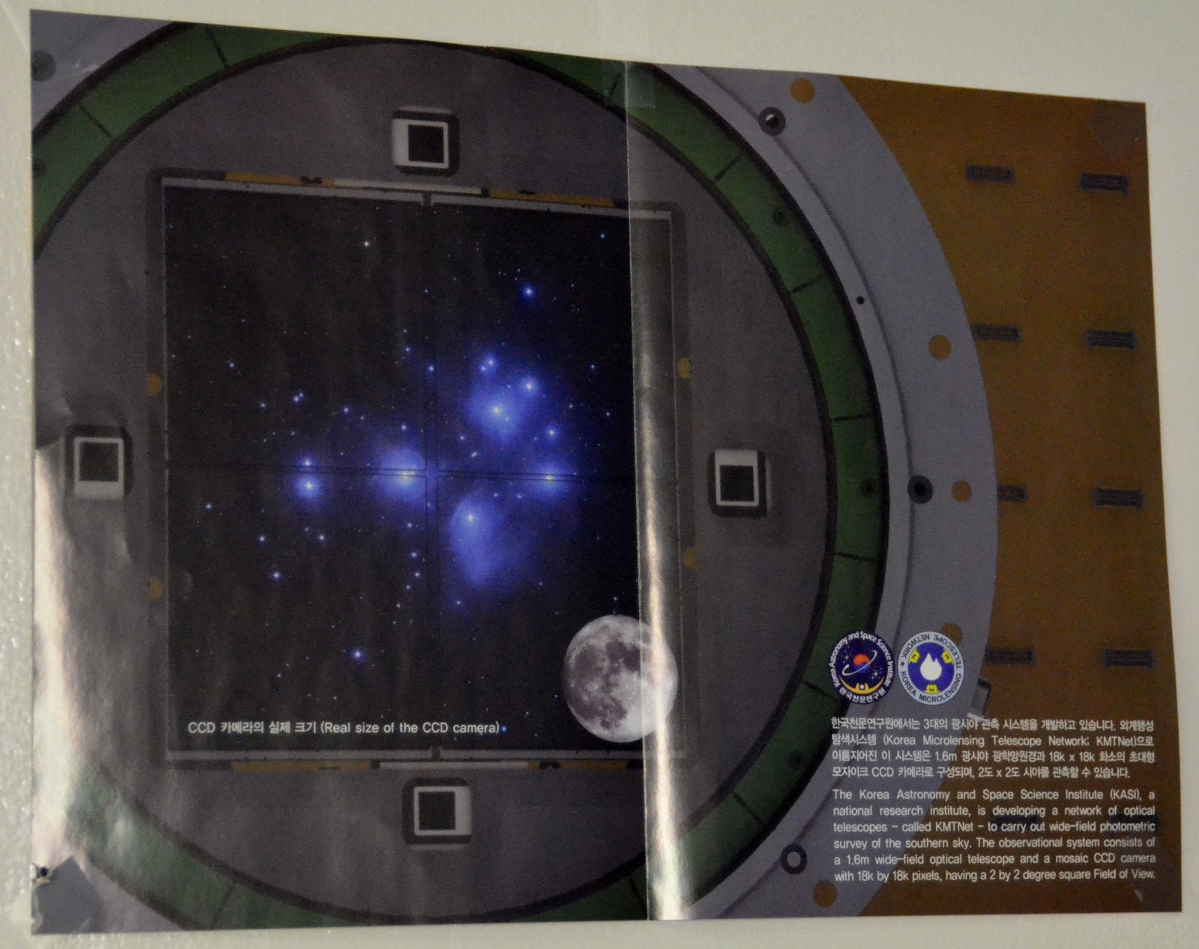

Slide 70
15m | Earth
1h | Neptune
2.5h | Saturn
5h | Jupiter

Slide 71
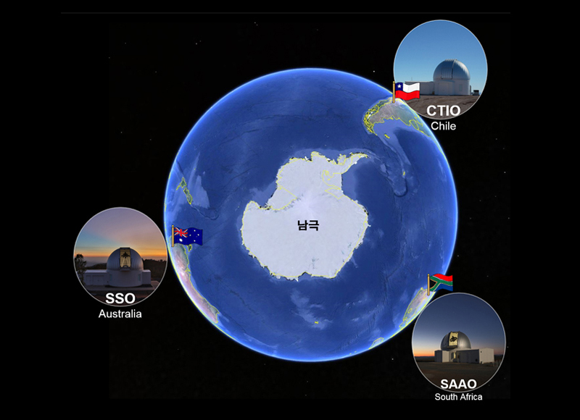
Antarctica
Notes:
Look for more accurate picture.

Slide 72
Apr 27
May 17
Jun 6
Jun 26
OGLE
KMT/CTIO
KMT/SAAO
I (magnitude)
KMT/SSO
HJD – 2,450,000 (days)
Shin et al. 2016 JKAS, 49, 73
Notes:
block out unnecessary figures
arrows to indicate zooming

Slide 73
Apr 27
May 17
Jun 6
Jun 26
OGLE
KMT/CTIO
KMT/SAAO
I (magnitude)
KMT/SSO
40 days
HJD – 2,450,000 (days)
Shin et al. 2016 JKAS, 49, 73

Slide 74
Apr 27
May 17
Jun 6
Jun 26
OGLE
KMT/CTIO
KMT/SAAO
I (magnitude)
KMT/SSO
HJD – 2,450,000 (days)
Shin et al. 2016 JKAS, 49, 73

Slide 75
Apr 27
May 17
Jun 6
Jun 26
OGLE
KMT/CTIO
KMT/SAAO
I (magnitude)
q = 0.01
KMT/SSO
HJD – 2,450,000 (days)
Shin et al. 2016 JKAS, 49, 73

Slide 76
Apr 27
May 17
Jun 6
Jun 26
OGLE
KMT/CTIO
KMT/SAAO
I (magnitude)
KMT/SSO
HJD – 2,450,000 (days)
Shin et al. 2016 JKAS, 49, 73

Slide 77
Apr 27
May 17
Jun 6
Jun 26
OGLE
KMT/CTIO
KMT/SAAO
I (magnitude)
KMT/SSO
HJD – 2,450,000 (days)
Shin et al. 2016 JKAS, 49, 73

Slide 78
Apr 27
May 17
Jun 6
Jun 26
OGLE
KMT/CTIO
30 min
KMT/SAAO
I (magnitude)
KMT/SSO
HJD – 2,450,000 (days)
Shin et al. 2016 JKAS, 49, 73
Notes:
add magnification map movie after this

Slide 79
Apr 27
May 17
Jun 6
Jun 26
OGLE
KMT/CTIO
30 min
12 hr
KMT/SAAO
I (magnitude)
KMT/SSO
40 days
HJD – 2,450,000 (days)
Shin et al. 2016 JKAS, 49, 73
Notes:
add magnification map movie after this

Slide 80
Three Main Microlensing Surveys

Slide 81
What Causes Short Timescale Microlensing?
~1 day
Sumi et al. 2011, Nature

Slide 82
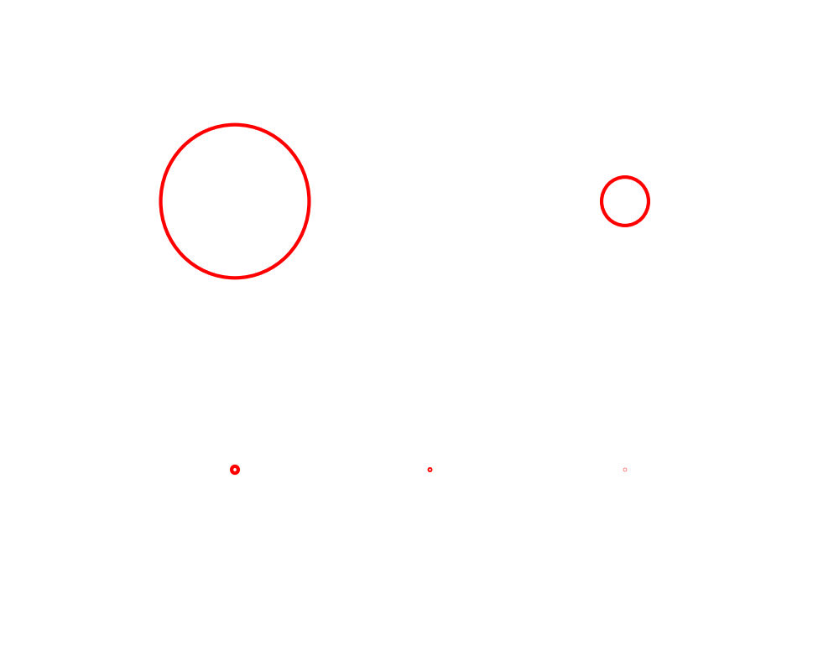
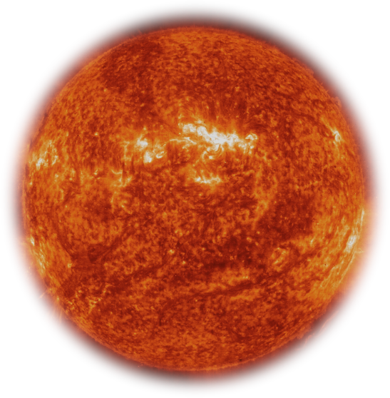
(and θ_{E}) depends on M_{L} and D_{L}
@4 kpc
~10 AU
Lens =

Slide 83
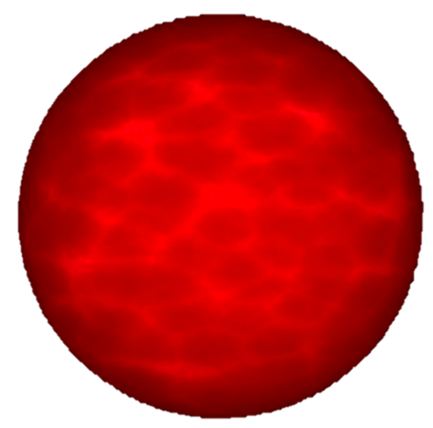
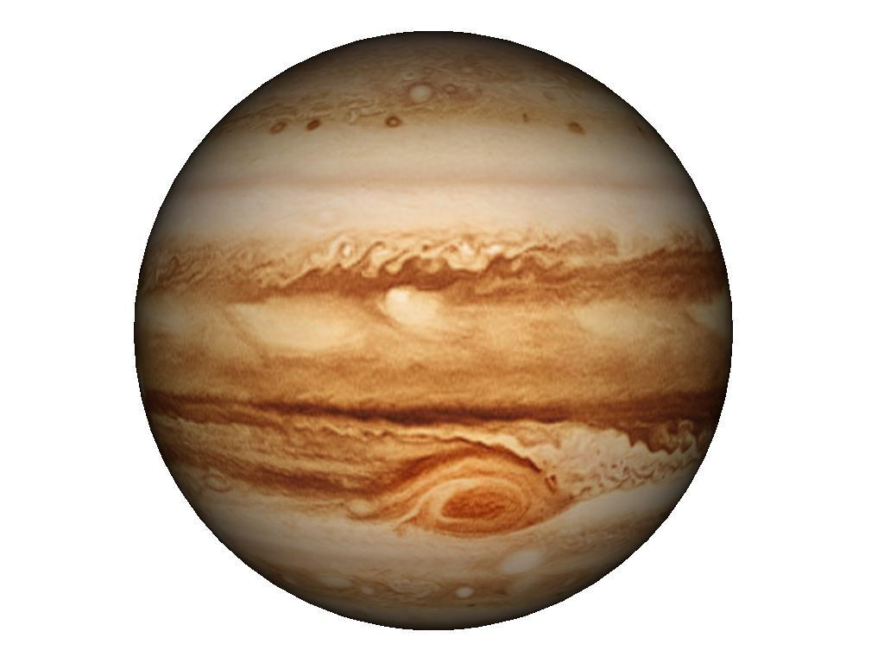
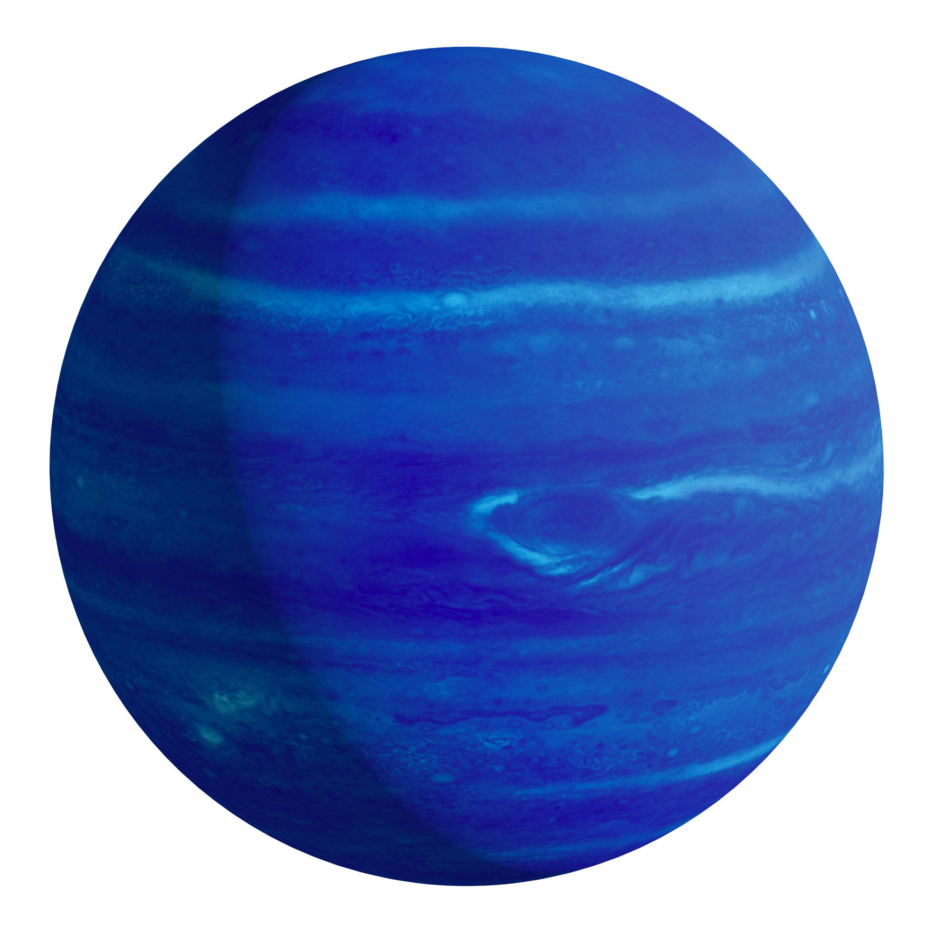
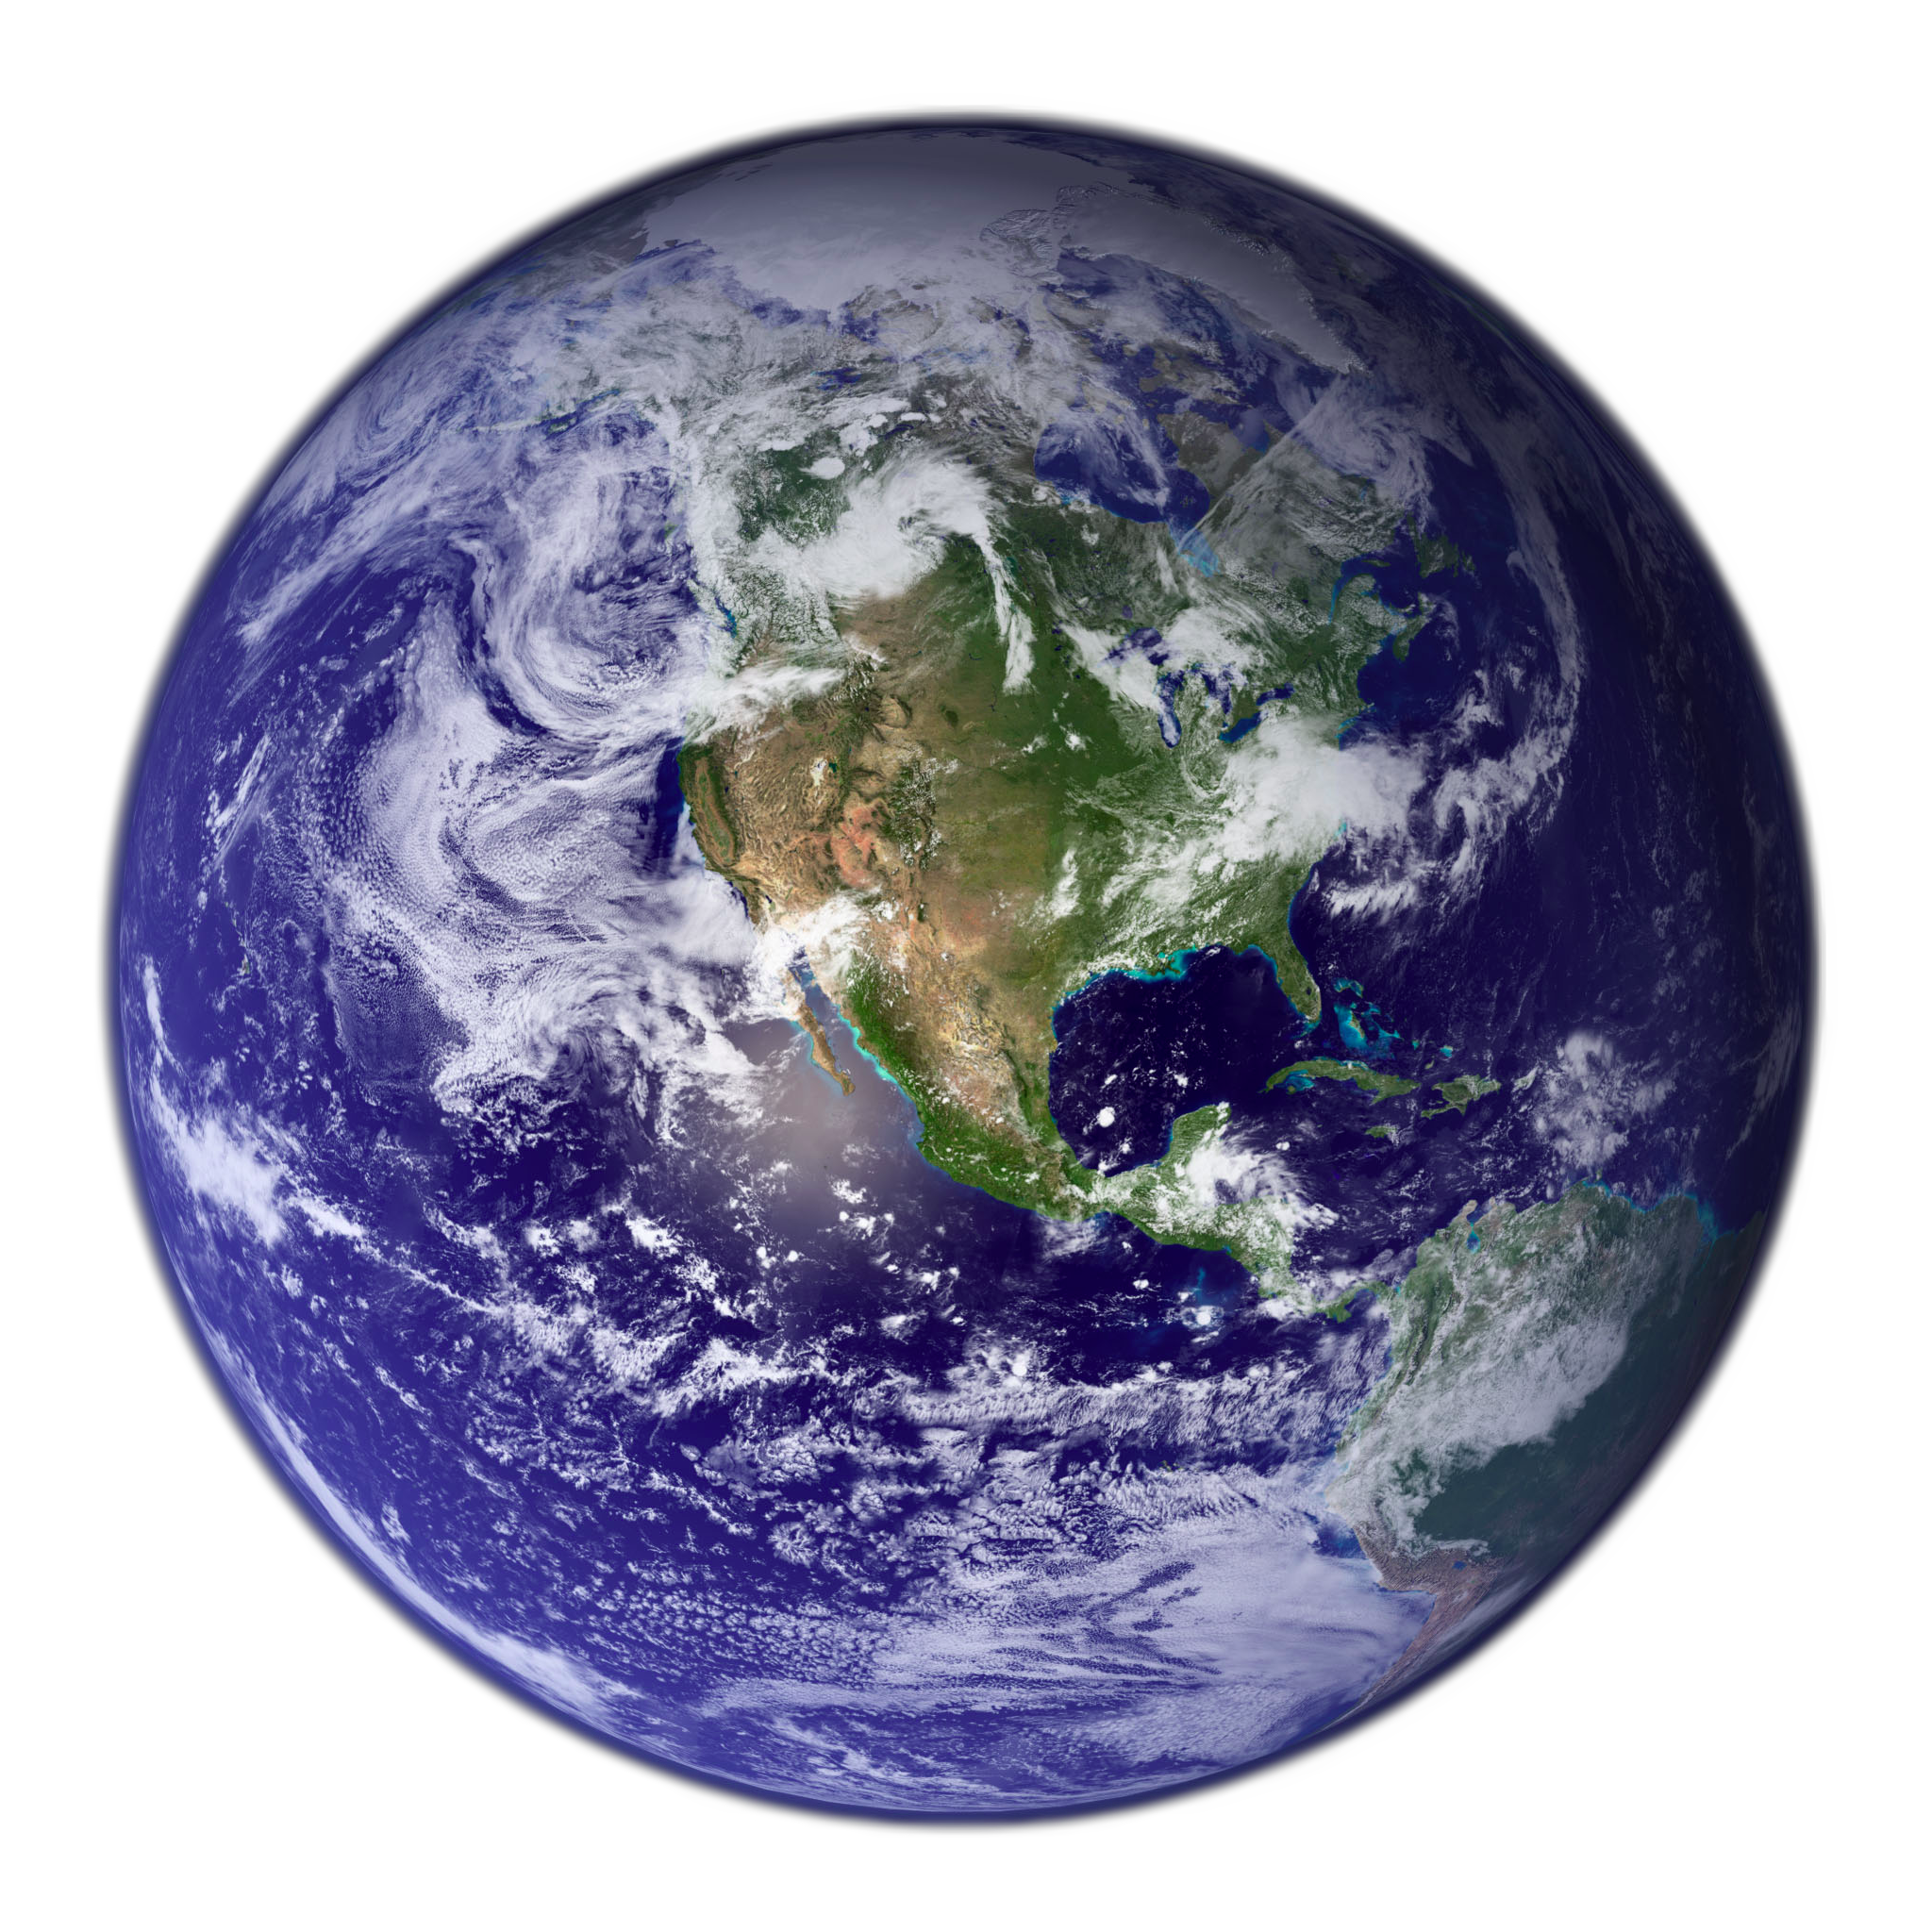
(and θ_{E}) depends on M_{L} and D_{L}
@4 kpc
~10 AU
Lens =

Slide 84
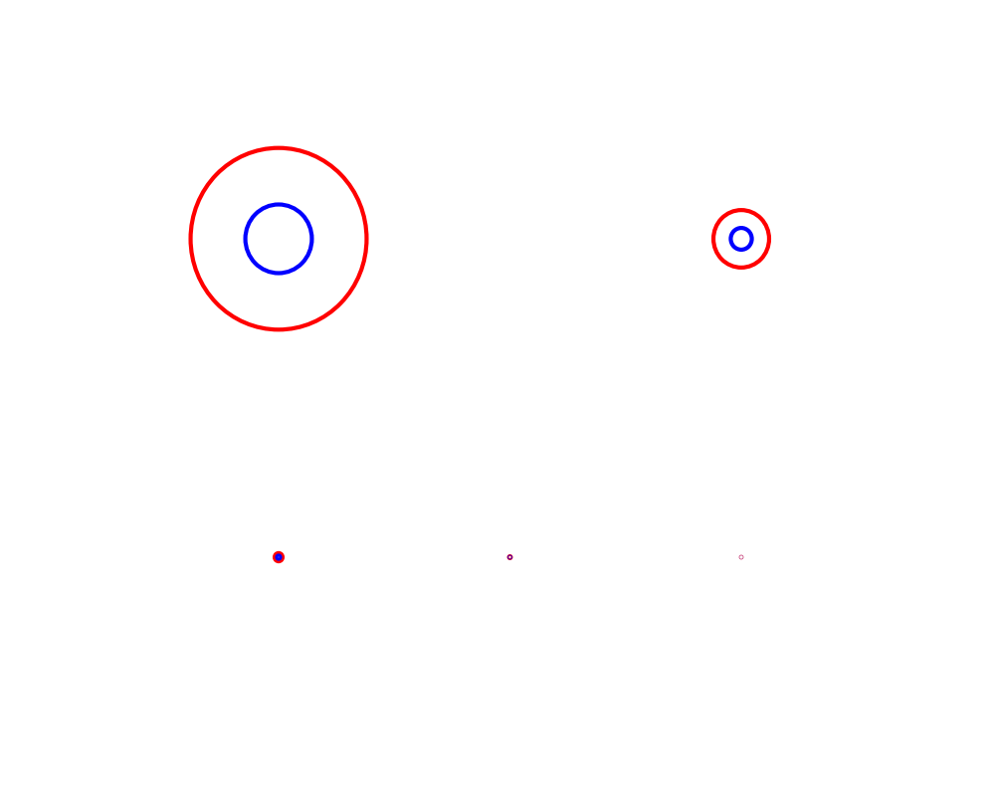
(and θ_{E}) depends on M_{L} and D_{L}
@4 kpc
@1 kpc
~10 AU
Lens =

Slide 85
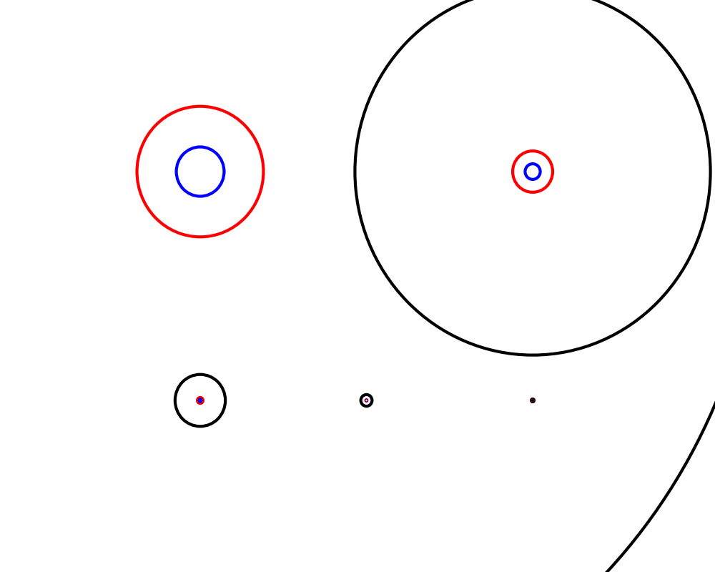
(and θ_{E}) depends on M_{L} and D_{L}
@4 kpc
@1 kpc
@7.9 kpc
~10 AU
Lens =

Slide 86
t_{E} = θ_{E}/μ
→t_{E}(M_{star}, D_{lens}, μ)

Slide 87
MOA Event Timescale Distribution
Sumi et al. 2011, Nature
Notes:
Red = power law, blue= log normal
Dashed = stellar
Dotted=planet delta function

Slide 88
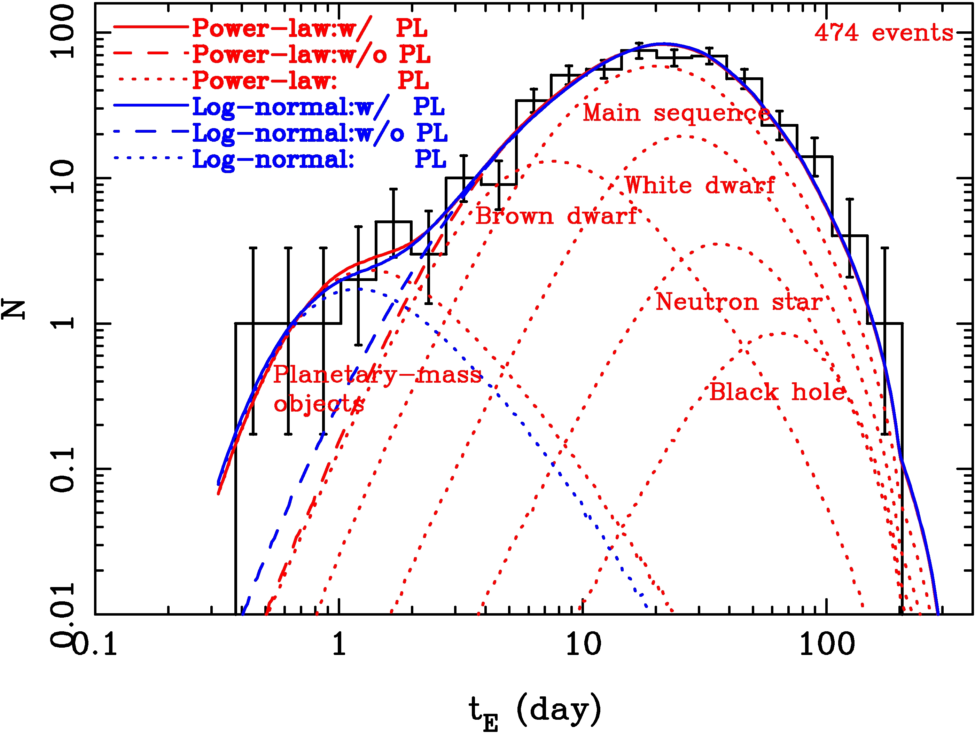
MOA Event Timescale Distribution
Sumi et al. 2011, Nature

Slide 89
MOA Event Timescale Distribution
Sumi et al. 2011, Nature

Slide 90
MOA Event Timescale Distribution
Sumi et al. 2011, Nature

Slide 91
MOA Event Timescale Distribution
Sumi et al. 2011, Nature

Slide 92
MOA Event Timescale Distribution
Sumi et al. 2011, Nature

Slide 93
MOA Event Timescale Distribution
Sumi et al. 2011, Nature

Slide 94
MOA Event Timescale Distribution
Sumi et al. 2011, Nature

Slide 95
MOA Event Timescale Distribution
Evidence for Free-Floating Planets
Sumi et al. 2011, Nature
Notes:
Red = power law, blue= log normal
Dashed = stellar
Dotted=planet delta function

Slide 96
MOA Event Timescale Distribution
Evidence for Free-Floating Planets
Sumi et al. 2011, Nature
Notes:
Red = power law, blue= log normal
Dashed = stellar
Dotted=planet delta function

Slide 97
Suzuki et al 2016 ApJ 833, 145

Slide 98
Suzuki et al 2016 ApJ 833, 145

Slide 99
Central
Caustic
Suzuki et al 2016 ApJ 833, 145

Slide 100
Planetary Caustic
Central
Caustic
Suzuki et al 2016 ApJ 833, 145

Slide 101
Planetary Caustic
Central
Caustic

Slide 102
Dave Bennett: Wednesday Afternoon
Suzuki et al 2016 ApJ 833, 145

Slide 103
Wei Zhu: Friday Afternoon

Slide 104
Wei Zhu: Friday Afternoon
Youn Kil Jung: Thursday Afternoon

Slide 105
Wei Zhu: Friday Afternoon
Youn Kil Jung: Thursday Afternoon
In-Gu Shin: Thur

