Slide 1


2016 Spitzer Microlens Parallax Campaign
Harvard-Smithsonian
Center for Astrophysics
Jennifer C. Yee
on behalf of the Spitzer Team:
Sebastiano Calchi Novati, Sean Carey, Andy Gould, Calen Henderson, Yossi Shvartzvald, Wei Zhu

Slide 2
Goal: Galactic Distribution of Planets
= Statistics
Requires carefully considered selection criteria.

Slide 10
???

Slide 19
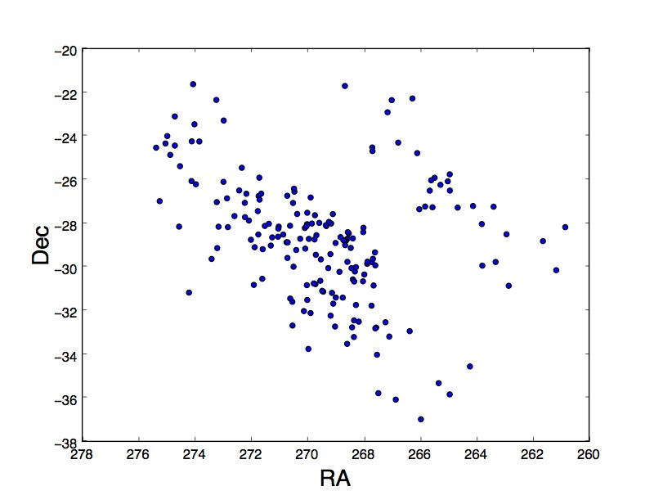

Slide 20
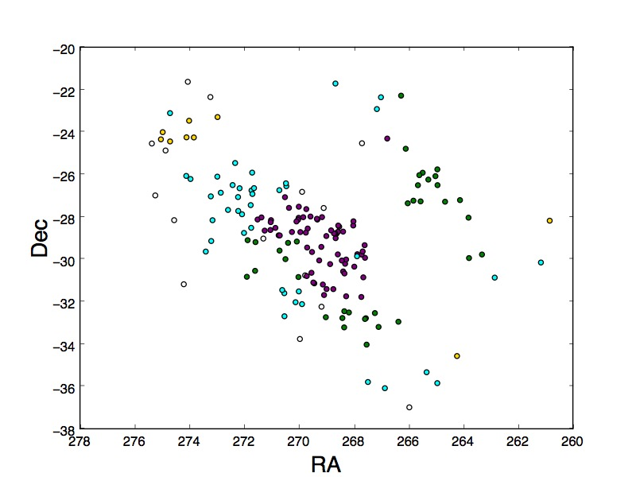

Slide 21
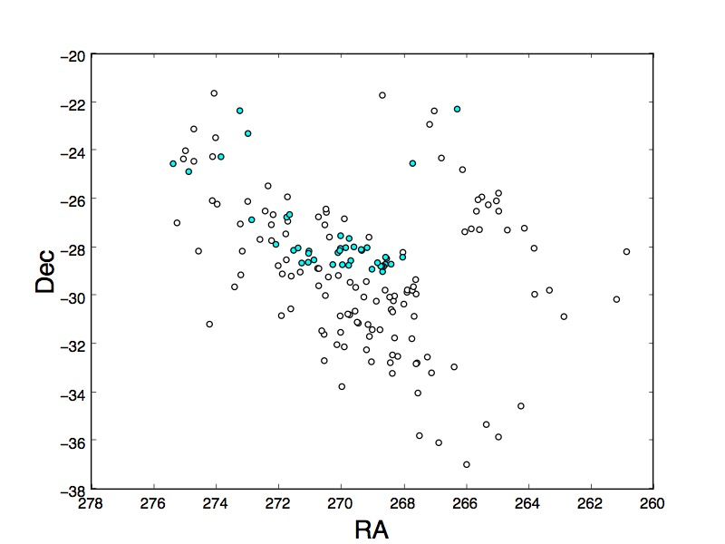

Slide 22
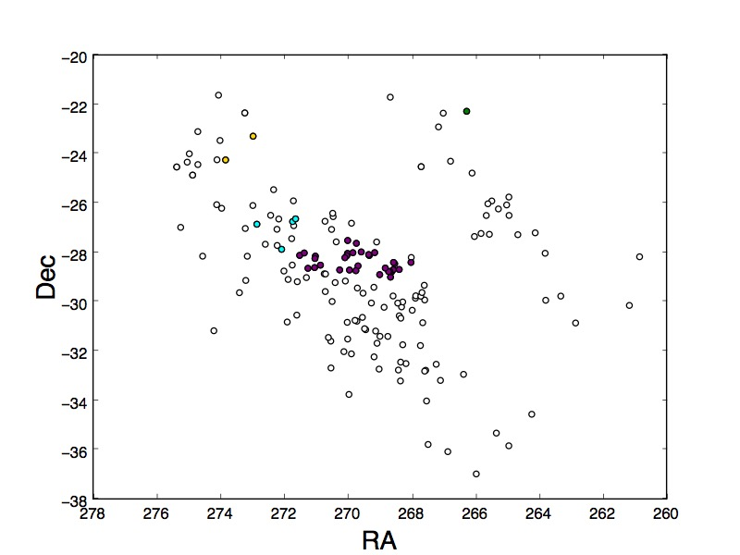

Slide 23
Summary of 2016 Spitzer Events
 | Total | K2/C9
Point Lens | 145 | 38
Binaries | 21 | 4
Planets | 3 | 1
Total | 169 | 45

Slide 24
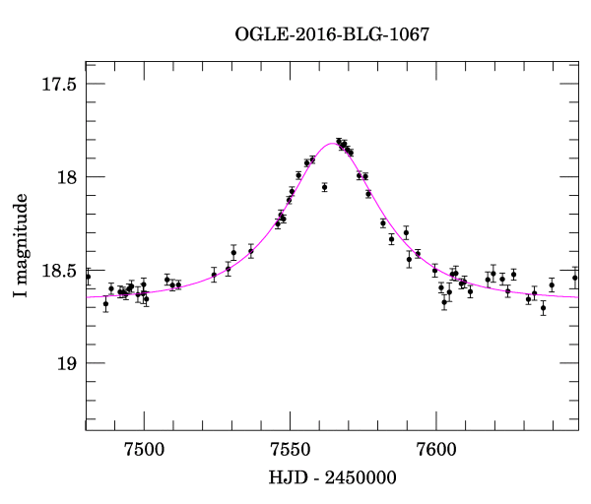

Slide 27
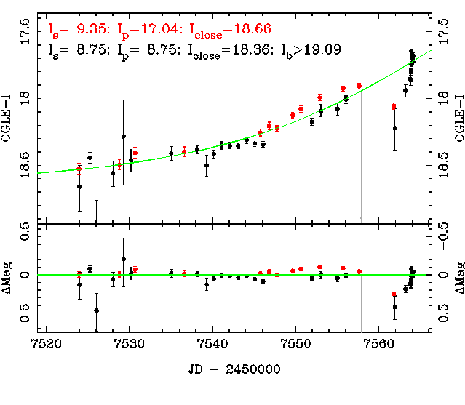

Slide 30
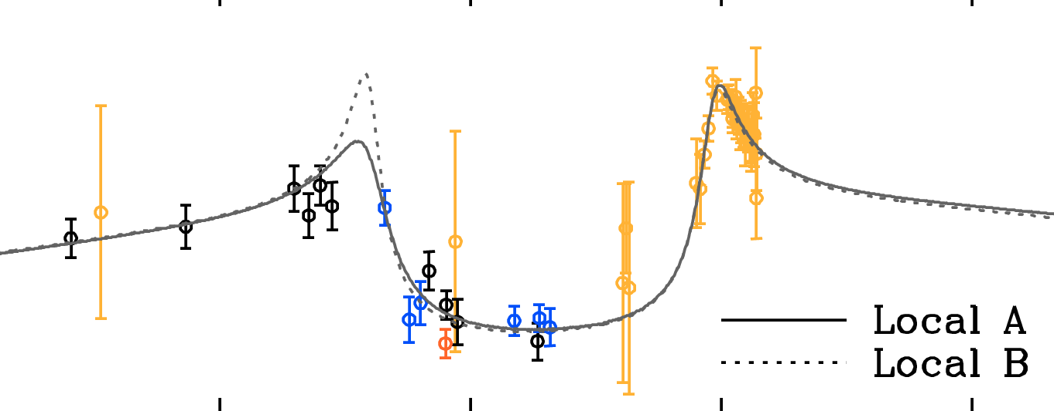

Slide 33
1190: Planet found by YH Ryu

Slide 34
1190: Planet found by YH Ryu

Slide 35
1190: Planet found by YH Ryu

Slide 36
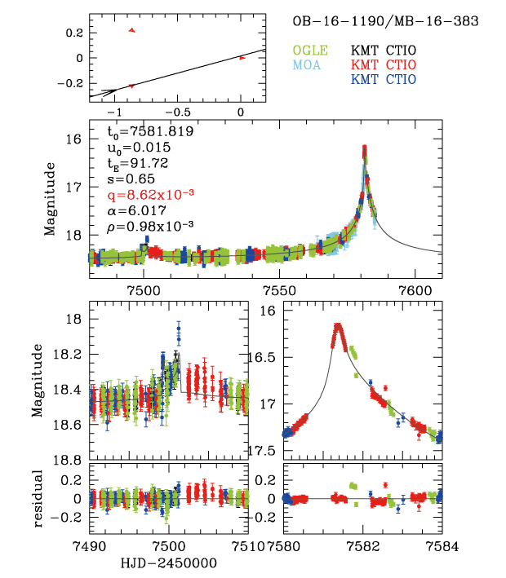
Planet cannot be counted.

Slide 37
Planet cannot be counted, unless K2 measures parallax.

Slide 43
Smallest Planet Ever: 6x10⁻⁵

Slide 44
Smallest Planet Ever: 6x10⁻⁵

Slide 45
OB160735: Clear Binary from Spitzer

Slide 46
0548: Binary

Slide 47
0548: Binary
Caustic Xings resolved by KMT

Slide 48
0548: Binary
Caustic Xings resolved by KMT
Weak Spitzer signal

Slide 49
0548: Binary
Caustic Xings resolved by KMT
Weak Spitzer signal
K2 Event

Slide 50
Summary of 2016 Spitzer Events
 | Total | K2/C9
Point Lens | 145 | 38
Binaries | 21 | 4
Planets | 3 | 1
Total | 169 | 45

