Slide 1
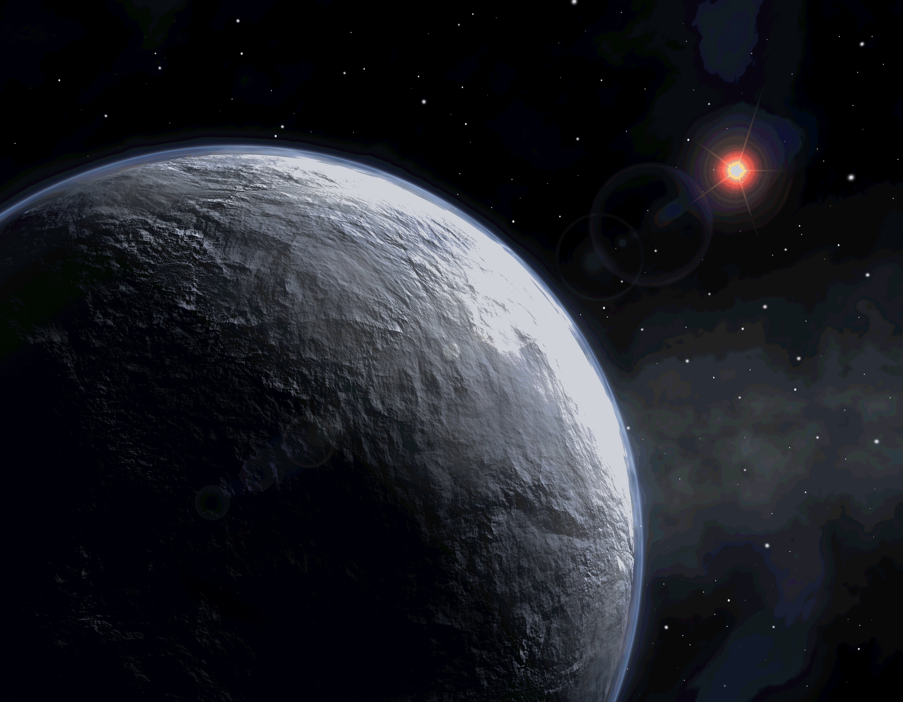

Completing the Census of Exoplanetary Systems with WFIRST.
21st International Microlnesing Conference
Ushering in the New Age of Microlensing from Space
January 5, 2017
Scott Gaudi
The Ohio State University
(with the WFIRST SDTs and on behalf of the WFIRST μSIT)

Slide 2
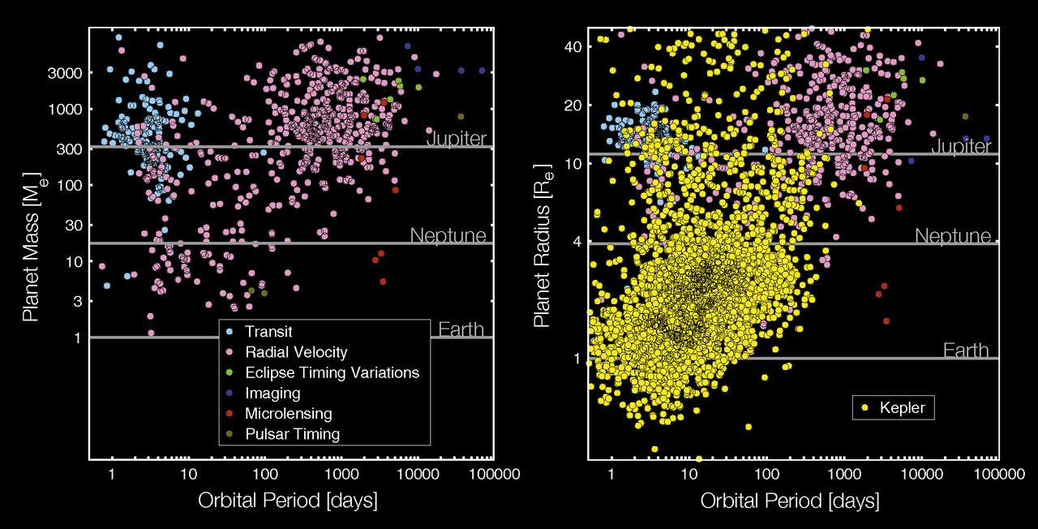
J
S
U
N
Natalie Batalha
V
E
~3447 Confirmed Planets
~4696 Kepler Candidates

Slide 3
Kepler’s
Search Area
M
V
E
M
J
S
U
N
P

Slide 4
Why complete the census?
A complete census is likely needed to understand planet formation and evolution.
  Most giant planets likely formed beyond the snow line.
  Place our solar system in context.
  Water for habitable planets likely delivered from beyond the snow line.
  Understand the frequency of planet formation in different environments.
Blah, blah, blah.

Slide 5
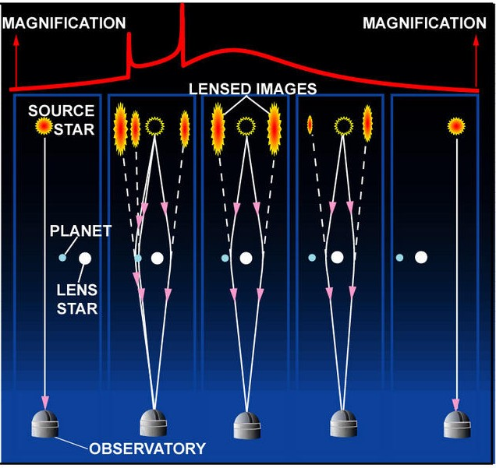
Why Microlensing?

Slide 6
Earth Mass and Below?
Monitor hundreds of millions of bulge stars continuously on a time scale of ~10 minutes.
  Event rate ~10⁻⁵/year/star.
  Detection probability ~0.1-1%.
  Shortest features are ~20 minutes.
Relative photometry of a few %.
  Deviations are few – 10%.
Resolve main sequence source stars for smallest planets.
Masses: resolve background stars for primary mass determinations.

Slide 7

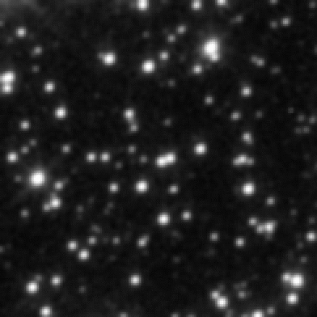
Ground vs. Space.
Infrared.
  More extincted fields.
  Smaller sources.
Resolution.
  Low-magnification events.
  Isolate light from the lens star.
Visibility.
  Complete coverage.
Smaller systematics.
  Better characterization.
  Robust quantification of sensitivities.
Ground
Space
The field of microlensing event
MACHO 96-BLG-5
(Bennett & Rhie 2002)
Science enabled from space: sub-Earth mass planets, habitable zone planets, free-floating Earth-mass planets, mass measurements.

Slide 8
WFIRST.

Slide 9
What is the Wide Field InfraRed Survey Telescope?
#1 recommendation of the 2010 Decadal Survey for a large space mission.
Notional mission, based on several different inputs, including:
  JDEM-Omega (Gehrels et al.)
  MPF (Bennett et al.)
  NISS (Stern et al.)
Three equal science areas:
  Dark energy (SNe, Weak Lensing, BAO).
  Exoplanet microlensing survey.
  GO program including a Galactic plane survey.

Slide 10
Is WFIRST Real?
Yes!
New start (KDP-A) February 18, 2016.
WFIRST Science Investigation Teams announced on December 18, 2015.

Slide 11
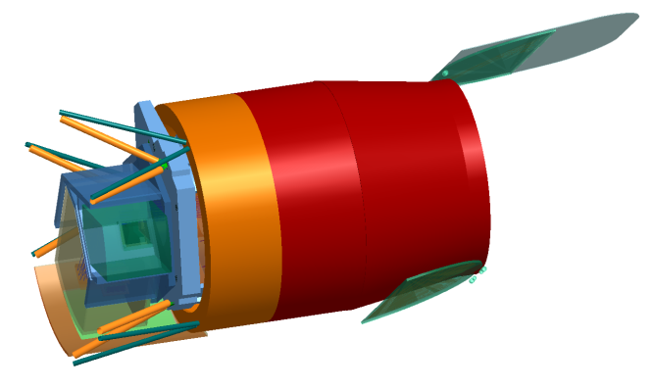
WFIRST-AFTA.
Wide-Field Instrument
Imaging & spectroscopy over 1000's sq deg.
Monitoring of SN and microlensing fields
0.7 – 2.0 micron bandpass
0.28 sq deg FoV (100X JWST FoV)
18 H4RG detectors (288 Mpixels)
4 filter imaging, grism + IFU spectroscopy
Coronagraph
Imaging of ice & gas giant exoplanets
Imaging of debris disks
400 – 1000 nm bandpass
10⁻⁹ contrast
200 milli-arcsec inner working angle
 | WFIRST-AFTA
Eff. Aperture | 2.28m
FOV | 0.281 deg²
Wavelengths | 0.7-2 μm
FWHM@1μm | 0.10”
Pixel Size | 0.11”
Lifetime | 5+1 years
Orbit | L2
Wide-Field Instrument
Imaging & spectroscopy over 1000's sq deg.
Monitoring of SN and microlensing fields
0.7 – 2.0 micron bandpass
0.28 sq deg FoV (100X JWST FoV)
18 H4RG detectors (288 Mpixels)
4 filter imaging, grism + IFU spectroscopy
Coronagraph
Imaging of ice & gas giant exoplanets
Imaging of debris disks
400 – 1000 nm bandpass
10⁻⁹ contrast
200 milli-arcsec inner working angle

Slide 12
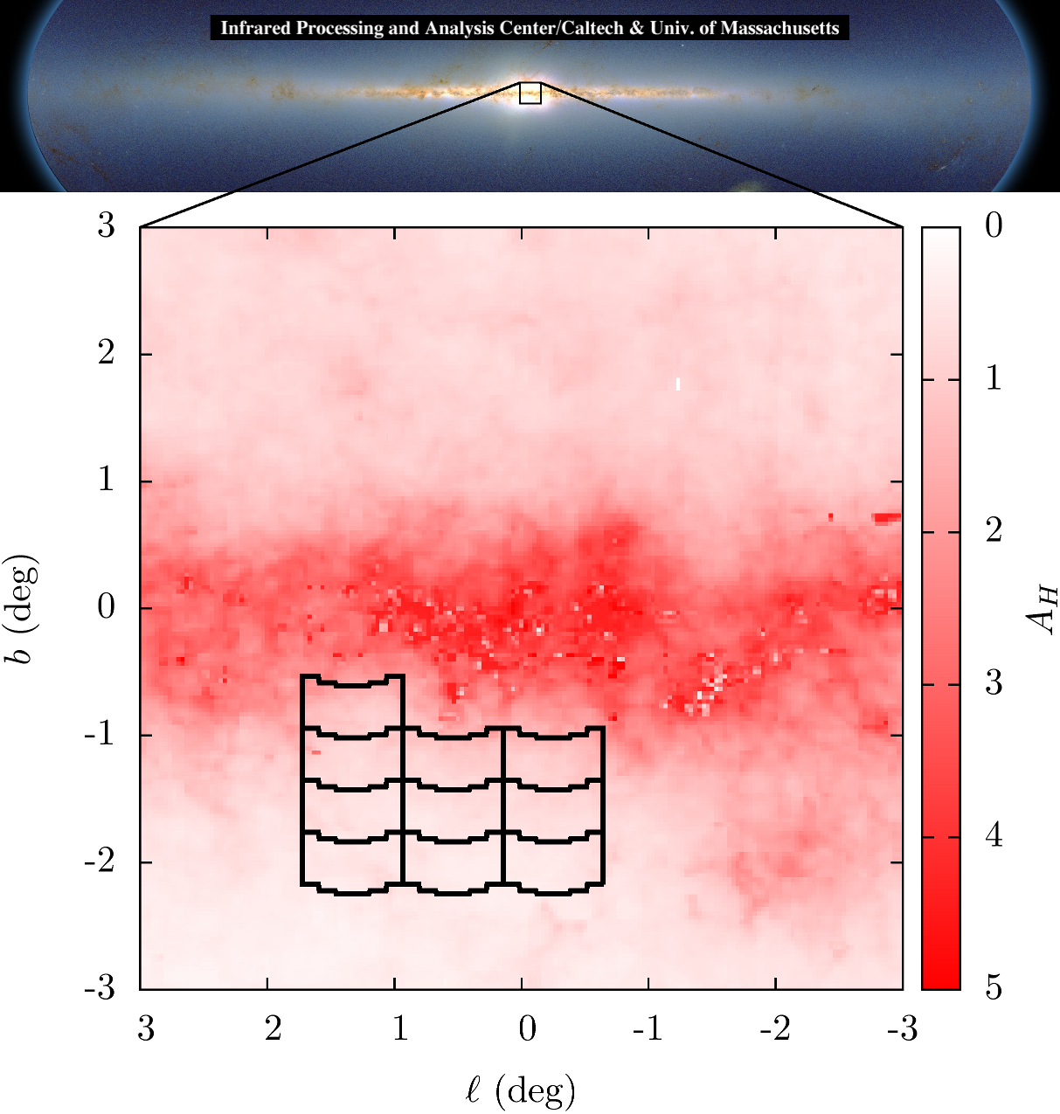
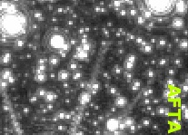
Microlensing Simulations.
(Matthew Penny)
Notes:
A microlensing event:
Occurs when one star passes close (<~milliarcsecond) to our line of sight to a more distant star. Events typically last a few days to a few months.
Rare (1 per star per 100,000 years toward the bulge) and unpredictable.
Must monitor 100s of million of stars on daily cadences to detect many microlensing events per year.
Surveys focus on the Galactic bulge, where the event rate is the highest. Results in very crowded fields.
Detecting planets
If the foreground star hosts a planet that is near one of the two images, it will create an additional perturbation.
Images are near the Einstein ring radius, which is a typically a few to 5 AU depending on host distances and mass, and a factor of ~2 beyond the snow line.
Thus microlensing is sensitive to cold planets.
Signal magnitude does not decrease with planet mass, thus very low mass planets are detectable (ultimately limited by source size).
Duration of signal declines as mass^{1/2}, thus need cadences of tens of minutes.
Microlensing survey
Given the areal density of stars in the bulge, must monitor several square degrees on timescales of 10s of minutes with photometric precisions of a few percent.

Slide 13
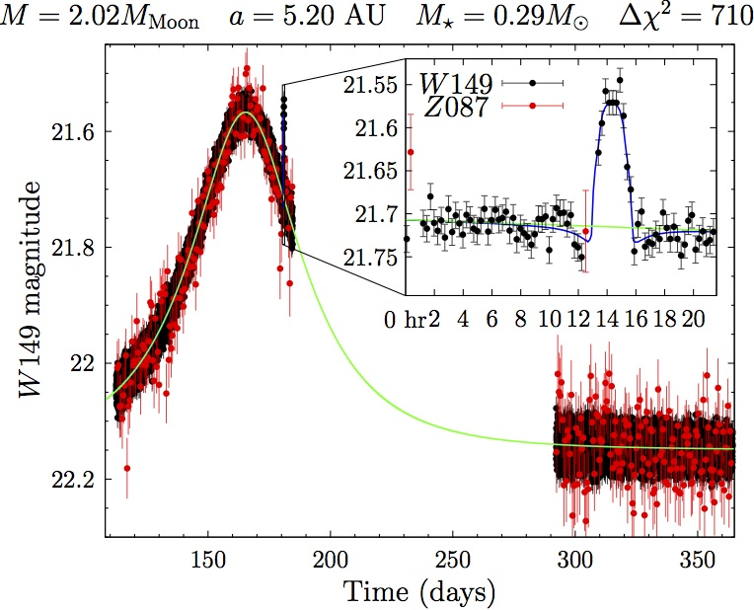
Microlensing Simulations.
(Matthew Penny)
(Penny et al. in prep)
Notes:
A microlensing event:
Occurs when one star passes close (<~milliarcsecond) to our line of sight to a more distant star. Events typically last a few days to a few months.
Rare (1 per star per 100,000 years toward the bulge) and unpredictable.
Must monitor 100s of million of stars on daily cadences to detect many microlensing events per year.
Surveys focus on the Galactic bulge, where the event rate is the highest. Results in very crowded fields.
Detecting planets
If the foreground star hosts a planet that is near one of the two images, it will create an additional perturbation.
Images are near the Einstein ring radius, which is a typically a few to 5 AU depending on host distances and mass, and a factor of ~2 beyond the snow line.
Thus microlensing is sensitive to cold planets.
Signal magnitude does not decrease with planet mass, thus very low mass planets are detectable (ultimately limited by source size).
Duration of signal declines as mass^{1/2}, thus need cadences of tens of minutes.
Microlensing survey
Given the areal density of stars in the bulge, must monitor several square degrees on timescales of 10s of minutes with photometric precisions of a few percent.

Slide 14
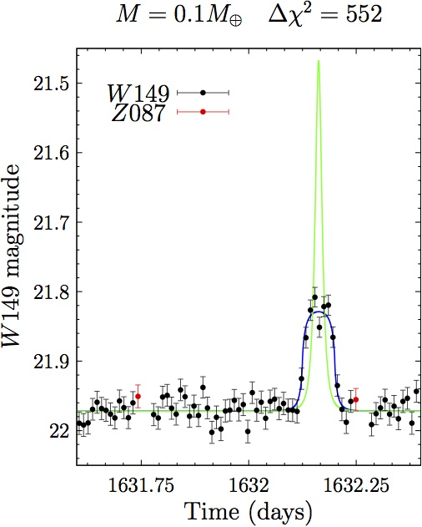
(Penny et al. in prep)
2 ✕ Mass of the Moon @ 5.2 AU
(~27 sigma)
Free floating Mars
(~23 sigma)

Slide 15
Kepler’s
Search Area
WFIRST’s
Search Area
M
V
E
M
J
S
U
N
P

Slide 16
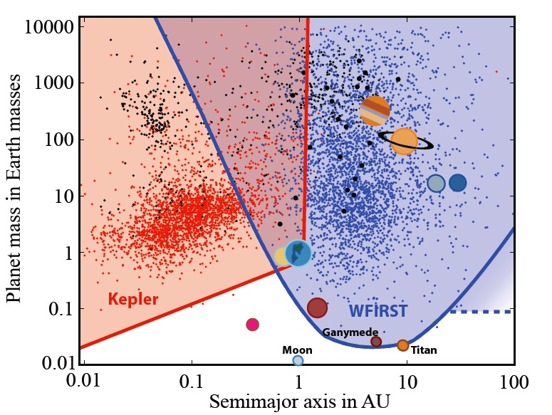
“The Penny Plot”
(Penny et al. in prep)

Slide 17
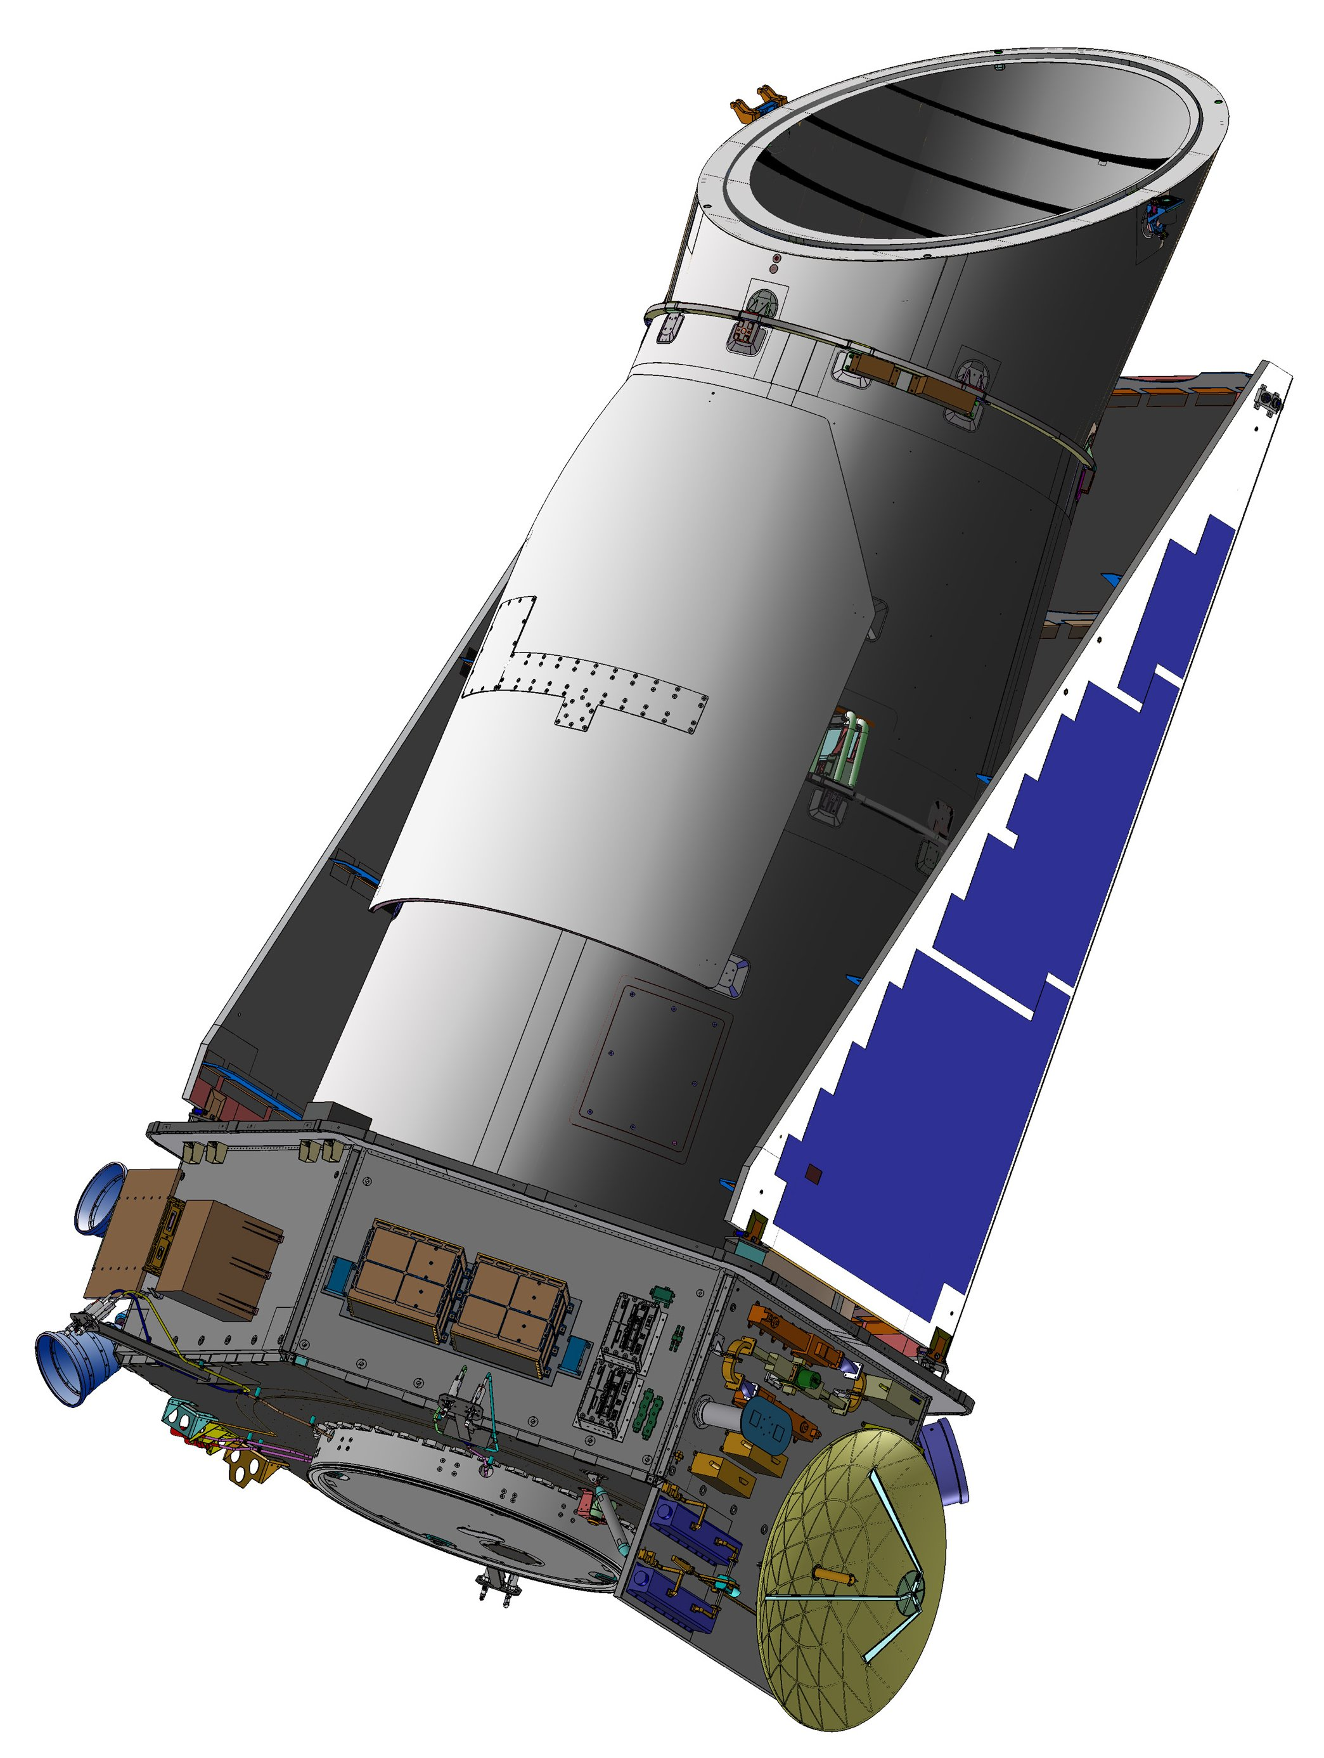
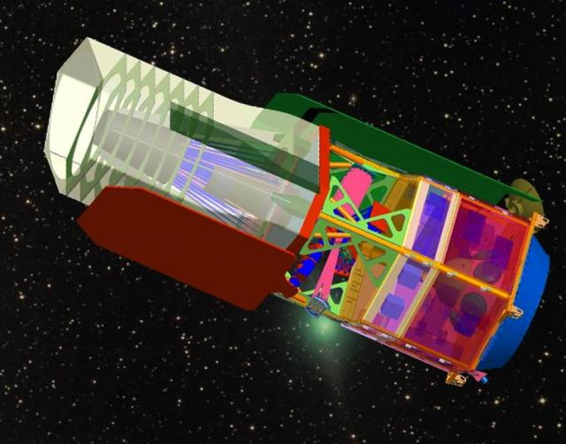
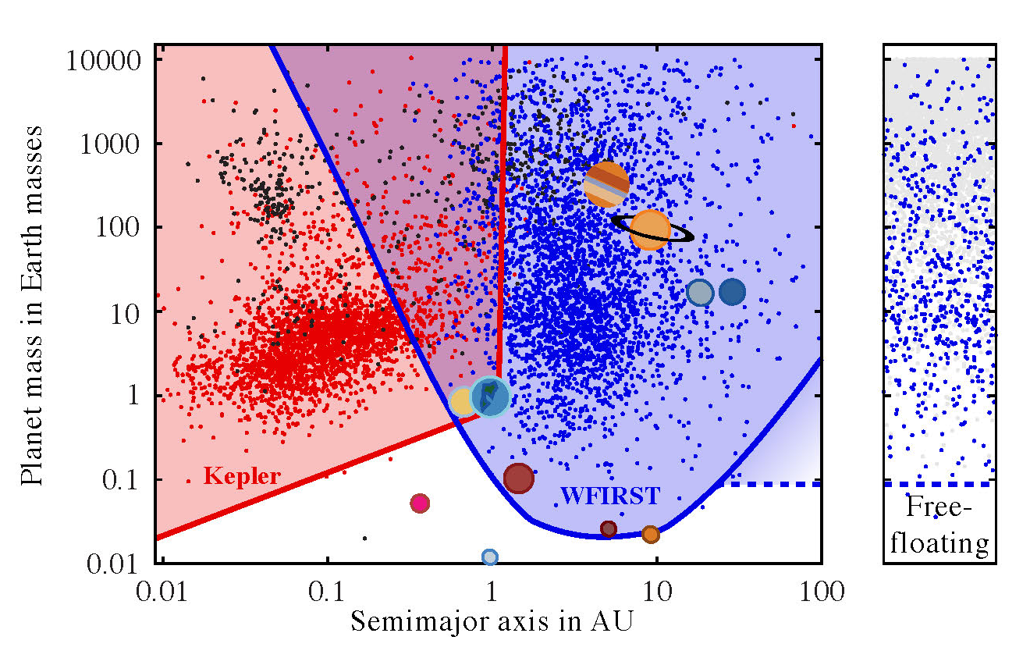
Completing the Exoplanet Census.
Together, Kepler and WFIRST complete the statistical census of planetary systems in the Galaxy.
~1500 detections.
Some sensitivity to “outer” habitable zone planets.
Sensitive to analogs of all the solar systems planets except Mercury.
Hundreds of free-floating planets.
Characterize the majority of host systems.
Galactic distribution of planets.
Sensitive to lunar-mass satellites.
10⁵ Transiting Planets.
(Penny et al. in prep)

Slide 18
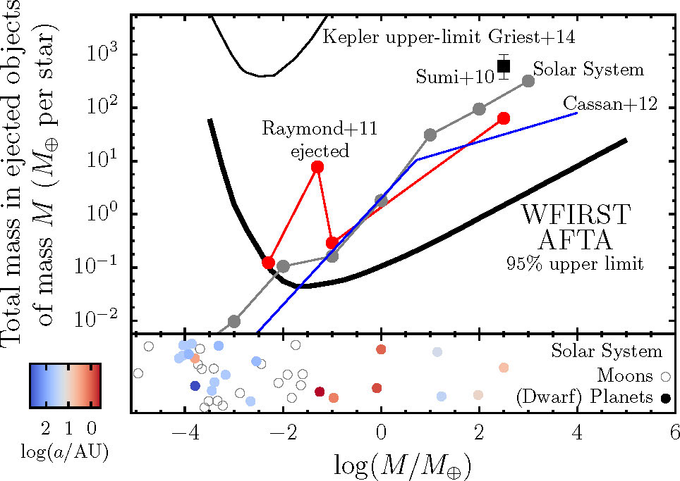
Free Floating* Planets.
(Penny et al., in prep)
  WFIRST-AFTA will measure the compact object mass function over at least 8 orders of magnitude in mass (from Mars to ~30 solar masses).
*Also known as “Rogue Planets”, “Solivagant Planets”, or “Nomads”.

Slide 19
To Do.
Lots!
  Improve our understanding of microlensing event rates:
    Refine Galactic models.
    Near-IR microlensing survey.
    Near-IR luminosity function.
    Measure the Galactic distribution of planets (Spitzer, K2).
  Optimize the survey strategy:
    Field location, number, and cadence.
    Optimize number and choice of filters.
    Contemporaneous ground and space-based observations.
  Determine the precision of the measured event parameters.
  Determine hardware, software, and calibration requirements.
  Identify and carry out needed precursor observations.
  Develop data reduction and analysis tools.
WFIRST Microlensing Science Investigation Team.
Help!

Slide 20
WFIRST μSIT.
Scott Gaudi (OSU, PI)
Dave Bennett (GSFC, Deputy PI, Pipeline/Algorithm Lead)
Jay Anderson (STScI, Co-I)
Sebastiano Calchi Novati (IPAC, Co-I)
Sean Carey (IPAC, Co-I, Calibration Lead)
Dan Foreman-Mackey (UW, Co-I)
Andrew Gould (?, Co-I)
Calen Henderson (JPL, Co-I, Precursor Data Lead)
Davy Kirkpatrick (IPAC)
Matthew Penny (OSU, Co-I, Survey Optimization Lead)
Radek Poleski (OSU, Co-I)
Yossi Shvartzvald (JPL, Co-I)
Rachel Street (LCOGT, Co-I)
Jennifer Yee (CfA, Co-I, Outreach Lead)
Chas Beichman (JPL, Collaborator)
Geoffrey Bryden (JPL, Collaborator)
Cheongho Han (Chungbuk National U., Collaborator)
David Nataf (ANU, Collaborator)
Keivan Stasssun (Vanderbilt, Collaborator)
Science Center Liaisons
Kailash Sahu (STScI)
Sean Carey (IPAC)

