Slide 1
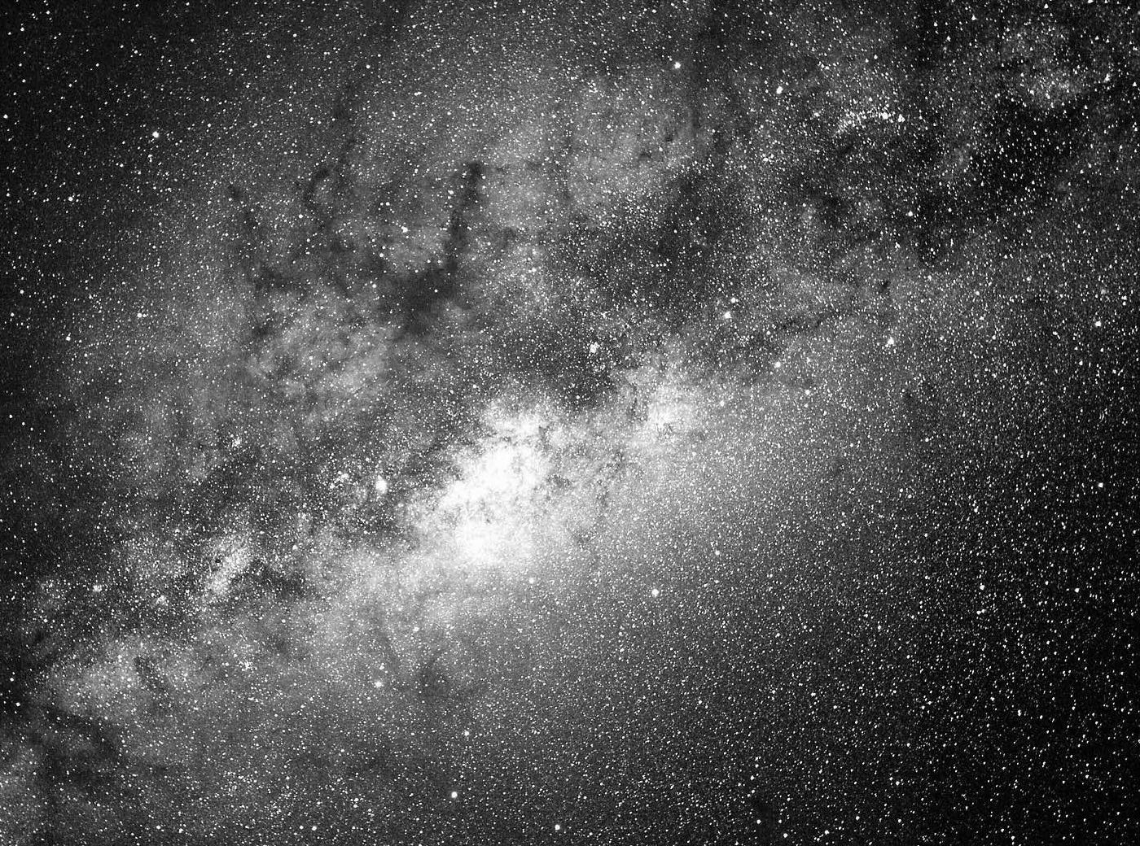
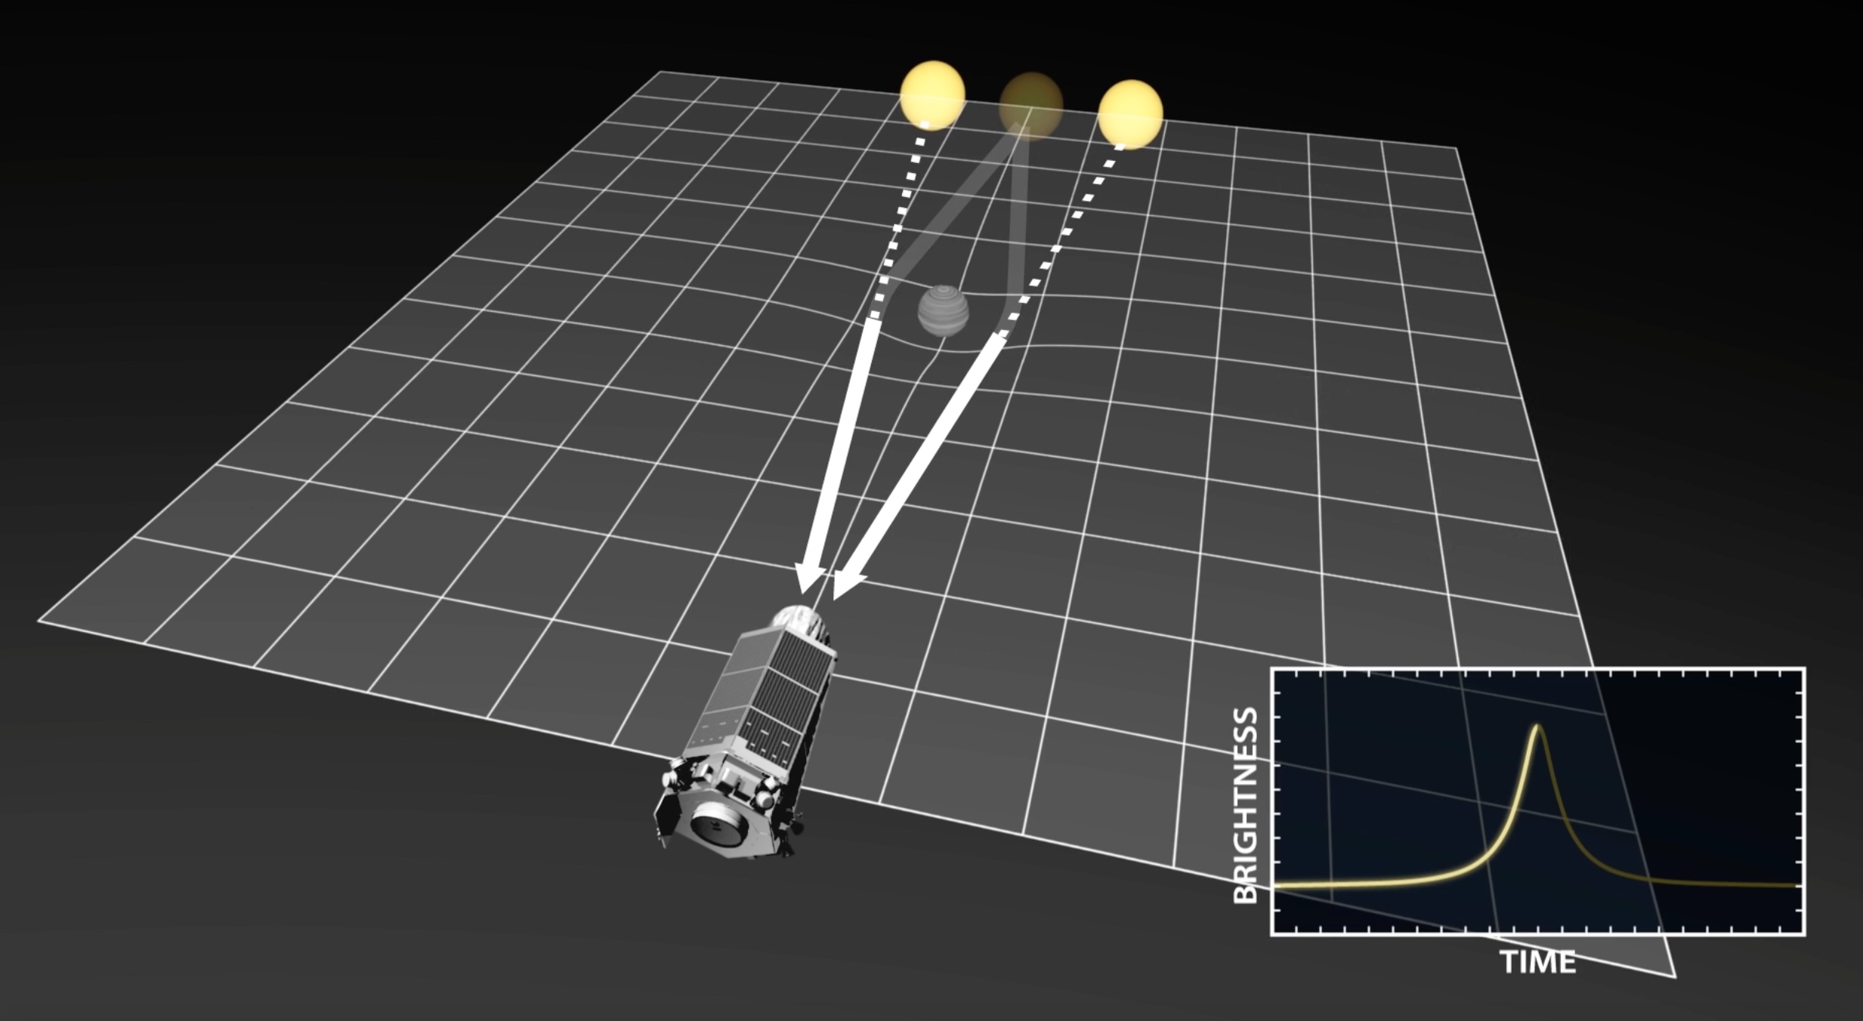

Extracting Physical Parameters
from Microlensing Observables
Calen B. Henderson
JPL/Caltech (NPP Fellow)
Microlensing 21: Tutorial
Tuesday, 31/Jan/2017

Slide 2
From Observables to Parameters
Observables
Single Object Lens
Two-body Lens
Einstein timescale: t_{E}
(Finite source size: ρ)
Source flux: F_{s}
Mass ratio: q
Projected separation: s
?
Parameters
Lens Mass: M_{l}
Lens System Distance: D_{l}
Calen B. Henderson
Microlensing 21 Tutorial

Slide 3
Why conduct microlensing from space?
Observables
Single Object Lens
Two-body Lens
M_{l} = θ_{E} / (κπ_{E})
Einstein timescale: t_{E}
(Finite source size: ρ)
Source flux: F_{s}
Mass ratio: q
Projected separation: s
?
Parameters
Lens Mass: M_{l}
Lens System Distance: D_{l}
Calen B. Henderson
Microlensing 21 Tutorial

Slide 4
Primary Channels for Deriving Physical Properties of Lens Systems
1
Finite-source effects (ρ→θ_{E})
2
Microlens parallax (π_{E})
3
Lens flux (F_{l})
4
Astrometry (θ_{E})
5
Keplerian solution
Calen B. Henderson
Microlensing 21 Tutorial

Slide 5
Finite-source Effects ρ→θ_{E}
ρ θ*/θ_{E}
θ_{E} = θ*/ρ
Calen B. Henderson
Microlensing 21 Tutorial

Slide 6
Finite-source Effects ρ→θ_{E}
θ_{E} θ*/ρ
Single lens:
u₀ ≲ ρ
Yoo+ (2004) ApJ, 603, 139
Calen B. Henderson
Microlensing 21 Tutorial

Slide 7
Finite-source Effects ρ→θ_{E}
θ_{E} θ*/ρ
Single lens:
u₀ ≲ ρ
Two-body lens:
Caustic crossing
Yoo+ (2004) ApJ, 603, 139
Bennett & Rhie (1996) ApJ, 472, 660
Calen B. Henderson
Microlensing 21 Tutorial

Slide 8
Finite-source Effects ρ→θ_{E}
θ_{E} θ*/ρ
Calibrate instrumental
source color
Convert source color to angular size
e.g., Henderson+ (2014) ApJ, 794, 71
Kervella+ (2004) A&A, 426, 297
Calen B. Henderson
Microlensing 21 Tutorial

Slide 9
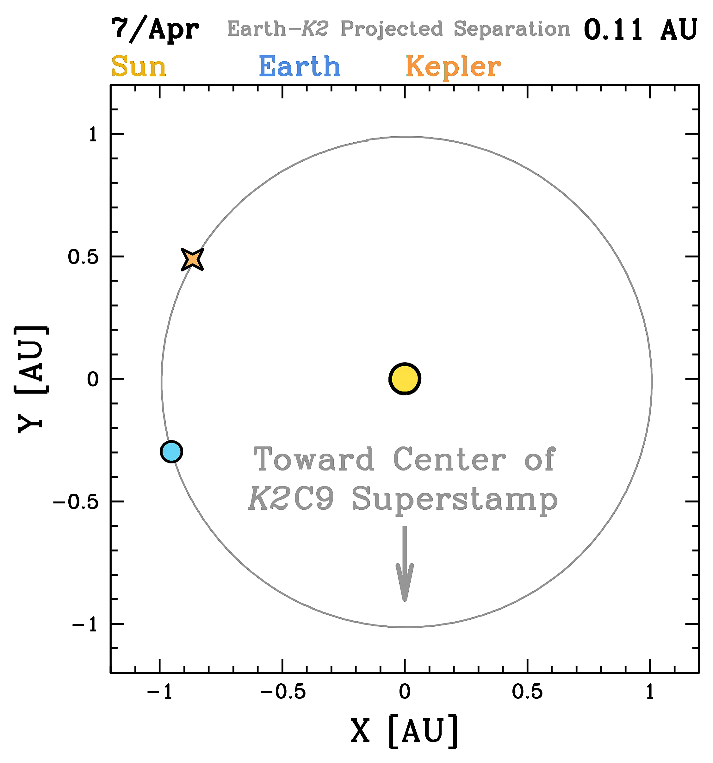
Microlens Parallax π_{E}: I. Satellite Parallax
Henderson+ (2016), PASP, 128, 124401
Found at:
http://www.astronomy.ohio-state.edu/~henderson/k2c9_parallax_animations/
Calen B. Henderson
Microlensing 21 Tutorial

Slide 10
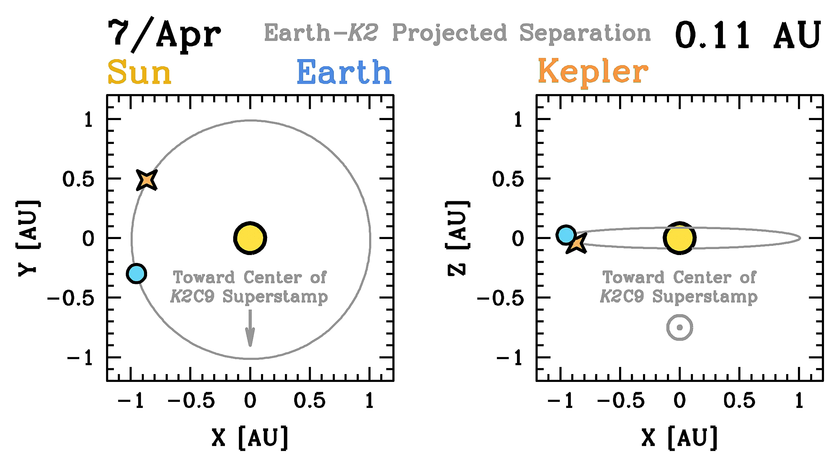
Microlens Parallax π_{E}: I. Satellite Parallax
Henderson+ (2016), PASP, 128, 124401
Found at:
http://www.astronomy.ohio-state.edu/~henderson/k2c9_parallax_animations/
Calen B. Henderson
Microlensing 21 Tutorial

Slide 11
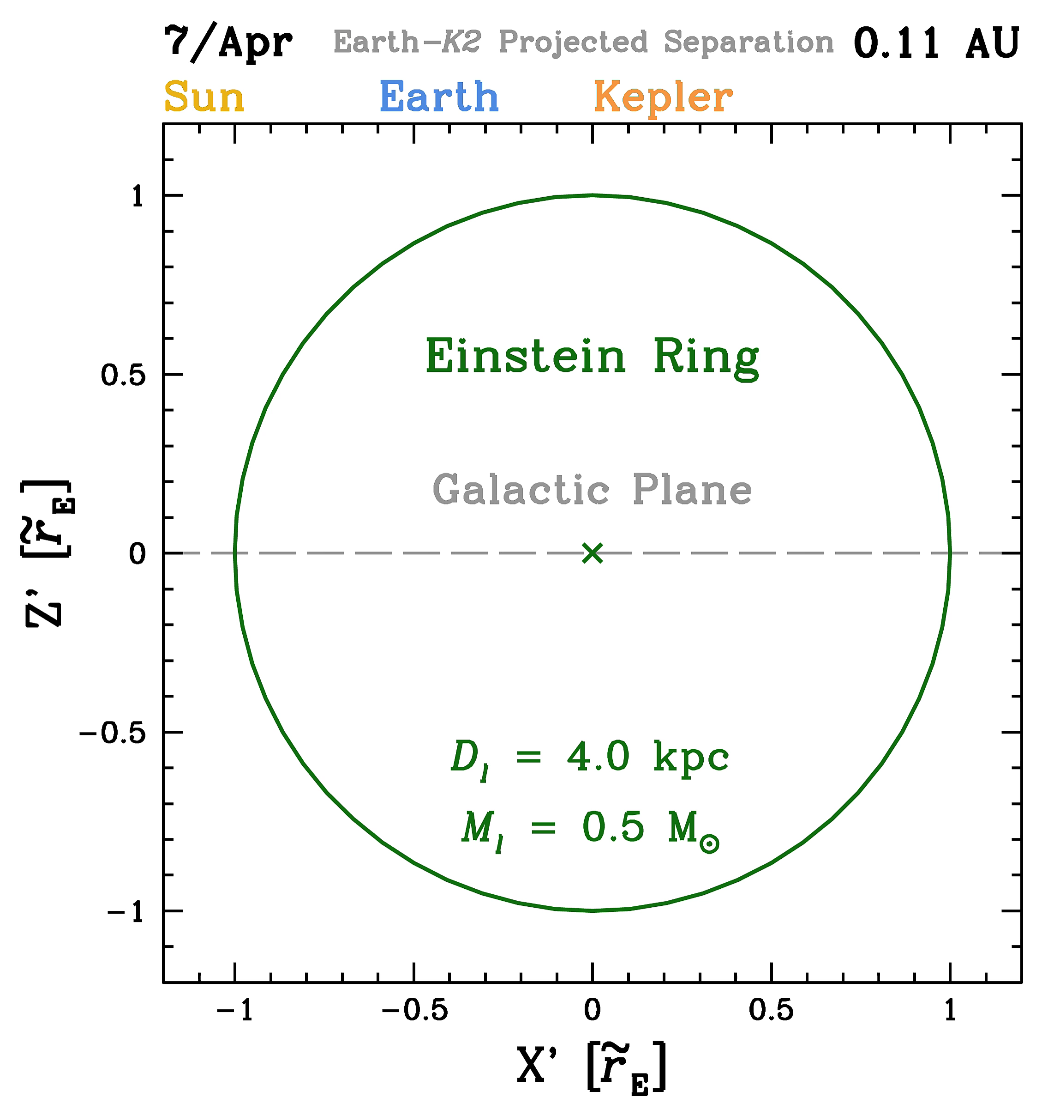
Microlens Parallax π_{E}: I. Satellite Parallax
Henderson+ (2016), PASP, 128, 124401
Found at:
http://www.astronomy.ohio-state.edu/~henderson/k2c9_parallax_animations/
Calen B. Henderson
Microlensing 21 Tutorial

Slide 12
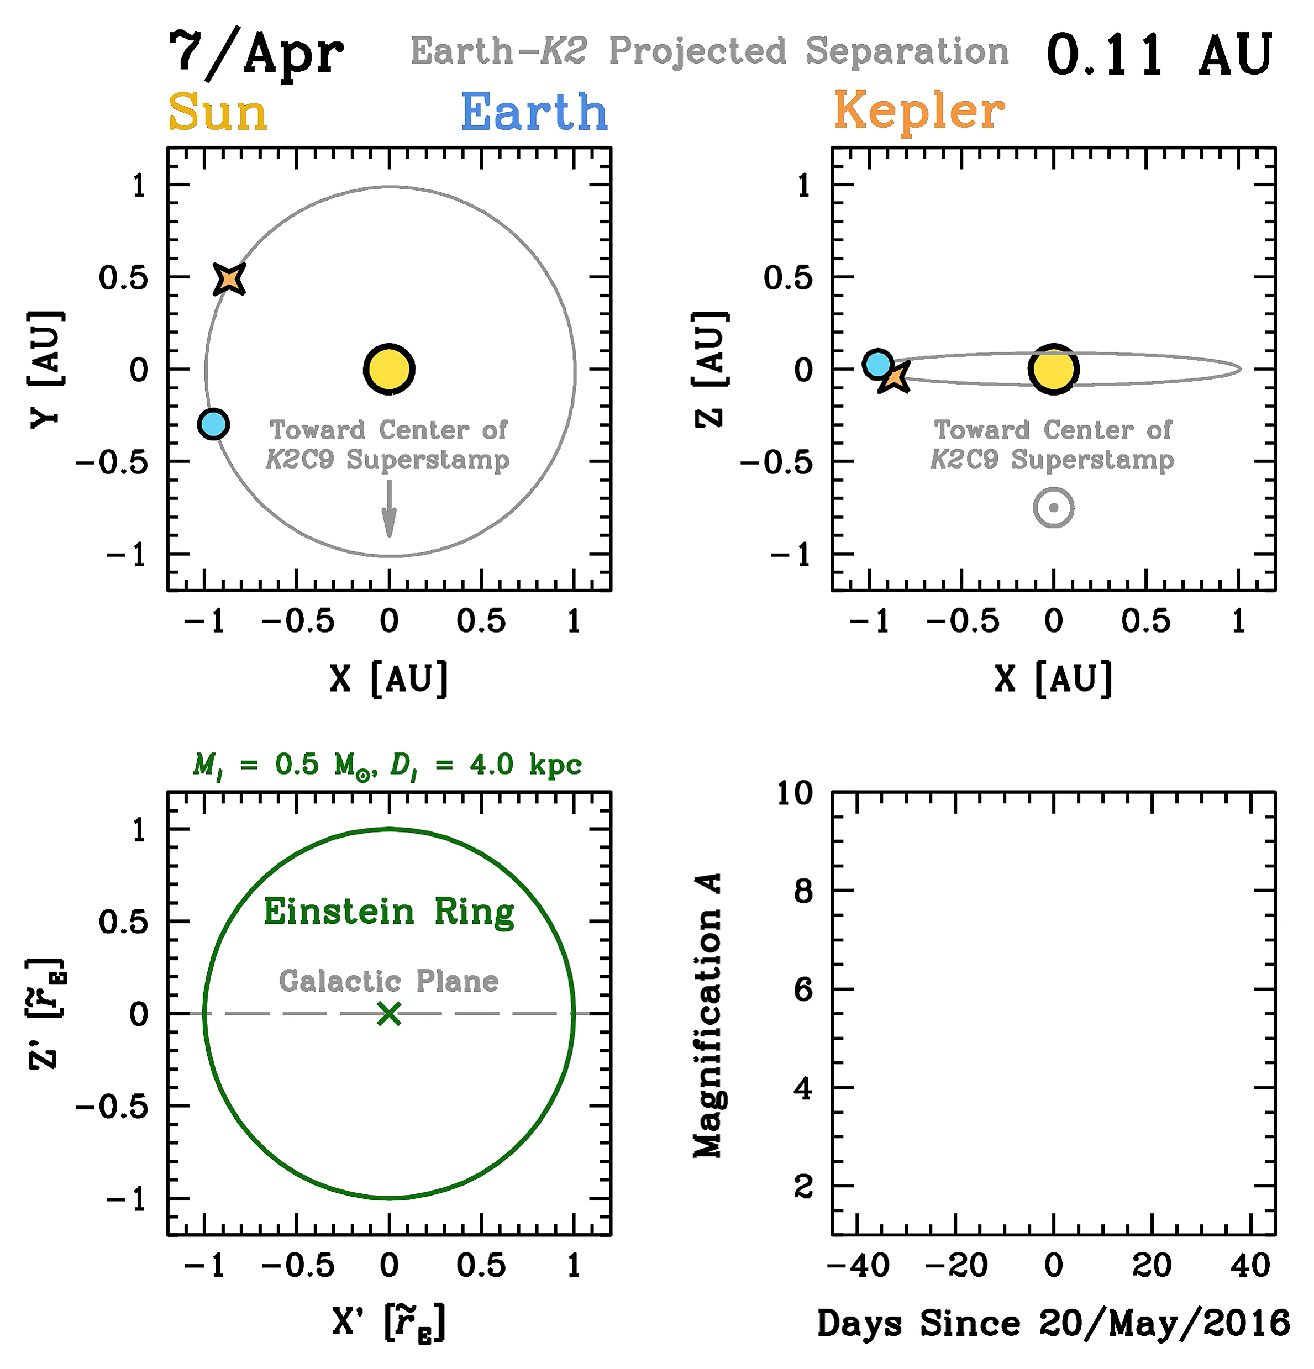
Microlens Parallax π_{E}: I. Satellite Parallax
Henderson+ (2016), PASP, 128, 124401
Found at:
http://www.astronomy.ohio-state.edu/~henderson/k2c9_parallax_animations/
Calen B. Henderson
Microlensing 21 Tutorial

Slide 13
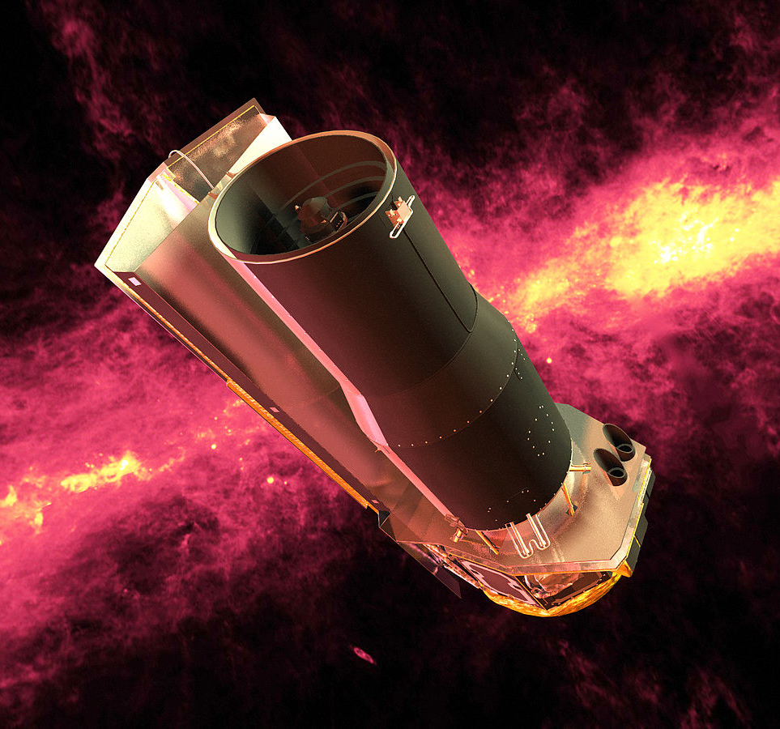
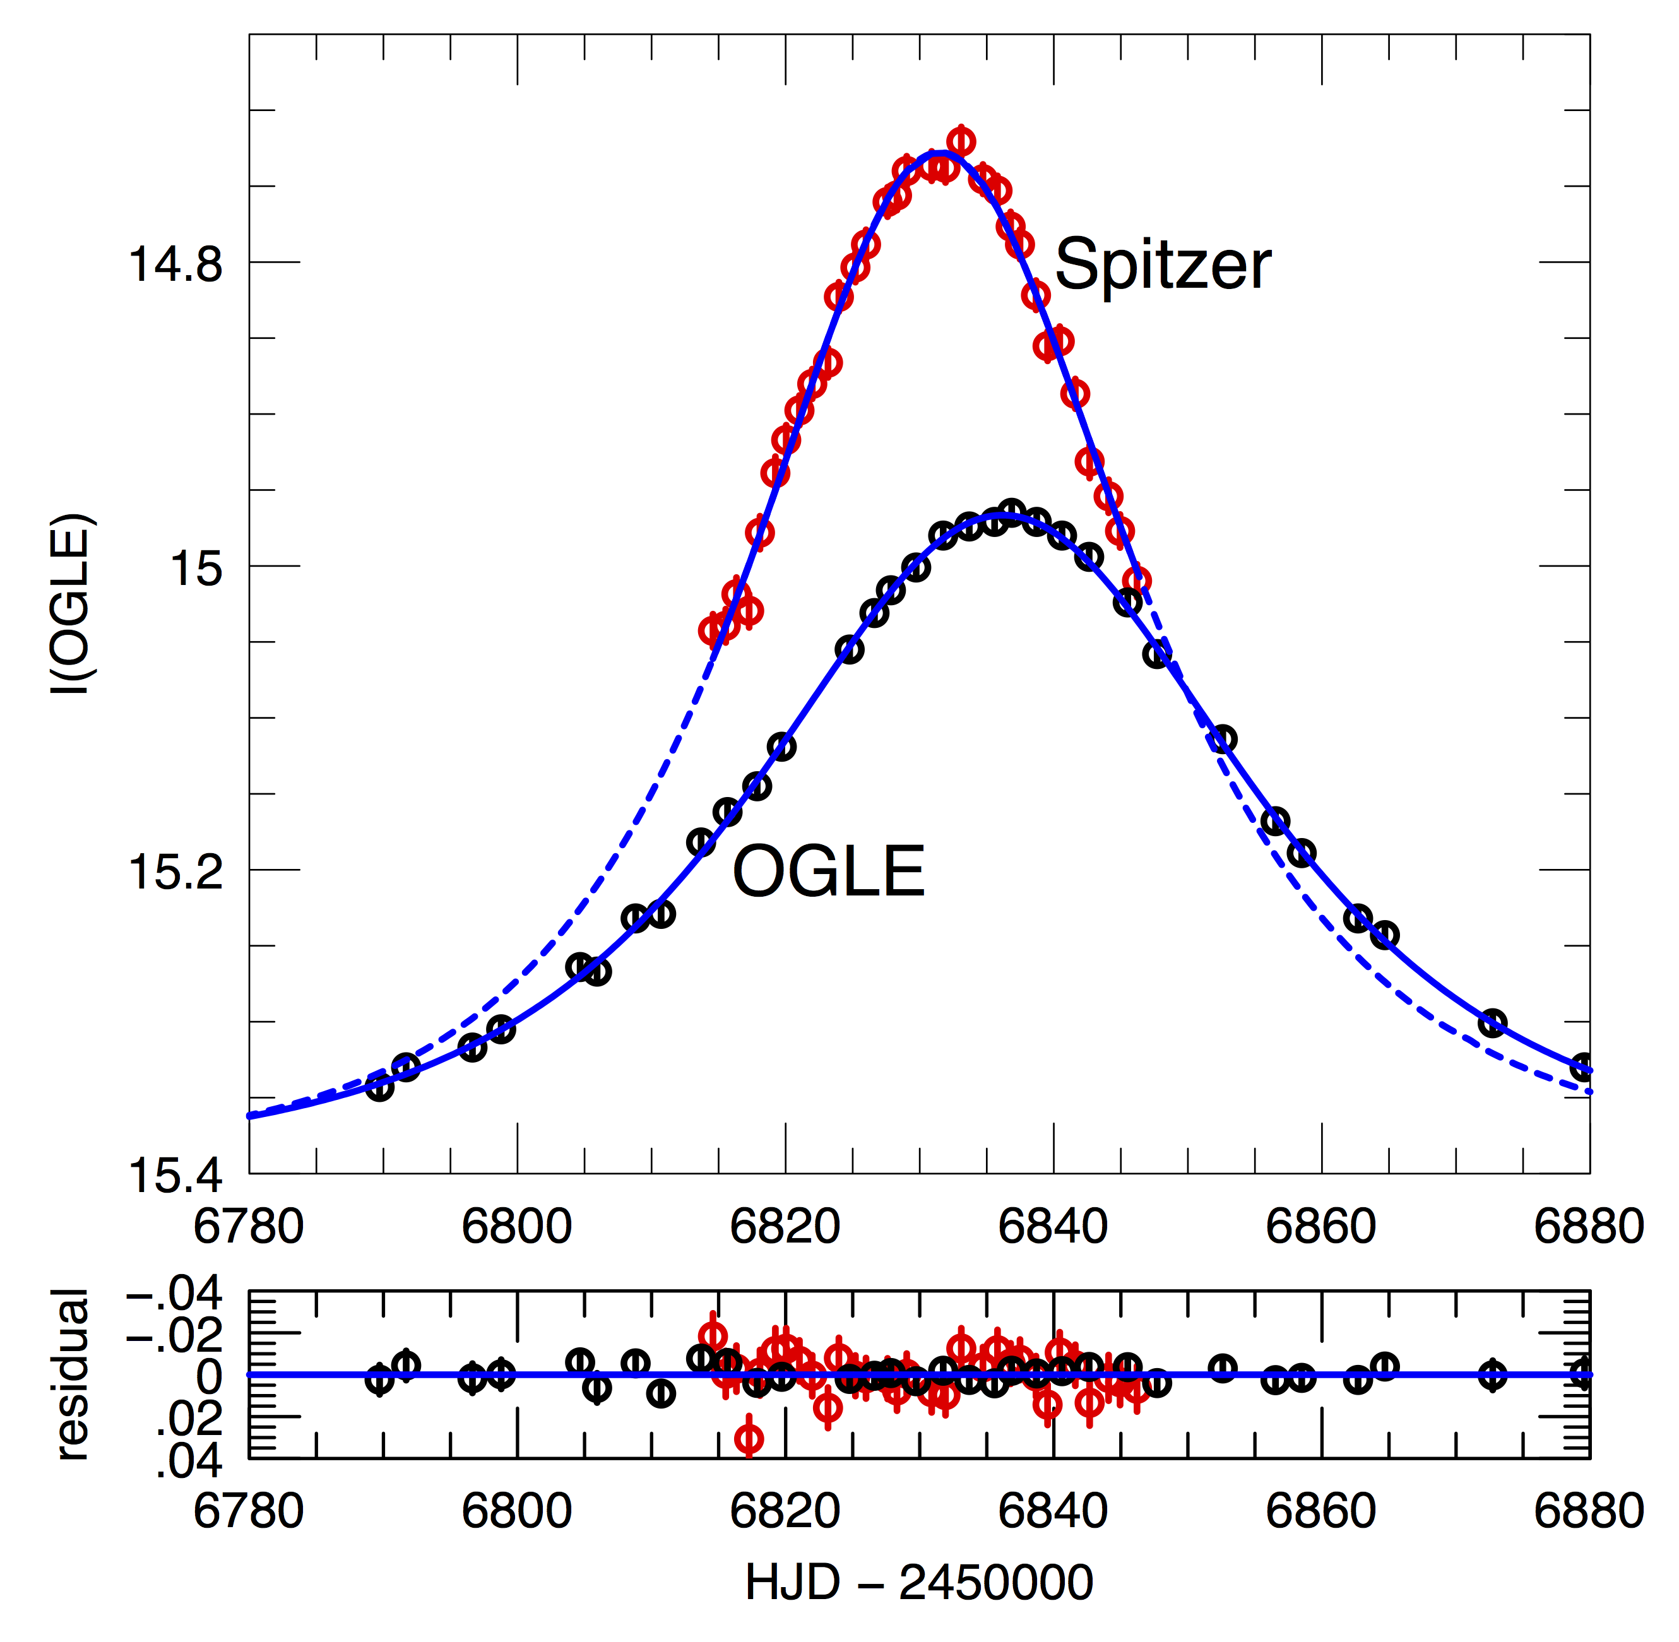
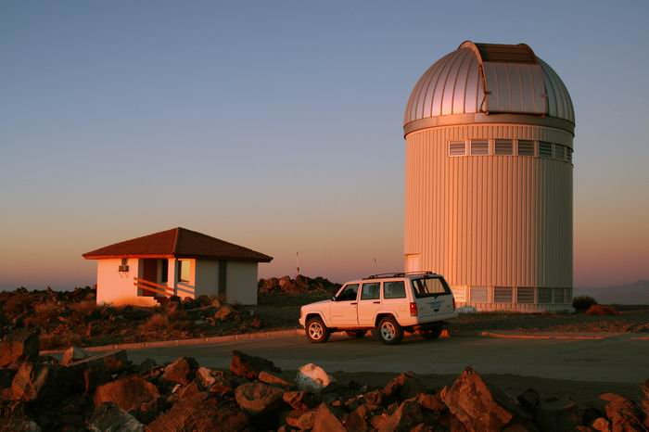
Microlens Parallax π_{E}: I. Satellite Parallax
OGLE-2014-BLG-0939
M*
0.23 ± 0.07 M☉
Credit: NASA/JPL-Caltech
D_{l}
3.1 ± 0.4 kpc
Credit: Krzysztof Ulaczyk
Yee+ (2015) ApJ, 802, 76
Calen B. Henderson
Microlensing 21 Tutorial

Slide 14
Microlens Parallax π_{E}: II. Orbital Parallax
OGLE3-ULENS-PAR-02
OGLE3-ULENS-PAR-05
t_{E} ~ 290 d
M_{l} ~ 8.7 M☉
D_{l} ~ 1.8 kpc
t_{E} ~ 160 d
M_{l} ~ 3.3 M☉
D_{l} ~ 2.9 kpc
Wyrzykowski+ (2016) MNRAS, 458, 3012
Calen B. Henderson
Microlensing 21 Tutorial

Slide 15
Microlens Parallax π_{E}: III. Terrestrial Parallax
OGLE-2007-BLG-224
Green: Bronberg (South Africa)
Blue: RoboNet (Canaries)
Red: OGLE I (LCO)
Magenta: SMARTS I (CTIO)
Black: SMARTS H (CTIO)
M*
0.056 ± 0.004 M☉
D_{l}
525 ± 40 kpc
Gould+ (2009) ApJL, 698, 147
Calen B. Henderson
Microlensing 21 Tutorial

Slide 16
Lens Flux F_{l}: Lens Mass – Distance Relations
Angular Einstein Radius
θ_{E} = f(D_{l}, M_{l})
Lens Flux
F_{l}
Mass-luminosity
Relation
Lens Extinction
Parameters
Lens Mass: M_{l}
Lens System Distance: D_{l}
Calen B. Henderson
Microlensing 21 Tutorial

Slide 17
Lens Flux F_{l}: Lens Mass – Distance Relations
Angular Einstein Radius
θ_{E} = f(D_{l}, M_{l})
Lens Flux
F_{l}
Mass-luminosity
Relation
Lens Extinction
Parameters
Lens Mass: M_{l}
Lens System Distance: D_{l}
Calen B. Henderson
Microlensing 21 Tutorial

Slide 18
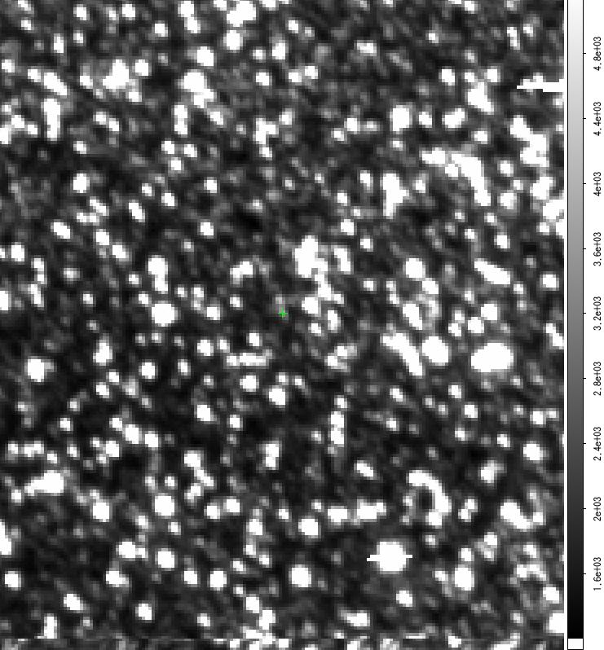
MOA: MOA-red (R+I)
90”
Calen B. Henderson
Microlensing 21 Tutorial

Slide 19
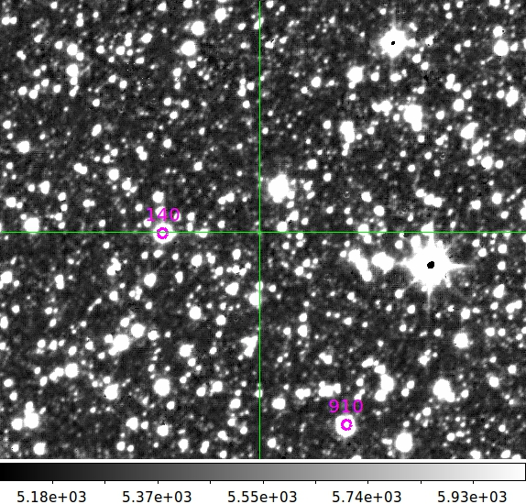
UKIRT: H
Calen B. Henderson
Microlensing 21 Tutorial

Slide 20
UKIRT: H
Calen B. Henderson
Microlensing 21 Tutorial

Slide 21
UKIRT: H
Calen B. Henderson
Microlensing 21 Tutorial

Slide 22
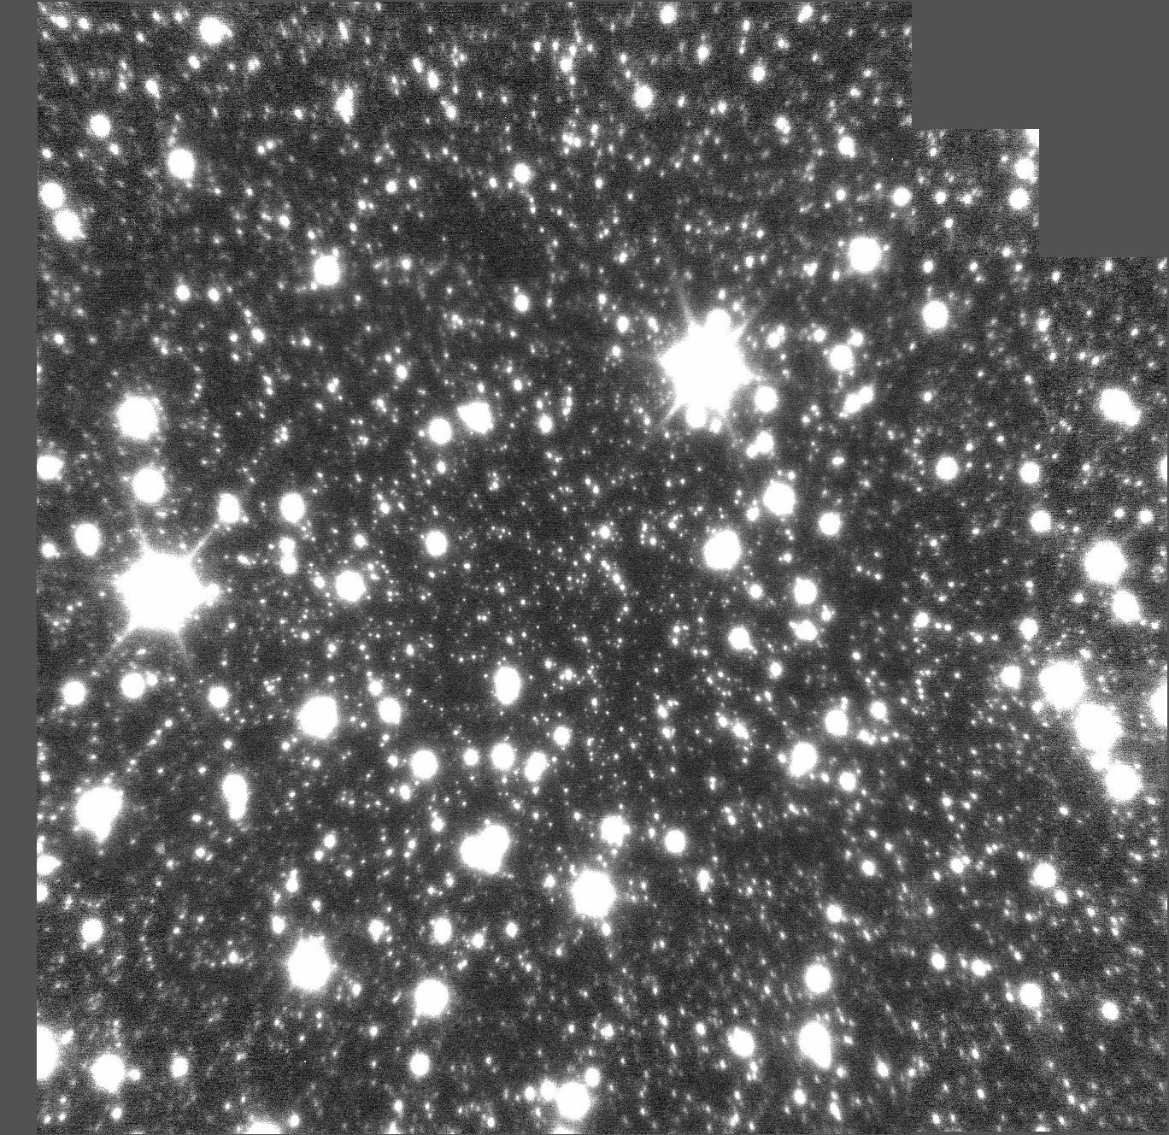
NIRC2 (Wide): H
Calen B. Henderson
Microlensing 21 Tutorial

Slide 23
NIRC2 (Wide): H
Calen B. Henderson
Microlensing 21 Tutorial

Slide 24
NIRC2 (Wide): H
Calen B. Henderson
Microlensing 21 Tutorial

Slide 25
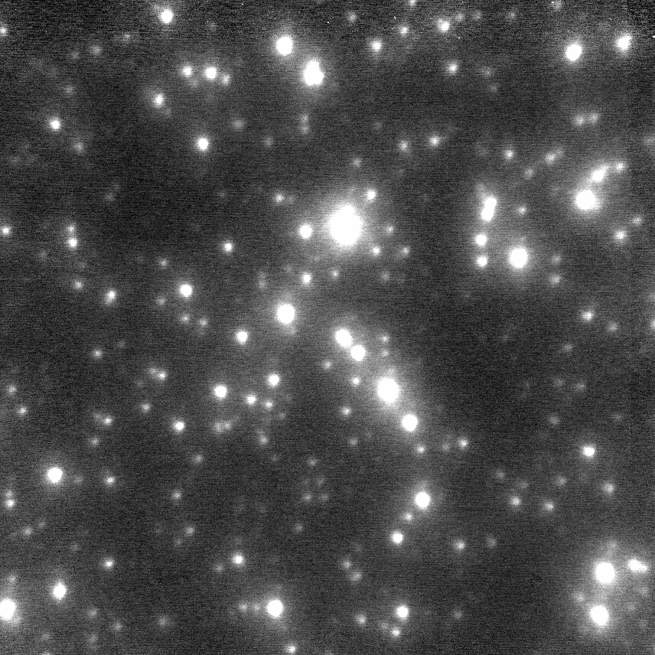
NIRC2 (Narrow): H
Calen B. Henderson
Microlensing 21 Tutorial

Slide 26
NIRC2 (Narrow): H
10”
Calen B. Henderson
Microlensing 21 Tutorial

Slide 27
NIRC2 (Narrow): H
10”
Calen B. Henderson
Microlensing 21 Tutorial

Slide 28
Benefit of High-resolution (e.g., AO, space)
MOA
NIRC2 Narrow
10”
10”
Calen B. Henderson
Microlensing 21 Tutorial

Slide 29
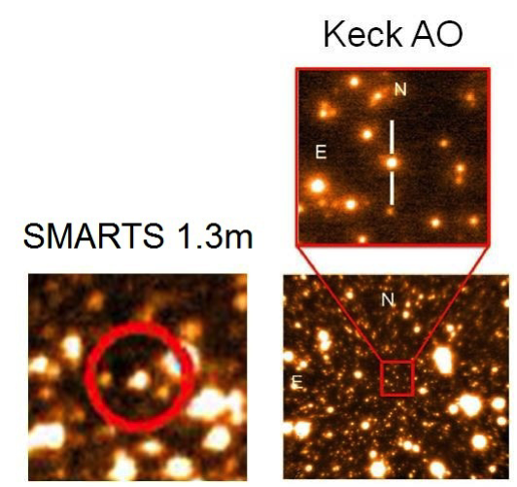
Lens Flux F_{l}: I. Prompt Follow-up
H_{s} from ground-based
  light curve data
H_{l+s} from high-resolution follow-up
Arithmetic!
Search for excess flux
Batista+ (2014) ApJ, 780, 54
Calen B. Henderson
Microlensing 21 Tutorial

Slide 30
Lens Flux F_{l}: II. Spatially Resolve Lens
OGLE-2005-BLG-169
q ~ 8⁺²₋₃ * 10⁻⁵ (~Neptune)
s ~ 1.0 ± 0.02
θ_{E} = 1.00 ± 0.22 mas
M* = ???
M_{p} = ???
a⟂ = ???
D_{l} = ???
Gould+ (2006) ApJ, 644, 37
Calen B. Henderson
Microlensing 21 Tutorial

Slide 31
Lens Flux F_{l}: II. Spatially Resolve Lens
OGLE-2005-BLG-169
M*
0.65 ± 0.05 M☉
M_{p}
13.2 ± 1.3 M⨁
D_{l}
4.0 ± 0.4 kpc
a⟂
3.4 ± 0.3 AU
Batista+ (2015) ApJ, 808, 170
Calen B. Henderson
Microlensing 21 Tutorial

Slide 32
Combining Constraints I.
Yee (2015) ApJL, 814, 11
Calen B. Henderson
Microlensing 21 Tutorial

Slide 33
Astrometric Microlensing θ_{E}
Lu+ (2016) ApJ, 830, 41
Calen B. Henderson
Microlensing 21 Tutorial

Slide 34
Combining Constraints II.
Yee (2015) ApJL, 814, 11
Calen B. Henderson
Microlensing 21 Tutorial

Slide 35
Keplerian Solution
OGLE-2009-BLG-020
Bright! (I_{l} = 15.6, I_{s} = 16.4)
Finite-source effects
Parallax
Lens orbital motion
RV
test bed
Skowron+ (2011) ApJ, 738, 87
Yee+ (2016) ApJ, 821, 121
Calen B. Henderson
Microlensing 21 Tutorial

