Slide 1
Developing WFIRST Exoplanet Mass Measurement Method
Aparna Bhattacharya
NASA GSFC, Notre Dame, UMBC
Collaborator: David Bennett
J.Anderson, N. Koshimoto,
V.Batista, J.-P. Beaulieu, I.A.Bond, A.Gould, D.Suzuki
21st Microlensing Workshop, NASAdena
February 2, 2017

Slide 2
A typical case of microlensing light curve modelling provides with planet-host star mass ratio q and planet – star separation s in Einstein radius. But does NOT provide planet, host star masses and distances in physical values
If lucky , parallax measurements from ground and SPITZER can provide us mass and distance measurements
We need high resolution images to detect the lens
Aparna Bhattacharya

Slide 3
$θ$_{E} from light curve models
Stage1
Stage 2
Stage 3
Input 2 a
Input 1 a
M_{L}= M_{P}+M_{H}
q = M_{P}/M_{H}
q (6×${10}^{−5}$)
Final Results
Output1
$$= \frac{4GM_{L}(D_{S}−D_{L})}{c2D_{S}D_{L}}$$
M_{H}, M_{P}
$$θ_{E}^{2}$$
M_{L}
Solutions
(Solving)
D_{L}/D_{S}
D_{L}, a ⊥
Mass – Luminosity
Empirical relation ^{1,2,3,4}
Output 2
D_{S} ̴ 8 kpc
a⊥ = $θ$_{E} s D_{L}
$θ$_{E} , s (known from light curve model)
From PSF fitting to HST image
Constrains I_{s} and total target brightness
Input 2 b
Input 1 b

Slide 4
Planetary Microlensing Events with Excess Flux Detection in High Resolution Images
MOA-2008-BLG-310 (Janczak+ 2010)
MOA-2011-BLG-293 (Batista+ 2014, Yee+ 2012)
OGLE-2012-BLG-0950(Koshimoto+ 2016)
OGLE-2012-BLG-563 (Fukui+ 2015)
OGLE-2007-BLG-368 (Sumi+ 2010)
MOA-2007-BLG-192 (Kubas+ 2010, Bennett+ 2008)
OGLE-2005-BLG-169 (Bennett+ 2015, Batista+ 2015, Gould+ 2006)
OGLE-2007-BLG-349 (Bennett+ 2016)
OGLE-2012-BLG-0026 (Beaulieu+ 2016)
OGLE-2006-BLG-109 (Gaudi+ 2010)
OGLE-2003-BLG-235 (Bennett+ 2006)
OGLE-2005-BLG-071 (Dong+ 2009, Udalski+ 2006)
Aparna Bhattacharya

Slide 5
Planetary Microlensing Events with Excess Flux Detection in High Resolution Images
Lens detection based on probability
P(Lens) = 1- P(contamination)
(Koshimoto+ 2017 in prep)
Planet- host mass measurements along with parallax
HST 2 sigma lens detection using color dependence centroid shift
Lens –source partially resolved,
lens detection verified
MOA-2008-BLG-310
MOA-2011-BLG-293
OGLE-2012-BLG-0950
OGLE-2012-BLG-563
OGLE-2007-BLG-368
MOA-2007-BLG-192
OGLE-2007-BLG-349
OGLE-2012-BLG-0026
OGLE-2006-BLG-109
OGLE-2003-BLG-235
OGLE-2005-BLG-071
OGLE-2005-BLG-169
Aparna Bhattacharya

Slide 6
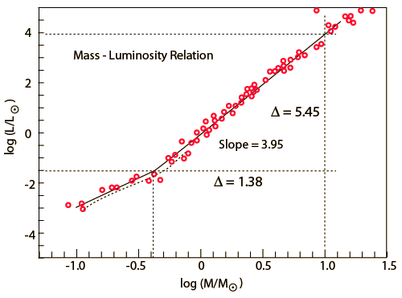
Finite Source Effects & Lens Brightness Measurement Yield Lens System Mass
source
Earth
Finite source effect or lens-source proper motion
Angular Einstein radius θ_{E}=θ*t_{E}/t*
θ* = source star angular radius
D_{L} and D_{S} are the lens and source distances
Lens brightness & color(AO,HST) used in
Mass- Luminosity relation
mass-distance relation➔D_{L ,} M_{L}
θ_{E}
lens
Aparna Bhattacharya
Notes:
1

Slide 7
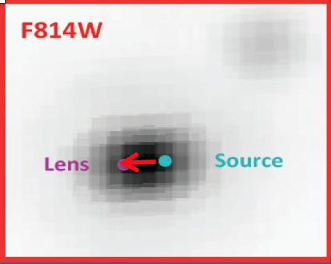
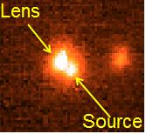
OGLE-2005-BLG-169: HST & Keck
8.3 years after discovery¹
HST
Keck
μ _{rel_l} = 7.39 ± .20 mas/yr
μ _{rel_b} = 1.33 ± .23 mas/yr
μ _{rel_l} = 7.28 ± .12 mas/yr
μ _{rel_b} = 1.54 ± .12 mas/yr
Both supports α ̴ 90 ̊ and q = 6×${10}^{−5}$ model
Host mass: 0.687 ± .021 M
Planet Mass:
14.1 ± 0.9 M⊕
D_{L} = 4.1 ± 0.4 kpc
Projected Separation(a⊥):
3.5 ± 0.3 AU
Host mass: 0.667 ± .049M
Planet Mass:
13 ± 1.5 M⊕
D_{L} = 3.9 ± 0.4 kpc
Projected Separation(a⊥):
3.4 ± 0.3 AU
Aparna Bhattacharya

Slide 8
MOA-2008-BLG-310
From Discovery paper¹:
^{q = (3.3±0.3)}
^{Sub Saturn mass planet}
μ _{relG} = 5.1 ± 0.3 mas/yr
Excess flux in H band (NACO Data)
Extra Flux detected on top of source in HST I and V band data in both epochs 3.6 and 5.6 years later
Image from NACO VLT data
×${ 10}^{−4}$
Aparna Bhattacharya

Slide 9
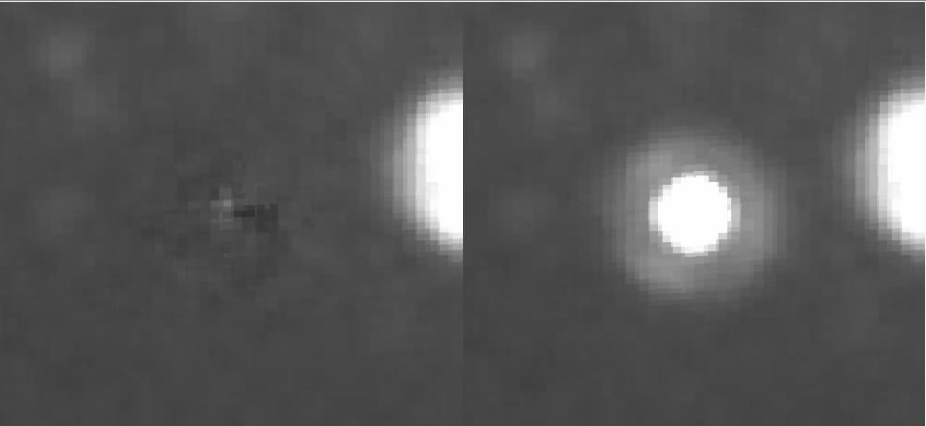
MOA-2008-BLG-310 Two star fit - Unconstrained
Residual
But neither star brightness matches with the source brightness. The separation does not match with predicted separation
Aparna Bhattacharya

Slide 10
MOA-2008-BLG-310 Two star fit – Source Flux Constrained
Source
Blend Star
2012 HST F814W
2014 HST F555W
Reality
S
S
B
B
Expected
Source Flux constrained from light curve fitting
Aparna Bhattacharya

Slide 11
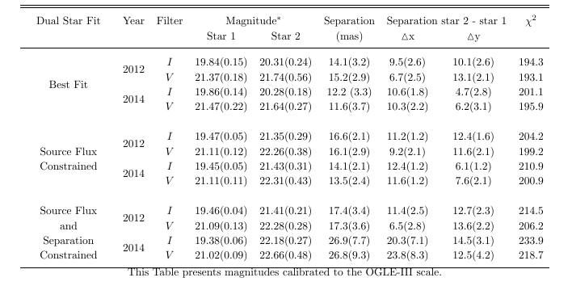
MOA-2008-BLG-310 Two star fit – Source Flux and Lens- Source Separation Constrained
χ²
is high
Aparna Bhattacharya

Slide 12
MOA-2008-BLG-310 Two star fit – Conclusions
The Extra flux on top of the source is primarily NOT due to the lens
Source Companion – The velocity of the blend star is too high to be source companion
Lens Companion – Velocity direction is not similar to lens– not a lens companion
Ambient Star – Possibly , the proper motion is consistent with bulge stars
Bhattacharya+ 2017 in prep
Aparna Bhattacharya

Slide 13
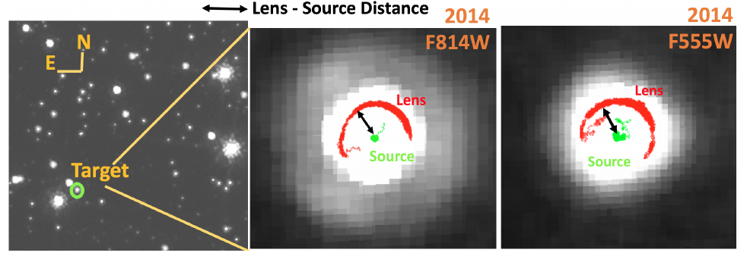
MOA-2008-BLG-310 Three star fit – Upper Limit on Lens Mass
Aparna Bhattacharya

Slide 14
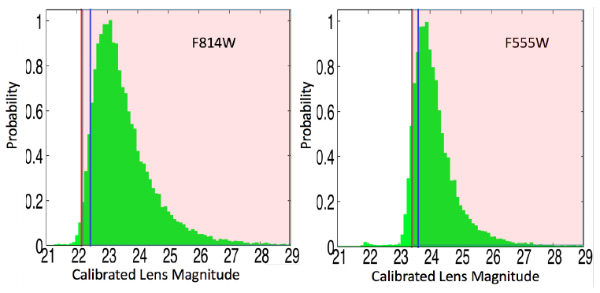
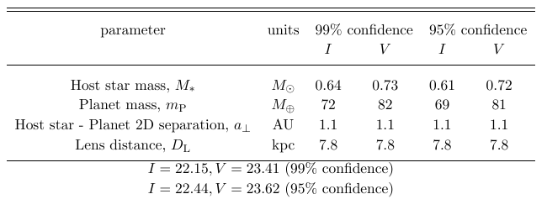
MOA-2008-BLG-310 Three star fit – Upper Limit on Lens Mass
Aparna Bhattacharya

Slide 15
MOA-2008-BLG-379 Three star fit
Aparna Bhattacharya

Slide 16
Conclusions
Extra Flux detection on top of the source is not necessarily the lens.
It is important to verify the lens with relative proper motion in high resolution images.
Since mass measurement with lens detection is going to be one of the primary methods of planet-host star mass measurement in WFIRST era, we need to be more careful with lens detection in high resolution images.
Aparna Bhattacharya

Slide 17
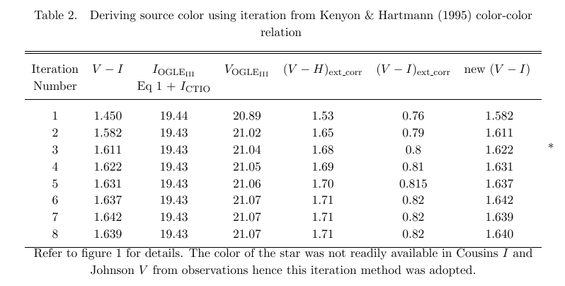

Slide 18
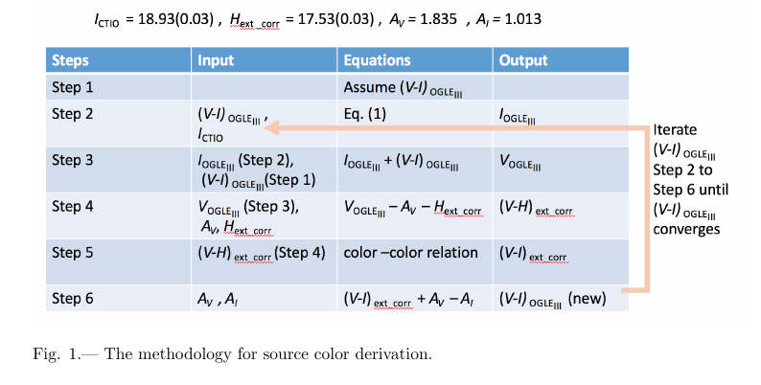

Slide 19
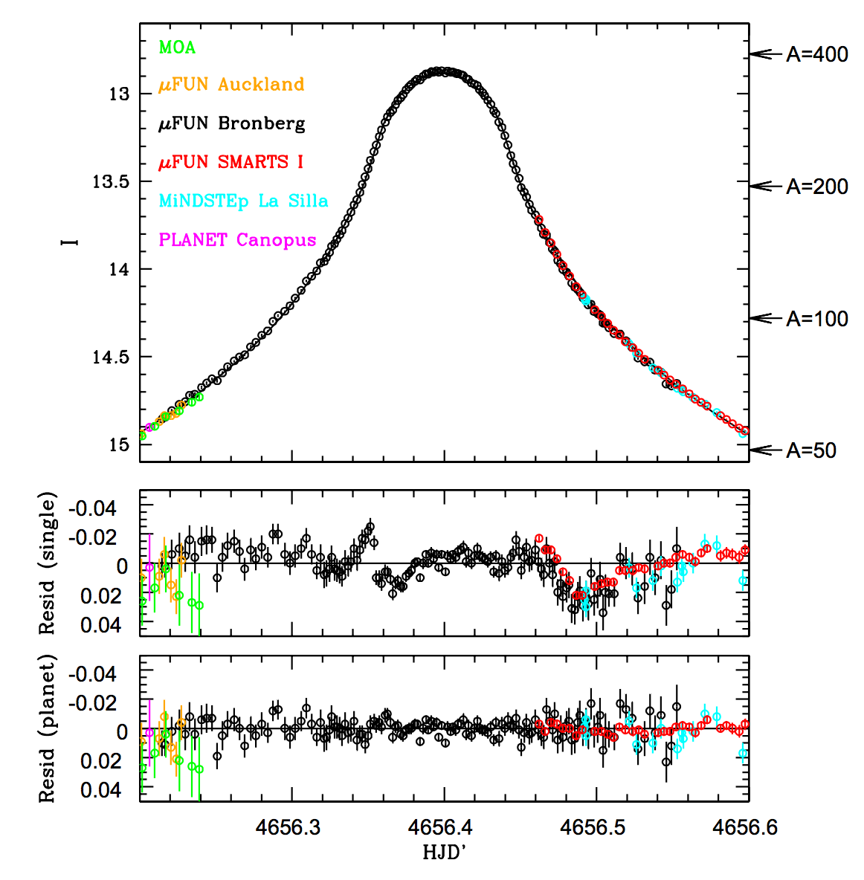

Slide 20
Thank you!
Aparna Bhattacharya

