Slide 1
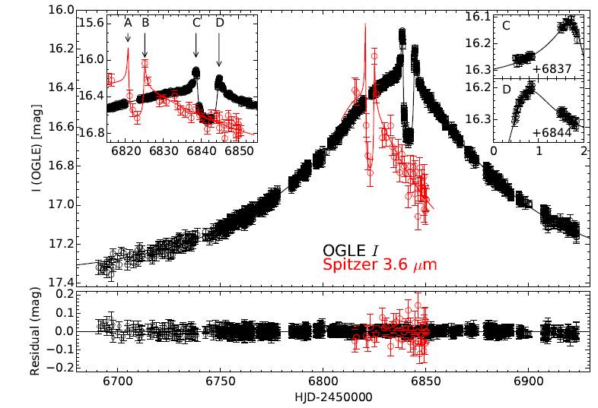
Microlensing Theory and Observables
Yossi Shvartzvald NPP Fellow @ JPL

Slide 2




Microlensing Geometry
$$S$$
$$O$$
$$D_{s}$$

Slide 3


Microlensing Geometry
$$S$$
$$O$$
$$L$$
$$D_{L}$$
$$D_{s}$$

Slide 4
Microlensing Geometry
$$S$$
$$O$$
$$L$$
$$D_{L}$$
$$D_{s}$$

Slide 5

Microlensing Geometry
$$I$$
$$S$$
$$O$$
$$L$$
$$D_{L}$$
$$D_{s}$$

Slide 6


Microlensing Geometry
$$I$$
$$S$$
$$θ$$
$$β$$
$$O$$
$$L$$
$$D_{L}$$
$$D_{s}$$

Slide 7


Microlensing Geometry
$$I$$
$${\hat{α}}_{d}=\frac{4GM_{L}}{c^{2}b}$$
$$S$$
$$b$$
$$O$$
$$L$$
$$D_{L}$$
$$D_{s}$$

Slide 8


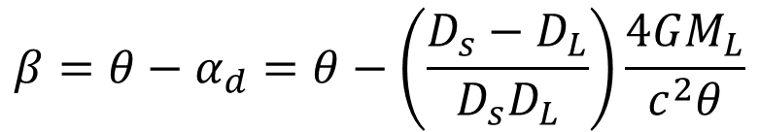
Microlensing Geometry
The Lensing Equation (single lens)
$$β=θ−α_{d}=θ−\left(\frac{D_{s}−D_{L}}{D_{s}D_{L}}\right)\frac{4GM_{L}}{c^{2}θ}$$
$$I$$
$${\hat{α}}_{d}=\frac{4GM_{L}}{c^{2}b}$$
$$S$$
$$b$$
$$α_{d}$$
$$θ$$
$$β$$
$$O$$
$$L$$
$$D_{L}$$
$$D_{s}$$

Slide 9
Microlensing Geometry
The Lensing Equation (single lens)
$$β=θ−α_{d}=θ−\left(\frac{D_{s}−D_{L}}{D_{s}D_{L}}\right)\frac{4GM_{L}}{c^{2}θ}$$
$$I$$
$${\hat{α}}_{d}=\frac{4GM_{L}}{c^{2}b}$$
$$S$$
$$b$$
$$α_{d}$$
$$θ$$
$$β$$
$$O$$
$$L$$
$$D_{L}$$
$$D_{s}$$

Slide 10
Microlensing Geometry
The Lensing Equation (single lens)
$$β=θ−α_{d}=θ−\left(\frac{D_{s}−D_{L}}{D_{s}D_{L}}\right)\frac{4GM_{L}}{c^{2}θ}$$
$$I$$
$${\hat{α}}_{d}=\frac{4GM_{L}}{c^{2}b}$$
$$S$$
$$b$$
$$α_{d}$$
$$θ$$
$$β$$
$$O$$
$$L$$
$$D_{L}$$
$$D_{s}$$

Slide 11


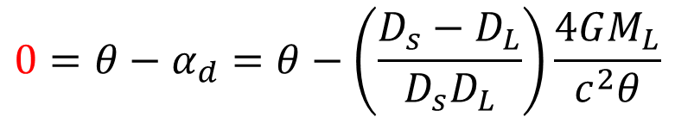
Microlensing Geometry
The Lensing Equation (single lens)
$$0=θ−α_{d}=θ−\left(\frac{D_{s}−D_{L}}{D_{s}D_{L}}\right)\frac{4GM_{L}}{c^{2}θ}$$
$$I$$
$${\hat{α}}_{d}=\frac{4GM_{L}}{c^{2}b}$$
$$b$$
$$θ$$
$$S$$
$$O$$
$$L$$
$$D_{L}$$
$$D_{s}$$

Slide 12
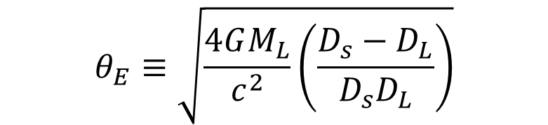



Microlensing Geometry
The Einstein Angular Radius
$$θ_{E}≡\sqrt{\frac{4GM_{L}}{c^{2}}\left(\frac{D_{s}−D_{L}}{D_{s}D_{L}}\right)}$$
$${\hat{α}}_{d}=\frac{4GM_{L}}{c^{2}r_{E}}$$
$$r_{E}$$
$$θ$$
$$S$$
$$O$$
$$L$$

Slide 13











Microlensing Geometry
The Lensing Equation (single lens)
$$β=θ−\frac{θ_{E}^{2}}{θ}$$
$$I$$
$${\hat{α}}_{d}=\frac{4GM_{L}}{c^{2}b}$$
$$S$$
$$α_{d}$$
$$θ$$
$$β$$
$$O$$
$$L$$
$$D_{L}$$
$$D_{s}$$

Slide 14
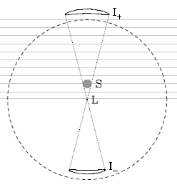

Microlensing Geometry
The Lensing Equation (single lens)
$$β=θ−\frac{θ_{E}^{2}}{θ}$$
Observer view
$$I$$
Side view
$${\hat{α}}_{d}=\frac{4GM_{L}}{c^{2}b}$$
$$S$$
$$α_{d}$$
$$θ$$
$$β$$
$$O$$
$$L$$
$$D_{L}$$
$$θ_{E}$$
$$D_{s}$$

Slide 15
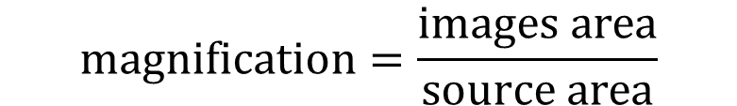
Magnification by a Single lens
$$magnification=\frac{images area}{source area}$$
Observer view
~milliarcsec
$$θ_{E}$$

Slide 16
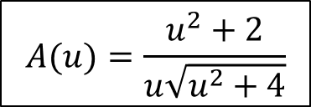
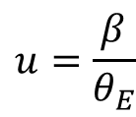
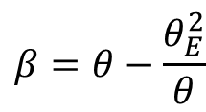
Magnification by a Single lens
$$magnification=\frac{images area}{source area}$$
Source plane to Lens plane
Observer view
$$β=θ−\frac{θ_{E}^{2}}{θ}$$
$$u=\frac{β}{θ_{E}}$$
$$A(u)=\frac{u^{2}+2}{u\sqrt{u^{2}+4}}$$
$$θ_{E}$$

Slide 17
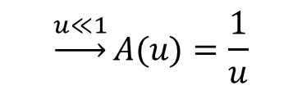
Magnification by a Single lens
$$magnification=\frac{images area}{source area}$$
Source plane to Lens plane
Observer view
$$β=θ−\frac{θ_{E}^{2}}{θ}$$
$$u=\frac{β}{θ_{E}}$$
$$A(u)=\frac{u^{2}+2}{u\sqrt{u^{2}+4}}$$
$$\underset{→}{u≪1}A(u)=\frac{1}{u}$$
$$θ_{E}$$

Slide 18

Microlensing observables – single lens
Event timescale: $t_{E}=\frac{θ_{E}}{μ_{rel}}$
Lens-Source relative proper motion

Slide 19
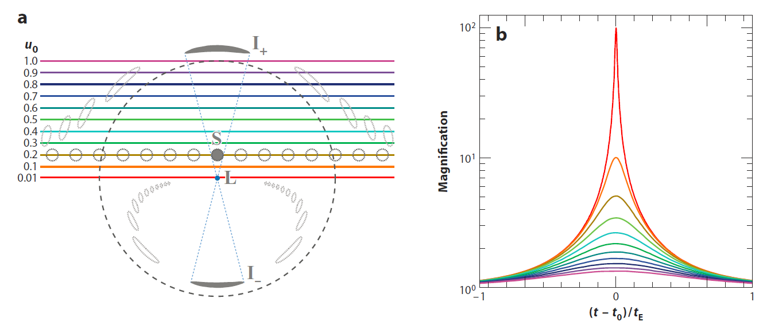
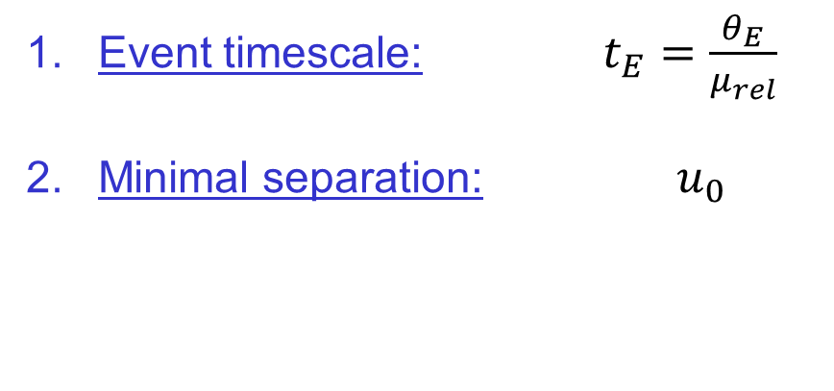
Microlensing observables – single lens
Event timescale: $t_{E}=\frac{θ_{E}}{μ_{rel}}$
Minimal separation: $u_{0}$
Gaudi 2012

Slide 20
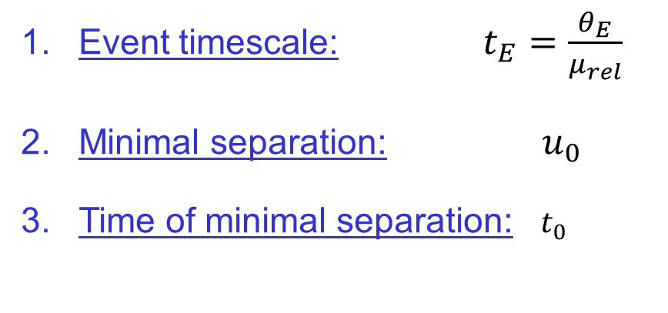
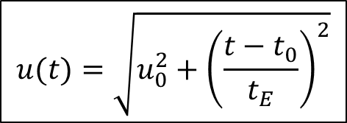
Microlensing observables – single lens
Event timescale: $t_{E}=\frac{θ_{E}}{μ_{rel}}$
Minimal separation: $u_{0}$
Time of minimal separation: $t_{0}$
$$u(t)=\sqrt{u_{0}^{2}+{\left(\frac{t−t_{0}}{t_{E}}\right)}^{2}}$$
Gaudi 2012

Slide 21
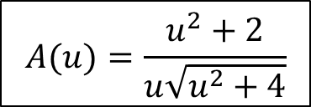
Microlensing observables – single lens
Event timescale: $t_{E}=\frac{θ_{E}}{μ_{rel}}$
Minimal separation: $u_{0}$
Time of minimal separation: $t_{0}$
$$u(t)=\sqrt{u_{0}^{2}+{\left(\frac{t−t_{0}}{t_{E}}\right)}^{2}}$$
$$A(u)=\frac{u^{2}+2}{u\sqrt{u^{2}+4}}$$
Gaudi 2012

Slide 22
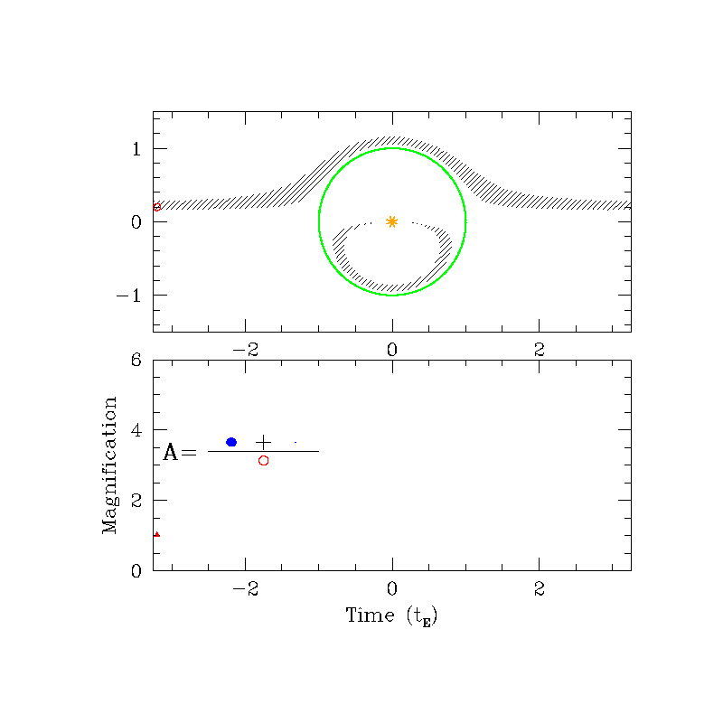
Microlensing observables – single lens
S. Gaudi

Slide 23


Microlensing observables – star+planet lens
Observer view
$$S$$
$$L$$
$$θ_{E}$$

Slide 24

Microlensing observables – star+planet lens
Observer view
$$p$$
$$S$$
$$L$$
$$θ_{E}$$

Slide 25
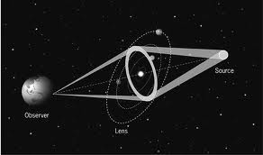
Microlensing observables – star+planet lens
Side view
Observer view
$$p$$
$$S$$
$$L$$
$$θ_{E}$$

Slide 26
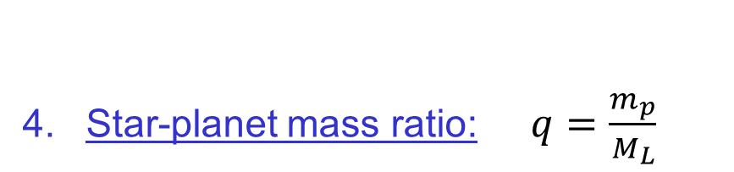
Microlensing observables – star+planet lens
Observer view
Star-planet mass ratio: $q=\frac{m_{p}}{M_{L}}$
$$p$$
$$S$$
$$L$$
$$θ_{E}$$

Slide 27

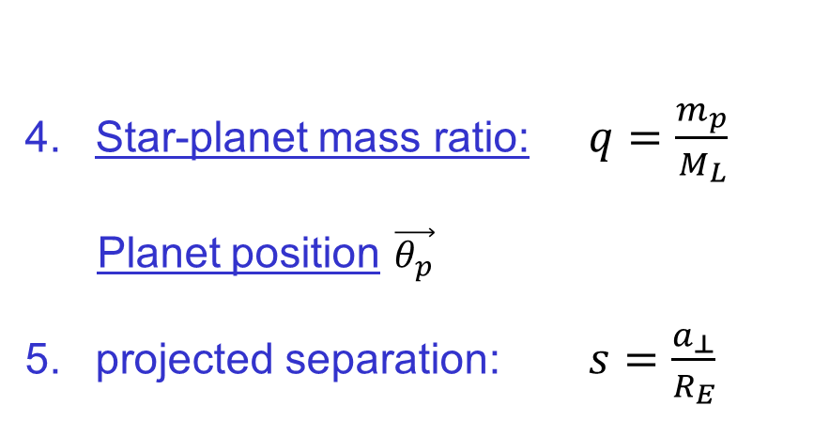
Microlensing observables – star+planet lens
Observer view
Star-planet mass ratio: $q=\frac{m_{p}}{M_{L}}$
Planet position $\vec{θ_{p}}$
projected separation: $s=\frac{a_{⊥}}{R_{E}}$
$$p$$
$$s$$
$$S$$
$$L$$
$$θ_{E}$$

Slide 28
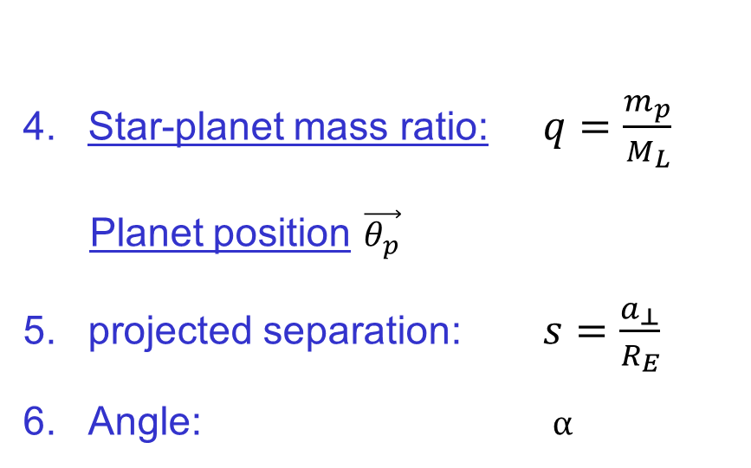

Microlensing observables – star+planet lens
Observer view
Star-planet mass ratio: $q=\frac{m_{p}}{M_{L}}$
Planet position $\vec{θ_{p}}$
projected separation: $s=\frac{a_{⊥}}{R_{E}}$
Angle: $α$
$$p$$
$$s$$
$$S$$
$$α$$
$$L$$
$$θ_{E}$$

Slide 29

Microlensing observables – star+planet lens
The Lensing Equation (2 lenses)
$$\vec{β}=\vec{θ}−\frac{θ_{E}^{2}}{\vec{θ}}−\frac{{qθ}_{E}^{2}}{\vec{θ}−\vec{θ_{p}}}$$
Observer view
Star-planet mass ratio: $q=\frac{m_{p}}{M_{L}}$
Planet position $\vec{θ_{p}}$
projected separation: $s=\frac{a_{⊥}}{R_{E}}$
Angle: $α$
$$p$$
$$s$$
$$S$$
$$α$$
$$L$$
$$θ_{E}$$

Slide 30
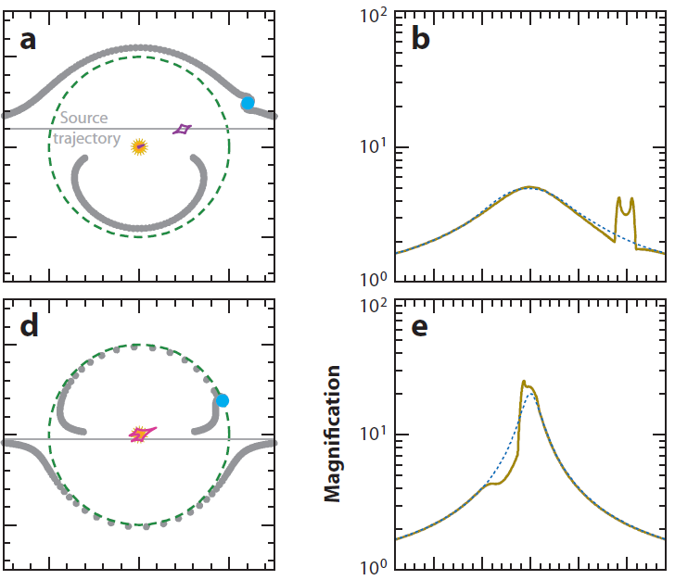
Magnification by star+planet lensing system
Magnification map
Caustics – contours of formally infinite magnification
Gaudi 2012

Slide 31
Magnification by star+planet lensing system
Magnification map
Caustics – contours of formally infinite magnification
Gaudi 2012

Slide 32
Magnification by star+planet lensing system
Gaudi 2012

Slide 33
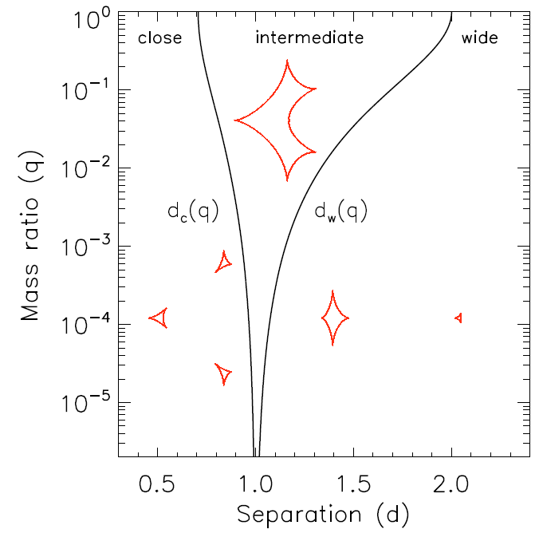

Magnification by star+planet lensing system
Caustics topologies
$$(s)$$
Cassan 2008

Slide 34
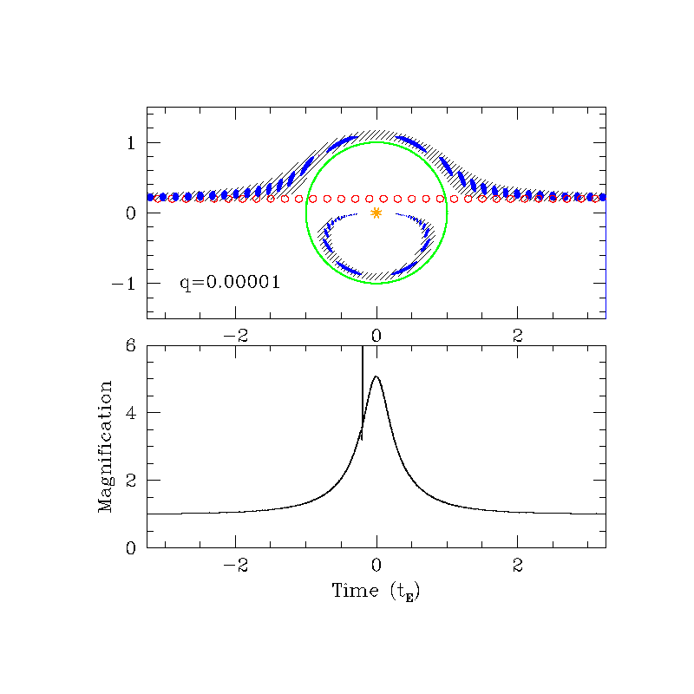
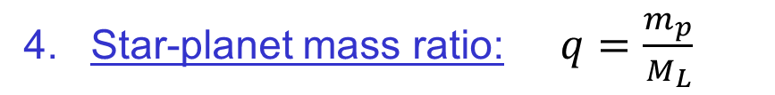
Microlensing observables – star+planet lens
Star-planet mass ratio: $q=\frac{m_{p}}{M_{L}}$
S. Gaudi

Slide 35
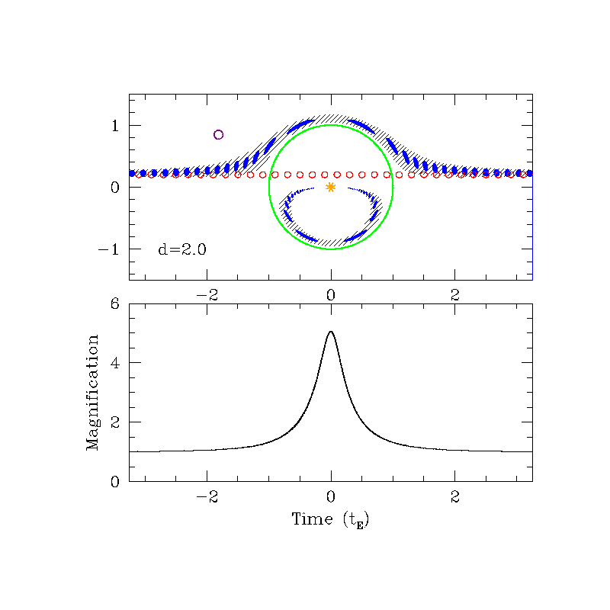


Microlensing observables – star+planet lens
projected separation: $s=\frac{a_{⊥}}{R_{E}}$
$$s$$
S. Gaudi

Slide 36
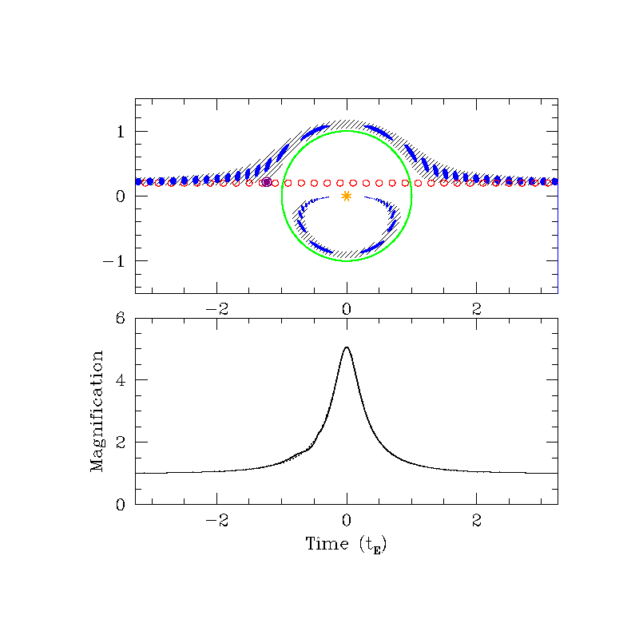

Microlensing observables – star+planet lens
Angle: $α$
S. Gaudi

Slide 37
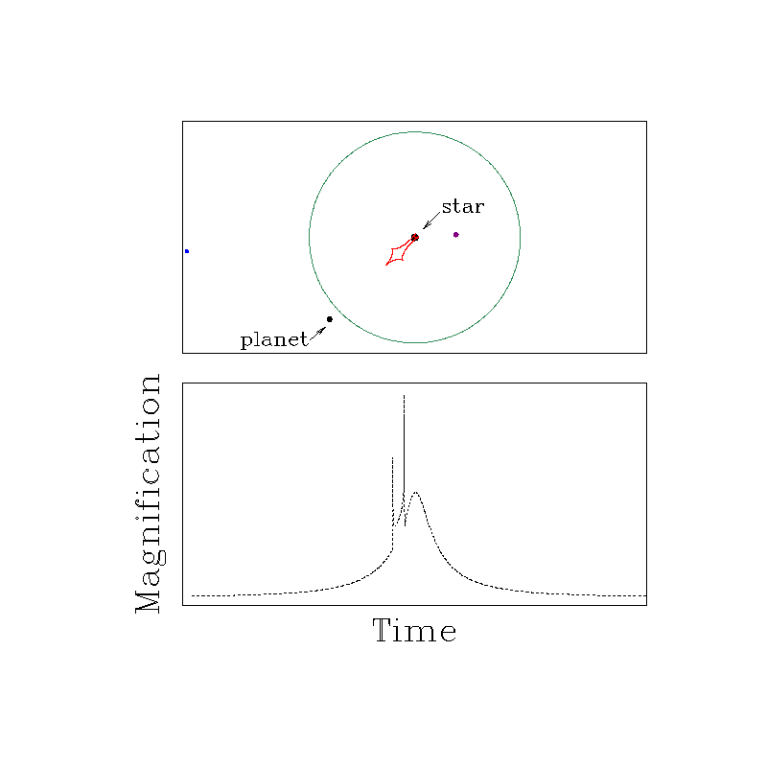
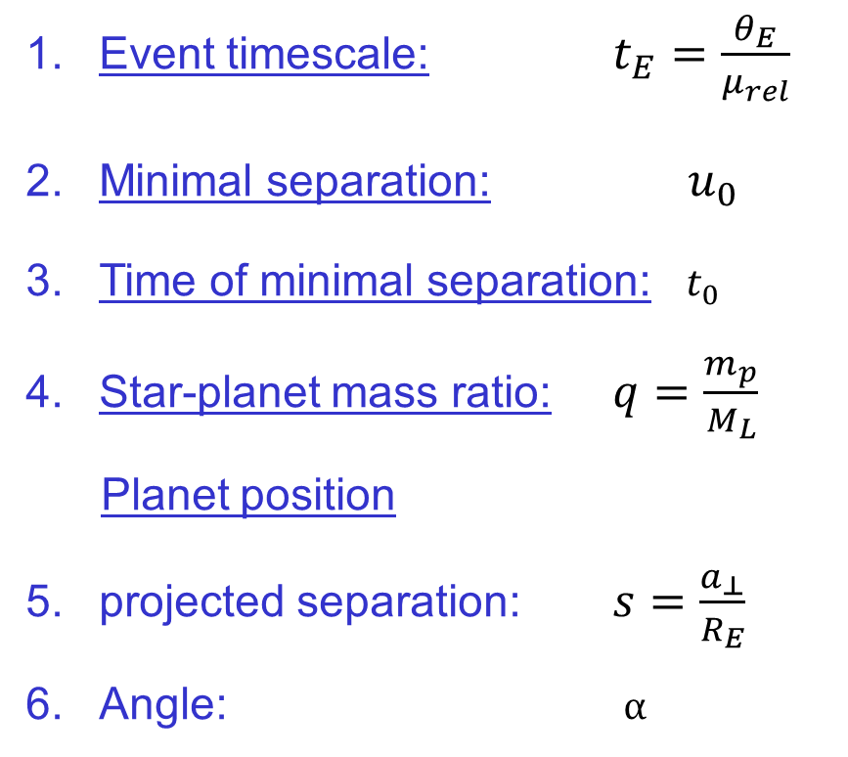
Microlensing observables – star+planet lens
Event timescale: $t_{E}=\frac{θ_{E}}{μ_{rel}}$
Minimal separation: $u_{0}$
Time of minimal separation: $t_{0}$
Star-planet mass ratio: $q=\frac{m_{p}}{M_{L}}$
Planet position
projected separation: $s=\frac{a_{⊥}}{R_{E}}$
Angle: $α$

Slide 38
Microlensing observables – star+planet lens
The Lensing Equation (2 lenses)
$$\vec{β}=\vec{θ}−\frac{θ_{E}^{2}}{\vec{θ}}−\frac{{qθ}_{E}^{2}}{\vec{θ}−\vec{θ_{p}}}$$
Observer view
Star-planet mass ratio: $q=\frac{m_{p}}{M_{L}}$
Planet position $\vec{θ_{p}}$
projected separation: $s=\frac{a_{⊥}}{R_{E}}$
Angle: $α$
$$p$$
$$S$$
$$L$$
$$θ_{E}$$

Slide 39
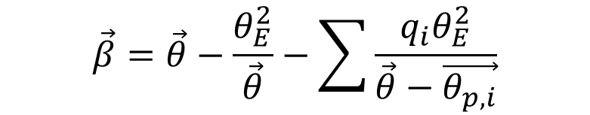




Microlensing observables – multiple planets
The Lensing Equation (multiple lenses)
$$\vec{β}=\vec{θ}−\frac{θ_{E}^{2}}{\vec{θ}}−\sum{\frac{{q_{i}θ}_{E}^{2}}{\vec{θ}−\vec{θ_{p,i}}}}$$
Observer view
Star-planet mass ratio: $q_{i}=\frac{m_{p}}{M_{L}}$
Planet position $\vec{θ_{p,i}}$
projected separation: $s_{i}=\frac{a_{⊥}}{R_{E}}$
Angle: $α_{i}$
$$p$$
$$p$$
$$p$$
$$S$$
$$L$$
$$p$$
$$θ_{E}$$

Slide 40
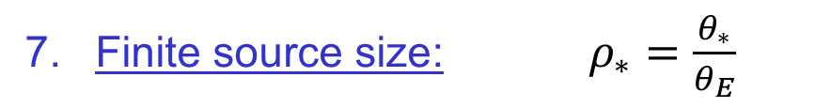
Microlensing observables – High order effects
Finite source size: $ρ_{∗}=\frac{θ_{∗}}{θ_{E}}$
Einstein angle
Point source
Lens

Slide 41
Microlensing observables – High order effects
Finite source size: $ρ_{∗}=\frac{θ_{∗}}{θ_{E}}$
Einstein angle
Finite-size source
Lens

Slide 42
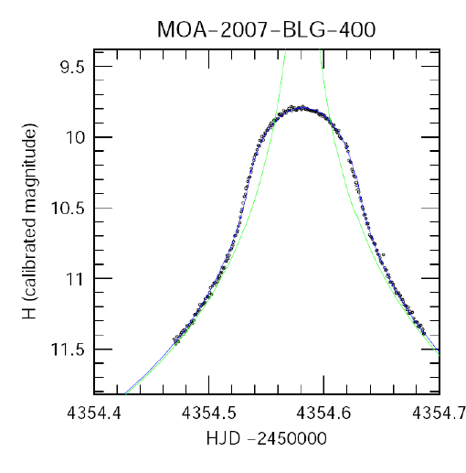
Microlensing observables – High order effects
Finite source size: $ρ_{∗}=\frac{θ_{∗}}{θ_{E}}$
Dong et al. 2009

Slide 43
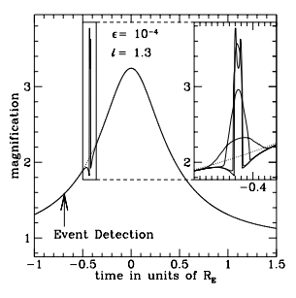
Microlensing observables – High order effects
Finite source size: $ρ_{∗}=\frac{θ_{∗}}{θ_{E}}$
Dong et al. 2009
Bennett & Rhie 1996

Slide 44
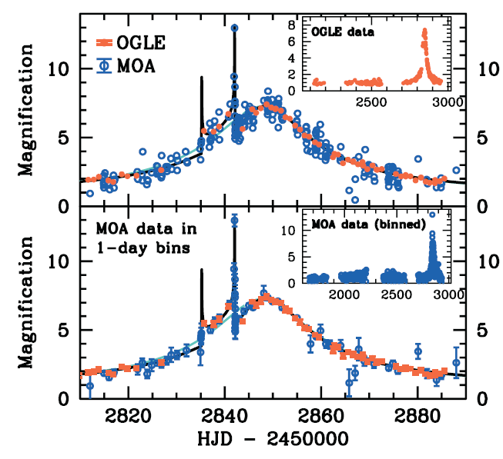
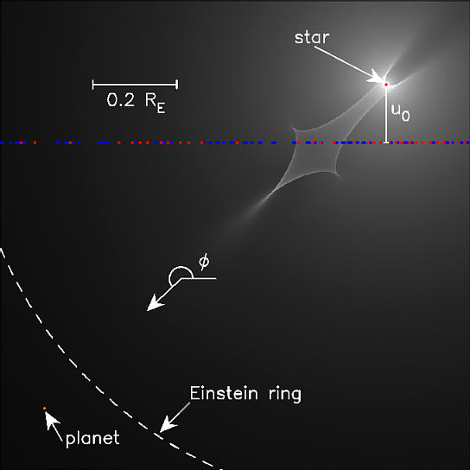
Microlensing observables – High order effects
Finite source size: $ρ_{∗}=\frac{θ_{∗}}{θ_{E}}$
Bond et al. 2004

Slide 45
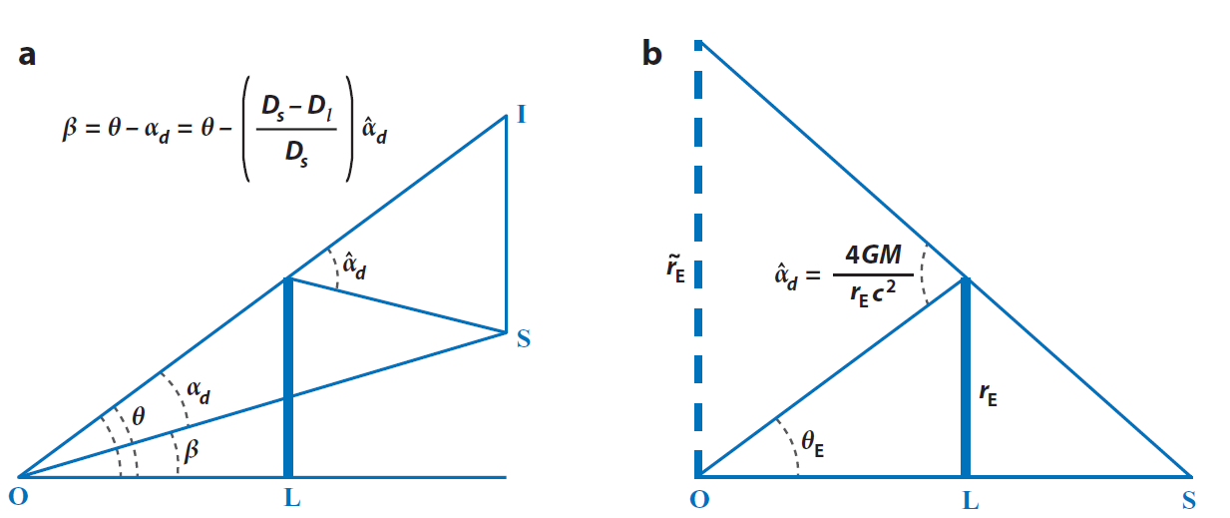
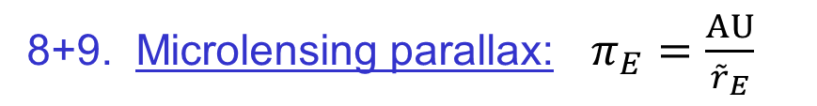
Microlensing observables – High order effects
8+9. Microlensing parallax: $π_{E}=\frac{AU}{{\tilde{r}}_{E}}$

Slide 46

From lensing observables to physical parameters
8+9. Microlensing parallax: $π_{E}=\frac{AU}{{\tilde{r}}_{E}}$
Orbital parallax -
single orbiting observer

Slide 47
From lensing observables to physical parameters
8+9. Microlensing parallax: $π_{E}=\frac{AU}{{\tilde{r}}_{E}}$
Orbital parallax -
single orbiting observer
Gould & Horne 2013

Slide 48
From lensing observables to physical parameters
8+9. Microlensing parallax: $π_{E}=\frac{AU}{{\tilde{r}}_{E}}$
Orbital parallax -
single orbiting observer
Gould & Horne 2013

Slide 49
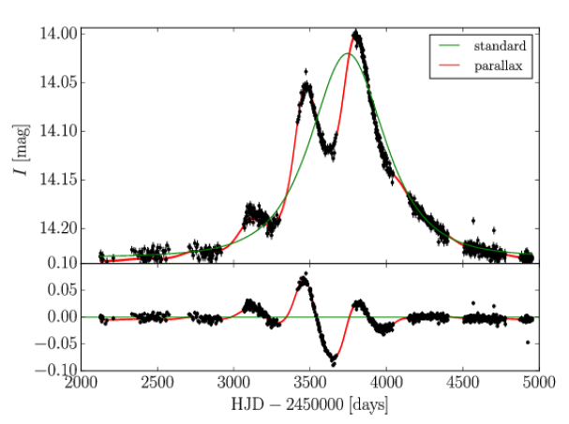
From lensing observables to physical parameters
8+9. Microlensing parallax: $π_{E}=\frac{AU}{{\tilde{r}}_{E}}$
Orbital parallax -
single orbiting observer
Wyrzykowski et al. 2016
Gould & Horne 2013

Slide 50
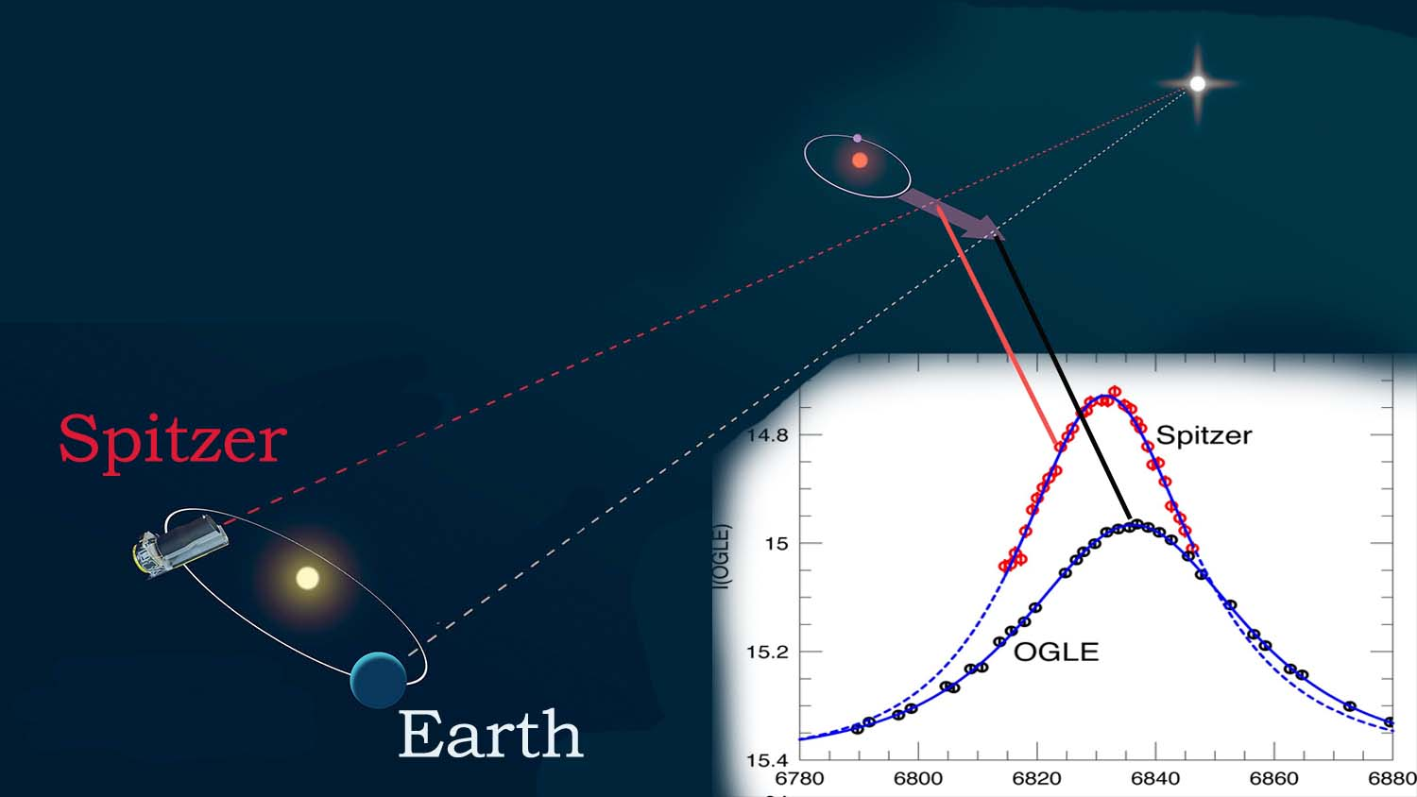
From lensing observables to physical parameters
8+9. Microlensing parallax: $π_{E}=\frac{AU}{{\tilde{r}}_{E}}$
Satellite parallax - two “fixed” observers
Yee et al. 2014

Slide 51
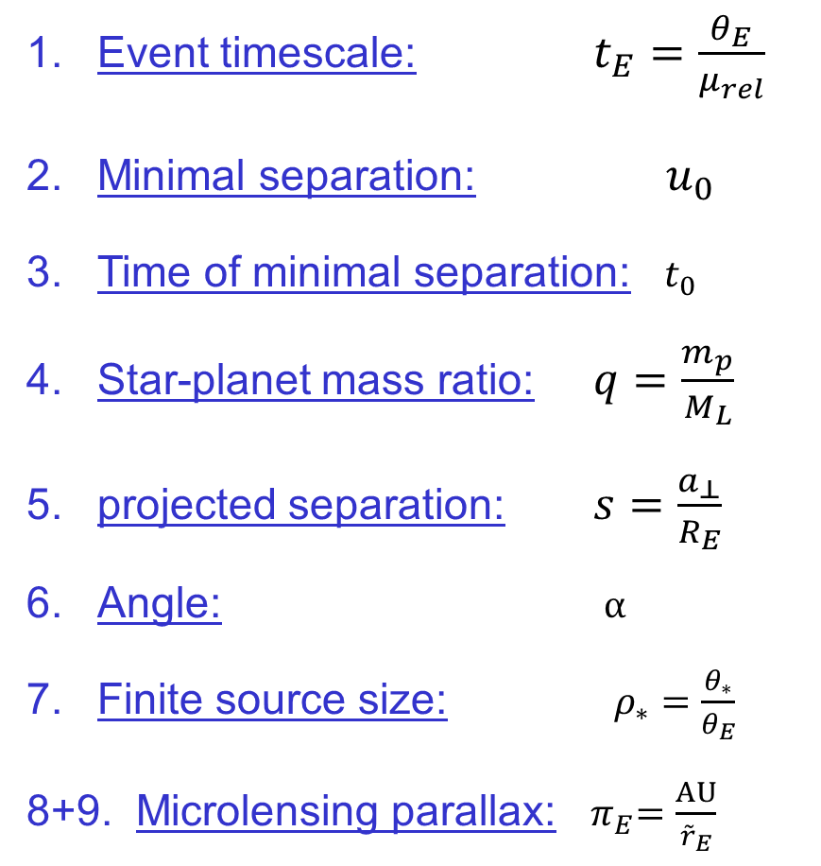
Microlensing observables – star+planet lens
Event timescale: $t_{E}=\frac{θ_{E}}{μ_{rel}}$
Minimal separation: $u_{0}$
Time of minimal separation: $t_{0}$
Star-planet mass ratio: $q=\frac{m_{p}}{M_{L}}$
projected separation: $s=\frac{a_{⊥}}{R_{E}}$
Angle: $α$
Finite source size: $ρ_{∗}=\frac{θ_{∗}}{θ_{E}}$
8+9. Microlensing parallax:${ π}_{E}=\frac{AU}{{\tilde{r}}_{E}}$
Udalski et al. 2015

Slide 52
Microlensing observables – star+planet lens
$$p$$
$$s$$
$$S$$
$$α$$
$$L$$
$$θ_{E}$$

Slide 53
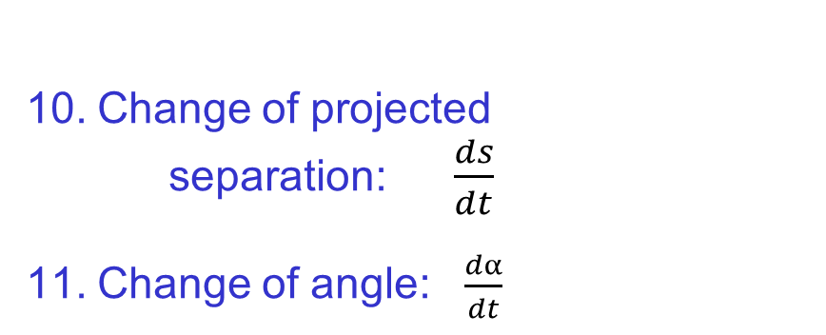
Microlensing observables – star+planet lens
Change of projected separation: $\frac{ds}{dt}$
Change of angle: $\frac{dα}{dt}$
$$p$$
$$s$$
$$S$$
$$α$$
$$L$$
$$θ_{E}$$

Slide 54
Microlensing observables – star+planet lens
Change of projected separation: $\frac{ds}{dt}$
Change of angle: $\frac{dα}{dt}$
$$p$$
$$s$$
$$S$$
$$α$$
$$L$$
$$θ_{E}$$
Skowron et al. 2011

Slide 55
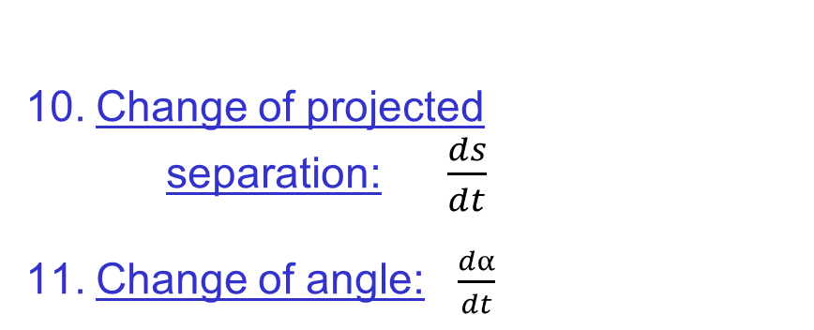
Microlensing observables – star+planet lens
Change of projected separation: $\frac{ds}{dt}$
Change of angle: $\frac{dα}{dt}$
Event timescale: $t_{E}=\frac{θ_{E}}{μ_{rel}}$
Minimal separation: $u_{0}$
Time of minimal separation: $t_{0}$
Star-planet mass ratio: $q=\frac{m_{p}}{M_{L}}$
projected separation: $s=\frac{a_{⊥}}{R_{E}}$
Angle: $α$
Finite source size: $ρ_{∗}=\frac{θ_{∗}}{θ_{E}}$
8+9. Microlensing parallax:${ π}_{E}=\frac{AU}{{\tilde{r}}_{E}}$

Slide 56
Microlensing observables – star+planet lens
Change of projected separation: $\frac{ds}{dt}$
Change of angle: $\frac{dα}{dt}$
Event timescale: $t_{E}=\frac{θ_{E}}{μ_{rel}}$
Minimal separation: $u_{0}$
Time of minimal separation: $t_{0}$
Star-planet mass ratio: $q=\frac{m_{p}}{M_{L}}$
projected separation: $s=\frac{a_{⊥}}{R_{E}}$
Angle: $α$
Finite source size: $ρ_{∗}=\frac{θ_{∗}}{θ_{E}}$
8+9. Microlensing parallax:${ π}_{E}=\frac{AU}{{\tilde{r}}_{E}}$
The End

