Slide 1
Does This Lightcurve Have a Planet?
Examples

Slide 2
Two Main Questions
Is it anomalous? (i.e. does it deviate from a point lens?)
If yes, is that anomaly due to a planet?

Slide 3
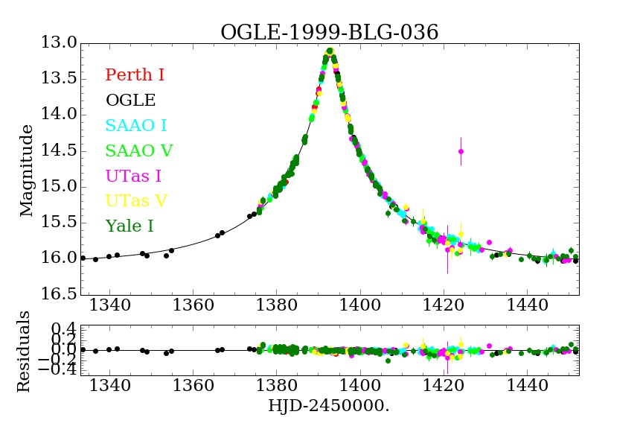
Notes:
OGLE-1999-BLG-036: Event is dominated a smooth, symmetric curve due to the star. There is one outlier at 1425 but nearby data do NOT support the hypothesis that it is a real perturbation → This is a point lens event with one bad data point.

Slide 4
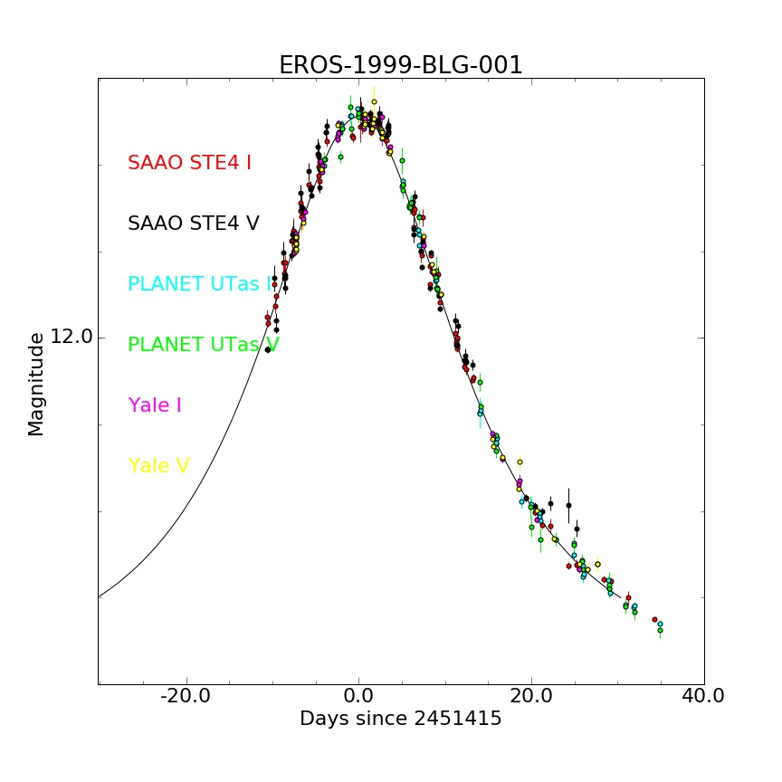
Notes:
EROS-1999-BLG-001: Dominated by a symmetric, point lens signal. There is a cluster of outliers at 2451415+22. Are they a planetary perturbation? No. The outliers are not coherent. Data from different sites contradict each other → This is a point lens with some bad data.

Slide 5
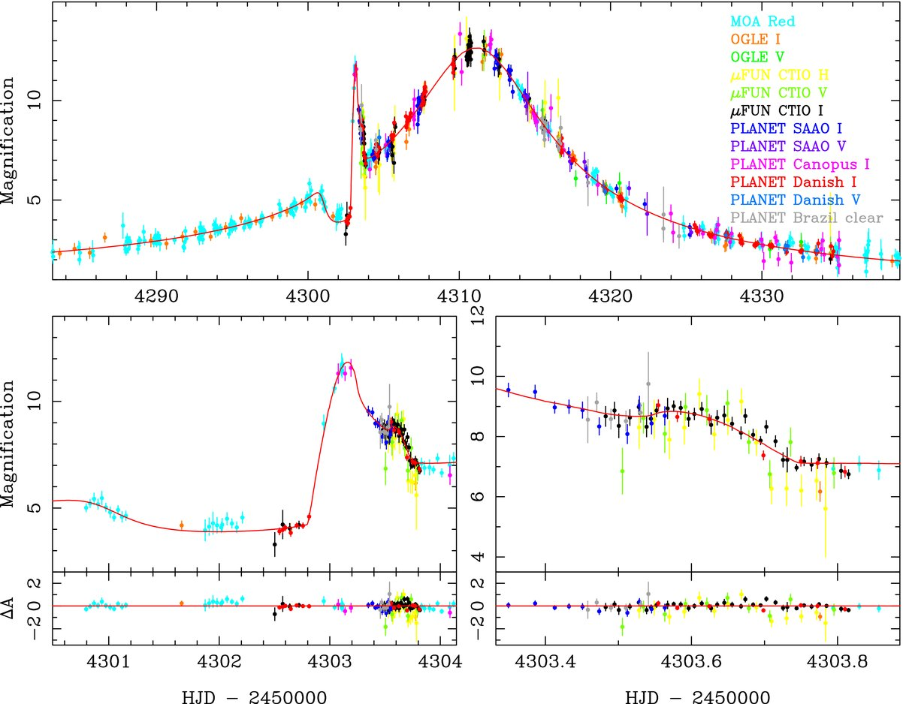
OGLE-2007-BLG-368
Notes:
OGLE-2007-BLG-368: Clear anomaly at ~4303. Two pieces of evidence it is a planet: 1. If you remove the anomaly, you are left with a symmetric, point lens lightcurve. 2. The anomaly goes significantly below the point lens curve → a minor image perturbation due to a planet.

Slide 6
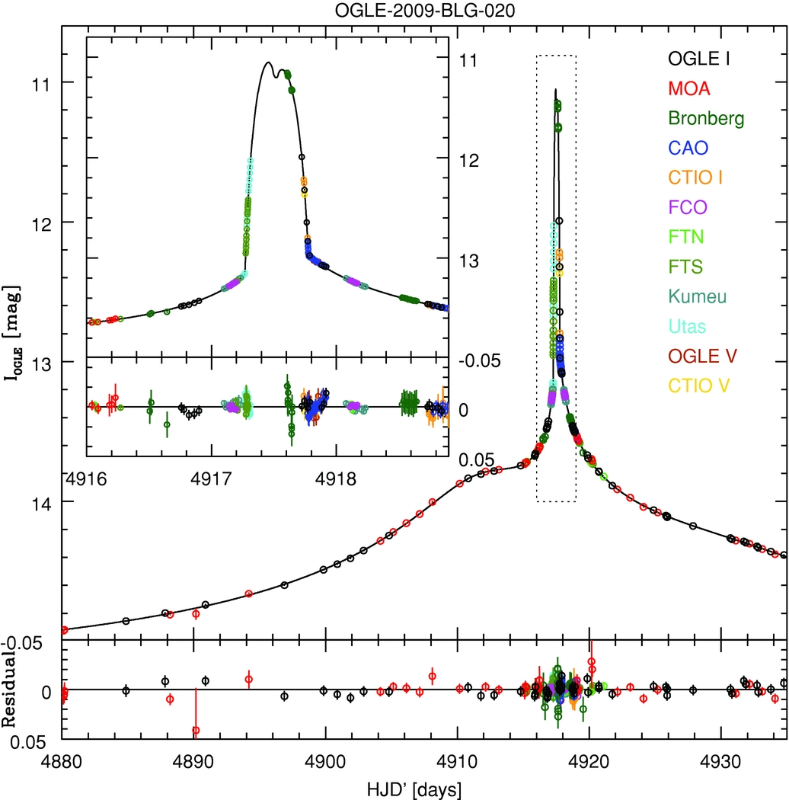
Notes:
OGLE-2009-BLG-020: Clear anomaly at ~4917.5. But 1) it is very large (Delta I = 2 magnitudes) and 2) if you remove the anomaly, the remaining lightcurve is not symmetric → binary (star) lens.

Slide 7
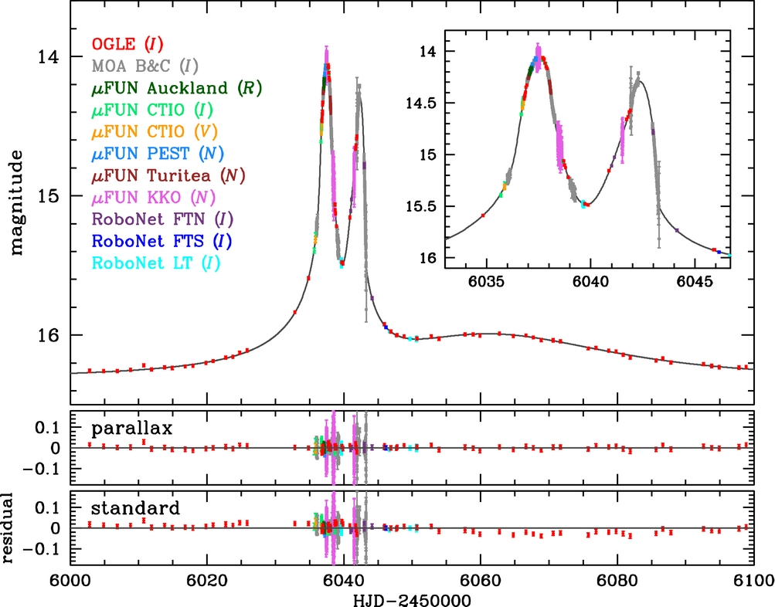
OGLE-2012-BLG-0358
Notes:
OGLE-2012-BLG-0358: Lightcurve is dominated by an anomaly. The anomaly increases the brightness by 2 magnitudes (A LOT!) → An anomaly due to a binary. BUT detailed analysis shows that even though q=0.08, M1 = 0.022 MSun, M2 = 1.9 MJup. From a microlensing perspective, we call this a binary because of the large mass ratio but the mass of the companion is “planetary”. Do you think it should be counted as a planet or a binary?

Slide 8
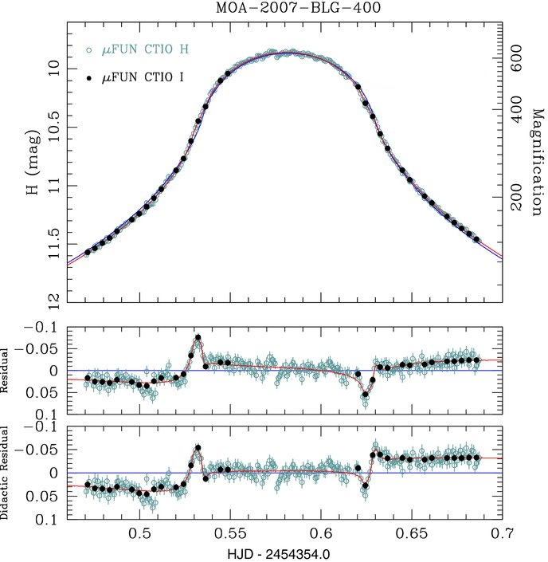
Source
Notes:
MOA-2007-BLG-400: Rounded top due to finite source effects → the impact parameter is smaller than the radius of the source. Symmetric → Point lens is dominant. But clear structures in the residuals to a point lens fit → a very small caustic structure passing over the face of the source. So, anomaly = Yes and small caustic = planet. Also key: the residuals occur where the finite source effects begin, which is what you expect because the biggest deviations should occur when the caustic crosses the limb of the source star.

Slide 9
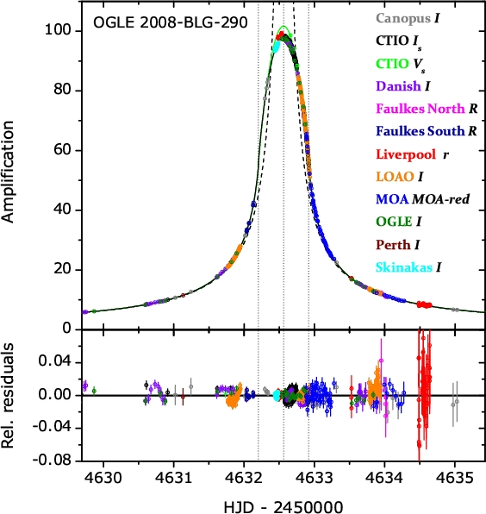
Notes:
OGLE-2008-BLG-290: Rounded top due to finite source effects → the impact parameter is smaller than the radius of the source. Symmetric → Point lens is dominant. No clear structures in residuals at the onset of finite effects → point lens. (structures well before the peak don’t count)

Slide 10
Break into 8 groups of 7-8 people each
Each group should break into 3 subgroups of 2-3 people each
20-30 minutes Subgroups review light curves
15 minutes Group makes final selections and enters them in the spreadsheet
Brief review of a few events
https://docs.google.com/spreadsheets/d/1CYah8UIwG7pWfetVDSjaQzQtrEq42w-pZnSaro8hT-0/edit?usp=sharing

Slide 11
Keep your packets and bring them for tomorrow’s Hands-On Session.

