Slide 1
2015 Sagan Summer Workshop Orientation Information
Dr. Dawn Gelino
Sagan Program Scientist
NASA Exoplanet Science Institute
July 27, 2015
Notes:
4

Slide 2
Welcome to the 2015 Sagan Summer Workshop!
The Sagan Program is part of NASA’s Exoplanet Exploration Program (ExEP), one of three science themed programs at NASA (including Cosmic Origins & Physics of the Cosmos)
The primary goal of missions within ExEP is to discover and characterize planetary systems and Earth-like planets around nearby stars.
The SSW continues the tradition of the past 15 Michelson/Sagan Summer Workshops
This year we have ~140 participants from institutions in 12 countries

Slide 3
The Organizing Committees
SOC:
Chas Beichman (NExScI)
Beth Biller (Univ. of Edinburgh)
Geoff Bryden (JPL)
Scott Gaudi (Ohio State University)
Dawn Gelino (NExScI)
Doug Lin (UC Santa Cruz)
Suvrath Mahadevan (Penn State)
Christoph Mordasini (MPIA/Univ. of Bern)
LOC:
Dawn Gelino
Irene Loera
Renee Newman
Ellen O’Leary
Roberta Paladini
Pat Patterson
Irene, Pat and Renee will be handling speaker and supported attendee travel reimbursements.

Slide 4
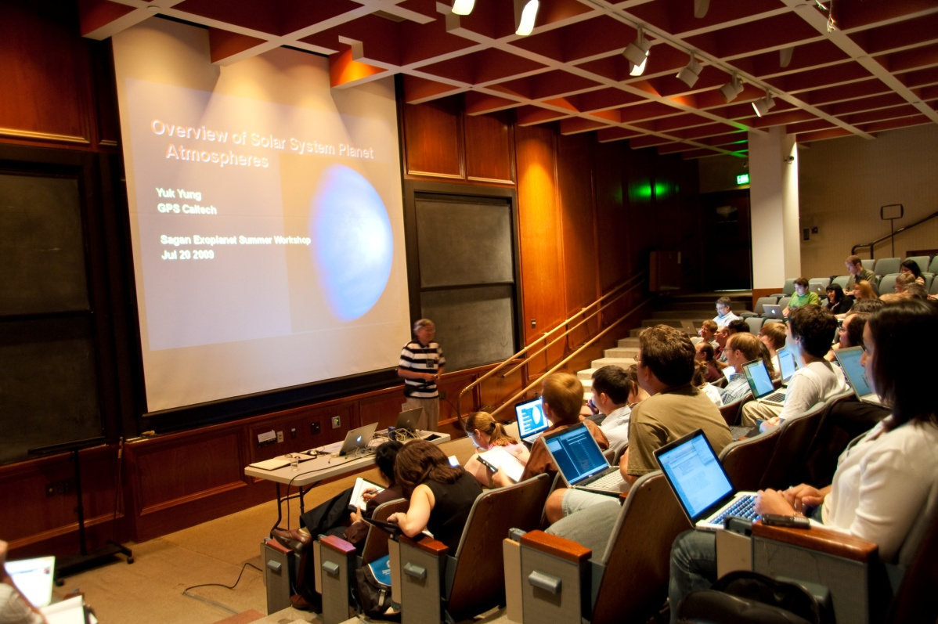
The Speakers
Special thanks to our
speakers for submitting
their presentations before
the workshop!
PDFs of all submitted presentations, including the POPs and posters, are on-line:
http://nexsci.caltech.edu/workshop/2015/agenda.shtml

Slide 5
The Presentations and Wireless
NOTICE
Caltech will be making audio/video recordings of this program. By attending this event, you may be included in these recordings and agree that Caltech may broadcast them for promotional or educational purposes in any media.
If you have not signed your speaker A/V waiver, please go to the registration desk and do so ASAP!
Presentation slides will be posted/updated during the week
Videos will be posted in the next couple weeks
Wireless Access:
Network name: Caltech conference
User name: SSW2015
Password: sagan15
Caltech is also part of eduroam!

Slide 6
Hands-On Sessions – Thank You!!
The preparation and computer support in getting ready for the hands-on sessions has been extensive and would not have been possible without the dedicated help from:
Christoph Mordasini (Univ. of Bern)
Geoff Bryden (JPL)
Roberta Paladini (IPAC)
Dennis Wittman (IPAC)
Wendy Burt (IPAC)
Alex Hui (IPAC)

Slide 7
POPs and Posters
Attendee Pops
All speakers in a group will line up at the front of the room
Each speaker will be given exactly
2 minutes to present their submitted
slides
Posters
The posters will be displayed outside around the DNA pool during the week
There are dedicated poster sessions on Wednesday and Thursday mornings during the coffee breaks

Slide 8
Workshop Refreshments and Lunches
Coffee and limited snacks in the classroom across
the courtyard
Box lunches for those who have pre-ordered
Please leave the vegetarian and other dietary needs lunches for those who ordered them
Please do not eat lunch in the courtyard since the building residents like to use this space
Thursday evening at 7 pm we will gather at El Cholo restaurant for the workshop dinner. If you would still like to attend, please pay for your ticket at the registration desk before the end of Monday.

Slide 9
Lunch with the Speakers
A few of the speakers have volunteered to have lunch with small groups of attendees on various days
Attendee sign up sheets at the registration desk
Meet the Speaker in the Courtyard at the beginning of the lunch hour
Pick up your pre-ordered lunch or
purchase one at Broad Café (or Chandler)
Find a shady spot by the posters or on
the grass and network!

Slide 10
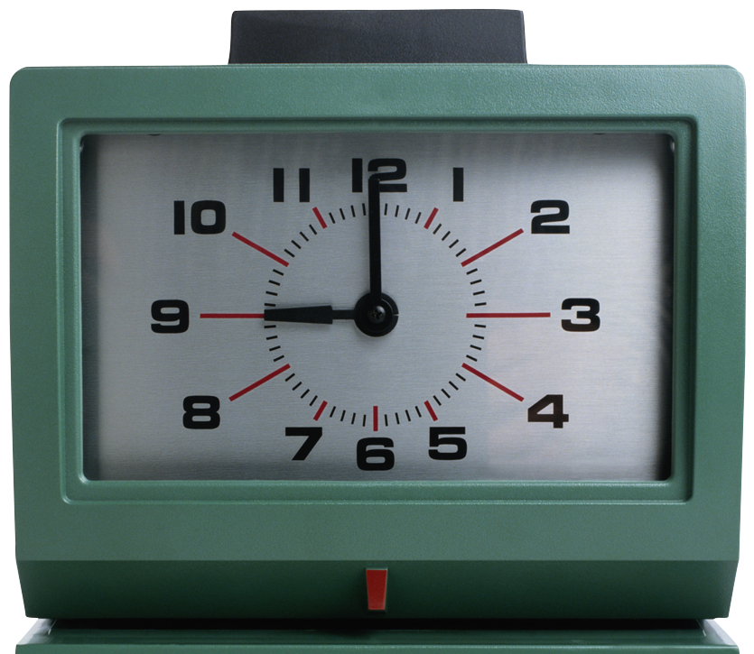
Speaker Instructions
55 & 60 minute talks:
Includes 7 minutes for questions
Yellow card means 5 minutes left
Red card means 2 minutes left
30 & 40 minute talks:
Includes 5 minutes for questions
Yellow card means 5 minutes left
Red card means 2 minutes left
10 & 15 minute talks:
Includes 5 minutes for questions
Yellow card means 3 minutes left
Red card means 1 minutes left
When timer sounds NO TIME LEFT!!

Slide 11
Hands-On Sessions
Have your computer ready to go!
Install a VNC viewer; Real VNC is recommended
Bring a power supply for US outlets
Bring an ethernet port or (tested) network adaptor to get on the wired network
Username, password and IP address behind your name badge (don’t lose this!)
For all hands-on sessions:
Green dot = Guggenheim (turn off wireless here!)
Yellow dot = Keith Spalding 4th floor
Group presentations on Friday!

Slide 12
General Information
Auditorium is not locked, so leave items at your own risk.
Complimentary internet is included at the Sheraton/Westin
We will NOT reimburse you for internet charges, so check your receipt!
Travel reports are to be submitted AFTER you return home
Travel Reports must include:
Completed reimbursement form (included in guidelines)
Original receipts
Working FAX number
Reminders:
No food/drink – except water - in the auditorium!
Silence your cell phones and laptops!

Slide 13
2016 Sagan Postdoctoral Program
For independent research related to the goals of the Exoplanet Exploration Program
Discovery and Characterization of
planetary systems and Earth-like planets
around nearby stars
Observational, theoretical, or Instrumental
2016 applications due Nov. 5, 2015
Information available next month
http://nexsci.caltech.edu/sagan/fellowship.shtml

Slide 14
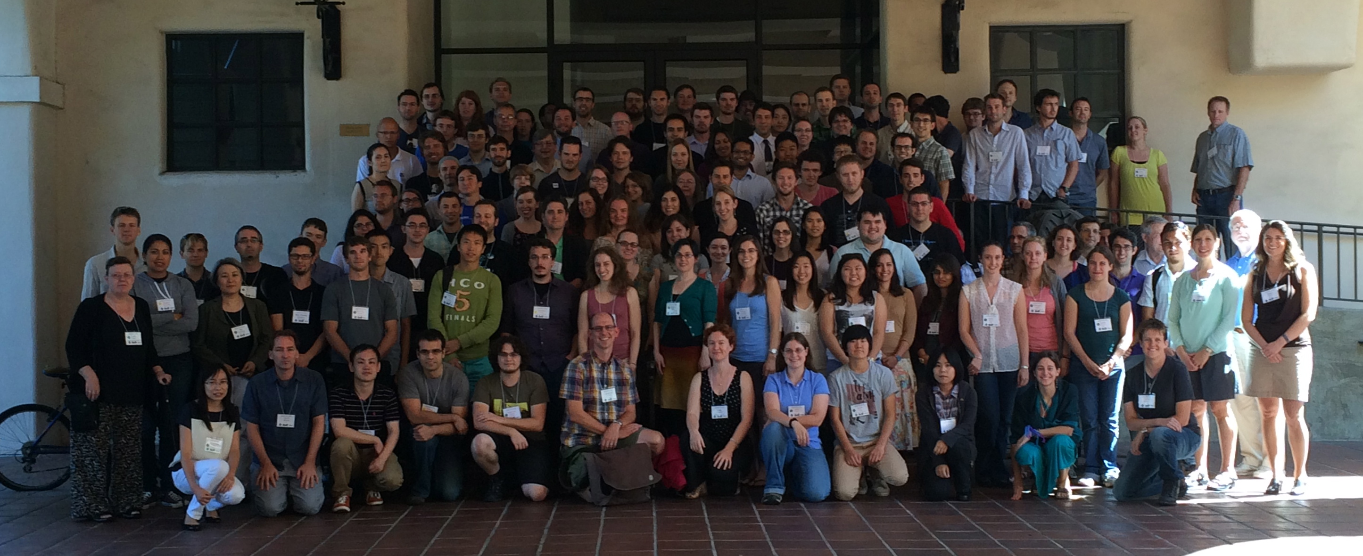
Let’s Get Started!!
Sagan Summer Workshop Class of 2014
Have Fun and Enjoy the Workshop!!

