Slide 1
Capturing Footage of Young Jovian Worlds
Jason Wang (Caltech)
As part of the Gemini Planet Imager Exoplanet Survey

Slide 2
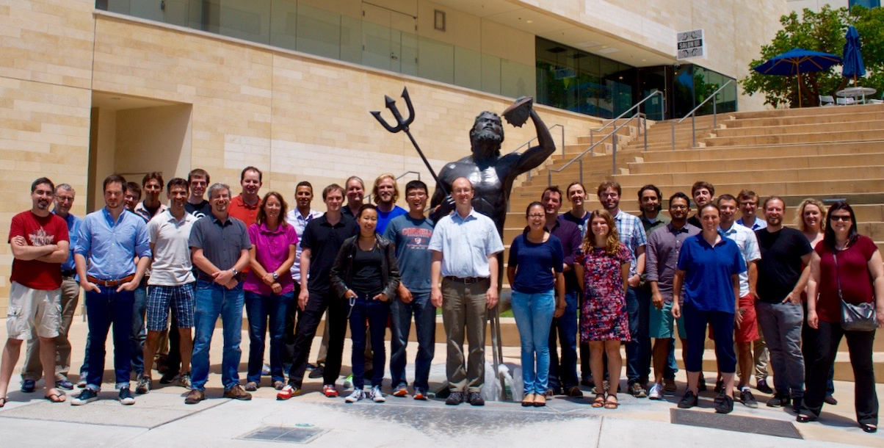
The GPIES Team

Slide 3
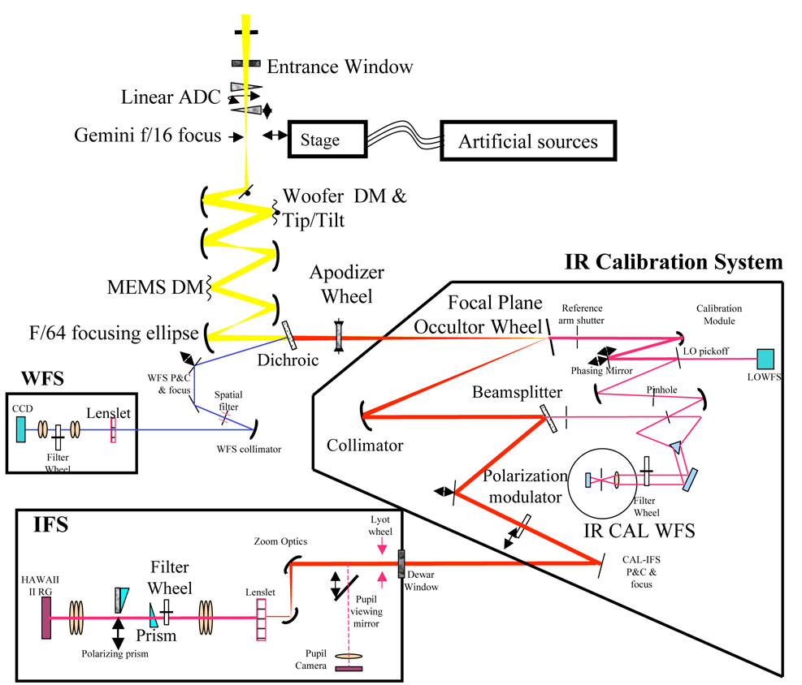
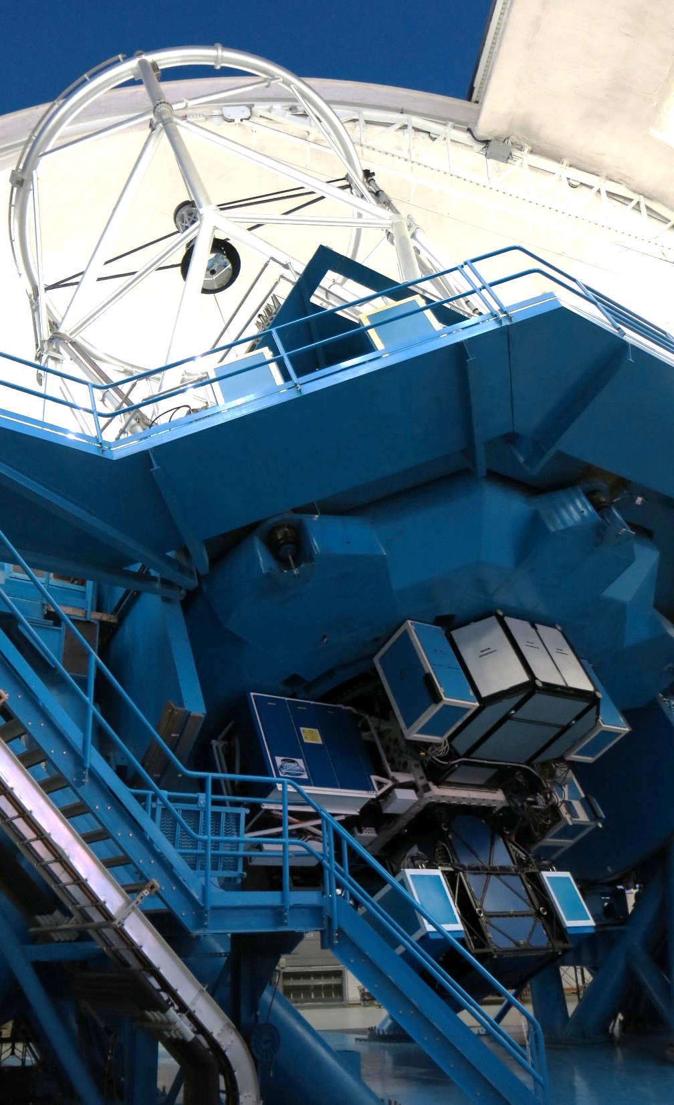
The Gemini Planet Imager

Slide 4
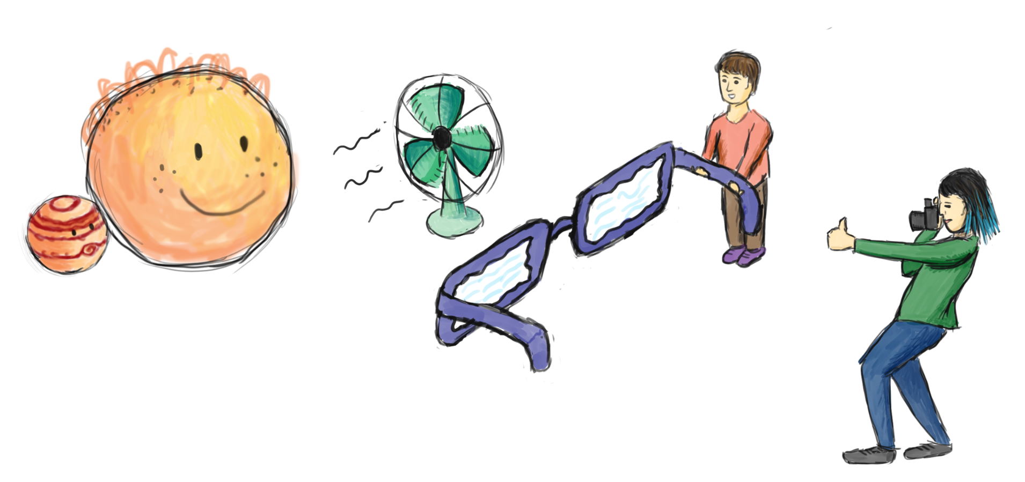
The Gemini Planet Imager

Slide 5
Integral Field Spectrograph

Slide 6
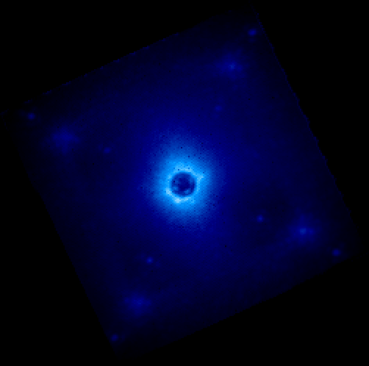
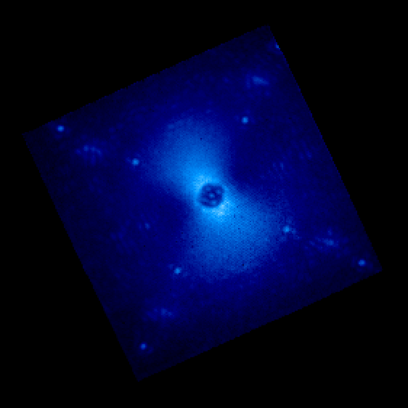
Spectral Datacubes Can you find the planet?
???
β Pic b: ~10⁻⁴ contrast
51 Eri b: ~10⁻⁶ contrast
GPI Data Reduction Pipeline (open-source on Github)
Leads: Marshall Perrin, Jérôme Maire, Kate Follette

Slide 7
Stellar PSF Subtraction
Use data taken at other times and wavelengths to model the star
Diversity of Images in Time
Diversity of Images in Wavelengths
Angular Differential Imaging (ADI)
Spectral Differential Imaging (SDI)
GPI data on Beta Pictoris b
Credit: Christian Marois

Slide 8
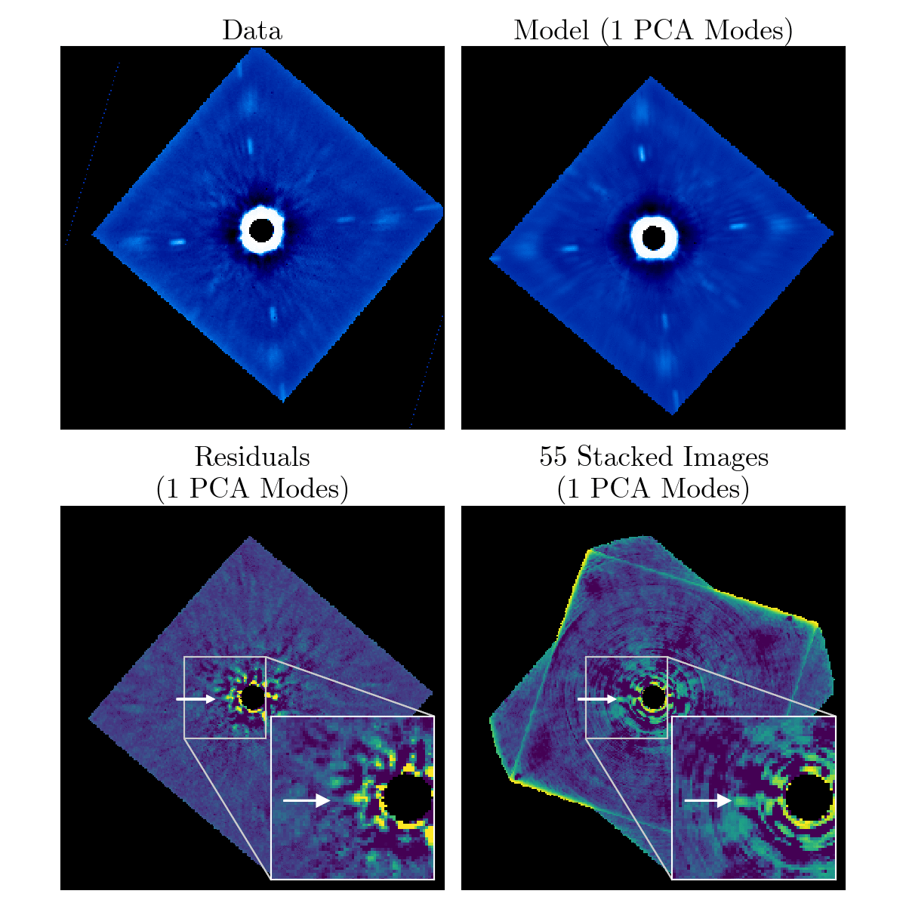

Slide 9
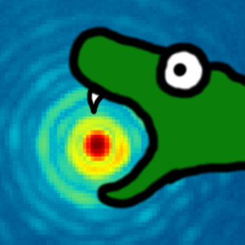
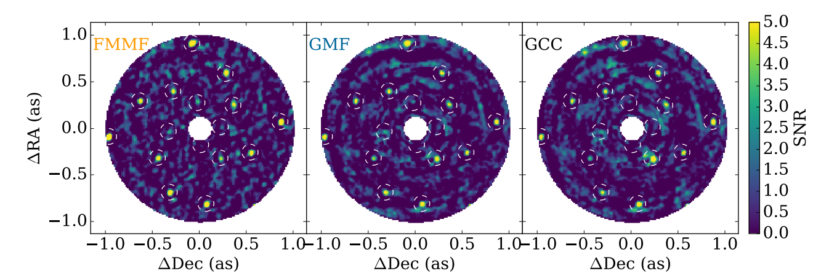
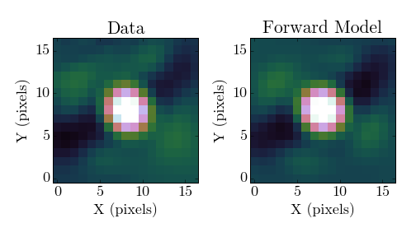
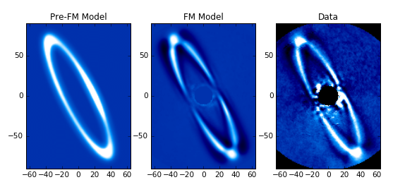
Planet Detection
(Ruffio+ 2017)
pyKLIP
Planet Astrometry & Spectrophotometry
(Wang+ 2016, Greenbaum+ 2018)
Keck NIRC2
Disk Forward Modelling
(Arriaga+ in prep, Esposito+ 2018.)
Wang+ 2015

Slide 10
The GPI Exoplanet Survey (GPIES)
Survey of 600 young, nearby stars
Young: < 300 Myr years
Dinosaurs or younger
Nearby: < 100 pc
Lots of data!

Slide 11
The GPIES Data Cruncher
Wang+ 2018
Leads: Jason Wang & Pauline Arriaga

Slide 12
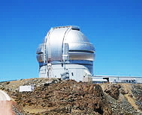
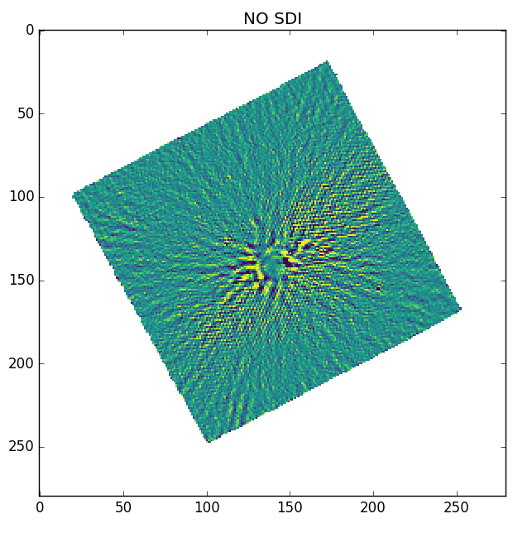
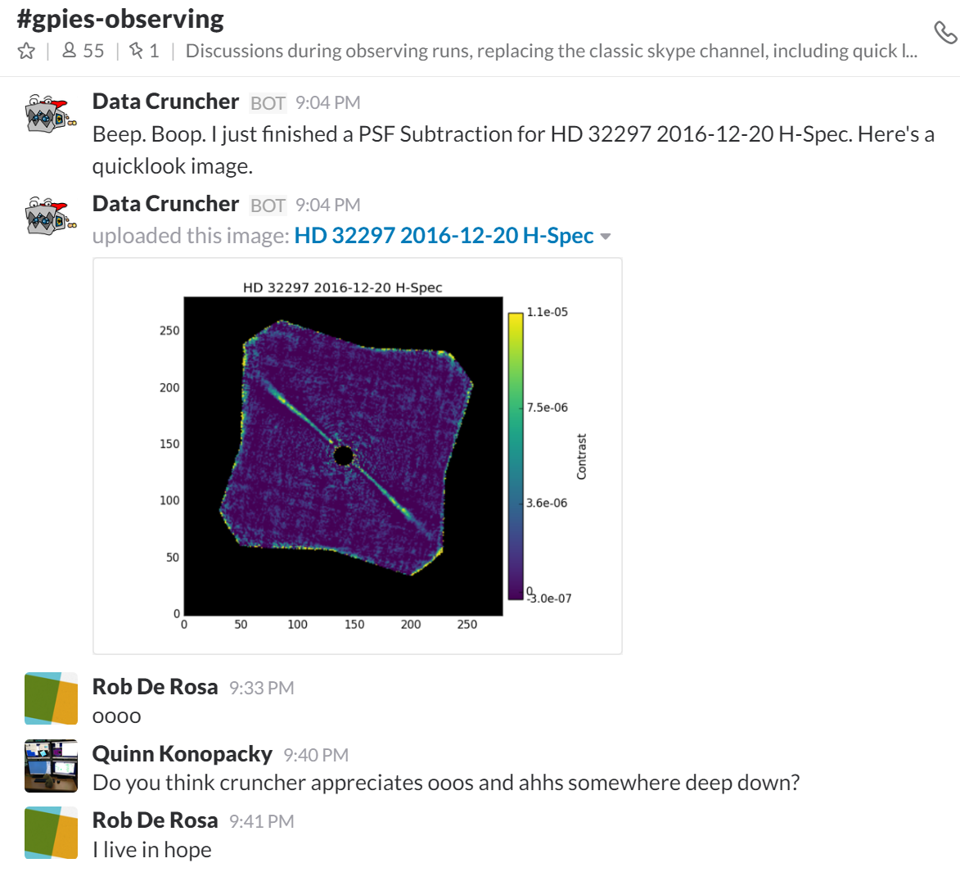
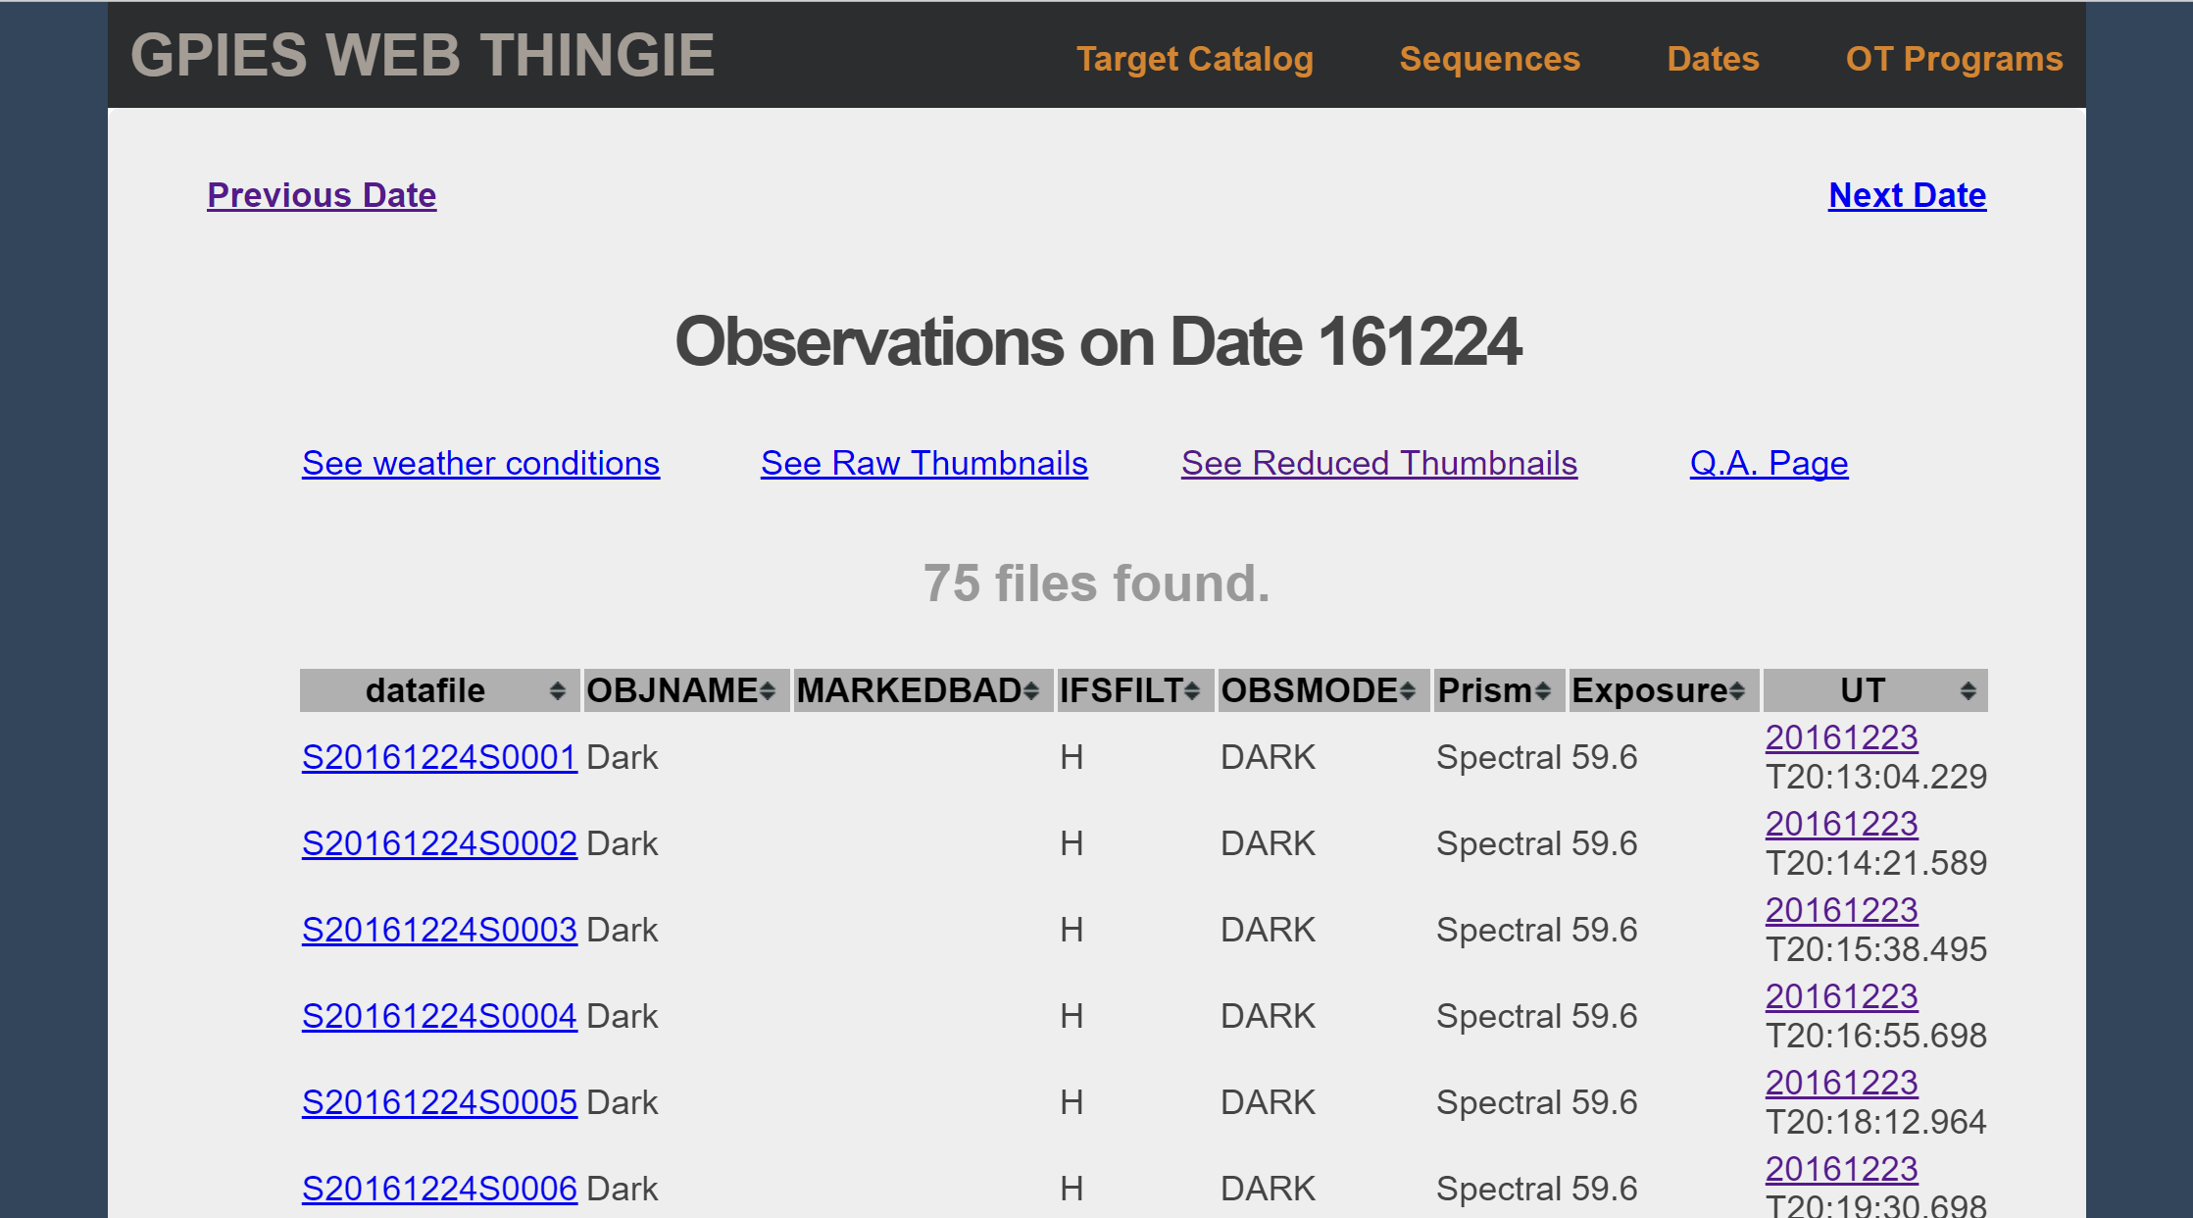
The GPIES Data Infrastructure
Summit
Quicklook + Logging
Dropbox
Stored and Synced
Data Cruncher
Automated Data Processing
Supercomputers
Reprocess all data
Auto planet detection
Query Data + DQ
Chatbot
Realtime
Reductions
Autofill Docs
MySQL DB
Metadata Logged
Web Frontend (Flask + Jinja2)
Wiki
Collaborative Docs
Slack
Collaboration Chat
DB Web Frontend
Realtime Quicklook
With: Marshall Perrin, Dmitry Savransky, Pauline Arriaga, Jeff Chilcote, JB Ruffio, Christian Marois
Wang+ 2018

Slide 13
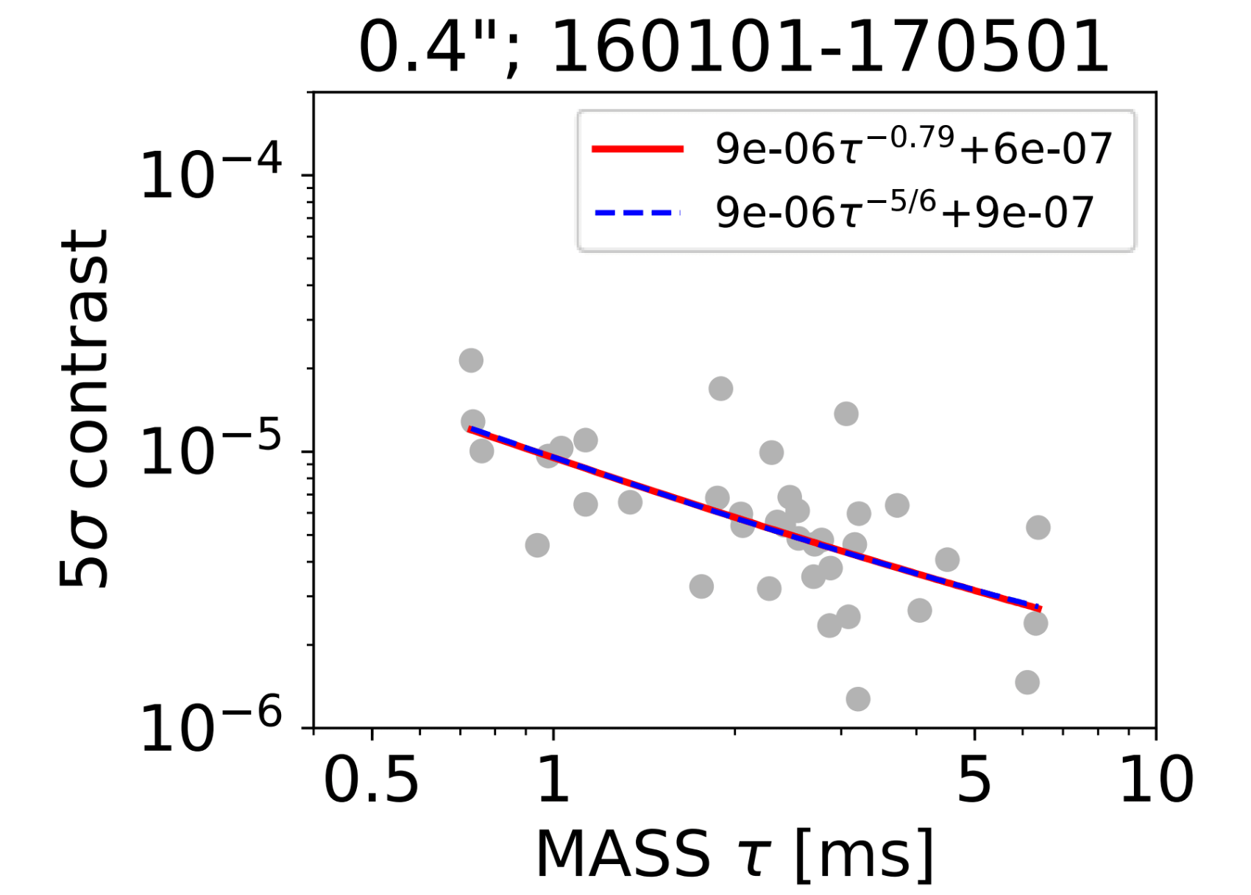
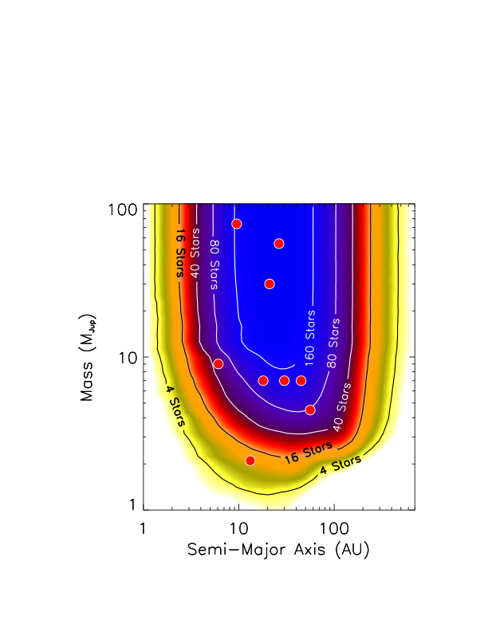
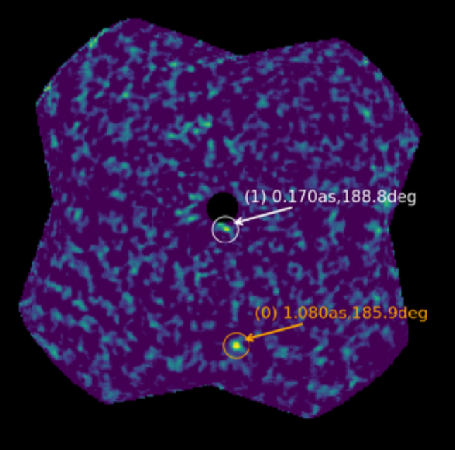
Benefits of The Data Infrastructure
Realtime Data Reduction
Instrument Performance
(Bailey+ 2016)
Unbiased Planet Population Constraints
(Nielsen+ in prep)
Automated Planet Detection
(Ruffio+ 2017)

Slide 14
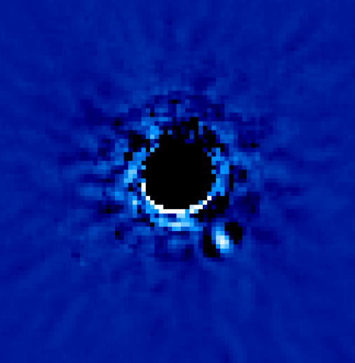
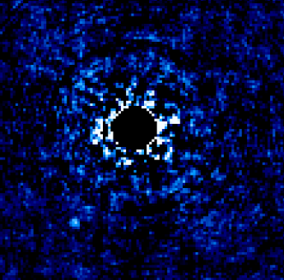
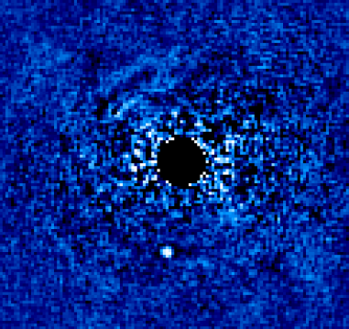
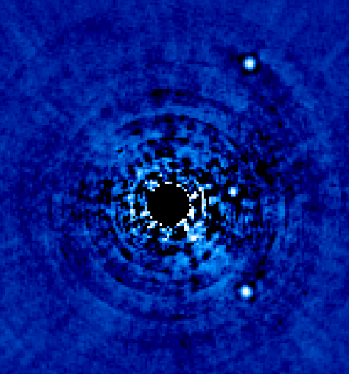
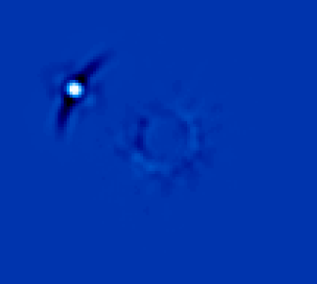
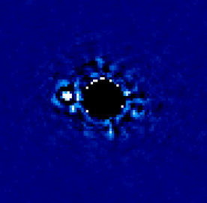
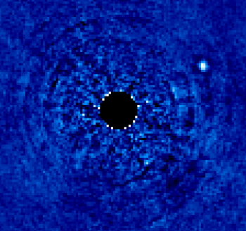
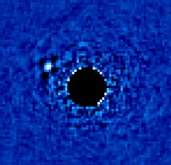
The GPIES Haul
Exoplanets
β Pic b
HD 95086 b
51 Eri b
HR 8799 cde
Brown Dwarfs
PZ Tel B
HD 984 B
HR 2562 B
HD 206893 B

Slide 15
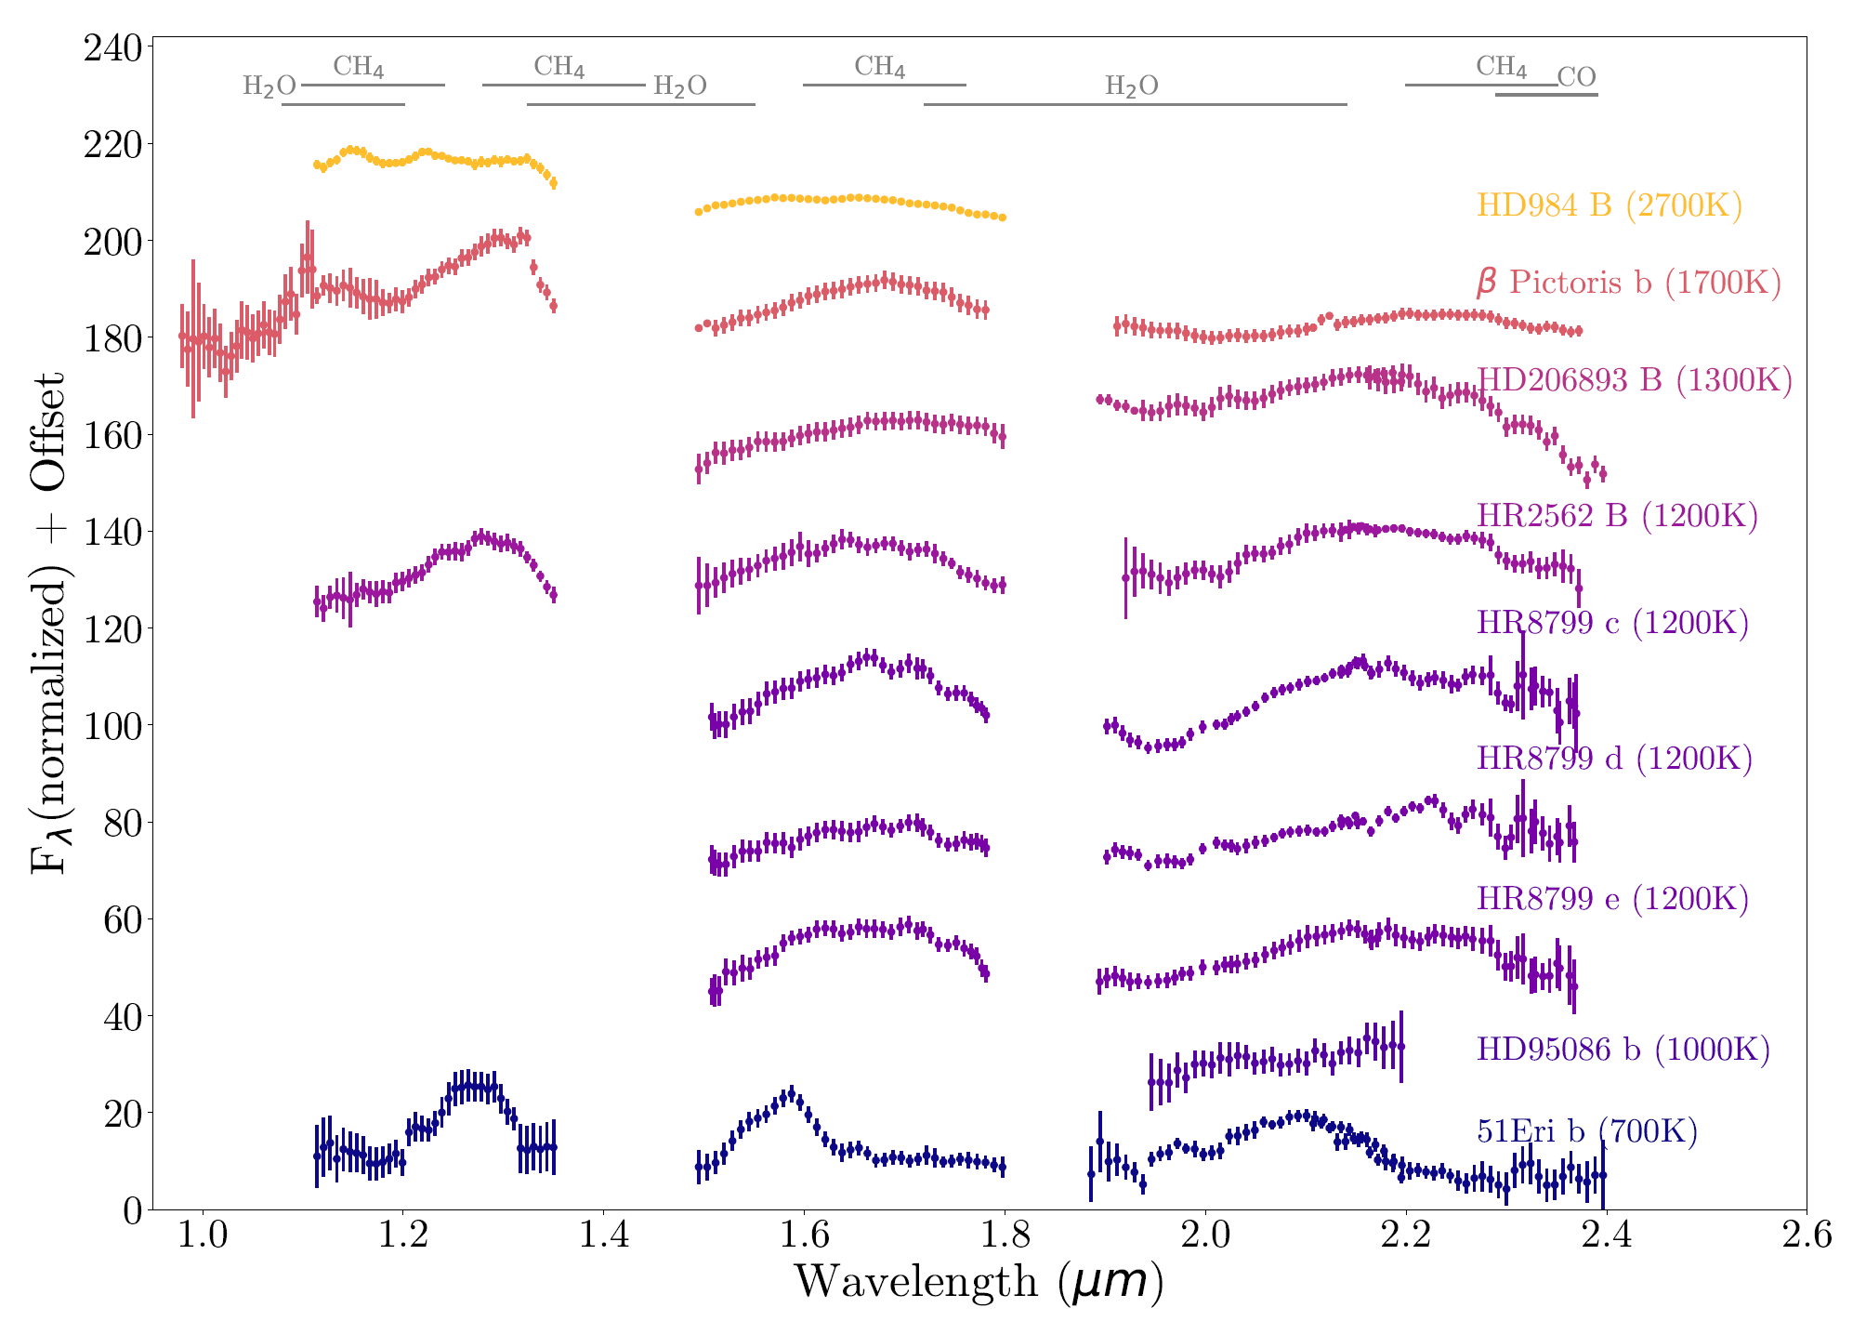
GPIES Spectral Library
Image Credit: Julien Rameau

Slide 16
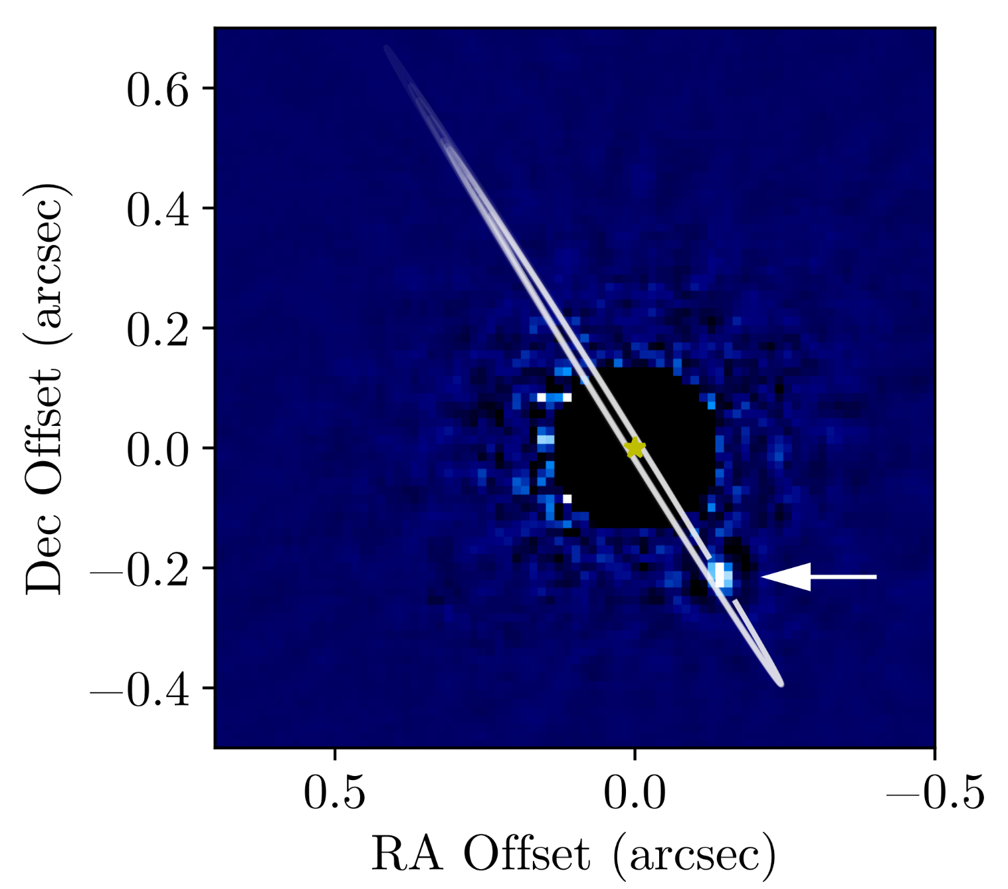
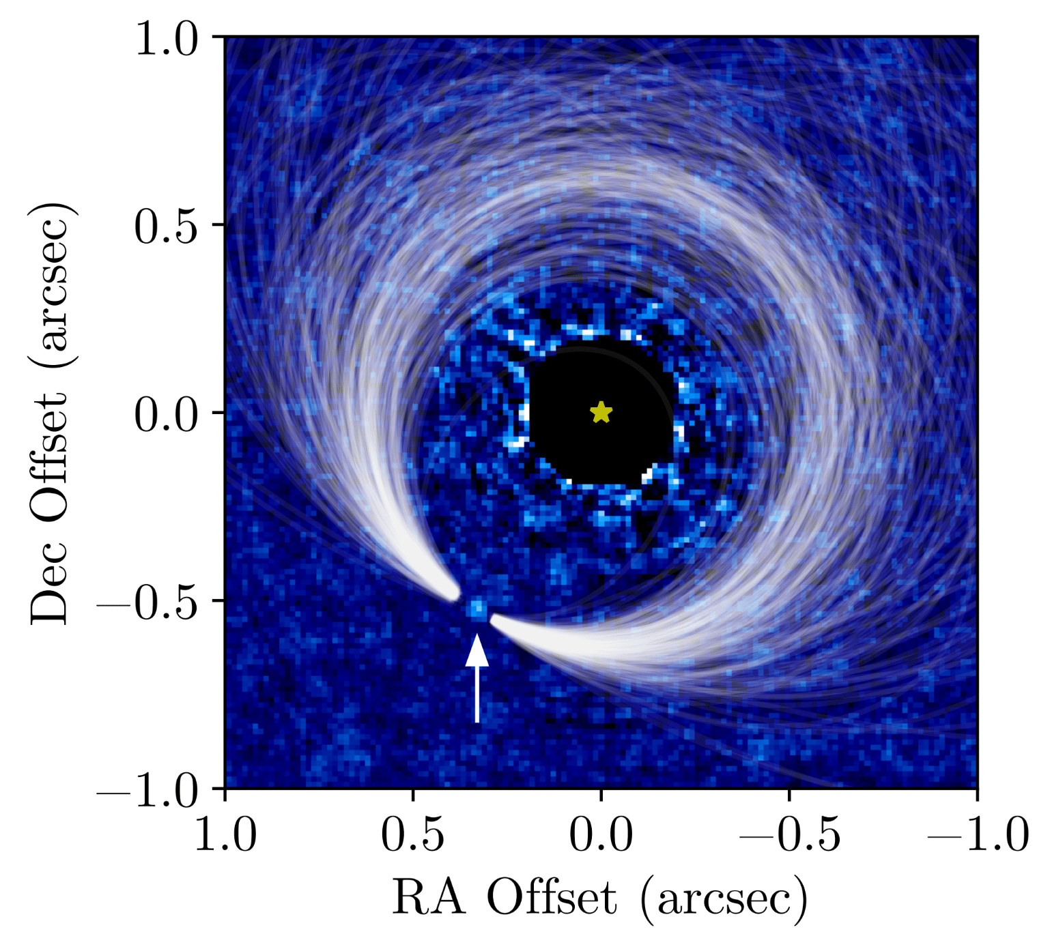
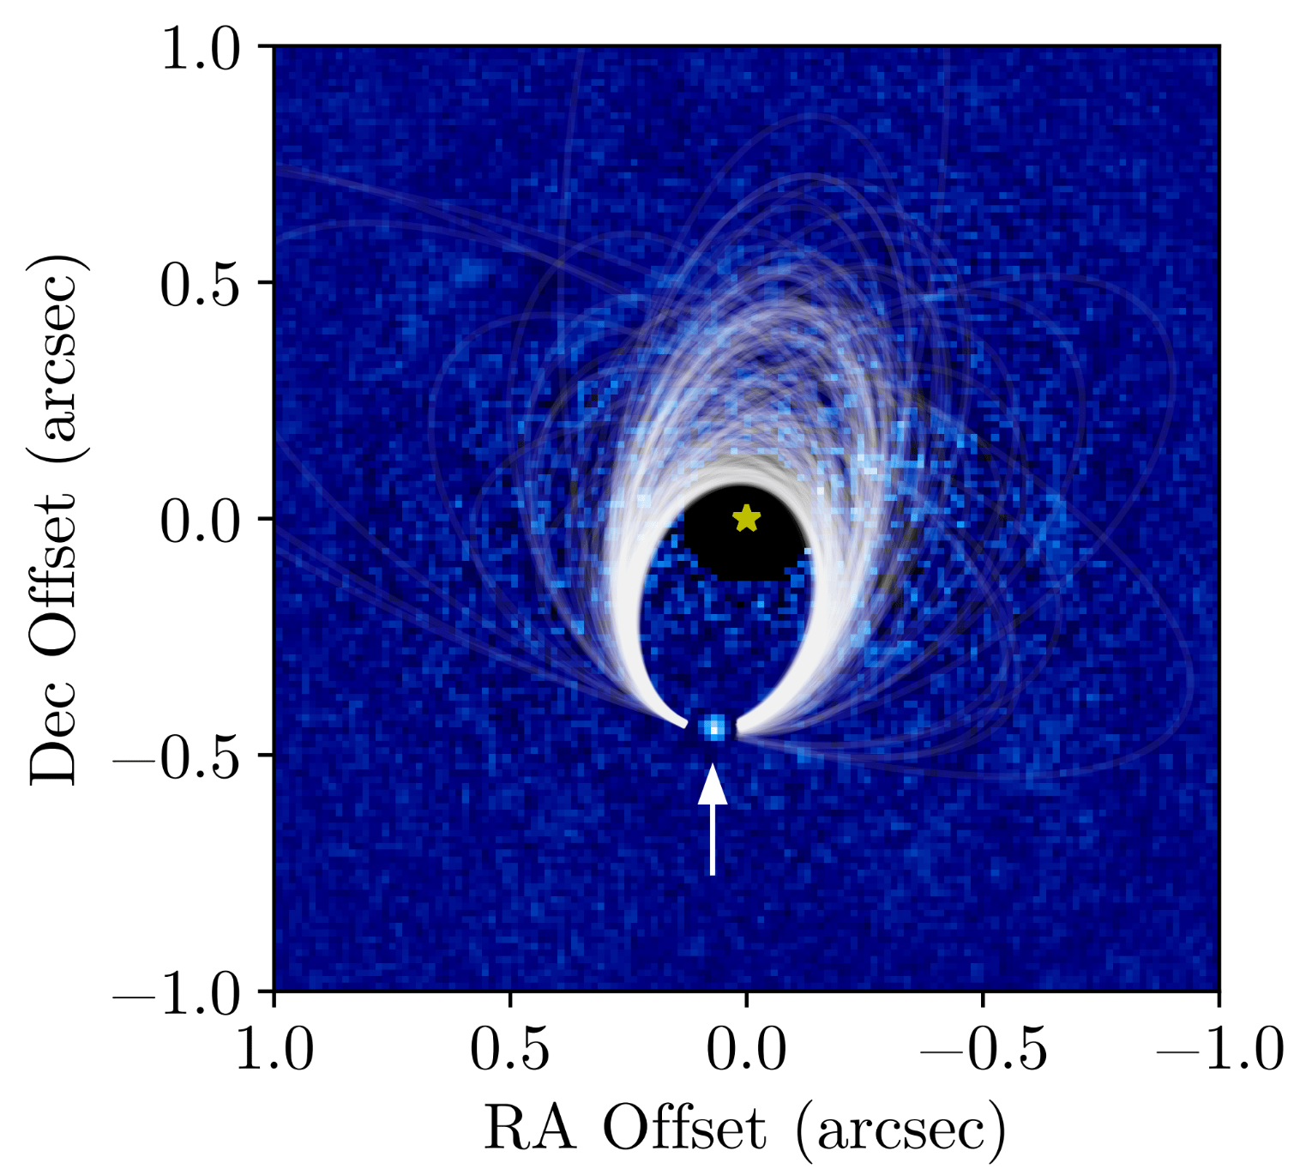
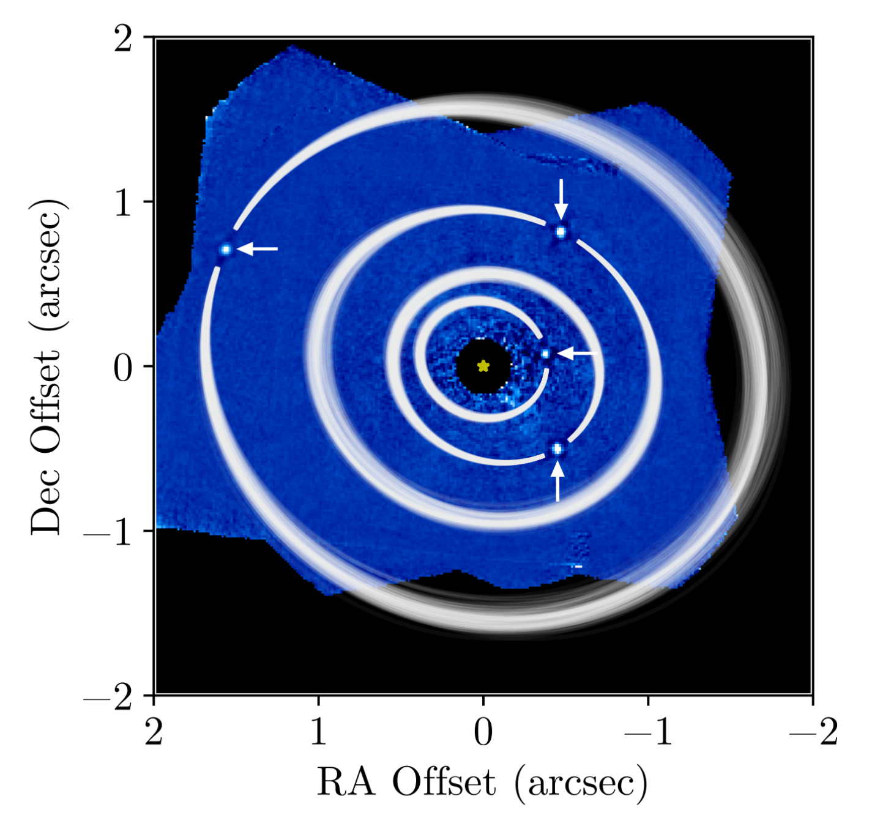
Orbits of Imaged Planets
β Pic b
Wang+ 2016
HD 95086 b
Rameau+ 2016
51 Eri b
De Rosa+ 2015
HR 8799 bcde
Wang+ 2018

Slide 17
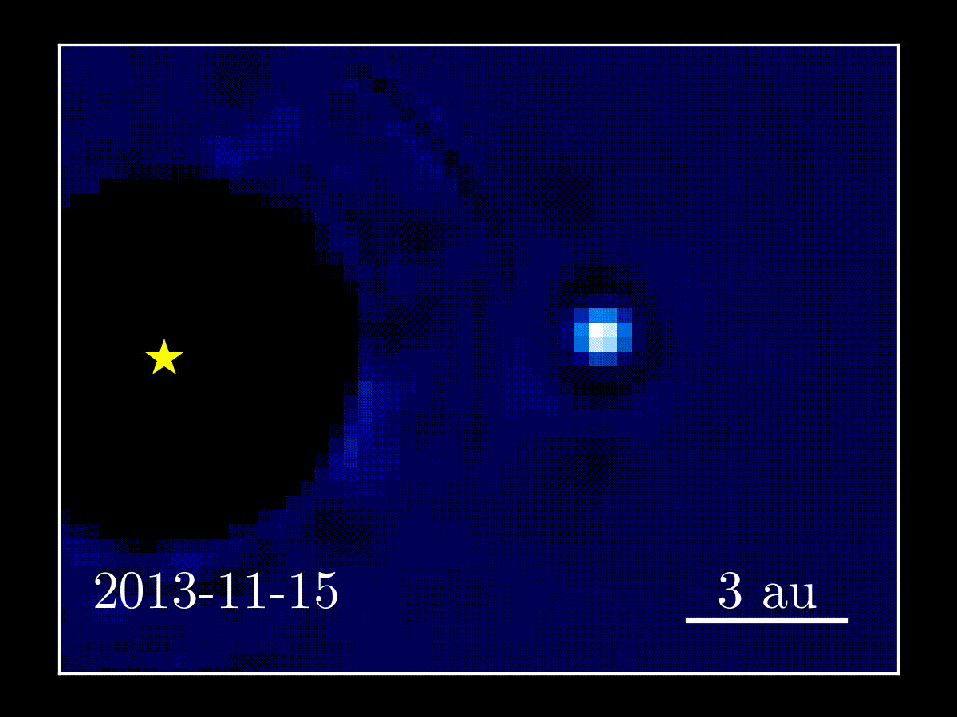
β Pic b

Slide 18
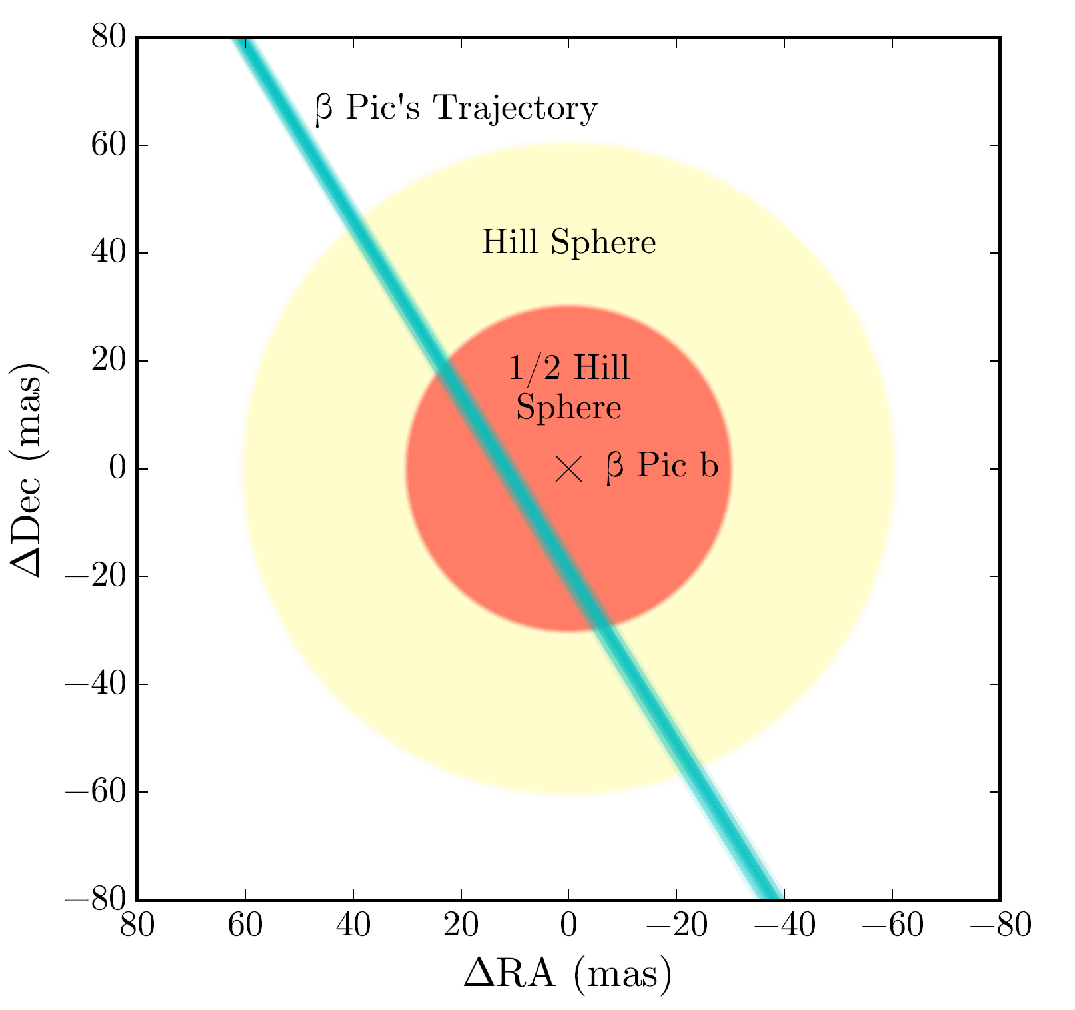
Hill Sphere Transit
2017 Apr 3 ± 7
2017 June 20 ± 9
Hard to see from ground
2017 Aug 31 ± 11
2017 Nov 12 ± 13
2018 Jan 29 ± 15
Wang et al. 2016

Slide 19
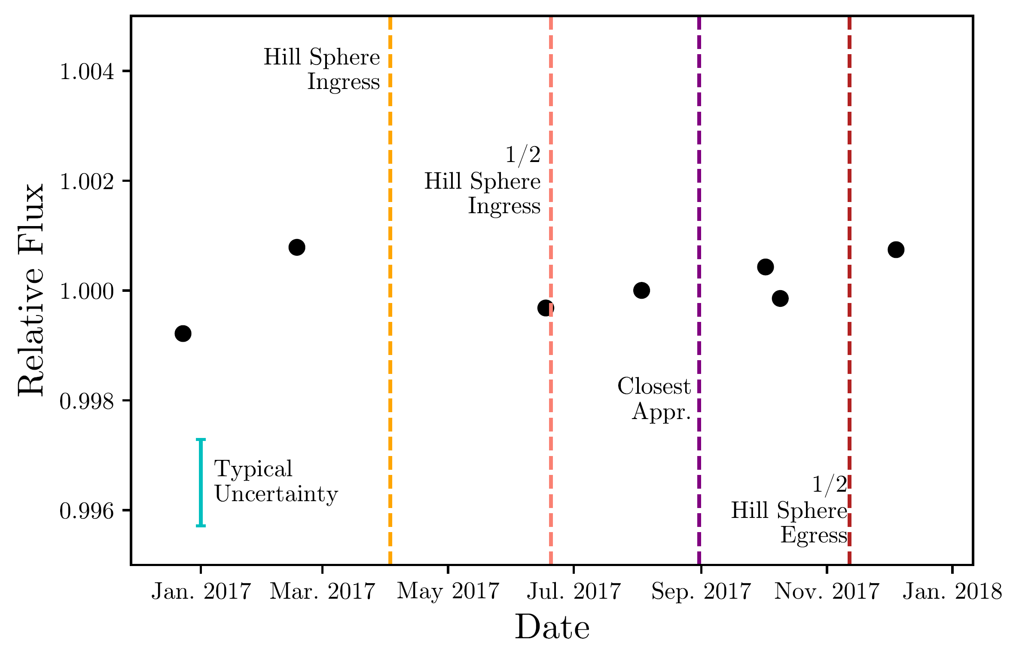
Hill Sphere Transit with HST
Nothing :(
Wang+ in prep

Slide 20
HR 8799

Slide 21
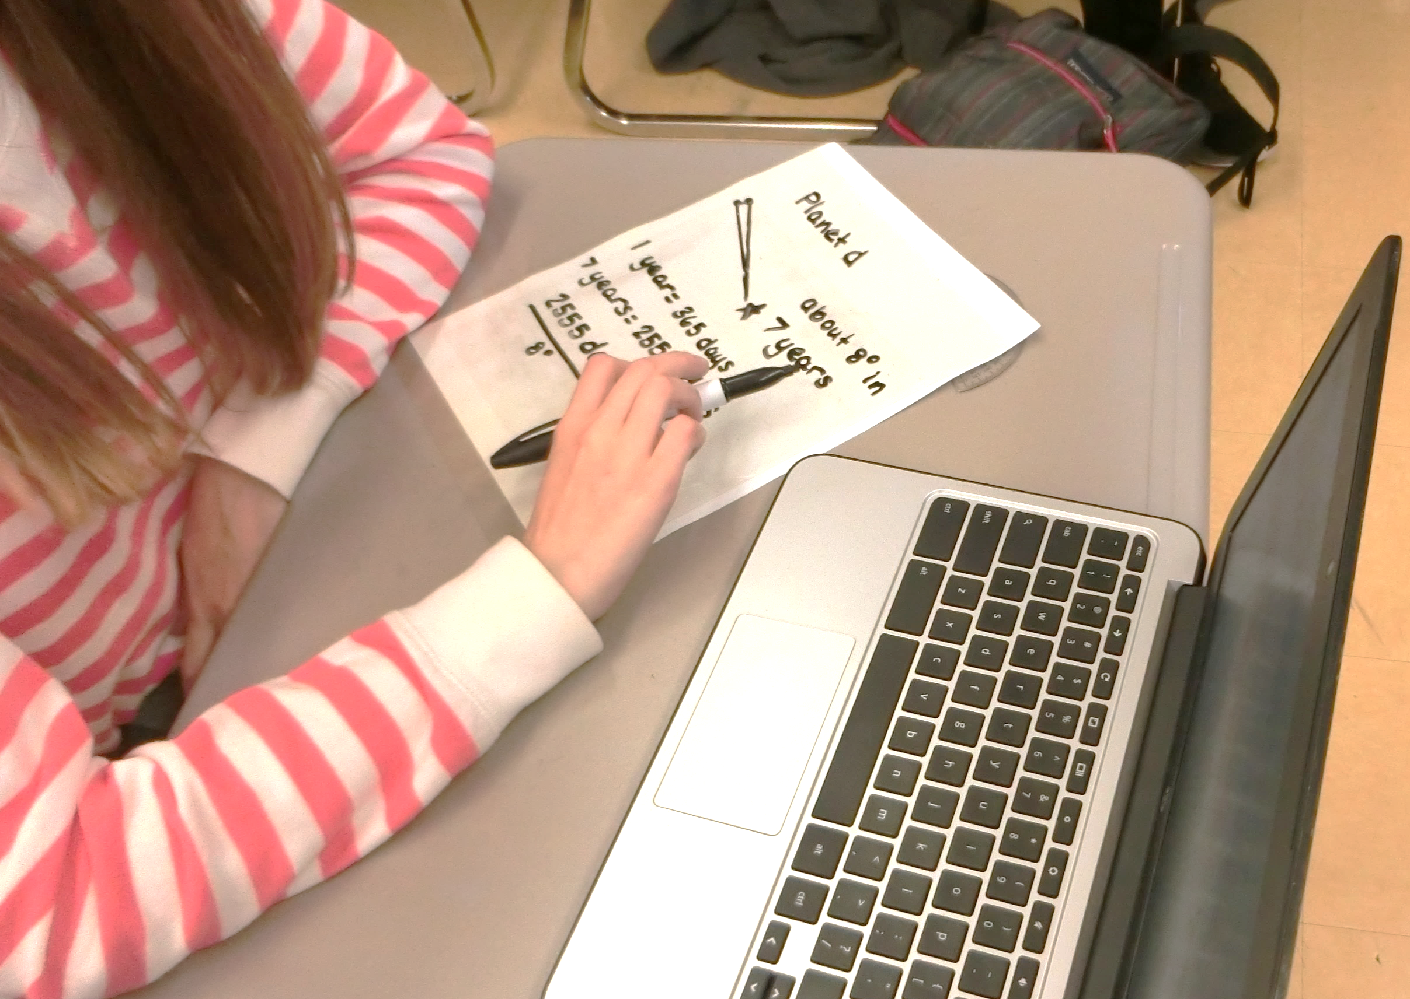
High School Astrometry

Slide 22
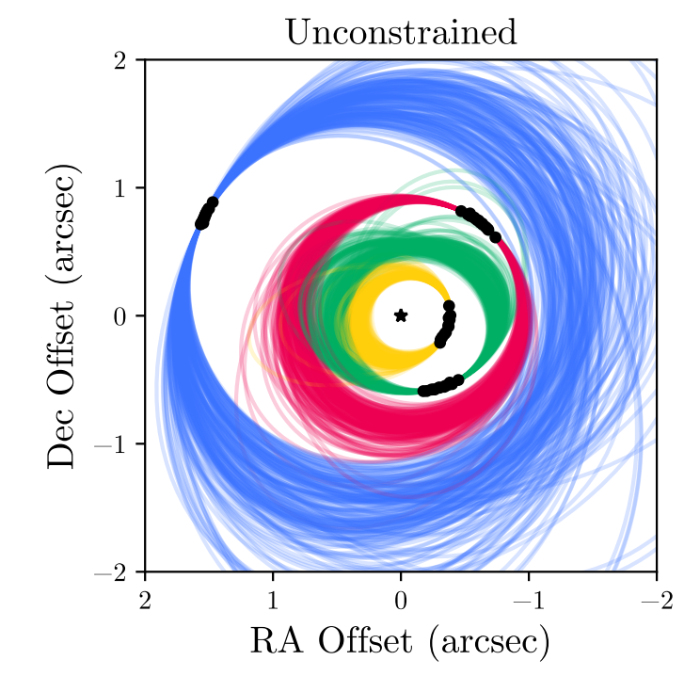
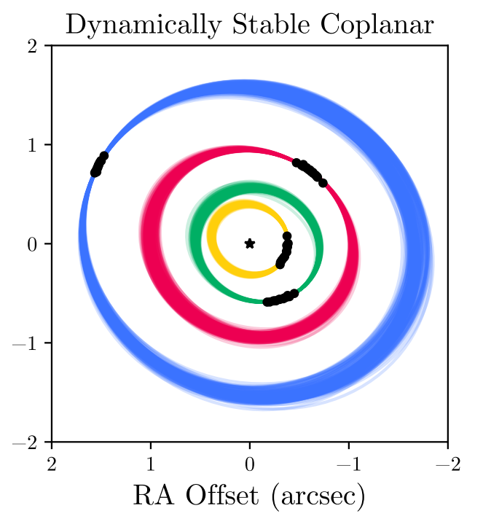
GPI + Keck Orbital Solutions
1 mas astometry with GPI using pyKLIP package
Orbit posteriors from MCMC orbit fitting
Posteriors → REBOUND to look for stable orbits
Wang+ in 2018

Slide 23
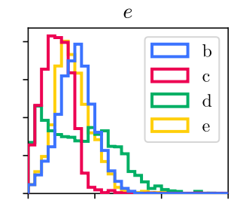
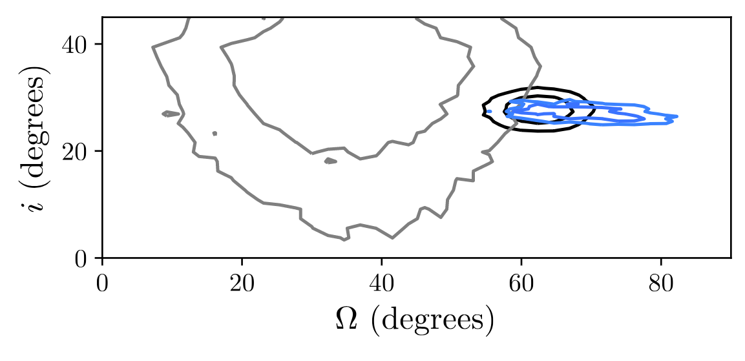
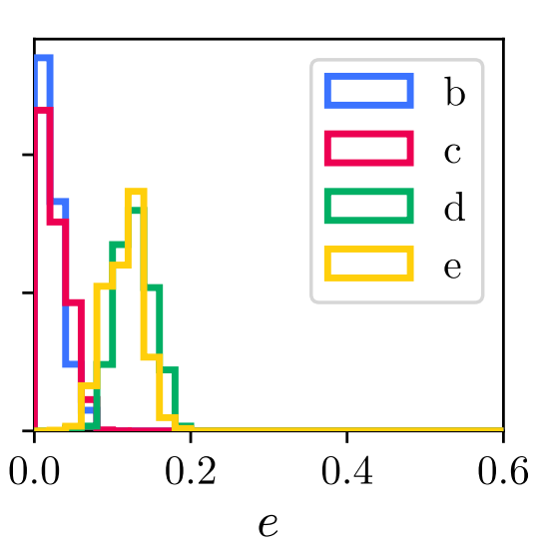
Orbital Constraints
Unconstrained
Planet-disk Coplanarity
SMA+ALMA
Planets (GPI)
Herschel
Stable Coplanar
Wang+ 2018

Slide 24
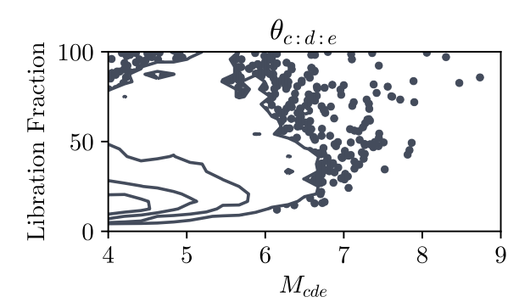
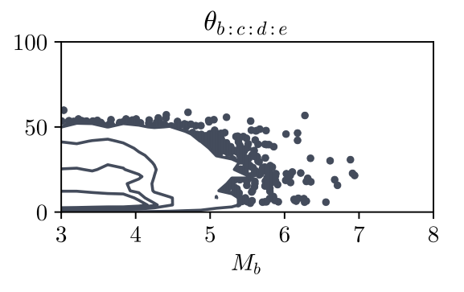
Orbital Resonances
Planets d & e (2:1)
Planets c & d (2:1)
Planets c, d, e (4:2:1)
Planets b, c, d, e (8:4:2:1)
Wang+ 2018

Slide 25
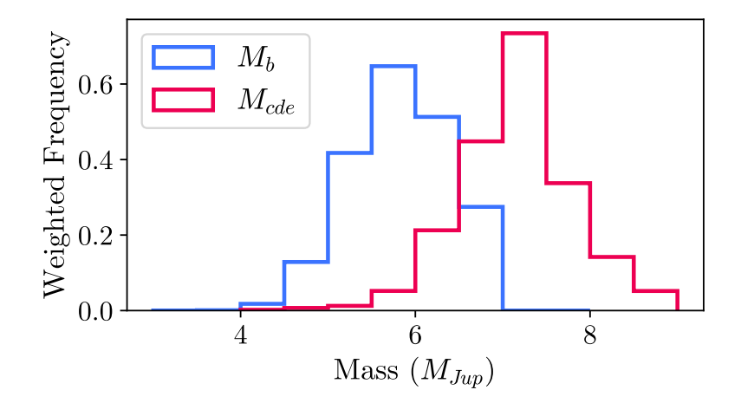
Dynamical Mass Constraints
Dynamical Stability + Luminosity + Hot Start Evolutionary Models
$$M_{cde}=7.2±0.7 M_{Jup}, M_{b}=5.8±0.5 M_{Jup}$$
Wang+ 2018

Slide 26
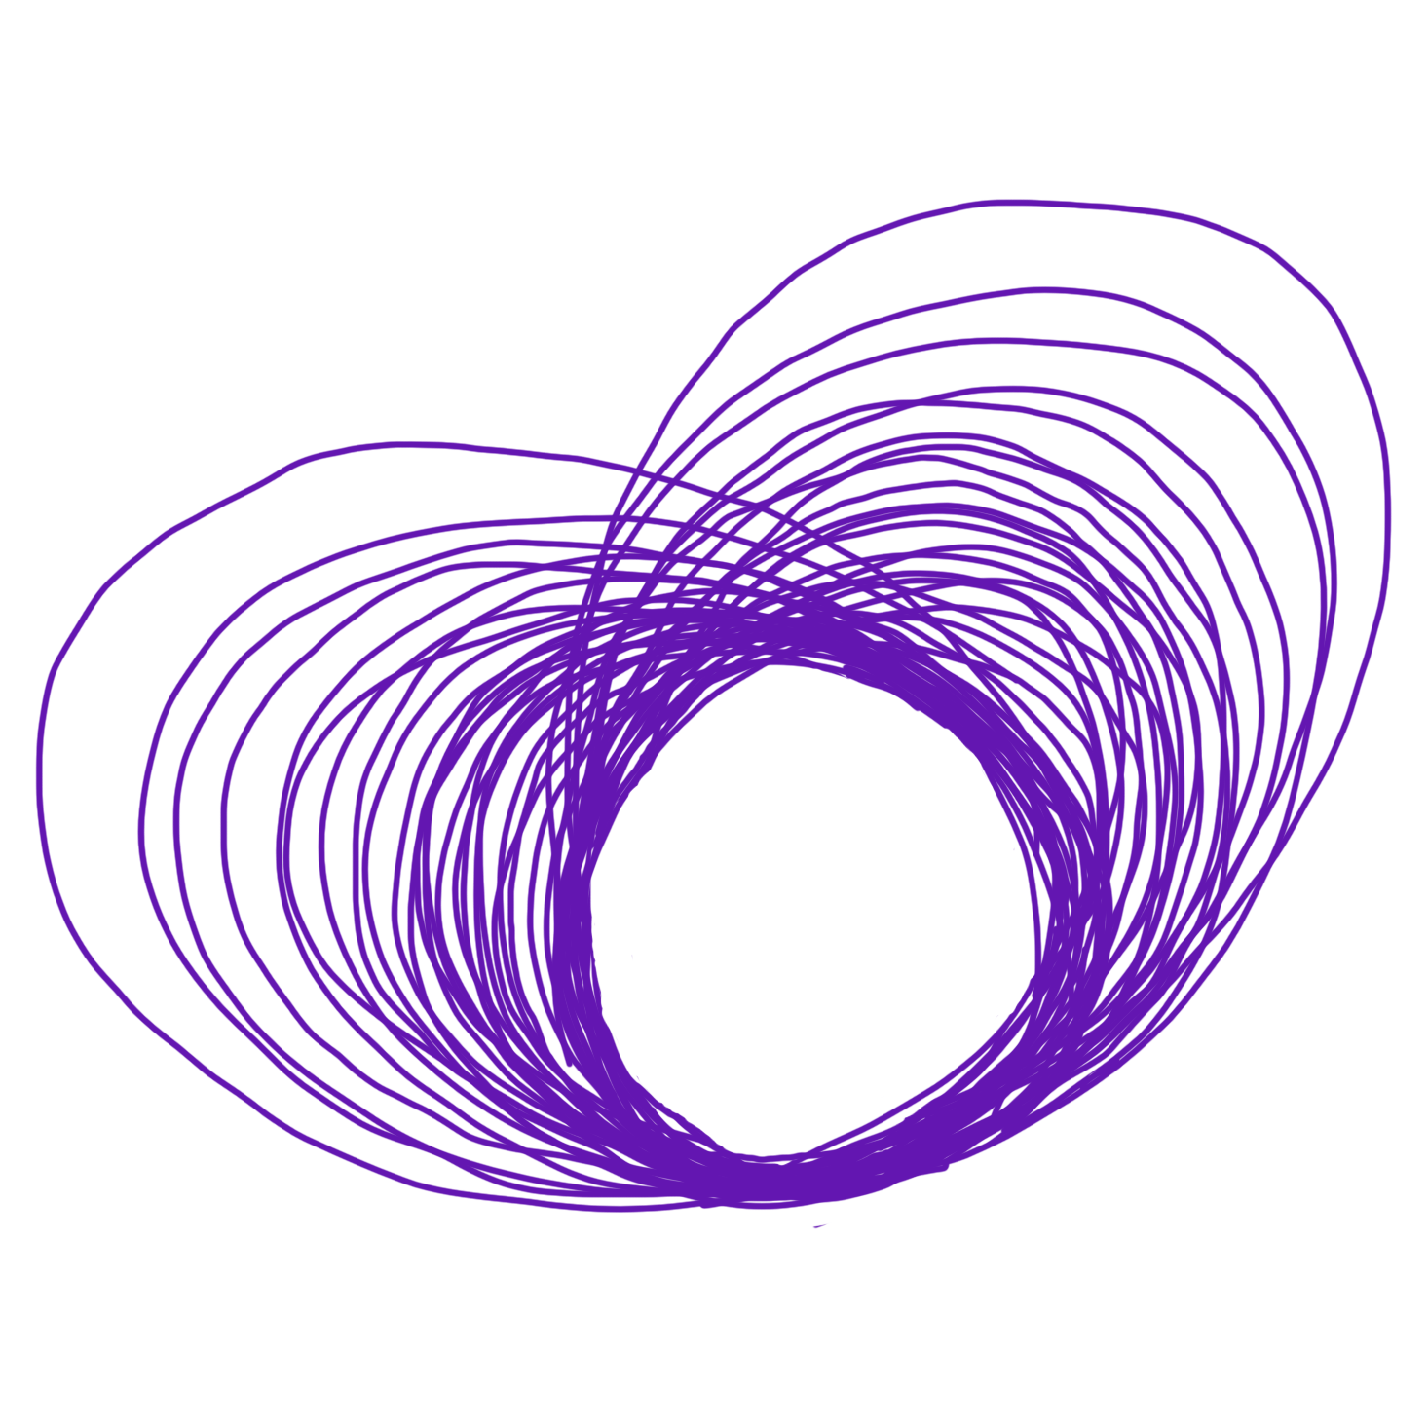
Software Development
Data Crunching for other exoplanet surveys
pyKLIP for other instruments
orbitize!
Direct imaging orbit fitting (release soon!)
w/ Sarah Blunt, Henry Ngo,
Isabel Angelo, among others

