Slide 1
Interpretation of two microlensing events
Y. K. Jung
OGLE, MOA, KMTNet collaborations
Notes:
Hello everyone. (Good afternoon ladies and gentlemen)
I am glad to present our recent work.
I would like to talk about the analyses and results of two microlensing events.

Slide 2
What We did
Analyze two microlensing events
OGLE-2016-BLG-0733
OGLE-2016-BLG-1003
Notes:
We analyze two microlensing events, OGLE-2016-BLG-0733 and OGLE-2016-BLG-1003.
These two events are quite interesting, because they show some characteristic features different from single-lensing events.
Actually, we initially thought that they are planetary microlensing events.
However, it turned out that they are not the planetary events.

Slide 3
OGLE-2016-BLG-0733
Deviate from the symmetric form of an event produced by a single mass
Begin with binary-lens
model
Notes:
At first, I will talk about the result of 0733.
As shown in the figure, the light curve shows a long-term asymmetric deviation.
We try to find the solution using a single-lens model with parallax effects, but the single-lens model could not explain the light curve.
Because such long-term deviations are consistent with a binary lens, we model the light curve using the binary lens interpretation.

Slide 4
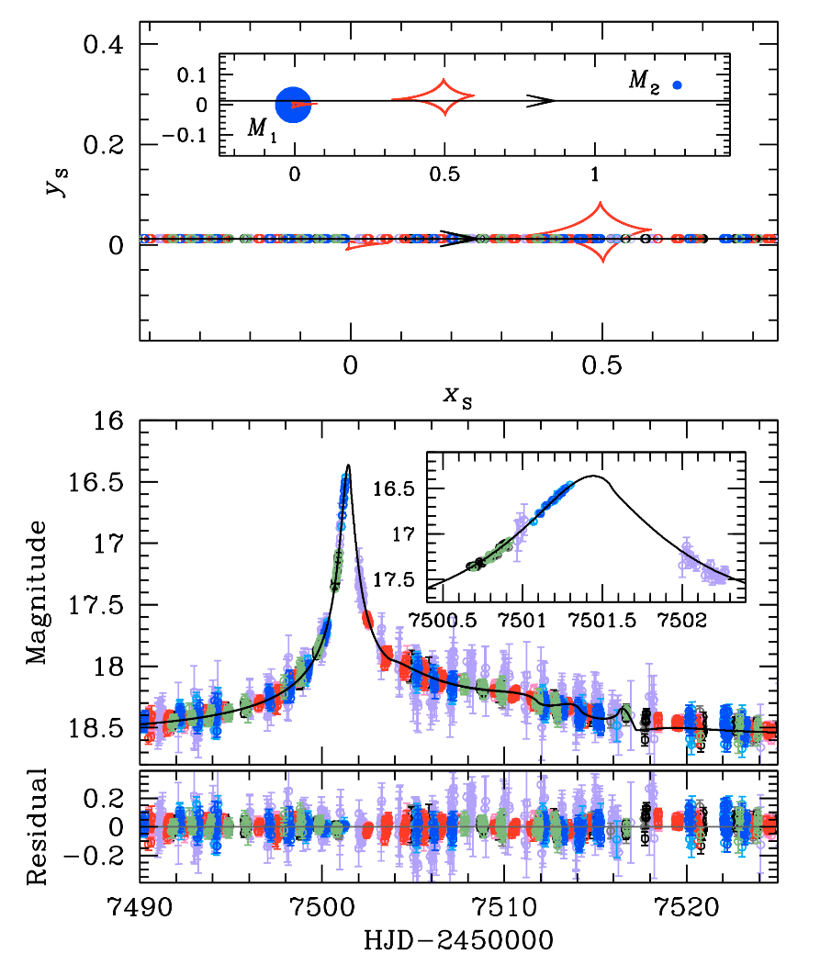
Extremely unlikely!
$$θ_{E} \sim 0.05 mas$$
$$μ_{rel} \sim 0.7 mas {yr}^{−1}$$
$$parameters$$ | values
$$t_{0} ({HJD}^{′})$$ | $$7501.570±0.004$$
$$u_{0}$$ | $$0.013±0.001$$
$$t_{E} (days)$$ | $$27.838±0.847$$
$$s$$ | $$1.281±0.007$$
$q$ $({10}^{−3})$ | $$3.912±0.258$$
$$α (rad)$$ | $$0.051±0.001$$
$$ρ_{∗} ({10}^{−3})$$ | $$8.317±0.392$$
?
Notes:
From the grid search, we find one local minimum.
By refining the local solutions, we find that the best-fit model has a planetary mass.
As you see, the fit appears quite good.
However, there are some residuals near the exit of the planetary caustic.
To fit the residuals, we also test the models including higher-order effects, but the higher-order effects cannot improve the fit.
At that time, we realize that the solution is quite strange.
One important clue is that the rho is unusually large considering that the source is a dwarf.
This large rho results in a very small Einstein radius and very small relative lens-source proper motion.
Although not impossible, these values are extremely unlikely.

Slide 5
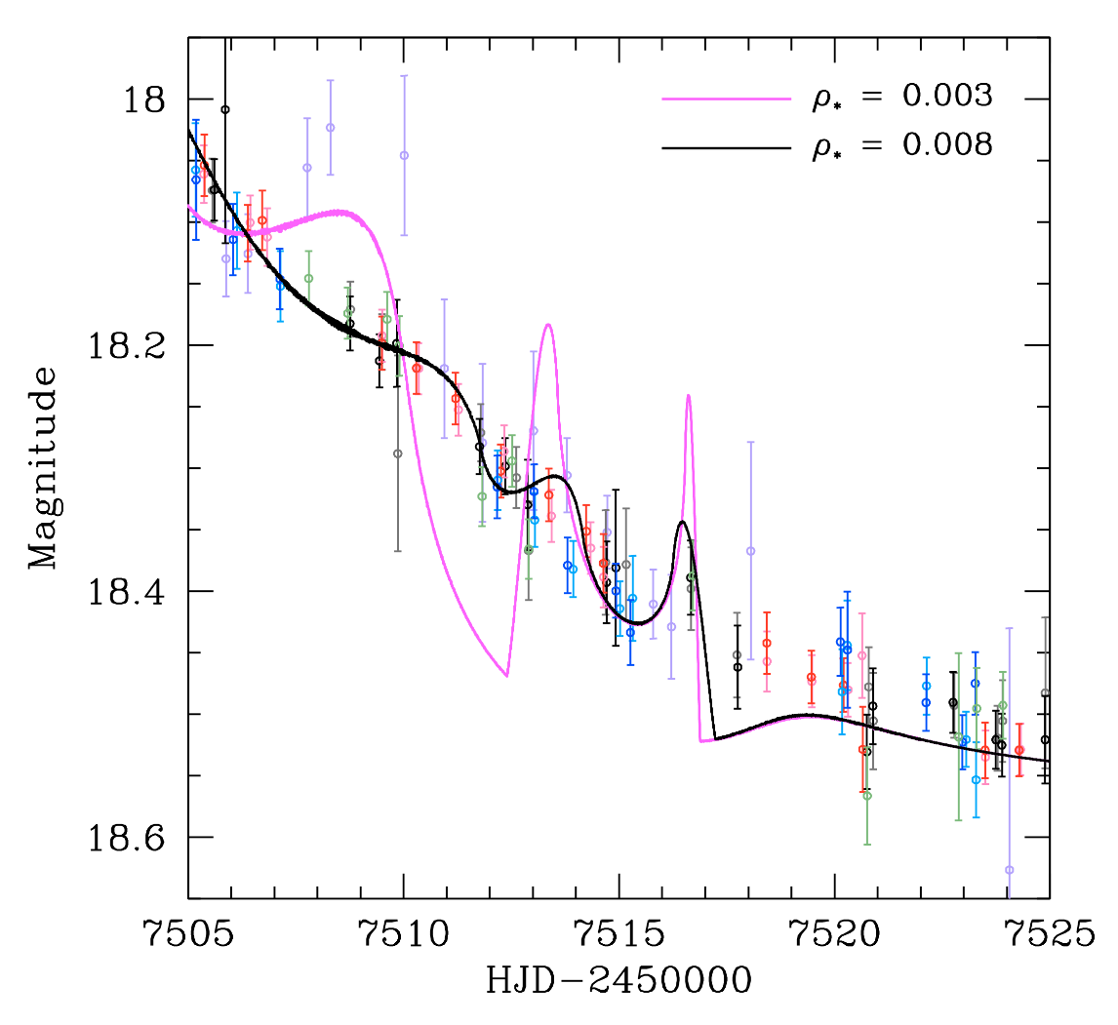
What raises the large $ρ_{∗}$
Notes:
Why the rho value is unusually large?
The answer is simple.
The rho should be large to match the smooth data to the bumpy model.
The left figure shows how the large rho decrease the magnification to fit the light curve.
To show the problem clearly, we binned the data and also present the same model with a more typical rho value.
As you see, the data are much smoother than the model for the typical rho and still smoother than the best-fit model.
Therefore, we conclude that the binary-lens model cannot be the solution, and we consider another interpretation.

Slide 6
Binary-Source Model
Find the solution by a downhill approach.
Use Markov Chain Monte Carlo method.
Set initial values based on the observed
light curve (peak time, magnification,
and duration of the event)
$$parameters$$ | values
$$t_{0,1} ({HJD}^{′})$$ | $$7501.374±0.005$$
$$t_{0,2} ({HJD}^{′})$$ | $$7507.804±0.116$$
$$u_{0,1}$$ | $$0.015±0.001$$
$$u_{0,2}$$ | $$0.365±0.033$$
$$t_{E} (days)$$ | $$14.428±0.602$$
$$q_{F,RI}$$ | $$2.078±0.201$$
$$q_{F,I}$$ | $$1.853±0.177$$
Notes:
We consider the possibility that the long-term deviation is caused by a single-lens with a binary-source.
We find that the binary-source model explains the light curve very well.
As shown in the right figure, the model precisely describes the long-term deviation that cannot be explained by the binary-lens model.
We present two light curves corresponding to the passband of each observatory, because the lensing magnification of the binary-source event can vary depending on the passbands.

Slide 7
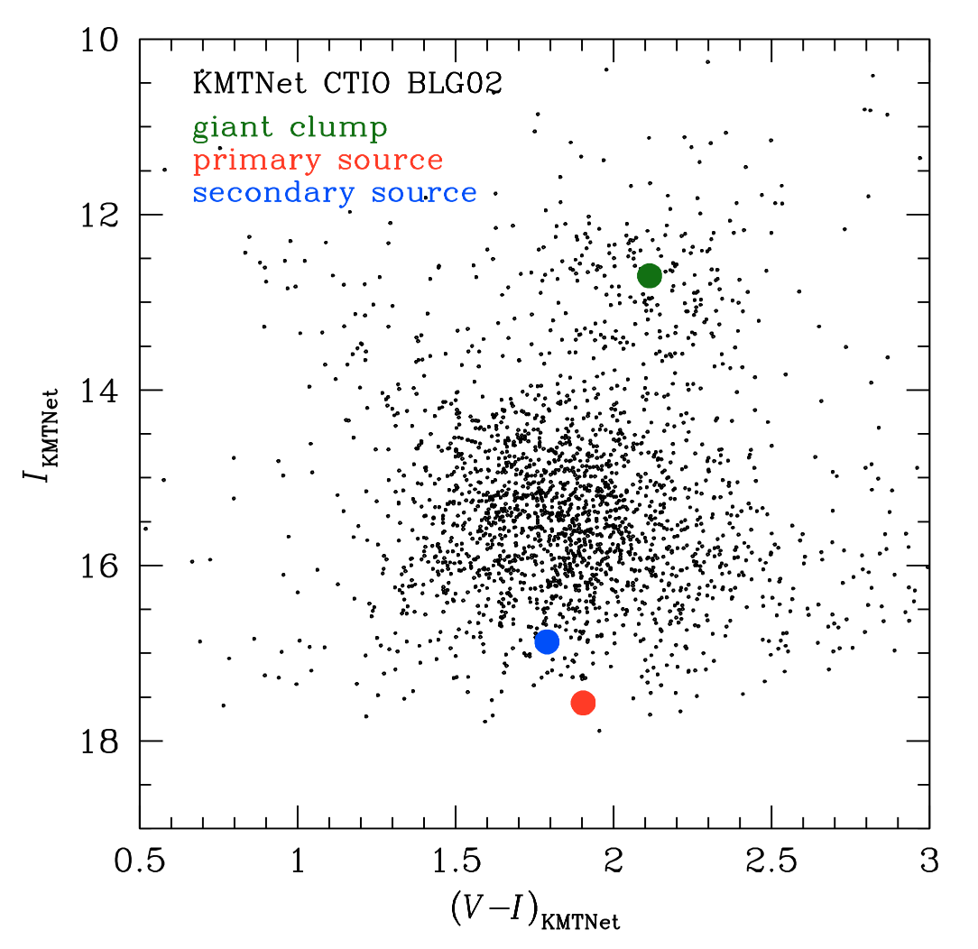
CHECK the solution
$${\left(V−I, I\right)}_{0,1}=(0.79±0.10, 19.32±0.05)$$
$${\left(V−I, I\right)}_{0,2}=(0.68±0.07, 18.63±0.03)$$
$Y^{2}$ isochrone
Notes:
We estimate the source type by following the standard method in this field.
One important characteristic of the binary source is that they are born in a same gas cloud.
So, if the model is correct, the estimated sources should lie on a single isochrone.
To check this, we build the set of isochrones using the Y² isochrone package, and put the sources in the isochrones.
As shown in the right figure, the two sources lie on the single isochrone, and therefore the model satisfies the requirement.

Slide 8
Implication
OGLE-2016-BLG-0733
A long-term asymmetric perturbation generated by a binary source with a single lens.
A new class of potential planet impersonators.
Importance of considering various interpretation and of high cadence observation.
Notes:
We find that the event is described by the binary-source model.
This result indicates that the long-term asymmetric planet-like deviations also can be mimicked by the binary source.
The planetary model is clearly disfavored by the unusually large rho.
However, distinguishing between the binary-lens and binary-source model may be difficult if the source is a subgiant or giant.
In addition, this event signifies the importance of high cadence observation for the secure detection of the planet.

Slide 9
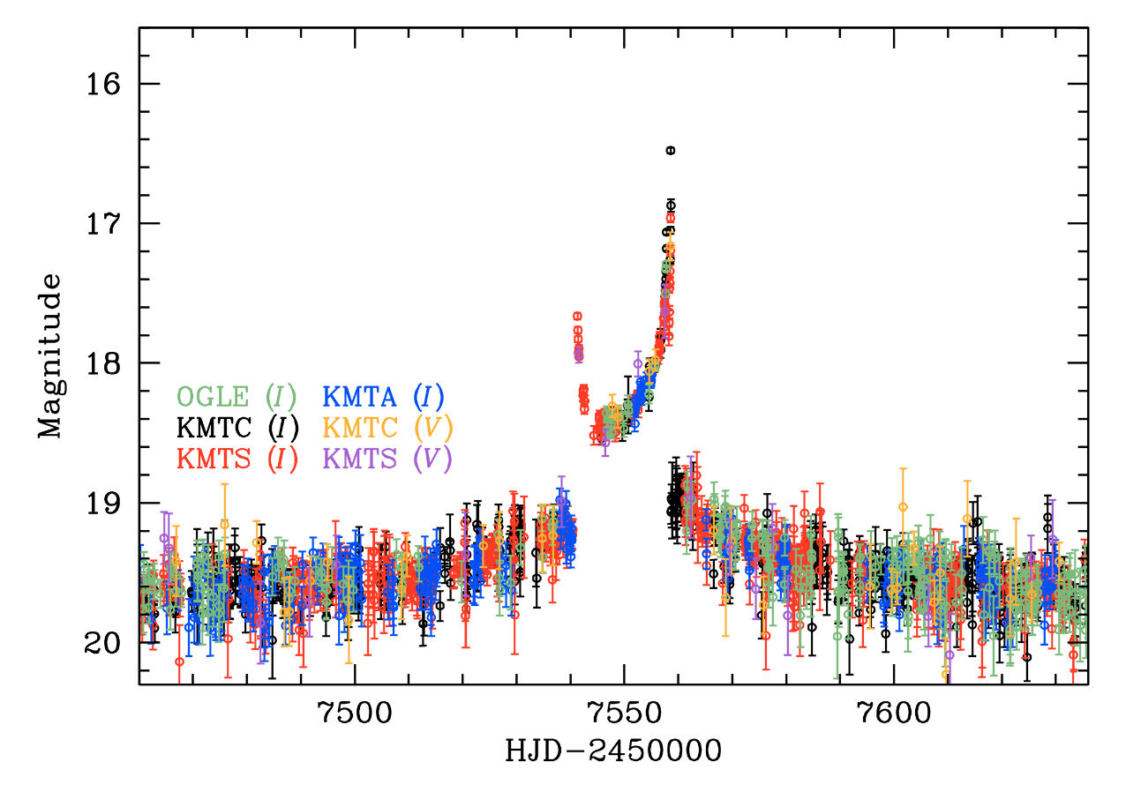
OGLE-2016-BLG-1003
Notes:
Next, I will talk about the analysis of 1003.
As shown in the figure, this event looks like a classic binary-lensing event generated by a kind of resonant caustic.

Slide 10
Two Caustic exits?
Notes:
However, surprisingly, the KMTNet survey reveals that the event has a complicate feature like two caustic exits.
To fit this striking feature, we search for the binary-lens solution, but the feature cannot be explained by the binary-lens model.

Slide 11
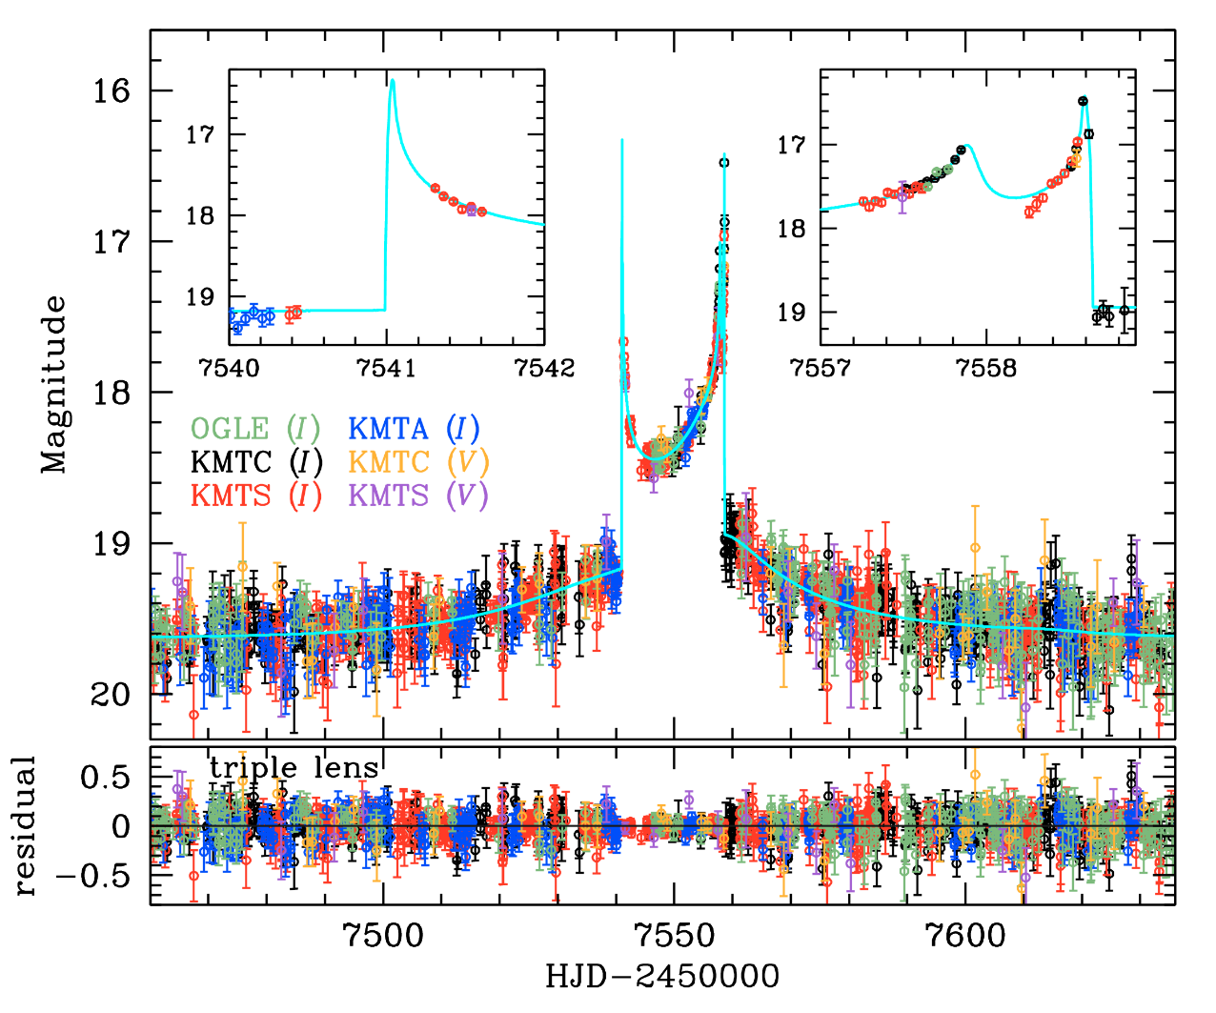
A Triple lens with a Single source?
Notes:
So, we consider more complicated interpretations.
We first consider the possibility that this feature might be generated by a triple-lens system.
From the modeling, we find that two circumbinary planet models can explain the light curve.

Slide 12
A Triple lens with a Single source?
$$parameters$$ | Local A (best-fit)
$$π_{E,N}$$ | $$−0.613±0.423$$
$$π_{E,E}$$ | $$0.382±0.153$$
$${ds}_{1}/dt ({yr}^{−1})$$ | $$−3.342±0.122$$
$dα/dt$ $({yr}^{−1})$ | $$1.273±0.179$$
$${ds}_{2}/dt ({yr}^{−1})$$ | $$−0.499±0.373$$
$$dφ/dt ({yr}^{−1})$$ | $$1.500±0.443$$
$$q_{1} \sim 0.2$$
$$M_{1} \sim 0.2 M_{⨀}$$
!?
$$M_{2} \sim 0.04 M_{⨀}$$
$$q_{2} \sim 0.001$$
$$M_{3} \sim 0.2 M_{J}$$
Notes:
If the model is correct, the lens system will be composed of a M-dwarf, a brown dwarf, and a Neptune mass planet.
However, as you see, the triple-lens models cannot fit the caustic exit precisely.
In addition, considering the lensing timescale, the derived higher-order effects are quite large.
So, we begin to suspect the solution and think about another interpretation.

Slide 13
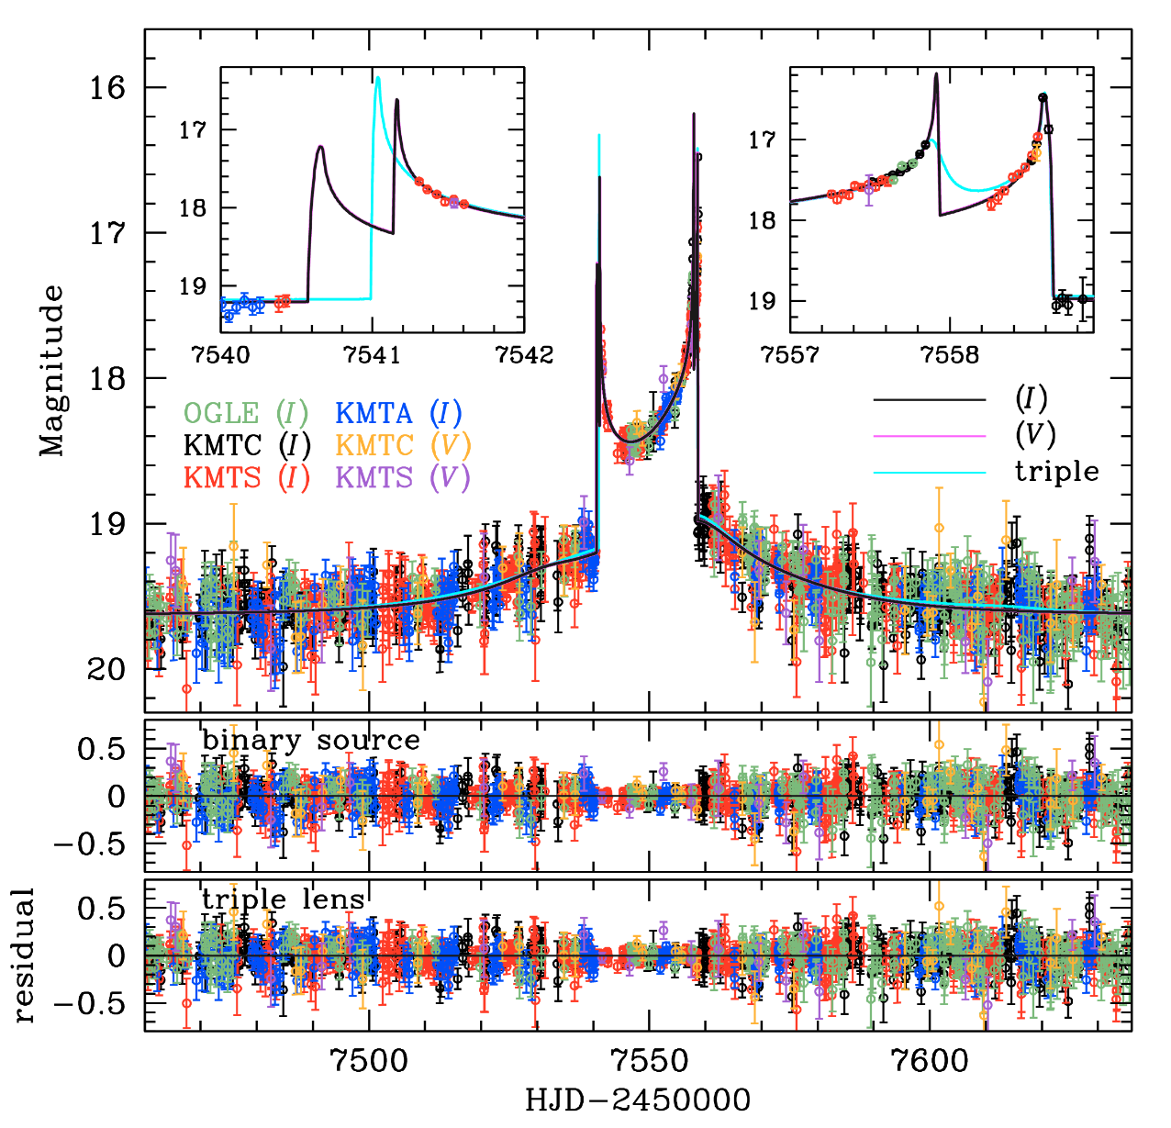
A Binary lens with A Binary source?
Notes:
We consider the possibility that the feature is generated by a binary source passing the binary-lens caustic.
We find that the binary-source model also can explain the light curve.
We know that if a light curve shows a caustic entrance, there also should exist a caustic exit for a single-source event.
So, if this event is really a binary-source event, the light curve should have two caustic entrances,
and we can distinguish between these two models.
Unfortunately, we didn’t have the data near the caustic entrance, and thus we thought that we cannot find the exact model until two weeks ago.

Slide 14
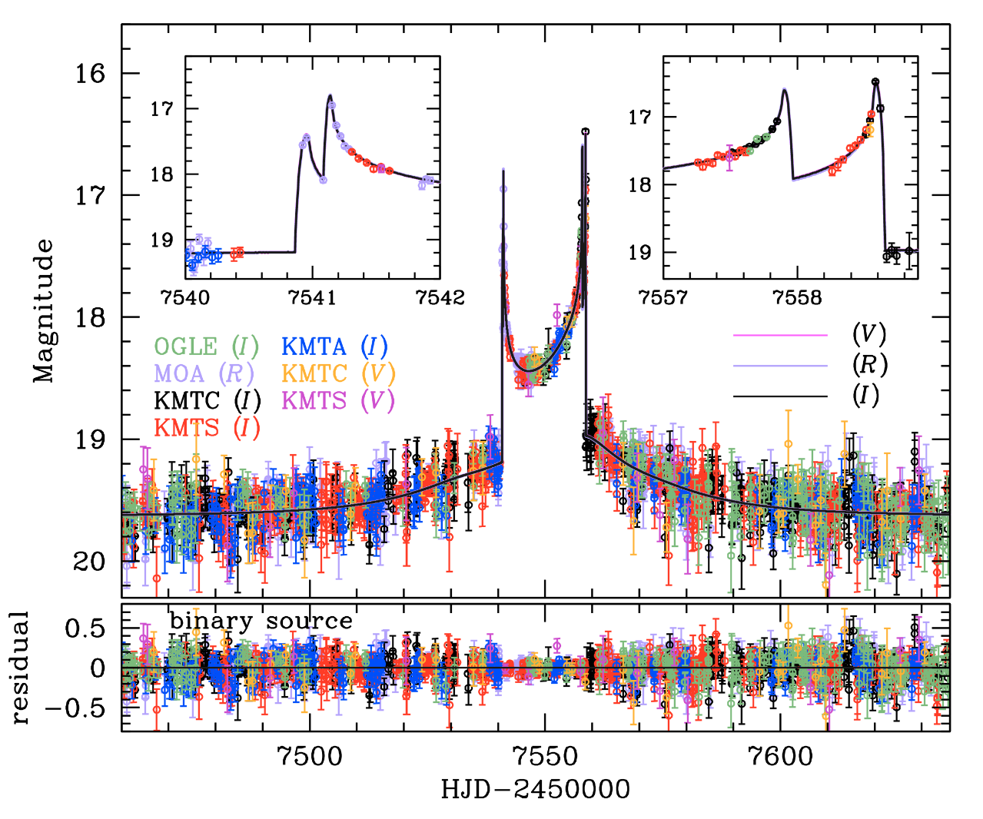
AMAZING MOA
Notes:
But, we realize that the event is also in one of the MOA fields.
So, we request the MOA for the reduction of the data, and Ian Bond kindly provide us the data.
Surprisingly, the MOA survey captures the caustic entrance, and the data clearly show the feature of two caustic entrance.
With the MOA data, we have the confidence that this event is generated by the binary-source rather than the triple-lens.

Slide 15
Implication
OGLE-2016-BLG-1003
The first resolved binary-source binary-lens event.
Still investigate the exact solution.
Demonstrate the importance of high cadence observation.
Notes:
We find that the event 1003 is the first resolved binary-source binary-lens event.
Unfortunately, we are still trying to find the exact solution.
However, this event also clearly shows the importance of high-cadence observation for characterizing the lensing event correctly.
Actually, with the progress of microlensing observation, we are now able to find more subtle and complicated lensing features routinely,
and this advance will be much more effective when the WIFST is launched.

Slide 16
Thank you
Notes:
Thank you for your attention.

Slide 17
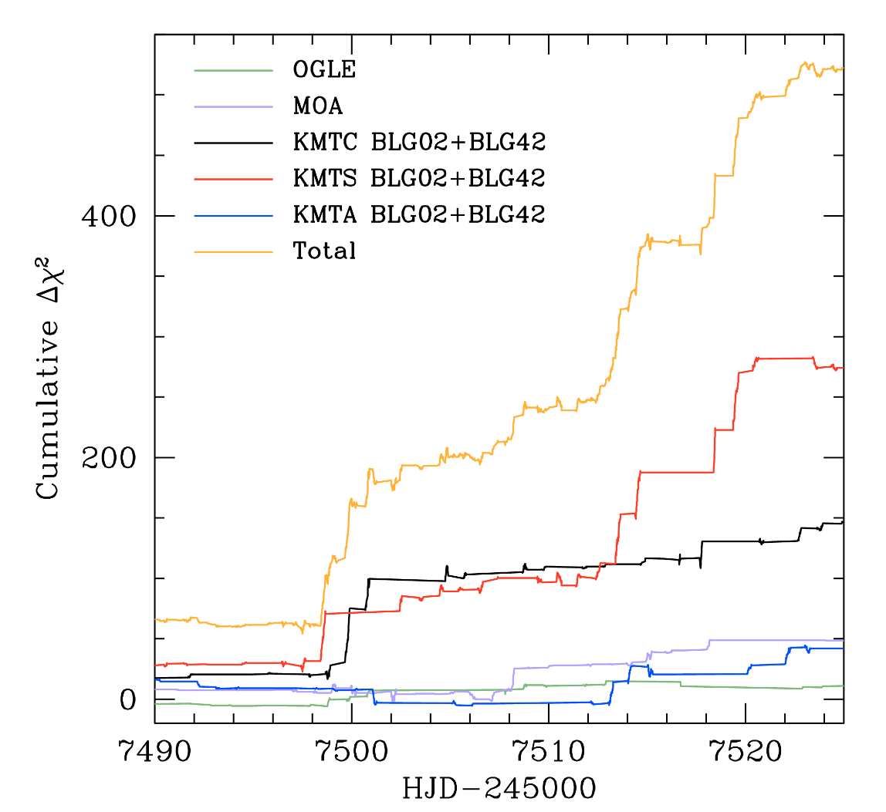
Binary-Source Model

