Slide 1
What is the Smallest Planet that JWST will Characterize? Drake Deming University of Maryland at College Park JWST Workshp, March 2014

Slide 2
Another dimension: what is the coldest and densest(?) planet JWST will characterize..?
transmission spectroscopy signal ~ T / ρ
and secondary eclipse depths ~ T R²
Simple estimates of a 300K, 5 g/cm³ planet
(rocky with a water atmosphere):
thermal emission at secondary eclipse
transmission spectroscopy

Slide 3
Thermal emission – secondary eclipse
(zodi-background limited – I think)
MIRI 11.3-micron filter
1-Earth radius at 13 pc > 0.36 micro-Jy
GJ1214-like star > 90 min eclipses
MIRI sensitivity: 1.7 micro-Jy = 10-sigma in 10⁴ sec
1 eclipse is 1.6-sigma
4 eclipses are 3.2-sigma, etc.
>>>> Have to achieve the dynamic range <<<<
(eclipse depth is about 0.0002)

Slide 4
What about transmission spectroscopy..?
Previous JWST simulations (including mine) may be too pessimistic
The best estimate may be a simple scaling from Hubble WFC3
(and the scale factor is modest: S/N ~ A^{0.5} = ~ 2.4)

Slide 5
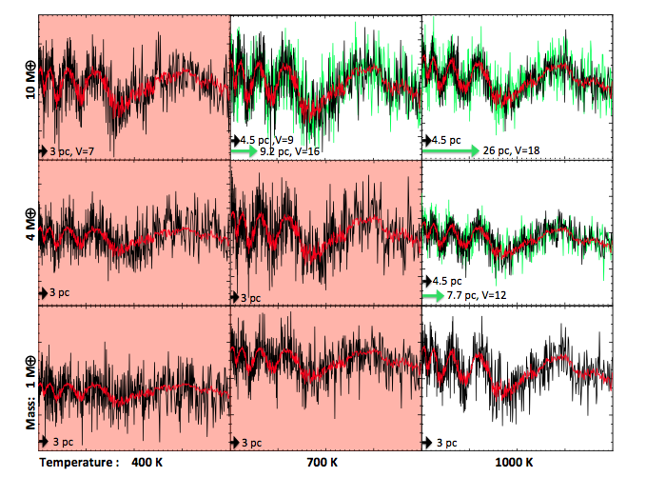
Batalha et al. 2013
25 transits
all panels
GJ1214b

Slide 6
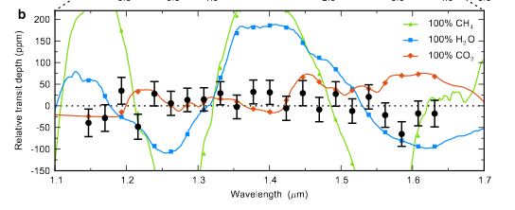
Kreidberg et al. (2014) have 29 ppm precision for GJ1214b in
12 transits; (expected 1.4 micron water amplitude is 275 ppm)
So the precision scales to 29 ppm / 2.4
= 12 ppm (per binned point)
Signal scales as T/ρ
T is smaller by about 2
ρ is larger by 3
So the signal is 275/6 = 45 ppm
about 4-sigma per wavelength point at
WFC3-like resolution

