Slide 1
Pre-Cursor Data Needed for JWST Transit and Eclipse Observations
David R. Ciardi
2014 March 12

Slide 2
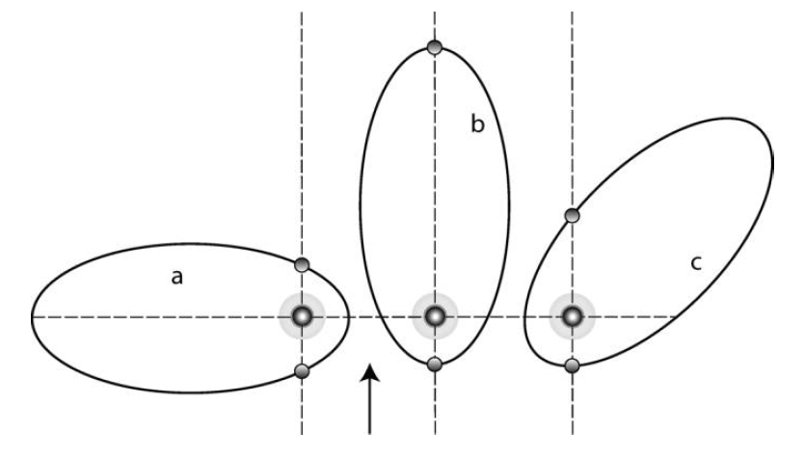
Prediction of Transit & Eclipse Times
Primary transits of KNOWN transiting systems likely not to be a big problem
Secondary transit prediction much more problematic
Predicted primary transits or phase curves of RV-planets – probably not a realistic use of JWST time

Slide 3
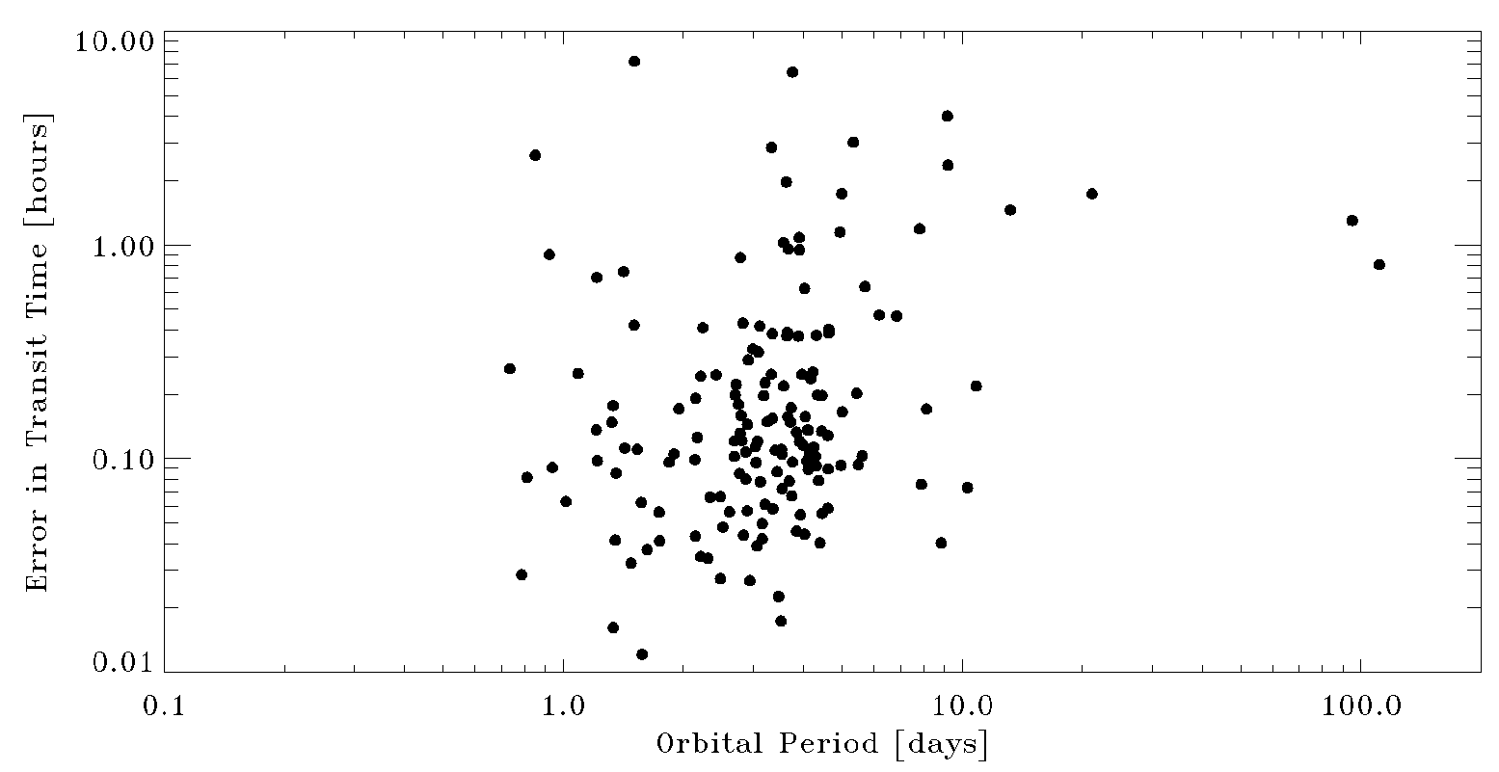
Primary Transits
Known (non-Kepler) transit uncertainties (period & epoch) propagated to mid-2018
Does not include systematic errors in ephemerides

Slide 4
Secondary Eclipses
This is much a more difficult problem
Eclipses generally not previously measured
Time of secondary eclipse depends on
Period
Eccentricity
Longitude of Periastron (!)
Epoch of Periastron (!)
Inclination
And the associated uncertainties

Slide 5
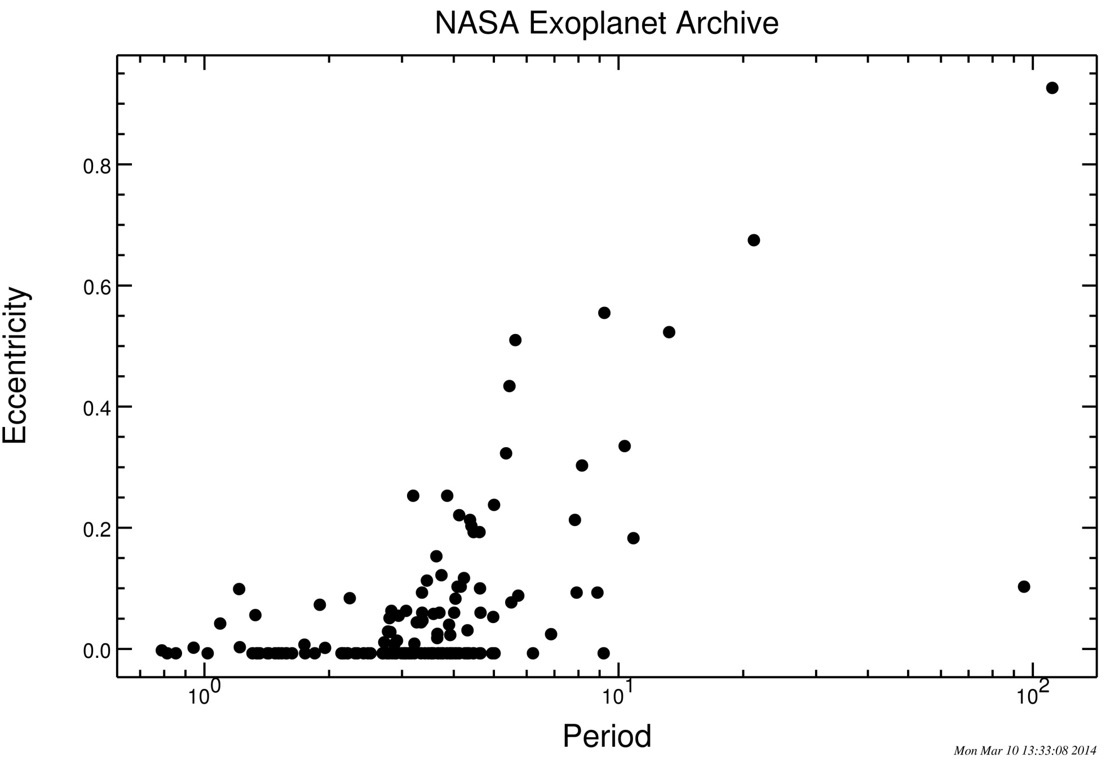
Eccentricity Distribution
Non-Kepler Transiting Planets

Slide 6
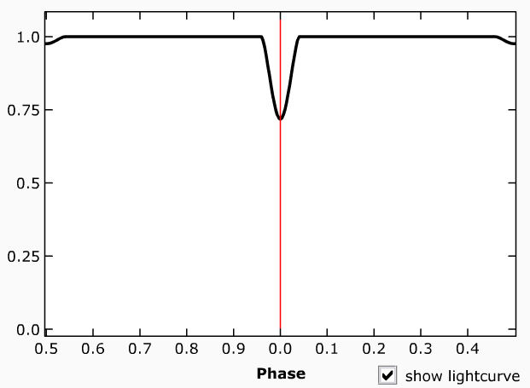
Eccentricity = N, longitude = 90

Slide 7
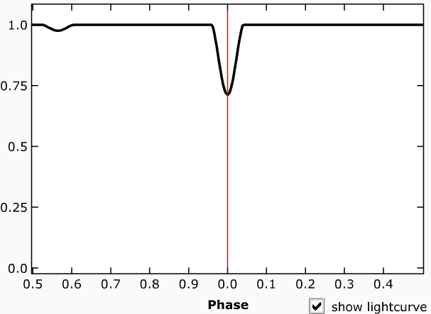
Eccentricity = 0.1, longitude = 0

Slide 8
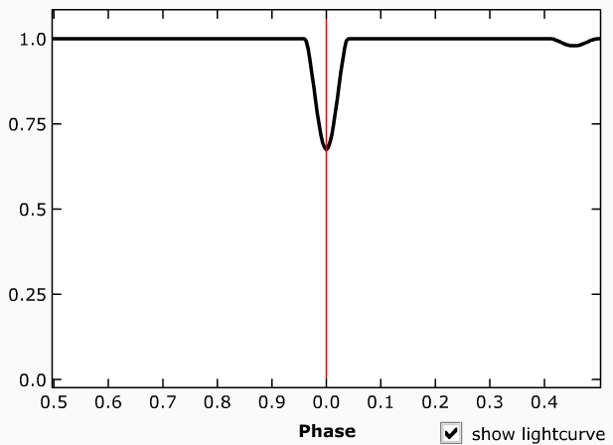
Eccentricity = 0.1, Longitude = 135

Slide 9
Eccentricity = 0.3, Longitude = 102.5

Slide 10
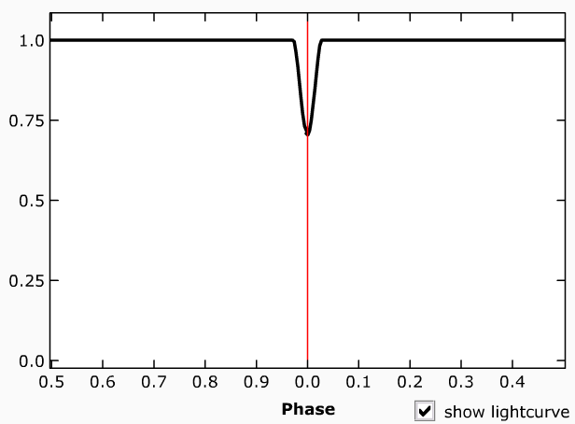
Eccentricity = 0.3, Longitude = 102.5, Inclination = 80

Slide 11
Kepler Sample
2903 Planetary Candidates
942 Confirmed or Validated Planets
20 – 30 planets have radial velocity orbits
Problem is likely even more expansive for TESS – but unlike Kepler (!)
Stars will be brighter
Orbital periods shorter
Planets more massive
Radial velocity easier

Slide 12
Target Selection
Systems with transiting planet already known
Brightness of target already known
Stellar characterization already known
High resolution image to make sure no nearby contaminating stars – Likely already obtained particularly for Kepler, K2, and TESS targets
Variability
Stellar variability does affect the ability to measure the transit and eclipse depths accurately
Phase curves vs. stellar rotation are particularly hard
Stellar spots and variability minimized in the infrared

Slide 13
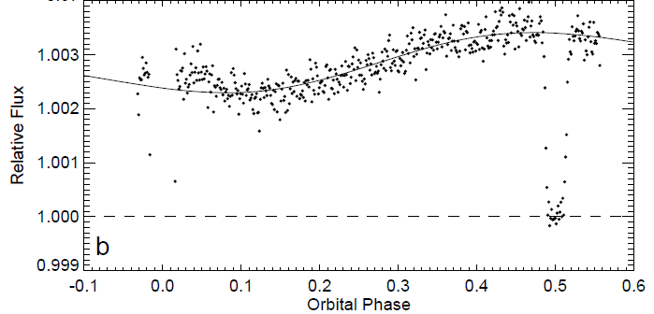
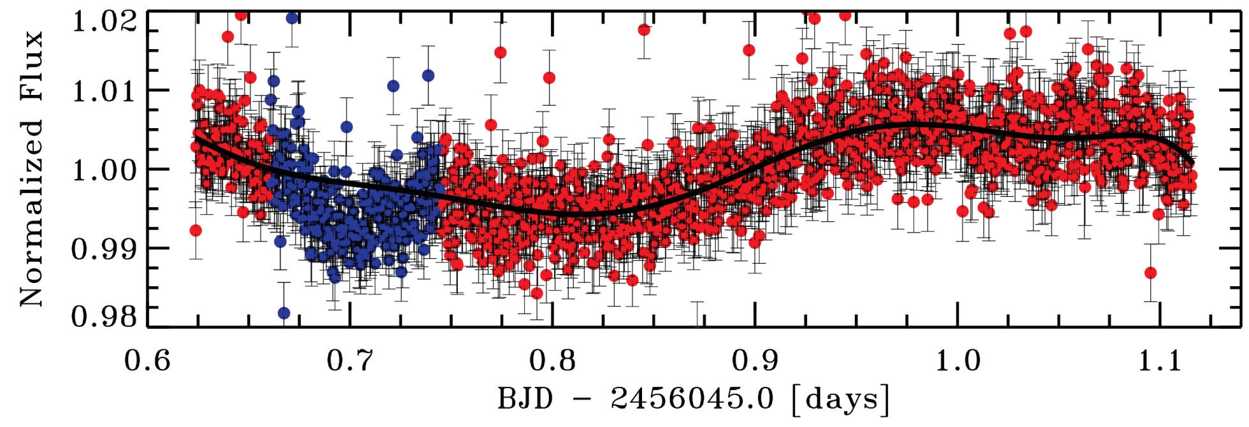
Phase Curves or Stellar Variability
If phase curves are the goal rather than transits or eclipses, then stellar variability is much more crucial to understand
Knutson et al. 2007, HD189733, 8μm
Ciardi et al. 2014, PTF, 4.5μm

Slide 14
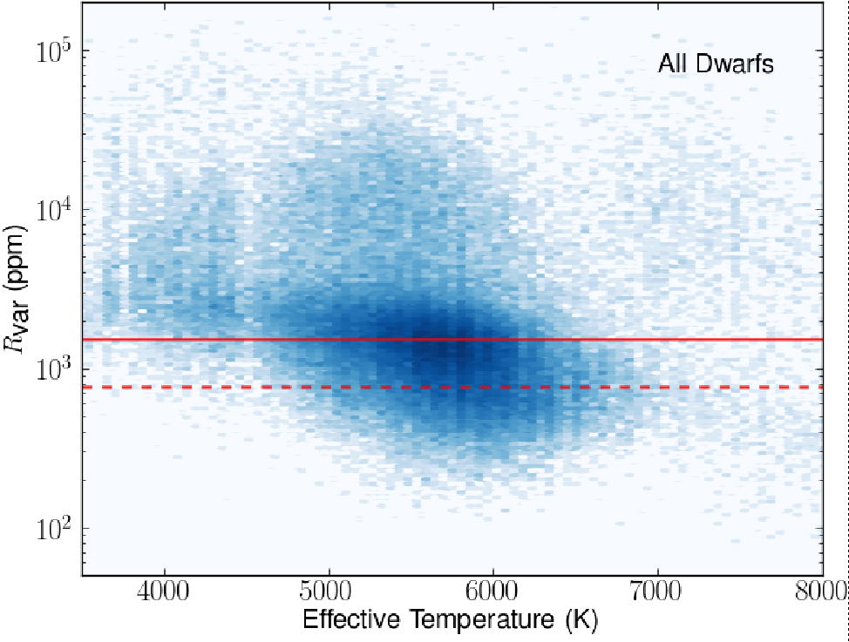
Stellar Variability
30 days
McQuillan et al. 2012

Slide 15
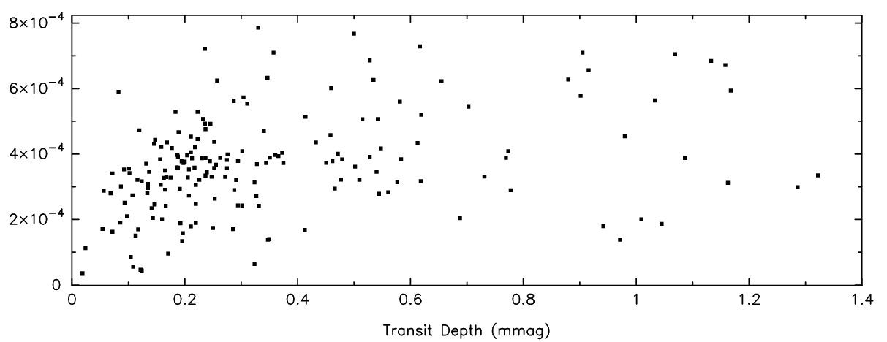
Smallest Planets around Quietest Stars
800
600
400
0.25 day rms dispersion [ppm]
200
0
Howell et al. 2014
0 0.2 0.4 0.6 0.8 1.0 1.2 1.4
Transit Depth [mmag]

Slide 16
What’s Needed Prior to Observing
Orbital Parameters
Most important in terms of pre-cursor observations for planning purposes – particularly for secondary eclipse observations
Radial velocity monitoring or photometric monitoring to find secondary eclipse
Stellar Variability Selection
Spots and variability could affect radii determinations
Strong Variability may be an issue particularly for phase curves

