Slide 1
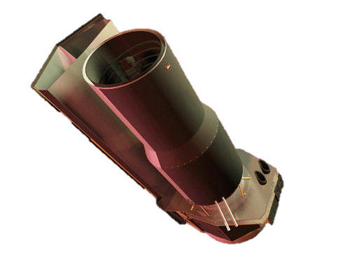
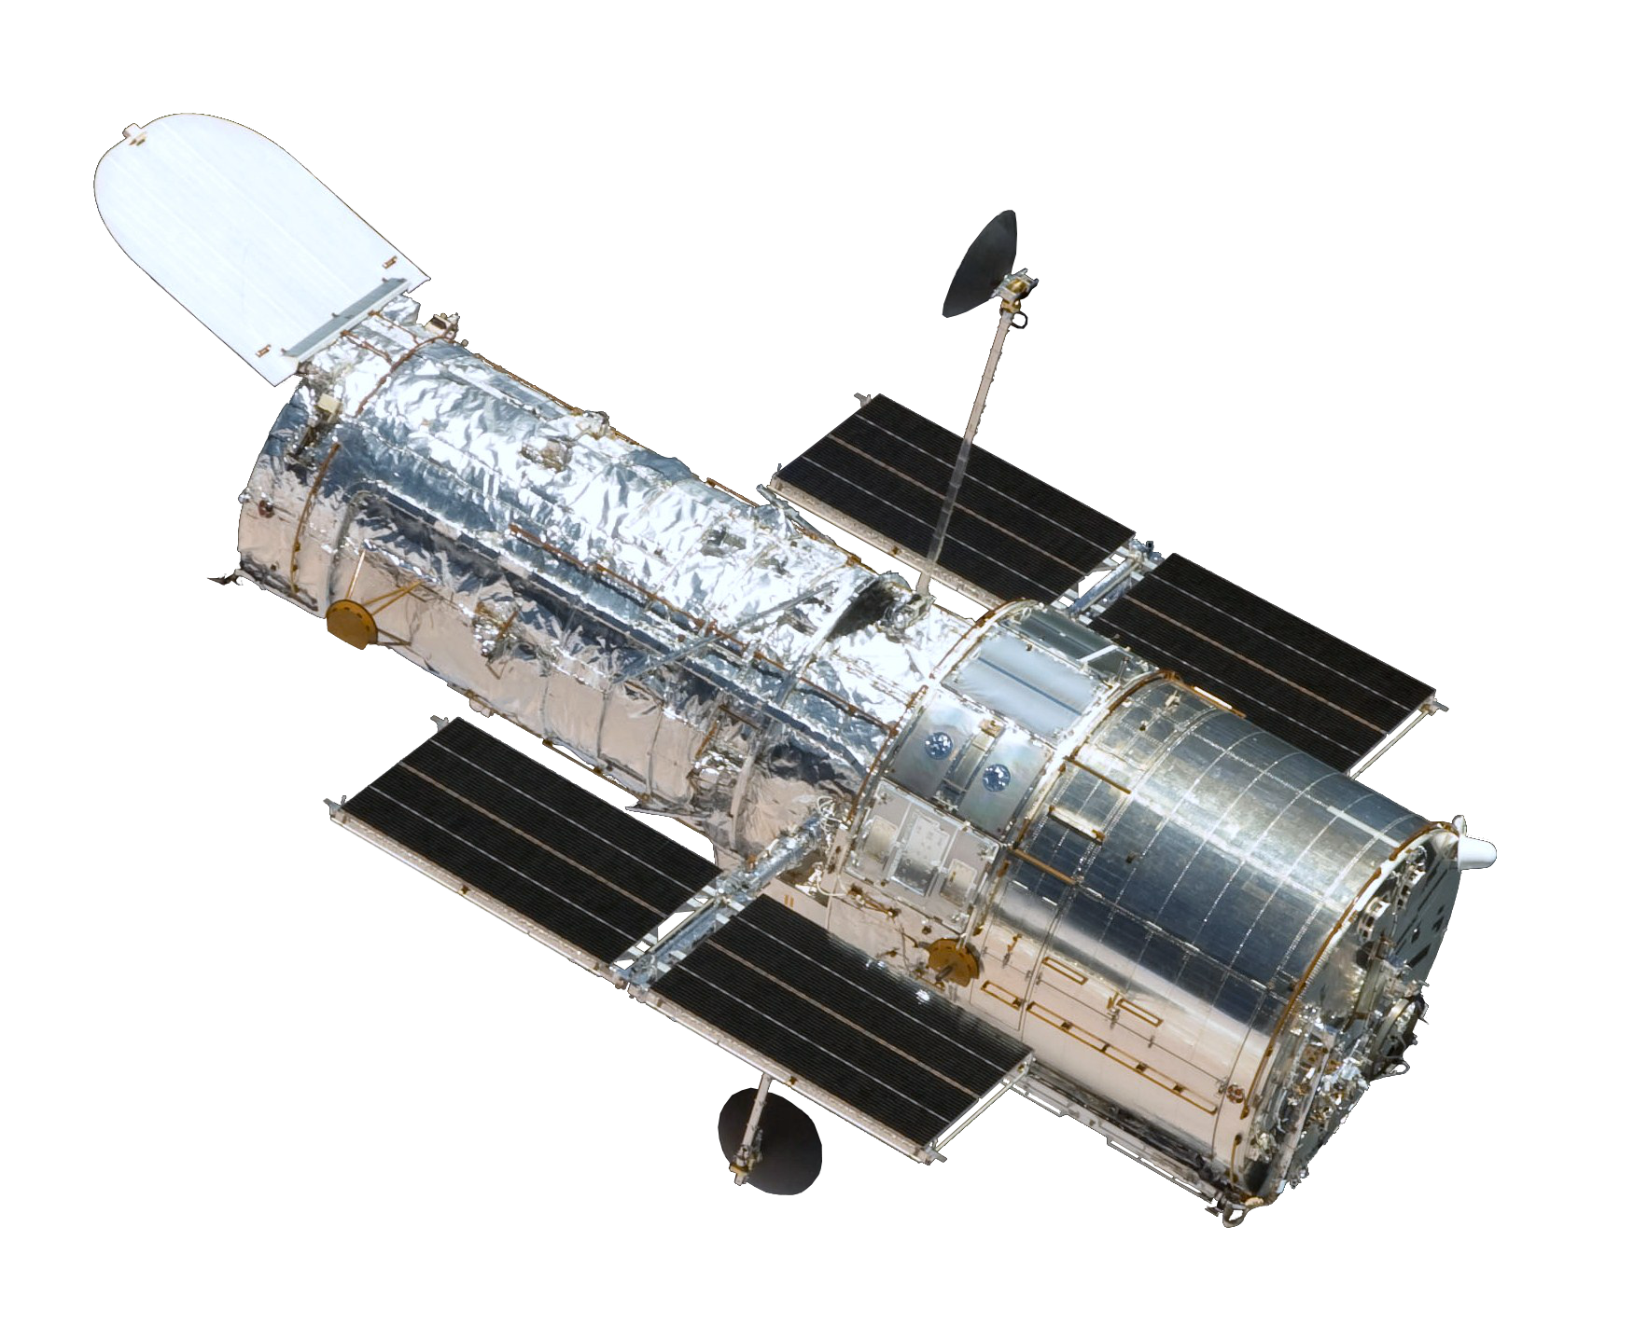
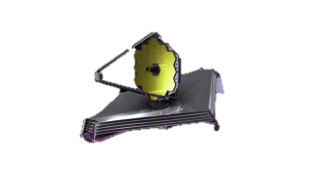
pipeline data processing challenges
(transits and phase curves)
Dr. Pieter Deroo,
Jet Propulsion Laboratory
California Institute of Technology

Slide 2
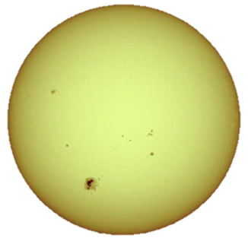

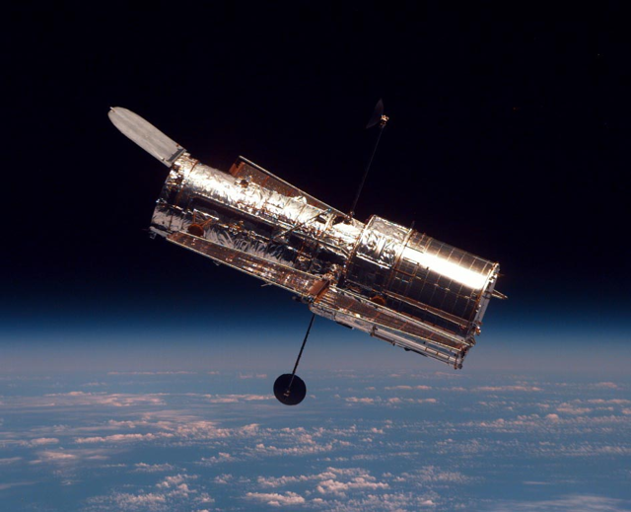
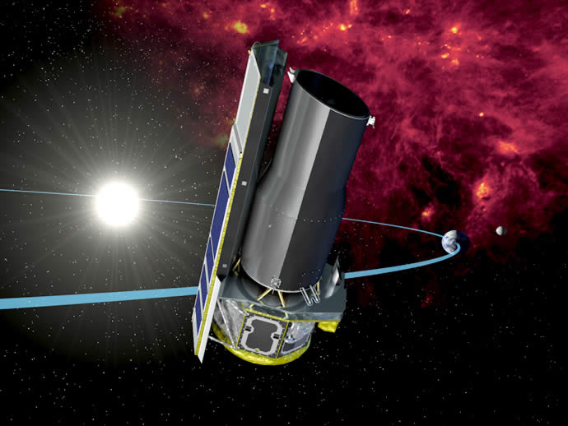
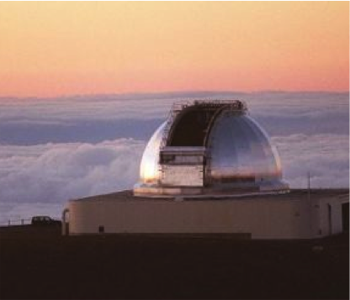
Calibration heroics drive exoplanet research
Characterizing exoplanet atmospheres is HARD!
Secondary eclipse
Emission Spectrum ~ F_{p}/F_{s} x [R_{p}/R_{s}]² ~ 10⁻⁴-10⁻³
Primary eclipse
Size of planet ~ [R_{p}/R_{s}]² ~ 10⁻²
Transmission Spectrum ~ atm. scaleheight/R_{s}² ~ 10⁻⁴ -10⁻³
HST/NICMOS
spectroscopy ~ 1 %
Spitzer/IRS
spectroscopy ~ 1 %
Ground-based
spectroscopy ~ 5 %
Notes:
The planet reveals also its molecules, but at a very tiny level, even during the eclipses.
For optimum planets, the size of the planet is at the level of a procent. But to see in the transmission spectrum molecular absorptions, you need an order to two orders of magnitude better precision. You need a precision of 1 part in 10,000. And that number is basically the same for a secondary eclipse, where in NIR, you need about 1:10,000 and in the mid-IR you need 1:1000.
This precision requirement really compares pretty awful to the standard precision advertised for the three avenues explored here.
HST/NICMOS: optimistically 1 % calibrated stability; Spitzer/IRS : realistically, 1% calibrated stablity; Ground-based spectroscopy: a really good night can give you 5% calibrated stability.

Slide 3

HST/NICMOS
spectroscopy ~ 1 %
Spitzer/IRS
spectroscopy ~ 1 %
Ground-based
spectroscopy ~ 5 %
Pipeline I
Approach:
optimize the observing mode
identify the systematic errors source
strategy to remove those errors
measure/interpret the spectrum
Pipeline II
Emission & Transmission Spectrum ~ 10⁻⁴ - 10⁻³ precision
Notes:
How do we get from those awful numbers to the precision required to detect molecules:
The strategy for the three avenues has a lot of similarities.
It basically starts with optimizing the obsersing mode or in other words ‘fully exploring the hardware option’ and all the rest needs to be done in post-processing.
In post-processing, we basically

Slide 4
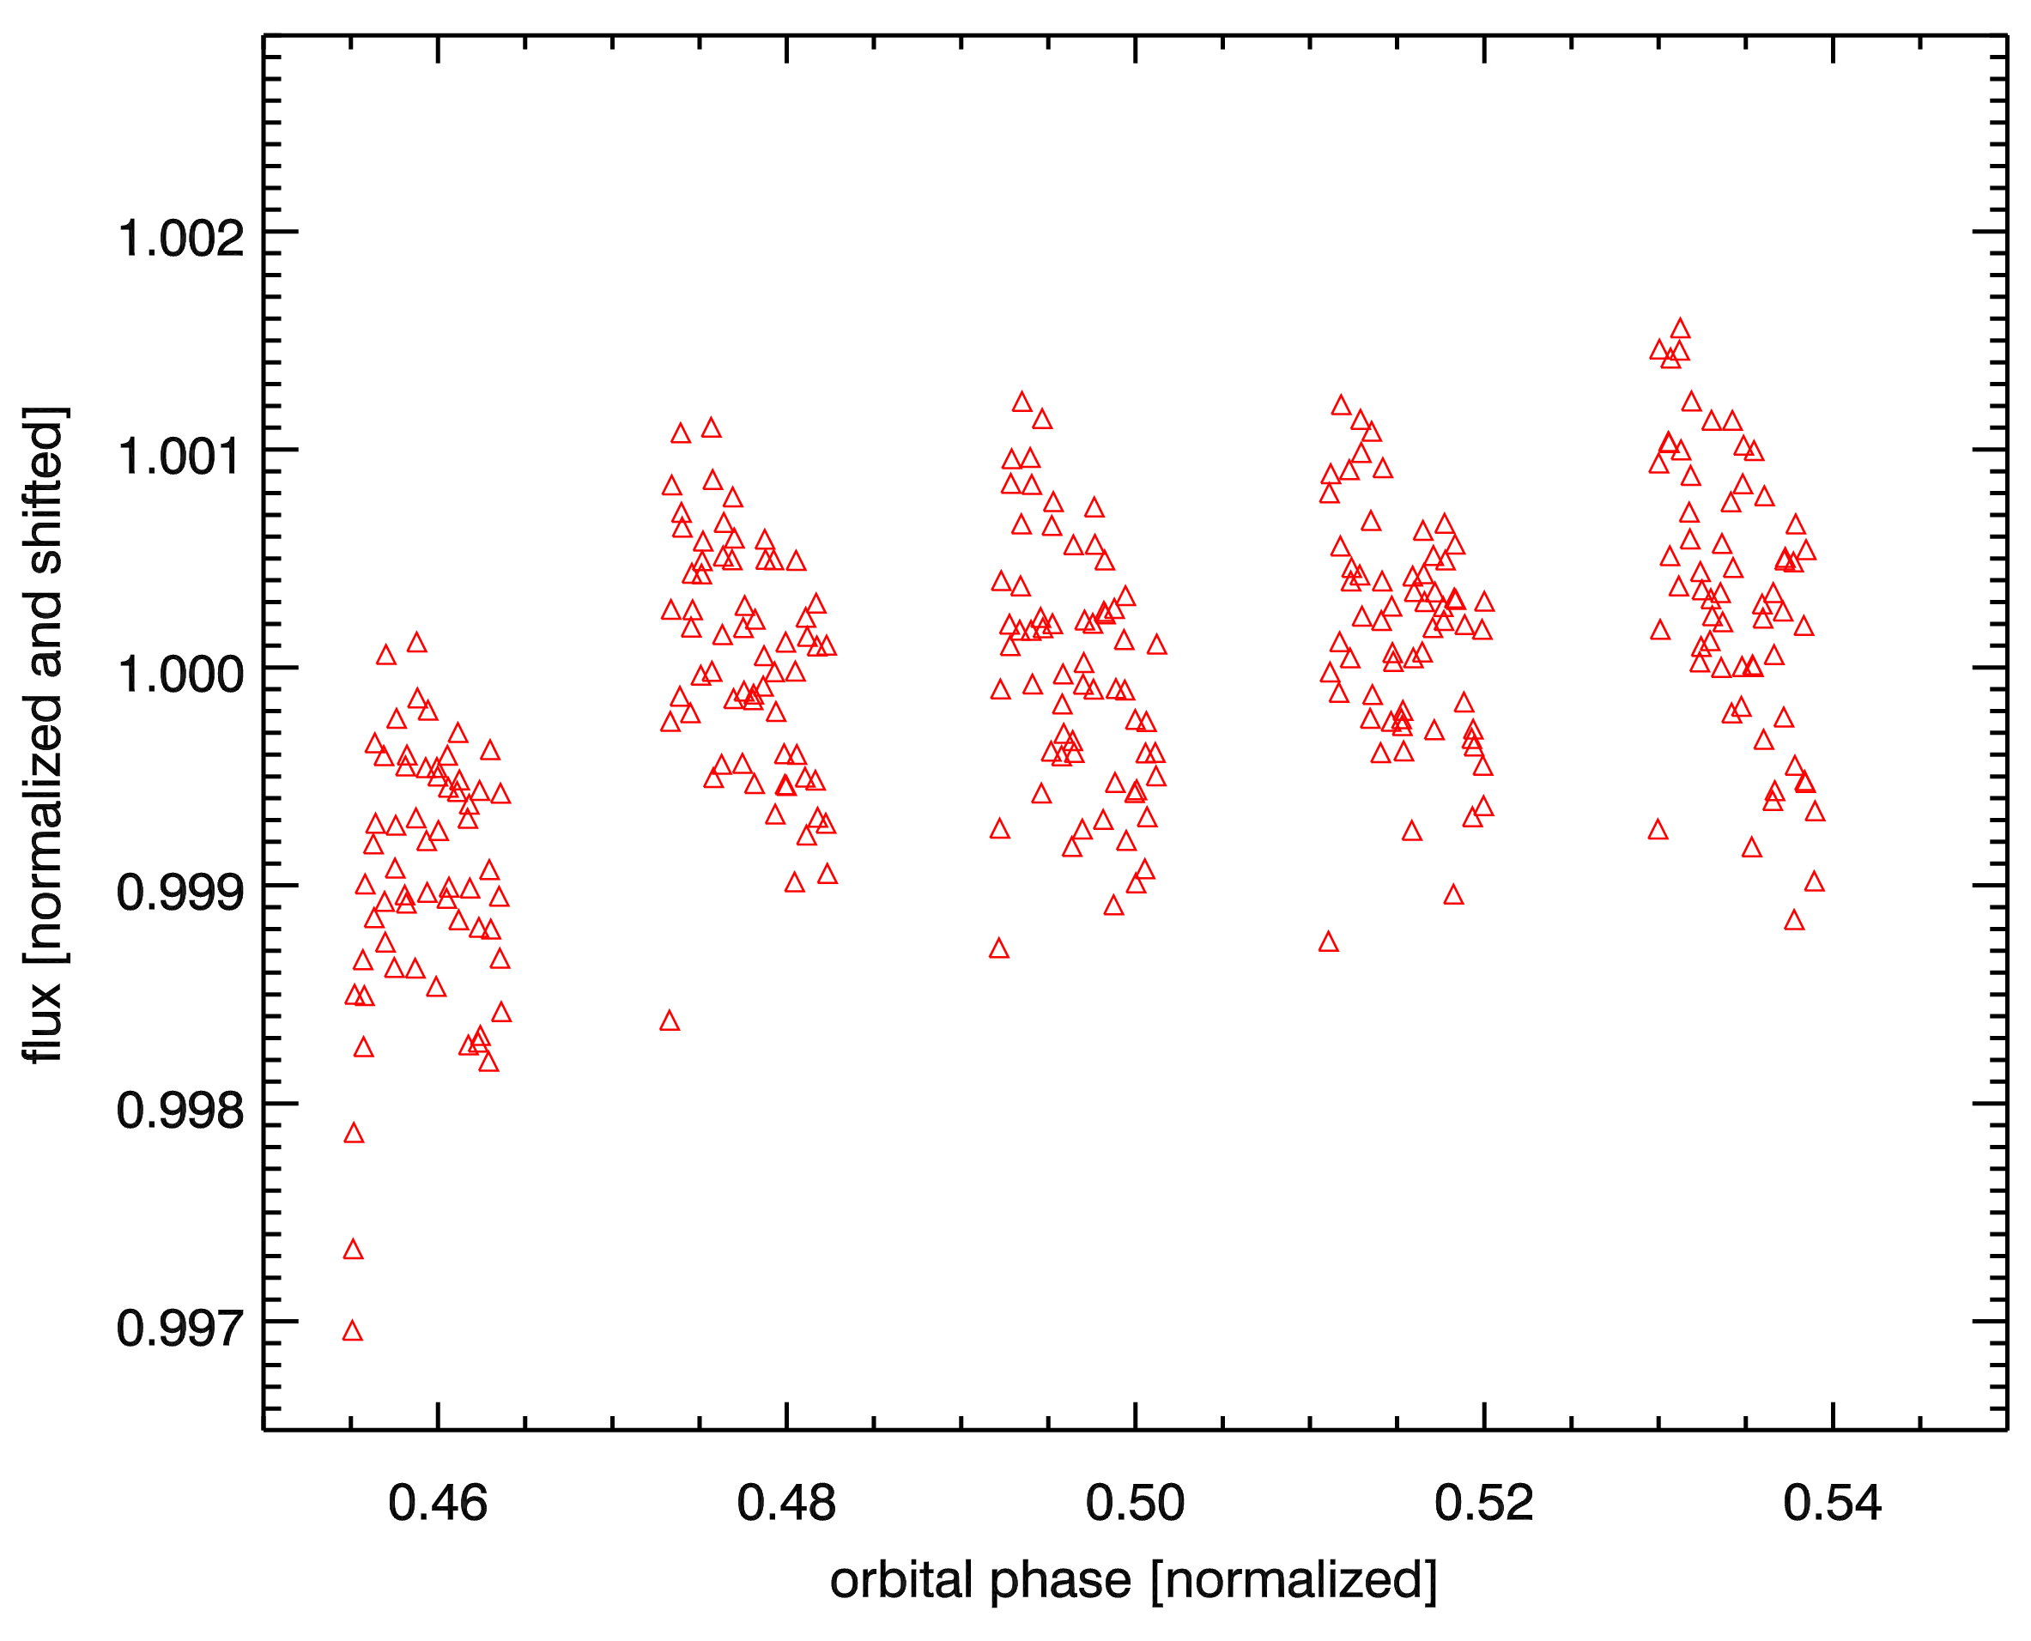
No instrument has been designed with combined light requirements in mind (yet!)
NICMOS secondary eclipse of HD 209458b
Spitzer/IRS secondary eclipse of HD 209458b
Where is the eclipse?
Where is the eclipse?
Spitzer photometry secondary eclipse of XO-2
STIS secondary eclipse of HD 189733b
Where is the eclipse?
(Evans et al. 2013)
In which panel is the eclipse?
(Machalak et al. 2009)
well-designed, well-performing instruments need significant post-processing if not designed for exoplanet spectroscopy!

Slide 5
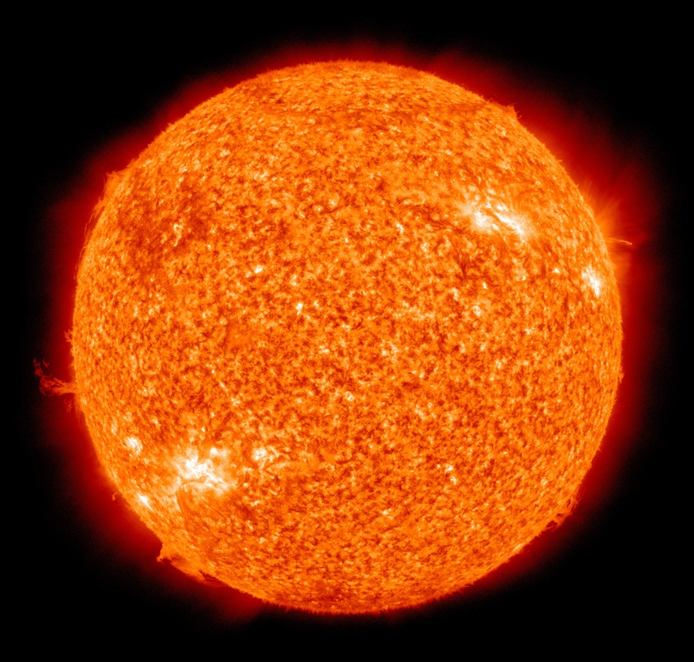
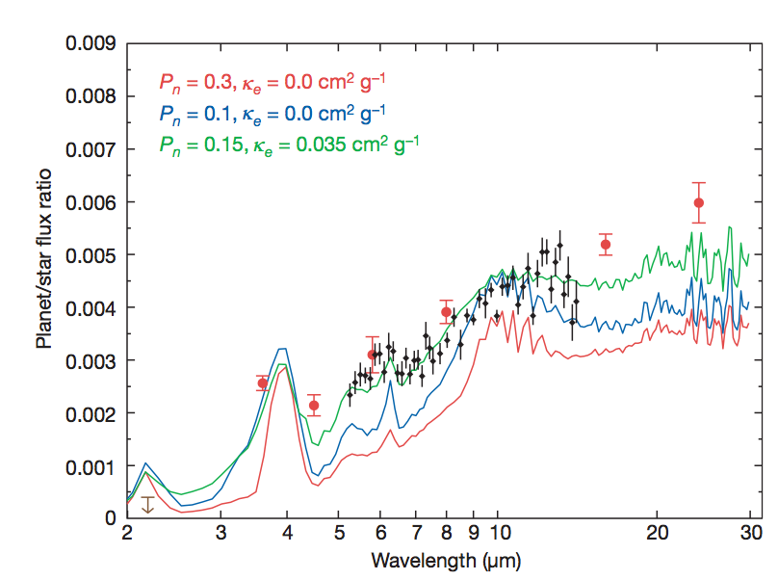
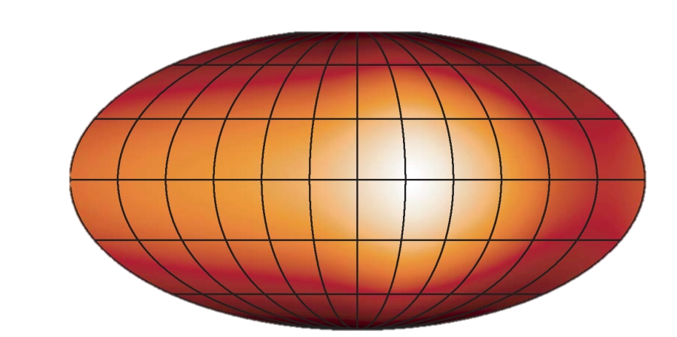
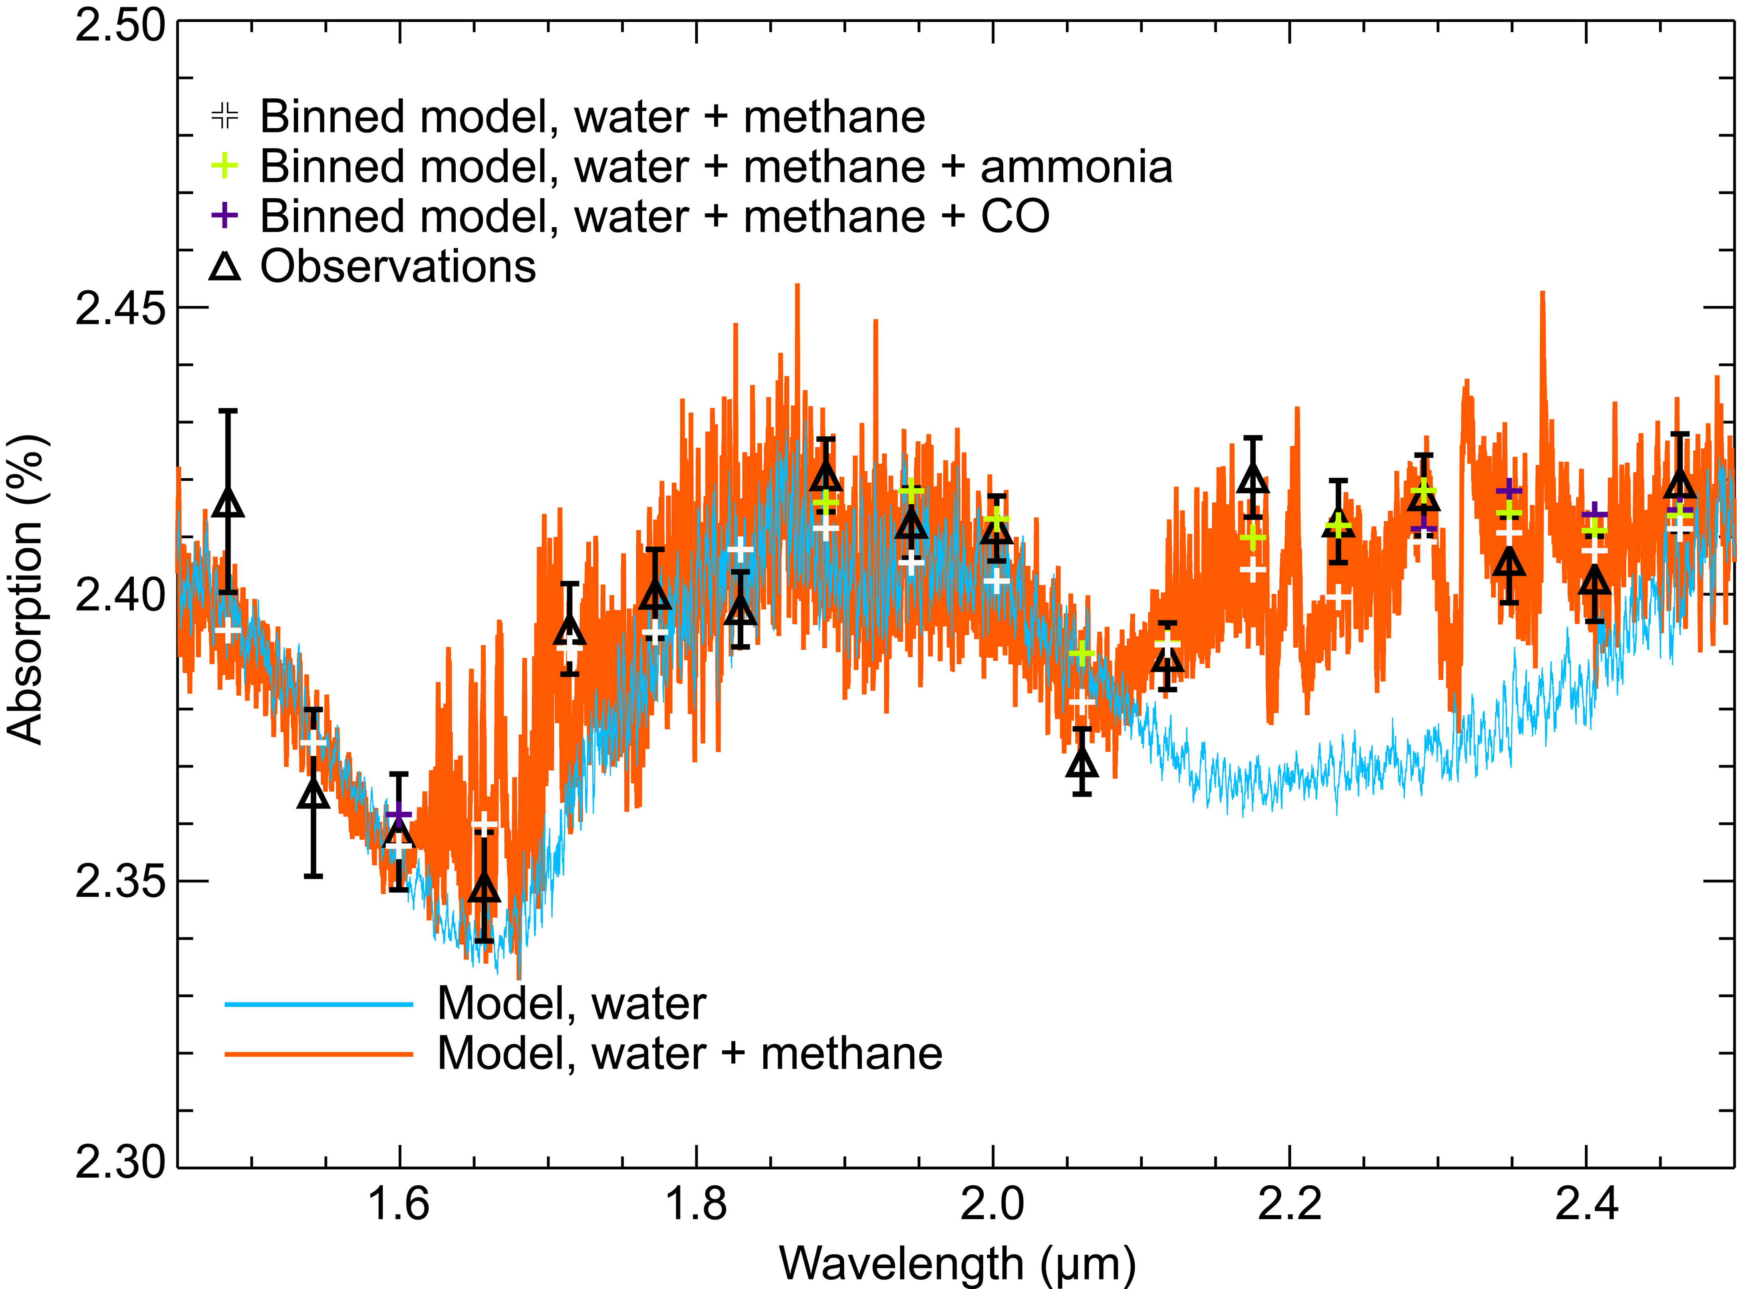
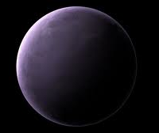
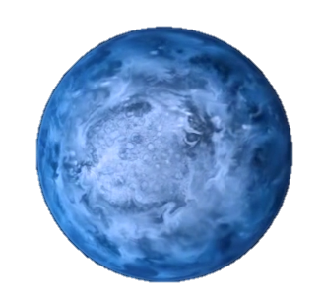

EMISSION SPECTROSCOPY
Grillmair et al. 2008
360° LONGITUDINAL VIEW
Knutson et al. 2007
TRANSMISSION SPECTROSCOPY
Swain et al. 2008
New science results
Show a deming
INFRARED IMAGE
Majeau et al. 2012
OPTICAL COLOR
Evans et al. 2013
HD 189733b
very exciting science possible, but low numbers
Goal: make this routine

Slide 6

BUT …
Measurement and revision are hallmark of this field.
With JWST, we want to move beyond that!

Slide 7
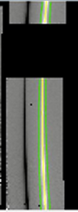
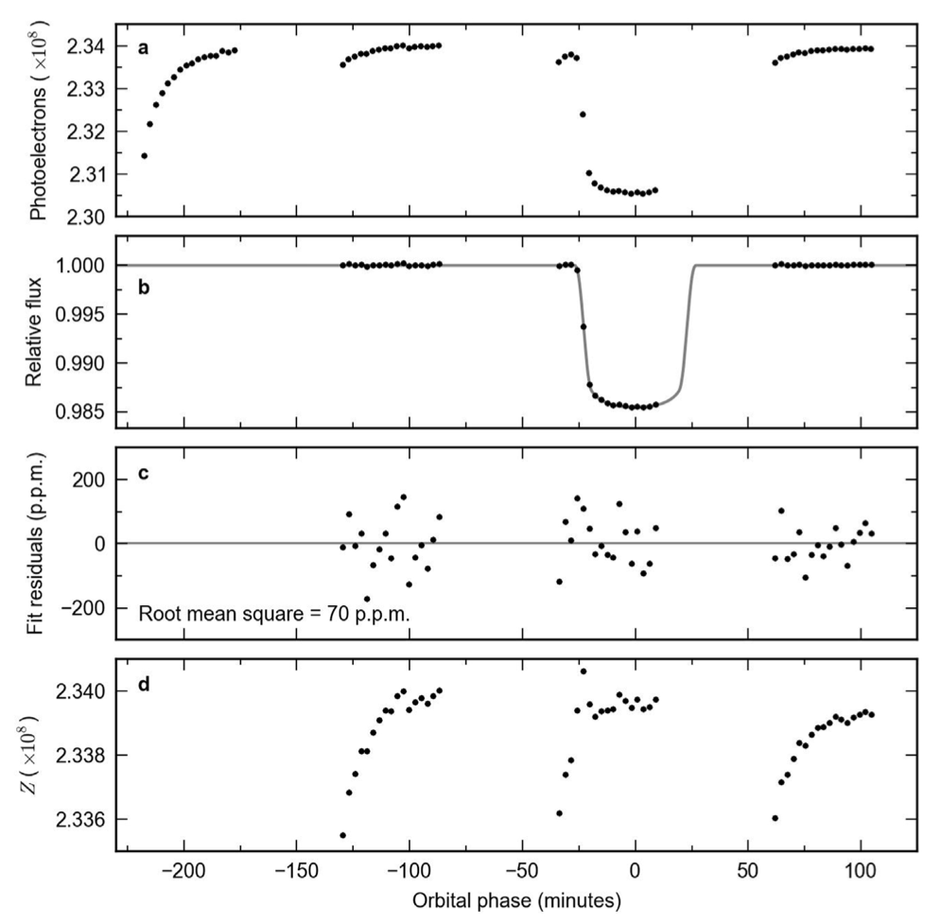
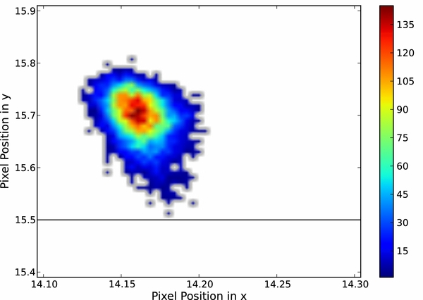
Pipeline and analysis ideas to move forward
Users: Validate and compare ALL elements of the data reduction
Extraction
Instrument
characterization
Time series calibration
and exoplanet spectrum
Kreidberg et al. 2014
Blecic et al. 2013
focus
T
IRS handbook
image cleaning algorithms, outlier rejection algorithms, version of the pipeline, background correction used, extraction algorithm, …
Pixel phase map based on which observations, instrument state vector choice, white-light removal, …
Multi-dimensional minimization, stopping criteria, characterization of systematics, …

Slide 8
Pipeline and analysis ideas to move forward
Archive:
Continuously track state-of-the instrument
No proprietary time on these instrument characterizing data
Need to be able to place each observation in context
  include in meta-data for all observations
  community effort to determine relevant parameters
  e.g. Knowing scan rate could help spatial scan mode calibration
Improved big-data analysis tools; big-data download tools
  Big data proves useful to characterize instrument, e.g. HST/WFC3 instrument effects; Spitzer phase map construction, etc.
  Current gui’s and query are not optimized for big-data queries:
    All spectral observations of stars of X-th mag
    All meta-data for a month-before and month-after observation
    …
Ability to query the ‘evolution’ of instrument
  Absolute calibration time-line
  Flatfield-timeline
  …

Slide 9
Pipeline and analysis ideas to move forward
JWST:
Null-test observation very early on for each instrument
Multi-object observations might allow this for free
If part of other program – make this calibration public soon
  Exoplanet transit ‘null-test’ over 8-hours
  Phase-curve ‘null-test’ over 4-days
ALL:
End-to-end simulation to quantify impact of instrument and calibration on science
  Quantifies impact of instrument, pipeline and analysis tools on retrieved exoplanet characteristics
  Incorporate ‘lessons-learned’ from current instruments
  ramp effect, detector noise, pixel sensitivity, …
  Calibrate and validate reduction and calibration tools
  Develop a consensus on the best methods to remove unknowns
  Will ready the field pre-launch to optimize JWST return

Slide 10
Summary:
Exoplanet time-series calibration is hard and has often been controversial
Steps can be taken to improve robustness
  Validation and quantification of ALL steps in the processing
  End-to-End simulations can quantify the impact of processing and instrument on the exoplanet characterization
  Archive tools and scripts can facilitate the development of a ‘holistic’ view of the instrument systematics using big-data tools
  Validate codes and techniques on ‘null-test’ data, either simulated or based on on-orbit observations
We really should not wait until JWST’s launch!

