Slide 1
JWST Science Timeline: Current Status
Janice C. Lee
STScI Science Mission Office
March 13, 2014

Slide 2
Engaging the community
to optimize science policies and operations
to maximize JWST’s science return
HST Project
NASA HQ
JWST Project
STScI
Director
HST MO
Science MO
JWST MO
STUC
user’s committee
TAC
time allocation
JSTAC
advisory to STScI
JWST SWG
advisory to NASA
User Community

Slide 3
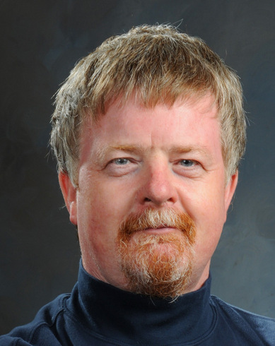
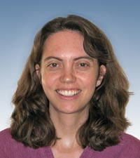
Engaging the community
to optimize science policies and operations
to maximize JWST’s science return
NASA HQ
JWST Project
STScI
Director
Neill Reid
STScI SMO Head
Science MO
JWST MO
JSTAC
advisory to STScI
JWST SWG
advisory to NASA
User Community
Janice Lee
SMO Astronomer
Jennifer Lotz
SMO Astronomer

Slide 4
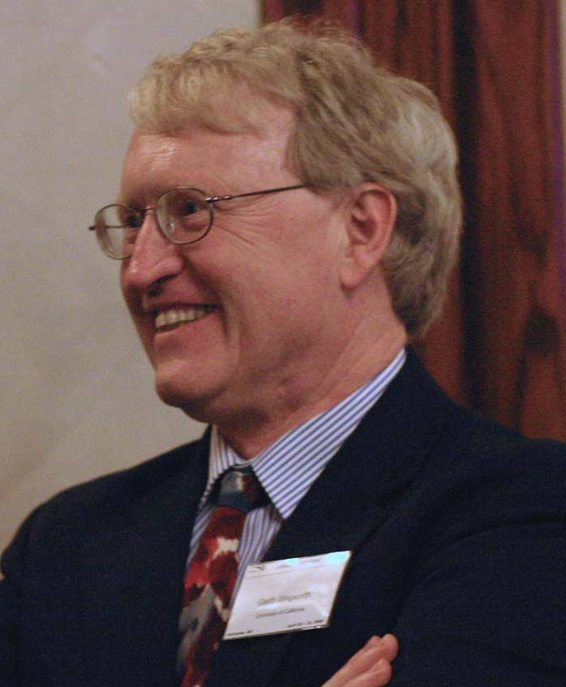
http://www.stsci.edu/jwst/advisory-committee
Roberto Abraham (Toronto)
Neta Bahcall (Princeton)
Stefi Baum (Rochester)
Roger Brissenden (Chandra/SAO)
Hashima Hasan (NASA, ex-officio)
Tim Heckman (Johns Hopkins)
Garth Illingworth (Santa Cruz, Chair)
Malcolm Longair (Cavendish)
John Mather (NASA, ex-officio)
Mark McCaughrean (ESA, ex-officio)
Chris McKee (Berkeley)
Brad Peterson (Ohio State)
Alain Ouellet (CSA, ex-officio)
Joseph Rothenberg (JHR Consulting)
Sara Seager (MIT)
Eric Smith (NASA, ex-officio)
Lisa Storrie-Lombardi (Spitzer/Caltech)
Monica Tosi (Bologna)
JSTAC
advisory to STScI
Charged with advising STScI Director on optimum strategies for maximizing the science productivity of JWST
Garth Illingworth (UCSC)
JSTAC Chair

Slide 5
http://www.stsci.edu/jwst/advisory-committee
Roberto Abraham (Toronto)
Neta Bahcall (Princeton)
Stefi Baum (Rochester)
Roger Brissenden (Chandra/SAO)
Hashima Hasan (NASA, ex-officio)
Tim Heckman (Johns Hopkins)
Garth Illingworth (Santa Cruz, Chair)
Malcolm Longair (Cavendish)
John Mather (NASA, ex-officio)
Mark McCaughrean (ESA, ex-officio)
Chris McKee (Berkeley)
Brad Peterson (Ohio State)
Alain Ouellet (CSA, ex-officio)
Joseph Rothenberg (JHR Consulting)
Sara Seager (MIT)
Eric Smith (NASA, ex-officio)
Lisa Storrie-Lombardi (Spitzer/Caltech)
Monica Tosi (Bologna)
JSTAC
advisory to STScI
Charged with advising STScI Director on optimum strategies for maximizing the science productivity of JWST
Garth Illingworth (UCSC)
JSTAC Chair

Slide 6
http://www.stsci.edu/jwst/advisory-committee
Roberto Abraham (Toronto)
Neta Bahcall (Princeton)
Stefi Baum (Rochester)
Roger Brissenden (Chandra/SAO)
Hashima Hasan (NASA, ex-officio)
Tim Heckman (Johns Hopkins)
Garth Illingworth (Santa Cruz, Chair)
Malcolm Longair (Cavendish)
John Mather (NASA, ex-officio)
Mark McCaughrean (ESA, ex-officio)
Chris McKee (Berkeley)
Brad Peterson (Ohio State)
Alain Ouellet (CSA, ex-officio)
Joseph Rothenberg (JHR Consulting)
Sara Seager (MIT)
Eric Smith (NASA, ex-officio)
Lisa Storrie-Lombardi (Spitzer/Caltech)
Monica Tosi (Bologna)
Convened 2009, meets twice annually. Advises on:
Capabilities at launch to maximize science return, e.g., archive, data analysis tools, and observing modes
Prioritization of capabilities offered at launch
Observing time allocation strategies, e.g., the balance between large and small programs
Readiness status of JW Science and Operation Center
Policy implementation, e.g., conflict resolution; availability, timing and level of support of observing modes for GOs and GTOs.
Garth Illingworth (UCSC)
JSTAC Chair

Slide 7
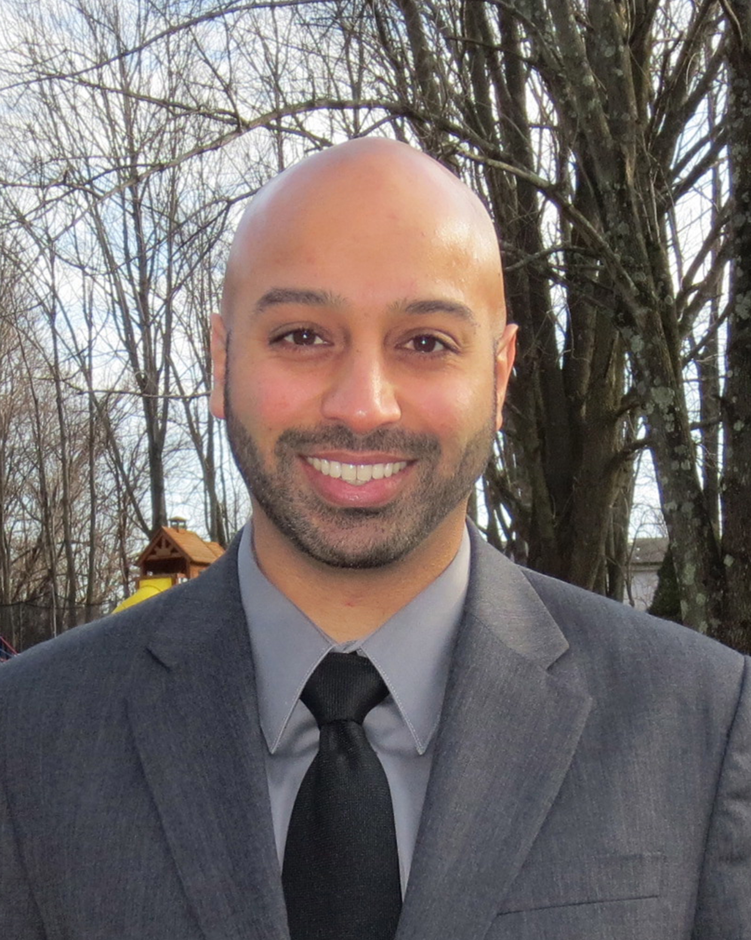
Engaging the community
to optimize science policies and operations
to maximize JWST’s science return
NASA HQ
JWST Project
STScI
Director
Massimo Stiavelli
STScI JWSTMO Head
Science MO
JWST MO
JSTAC
advisory to STScI
JWST SWG
advisory to NASA
User Community
Jason Kalirai
JWSTMO Project Scientist
Rachel Osten
JWSTMO Deputy Project Scientist

Slide 8
JWST Science Planning Timeline
(as of 2014Feb)
2015
2016
2017
2018
2019
2020
2021
launch
2018Oct

Slide 9
JWST Science Planning Timeline
(as of 2014Feb)
commissioning proposals
commissioning (6 mo)
2015
2016
2017
2018
2019
2020
2021
launch
2018Oct

Slide 10
Classes of Observations
Commissioning [6 mo: 2018 Oct-2019 Apr]
- full schedule of deployment & check-out activities
- limited set of science calibration obs possible
- science obs highly unlikely

Slide 11
JWST Science Planning Timeline
(as of 2014Feb)
commissioning proposals
commissioning (6 mo)
2015
2016
2017
2018
2019
2020
2021
launch
2018Oct

Slide 12
JWST Science Planning Timeline
(as of 2014Feb)
commissioning proposals
GO CP
2017Nov
GO cy1
deadline
2018Feb
commissioning (6 mo)
cycle 1
2019Apr
GTO & GO
2015
2016
2017
2018
2019
2020
2021
launch
2018Oct

Slide 13
JWST Science Planning Timeline
(as of 2014Feb)
commissioning proposals
GO CP
2017Nov
GO cy1
deadline
2018Feb
commissioning (6 mo)
cycle 1
2019Apr
GTO & GO
2015
2016
2017
2018
2019
2020
2021
Cy2 CP
mid-late 2019
launch
2018Oct

Slide 14
Classes of Observations
Commissioning Program [6 mo: 2018 Oct-2019 Apr]
- full schedule of deployment & check-out activities
- limited set of science calibration obs possible
- science obs highly unlikely
Guest Observer Program [2019 Apr -]
- use GO programs from HST, Spitzer, Chandra, etc. as models
- flexible to accommodate programs with range of sizes
- support archival research
- details TBD, consultations with JSTAC

Slide 15
JWST Science Planning Timeline
(as of 2014Feb)
commissioning proposals
GO CP
2017Nov
GO cy1
deadline
2018Feb
commissioning (6 mo)
cycle 1
2019Apr
GTO & GO
2015
2016
2017
2018
2019
2020
2021
Cy2 CP
mid-late 2019
launch
2018Oct

Slide 16
JWST Science Planning Timeline
(as of 2014Feb)
commissioning proposals
GO CP
2017Nov
GO cy1
deadline
2018Feb
commissioning (6 mo)
cycle 1
2019Apr
GTO & GO
7 mo
2015
2016
2017
2018
2019
2020
2021
GTO CP
2016Nov
Cy2 CP
mid-late 2019
launch
2018Oct
GTO targets
selected
2017Mar

Slide 17
Classes of Observations
Commissioning Program [6 mo: 2018 Oct-2019 Apr]
- full schedule of deployment & check-out activities
- limited set of science calibration obs possible
- science obs highly unlikely
Guest Observer Program [2019 Apr -]
- use GO programs from HST, Spitzer, etc. as models
- will accommodate programs with range of sizes
- support archival research
- details TBD, consultations with JSTAC
Guaranteed Time Observation Program [2019 Apr -]
- 3,960 hr total allocation in first 30 mo. after commissioning
- ~10% of time available in nominal 5 yr lifetime

Slide 18
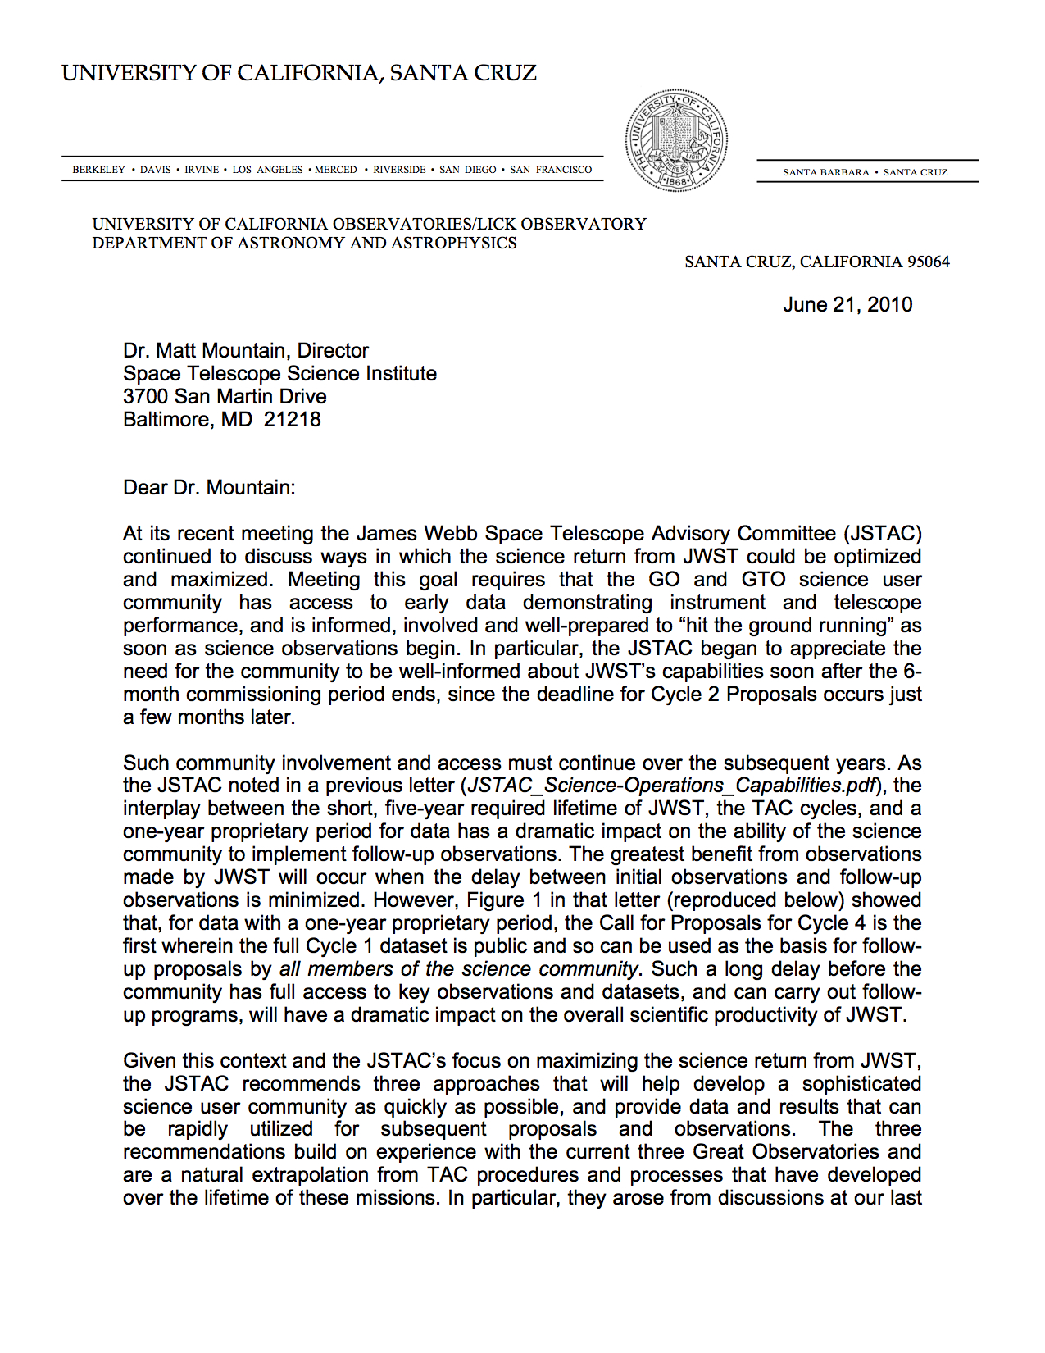
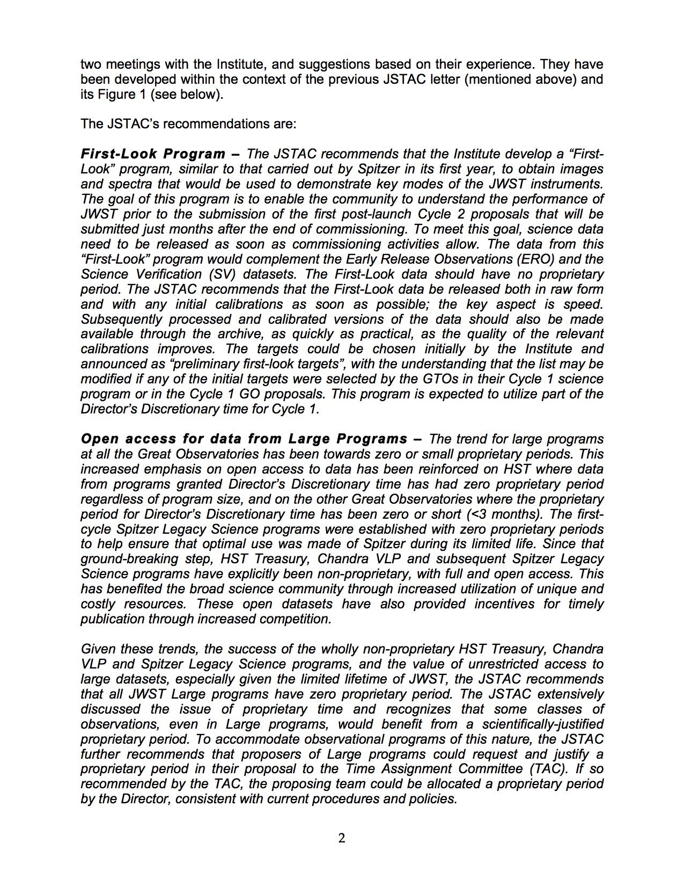
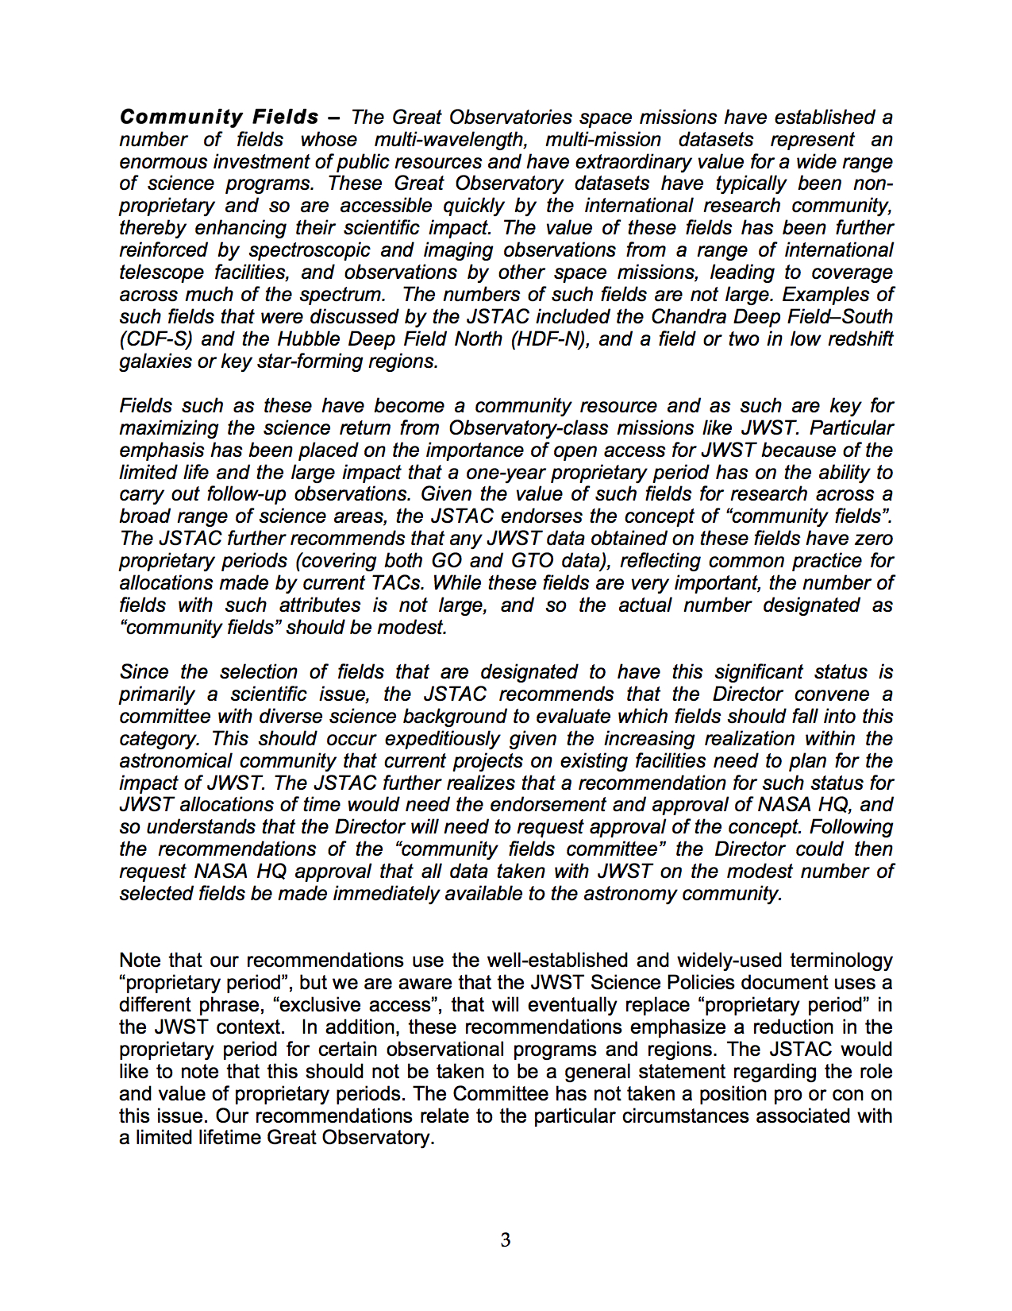
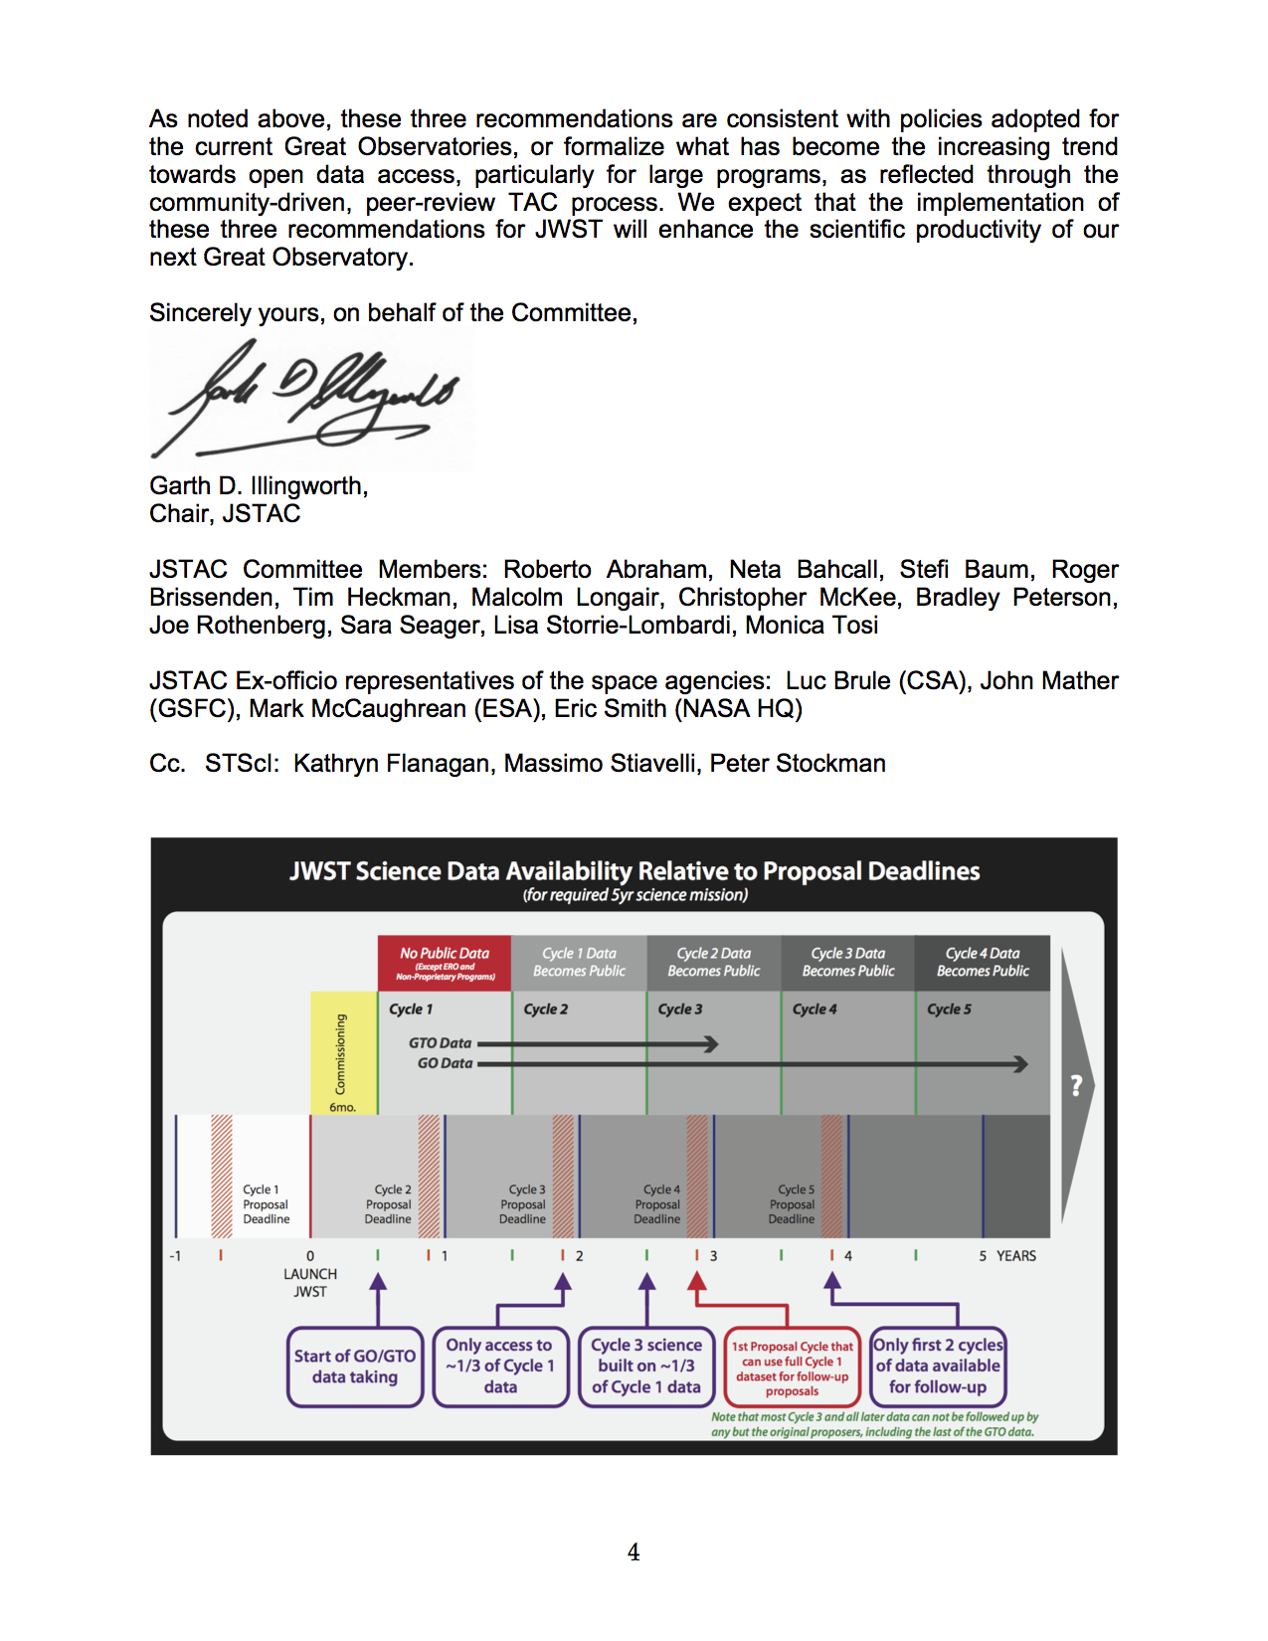
Classes of Observations
Early Release Science Program
- implementation recommended by JSTAC, but size/scope TBD
2010 June

Slide 19
Classes of Observations
Early Release Science Program
- implementation recommended by JSTAC, but size/scope TBD
“..to obtain images and spectra that would be used to demonstrate key modes of the JWST instruments. The goal of this program is to enable the community to understand the performance of JWST prior to the submission of the first post-launch Cycle 2 proposals that will be submitted just months after the end of commissioning.”
“The data from this `First-Look’ program would complement the Early Release Observations (ERO) and the Science Verification (SV) datasets.”
Program will be supported by Director’s Discretionary Time, and data will be non-proprietary
“The JSTAC recommends that the First-Look data be released both in raw form and with any initial calibrations as soon as possible; the key aspect is speed.”
- The JSTAC reaffirmed its support for the ERS program at its 2013May meeting.

Slide 20
Thanks to the NIRcam team for organizing the workshop.
We look forward to the white paper and to the future of
exoplanet science with JWST.
Additional Resources
JW Primer, Science Planning Timeline, Calculators
http://www.stsci.edu/jwst/
JWST Advisory Committee (JSTAC)
http://www.stsci.edu/jwst/advisory-committee
JWST Science Working Group
http://www.jwst.nasa.gov/workinggroup.html
http://www.stsci.edu/jwst/science/science-working-group
STScI Contacts
Neill Reid, Science Mission Office Head
inr@stsci.edu
Jason Kalirai, JWST Mission Office Project Scientist
jkalirai@stsci.edu

