Slide 1
Snapshot Phase Curves
Krick, Ingalls, Carey, Grillmair,
IRAC Team

Slide 2
Snapcurves – P80016
Suppose you don’t have stability on long (day) timescales, but you think you have a well characterized instrument.
Or you don’t want to observe an entire phase
Or can’t observe an entire phase.
Is it possible to recover a phase curve with random snapshot observations?

Slide 3
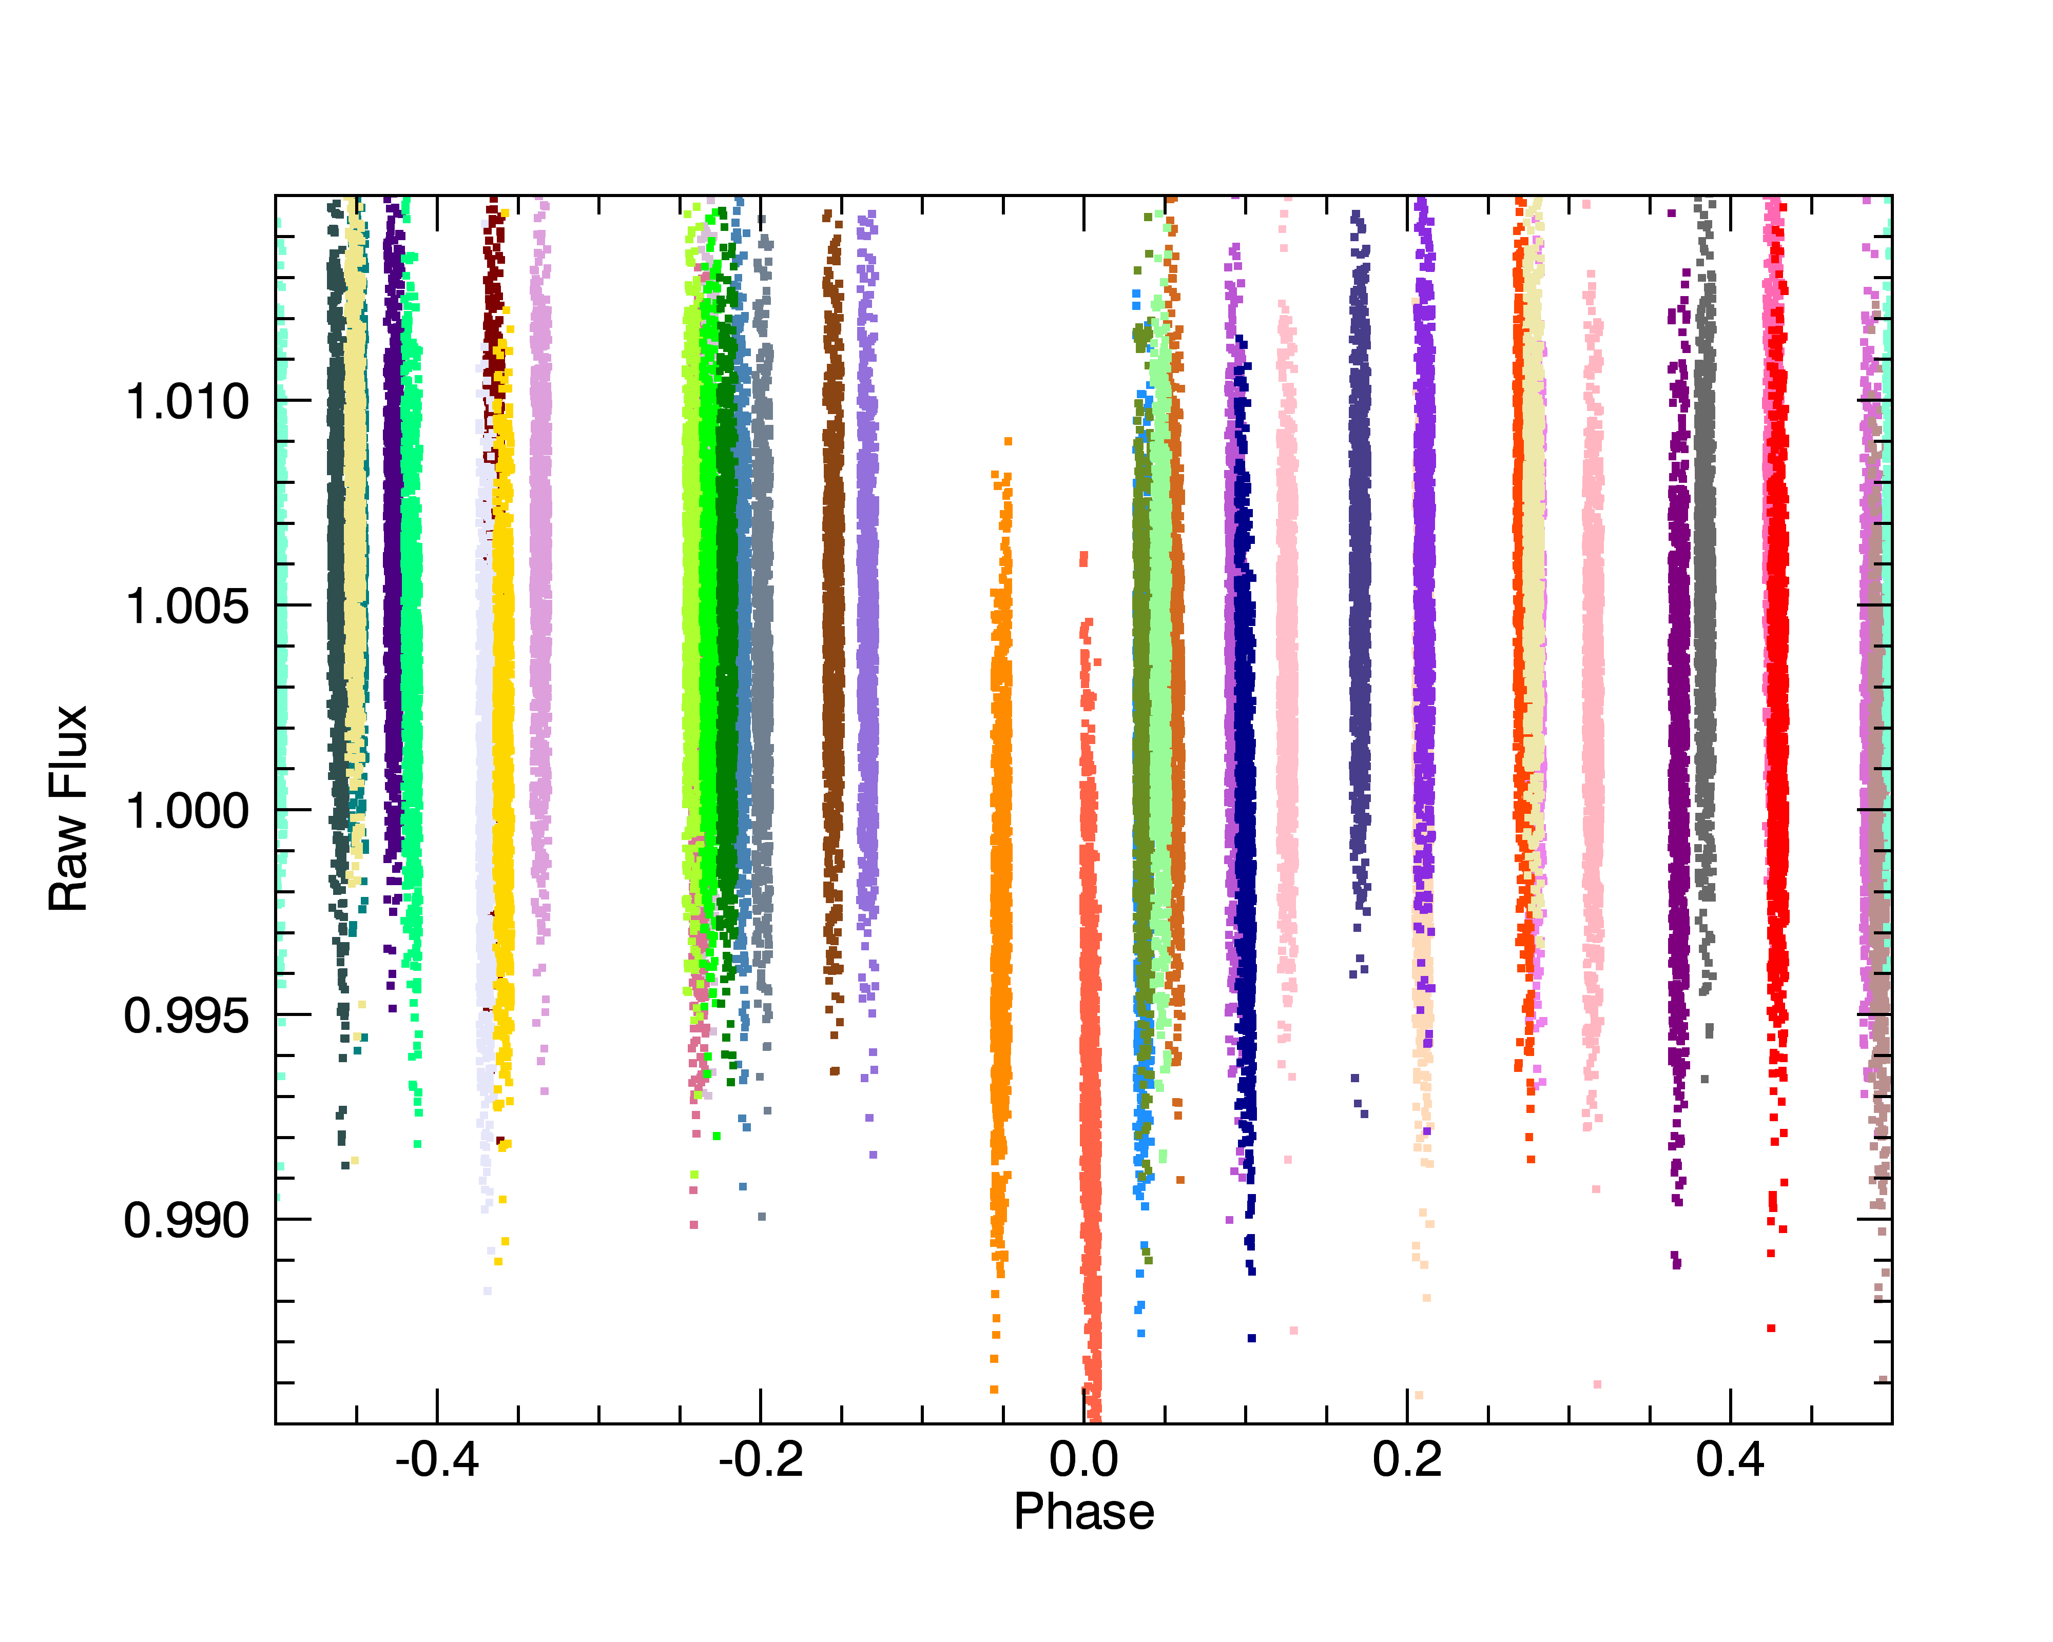
Preliminary Results - raw

Slide 4
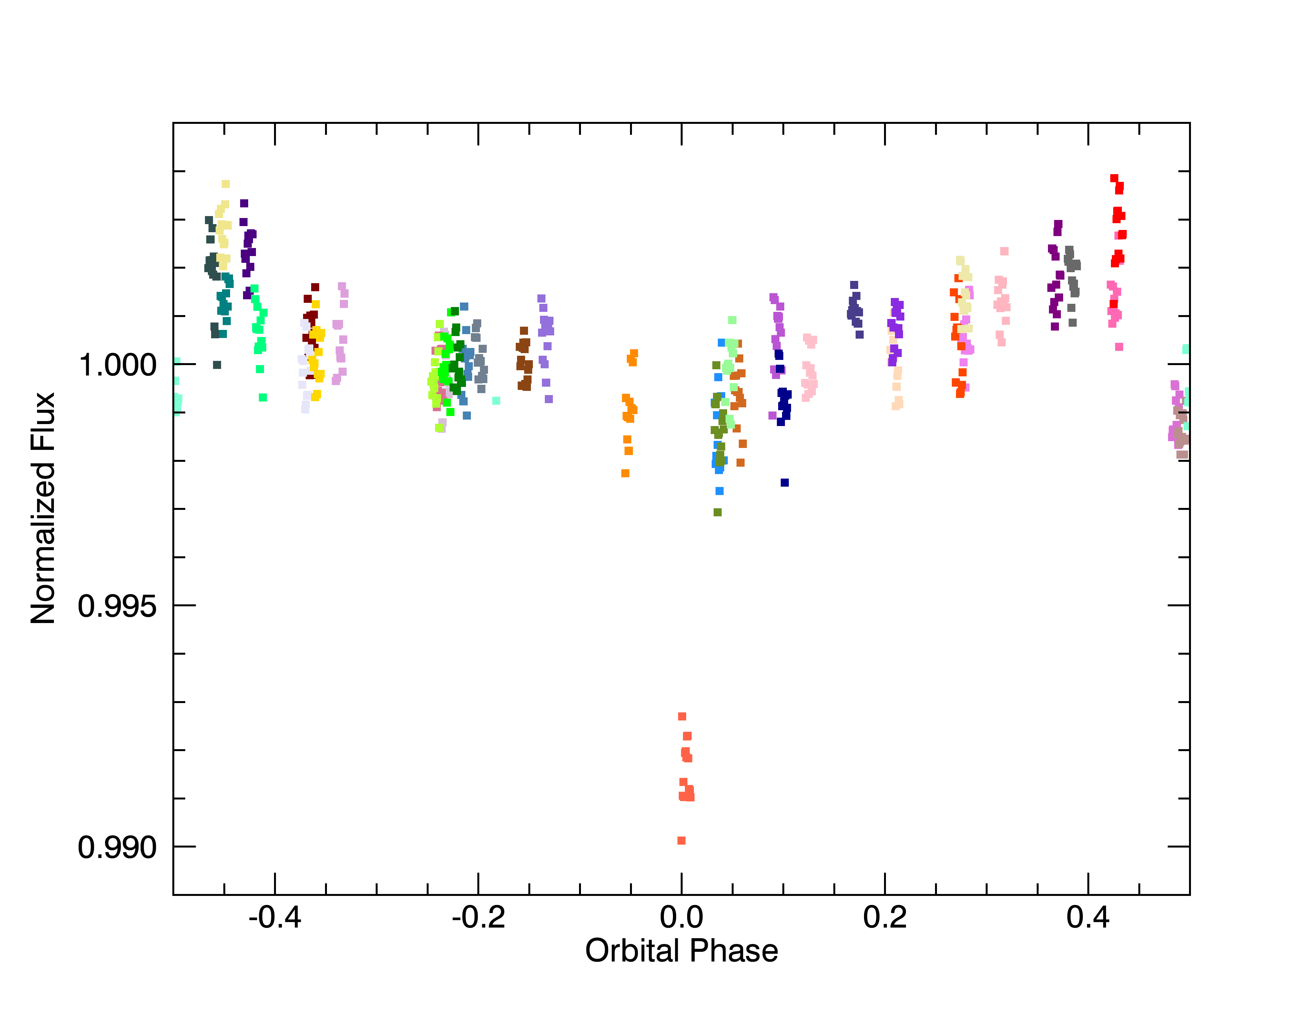
Preliminary Results - corrected

Slide 5
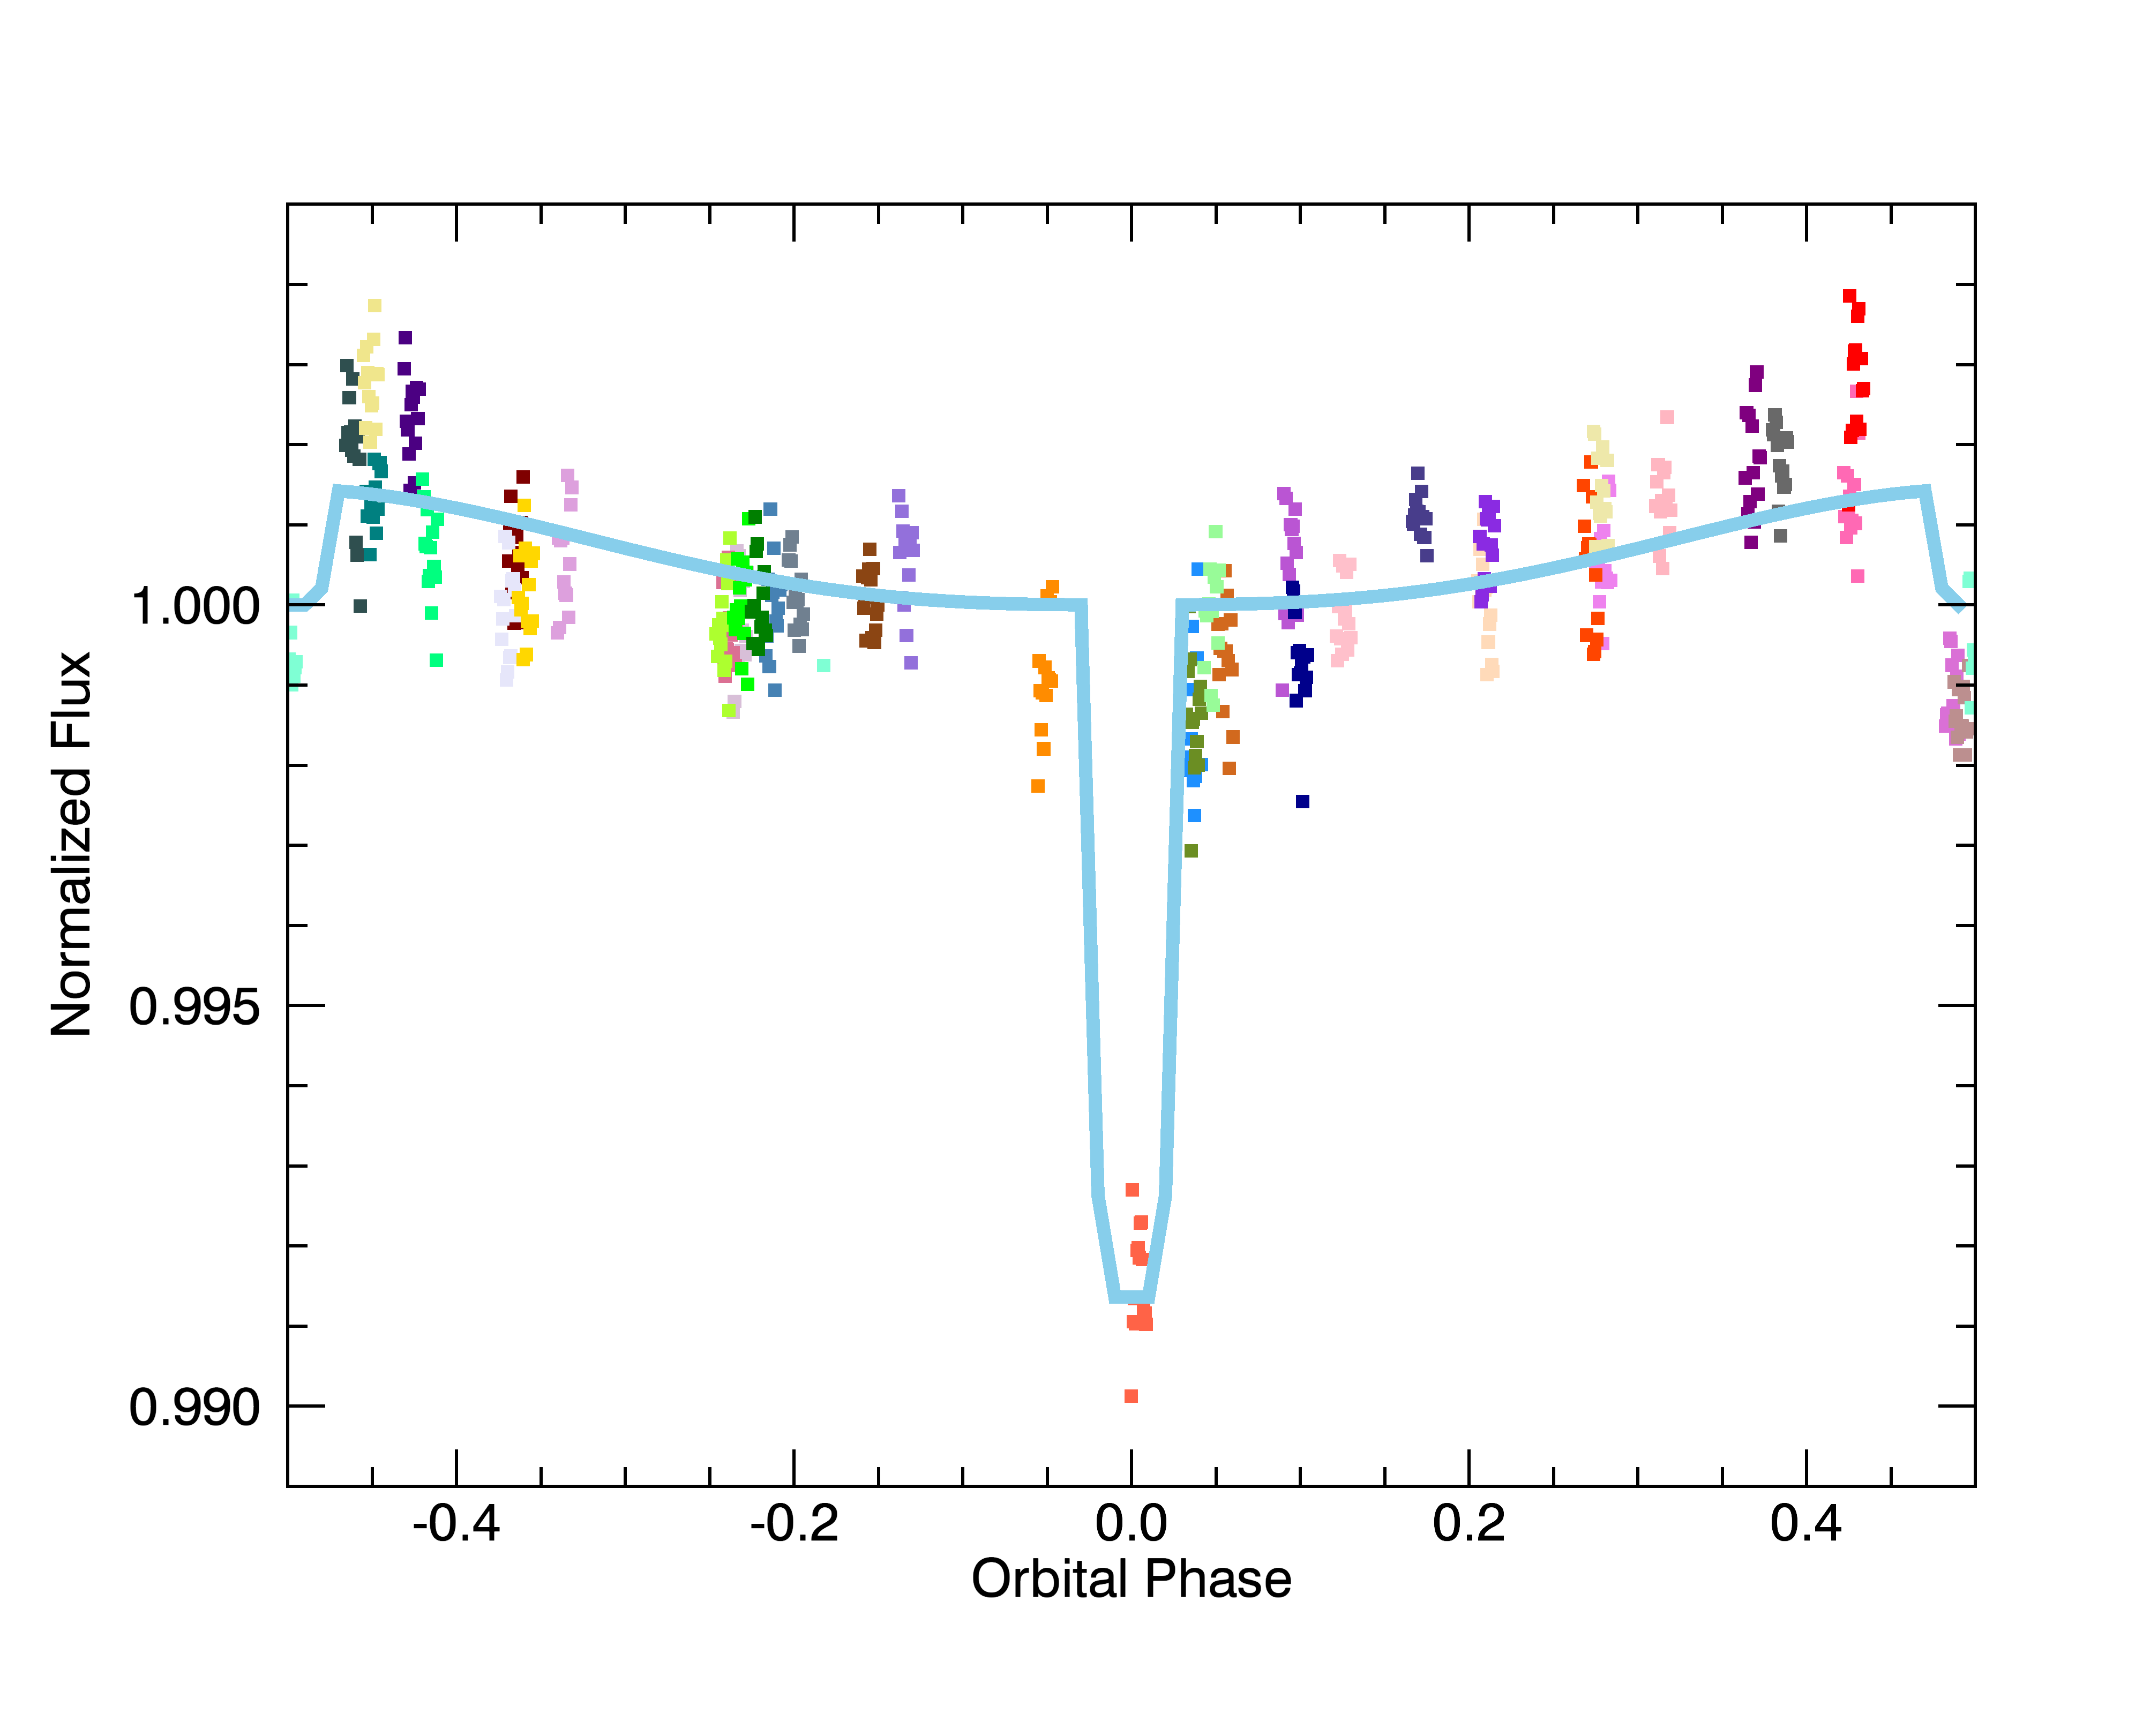
Preliminary Results – fit

Slide 6
Challenges
Gain as a function of position & undersampling
Pmap data which is not the observation itself
Residual non-linearity
Is randomly observing possible?
Assumes no changes in phase curve between phases

Slide 7
Time Series Data Reduction With IRAC: Identifying and Removing Sources of Correlated Noise
Boston AAS splinter session
Sunday June 1, 2014 1:00 – 5:30pm
Short talks about warm data reduction
Data challenge
Please contact Sean Carey, Carl Grillmair, Jim Ingalls or Jessica Krick at the SSC for details

