Slide 1
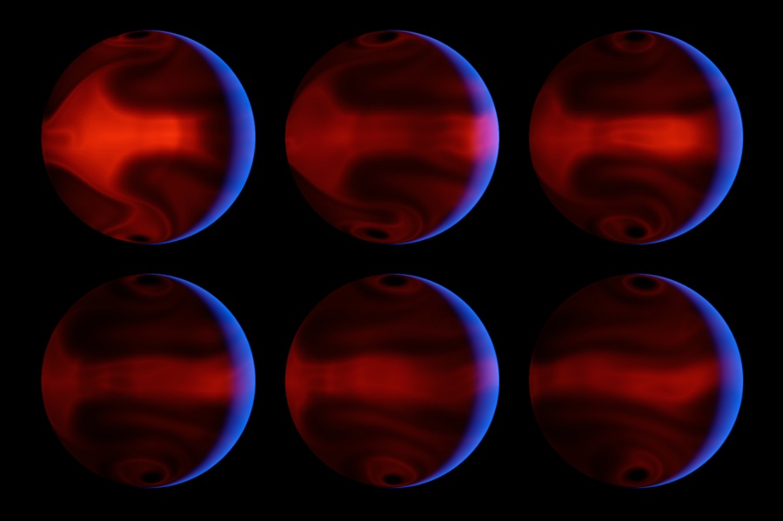
Atmospheric Dynamics of Extrasolar Planets
Circulation models for HD 80606b (Laughlin et al. 2009).
Image credit D. Kasen (UCSC)/NASA/JPL-Caltech
Heather Knutson
Division of Geological and Planetary Sciences
California Institute of Technology

Slide 2
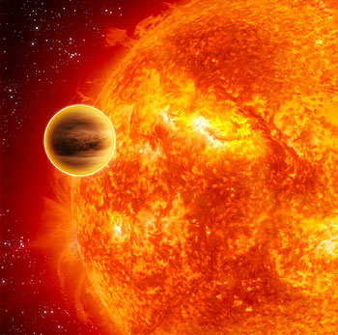
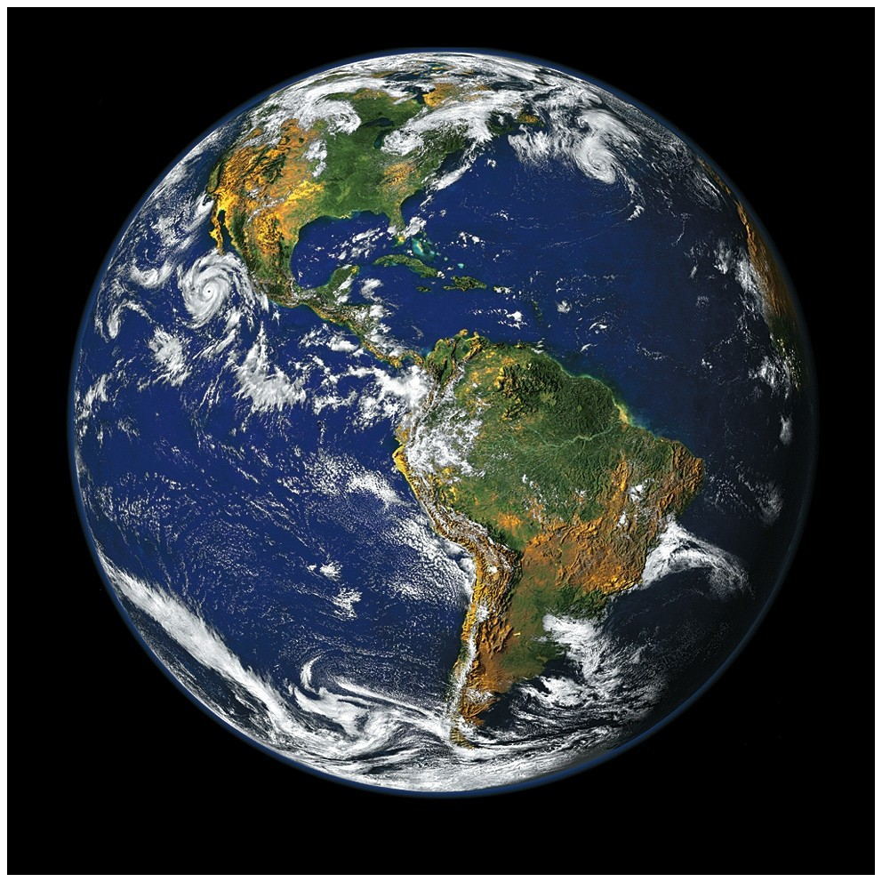
Image credit: ESA/C. Carreau
Exotic Exoplanet Climates
Circulation model for HD 80606b Laughlin et al. 2009, image credit D. Kasen (UCSC)/NASA/JPL-Caltech
Tidally locked planets may have large thermal and/or chemical gradients between the two hemispheres.
Planet’s slow rotation means that the circulation should be global in scale (broad jets, large vortices).
Jupiter at 4.8 μm.
Image credit Glen Orton
Potentially habitable Earths orbiting M stars are also likely to be tidally locked. How do atmospheres behave in this regime?

Slide 3
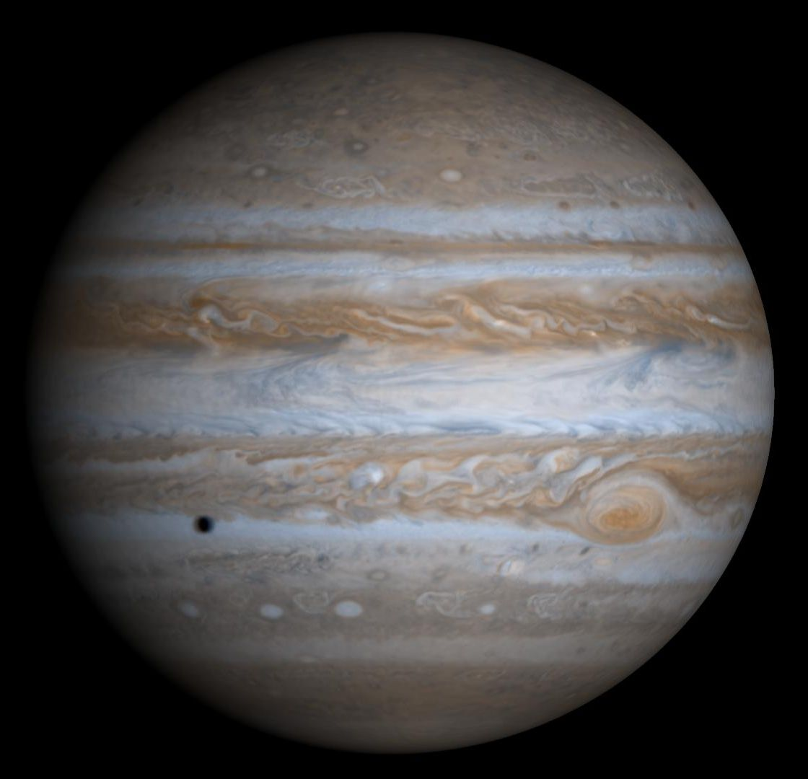
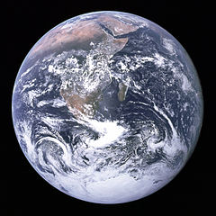
The Science and the Art of Climate Modeling
Exoplanet models adapted from solar system templates.
Limited computing power forces trade-offs between spatial resolution and relevant physics.
Models tuned to reproduce Earth, Jupiter, but same choices might not be appropriate for exoplanets.
Earth and Jupiter to scale.

Slide 4
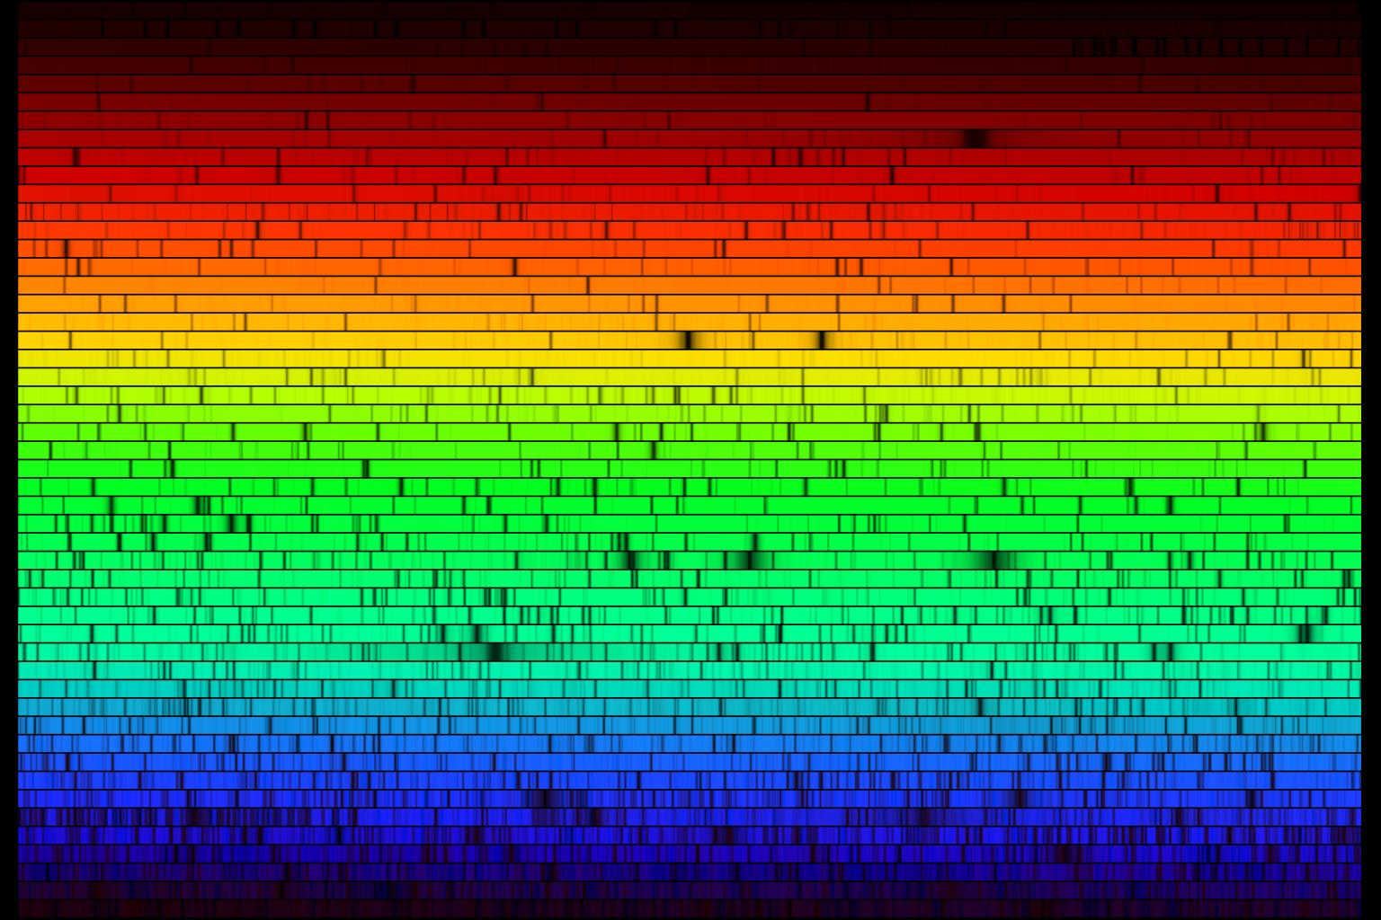
Testing Climate Models: From the Simple to the Complex
What is the day-night temperature gradient?
What are the locations of the hottest and coldest regions?
Multi-wavelength
How does this structure vary with altitude/pressure?
How does the composition of the atmosphere vary with location?

Slide 5
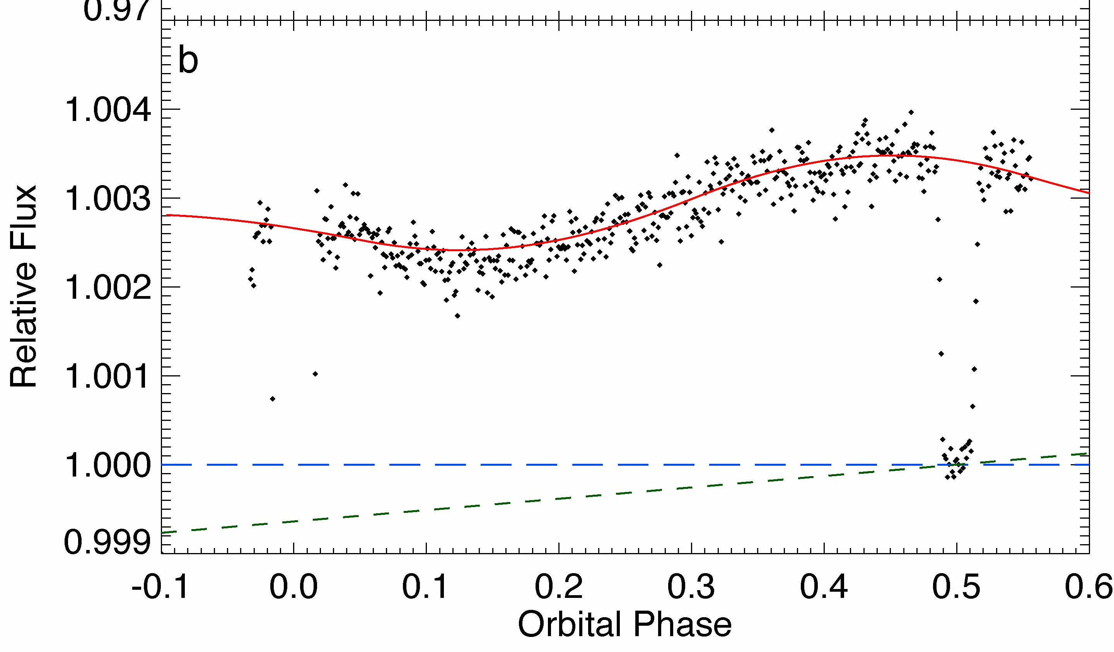
Phase Curves 101: An Example from Spitzer
1200 K hot spot
1000 K cold spot
Phase curve for HD 189733b observed at 8 μm with Spitzer (Knutson et al. 2007)
Observer’s View of Planet

Slide 6
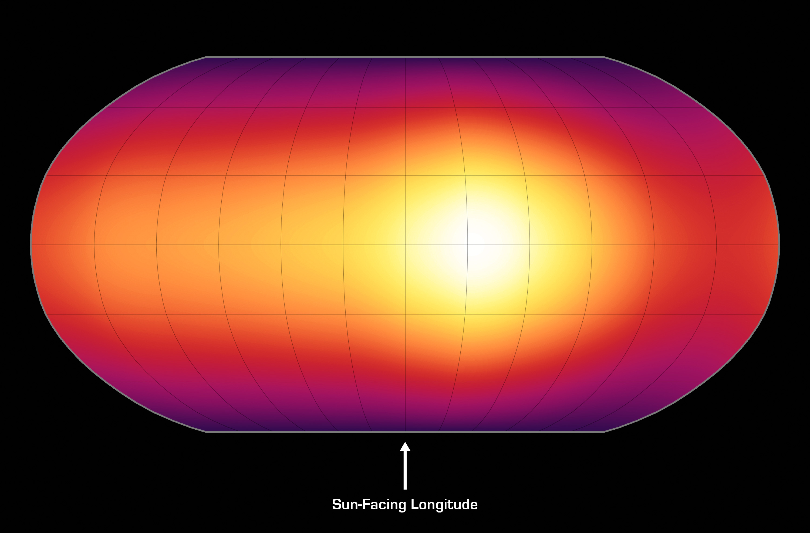
End Result: A Longitudinal Brightness Map
No information on vertical (latitudinal) temperature gradient
Cooler gas on night side
Hot spot on day side
Nature, May 14 2007
Notes:
Talk about model fit, early data near transit.

Slide 7
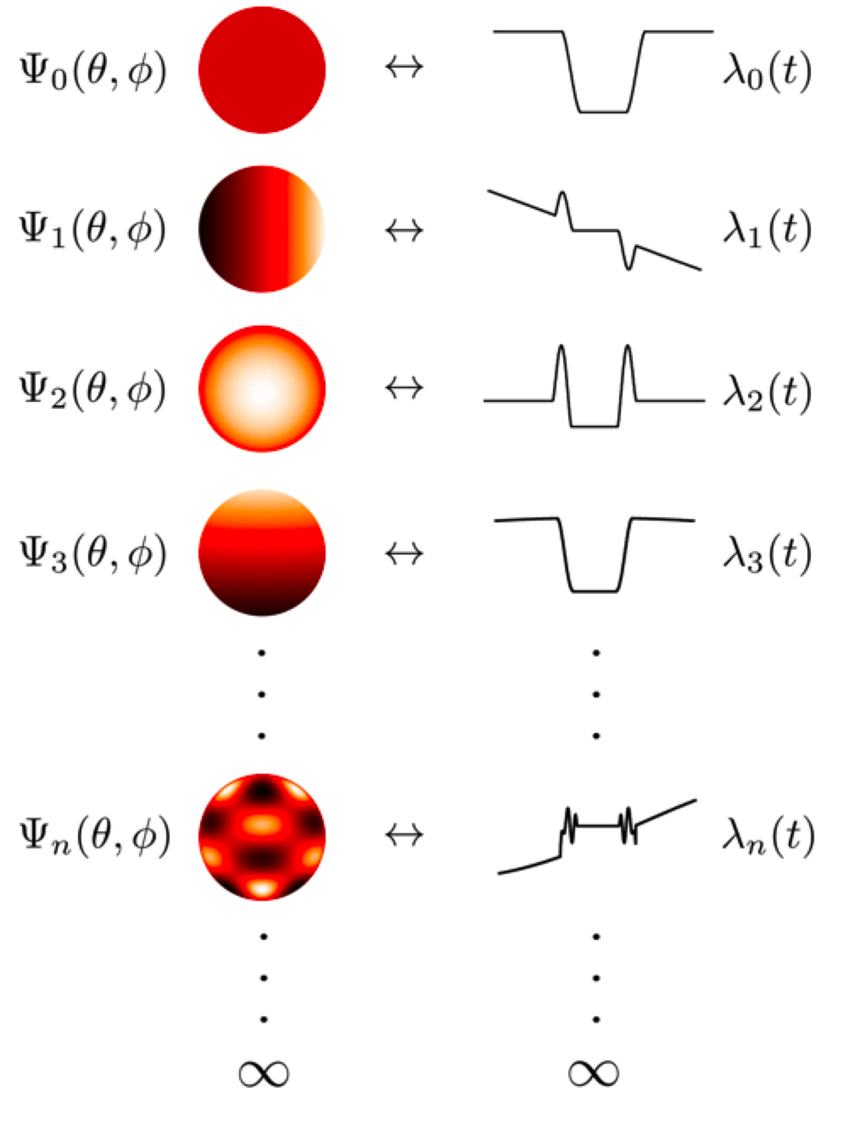
Secondary Eclipse Mapping: A Complementary Way to Study Climate
Ingress
Egress
HD 189733b 8 μm secondary eclipse (Agol et al. 2010, de Wit et al. 2012, Majeau et al. 2012).
Majeau, Agol, & Cowan (2012)
Also see Williams et al. (2006).

Slide 8
Secondary Eclipse Mapping is Sensitive to Temperature Gradients in Longitude and Latitude
Majeau, Agol, & Cowan (2012)

Slide 9
Testing Climate Models: From the Simple to the Complex
What is the day-night temperature gradient?
What are the locations of the hottest and coldest regions?
Multi-wavelength
How does this structure vary with altitude/pressure?
How does the composition of the atmosphere vary with location?

Slide 10
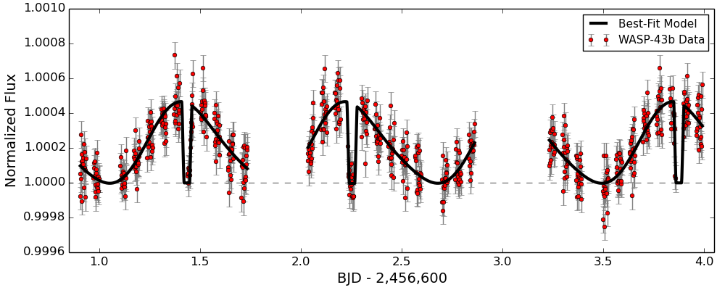
The New Frontier: Spectroscopic Phase Curves
White-light phase curve spanning three planet orbits (3 days).
40 HST orbits of the transiting hot Jupiter WASP-43b observed with HST WFC3 spectroscopy from 1.1-1.7 μm (Stevenson et al. in prep.)
Notes:
Minimum occurs *before* the transit!! Feature observed in 8 micron data is likely a detector effect related to the detector ramp, which we didn’t know about at the time of that publication. 8 micron contrast is either 247 +/- 51 K or 160 +/- 51 K, and 24 micron contrast is 236 +/- 48 K or 188 +/- 48 K.

Slide 11
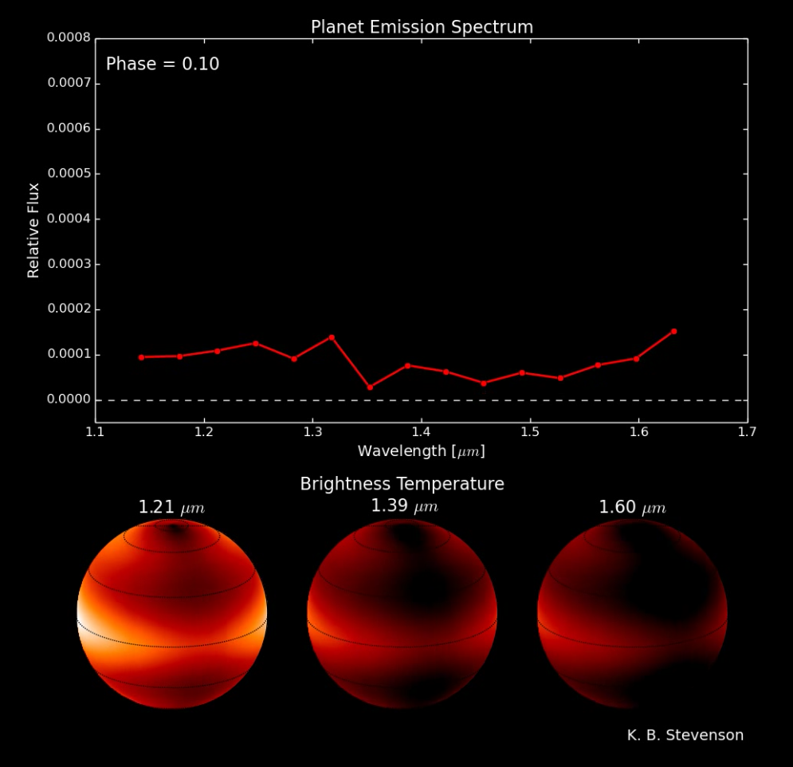
Night Side Spectrum + Maps
Each wavelength probes a different depth in the atmosphere.
Notes:
Minimum occurs *before* the transit!! Feature observed in 8 micron data is likely a detector effect related to the detector ramp, which we didn’t know about at the time of that publication. 8 micron contrast is either 247 +/- 51 K or 160 +/- 51 K, and 24 micron contrast is 236 +/- 48 K or 188 +/- 48 K.

Slide 12
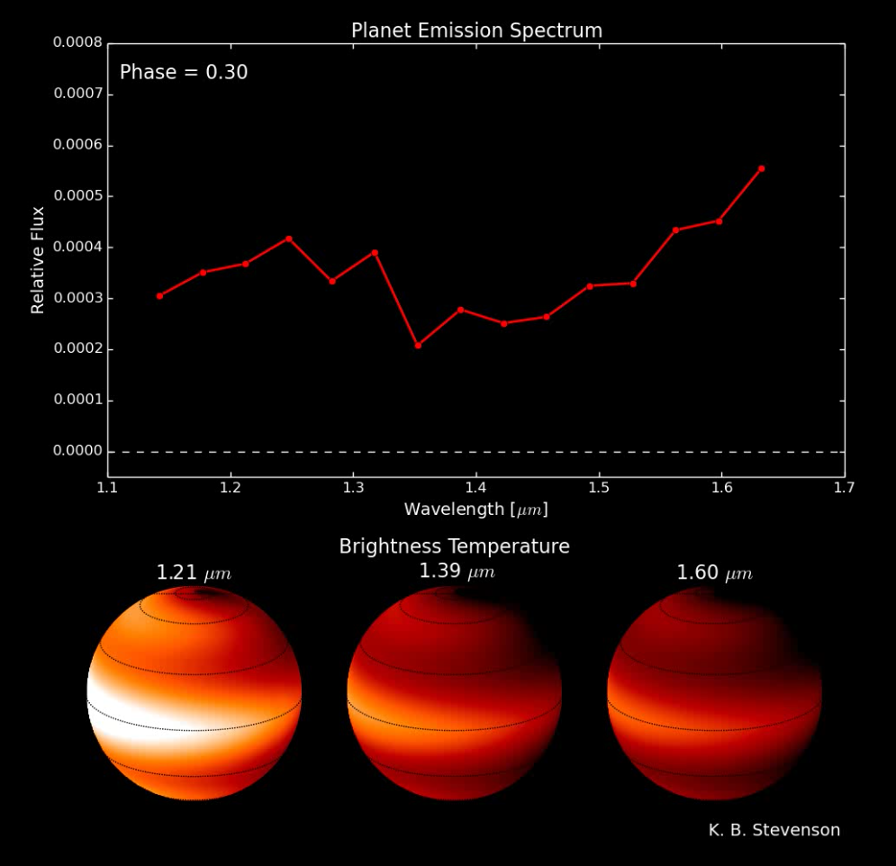
Quarter Phase Spectrum + Maps
Notes:
Minimum occurs *before* the transit!! Feature observed in 8 micron data is likely a detector effect related to the detector ramp, which we didn’t know about at the time of that publication. 8 micron contrast is either 247 +/- 51 K or 160 +/- 51 K, and 24 micron contrast is 236 +/- 48 K or 188 +/- 48 K.

Slide 13
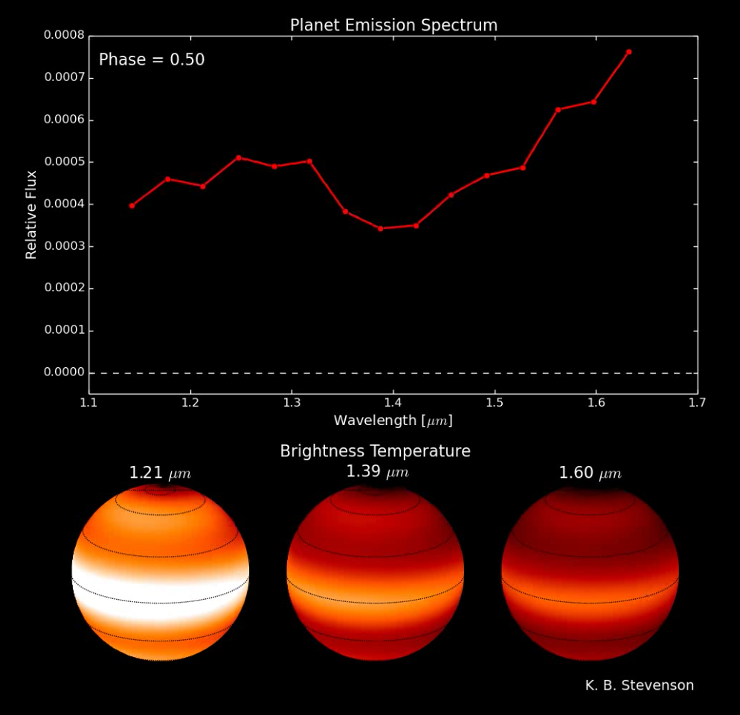
Day Side Spectrum + Maps
Water absorption
Spectra constrain chemical and thermal gradients.
Notes:
Minimum occurs *before* the transit!! Feature observed in 8 micron data is likely a detector effect related to the detector ramp, which we didn’t know about at the time of that publication. 8 micron contrast is either 247 +/- 51 K or 160 +/- 51 K, and 24 micron contrast is 236 +/- 48 K or 188 +/- 48 K.

Slide 14
Testing Climate Models: From the Simple to the Complex
What is the day-night temperature gradient?
What are the locations of the hottest and coldest regions?
Multi-wavelength
How does this structure vary with altitude/pressure?
How does the composition of the atmosphere vary with location?

Slide 15
What Can We Learn From IR Phase Curves of Terrestrial Planets?
1. Airless planets will have larger phase curve amplitudes as compared to planets with thick atmospheres.
2. Even band-integrated phase curve shapes are still sensitive to patchy clouds.
3. Would require nearly photon-limited precision on time scales of weeks (months) for a tidally locked 2 R_{Earth} planet in the habitable zone of a late (early) M star.
See Yang, Cowan, & Abbott (2013) for more information.

Slide 16
The need for spectroscopy: Planets are not blackbodies (and we shouldn’t treat them that way).
Image credit G. Orton
Notes:
Understanding how the properties of the planet vary as a function of longitude is crucial for interpreting the dayside emission spectra from secondary eclipse obs.

Slide 17
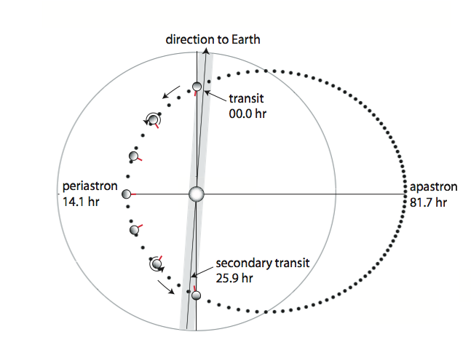
For eccentric planets, must worry about time-varying heating as well.
Figure courtesy G. Laughlin
Peak flux occurs 4-6 hours after periastron passage.
(Lewis et al. 2013)
HAT-P-2b
5 day orbit
e=0.52
3.6 μm
Notes:
Minimum occurs *before* the transit!! Feature observed in 8 micron data is likely a detector effect related to the detector ramp, which we didn’t know about at the time of that publication. 8 micron contrast is either 247 +/- 51 K or 160 +/- 51 K, and 24 micron contrast is 236 +/- 48 K or 188 +/- 48 K.

Slide 18
Yang, Cowan, & Abbot (2013)
Notes:
Minimum occurs *before* the transit!! Feature observed in 8 micron data is likely a detector effect related to the detector ramp, which we didn’t know about at the time of that publication. 8 micron contrast is either 247 +/- 51 K or 160 +/- 51 K, and 24 micron contrast is 236 +/- 48 K or 188 +/- 48 K.

