Slide 1
Kepler – Best Performance and Best Practices
JWST Transit Planning Meeting
March 11, 2014
Jessie Christiansen
jessie.christiansen@caltech.edu

Slide 2
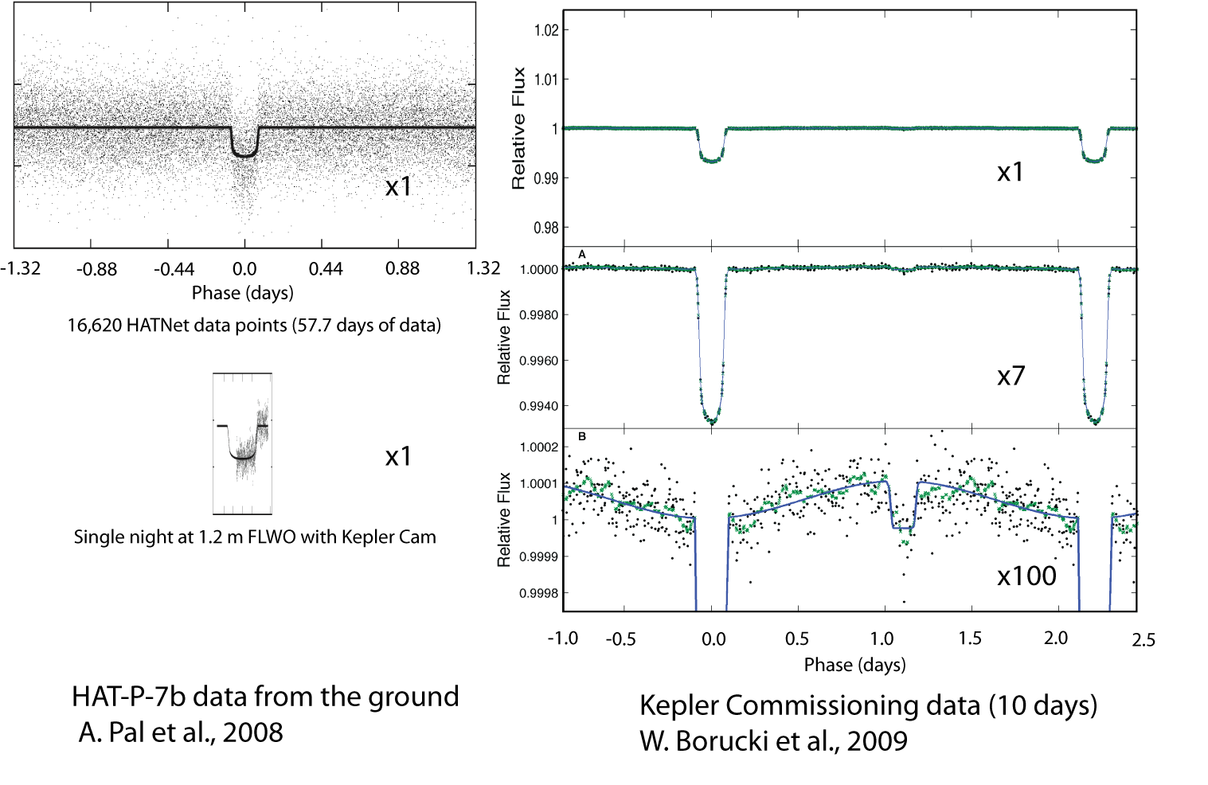
How to build an exquisite photometer

Slide 3
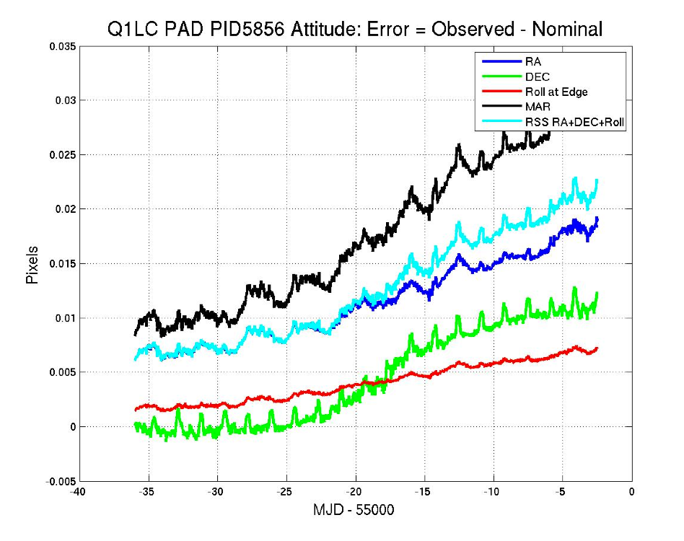
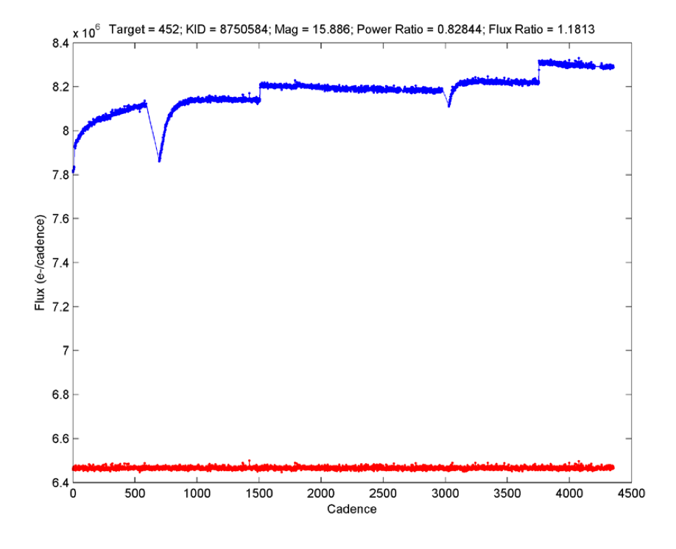
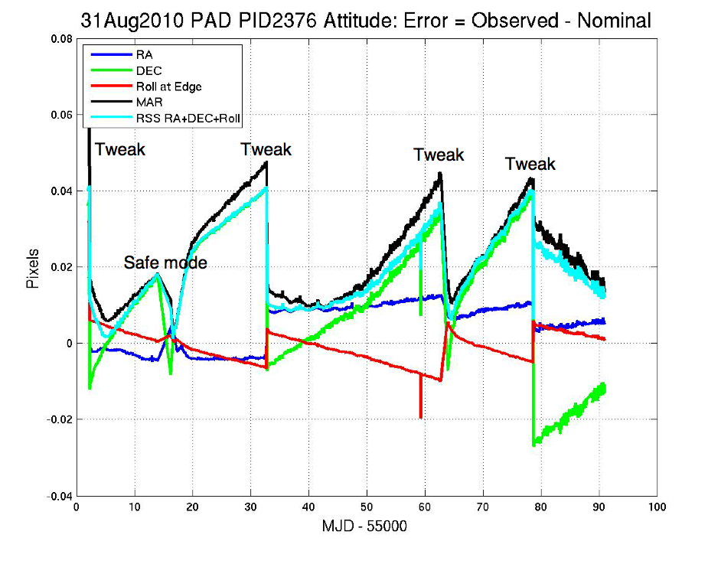
Pointing
Pre-launch requirement of 3mas (~1 millipixel) pointing jitter in 15 mins
Measured month to month drift 10-15 millipixels
Largely eliminated the requirement for absolute flatfielding (large scale flat a geometric model derived from optics)
Tweaks/sudden impulses are substantially more difficult to cotrend/detrend after the fact (we modified the ADCS to eliminate the drift)
This will be more of an issue with K2

Slide 4
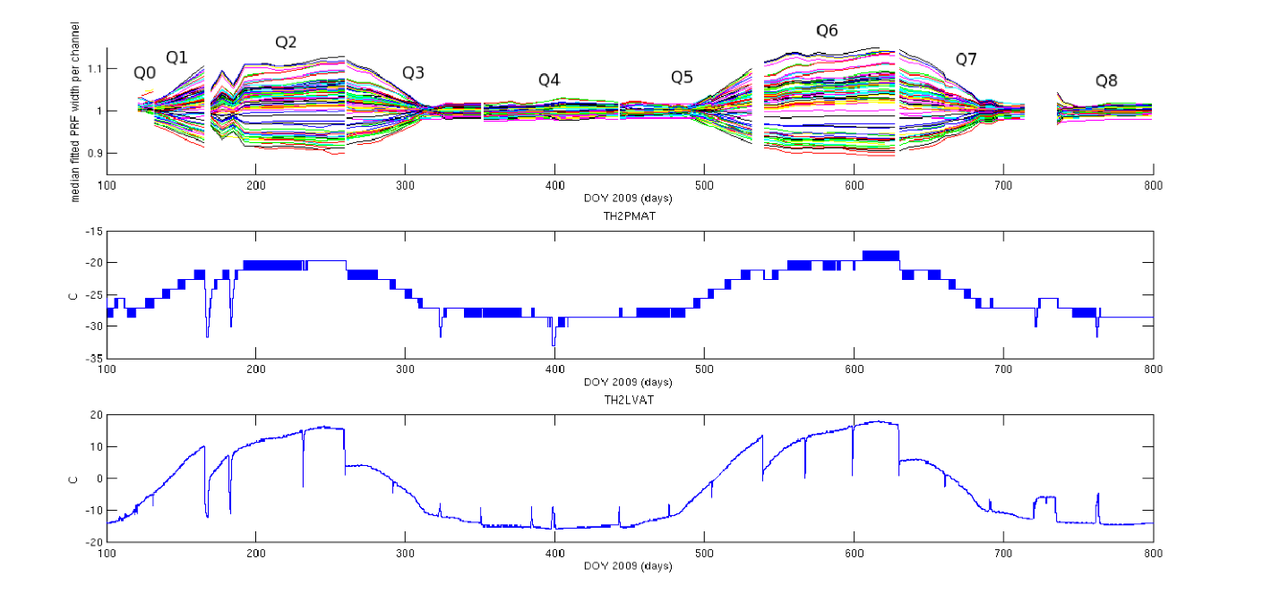
Focus
We’re building an $8b thermometer
Ideally, separate temperature change timescales from scientific timescales
As much thermal ancillary data as possible (reaction wheel heaters! etc)
Tailor photometry method to capture flux – either large apertures or PRF-fitting
L2/sun shade = excellent
Too
quantized

Slide 5
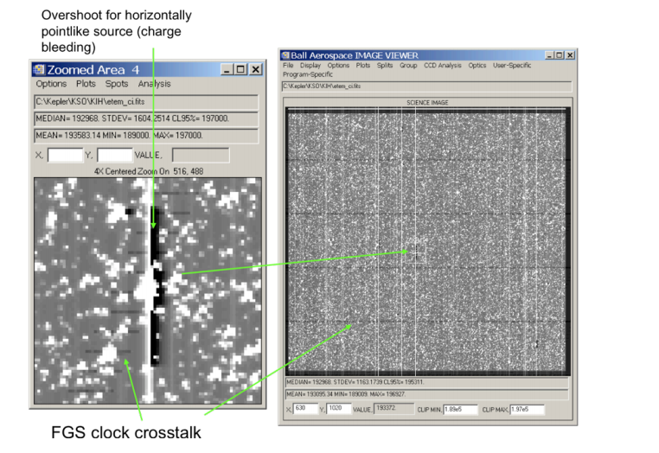
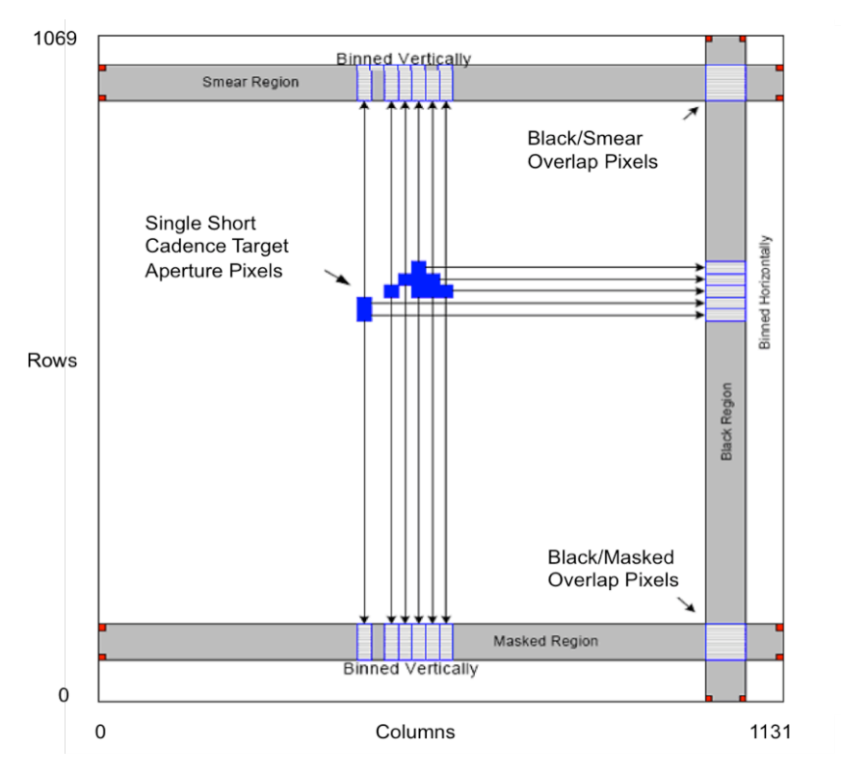
Calibration
Test early, test often
Don’t scrimp on calibration pixels
- Undershoot was 10x worse when found, but was found early enough in testing that some patches were able to be made
- Moire pattern (resonance in the LDE amplifier circuit), not so much

Slide 6
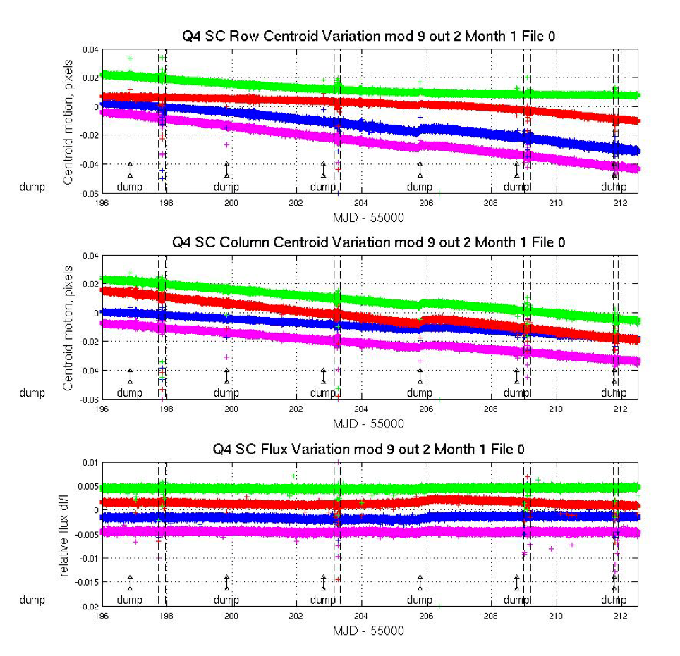
Reaction wheels
Better pointing jitter achieved with higher RPM (Kepler was more stable with three wheels at high RPM than four wheels at low RPM)
Zero crossings degraded pointing and flux time series – if timing is negotiable, try to keep them away from transits

Slide 7
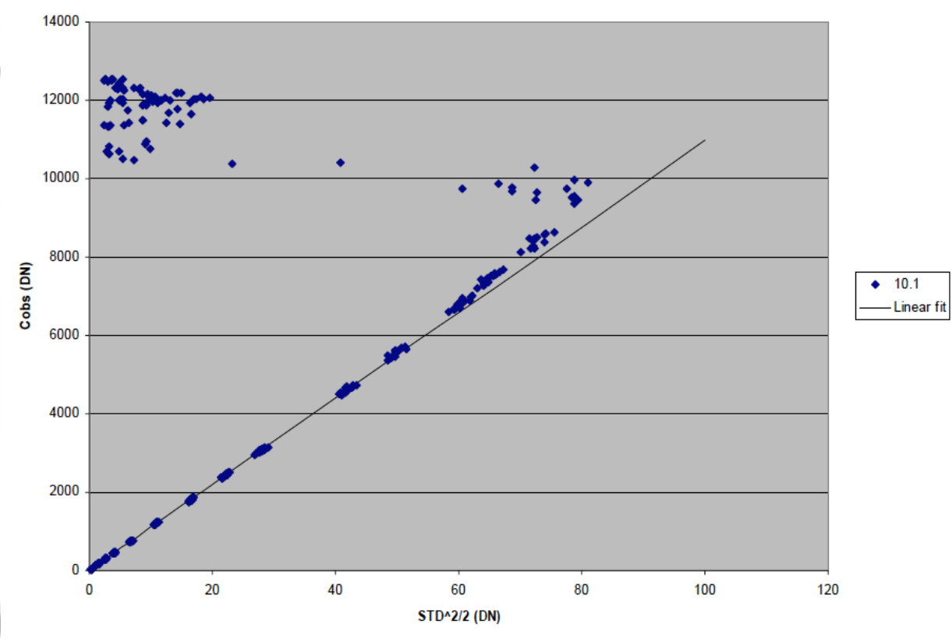
Saturation
Don’t be afraid of saturation!
(If you have a handle on your non-linearity and you have the ability to capture the spilled charge).
Theta Cyg (4.5th mag),
CH Cyg (8th mag)
Bright TESS and K2 targets should be on the table

Slide 8
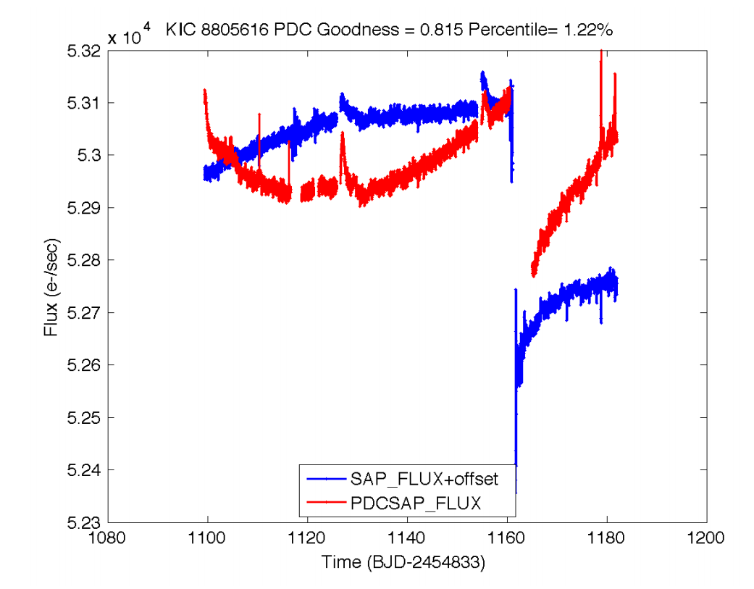
Gotchas
Provide multiple levels of processing/calibration
Time system – Kepler AND EPOXI both had trouble
Accumulation of high-energy particle hits on the detectors (SPSDs, CMEs…)
Try not to use variable stars as guide stars
Don’t forget about Jupiter! (And solar system objects in general…)

