Slide 1
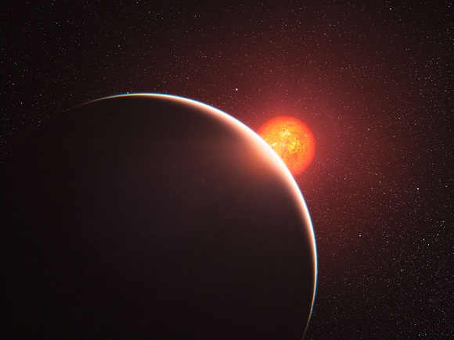
M Dwarfs as Targets for JWST
Funding provided by NSF GRFP awarded to CD & NASA Kepler PSP awarded to DC
Courtney Dressing
& David Charbonneau
Harvard-Smithsonian Center for Astrophysics
JWST Transit Planning Meeting
March 12, 2014
Image credit: ESO/L. Calçada

Slide 2
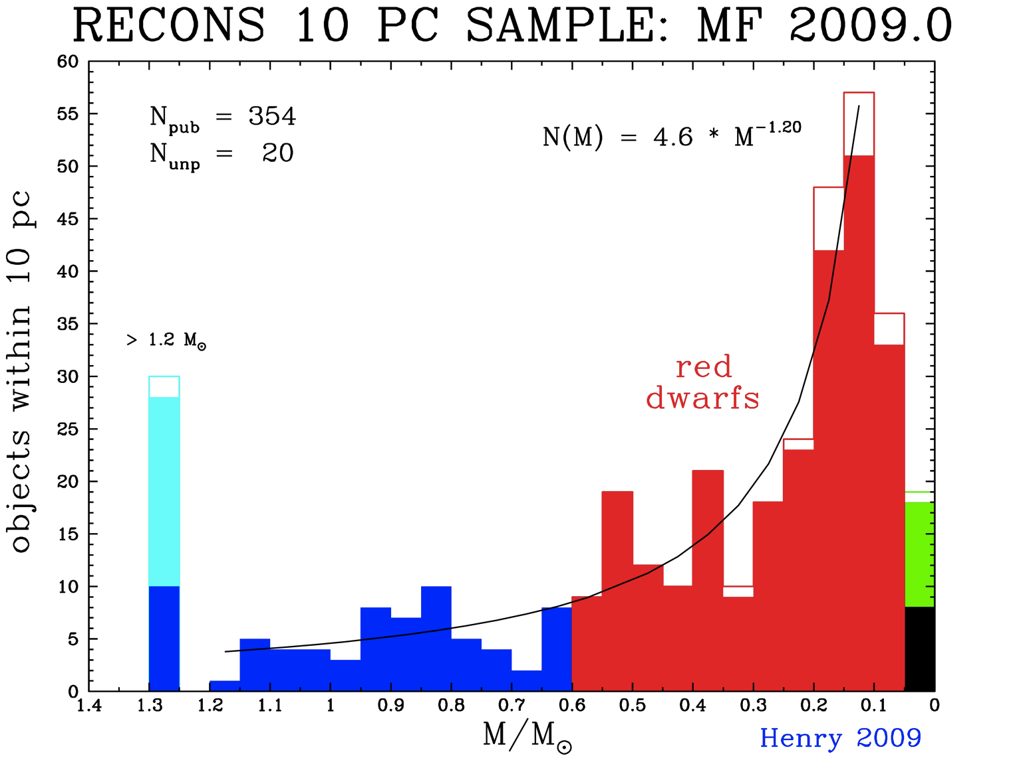
Motivation
M dwarfs are plentiful, nearby, and small

Slide 3
Methodology
Generate stellar sample
Assign planets to stars based on Kepler occurrence rates
Query properties of the transiting planet host stars
Assess detectability & plan for JWST observations (rest of this meeting)

Slide 4
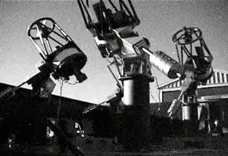
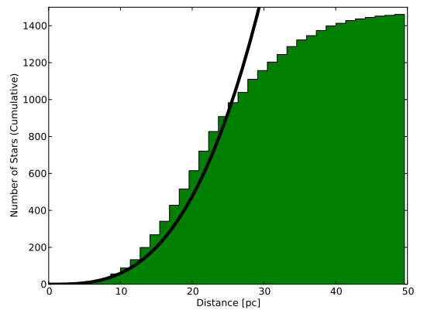
Step 1: Construct Stellar Sample
Number of Stars
(Cumulative)
Dittmann et al. 2013
MEarth telescopes in Arizona
Distance (pc)
Notes:
MEarth sample complete to 25 pc for M5.5 & earlier. Complete to 20 pc for later type stars.

Slide 5
Step 1: Construct Stellar Sample
Incorporate additional stars within 33pc
from Lepine 2005
Notes:
These stars may have been excluded from the original MEarth catalog because of their lower proper motions

Slide 6
Step 1: Construct Stellar Sample
Hipparcos Main Catalog (Perryman et al. 1997)

Slide 7
Step 1: Construct Stellar Sample
Yale Parallax Catalog (van Altena et al. 1995)

Slide 8
Step 1: Construct Stellar Sample
Correct for incompleteness in the southern sky.

Slide 9
Step 2: Estimate Planet Occurrence Rate
Analytic expression from Berta et al. 2013 (based on Dressing & Charbonneau 2013)

Slide 10
Step 3: Host Star Properties

Slide 11
Step 3: Host Star Properties

Slide 12
Step 3: Host Star Properties

Slide 13
Implications
 | All Transiting | Small HZ Transiting
Number within 20 pc | 79 (-5/+6) | 8.1 (-3.1/+2.9)
Distance to closest (pc) | 2.5 (-0.5/+2.4) | 9.1 (-3.7/+3.5)
Brightest in J | 4.2 (-0.5/+1.2) | 6.3 (-0.8/+0.9)
Brightest in K | 3.3 (-0.5/+1.4) | 5.5 (-0.9/+0.9)
The most probable distance to the
nearest transiting Earth-size planet
in the habitable zone is 9 pc.

Slide 14
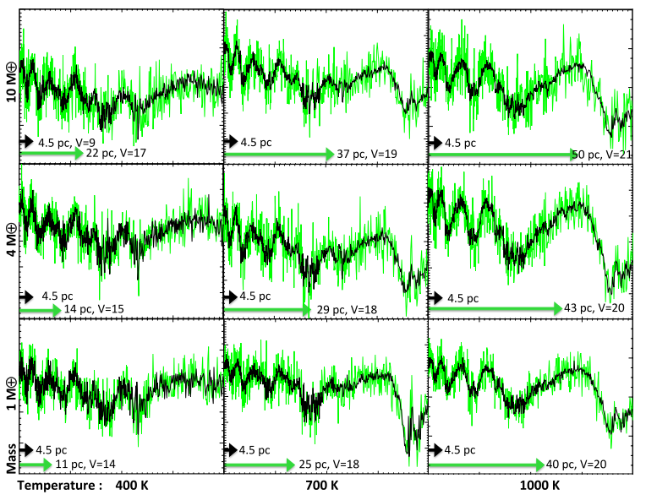
Detectability: Planet with Hydrogen-Rich Atmosphere around 0.2 M Star
Batalha et al. 2013

Slide 15
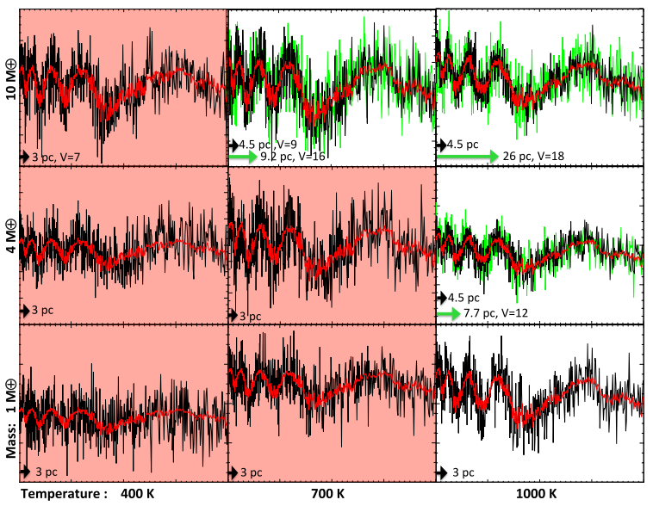
Detectability: Planet with Hydrogen-Poor Atmosphere around 0.2 M Star
Batalha et al. 2013

Slide 16
Revisiting the Stellar Sample
Compiled list of nearby stars
  Northern Stars Proper Motion Catalog (Lepine & Shara 2005)
  Northern stars within 33 pc (Lepine 2005)
  MEarth Trigonometric Parallax sample (Dittmann et al. 2013)
  Hipparcos Catalog (Perryman et al. 1997)
  Yale Parallax Catalog (van Altena et al. 1995)
Areas for improvement
  Census of southern M dwarfs
  Northern M dwarf sample incomplete beyond 25 pc
Future steps
  Use catalogs compiled for TESS & K2 target selection
  Incorporate GAIA distance estimates
Notes:
van Altena et al. 199

Slide 17
Ongoing Work:
Updating the Planet Occurrence Rate Estimate
  Measuring the detection threshold for M dwarfs
  Searching for additional planets in Q1-Q16 data
  Inspecting high-resolution follow-up images
  Checking for centroid shifts
  Comparing periods & ephemerides to known planets & EBs
  Incorporating false positive correction
  End Goals: Update planet properties & revise planet occurrence rate
Notes:
USE SNR Ramp of 6 sigma – 12 sigma (like Morton & Swift) based on their communication with Francois that the new Q1-Q8 KOI list is better characterized by a steeper ramp

Slide 18
Updated Estimate Using Q1-12 Data
& New HZ Boundaries
HZ: Kopparapu et al. 2013, ApJ 765: 131 Stellar Models: Dotter et al. 2008, ApJS, 178, 89

Slide 19
Updated Estimate Using Q1-12 Data
& New HZ Boundaries
0.56 (+0.32/-0.13)
0.5-1.4 R_{Earth} Planets per HZ
(See also Kopparapu 2013, Gaidos et al. 2013)
Planet Candidates: Q1-Q12 KOI List
HZ: Kopparapu et al. 2013, ApJ 765: 131 Stellar Models: Dotter et al. 2008, ApJS, 178, 89

Slide 20
Number of Earths per HZ
Paper | Eta Earth | HZ Inner Edge | HZ Outer Edge | Planet Properties
Bonfils+ 2013 | 0.41 (+0.54/-0.13) | Recent Venus (Selsis+2007) | Early Mars (Selsis+ 2007) | 1 < m sin I < 10 M_{Earth}
Gaidos 2013 | 0.46 (+0.18/-0.15) | 50% Clouds (Selsis+ 2007) | 50% Clouds (Selsis+ 2007) | R_{P} > 0.8 R_{Earth}
Kopparapu 2013 (Conservative) | 0.48 (+0.12/-0.24) | Moist Greenhouse (Kopparapu+ 2013) | Max Greenhouse (Kopparapu+ 2013) | 0.5 < R_{P} < 1.4 R_{Earth}
Kopparapu 2013 (Optimistic) | 0.61 (+0.07/-0.15) | Recent Venus (Kopparapu+ 2013) | Early Mars (Kopparapu+ 2013) | 0.5 < R_{P} < 2 R_{Earth}
Dressing & Charbonneau 2013 | 0.15 (+0.13/-0.06) | Water Loss (Kasting+ 1993) | CO₂ Condensation (Kasting+ 1993) | 0.5 < R_{P} < 1.4 R_{Earth}
Dressing & Charbonneau (in prep) | 0.56 (+0.32/-0.13) | Moist Greenhouse (Kopparapu+ 2013) | Max Greenhouse (Kopparapu+ 2013) | 0.5 < R_{P} < 1.4 R_{Earth}
Dressing & Charbonneau (in prep) | 0.66 (+0.25/-0.12) | Moist Greenhouse with Clouds (Yang+ 2013) | Max Greenhouse (Kopparapu+ 2013) | 0.5 < R_{P} < 1.4 R_{Earth}

Slide 21
Planet Detection Pipeline
Detrend & clean Kepler light curves
Generate Box-fitting Least Squares power spectrum for each star
Identify highest peaks & fit simple transit models
Excise data near accepted transits
Repeat until no new signals are detected
(Scott Fleming’s Fortran implementation of Kovacs et al. 2002)
Notes:
Accept & reject transiting planet interpretation based on delta chi-squared & ratio of maximum transit depth to median depth

Slide 22
We Recover Most Known KOIs

Slide 23
Transit Injection & Recovery

Slide 24
Implications
 | All Transiting | Small HZ Transiting
Number within 20 pc | 79 (-5/+6) | 8.1 (-3.1/+2.9)
Distance to closest (pc) | 2.5 (-0.5/+2.4) | 9.1 (-3.7/+3.5)
Brightest in J | 4.2 (-0.5/+1.2) | 6.3 (-0.8/+0.9)
Brightest in K | 3.3 (-0.5/+1.4) | 5.5 (-0.9/+0.9)
The most probable distance to the
nearest transiting Earth-size planet
in the habitable zone is 9 pc.

Slide 25
Additional Slides

Slide 26

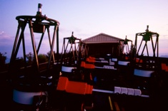
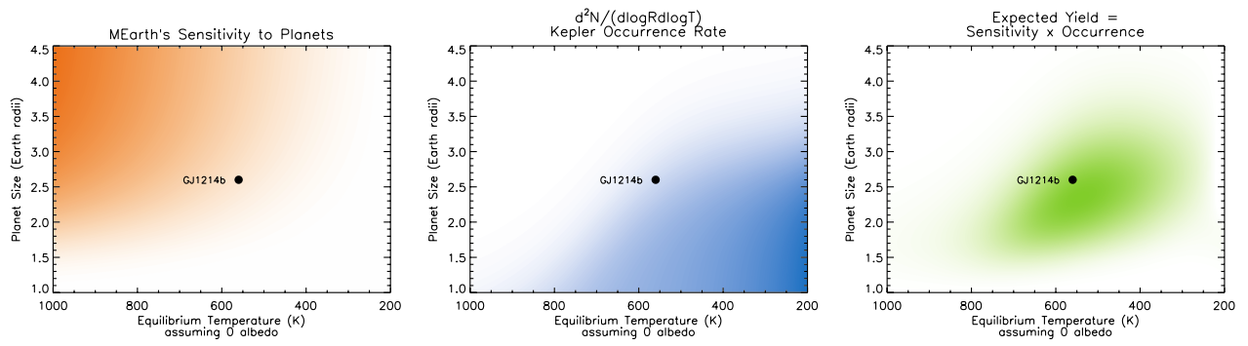
MEarth Results are Consistent with Occurrence Rates from Kepler
8 16” telescopes
Mount Hopkins, AZ
2008 - present
MEarth Team
Photo: J. Irwin
David Charbonneau (PI)
Jonathan Irwin
Jason Dittmann
Emilio Falco
Zachory K. Berta-Thompson
Elisabeth Newton
MEarth Sensitivity
Kepler Occurrence Rate
Estimated Planet Yield
Planet Size (Earth Radii)
Planet Size (Earth Radii)
Planet Size (Earth Radii)
GJ1214b
GJ1214b
GJ1214b
Planet Equilibrium Temperature
Planet Equilibrium Temperature
Planet Equilibrium Temperature
Berta et al. 2013, ApJ, 775, 91

Slide 27
Updated Estimate Using Q1-12 Data
& Kopparapu et al. 2013 HZ Boundaries
0.56 (+0.32/-0.13)
0.5-1.4 R_{Earth} Planets per HZ
(See also Kopparapu 2013, Gaidos et al. 2013)
Planet Candidates: Q1-Q12 KOI List
HZ: Kopparapu et al. 2013, ApJ 765: 131 Stellar Models: Dotter et al. 2008, ApJS, 178, 89

Slide 28
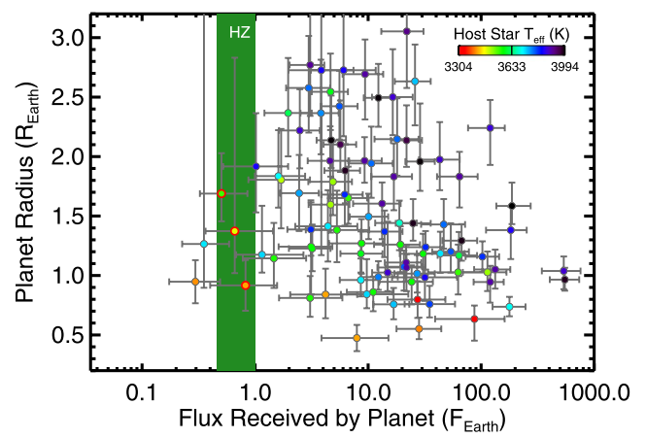
D+C 2013: M Dwarf Planet Occurrence Estimate using Q1-Q6 Data
0.15 (+0.13/-0.06) Earth-size planets per HZ
Dressing & Charbonneau 2013, ApJ, 767, 95
Notes:
Mention Muirhead, Mann, & spectra people.

Slide 29
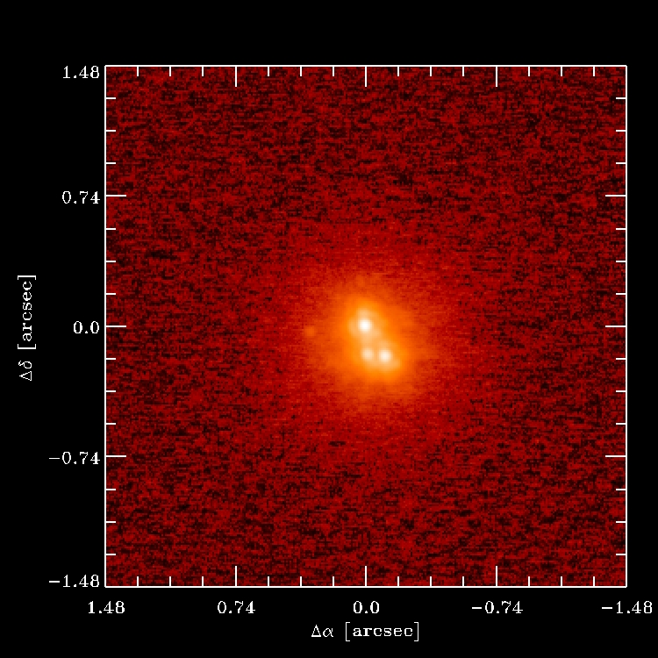
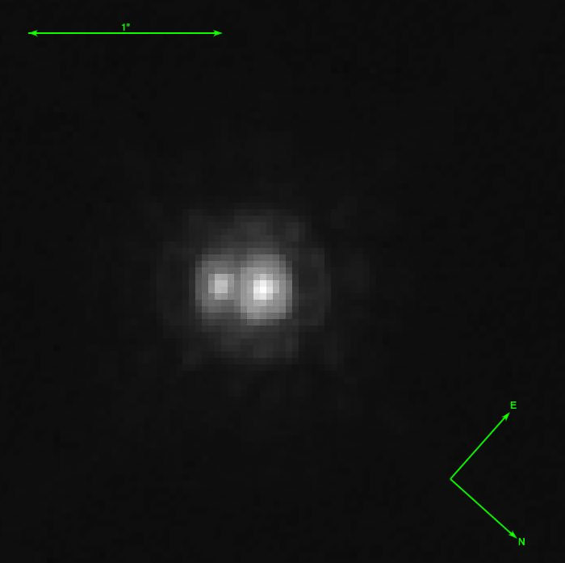

Follow-Up Images of Potentially Habitable KOIs
1”
KOI 2626
KOI 1422
Keck
Ciardi
HST
Gilliland
0.74”

Slide 30
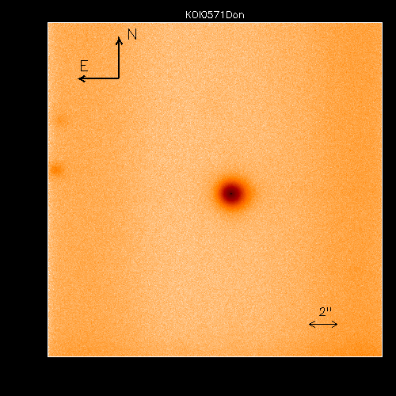
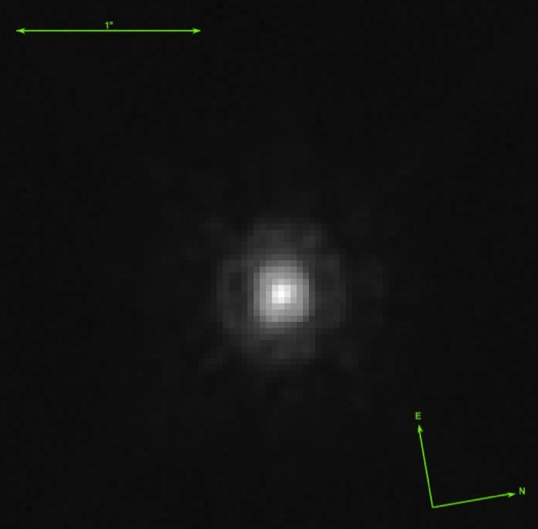

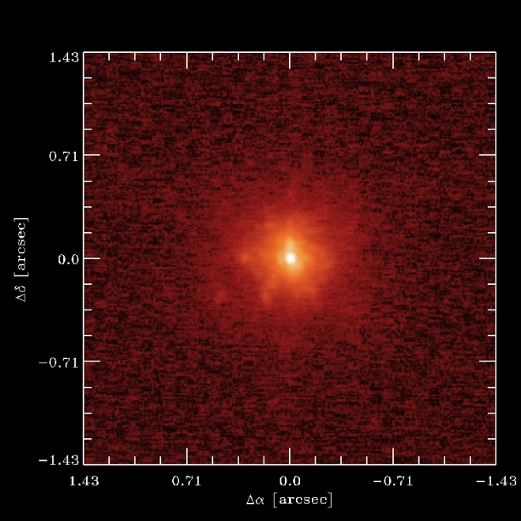
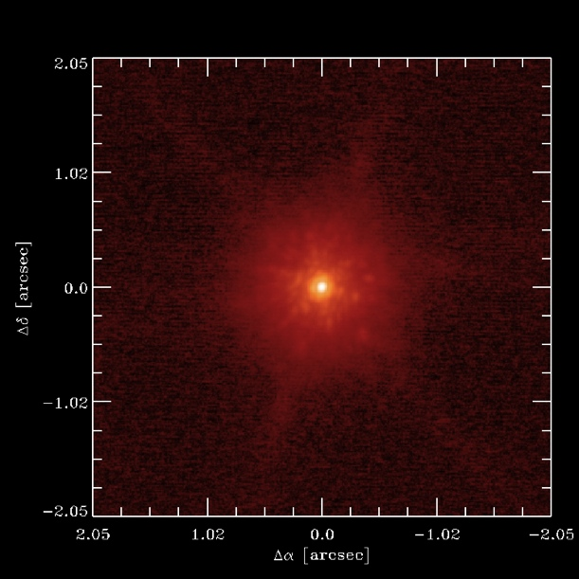
Follow-Up Images of Potentially Habitable KOIs
1”
1”
KOI 571
KOI 854
KOI 1686
AstraLux
Lillobox
HST
Gilliland
HST
Gilliland
2”
KOI 2418
KOI 4087
All images from the Kepler Community Follow-up Observing Program (CFOP) website
Keck
Ciardi
Keck
Ciardi
0.7”
1”

