Slide 1
Testing The Stability of JWST/NIRCam Grism Mode for Transit Observations
C. Beichman, Dimitra Touli,
Gautam Vasisht, Roger Smith
Tom Greene
4 March 2014

Slide 2
Caltech Detector Testbed
Caltech testbed (Roger Smith) projects simulated spectra and other images onto HgCdTe array to assess precision photometry for transits, weak lensing, etc. for Explorer concepts, JWST, WFIRST, EUCLID
For ELEKTRA and FINESSE we demonstrated <50 ppm with star fields (Clanton et al 2012) and spectra
For JWST we produce monochromatic bands of light simulating grism spectra as expected for NIRCam
Presently using SNAP 1.7 μm HgCdTe H2RG array, but shifting to 2.4 μm JWST flight-like unit from UofA
Goal to demonstrate ability to extract weak transit spectra at <<100 ppm.

Slide 3
ELEKTRA Explorer Projector
System (Caltech)
Lamp
>40mm square field
Star Field Simulation Mask Precision motion control
100 mm pupil
f/22 beam to detector.
19 um diffraction spot vs. 18 um pixel
Detector
Notes:
Actually I think we are stopped down to f/22 at present, so 19µm FWHM.

Slide 4
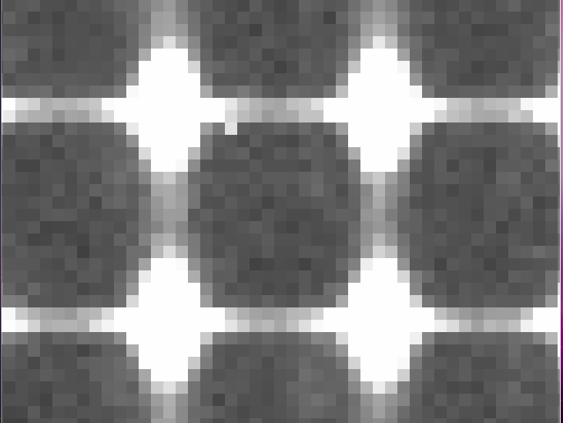
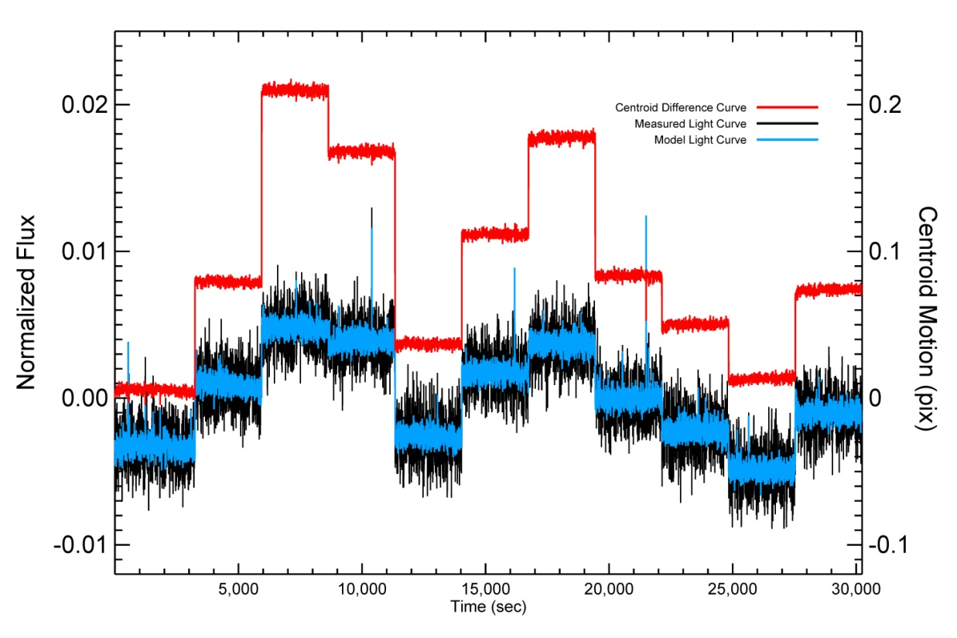
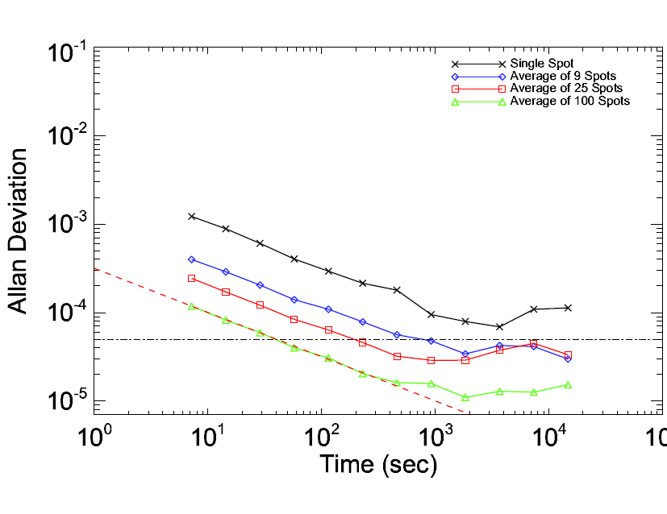
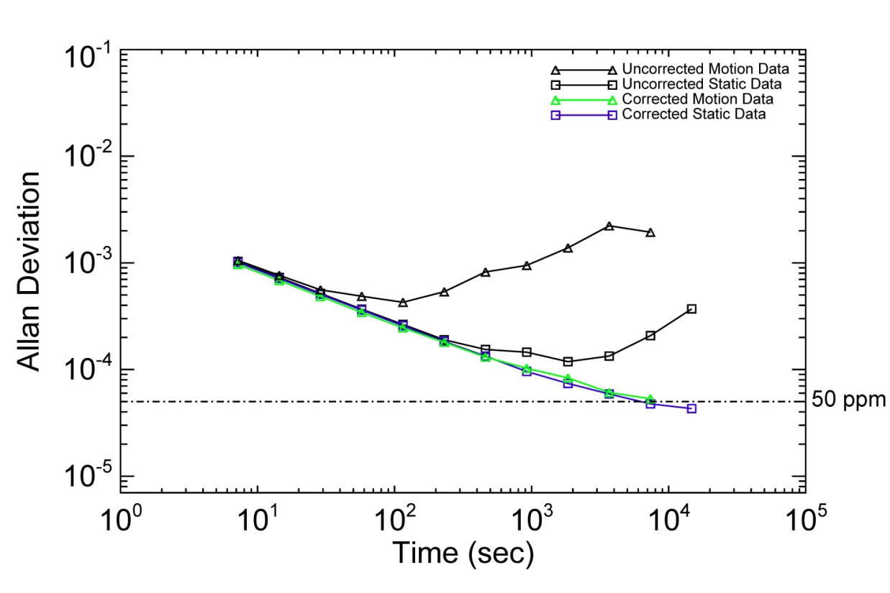
Point Source Testbed Results
Clanton et al 2012
50 ppm

Slide 5
JWST Projector System
(Caltech)
Lamp 1
STAR
Lamp 2
PLANET
>40mm square field
Beam Combiner
Spectral
Simulation
Mask
100 mm pupil
f/22 beam to detector.
19 um diffraction spot vs. 18 um pixel
Detector
circular filter currently restricts field to 25 mm circle
Notes:
Actually I think we are stopped down to f/22 at present, so 19µm FWHM.

Slide 6
High Dynamic Range Optical Configuration
Use combination of two lamps to increase dynamic range
Lamp1 = flat illumination to simulate stellar continuum
Lamp2 = weaker “planet” signal modulated by “spectral line”
Typical Lamp ratio of 1,000:1.
For typical lamp settings we observe 80,000 elec in 0.06 sec integration. Observations are photon-noise limited
Simulated lines have variety of amplitudes (±1%, ±5%, ± 10%), widths (2,4,8 pixels) and heights (1,2,6,10 pix)
Mask designed by John Krist
Fabricated at JPL/MDL
Notes:
Lamp1 = flat illumination to simulate continuum.

Slide 7
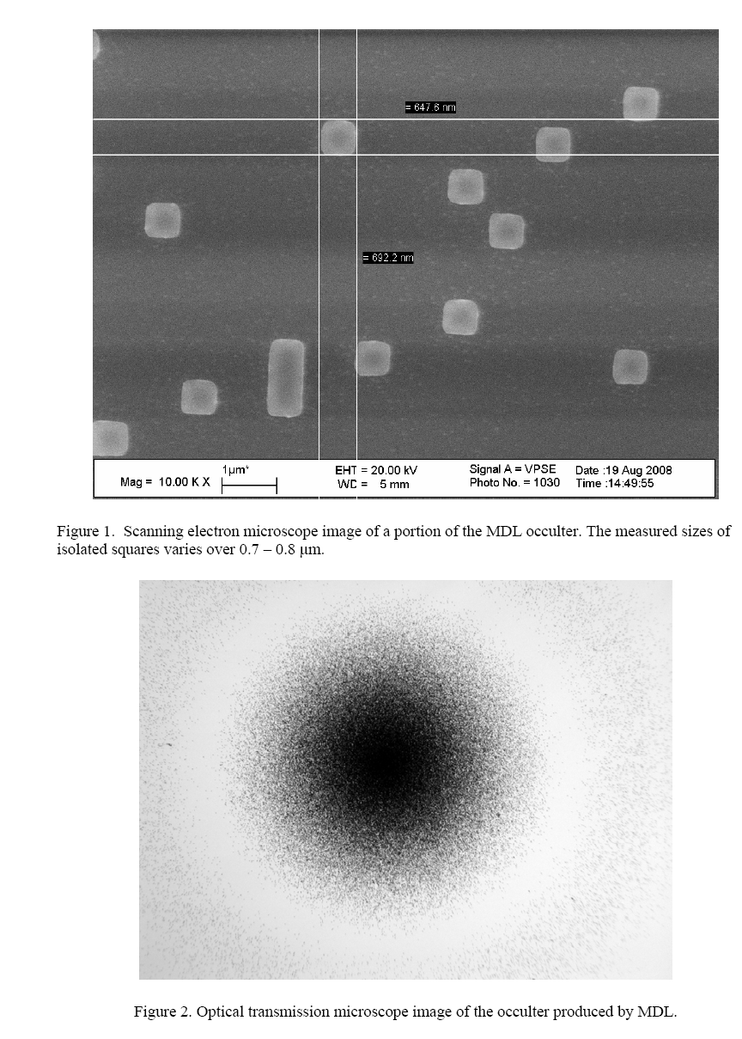
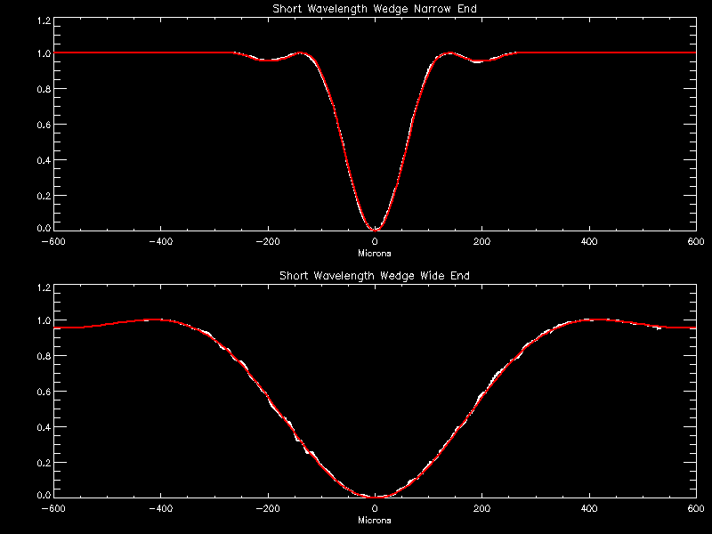
Mask Fabrication at JPL/MDL
Fabrication technique similar to NIRCam coronagraph mask using random pattern of small spots to make “half-tone” images
Use variable spot size as opposed to variable spot density.
JWST Coronagraphic Mask Profile:
red as designed; white, actual
Notes:
Key to grey scale resolution is variable spot size as opposed to variable spot density.

Slide 8
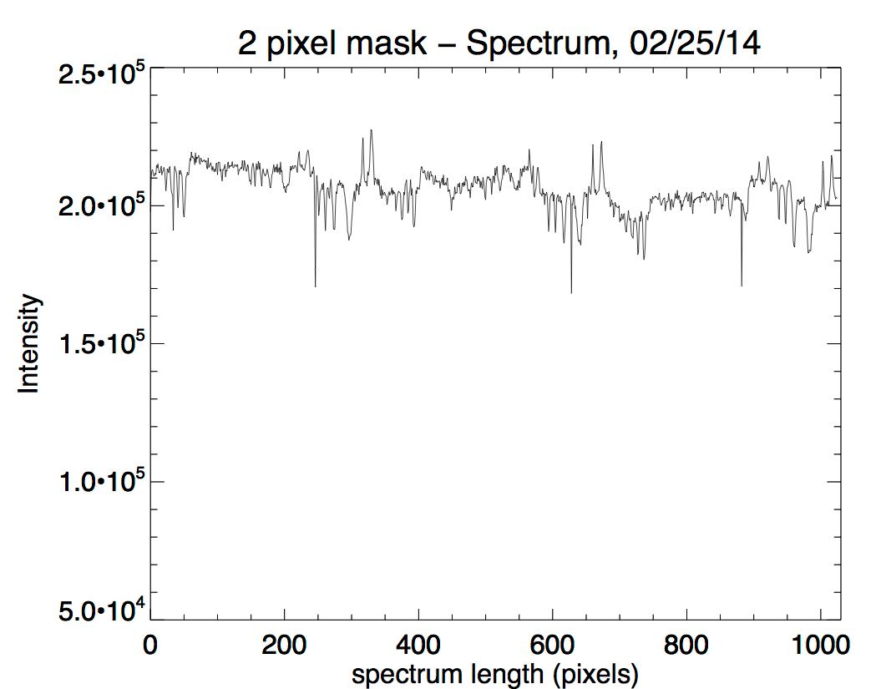
Recent Experimental Results
Star:planet ratio to ~600:1
Decorrelate data using Principal Component Analysis, fitting for temporal variations of lamp intensity and spatial shifts (x,x²,y,y²) determined from fitting overall position of mask
Lamp intensity stable at ~0.1%
Position drifts <0.5 pixel
0.6 sec
68 sec

Slide 9
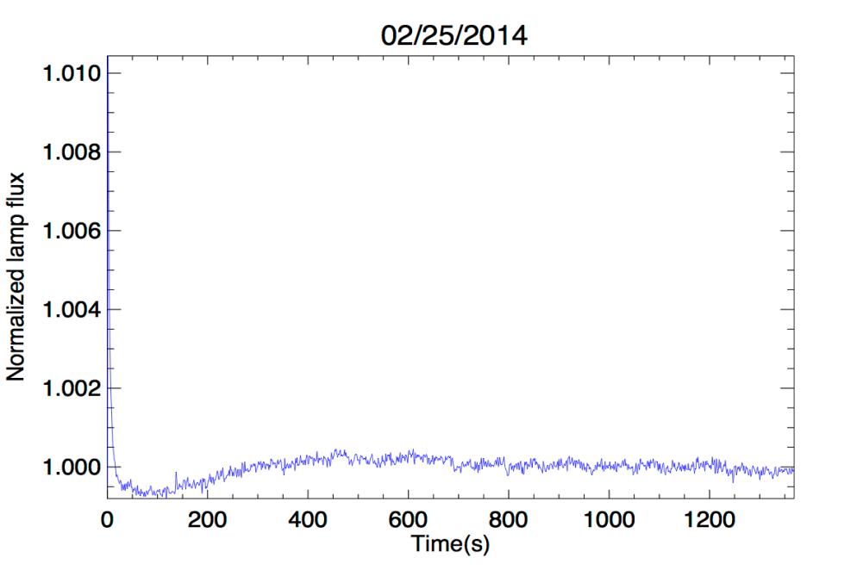
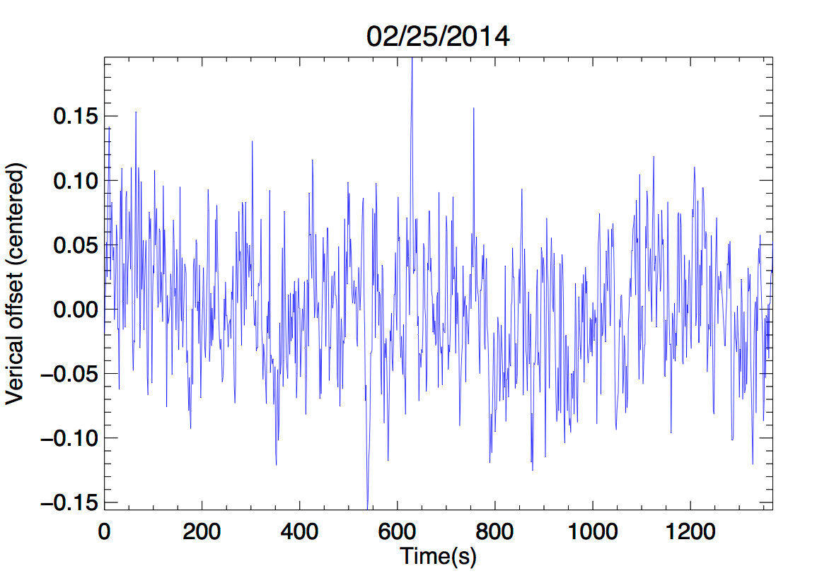
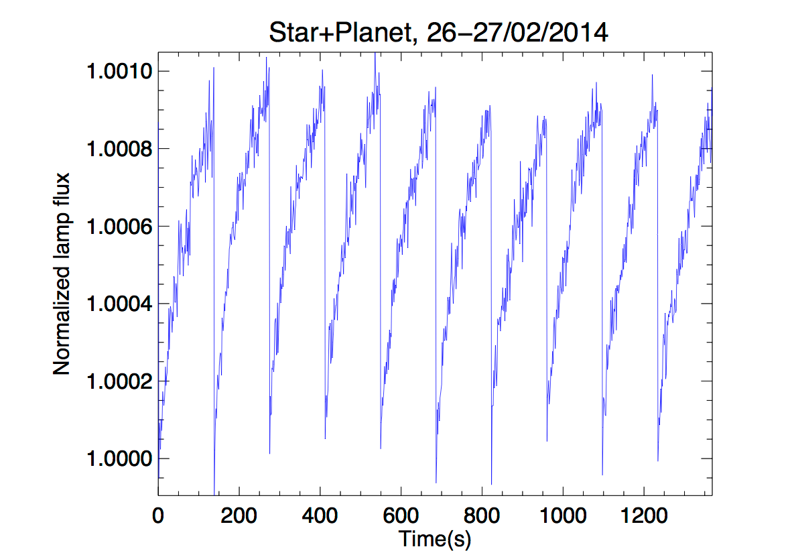
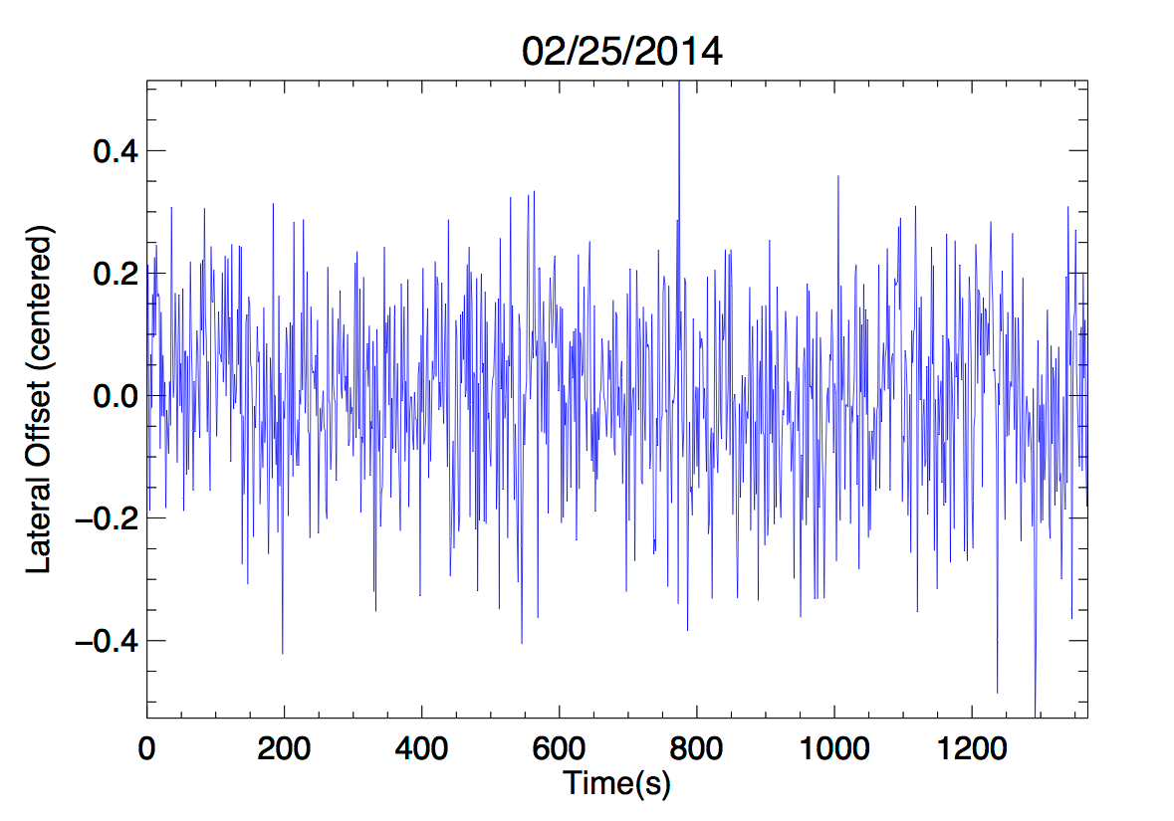
PCA Removes Lamp and Image Drifts

Slide 10
De-correlate 0.25 Pixel Shifts

Slide 11
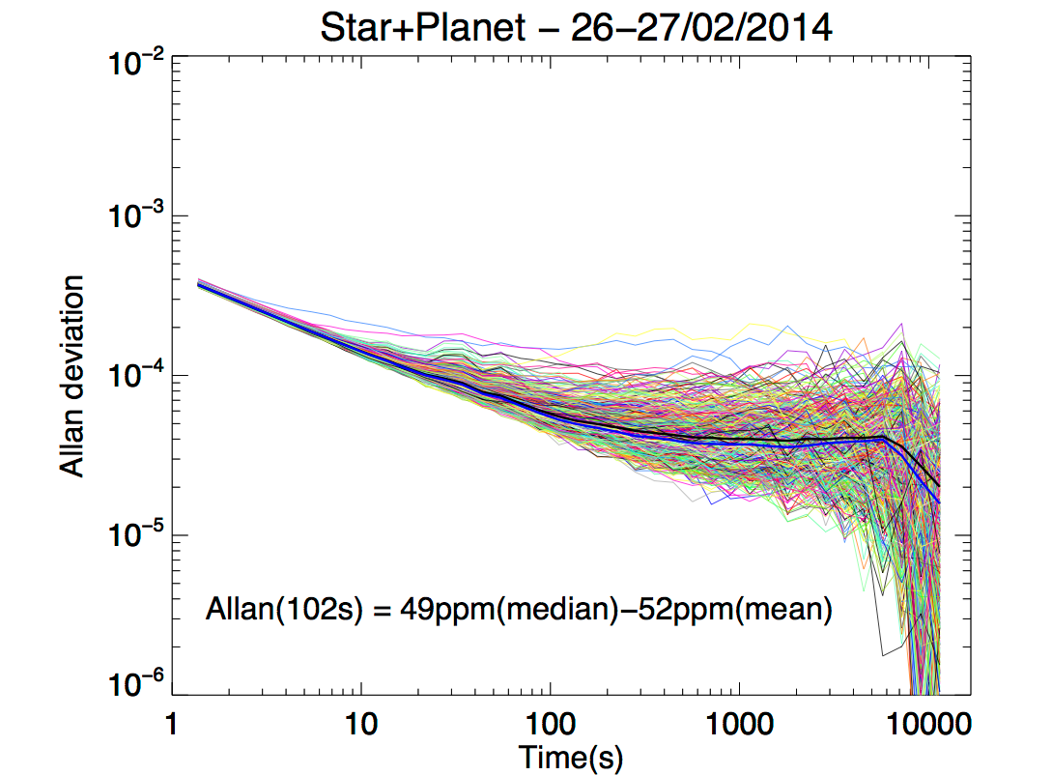
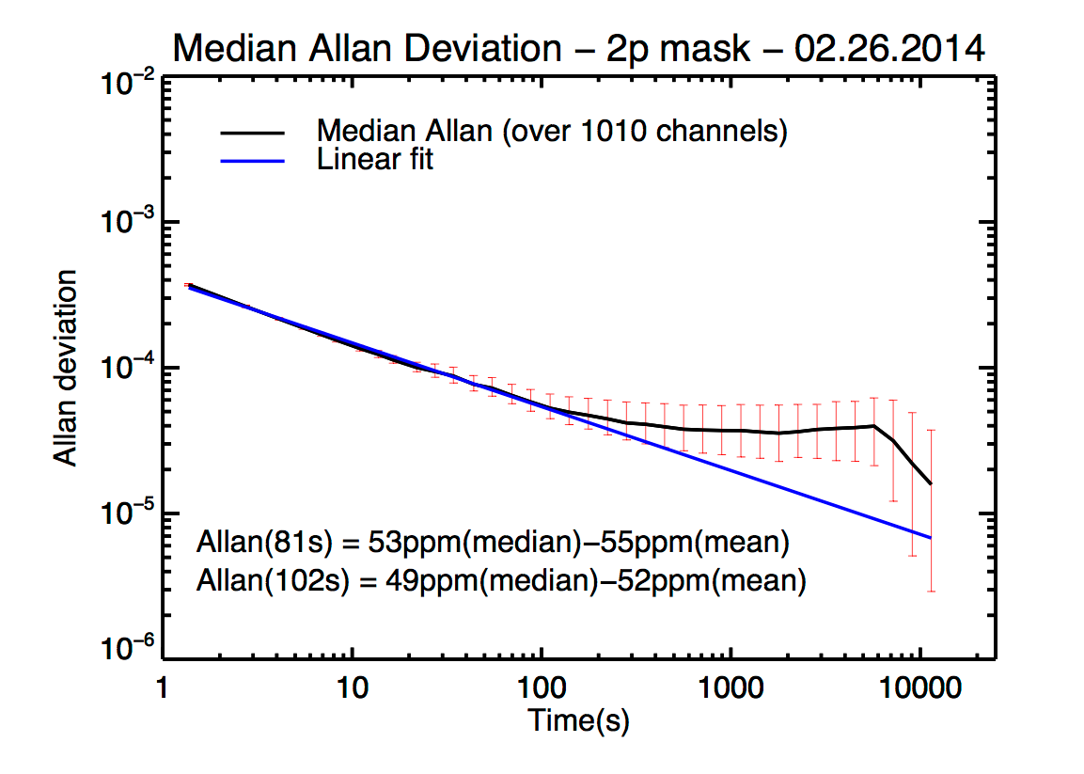
Limiting Performance To Date --- 50 ppm
Decorrelated data show photon-noise limited performance at 50 ppm after 100 sec
Deviation from shot-noise line around 50 ppm traced to data-acquisition reset at 100 sec injecting excess noise
Expect to break 50 ppm barrier in near term

Slide 12
Near-Term Plans
Improve astrometric knowledge to <0.1 pixel in star+planet case
Add image stabilization and precision motion control (<0.1 pixel) to allow higher precision spatial decorrelation, simulate pointing jitter, explore image scanning to improve flat-fielding
Explore effects of spectral sampling (1,2,10 pixel high spectra)

Slide 13
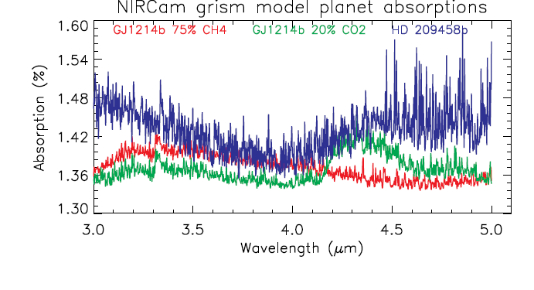
New Spectral Masks for Future Tests
Use models for HD 209458b, GJ 1214b (20% CO2 and 75% CH4) from Fortney et al.
“Observe” using native NIRCam grism dispersion λ/Δλ = 3400 per pixel but smoothed to R=1700 with a 2 pixel Gaussian
Select 1000 pixels near 3.9 - 5.0 μm for mask
Include simulation of weak lens images for photometry of bright systems

Slide 14
Longer Term Plans
Change from 1.7 μm detector to flight-like 2.4 μm detector
Explore additional detector pathologies, e.g. persistence, transients
Open to suggestions for additional experiments, more masks, etc.

