Slide 1
Considerations For High-Precision Photometry : IRAC Performance

Slide 2
IRAC Best Performance
Observations reach close to the photon-limit for binning over timescales of up to several hours
  Correlated noise is increasingly important for larger bins
  Observations can reach up to ~90% of photon-limited precision
Multiple epochs for transits can be fit simultaneously to improve SNR
  40 ppm precision for GJ 1214 (Fraine et al. 2013)
Systematics need to be minimized and de-trended
  Staring mode observations
  MIRI detector modeled after IRAC Si:As (channels 3 and 4)
GJ 1214b (Fraine et al. 2013)

Slide 3
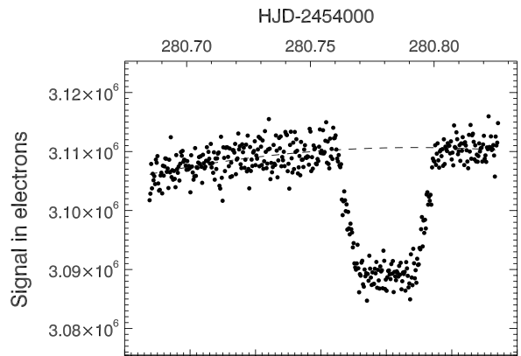
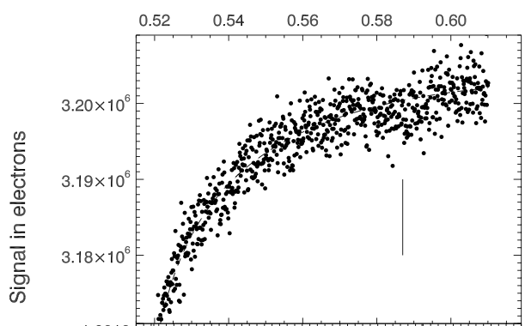
8.0 μm Ramp – “Charge Trapping”
Change in effective gain for 8.0 μm staring observations
  Removal of traps in detector material which capture photons thereby reducing measured flux
  Traps are long-lived and cross-section is small ⇒ not seen in normal observations
  Related to but different from long term residual images at 8 μm
Number of traps dependent on previous observation history
Can mitigate ramp by removing traps prior to observation ⇒ pre-flash
  > 2000 MJy/sr extended blob for 30 minutes
Gain change (G) should have functional form of
where N is number of traps, F flux of star, and C has all the physics
  Best to correct on pixel by pixel basis
  Linear for low flux values
With pre-flash
Without pre-flash
GJ 436b (Deming)

Slide 4
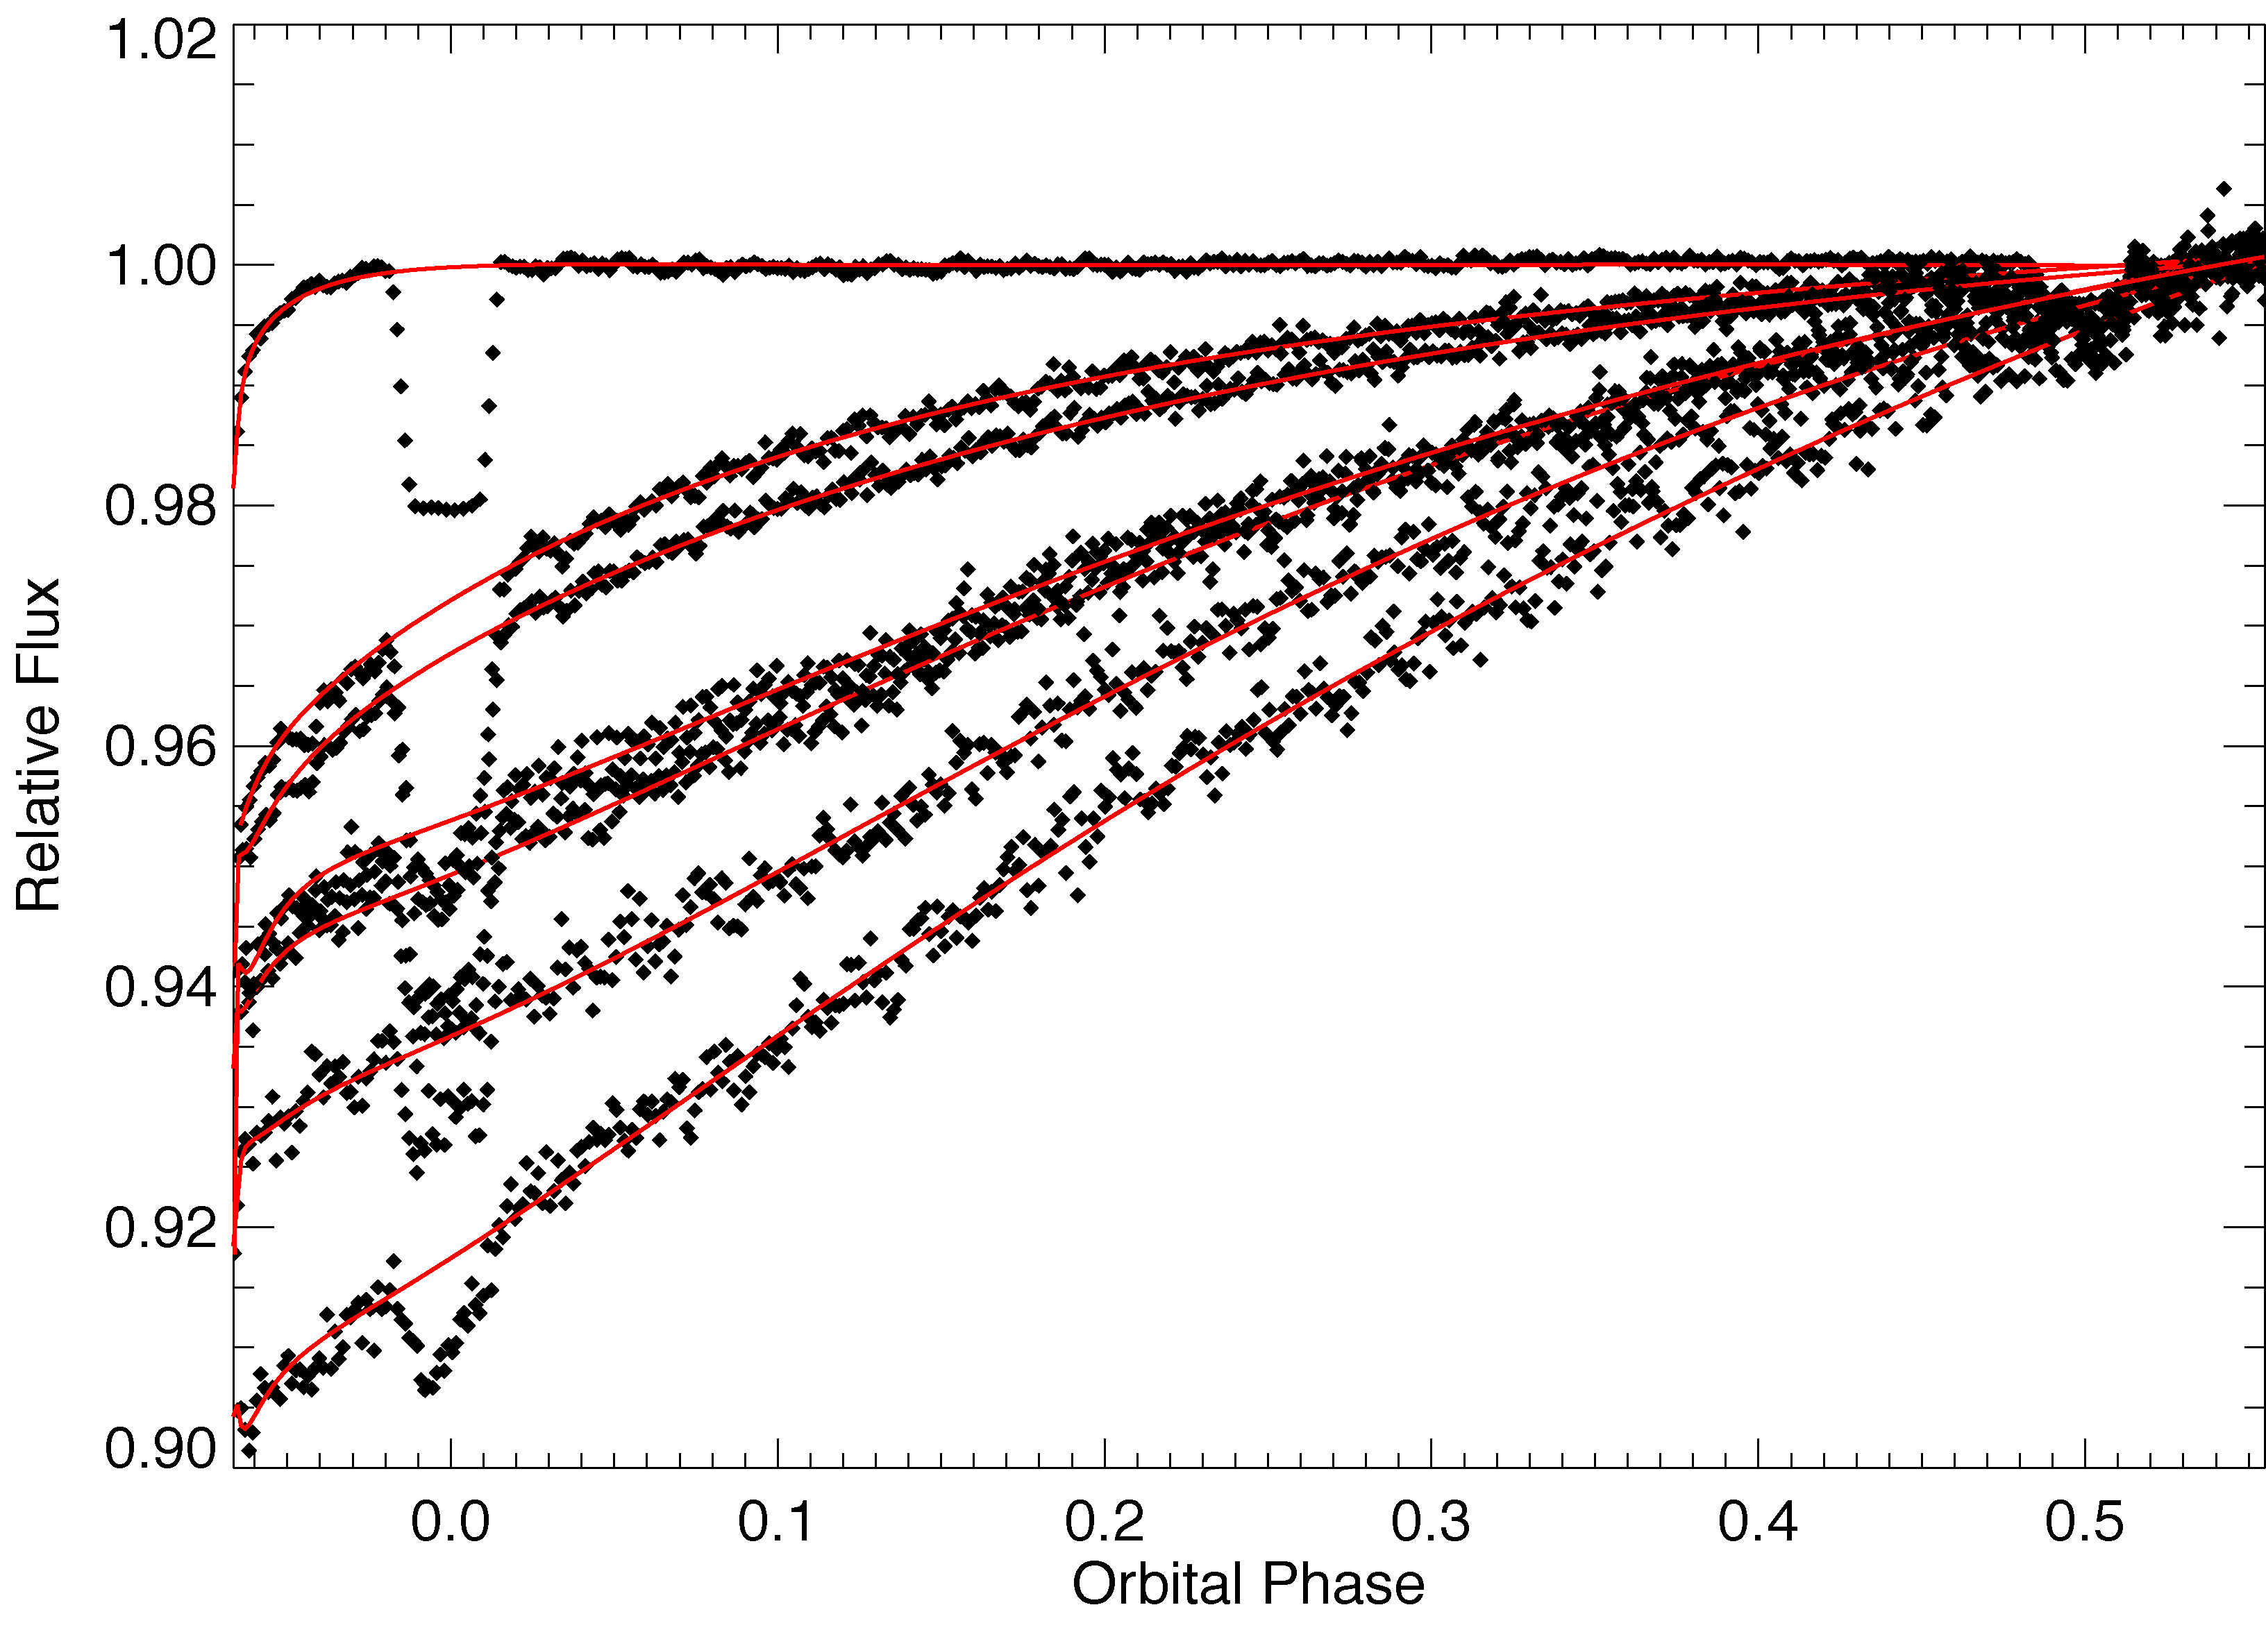
Correction for HD 189733b
(Knutson et al 2008)

Slide 5
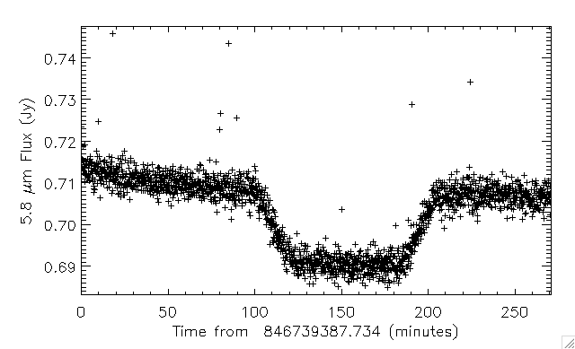
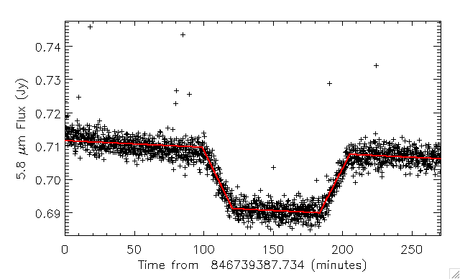
5.8 μm Anti-Ramp
Decrease in effective signal at 5.8 μm
  Cannot be charge trapping
  Probably a persistence effect in the readout multiplexers
Need to trend using data
  Be careful not to overfit effect
  But do look for weak trends
Appears to be a thresholding behavior
  Do not see anti-ramp at low flux levels

Slide 6
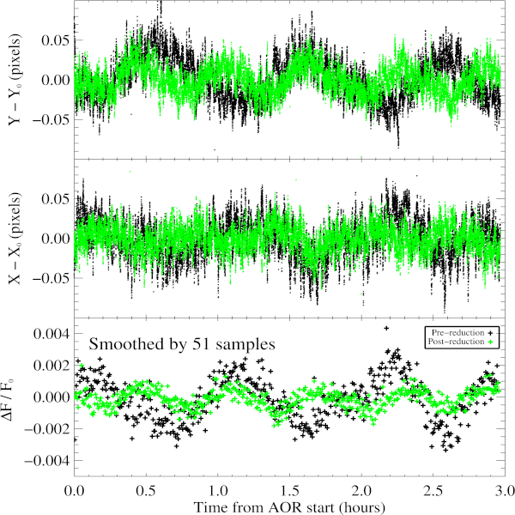
Telescope Motions Influence
Photometry
Precision limited by correlated noise
  Inter-pixel gain variations (4-7% across pixel) convolved with pointing variations for InSb arrays
  Undersampling increases effect
Pointing variations consist of:
  Pointing wobble with amplitude of ~0.08 arcsec, period of 36-60 minutes
  Pointing drift of 0.3 arcsec/day in 80% of observations
  Pointing jitter of ~0.03 arcsec amplitude
  Variations are a fraction of IRAC pixel (1.2 arcsec)

Slide 7
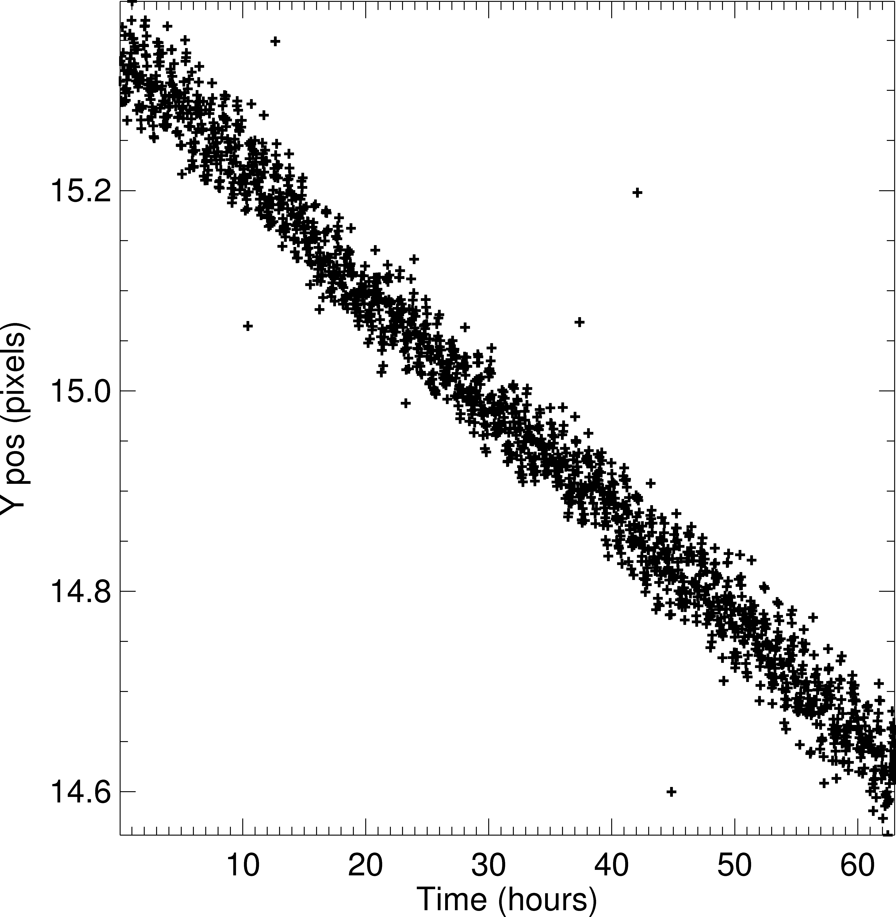
Telescope Motions Influence
Photometry
Precision limited by correlated noise
  Inter-pixel gain variations (4-7% across pixel) convolved with pointing variations for InSb arrays
  Undersampling increases effect
Pointing variations consist of:
  Pointing wobble with amplitude of ~0.08 arcsec, period of 36-60 minutes
  Pointing drift of 0.3 arcsec/day in 80% of observations
  Pointing jitter of ~0.03 arcsec amplitude
  Variations are a fraction of IRAC pixel (1.2 arcsec)
Centroid drift of staring mode observation of XO3

Slide 8
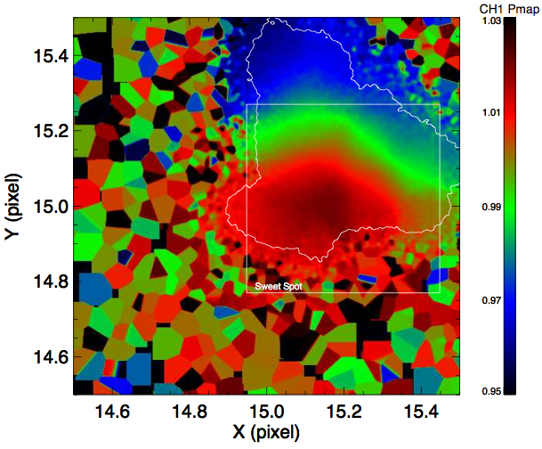
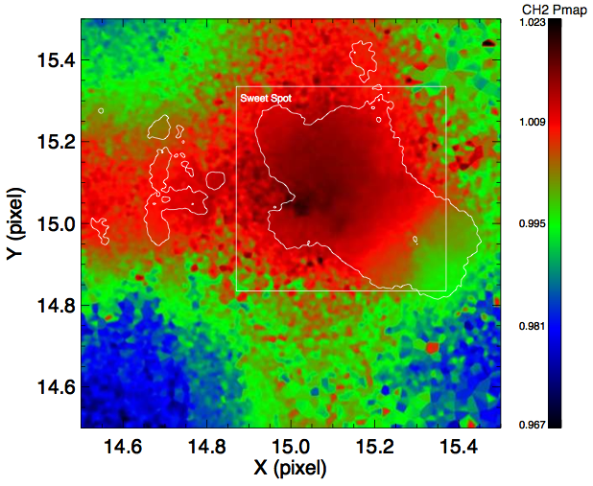
Intra-pixel Gain Maps
3.6 μm
4.5 μm

Slide 9
Meeting Advertisement
Time Series Data Reduction With IRAC - Identifying and Removing Sources of Correlated Noise
To be held at the Boston AAS meeting
4 hr splinter session covering warm IRAC data
Short talks about current data reduction issues
Data challenge
Currently soliciting input: Please contact Sean Carey, Carl Grillmair, Jim Ingalls or Jessica Krick at the SSC

Slide 10
Extra Material

Slide 11
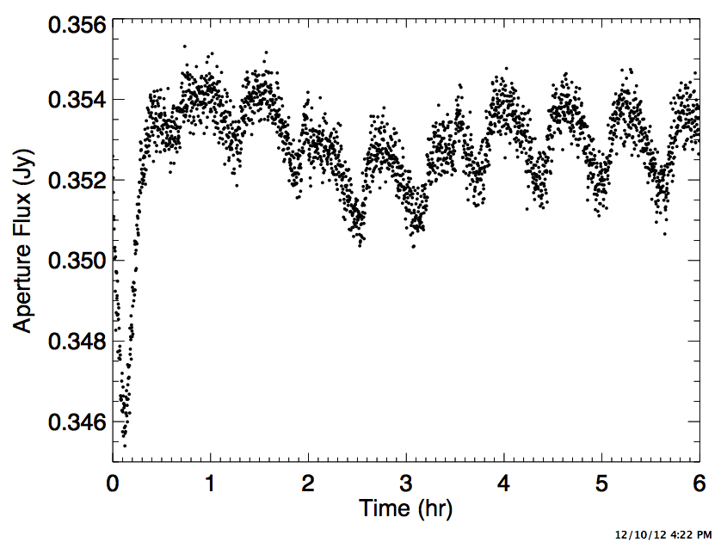
Exoplanet Observation
Simulator
Written by Jim Ingalls
Simulates IRAC images with realistic models of:
  Pointing jitter
  Pointing wobble and drift
  Intra-pixel gain variations
Properly accounts for Fowler sampling
Being used to examine truncation error
Model interplay of drift with different gain maps
Test conceptual gain maps
Plan to use as part of Exoplanet data workshop
Simulated 3.6 μm transit of 0.3% depth occurring between 2-3.5 hours

Slide 12
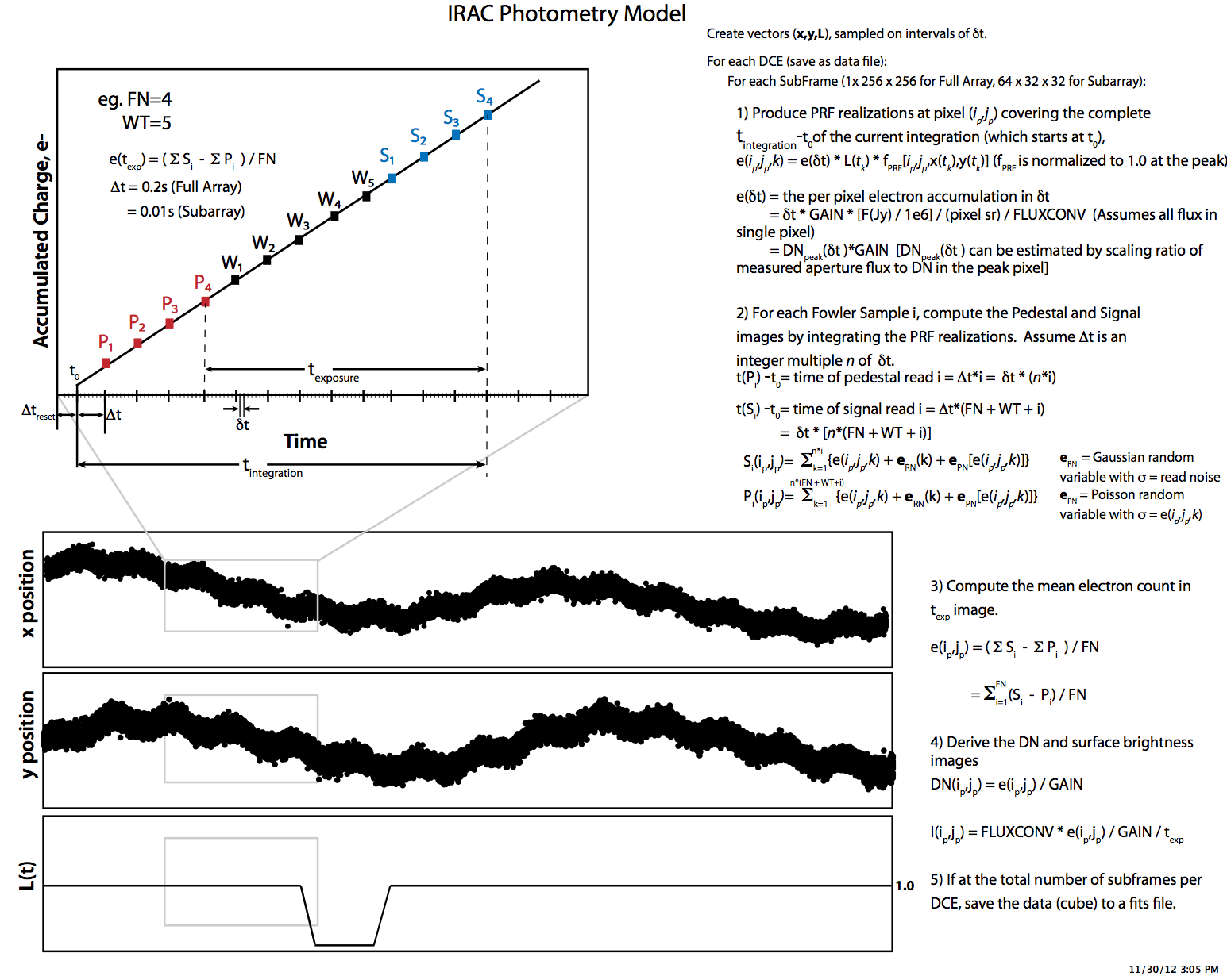
Efficacy of PCRS peakup and other pointing considerations
PCRS peakup on target continues to be effective
  0.1 arcsec radial (1σ) rms in initial pointing for the 87 observations using self-peakup analyzed
  Using guide star critically dependent on accurate astrometry between guide star and target
  Most problems using guide star have been traced to targets having poor proper motion knowledge
30 minute pre-stare effective in mitigating initial drift
  Average radial variation from start of observation to 2 hours is ~0.04 pixels instead of a drift which could be ~0.3 pixels in magnitude.
Continuing to explore mitigations of long-term pointing drift

Slide 13
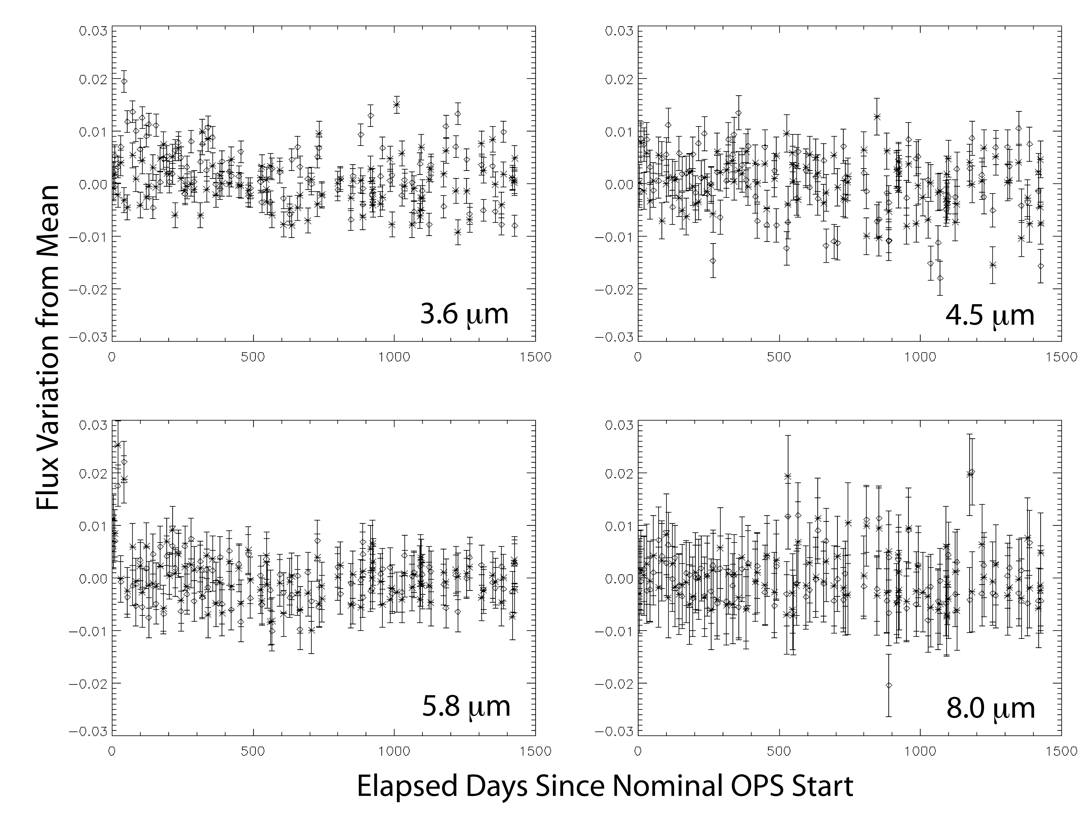
Photometric Stability for IRAC is Excellent

Slide 14
Photometric Stability with Dithering
Examined question of how stable is the photometry when dithering
  ~18000 0.4s 3.6 μm subarray observations throughout the warm mission (~3.2 yrs of data)
Fraction of a percent photometry can be achieved
Photometric noise goes as N^{-0.5}
Noise is 4× theoretical (Poisson plus read noise)
Noise could improve with better understanding of offsets between dither positions
Could facilitate efficient transit searches

Slide 15
(Transition to IRS/MIPS section)

Slide 16



Mid-IR Photometry With
Spitzer/IRS and MIPS
Ian Crossfield, MPIA
2014/03/11

Slide 17
Mid-IR Eclipses, Transits & Phase Curves
 | MIPS Photometry | IRS Photometry | IRS Spectroscopy
HD 189733b | E,T,P: Knutson+2009 | E: Deming+2006 | E: Grillmair+2007, 2008 T: unpublished?
HD 209458b | E: Deming+2005, T: Richardson+2006, E,T,P: Crossfield+2012 | E: Charbonneau+2008 T: unpublished? | E: Richardson+2007, Swain+2008 T: unpublished?
GJ 436b | E: Stevenson+2010 | E: Stevenson+2010 | –––
TrES-1b | ––– | T, E: unpublished? | –––
TrES-4b | ––– | E: Knutson+2009 | –––
HD 149026b | ––– | E: Stevenson+2011 | –––
ups And b | P: Crossfield+2010 | ––– | –––
See J. Bouwman’s talk (next)

Slide 18
MIPS & IRS: Known Systematics
Effect | Magnitude | Timescale | Seen in MIPS? | Seen in IRS?
Absolute offsets at each dither positions | 2% | each frame | Yes | ???
“Ramp” at observation start | 2% | 2-10 hours | Sometimes | Always
“Fallback” after ramp saturates | 0.2% | 10-30 hours | Sometimes | No
Position-dependent sensitivity | 0.2% | 1-3 hours | Yes | Yes
Artificial background flux variations | 0.2% | each AOR | Yes | ???
Latent bright/dark regions | <2% | hours to days | Yes

Slide 19
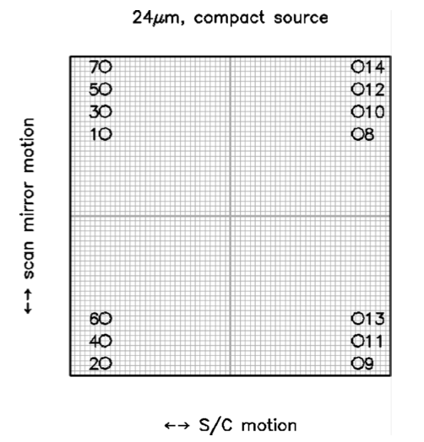
MIPS: 14 dither positions. Sensitivity at each position varies by ~2%.
Let’s avoid this with JWST! Just stare at a single, clean region of detector.
MIPS Handbook

Slide 20
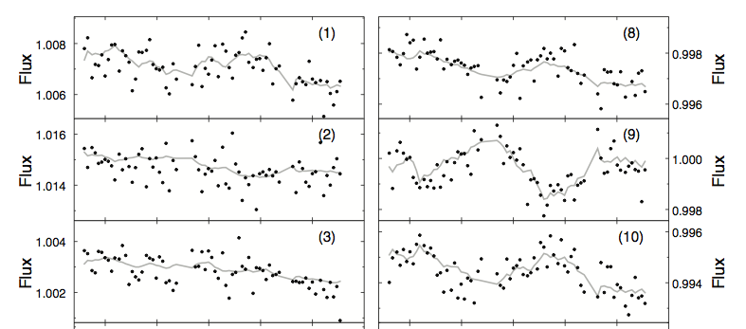
Pointing-dependent sensitivity variations. Different at each dither position:
~20 hours
~20 hours
Crossfield+2010
Not an intrapixel effect! Maybe flat-field errors?

Slide 21
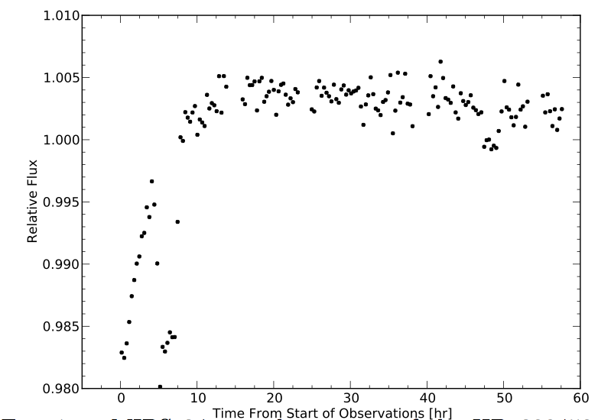
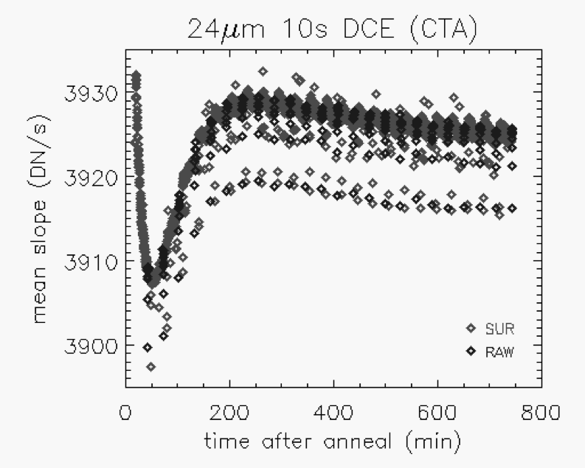
“Ramp” and “fallback” effects:
Fallback (~0.2%)
Ramp (~2%)
HD 209458 photometry
MIPS lab
test data
Young+2003
Crossfield+2012
Reliably measuring planetary phase curves requires lots of testing and great stability!

Slide 22
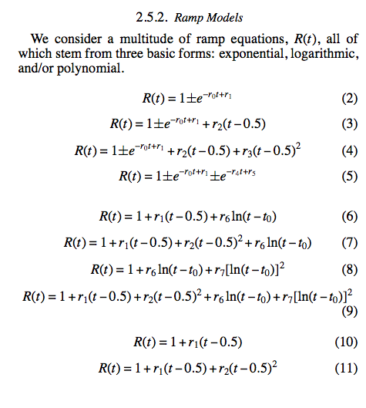
Ramps (and other systematics) require exploring many possible functional forms:
Stevenson+2011

Slide 23
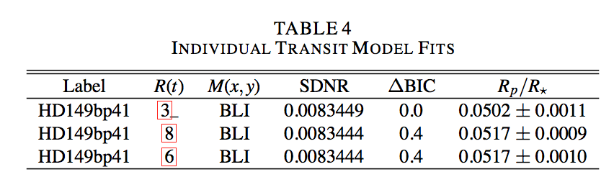
Ramps (and other systematics) require exploring many possible functional forms:
Ramp
function
Goodness-of-fit
Transit depth
Stevenson+2011

Slide 24
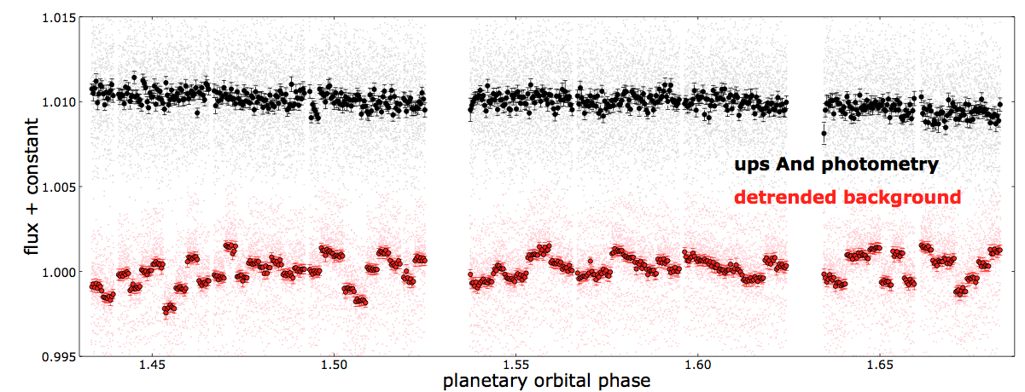
MIPS: sky background varies in each AOR.
Stellar photometry is highly stable:
Background changes with each AOR:
~20 hours
Crossfield+2010
Calibration issue? Scattered light?
Troubling, but maybe OK for photometry.

Slide 25
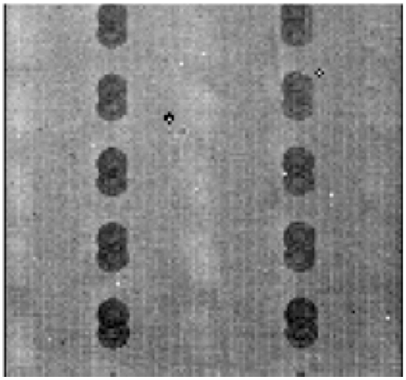
Bright and Dark Latents
Bright latents
Dark latents
Could bias PSF-fitting or aperture photometry if not recognized.
MIPS handbook

Slide 26
Suggested “Best Practices”:
Systematic Effect | Mitigation Strategy
Systematic offset at dither positions | --Don’t dither during observations .
“Ramp” at observation start | --Pre-flash? --Use many functional forms to fit.
“Fallback” after ramp saturates | --Obtain detailed detector characterization.
Position-dependent sensitivity | --Use low-order polynomial in x & y in fit. --Use empirical flat-field? (may require dithering)
Artificial background flux variations | --Probably not an issue, but troubling.
Latent bright/dark regions | --Take ~few frames, then offset for main data.
PSF-fitting photometry was great for MIPS & IRS.
Will this be true with JWST’s variable PSF?

