Slide 1
Data simulations / Community challenges Stephan Birkmann / Jeff Valenti

Slide 2
Simulator uses
Create
simulator
Performance
Description
Release
simulated
data
Organize
data
challenge
Release
simulator

Slide 3
Agree on simulation guidelines
Science inputs
e.g., simulated spectrum, parameter space
Operational assumptions (the “rules”)
e.g., reset, read, read
Instrumental effects to consider
e.g., photon noise, read noise, intra-pixel, …
Presentation of results
e.g., PPM vs. wavelength

Slide 4
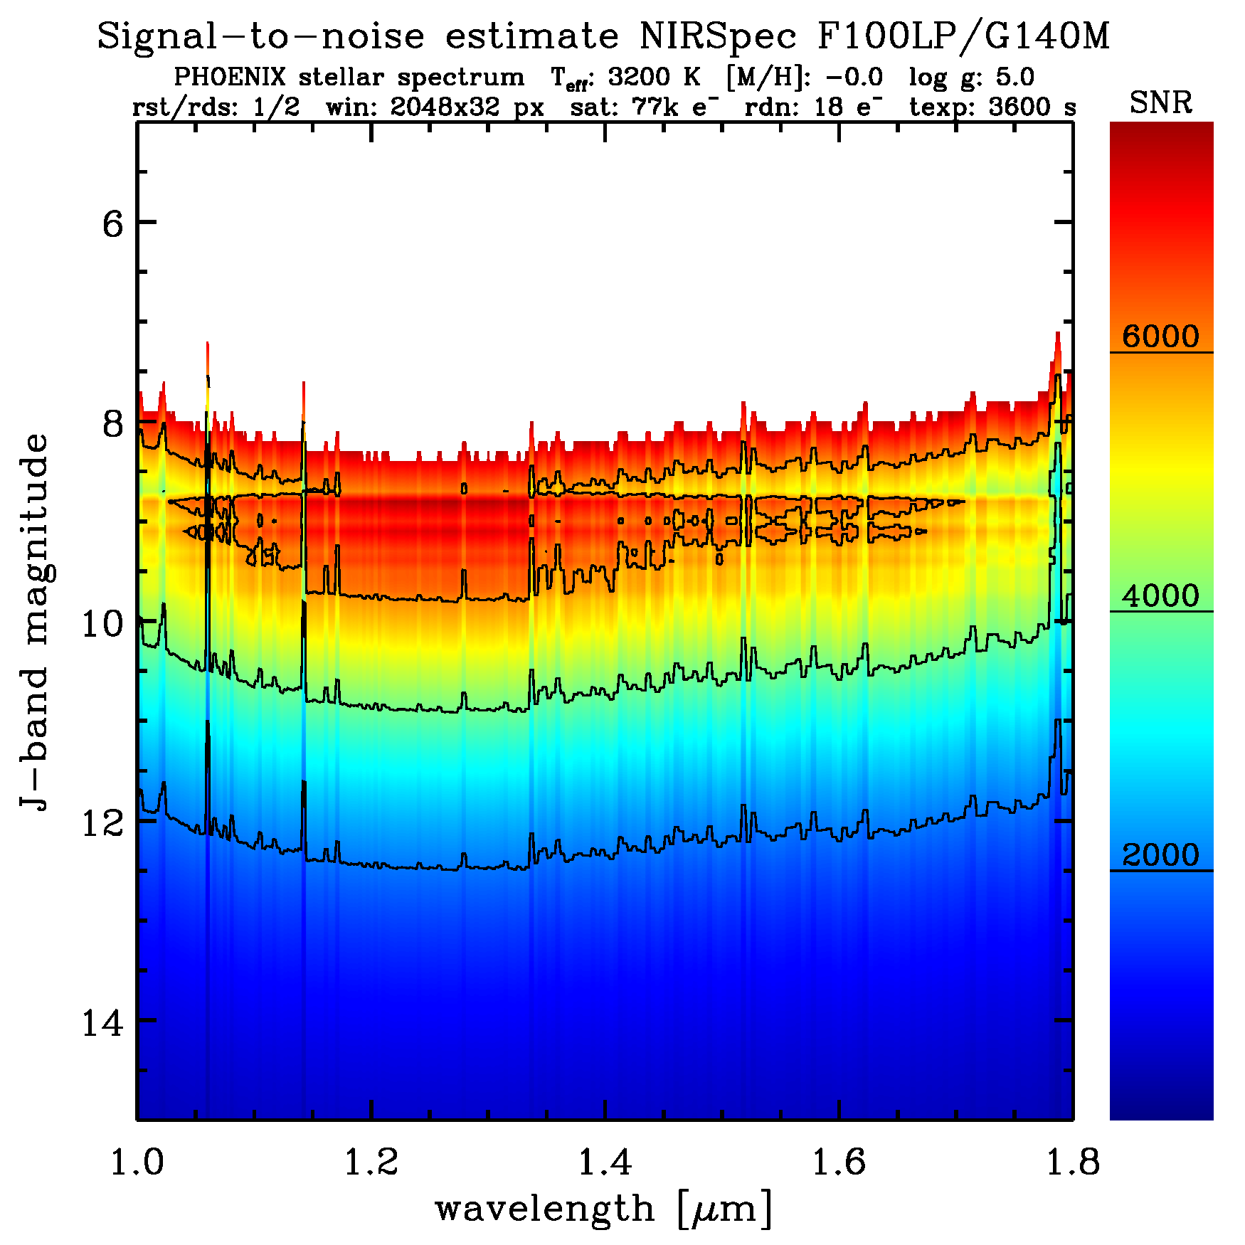
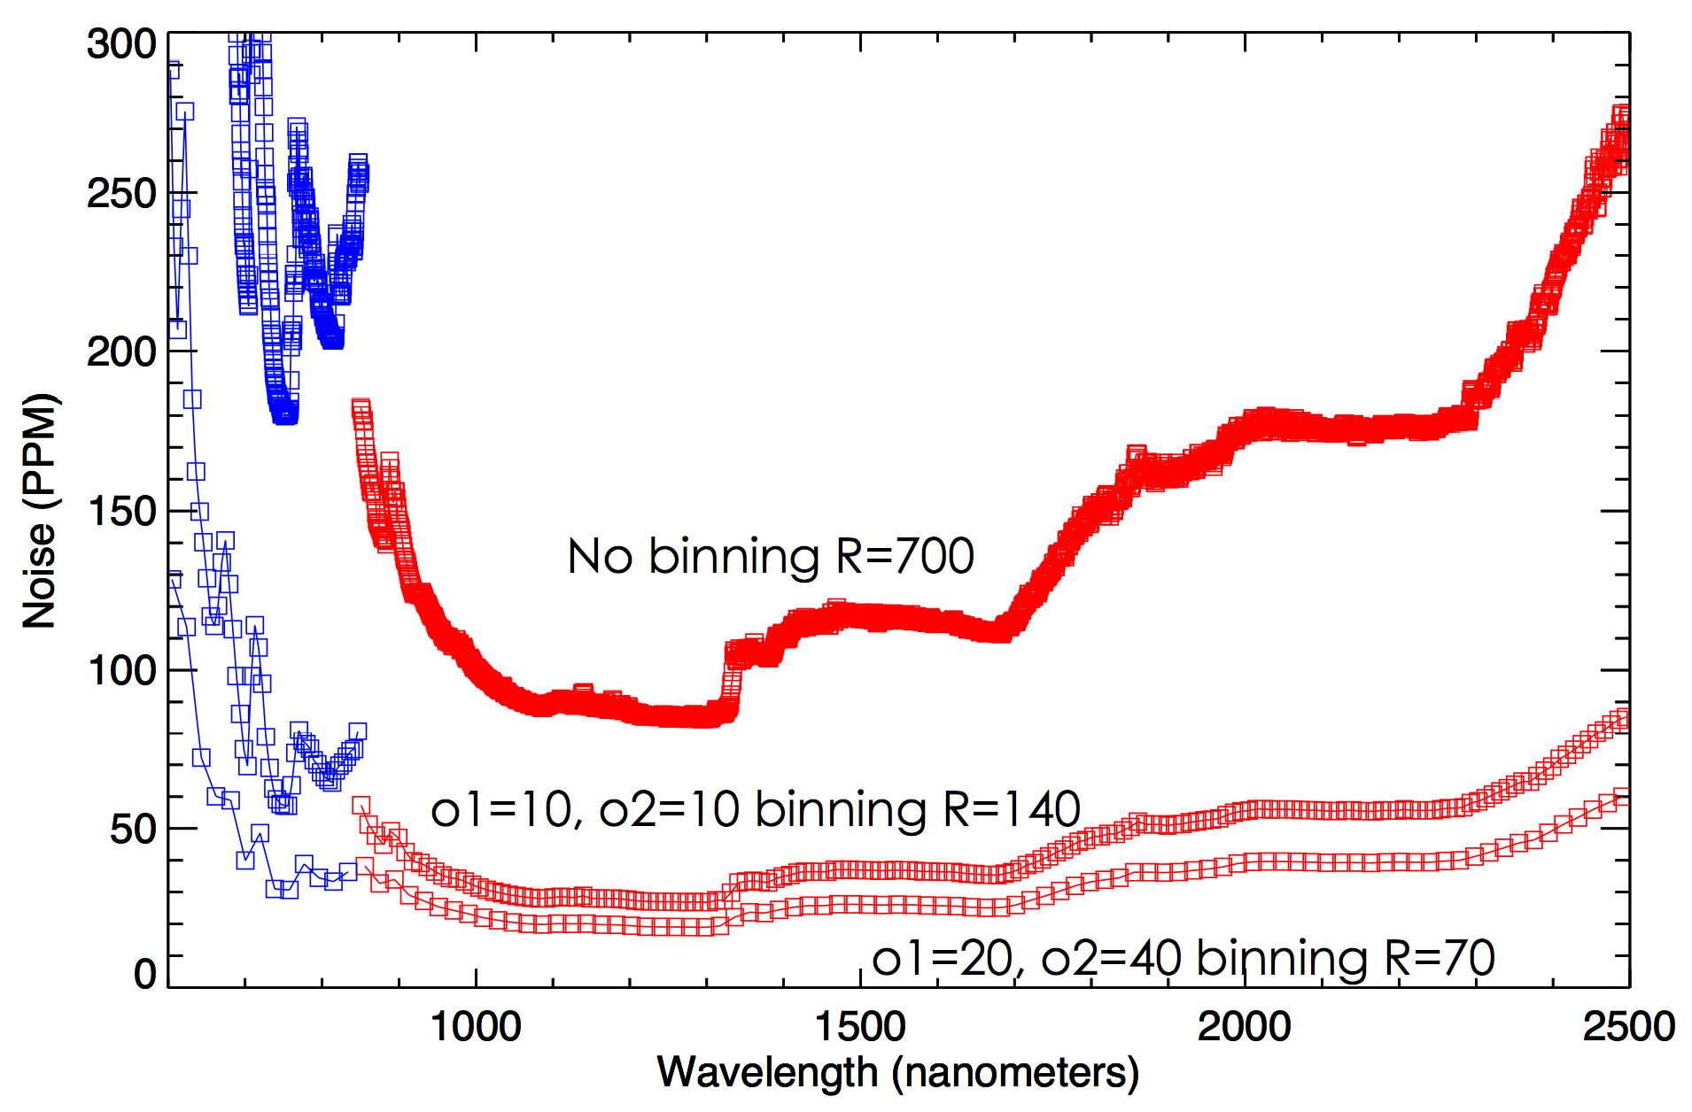
Performance description examples
PPM vs. wavelength
6-hr clock time → 1 hr
R=700 bin → R=100

Slide 5
How to agree on simulation guidelines?
(Very) small working group?
1-2 participants per IDT
when?

Slide 6
Types of data challenges
Types of simulated data
Raw images
Instrument artifacts
Reduced spectroscopy/photometry
Model constraints
Types of analyses
Recover inputs with knowledge of input
Recover inputs from blind analysis

Slide 7
(Benefits of data challenges)
(Build community support)
We are beyond this point
(List key factors that affect experiment)
Data quality issues
Model parameters
Product of simulation step
(Build familiarity with ground system)
Standard data products
Observing templates
Product of simulation step

Slide 8
Benefits of data challenges
Formulate observing strategy based on...
Ability to remove known instrumental effects
e.g., persistence, ghosts, jitter
Only useful until real data are released
Ability to recover input model parameters
e.g., composition, thermal structure
Useful throughout mission lifetime
Inform TAC
Allocate observing time wisely
Facilitate pipeline algorithm development

Slide 9
Participation in data challenges
Advantages
Craft better proposals
Become a recognized expert
Advertise instrument capabilities
(Obtain funding)
Disadvantages
May help competing proposals
Requires significant effort

Slide 10
Which must be done? Would you participate?
Create
simulator
Performance
Description
Release
simulated
data
Data
challenge
Release
simulator

