Slide 1
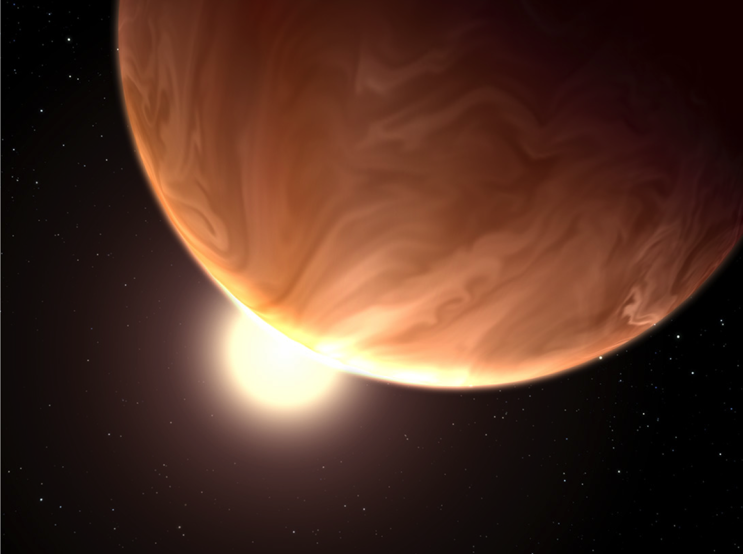
Targets for JWST:
Ground-Based Transits and Radial Velocity
Jacob Bean
University of Chicago

Slide 2
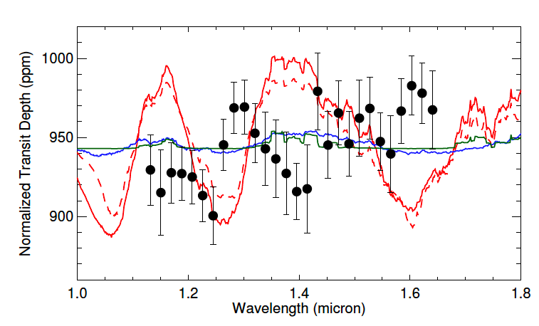
The challenge of observing bright targets
GJ 1214b
Kreidberg et al. 2014
transit depth uncertainty: 30 ppm
R* = 0.2 R_{sun}
H = 9.1
HD 97658b
Knutson et al., submitted
transit depth uncertainty: 20 ppm
R* = 0.8 R_{sun}
H = 5.8

Slide 3
Key Points (my opinion!)
We should not be simply targeting the brightest stars.
It is also a false economy to optimize the photon-limited S/N for atmospheric studies.
We want to find the brightest examples of the planet-star systems that have the largest expected atmospheric signals.
Knowing the masses of the JWST targets will be critical.

Slide 4
Key Points (my opinion!)
We should not be simply targeting the brightest stars.
It is also a false economy to optimize the photon-limited S/N for atmospheric studies.
We want to find the brightest examples of the planet-star systems that have the largest expected atmospheric signals.
Knowing the masses of the JWST targets will be critical.

Slide 5
Key Points (my opinion!)
We should not be simply targeting the brightest stars.
It is also a false economy to optimize the photon-limited S/N for atmospheric studies.
We want to find the brightest examples of the planet-star systems that have the largest expected atmospheric signals.
Knowing the masses of the JWST targets will be critical.

Slide 6
Key Points (my opinion!)
We should not be simply targeting the brightest stars.
It is also a false economy to optimize the photon-limited S/N for atmospheric studies.
We want to find the brightest examples of the planet-star systems that have the largest expected atmospheric signals.
Knowing the masses of the JWST targets will be critical.

Slide 7
Key Points (my opinion!)
We should not be simply targeting the brightest stars.
It is also a false economy to optimize the photon-limited S/N for atmospheric studies.
We want to find the brightest examples of the planet-star systems that have the largest expected atmospheric signals.
Knowing the masses of the JWST targets will be critical.

Slide 8
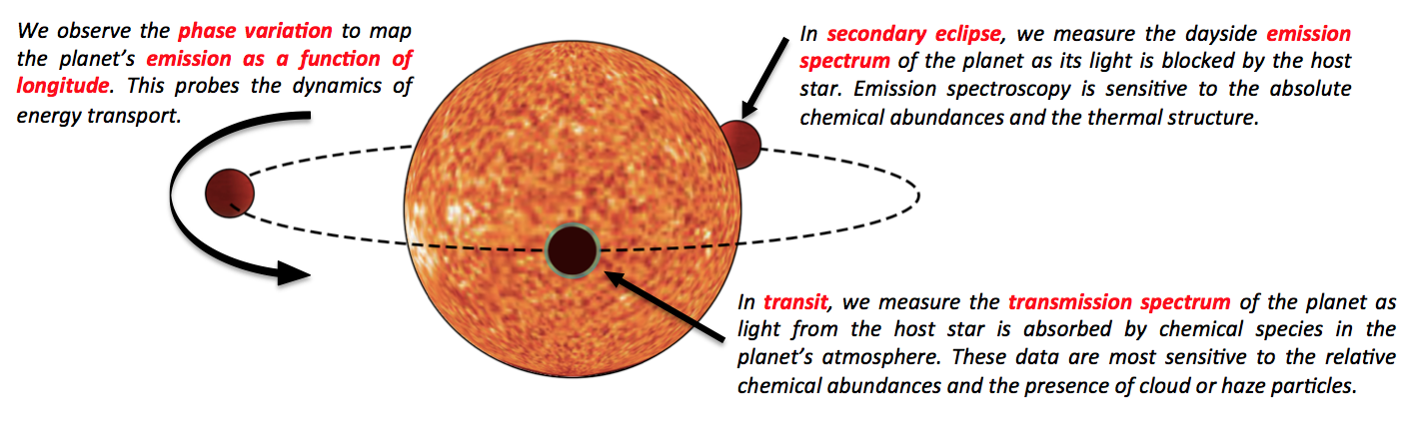
The small star advantage
For a given planet size and temperature, the atmospheric signal goes as R*⁻²
figure by Kevin Stevenson

Slide 9
M Dwarf Properties
0.07 < mass < 0.6 M_{sun}
M6
M = 0.12 M_{sun}
R = 0.18 R_{sun}
T = 2900 K
G2
M = 1 M_{sun}
R = 1 R_{sun}
T = 5800 K
M3
M = 0.45 M_{sun}
R = 0.45 R_{sun}
T = 3500 K
Earth
--sizes to scale--

Slide 10
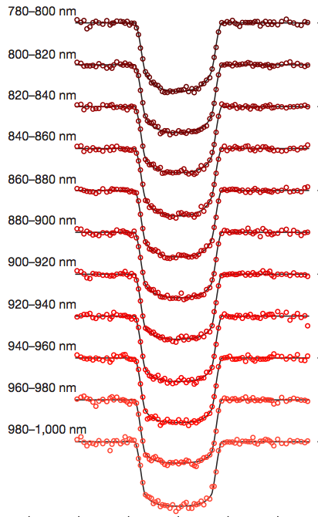
Ground-Based Transit Searches

Slide 11
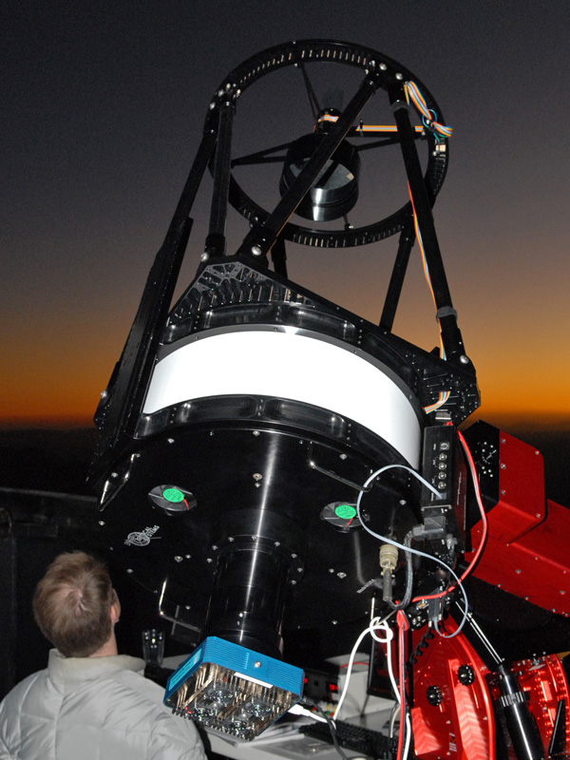
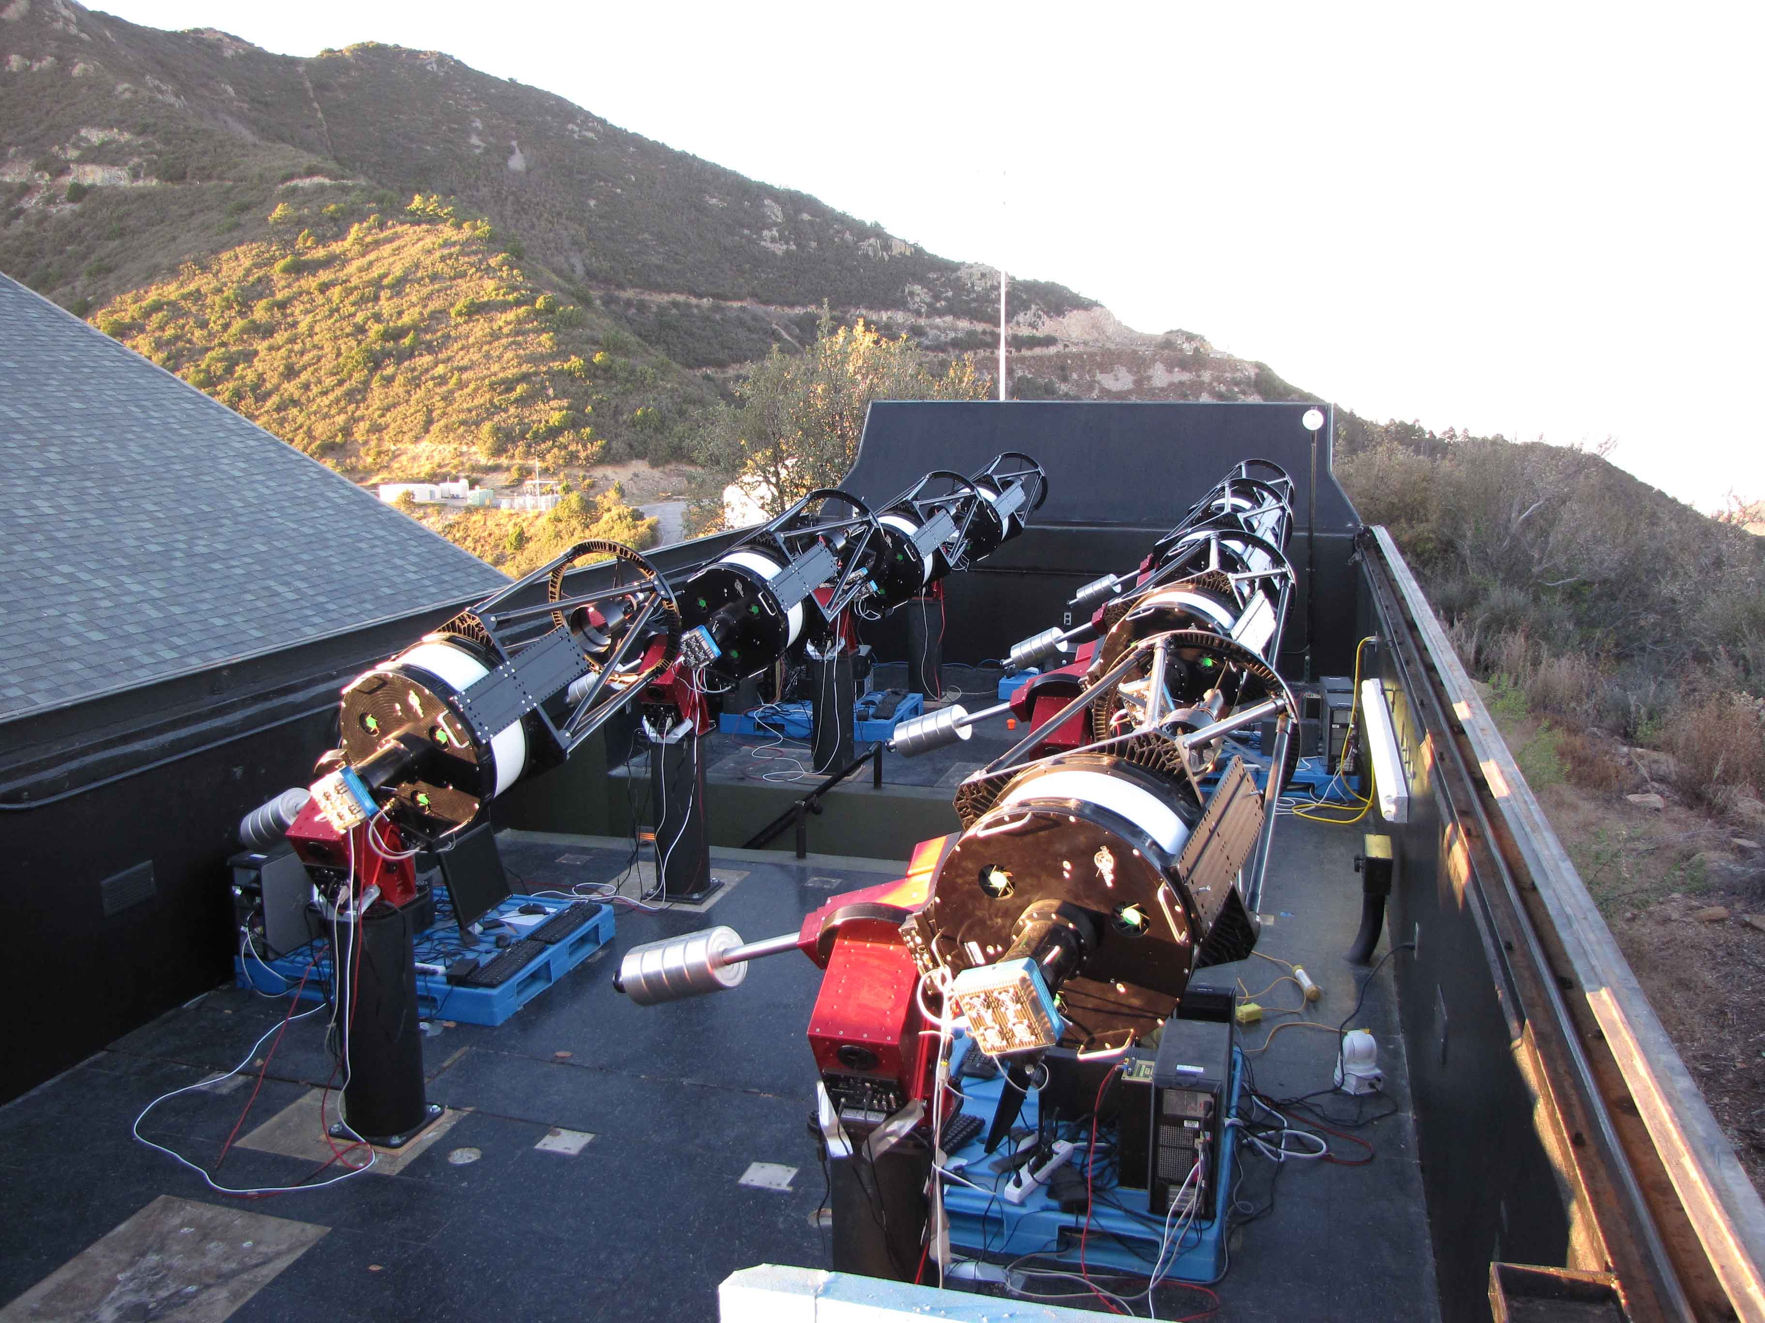
The MEarth Project
Nutzman & Charbonneau 2008; Berta et al. 2013
Using 8 X 40cm telescopes, we are surveying the 2000 nearest low-mass stars for planets as small as 2 R_{Earth} orbiting within the habitable zone.
MEarth is different: Monitor stars sequentially & detect transits in progress
THE PRIMARY PURPOSE OF MEARTH
IS TO FIND THE IDEAL TARGETS FOR CHARACTERIZATION
WITH THE ELTs and JWST

Slide 12
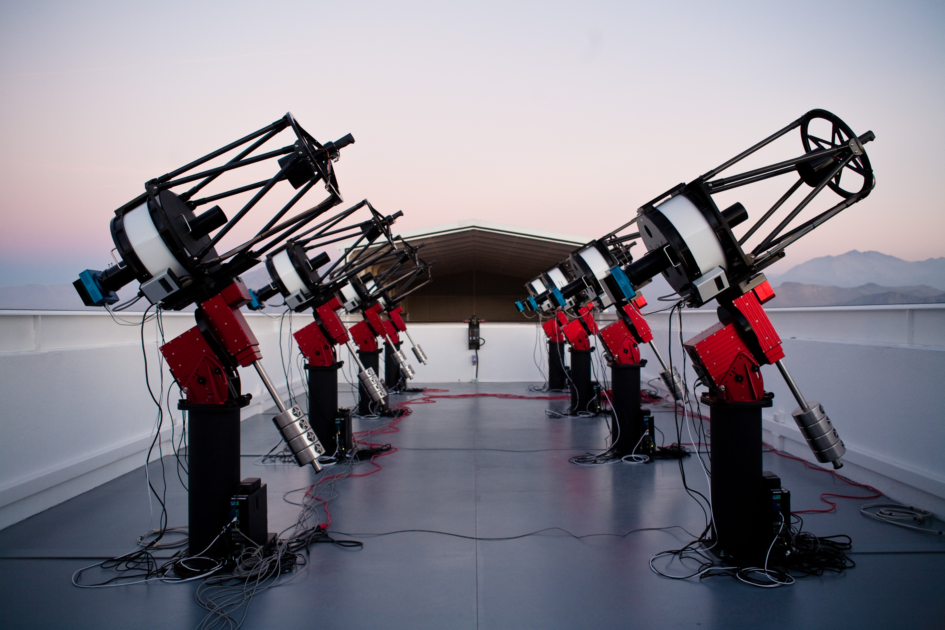
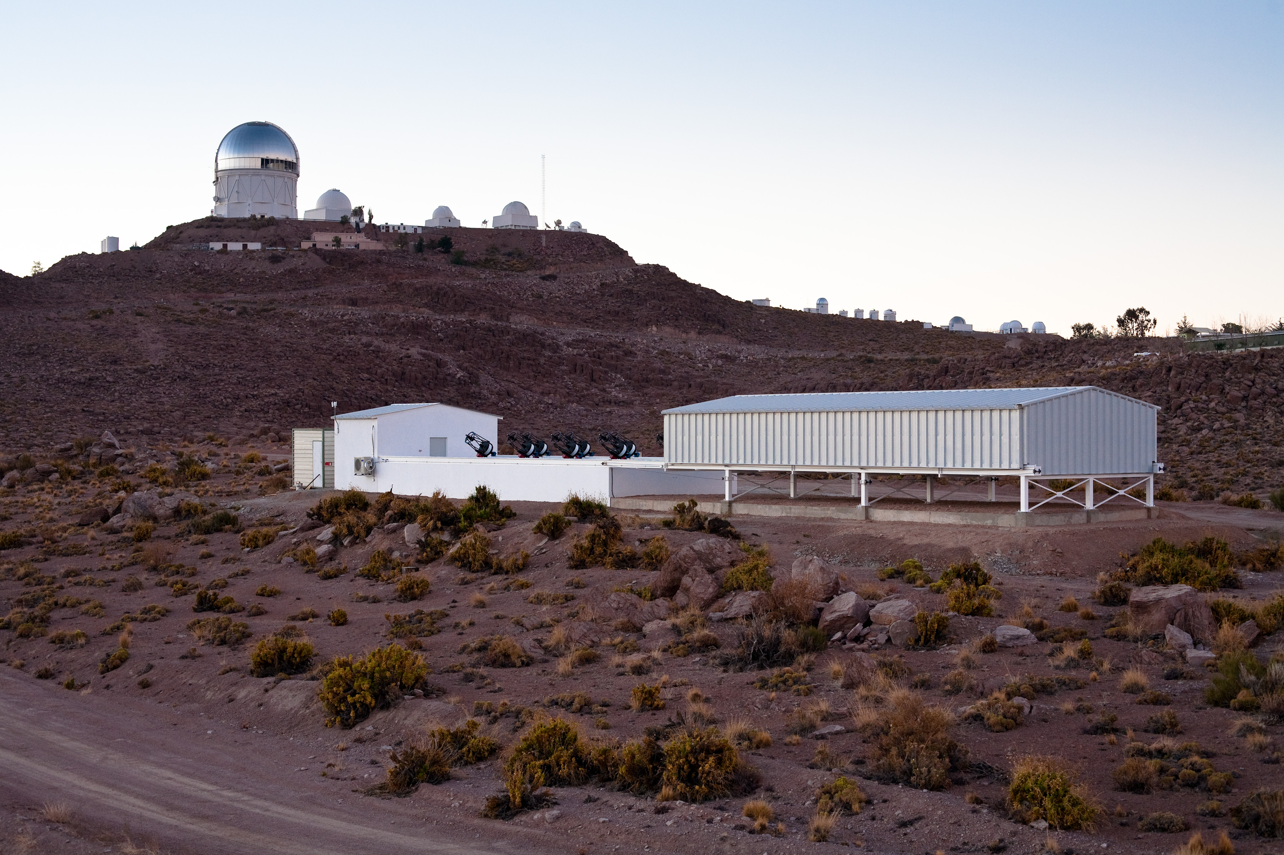
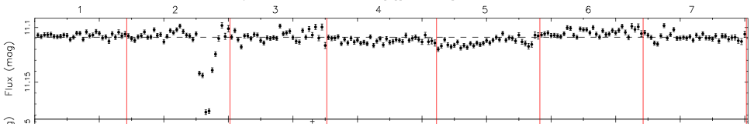
MEarth-South at Cerro Tololo
Operational as of January 2014
(credit for images & working observatory: J. Irwin)

Slide 13
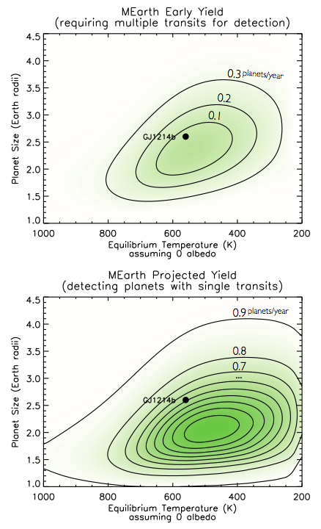
Can MEarth do better?
Berta, Irwin, Charbonneau (2013)

Slide 14
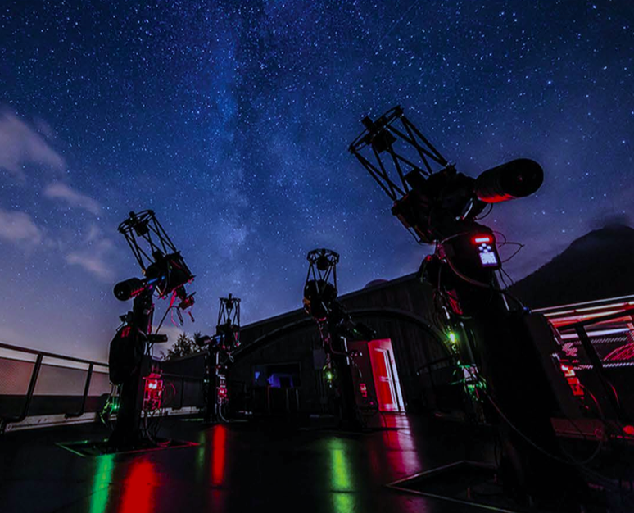
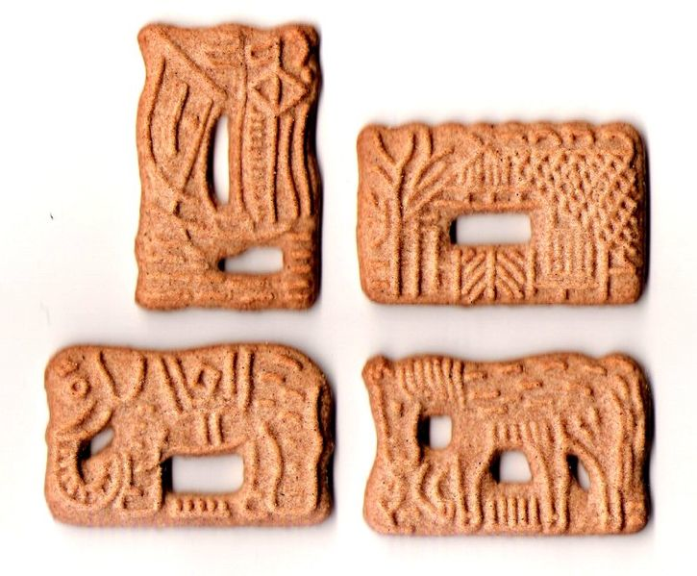
Other M Dwarf-Focused Searches
APACHE
5 x 40cm telescopes
Located in Italian Alps
Operating since 2012
SPECULOOS
  “Several” 1m telescopes
  Located in Chile
  Planned for 2015

Slide 15
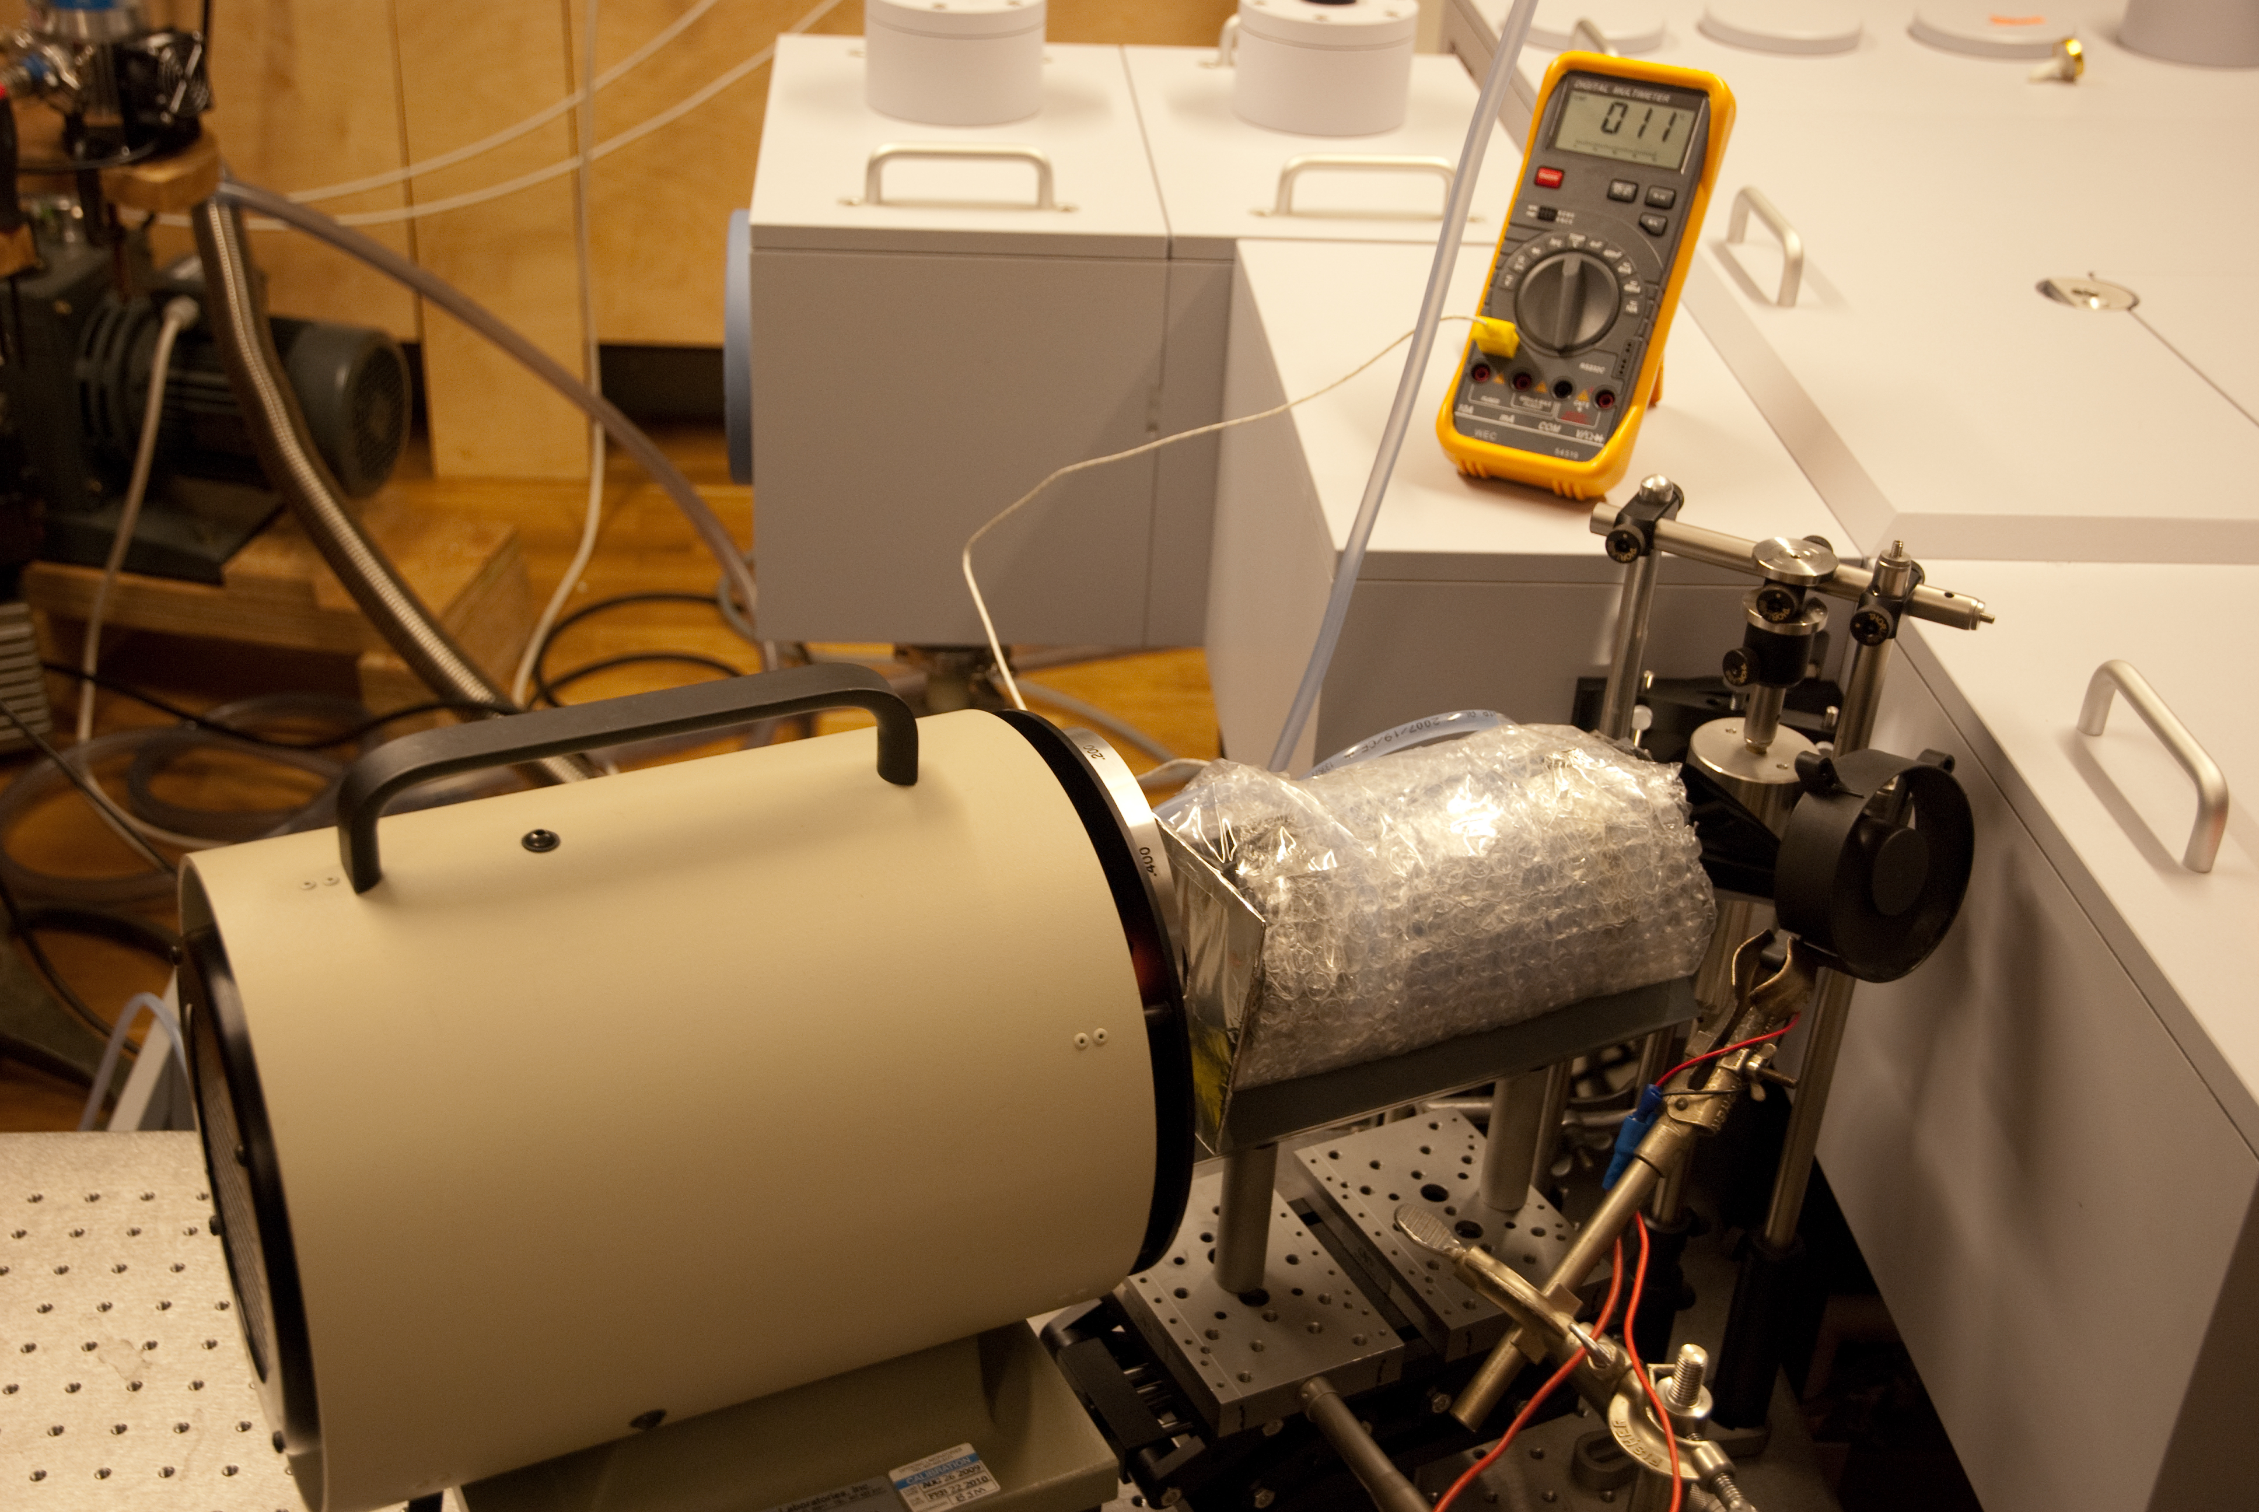
(Ground-Based) Radial Velocity

Slide 16
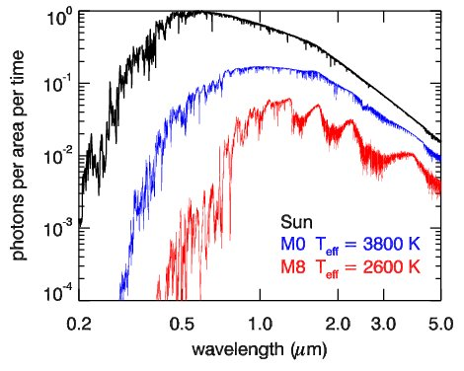
The need for red RVs

Slide 17
The need for red RVs
normal RV measurements
@ 10 pc
Sun V=4.8
M0 V=9.0
M8 V=18.7

Slide 18
The need for red RVs
normal RV measurements
more flux in the red/NIR

Slide 19
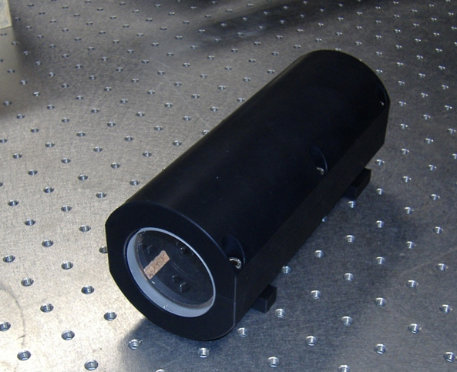
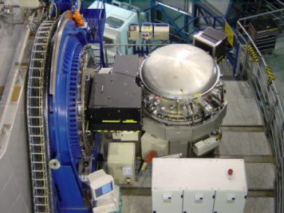
Current state-of-the-art
Ammonia gas cell
CRIRES at the VLT
ESO

Slide 20
Current state-of-the-art
Velocity precision tests
(Bean et al. 2010)

Slide 21
Current state-of-the-art
Velocity precision tests
5 m s⁻¹ noise floor insufficient to detect habitable planets!
(Bean et al. 2010)

Slide 22
Limitations of current approach
Telluric line contamination
Only have short section of spectra
Lack of image scrambling
Instrument not stabilized
Gas cell calibration imperfect and inefficient
K-band (2.3μm) not at the peak of the SED, nor the max RV information content

Slide 23
Limitations of current approach
Telluric line contamination
Only have short section of spectra
Lack of image scrambling
Instrument not stabilized
Gas cell calibration imperfect and inefficient
K-band (2.3μm) not at the peak of the SED, nor the max RV information content
New instrumentation needed!

Slide 24

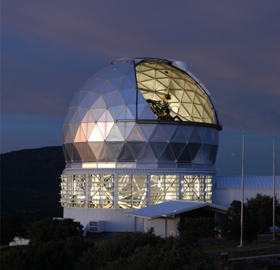


All:
Aim for 1 m s⁻¹ precision
Stabilized + fiber fed
On-sky ~ 2017
Ongoing efforts
0.52 – 1.65 μm with two separate spectrographs
3.5m telescope @ Calar Alto
R = 82,000
0.92 – 1.65 μm
9m Hobby-Eberly Telescope (HET)
R = 50,000
HPF
0.98 – 2.35 μm
4m Canada-France-Hawaii Telescope (CFHT)
R = 75,000 + polarimetry!
N
0.5 – 0.9 μm
6.5m Magellan telescope
R = 85,000
S

Slide 25
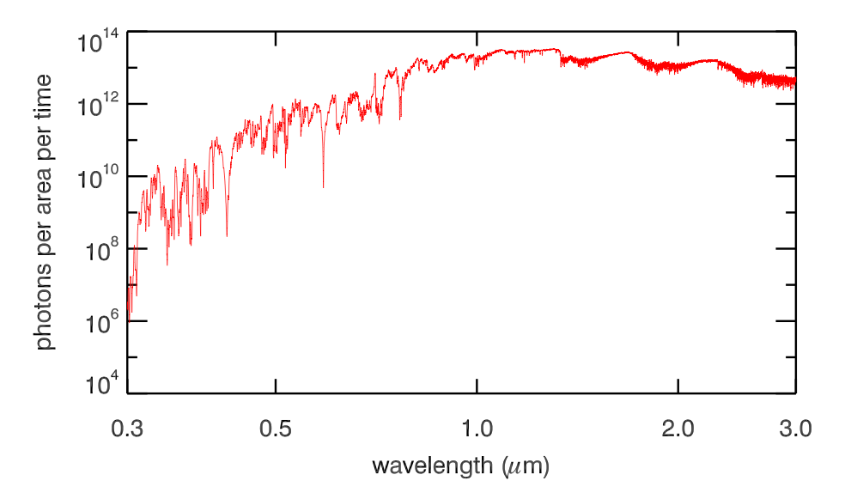
Ongoing efforts
M7 model spectrum
HPF
SPIRou
CARMENES
MAROON-X
ESPRESSO

Slide 26
Extra Slides

Slide 27
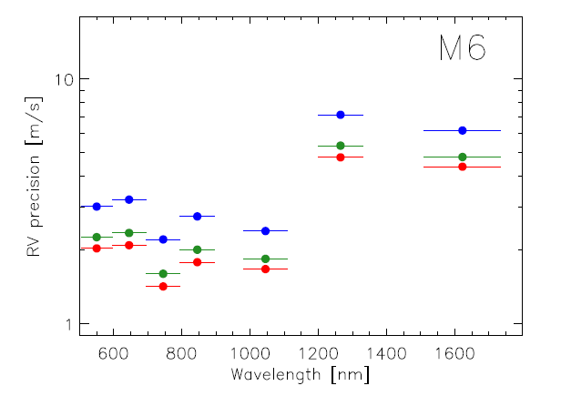
R = 60k
R = 85k
R = 100k

Slide 28
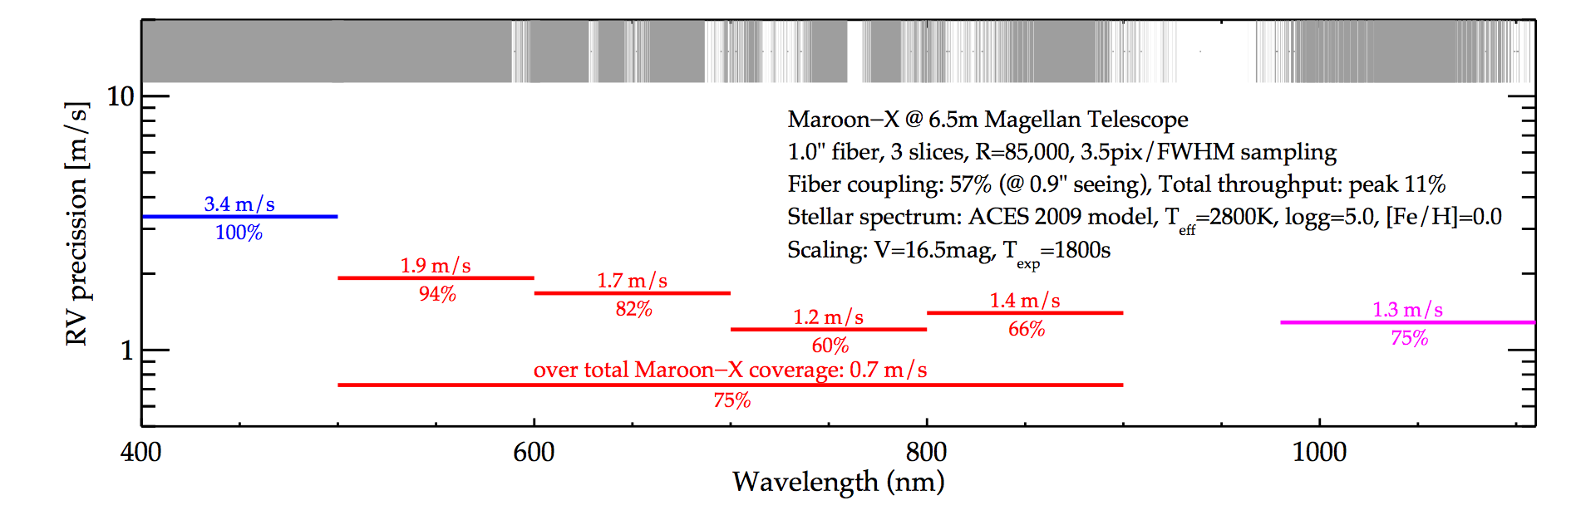

Slide 29
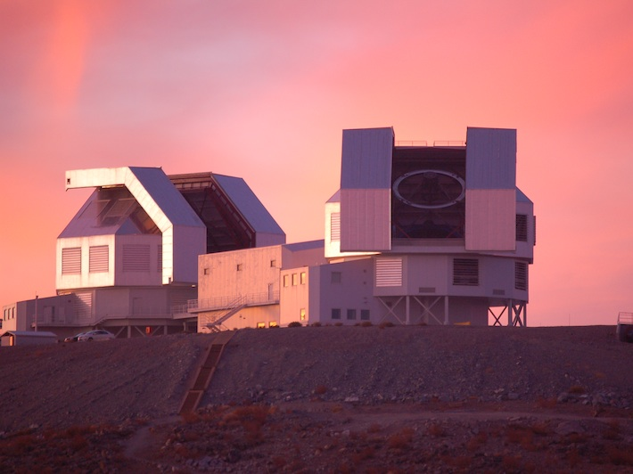
The shortcut to habitable planets
New RV Machine for Late M Dwarfs at Magellan
Science case is RV follow-up of transiting planets and taking the census of habitable worlds in the solar neighborhood.
Goal is σ = 1 m s⁻¹ in 30 min for a late M dwarf at 19 pc (V=16.5).
(Dressing & Charbonneau 2013)
Approach is a highly- stabilized, fiber-fed spectrograph covering 500 – 900 nm at R=85k with simultaneous calibration feed and image slicing.

Slide 30
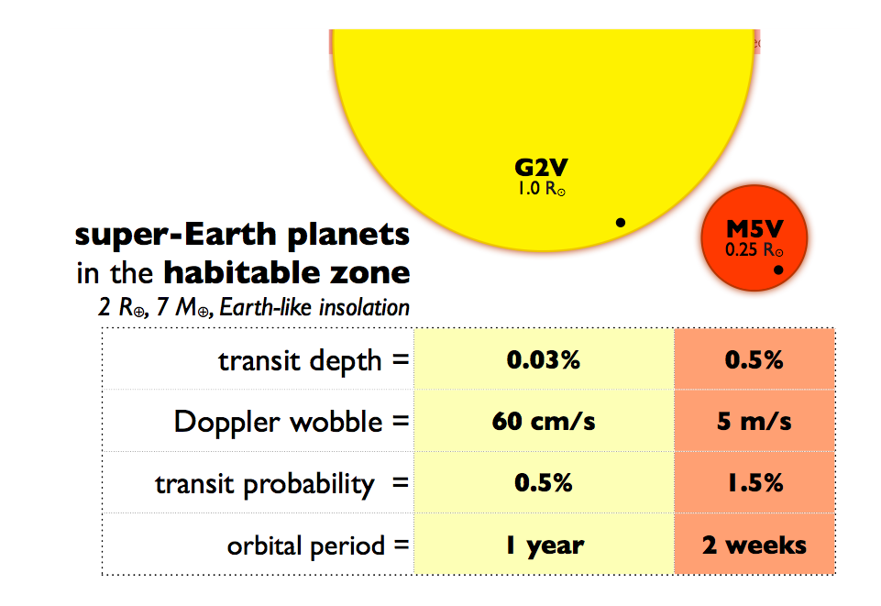
Slide from David Charbonneau

