Slide 1
Effects of Stellar Variability:
Important for transits (see next slides).
Transit depth = [ R_{planet}(λ,t) / R_{star}(λ,t) ]²
Not so important for eclipses because the eclipse is a simple difference, and the stellar variability typically is slower than the eclipse:
PLANET(t) = [ (STAR(t)+PLANET(t)) – STAR(t) ]
Can be very important for phase curves. How to disentangle?
Brighter stars are better. Poisson
Smaller stars are better. Contrast
Stable stars and stars with simpler spectra are better. Interpretation

Slide 2
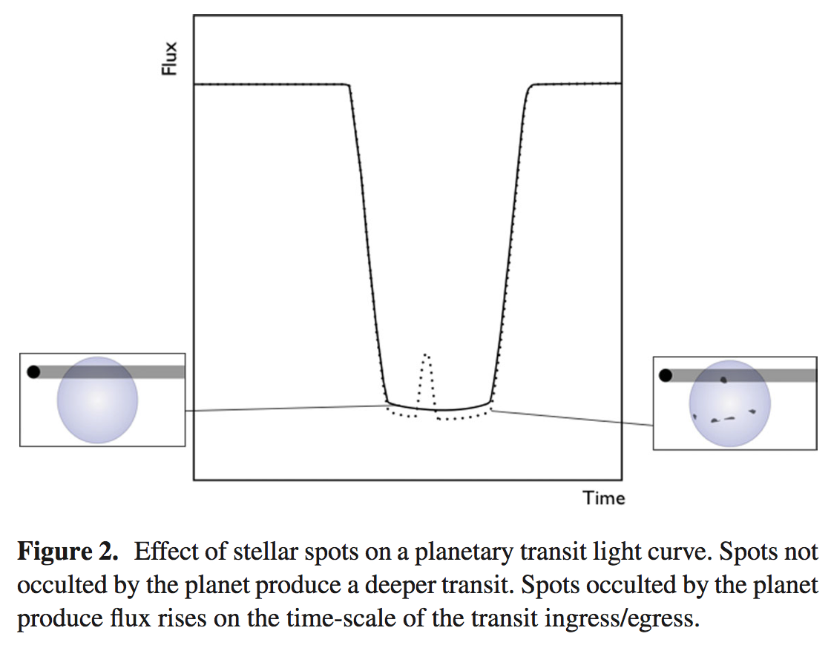
Pont et al. (2013)

Slide 4
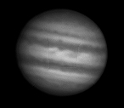
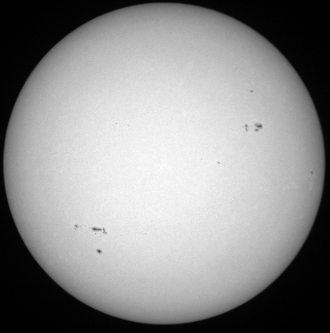
Stellar Spots?
HD 189733
K star
T_{eff} = 5000 K
Correction required for unocculted spots:
Sum of spot areas ~5% or
~2x area of planet
Temperature of spots ~4000 K
Illustration shows two dominant spots, but it could be a few or many smaller ones, possibly in bands (see inset) or polar spot(s).

Slide 5
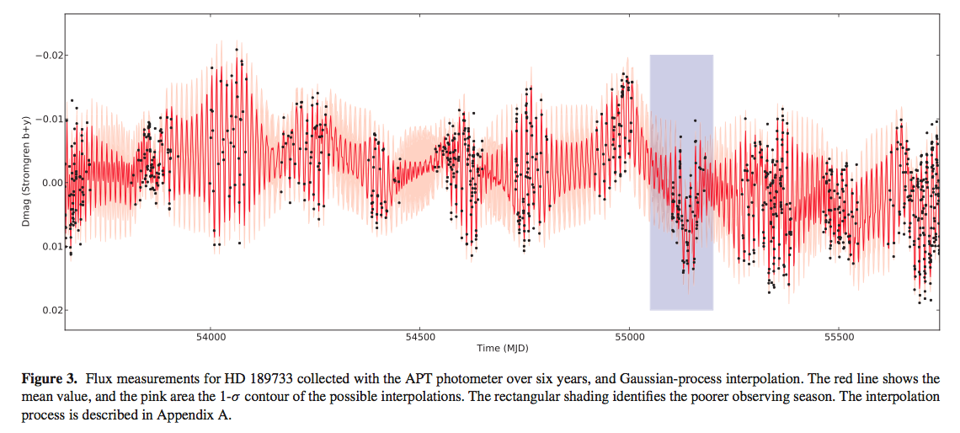
Pont et al. (2013)
1.02
1.00
0.98
Stellar Flux
Time (total ~ 6 years)

Slide 6
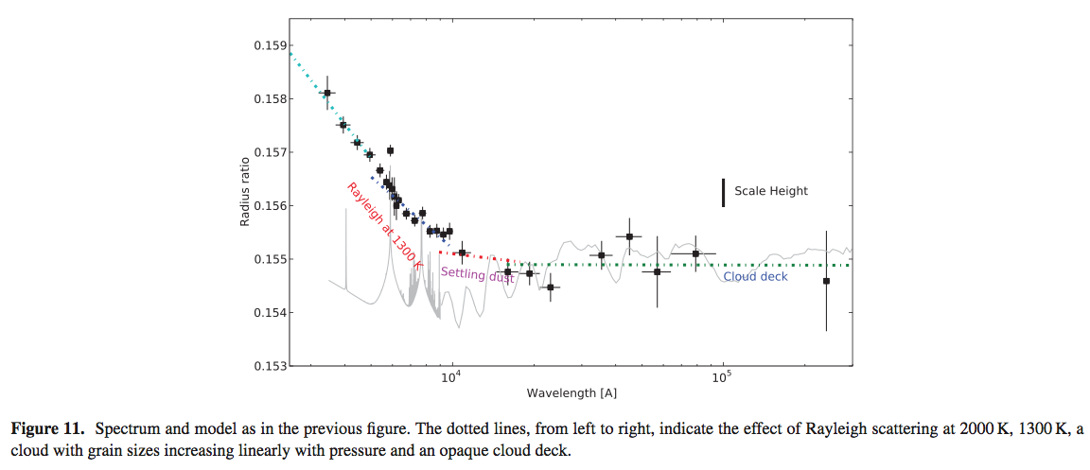
Planetary Rayleigh Scattering?
Pont et al. (2013)
Effect on radius highly exaggerated.
Lecavelier des Estangs et al. 2008
…
Pont et al. 2013

Slide 7
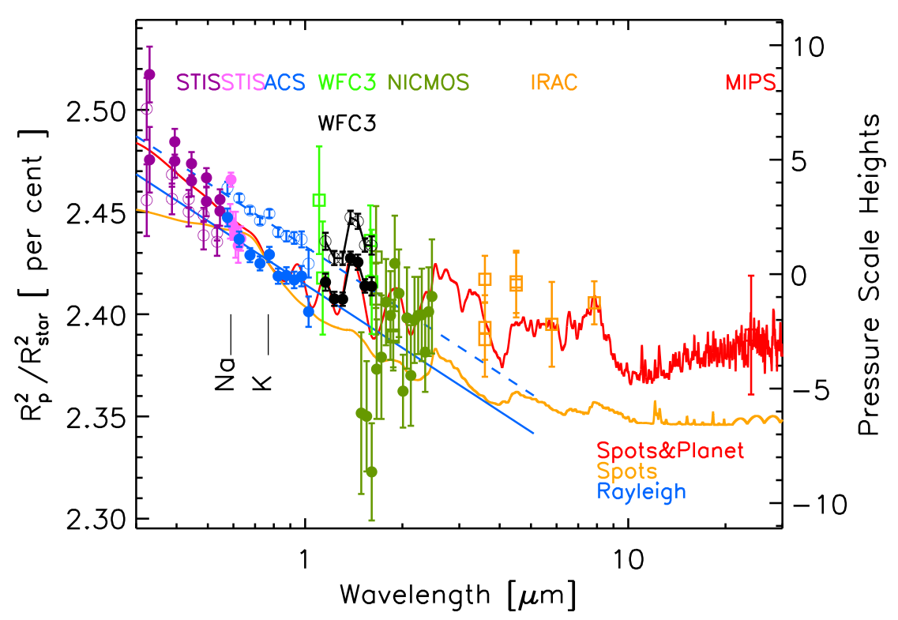
1.0% (open) and 1.7% (filled)
spot corrections were applied to ACS data
McCullough et al. 2014

