Slide 1
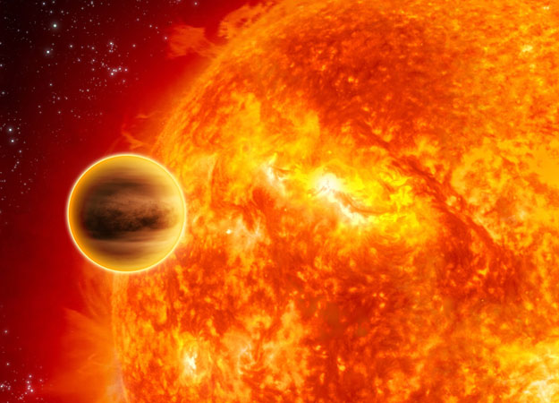
Analysis of Hot Jupiter Transit Spectroscopy
with HST/WFC3
Avi M. Mandell
NASA GSFC
Collaborators:
Korey Haynes
Evan Sinukoff
Drake Deming
Adam Burrows
Nikku Madhusudhan
Mark Clampin
Don Lindler
Natasha Batalha
Heather Knutson
(others as well)

Slide 2
HST / WFC3 Grism Spectroscopy:
Resolving Molecular Absorption
Wavelength range (1.1 – 1.7 μm) samples water bands at 1.15 and 1.4 μm as well as several hydrocarbons and continuum regions on either side
WFC3 Region
Can answer major questions about temperature and chemistry
But at LOW resolution over a NARROW bandpass, degeneracies still remain!

Slide 3
Cycles 18 & 19 Programs
Primarily large program (Deming et al.) focused on hot Jupiters
Sample of 16 objects
A number of planets may have upper-atmosphere temperature inversions or high C/O ratios
We started with several interesting (and outlying) cases:
WASP-12: Very hot, first possible carbon-rich exoplanet, but results now in dispute
WASP-17: Ultra-low density, retrograde orbit
WASP-19: Shortest-period planet known (P ~ 19 hr) but no temperature inversion
WASP-33: Very hot and massive, orbiting an A-type star, possibly carbon-rich
List of Observed Planets
CoRoT-1 b
CoRoT-2 b
HAT-P-7 b
HAT-P-12 b
HAT-P-13 b
HD189733 b
HD209458 b
TrES-2 b
TrES-3 b
TrES-4 b
WASP-4 b
WASP-12 b
WASP-17 b
WASP-18 b
WASP-19 b
XO-1 b
WASP-33 b
WASP-12
WASP-33
WASP-19
WASP-4
WASP-17
Transits
Eclipses

Slide 4
Transit Spectra Analysis:
Systematics Removal Through Self-Calibration
We used the divide-oot method (Berta et al. 2012) to fit the band-integrated light curve
We subtracted the model from the raw light curve to obtain the residual systematic variation; additional trends due to spectral drift were also measured
We created a model for each wavelength bin, with a scaling parameter for each possible systematic trend in the data and an overall visit-long slope
WASP-12
WASP-17
WASP-17
WASP-19

Slide 5
The Effects of Bin Size on Spectral Information
We examined a range of options for the number of spectral channels that we combined into a single bin
We noticed that the overall rms of the spectrum improves according to photon-noise statistics only up to bin sizes of 5 - 6 channels
Larger bins do not lead to an overall decrease in the rms, and therefore larger bins run the risk of losing spectral information
But it remains to be seen whether this variation is instrumental rather than astrophysical…

Slide 6
Primary Result: Amplitude of water absorption band is lower than expected based on previous observations
Due to either:
An unexplained haze layer that increases the continuum opacity below a certain altitude
Less water due to non-solar abundances
(T ~ 2900K)
(T ~ 2500K)
(T ~ 2000K)

Slide 7
Primary Result: Amplitude of water absorption band is lower than expected (based on previous Spitzer obs.)
Due to either:
An unexplained haze layer that increases the continuum opacity below a certain altitude
Less water due to non-solar abundances
(T ~ 2000K)
A
2
Cooler planets seem to show well-defined spectral features, while hotter planets are ambiguous…
NEED MORE SPECTRAL COVERAGE for MORE PLANETS
(T ~ 1800K)
(T ~ 1700K)

Slide 8
Conclusions
The WFC3 instrument on HST has now been validated as a reliable platform for high-precision exoplanet transit observations
Relative-depth analysis proves to be a reliable and flexible strategy
Systematic trends seen in the band-integrated light curve are common-mode, and can therefore be removed using linear combination
The issues inherent in HST data (i.e. orbit spacing) and detector effects impact only the uncertainty in the overall shift in the data, enabling robust detection of spectral features

Slide 9
Questions?

