Slide 1
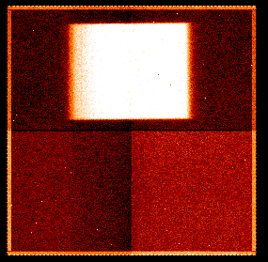
Measurement Repeatability
WFC3 – spatial scan mode analysis – work in progress
Mark Swain, Pieter Deroo, Kiri Wagstaff
IPAC JWST workshop 3/11/14
Jet Propulsion Laboratory, California Institute of Technology
Copyright 2014 California Institute of Technology. All rights reserved.

Slide 2
Questions Investigated
Multiple timescales involved
What are the properties of the measurements in individual integrations?
  Mean, standard deviation, Gaussianity
What are the properties for orbit-to-orbit groups of measurements?
  Mean, standard deviation, Gaussianity
measurement
repeatability test

Slide 3
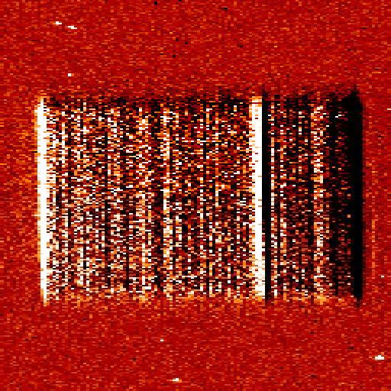
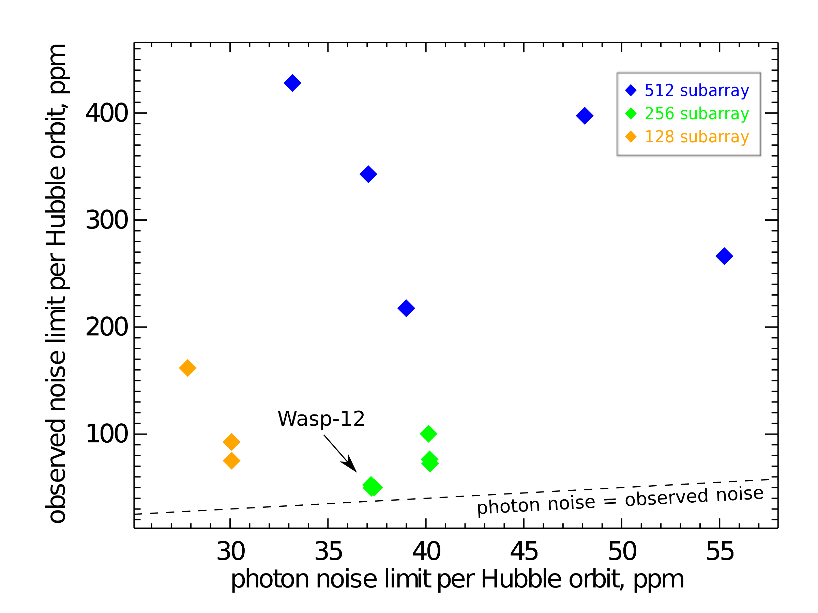
Data analyzed observations of GJ 1214
Scan rate artifacts present
Instrument performance changes with time – also true in stare mode
wavelength
Swain et al. 2013
time

Slide 4
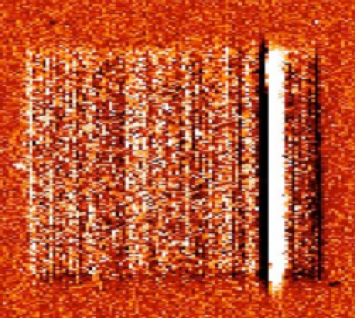
Single integration
 | frame | λ row
<N> | ~2.4e4 | ~2.4e4
σ | 3.3 theory | ~2.0 theory
Gaussianity | ~no | ~no
flux histogram green box
3.3x theoretical noise
Green: 9882 pixels in green box
Red: 81 pixel in single wavelength pixel

Slide 5
Single orbit
Histogram 187,758 pixel values in the orbit with and without integration mean shifting.
Integration mean value shifts do not materially change measurement properties.
Measurements are 3.8 x theoretical noise & non-Gaussian

Slide 6
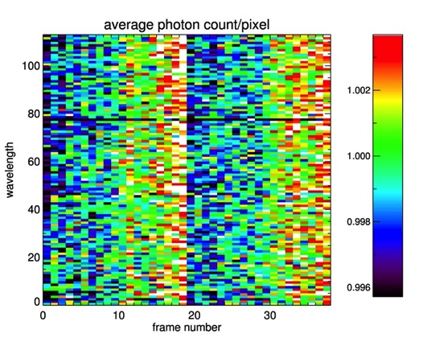
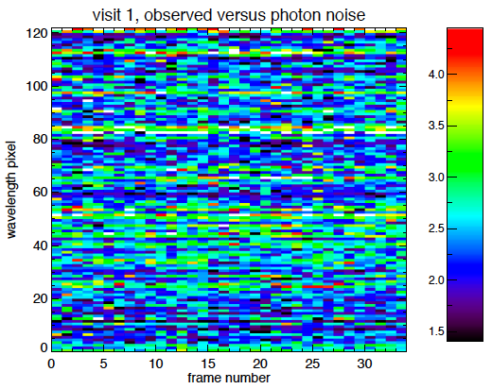
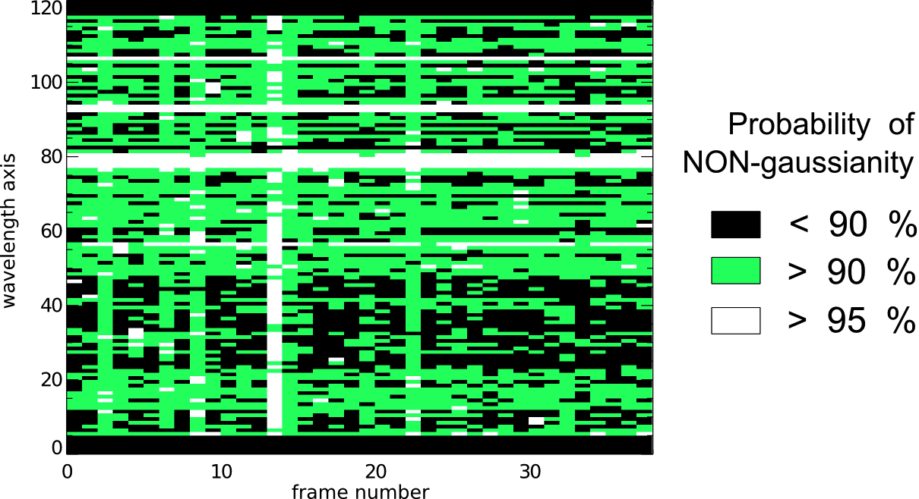
Visit (orbits 2&4) – raw and ima give same results each pixel in images below is based on of 81 detector pixels
Flux Normalized to Visit Mean
σ_{measured}/σ_{thory}
60% data non Gaussian with P>90%
σ_{M}/σ_{T} Histogram
Notes:
Question: does the theoretical noise simulation have as many samples as the observed noise measurement? That could be making the theoretical noise look narrower maybe?

Slide 7
Measurement Repeatability
NSAMP=2
NSAMP=8
Compare:
Orbit_1,Nsamp_2 – Orbit_3,Nsamp_2
Orbit_1,Nsamp_8 – Orbit_3,Nsamp_8

Slide 8
Data summary
Standard deviation ~2-3 x theoretical noise during a detector integration.
  Not changed by shifting the broadband or spectral integration mean values.
Majority of measurements non-Gaussian.
  Implies systematics present during a single detector integration.
  Confidence interval determination problematic.
Measurement repeatability problems seen with individual samples up the ramp.
  Shows systematic differences between nondestructive reads during an integration.

