Slide 1
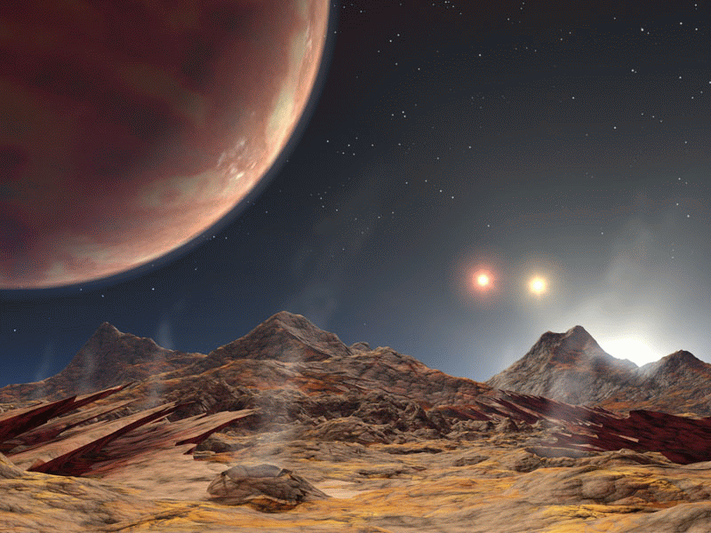
Targets for JWST: Kepler and K2
Steve B. Howell
NASA Ames Research Center
11-13 March 2014

Slide 2
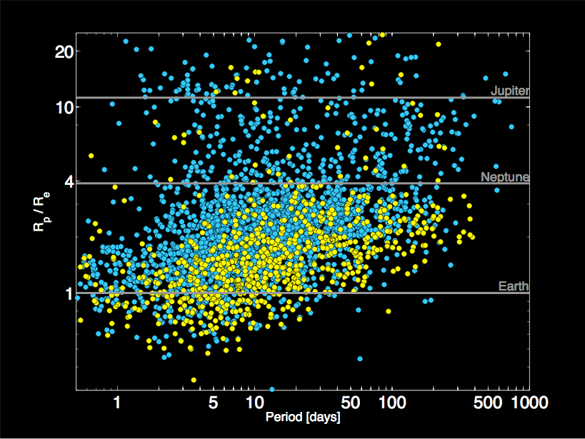
Q1-Q12 Planet Candidates

Slide 3
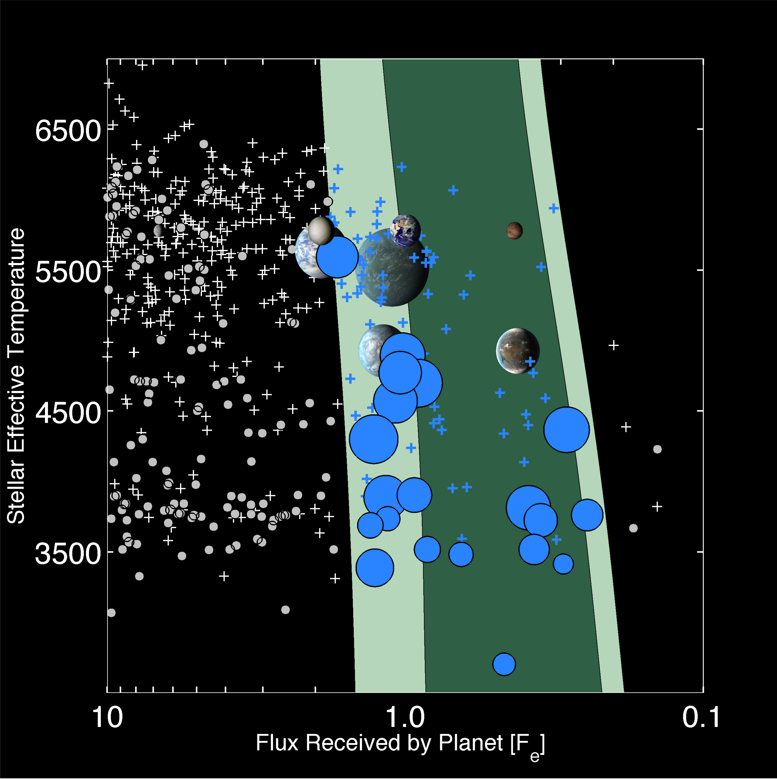
Kepler Planets:
Habitable Zone, Frequency
Approximately 50% of M dwarfs harbor a planet smaller than 1.4 R_{e} in the HZ (Dressing & Charbonneau 2013; Kopparapu 2013; Gaidos (2013)
Approximately 7% of G & K dwarfs harbor a planet smaller than 1.4 R_{e} in the HZ (Petigura et al. 2013) based on results from independent pipeline, extrapolated to longer orbital periods.

Slide 4
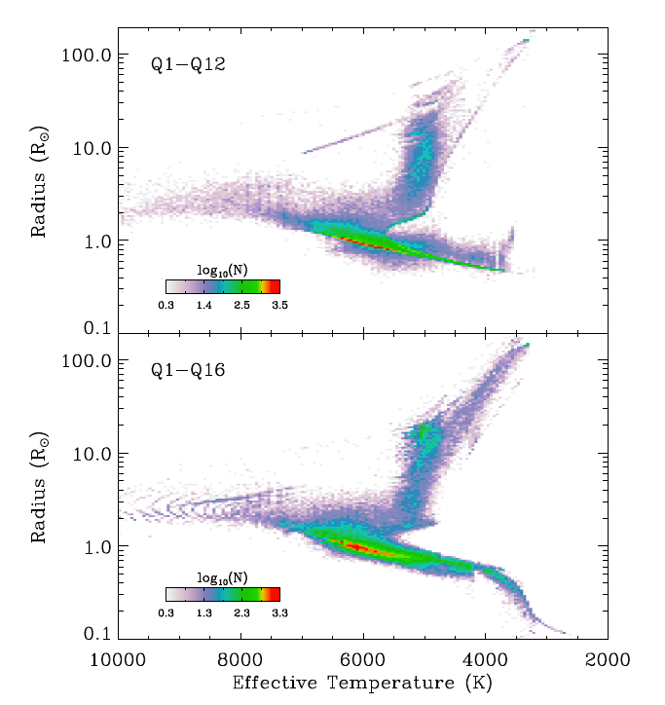
Kepler Input Stars
Radius vs. effective temperature of the ~190,000 stars observed by Kepler during the prime mission.
The upper panel shows the properties that were used for the 12 quarter software pipeline run.
The lower panel shows the properties that were used for the 16 quarter pipeline run.
Figure taken from Huber et al. 2013.

Slide 5
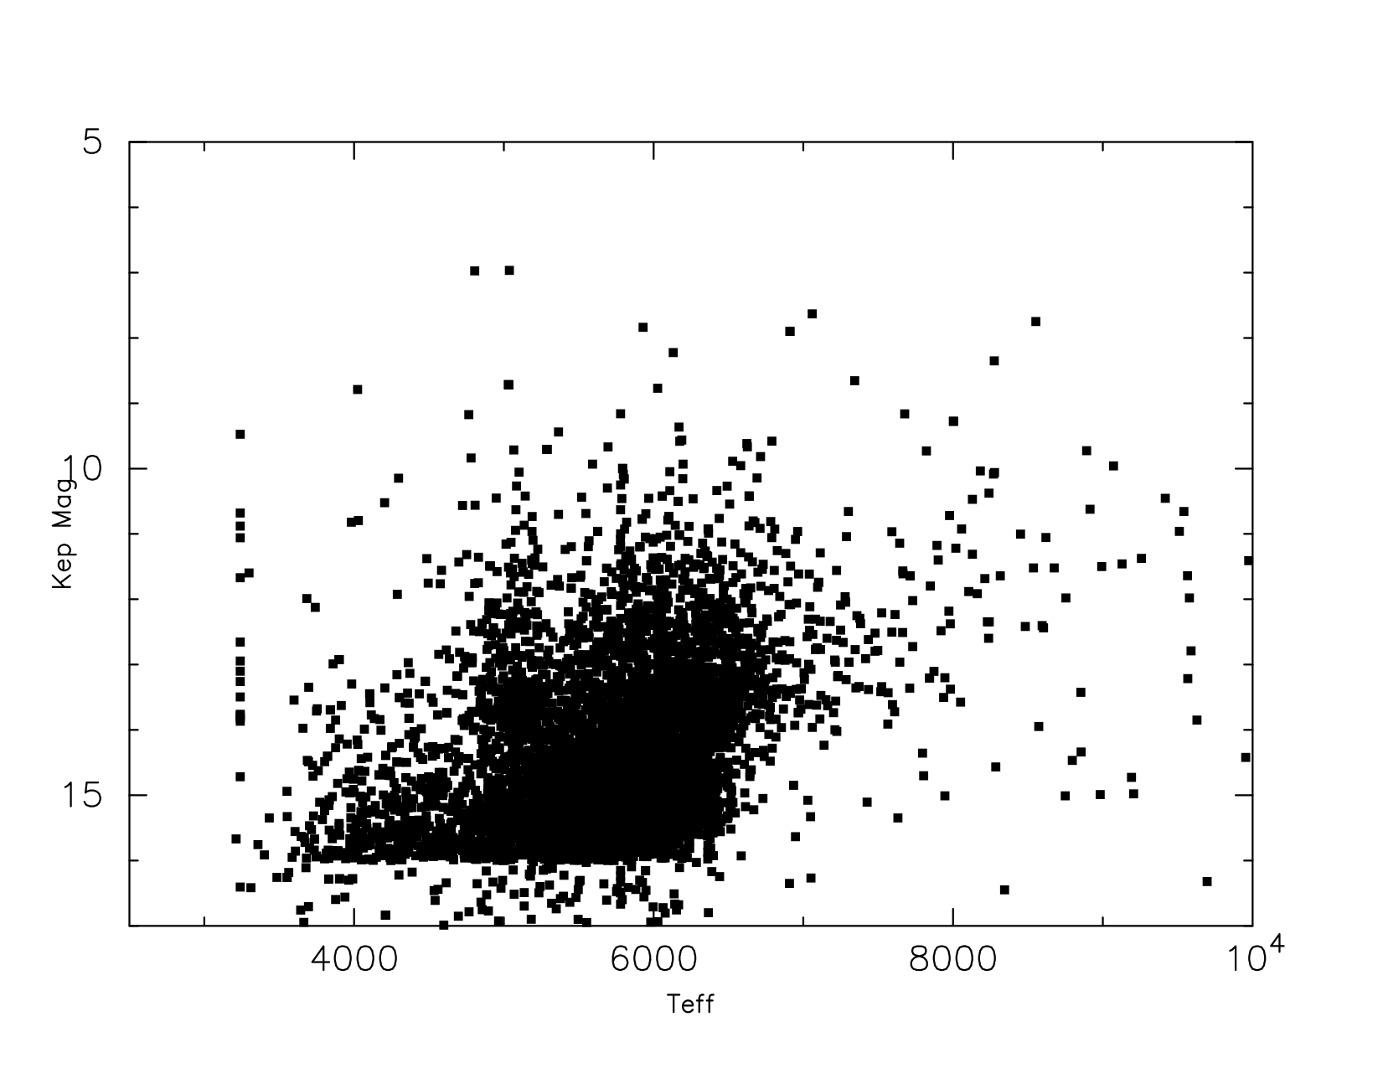
Kepler KOIs: Teff vs. Kep Mag

Slide 6
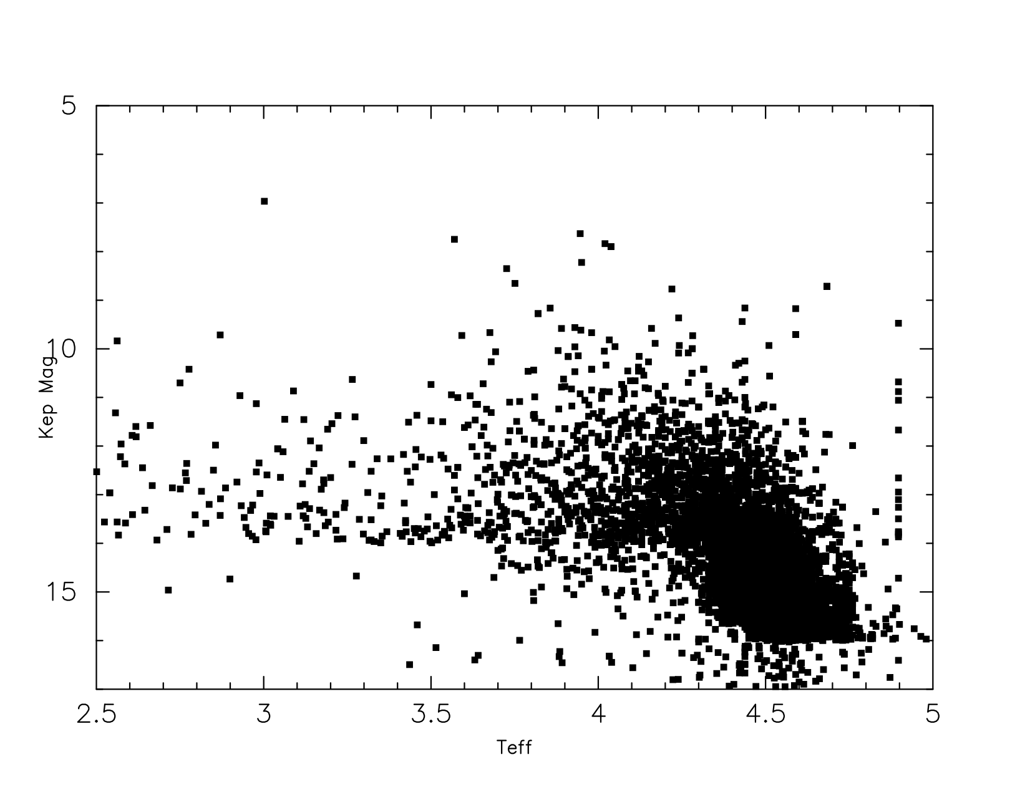
Kepler KOIs: log g vs. KepMag
Log g

Slide 7
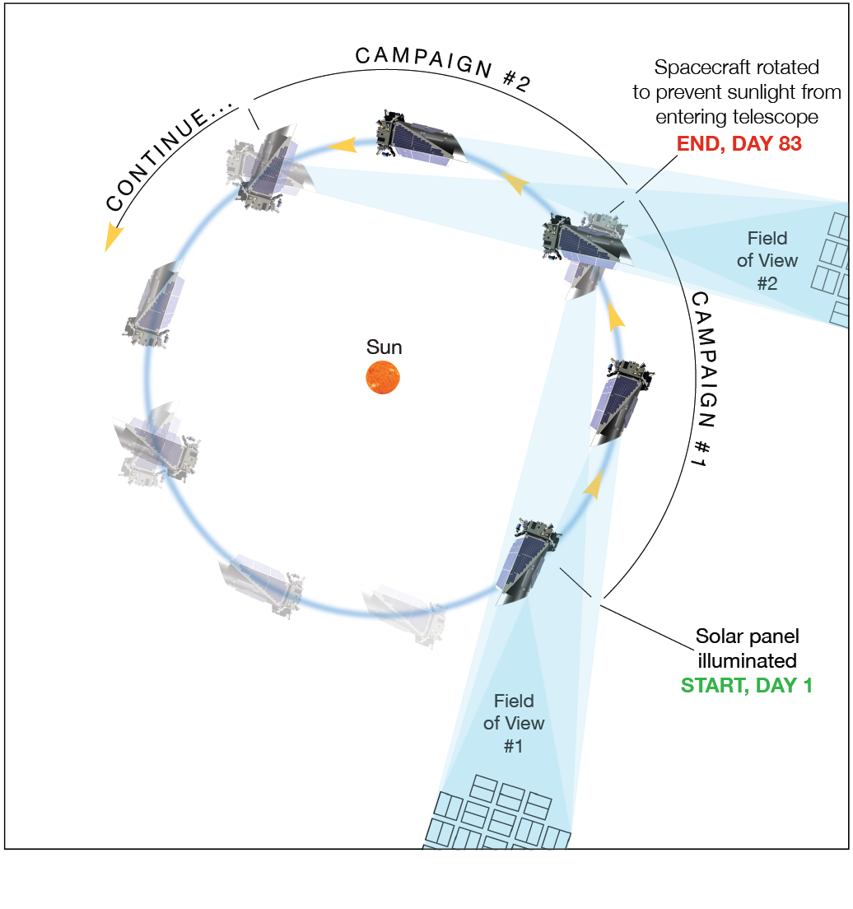
K2 Ecliptic Mission Concept
Use solar pressure
as “third wheel”
View series of
ecliptic fields
Each field in-view
for ~83 days
Described in
Howell et al., 2014,
In PASP
(arXiv: 1402.5163)

Slide 8
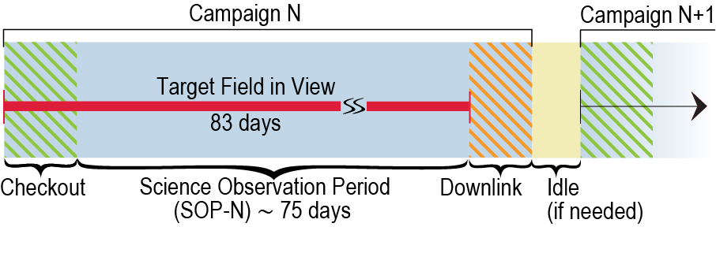
Schematic K2 campaign
Science time per campaign is ~75 days. Science data downlink takes
~1-2 days. Campaign 0, an engineering campaign, underway now.

Slide 9
K2 Fields – Next 2 years
Fields planned “around” field 4, stepping back and forward by 83 days.
Final adjustments for each field happens (6 months ahead) as they come along.
All targets from peer-reviewed community proposals, no proprietary data.

Slide 10
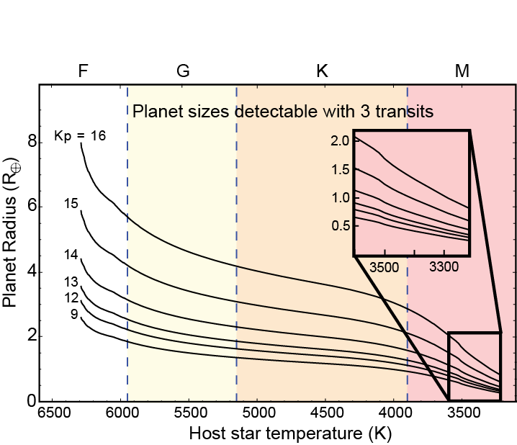
K2 Detection Space / M stars
K2 detection space:
3 transits at
80 ppm, 6hr. mean
~4000 M stars / field
M star rocky planets:
~50 / year
Need spectra for all
host stars

Slide 11
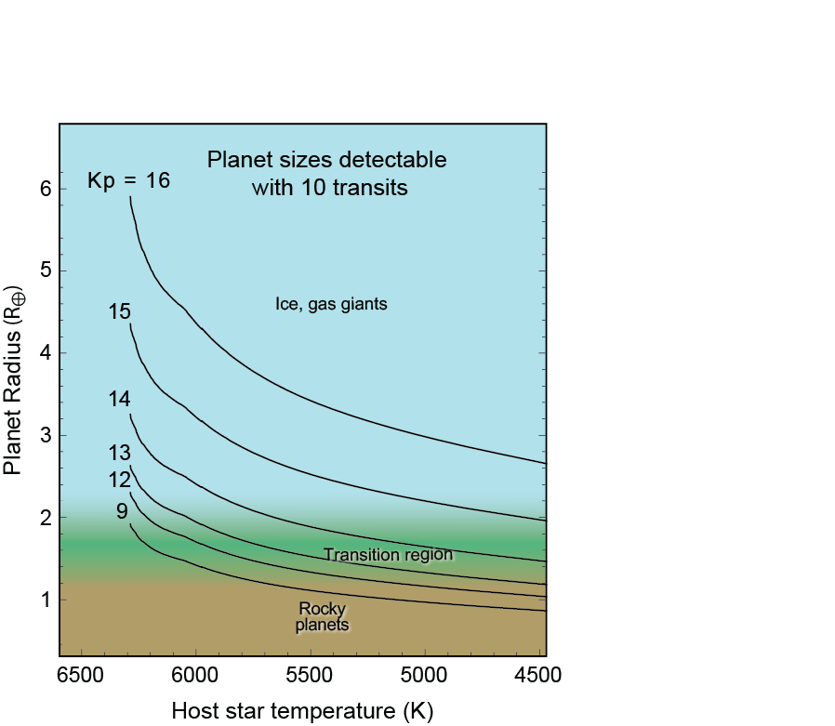
K2 Bright Stars
K2 detection space for bright
stars and 10 transits
4000-7000 V<12 stars / campaign
~50 bright star planets/year
Probe transition region:
gas to ice to rocky

Slide 12
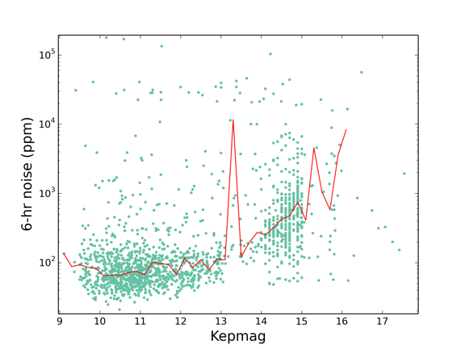
K2 Noise Level – Prelim

Slide 13
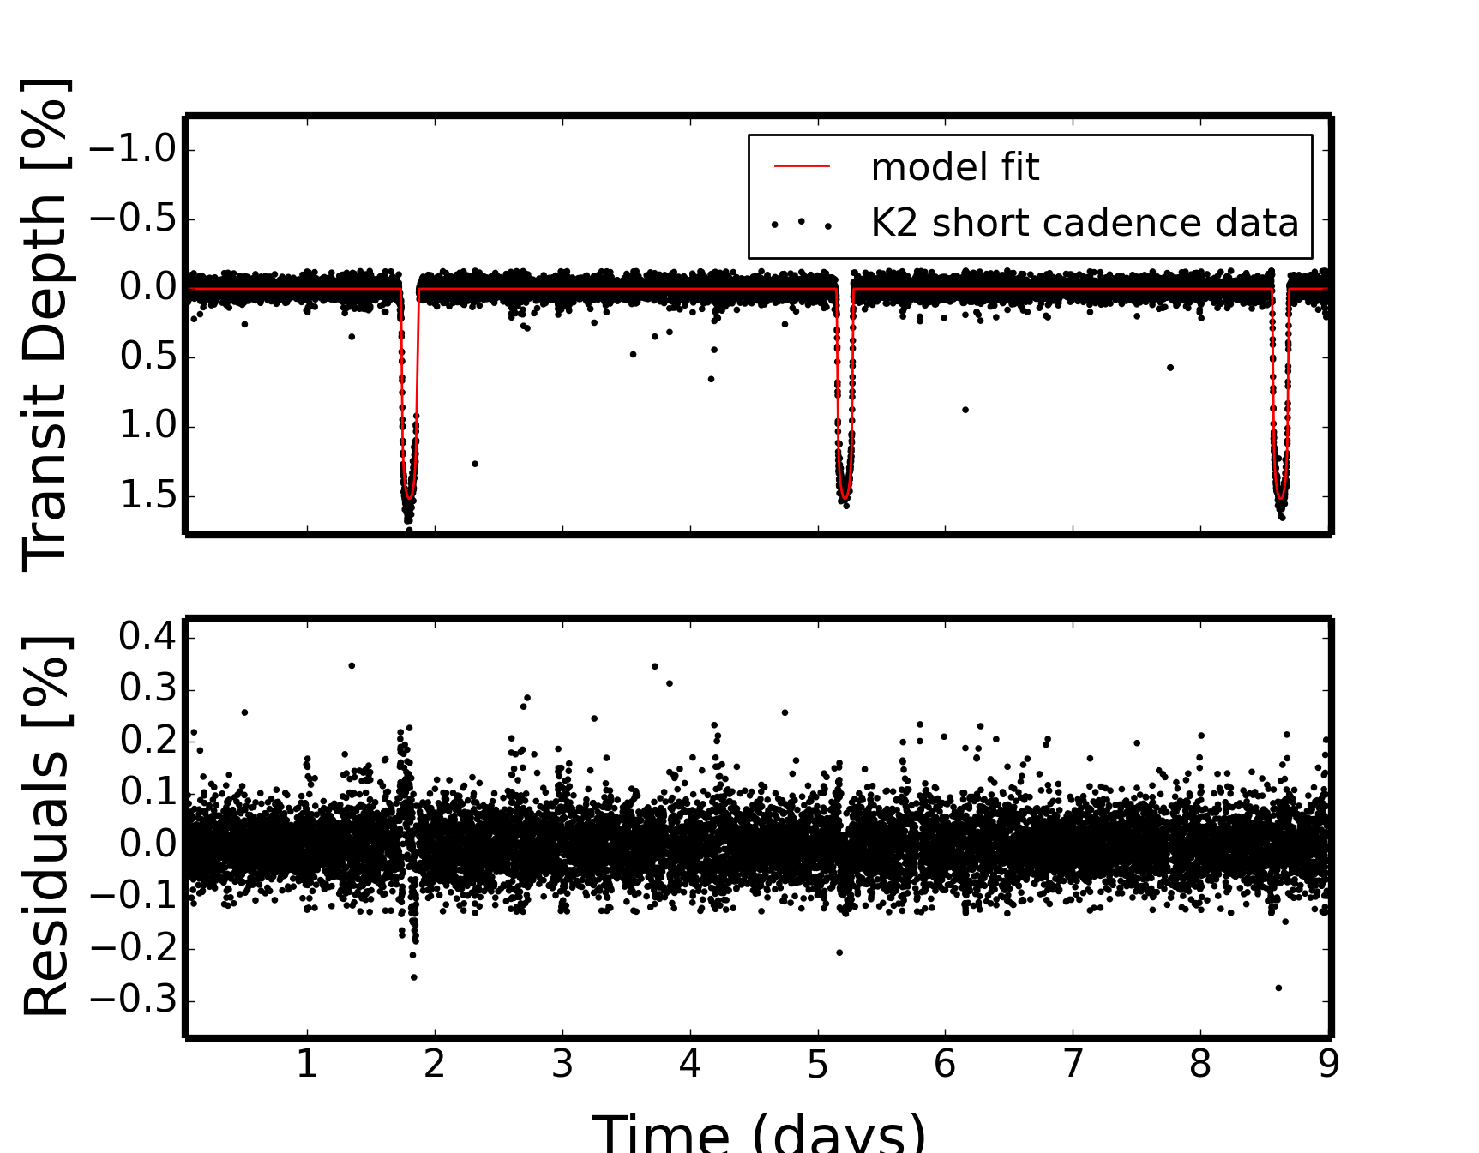
K2 Engineering Data – WASP 28b

Slide 14
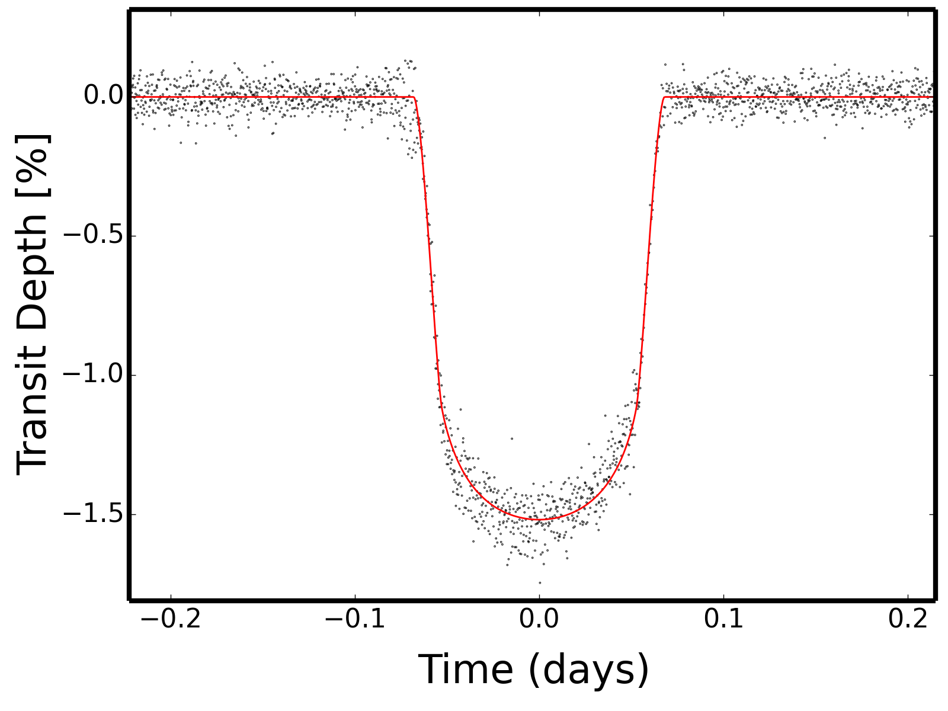
WASP 28b
WASP 28b – three transits
Point-to-point (rms) scatter of 0.12%.
6-hr integrated noise level = 84 ppm.

