Slide 1
Introduction: Goals for JWST Transit Meeting
C. Beichman
Jonathan Lunine
March 11, 2014

Slide 2
JWST and Exoplanets
Observations of transits and complete phase curves with JWST will revolutionize our knowledge of the physical properties of tens to hundreds of exoplanets and provide important clues as to their formation and evolution
JWST will expand field of planetary atmospheres from 8 planets in our solar system to hundreds of widely varied objects
JWST will study a diverse population of planets in a wide variety of environments
Gas and icy giants with analogs in our solar system
Sub-Uranus/Neptune sized gas/ice/water worlds not found in our solar system
Rocky Super-Earths and possibly even Earths
Stable to wildly eccentric orbits
High to low levels of insolation
Wide variety of host stars, from low to high mass, from low to high metallicity
JWST will enable precise determination of planetary properties
Accurate transit and orbital parameters with high SNR measurements
Long baseline transit timing variations (wrt Kepler, TESS, CHEOPS observations)
Most importantly, JWST will investigate planetary atmospheres
Determine detailed atomic and molecular composition
Probe vertical and horizontal structure, including making 2-D maps
Follow dynamical evolution (from weather to climate change in HD 80606)

Slide 3
What Does JWST Bring to Transit Science?
Dramatic improvement in raw sensitivity
7.5x SNR compared with Spitzer
2.7x SNR compared with HST
Highly stable observing conditions
Long uninterrupted observing sequences compared with HST or ground
Highly stable telescope figure and precision pointing
No atmospheric drifts or confusing atmospheric emission/absorption lines
Broad suite of instrumentation
Transit photometry from 0.7 to 28 μm for stars as bright a K=4 mag in broad to narrow band filers (R~4 to 100)
Transit spectroscopy from 0.7 to 28 μm with R~100 to 3,000
Modern detectors capable of <<100 ppm precision over hours to days
5 years of operation (and probably 10 or more years)
Adequate observing time to study of 10s to 100s of planets with multiple visits over long temporal baselines
Opportunity to investigate new systems as they become available from on-going ground or space surveys

Slide 4
Goals of Meeting
Define most important scientific cases for JWST transit observations
Improve understanding of instrument capabilities to accomplish these goals
Inform instrument teams, the project, & STScI about unique requirements of for maximum precision (cadence, astrometry, duration, etc.)
Bring out lessons learned from other facilities, e.g. HST, Kepler, Spitzer
Develop plans for near term work to ensure optimum on-orbit performance, e.g. improving and validating data acquisition procedures or using testbeds and data simulations to prepare data reduction tools and pipelines
Identify precursor activities needed for obs. planning and/or interpretation
Rapid follow-up of most favorable TESS targets
Libraries of model atmospheres
Detailed knowledge of properties of host stars (radius, metallicity, etc)
Precision ephemerides
Early in-orbit test plans
Encourage and inform community about how they might use JWST, e.g. large, coherent Key/Legacy programs, smaller individual programs, etc
Exoplanet research is one of JWST’s 4 high level goals➔
Exoplanet Science should capture 25% of JWST observing time
900 days in 10 years corresponds to a lot of transit opportunities

Slide 5
Prior JWST White Papers at http://www.stsci.edu/jwst/doc-archive/white-papers

Slide 6
Prior JWST White Papers at http://www.stsci.edu/jwst/doc-archive/white-papers

Slide 7
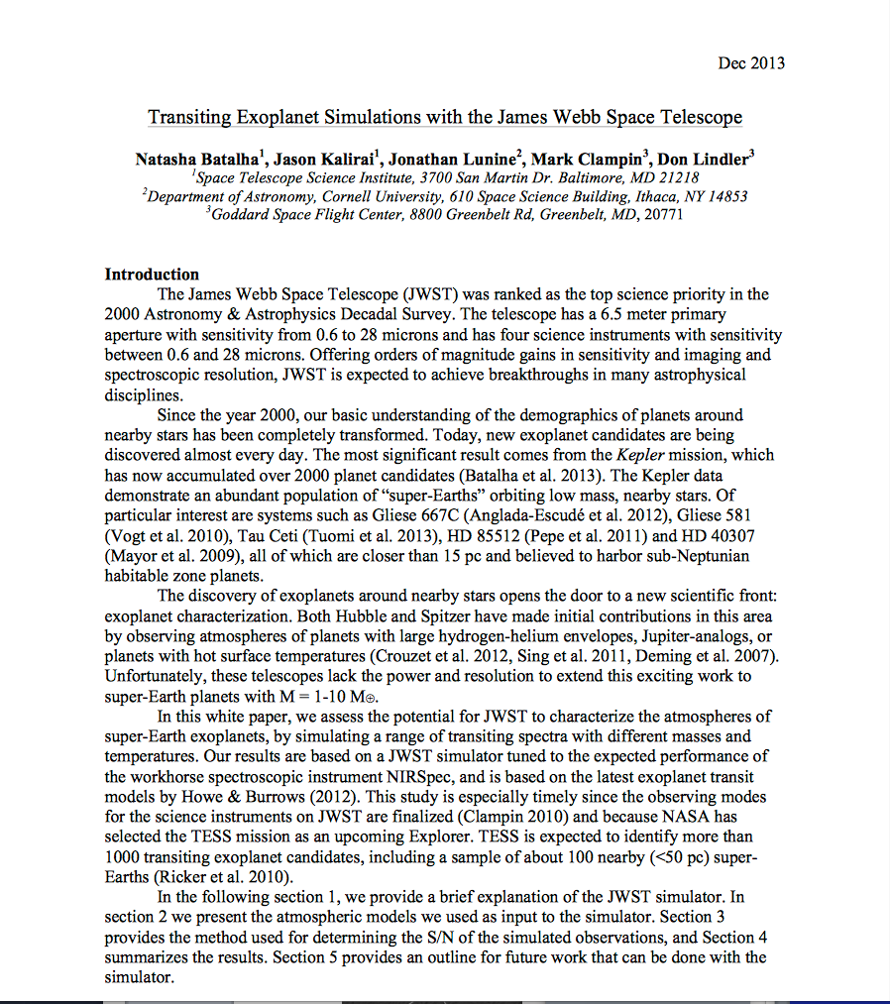
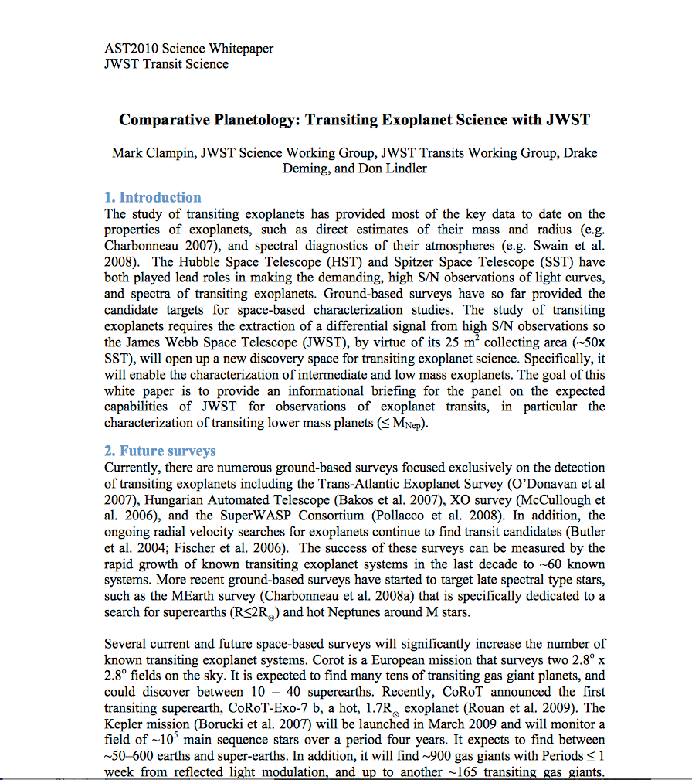
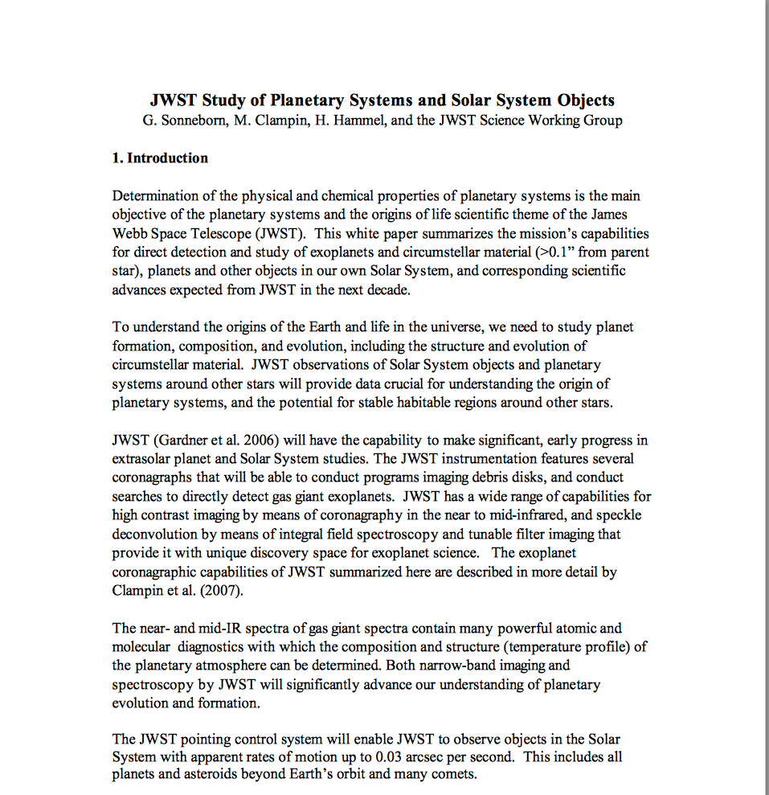
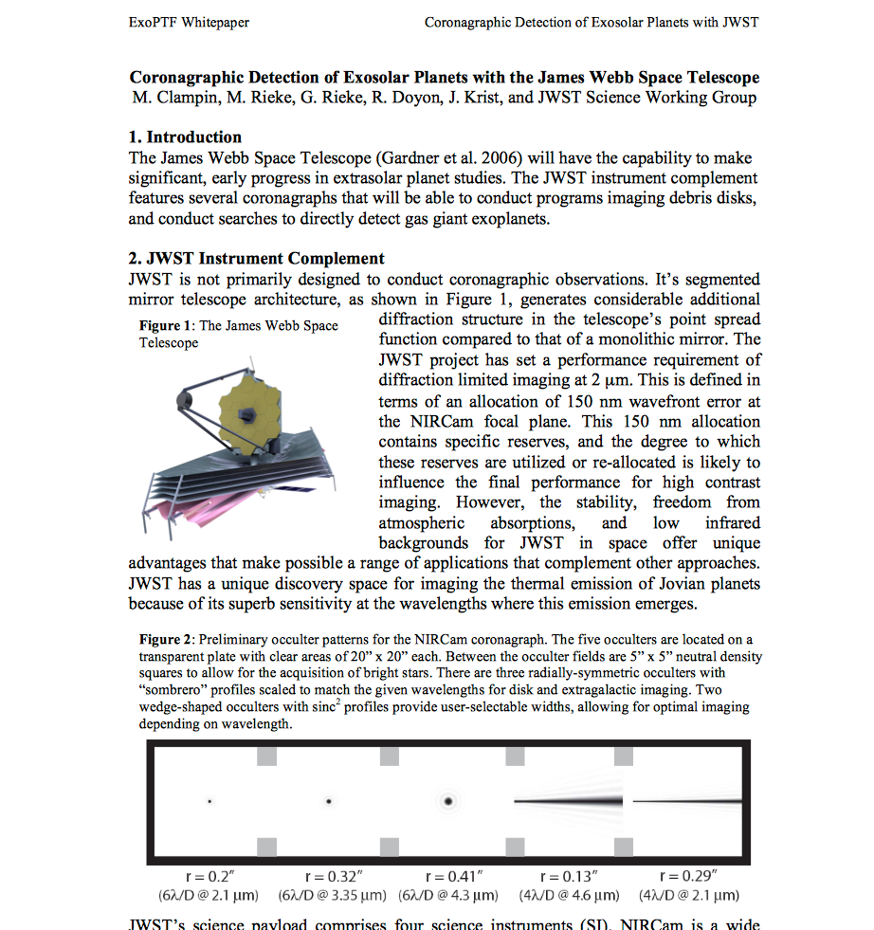
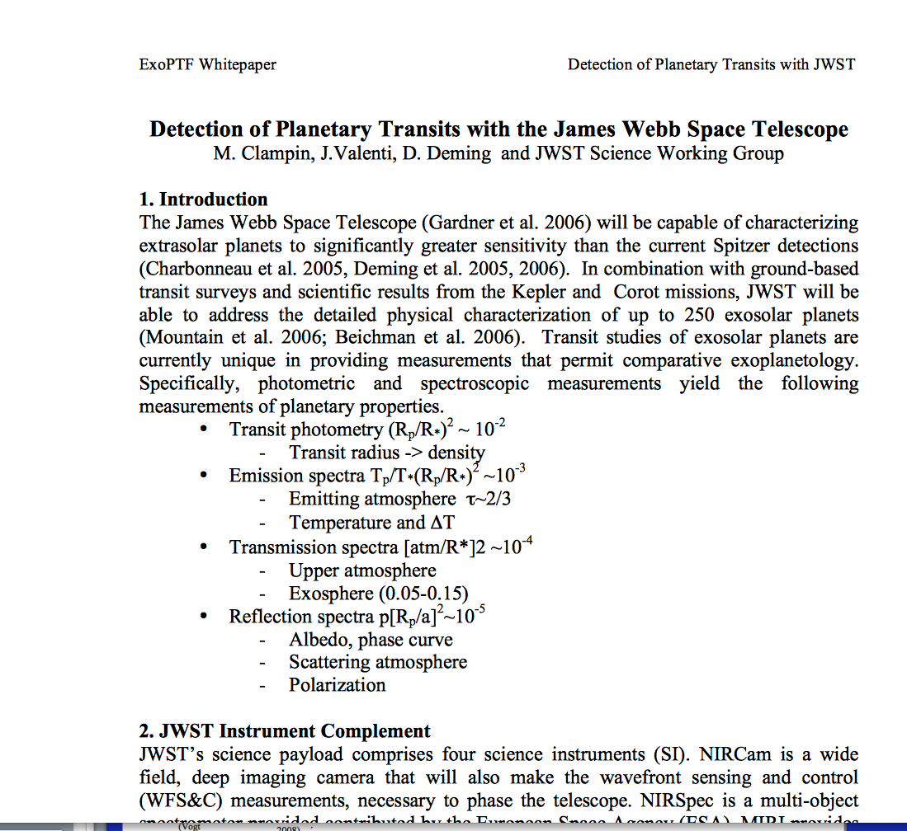
Five white papers in particular are worthy of attention
Feel free to read and discuss these during the workshop

Slide 8
Plans for White Paper
Important to have meeting summary as well as online viewgraphs
Suggest PASP article available by mid-summer.
To minimize effort I suggest having rapporteurs write summaries (2-3 page + 2-3 figures) for each section. List of “volunteers” here.

Slide 9
Logistics
Please email talks to ellen@ipac.caltech.edu to post on the meeting website before the start of your session
Keep your talks focused, snappy, and short to leave time for discussion
Rapporteurs have been identified for each session to provide sections in a white paper from the meeting.
Please pay $20/day (cash or check) for refreshments and $50 for the banquet.

