Slide 1
Known transit validation, high precision characterization (TTV), searches for new planets in known systems Drake Deming University of Maryland at College Park JWST Workshop, March 2014

Slide 2
Will JWST be used for this science?
(Some) history of Spitzer work on this topic
Advantages of transits in the IR
Disadvantages of transits in the IR
Transit timing in the IR
Searching for transits of unseen specific planets

Slide 3
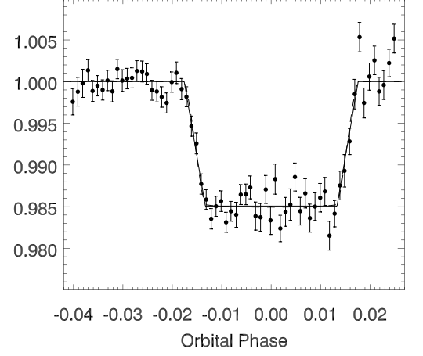
Transits (not eclipses!) with Spitzer:
First IR transit was HD209458b with MIPS 24-microns
(Richardson et al. 2006, ApJ 649, 1043)
Was associated with our first-light eclipse observations
lack of IR limb darkening
produces a very "tophat"
transit – sharp ingress/egress
transit depth is simply (Rp/Rs)²
(gives a more model-indpendent radius)

Slide 4
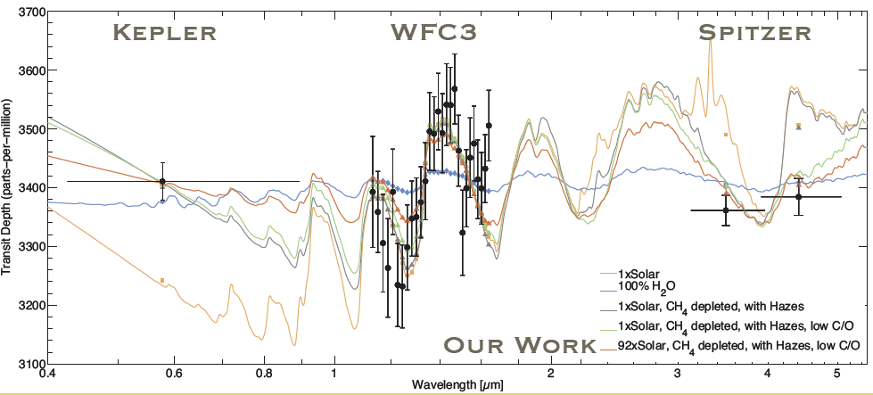
IR photometry of transits for atmospheric characterization
Fraine et al. 2014
also, Spitzer 90092, J.-M. Desert, P.I.

Slide 5
Kepler transit validation with Spitzer
Cycle-6 Warm Spitzer program (D. Charbonneau, P.I.)
Kepler false positives generally have a different transit depth in the infrared
Kepler-19 Ballard et al. 2011

Slide 6
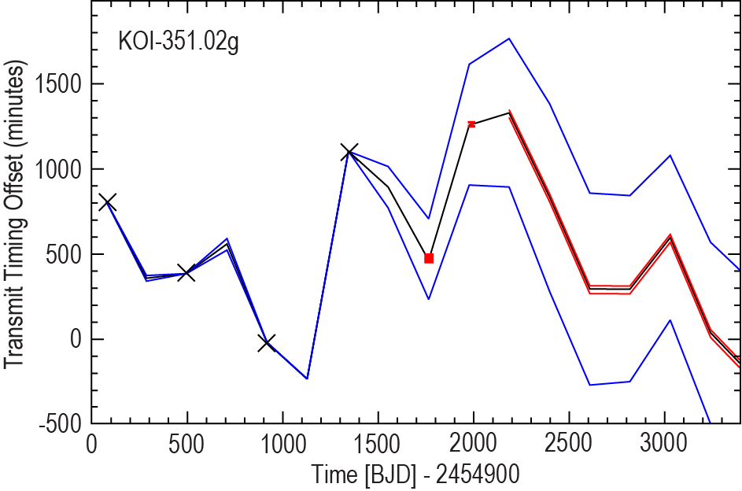
Transit timing variations (TTVs)
to infer the presence and masses of unseen planets
facilitated by continuous viewing
Spitzer Cycle-10 program 101027 (D. Fabrycki, P.I.)
recovery of Kepler science
To justify JWST for this would
require arguing that it can't
be done from the ground
and the targeted systems
would have to be of compelling
importance
(e.g., a nearby habitable system
from TESS)

Slide 7
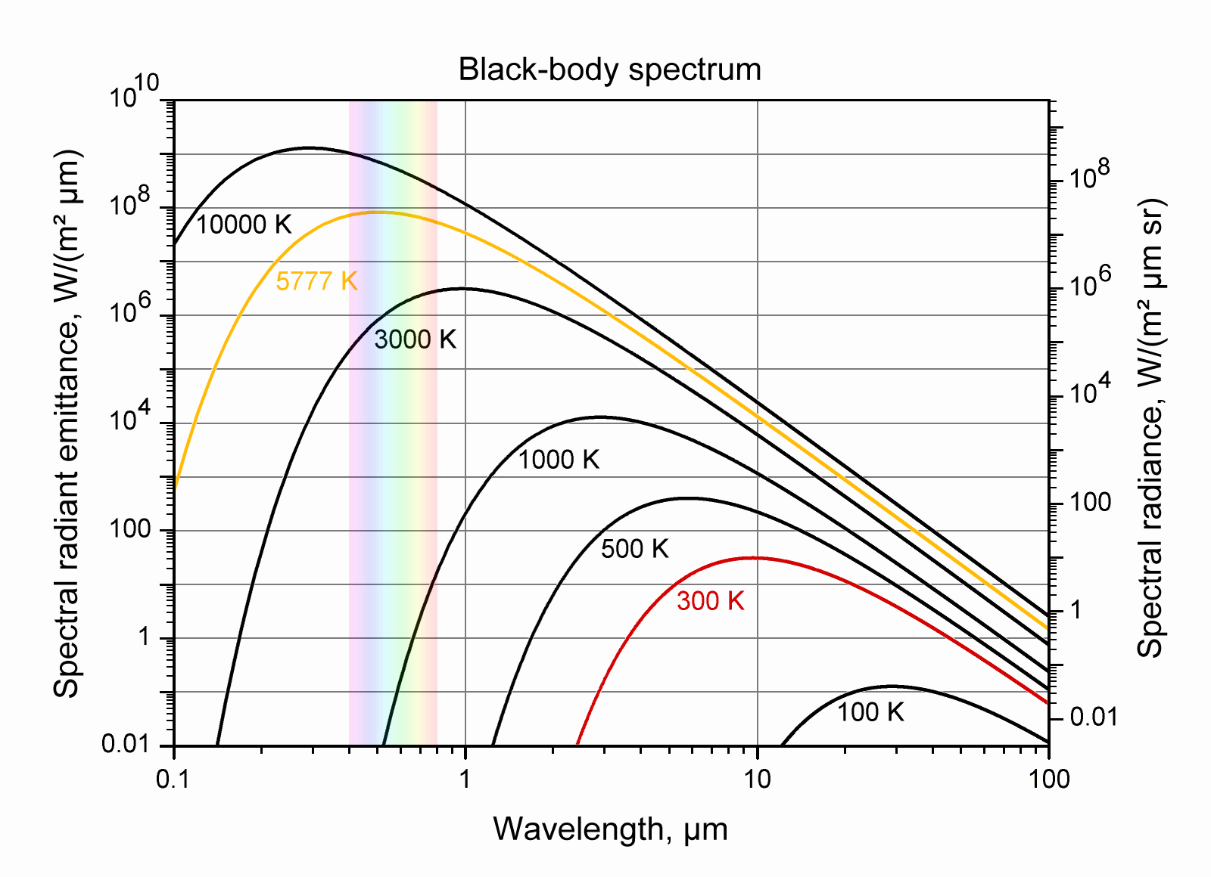
Dis-advantage of transits in the IR
the Planck function peaks
in the optical for
temperatures
of FGK stars
But planets transiting
M-dwarfs,
and Brown Dwarfs
> get highest S/N in the IR

Slide 8
Implications for JWST
We probably will not use JWST to reject TESS false-positives
We probably will not use JWST to measure
more precise values of Rp/Rs
(but yes for wavelength-dependence via spectroscopy)
I doubt that we will use JWST to detect TTVs
But we might use it to find transits of specific,
unseen, interesting planets

Slide 9
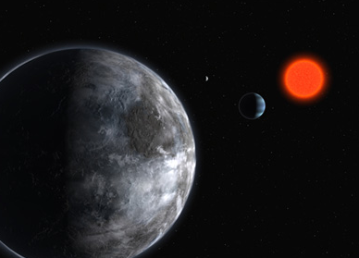
To find a habitable transiting planet
in the GJ1214 system
Also:
search for the secondary eclipse
improve the wavelength-dependent planetary radius
485-hour quasi-continuous
observation by Spitzer
- 4.5 microns, subarray mode
- 791000 individual exposures
- one of the longest continuous observations
ever made by Spitzer
(Cycle-7, Warm Spitzer)

Slide 10
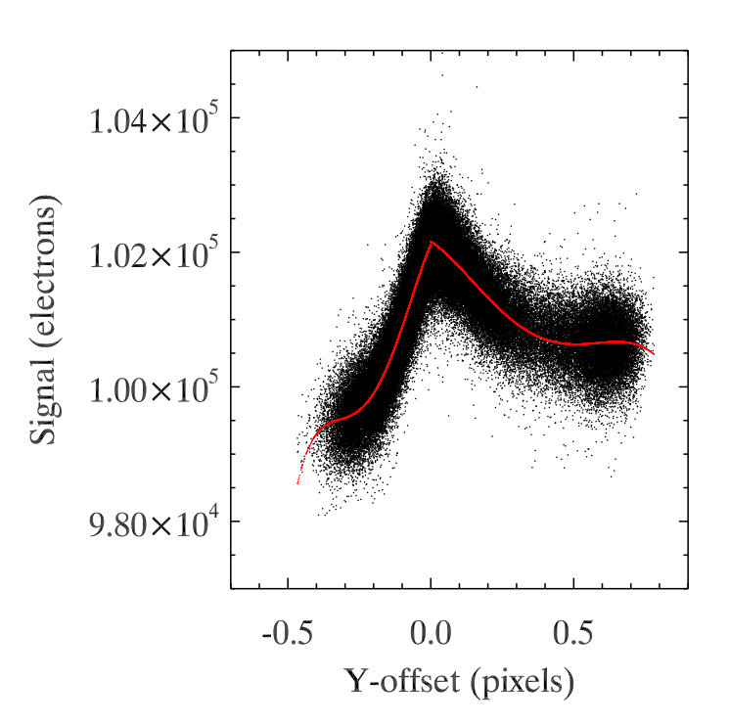
Prominent intra-pixel effect
peak intensity at pixel center
Decorrelate using
4th order polynominal in Y
(not perfect)
Fraine et al. 2013

Slide 11
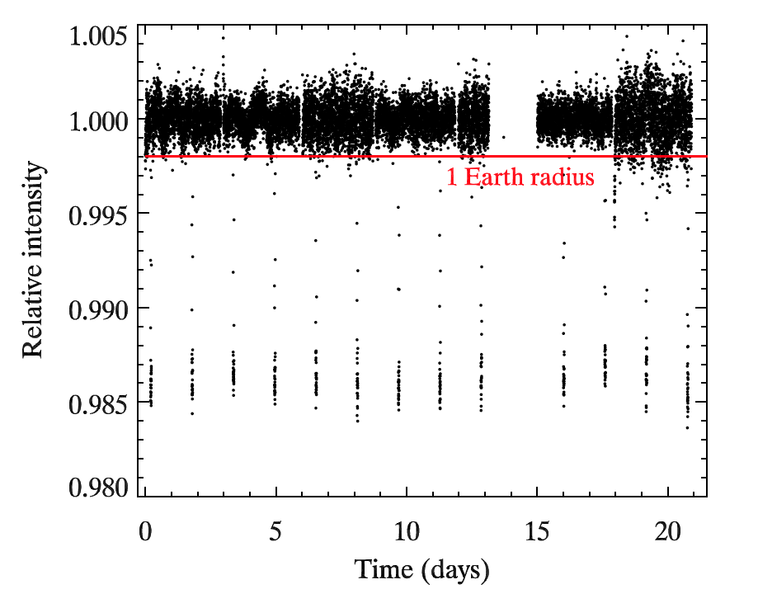
Gillon et al. 2014, A&A 563, id.A21`.
JWST search of an M-dwarf HZ might be justifiable

Slide 12
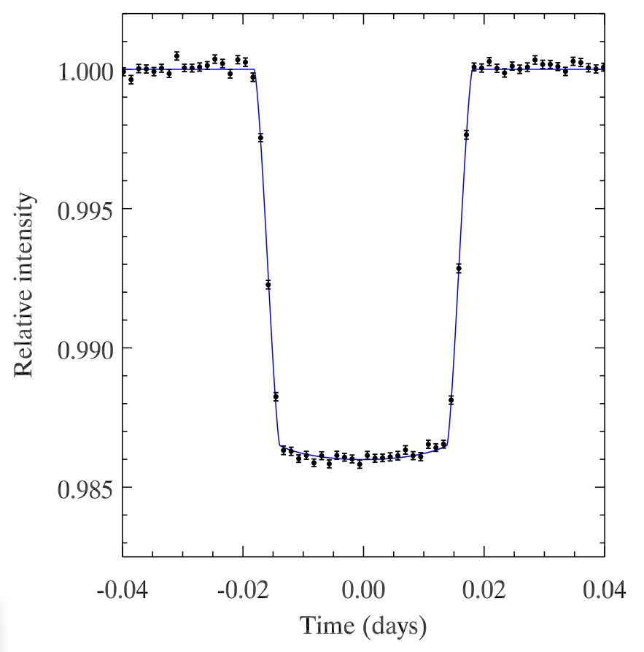
Fraine et al. 2013
ApJ 765, id.127
Rp/Rs = 0.1172 +/- 0.0003

Slide 13
Conclusions:
We probably won't use JWST for validation of TESS planets (but for atmospheric characterization, yes)
We probably won't use JWST to detect TTVs in any transiting systems
We might use JWST to find transits of specific, compelling, planets (e.g., in the HZ of nearby M-dwarfs)
IR photometry of transits is valuable, but spectroscopy is better

